Slide 1
S a n d i a N a t i o n a l L a b o r a t o r i e s
Fusion at Sandia National Laboratories
Mark C. Herrmann
Pulsed Power Sciences Center, Sandia National Laboratories
in collaboration with my colleagues at Sandia National Laboratories
December 5, 2012
Sandia is a multiprogram laboratory operated by Sandia Corporation, a Lockheed Martin Company, for the United States Department of Energy’s National Nuclear Security Administration under contract DE-AC04-94AL85000.

Slide 2
Summary
Pulsed power is an efficient, cost-effective way to create matter at high energy densities
Magnetically driven implosions offer a path to coupling much higher fractions of the driver stored energy to fusion fuel
Magnetized Liner Inertial Fusion (MagLIF) offers a near term chance for testing our understanding of magnetically driven implosions.
Experimental data on the Magneto-Rayleigh Taylor instability is promising, we will begin integrated MagLIF testing in 2013.
A high-yield (GJs), high-gain (>500) MagLIF design is under development. Much of the relevant physics can be tested on Z.

Slide 3
Large currents and the corresponding magnetic fields can create and manipulate high energy density(HED) matter
HED Matter P > 1 Mbar, B > 5 Megagauss
Magnetic fields have some unique advantages when creating HED plasmas:
Magnetic fields are very efficient at creating HED matter enabling large samples and energetic sources
Magnetic fields have very interesting properties in converging geometry
Magnetic fields have interesting contrasts with other ways of generating HED:
Magnetic fields can create high pressures without making material hot
Magnetic fields can be generated over long time scales with significant control over the time history
Magnetic fields change the way particles and energy are transported in a plasma

Slide 4
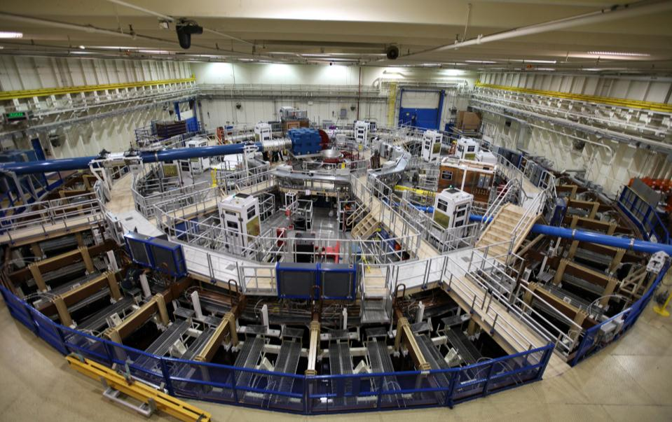
We use the Z pulsed power facility to generate large magnetic fields
Tank~10,000 ft²
22 MJ stored energy
3MJ delivered to the load
26 MA peak current
5 – 50 Megagauss (1-100 Megabar)
100-600 ns pulse length

Slide 5
Magnetically driven implosions can efficiently couple energy at high drive pressure
Magnetic drive can reach very high drive pressures if current reaches small radius
Magnetic drive is very efficient at coupling energy to the load (no energy wasted on ablation)
100 MBar is comparable to drive pressure on a NIF capsule
Magnetically-Driven Implosion
MBar
drive
current
I
R
100 MBar at 26 MA and 1 mm
However cylindrical implosions do not have nearly as high a pressure multiplier on stagnation
Cylindrical shells must be thick to avoid disruption by instabilities
Thick shells are slow, making the pressure problem harder

Slide 6
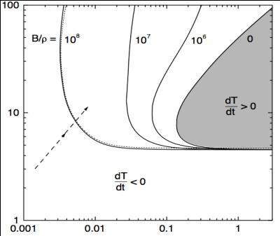
Magnetization significantly reduces the self heating requirements for inertial confinement fusion
*Basko et al. Nuc. Fusion 40, 59 (2000)
The ρr needed for ignition can be significantly reduced by the presence of a strong magnetic field
inhibits electron conduction
enhances confinement of alpha particles
Lower ρr means lower densities are needed (~1 g/cc)
Pressure required for ignition can be significantly reduced to ~5 Gbar
(<< 500 Gbar for hotspot ignition)
Large values of B/ρ are needed and
therefore large values of B are needed.
B~ 50-150 Megagauss >> B₀ -> flux compression is needed
Temperature (keV)
Z
goal
Fuel areal density (g/cm²)

Slide 7
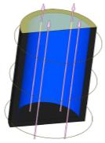
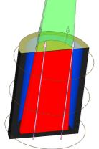
The Z facility provides an opportunity to test the benefits of fuel magnetization and preheat
Metal (beryllium)
Cylindrical Liner
A 100-500 kG axial magnetic field
is applied before the implosion
cold deuterium/tritium
gas (fuel)
laser
beam
2. Z Beamlet can preheat the fuel to ~100 - 1000 eV
to reduce the compression and velocity needed
Laser
preheated
fuel
compressed
axial field
3. The Z accelerator can provide the drive current which generates an azimuthal drive field (pressure) to efficiently implode the thick liner at 50-100 km/sec
and compress the axial field to 100 MG
Simulations indicate fusion energy out = energy deposited in fusion fuel
may be possible on Z
* S. A. Slutz et al., Physics of Plasmas 17, 056303 (2010).

Slide 8
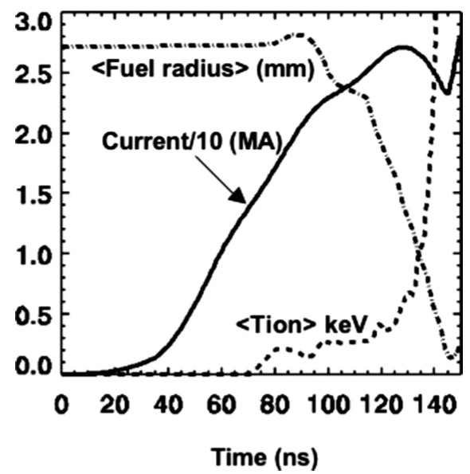
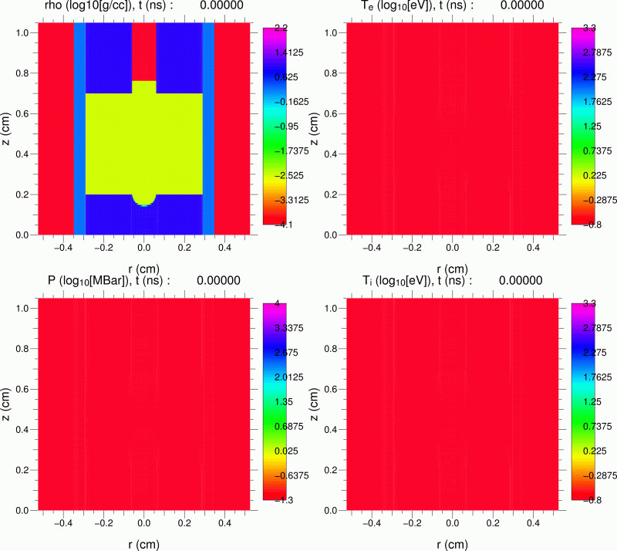
laser heating: 120-124 ns

Slide 9
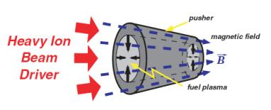
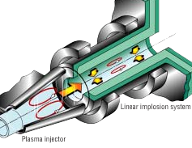
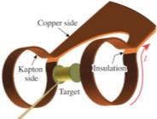
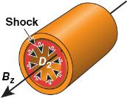
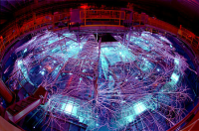
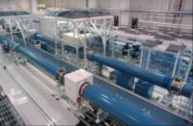
The parameter space for magnetized ICF is large allowing a diverse set of approaches
Max Planck / ITEP
Los Alamos / Air Force Research Lab
Field Reversed Configuration
Shiva Star generator
~20 μs, 0.5 cm/μs liner implosion
Taccetti, Intrator, Wurden et al., Rev. Sci, Instr. 74, 4314 (2003)
Degnan et al., IEEE Trans. Plas. Sci. 36, 80 (2008)
Basko, Kemp, Meyer-ter-Vehn, Nucl. Fusion 40, 59 (2000)
Kemp, Basko, Meyer-ter-Vehn, Nucl. Fusion 43, 16 (2003)
U. Rochester LLE
Sandia National Laboratories
Magnetized Liner Inertial Fusion
Laser preheated magnetized fuel
LASNEX simulations indicate interesting yields
liner
B_{z}
current
Z
Direct drive laser implosion of cylinders
-- shock pre-heating, high implosion velocity
Gotchev et al., Bull. Am. Phys. Soc. 52, 250 (2007)
Gotchev et al., Rev. Sci. Instr. 80, 043504 (2009)
Gotchev et al., Phys. Rev. Lett. 103, 215004 (2009)
Knauer et al., Phys. Plasmas 17, 056318 (2010)
ZBL
S. A. Slutz et al., Phys. Plasmas, 17, 056303 (2010).
D.B. Sinars et al., Phys. Rev. Lett. 105, 185001 (2010)

Slide 10
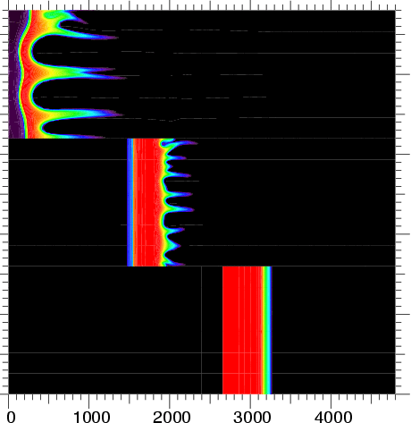
Simulations indicate fusion energy out = energy deposited in fusion fuel may be possible on Z with DT fuel
60 nm surface roughness,
80 (μm) waves are resolved
INITIAL CONDITIONS
Peak Current: 27 MA
Be Liner R0: 2.7 mm
Liner height: 5 mm
Aspect ratio (R0/ΔR): 6
Initial gas fuel density: 3 mg/cc
Initial B-field: 30 T
Preheat Temperature: 250 eV
FINAL CONDITIONS
Energy in Fusion Fuel ~200 kJ
Target Yield: 500 kJ
Convergence ratio (R0/Rf): 23
Final on-axis fuel density: 0.5 g/cc
Peak avg. ion temperature: 8 keV
Final peak B-field: 13500 T
Peak pressure: 3 Gbar
Radius (μm)
2D yield for a DT target ~ 350 kJ (70% of 1D)
The magneto-Rayleigh Taylor instability is a big concern for this concept

Slide 11
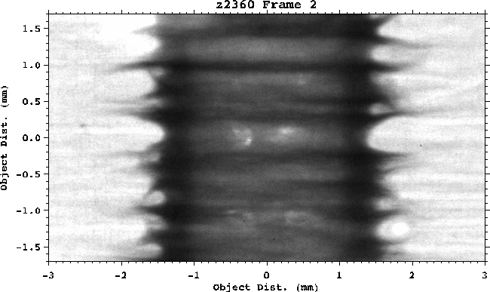
The lower opacity of beryllium at 6.151 keV allows us to take penetrating radiographs of the liner implosions
High opacity of Al means that we only see the edge of the liner
Lower opacity of Be means that we can see through the liner and the “spikes” show up as dark bands
Machining of beryllium targets is done at General Atomics in La Jolla, CA

Slide 12
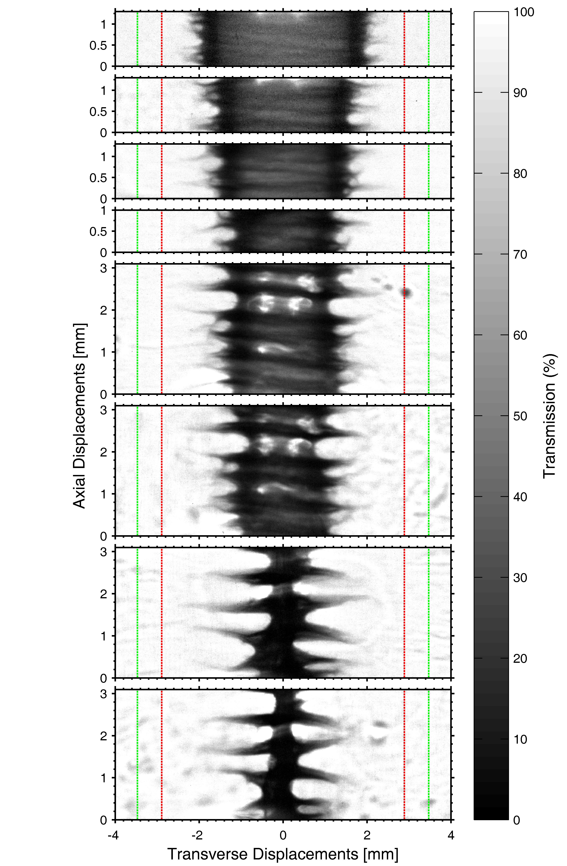
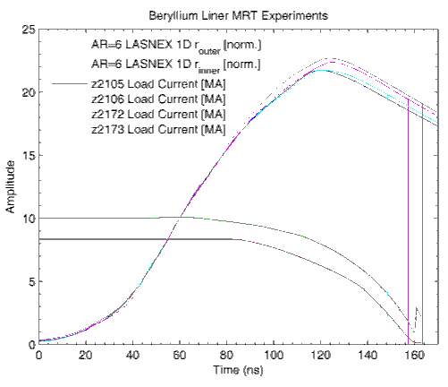
We’ve done stability experiments on Be liners at higher radial convergence
AR=6:
r_{outer,0} = 3.47 mm
r_{inner,0} = 2.89 mm
How does the 2D correlation emerge?

Slide 13
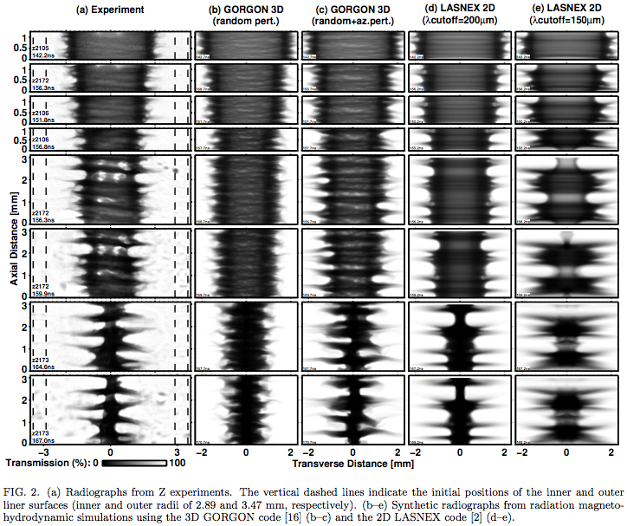
MagLIF-relevant beryllium liner implosion data was collected and is actively being used to benchmark our modeling tools
R.D. McBride et al., Phys. Rev. Lett. 2012; APS-DPP invited talk in October

Slide 14
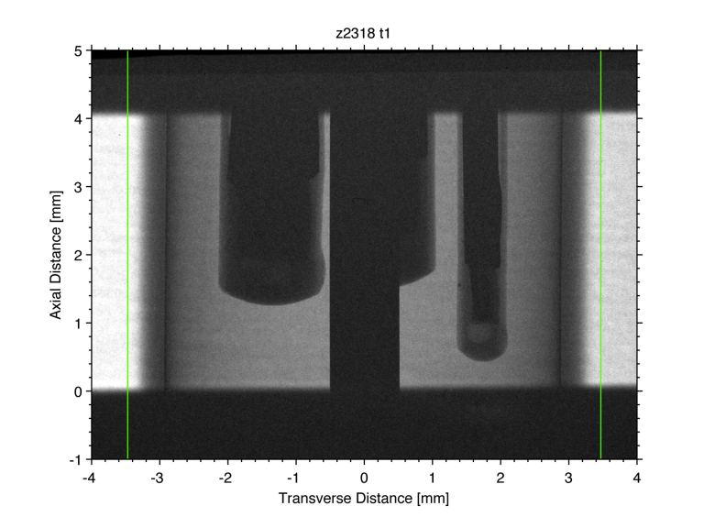
Recent studies examined a thin Al sleeve inside a Be liner to study the integrity of the inner surface

Slide 15
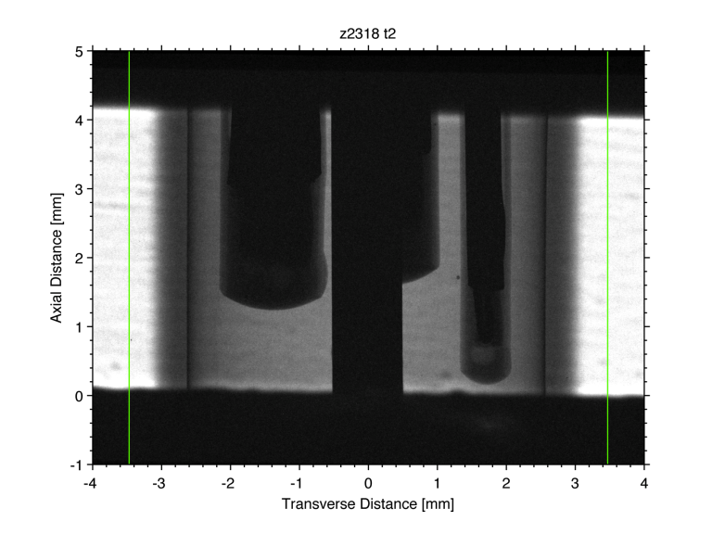
Recent studies examined a thin Al sleeve inside a Be liner to study the integrity of the inner surface

Slide 16
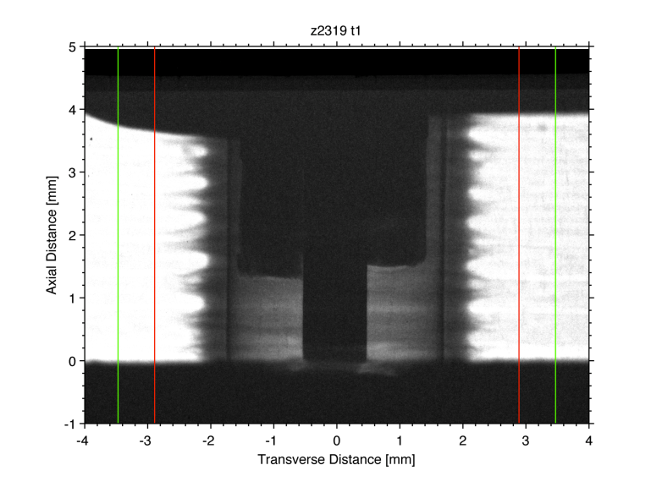
Recent studies examined a thin Al sleeve inside a Be liner to study the integrity of the inner surface

Slide 17
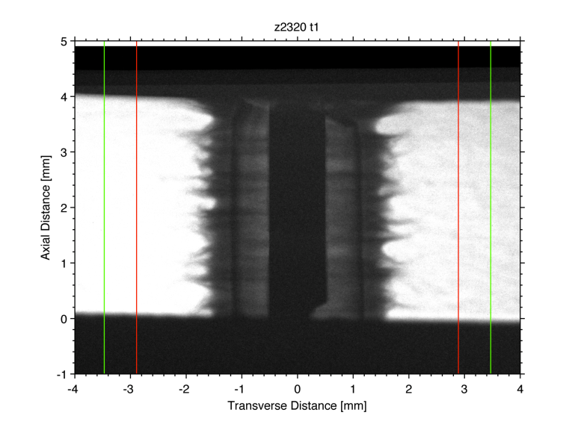
Recent studies examined a thin Al sleeve inside a Be liner to study the integrity of the inner surface

Slide 18
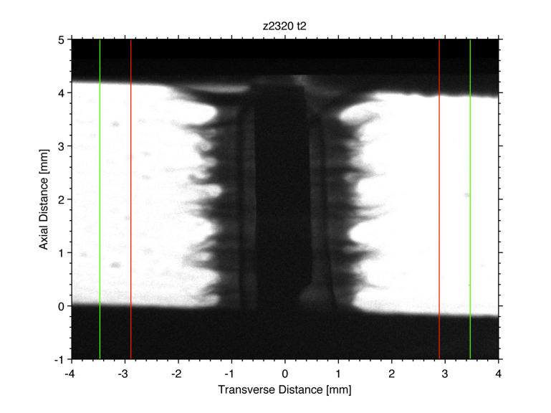
Recent studies examined a thin Al sleeve inside a Be liner to study the integrity of the inner surface

Slide 19
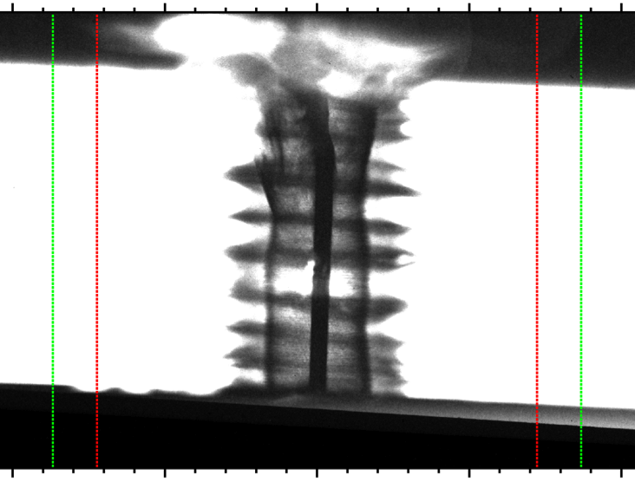
Recent Z experiments have examined
how the target compresses
Wall
Perturbed
Outer Surface
Liner
Initial
Radius
Intact
Inner
Surface
MagLIF Goal
~ 200 microns
(2 human hairs)
Successful compression of a MagLIF liner observed to convergence ratio 5

Slide 20
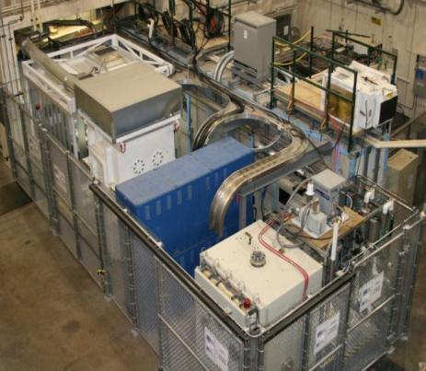
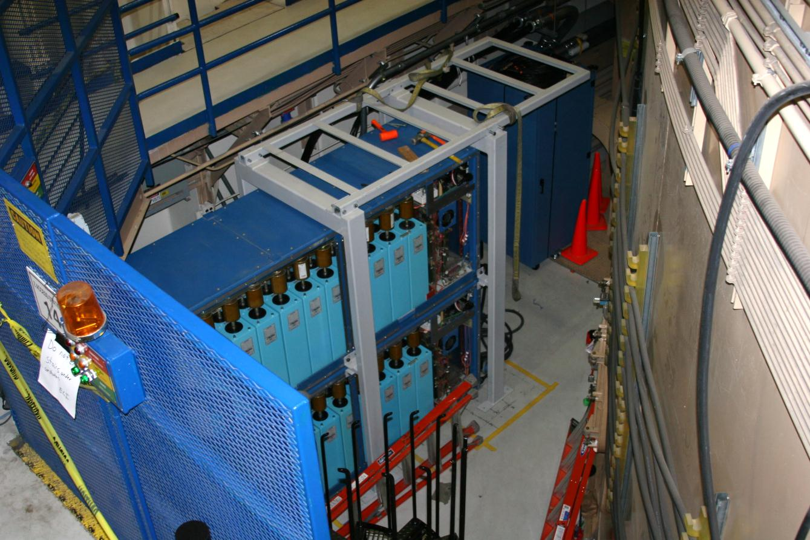
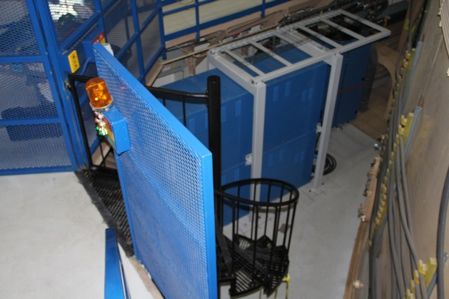
An 8 mF, 15 kV, 900 kJ capacitor bank is being installed on Z to drive the coils
Two identical units (repurposed from ion beam facilities) allows for high-fidelity surrogacy testing in separate test facility
We believe 900 kJ is enough to meet our short and long term goals (30 T)
The SITF Testbed in Bldg. 970
Magnetic Coil Testbed (MCTB)
1st 900kJ Capacitor Banks
Surrogate Vacuum Chamber (SVC)
Commissioning of coils in the Z chamber to begin in January
Photo of capacitor bank w/o covers; with covers
D.C. Rovang et al., see http://www.sandia.gov/pulsedpower/maglifpres/Agenda.html

Slide 21
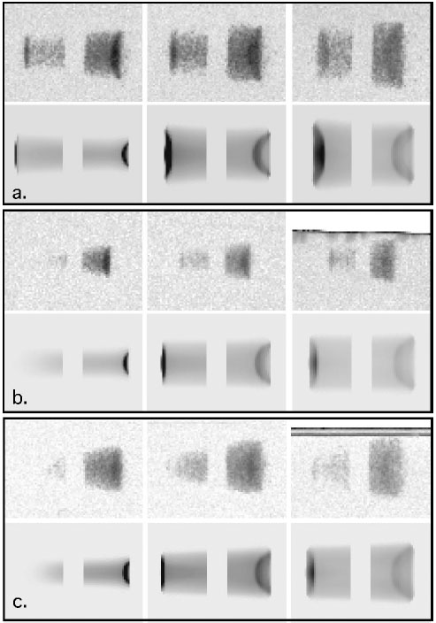
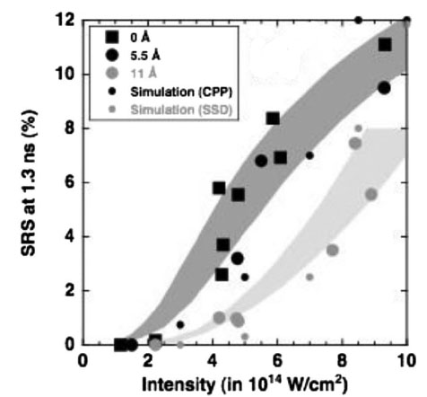
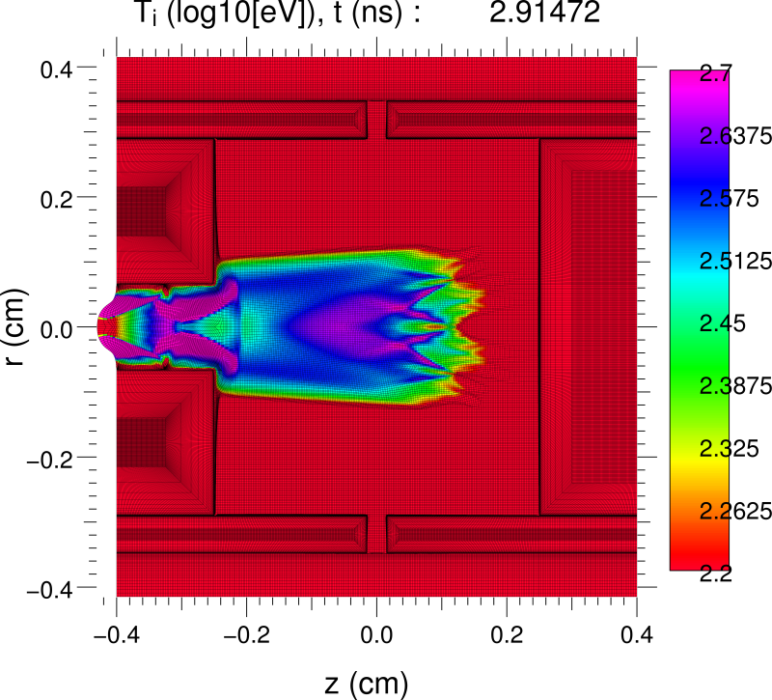
Preheating experiments using the 2ω Z Beamlet laser will begin soon
Prior work* found agreement between experiments and Hydra simulations assuming classical absorption of 2ω for n_{e}/n_{cr} ~ 0.05 to 0.15 gasbag targets on the HELEN Laser
2ω beam
0.08 n_{cr}
gas
polyimide membrane
0.12 n_{cr}
Other work** showed efficient coupling of 2ω to 0.13n_{cr} gasbag plasmas at intensities <3x10¹⁴ W/cm², even without beam smoothing
0.16 n_{cr}
Standalone preheat experiments on Z in January using 2 kJ from ZBL will be used to test our HYDRA predictions for the level of plasma heating. We are also looking at the possibility of OMEGA experiments to study plasma lifetimes in the presence of a magnetic field.
* N.B. Meezan et al., Phys. Plasmas (2004); ** J.D. Moody et al., Phys. Plasmas (2009).

Slide 22
Next Steps for MagLIF concept
Initial experiments with an external magnetic field are scheduled for February, 2013.
Laser preheat experiments will also be performed in February, 2013.
Initial integrated experiments with both laser preheat and Bz will be performed next July.
Integrated experiments with full capability (laser and Bz) will take place in CY14/15.
If successful we will examine what it would take to pursue experiments with Tritium.

Slide 23
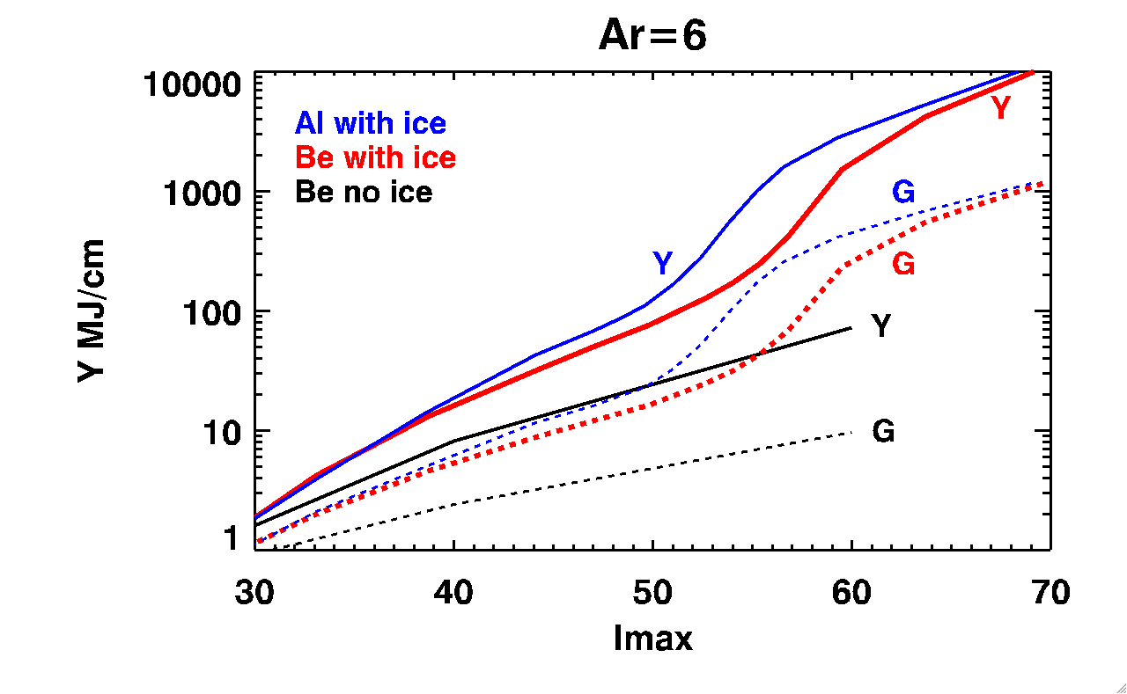
Calculations indicate yields > 1GJ are possible with MagLIF targets at currents of 60 MA
Laser beam
Al with cryo
Be with cryo
Be no cryo
heated gas
Yield (MJ/cm) or Gain
Axial distance
Cryogenic DT
unheated gas
B_{Θ}
Metal liner
Drive current
Radius
Peak current (MA)
*S.A. Slutz and R.A. Vesey Physical Review Letters 108, 025003 (2012)

Slide 24
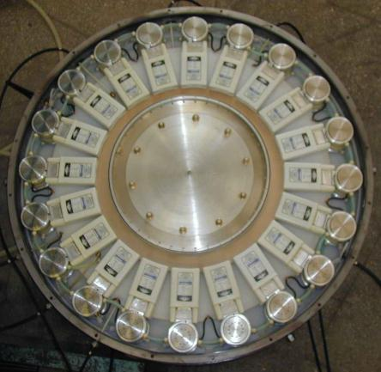
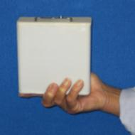
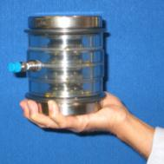
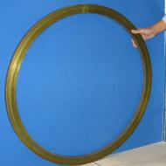
The Linear Transformer Driver (LTD) is the most fundamental advance in pulsed power since the invention of the Marx generator in 1924
An LTD consists of :
Capacitors
Switches
Magnetic cores
An LTD Cavity is the building block of SPARC
SPARC-Z= 5400 cavities

Slide 25
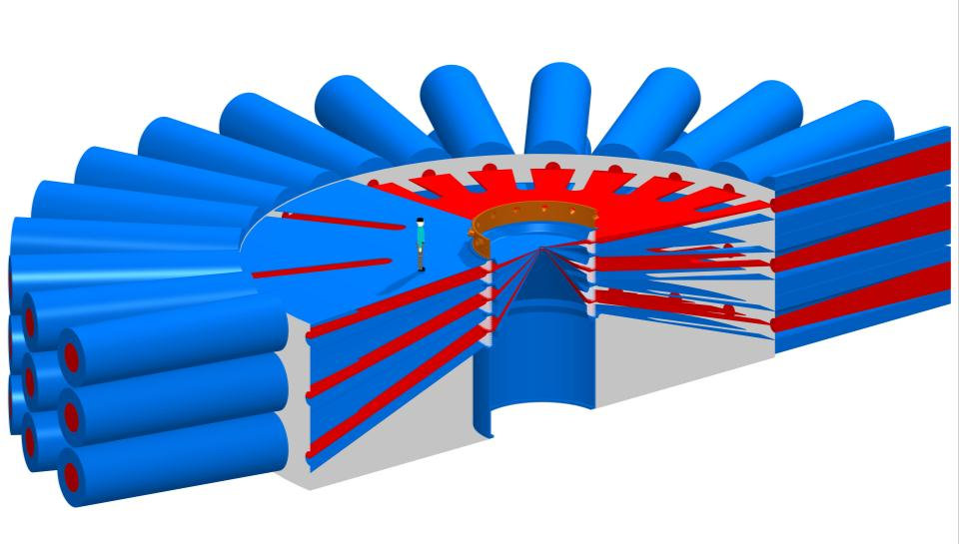
SPARC-Z would be an 800-TW, 63MA, 50 m diameter pulsed-power accelerator.
P_{g} = 830 TW
V_{stack} = 16 MV
I_{load} = 63 MA
E_{radiated} = 20 MJ
= 15%
E_{g} = 130 MJ
L_{vacuum} = 20 nH
τ_{implosion} = 110 ns
diameter = 50 m
magnetically insulated transmission lines (MITLs)
vacuum-insulator stack
linear-transformer-driver (LTD) modules (90 total)
water-insulated radial-transmission-line impedance transformers
Notes:
Minor changes to the references.

Slide 26
A fully automated proof-of-principle facility provides the first test of defined RTL requirements
Fully engineered prototype facility
~10 second cycle time
>10,000 cycles
Compatible with IFE facility concept
MITL vacuum/power-flow continuity
Pre-pumped MITLs
Extended transmission lines or fast
closure valves for high-yield standoff
Small-scale (~1/5) prototype
Ease of maintenance
Rapid modifications and retrofits
Compatible with LTD architecture
High-rep-rate pulsed power testing
Repetitive electrode conditioning studies; increased efficiency

Slide 27
Summary
Pulsed power is an efficient, cost-effective way to create matter at high energy densities
Magnetically driven implosions offer a path to coupling much higher fractions of the driver stored energy to fusion fuel
Magnetized Liner Inertial Fusion (MagLIF) offers a near term chance for testing our understanding of magnetically driven implosions.
Experimental data on the Magneto-Rayleigh Taylor instability is promising, we hope to begin integrated MagLIF testing in 2012.
A high-yield (GJs), high-gain (>500) MagLIF design is under development. Much of the relevant physics can be tested on Z.

