Slide 1
Fusion Activities of the American Security Project
Andrew Holland, ASP Senior Fellow for Energy and Climate Policy
December 5, 2012
Fusion Power Associates Annual Meeting and Symposium

Slide 2
Why does ASP Support Fusion?
Fusion is clean.
Fusion is safe.
Fusion energy is virtually unlimited.
Fusion is secure.
Fusion will spark scientific achievements.
America’s Competitors are hard at work – we must not give up our lead.
Notes:
In a time in which the government is looking for long-term, sustainable energy sources, fusion promises to be the best.
We can

Slide 3
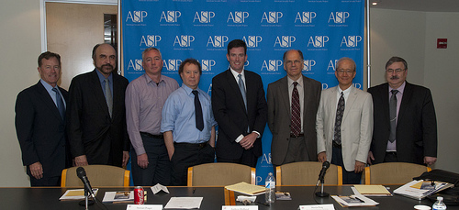
ASP June 5 Workshop: “Magnetic Fusion Energy–Steps to Commercialization”
There are routes to get to fusion that could be faster and cheaper
Assured, sustained investment is required.
Annual Budget Fights harm the ability to plan
There are no shortage of Roadmaps
Notes:
You might recognize some of those people in the lower picture
The presentations from the fusion scientists pictured – many of whom are also here in the room proved that there is no shortage of roadmaps, and plans to get there. Indeed, there were some very good ideas about how to move forward. Instead, what is missing is the assured, sustained investment that is required.
Unfortunately, as you’ve heard from I am afraid that this requires fusion

Slide 4
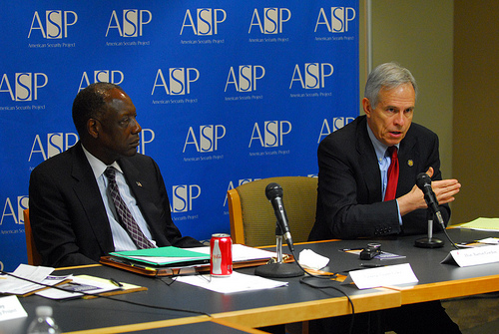
ASP June 5 Workshop: “Magnetic Fusion Energy–Steps to Commercialization”
Lessons from Outside the Fusion Community
General Lyles: communicate “a clear understanding of the importance of fusion” and the “threat that fusion is intended to solve”
Congressman Gordon: Members of Congress need to be able to “understand the benefits of fusion” and “a clear plan for fusion development.”
Notes:
You might recognize some of those people in the lower picture
Congressman Gordon, former Chairman of the House Science and Technology Committee spoke, saying that With many areas of scientific research on the chopping block, a clear plan for fusion development is needed, complete with funding requirements and a timeframe for achievable goals. He said that members of Congress need to be able to understand the multiple benefits of fusion to justify funding; benefits to economic growth and job creation, energy independence, national security, and scientific discovery.
General Lyles, a member of ASP’s board, and a retired 4-star Air Force General, spoke about the importantce of communicating to a broad audience…

Slide 5
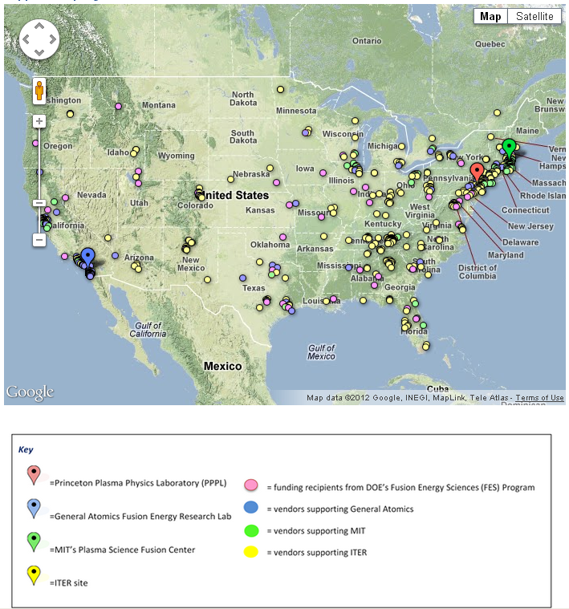
Fusion’s Reach Across America
New ASP website that seeks to detail all vendors and funding recipients from the DOE FES budget
Fusion touches 47 out of 50 states
Over 775 research institutions and businesses supporting fusion research
At least 1,200 direct research positions in the fusion industry – with countless more supporting positions
Key States:
California: At least 168 affiliated institutions and businesses
Tennessee: At least 108
Massachusetts: At least 95
Many are still not yet even included!

Slide 6
Fusion Stakeholders Coalition
A Fusion Industry Coalition under the American Security Project
Will help efforts to lobby for increased investment
We need more support, from you and your vendors
Notes:
We have begun to put together an industry coalition of stakeholders, to support and make sustainable the advocacy and lobbying work that we . It is still only a skeleton coalition, but
This will function much like other industry coalitions – it will give you greater visibility on the Hill, and it will allow coordinated
ASP’s

Slide 7
New ASP Fusion Whitepaper
Will Support an “Accelerated Push” for Fusion Energy
5 Specific Recommendations:
Accelerate progress in materials science
Pursue multiple paths of fusion development
Increase financial support to research institutions
Experiment with new innovations in reactor and component design
Begin establishing a regulatory regime
It will argue that fusion can be completed on a relevant time frame.
Notes:
This whitepaper is based off the results of our June 5 Workshop.
We must make sure that
It should not be “just a science experiment”

Slide 8
2013 Activities
Release of Updated ASP Fusion Whitepaper
Capitol Hill Event to launch Whitepaper –
Mid January, 2013
Energy Workshop
Late February, 2013
Renew “Fusion News” newsletter
Site visits for policymakers and opinion leaders
Other Suggestions?

Slide 9
ASP is Here to Support You
But we need your help!

