Slide 1
Fusion Activities at PPPL
S. Prager
FPA Meeting
December, 2012

Slide 2
Strategy in time of great uncertainty in fusion budget and US fusion policy
Develop multiple fusion scientific ideas, maintain flexibility
Contribute to and prepare for ITER

Slide 3
Strategy in time of great uncertainty in fusion budget and US fusion policy
Develop multiple fusion scientific ideas, maintain flexibility
Contribute to and prepare for ITER
Focus on areas of breakthrough potential,
where the US can lead
Develop science to enable a breakout of US program into an energy development program
(establish readiness for various possible next facility steps for US – FNSF, deuterium PMI facility, stellarator….. )

Slide 4
PPPL strategic elements for magnetic fusion
Advance the spherical tokamak for multiple fusion applications
Explore the physics and engineering science of plasmas producing fusion power (ITER plus)
Develop solutions for the plasma-material interface
Use 3D magnetic fields for steady-state, disruption-free plasma confinement
Supporting program element:
Integrated Fusion Simulation

Slide 5
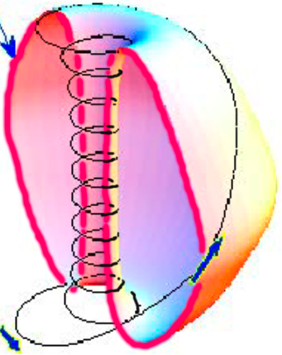
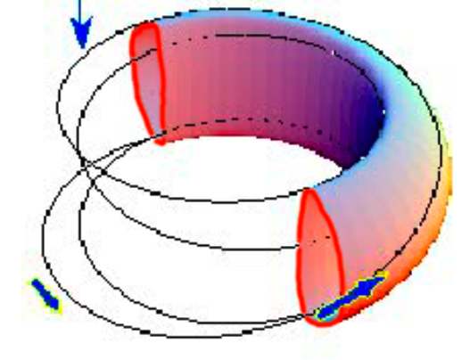
Advance the spherical tokamak for multiple fusion science applications
tokamak spherical tokamak
strongly curved magnetic field
high plasma pressure,
and fairly compact

Slide 6
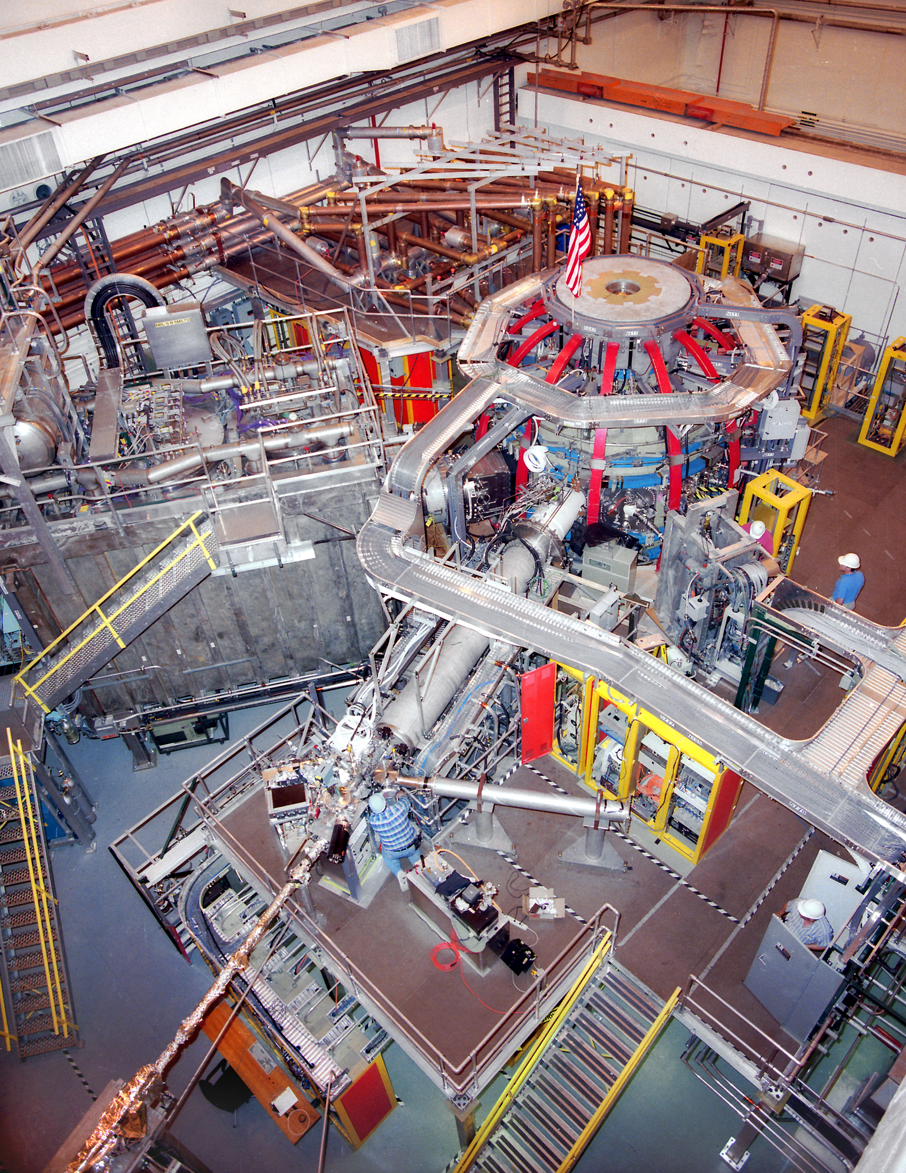
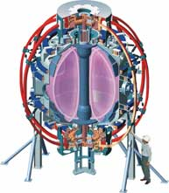
National Spherical Torus Experiment (NSTX)
Compact, high normalized pressure

Slide 8
NSTX Upgrade (under construction)
Increase current, plasma duration, heating and CD
1 MA to 2 MA
toroidal magnetic field 0.5 T to 1 T
1 sec to 5 sec
Beam heating power: 5 to 10 MW
Large advance in all NSTX missions
Plasma-material interface: increases heat flux to ≥ ITER level
Next step facilities: advances parameters toward the next steps
New physics regimes: reduces collisionality ~ 6X

Slide 9
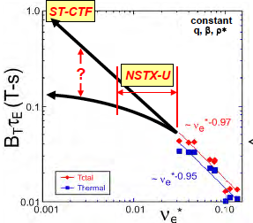
What determines confinement scaling?
ST FNSF
Confinement quality
Collisionality ( )
hotter
Favorable confinement trend
Microtearing turbulence theory agrees with experiment (so far)

Slide 10
Will collisionality scaling of the ST persist?
ST FNSF
NSTX-Upgrade will add substantial dynamic range to collisionality

Slide 11
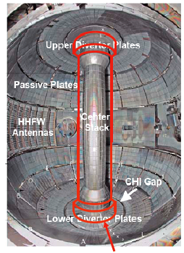
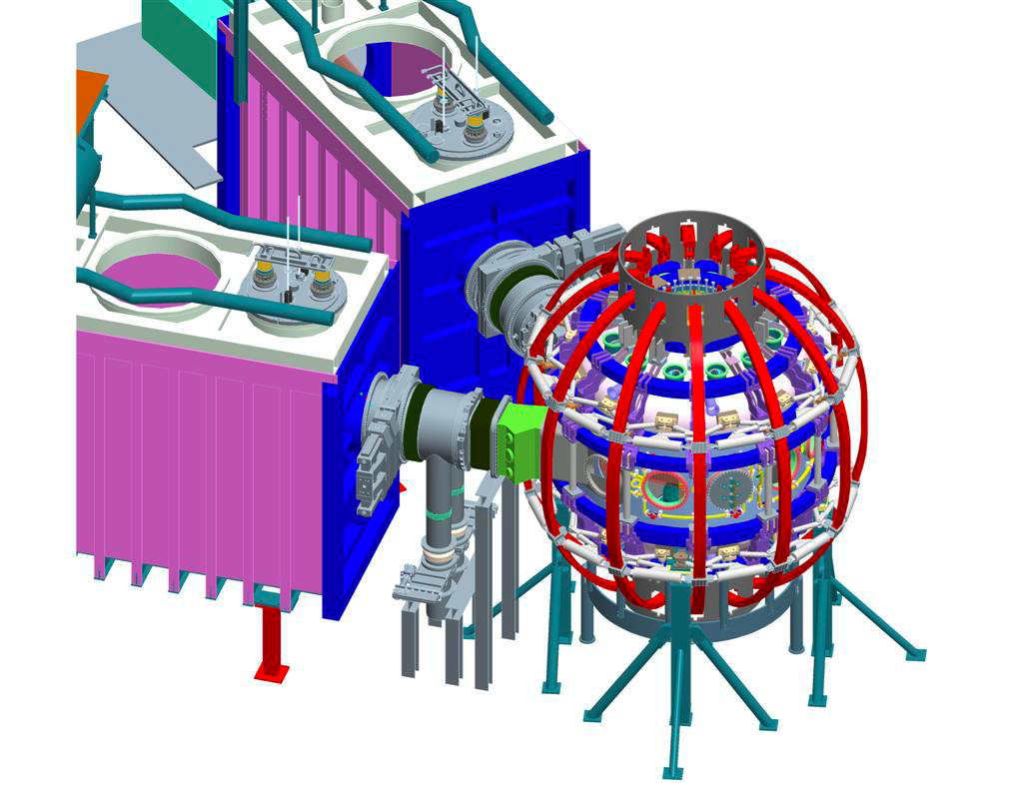
NSTX- Upgrade
new center stack second neutral beam

Slide 12
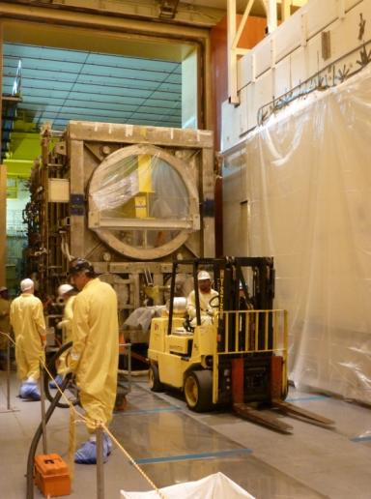
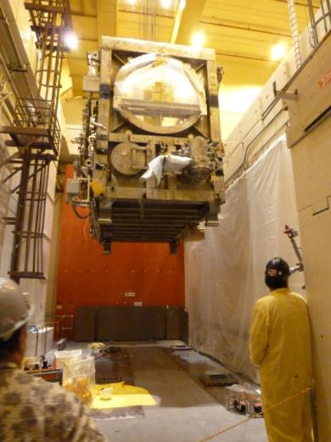
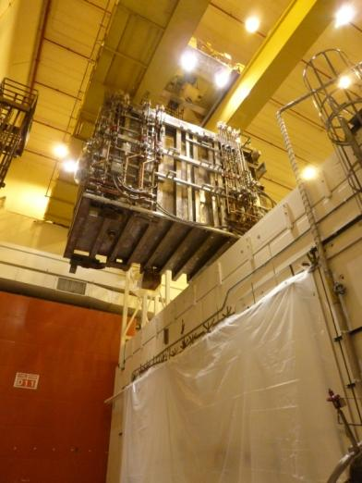
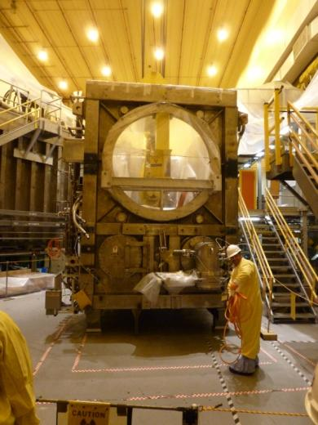
Second neutral beam moved to NSTX cell
Beam box = 40 tons
Lid = 14 tons

Slide 13
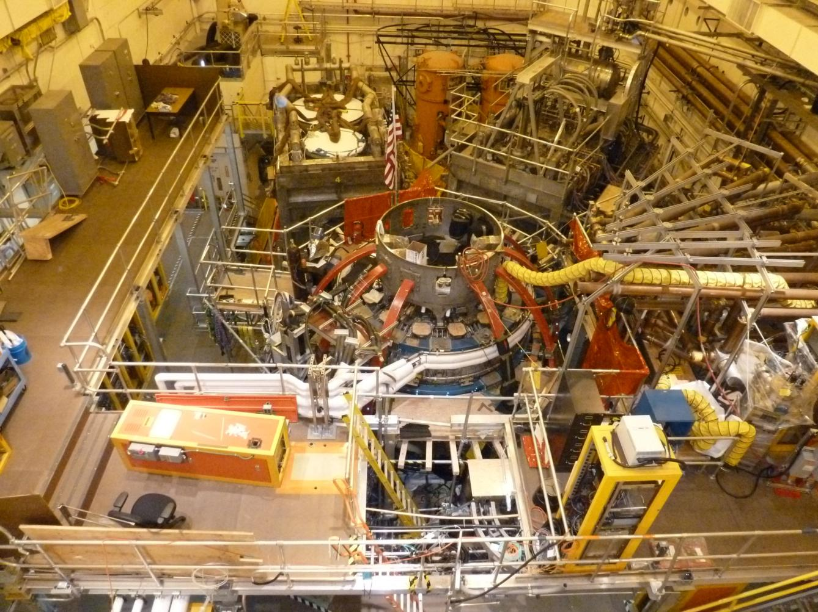
NSTXU Test Cell - Current
Second beamline in place

Slide 14
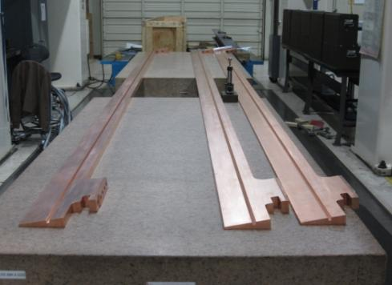
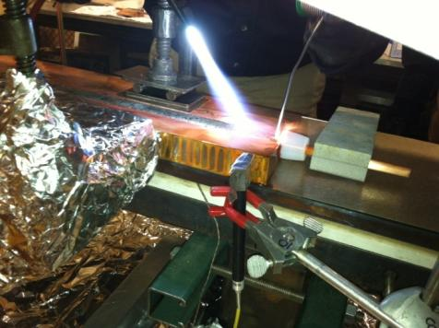
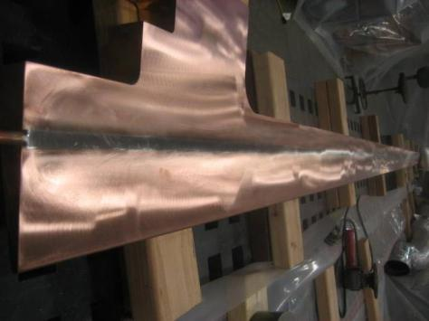
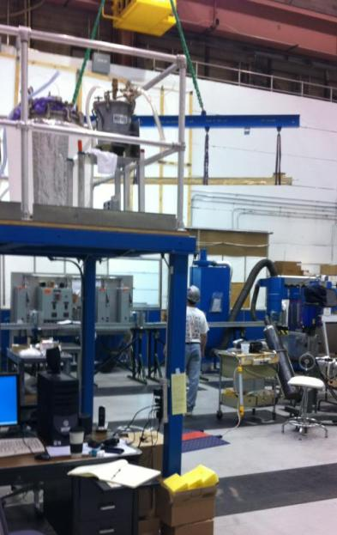
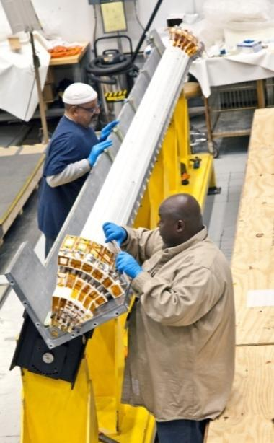
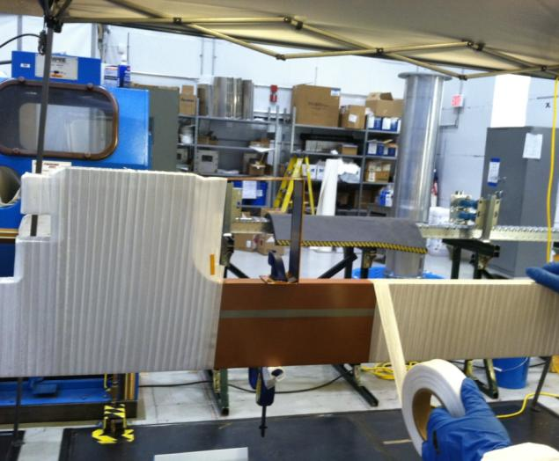
Center Stack Fabrication & Assembly Making Good Progress
Machined conductor delivered
Cooling tube soldered into conductor
Grinding of conductor, moved to oven to bakeout flux
Conductor wrapped with fiberglass insulation
Insulated conductor placed into mold
Conductor removed from oven after sandblasting and priming

Slide 15
Center Stack Fabrication & Assembly Making Good Progress
Machined conductor at Major Tool being prepared for shipment to PPPL
Cooling tube being soldered into conductor at PPPL
Early finish date: September 2014
Funded mainly from ongoing PPPL budget
(shifting operations labor to assembly)
Conductor after cooling tube installation and grinding
Conductor being wrapped with fiberglass insulation
Insulated conductor being placed into mold
Conductor being removed from oven after sandblasting and priming

Slide 16
Scoping Studies of ST-FNSF
Assessing mission, performance, tritium breeding, magnet design,
power exhaust maintenance vs size
Dimensionless parameters close to NSTX-U
Extension of prior pilot plant studies

Slide 17
Liquid metals as the plasma-facing material
Liquid lithium (and other liquid metals)
Self-regenerating (against continuous and transient erosion)
No neutron damage, controllable heat removal
Highly absorbing: no influx to plasma, improved plasma confinement
A breakthrough solution if it can be proven to be feasible

Slide 18
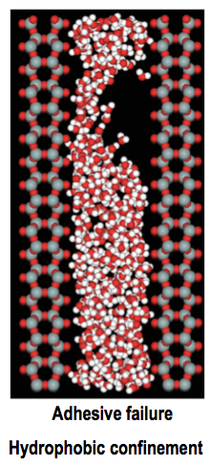
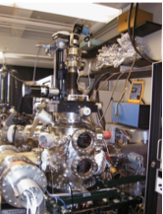
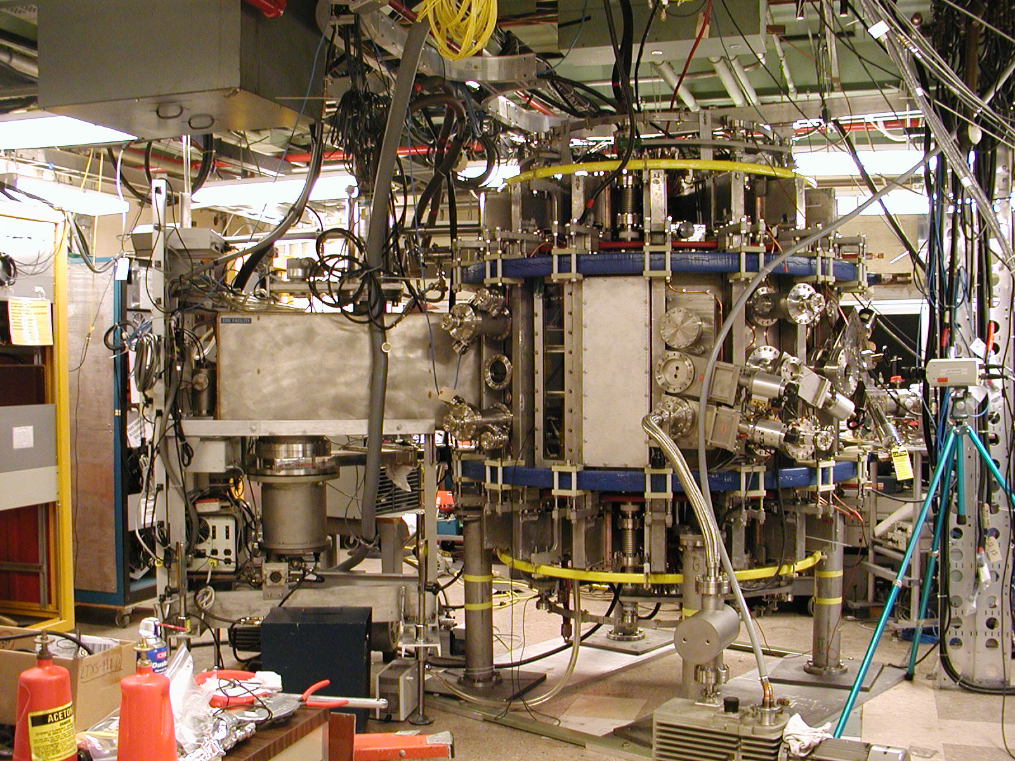
Liquid metals as the plasma-facing material
From atoms to tokamaks
Assembling a program that includes
Theoretical materials science of liquids
Instrumentation for material characterization
Fluid dynamics of thin film flow
Studies in tokamaks (LTX, NSTX-U)
Lithium Tokamak
Experiment
(LTX)

Slide 19
PPPL contributions to ITER
Research
A focus of NSTX research, theory, and extensive collaborations on other tokamaks, domestic and international
(DIII-D, CMOD, EAST, JET, KSTAR)
PPPL manages US diagnostic contributions and
construction of steady state electric power network
and
Construction Activities

Slide 20
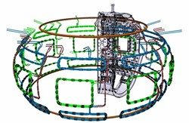
PPPL playing role in ITER diagnostic design
Design for diagnostic port plugs
Preliminary design of the diagnostic first wall.
PPPL performing design for in-vessel coils
Completed preliminary design,
through US ITER Project Office
Performing the final design,
under contract with China

Slide 21
Stellarator research
Critical for fusion:
steady-state, disruption-free,
high gain plasma

Slide 22
Stellarator research
Critical for fusion:
steady-state, disruption-free,
high gain plasma
(note: EU “early DEMO,” based on “realistic” parameters is pulsed and very large, R= 9m, 2.4 hour pulse;
too conservative?)
must develop stellarator in parallel with the tokamak

Slide 23
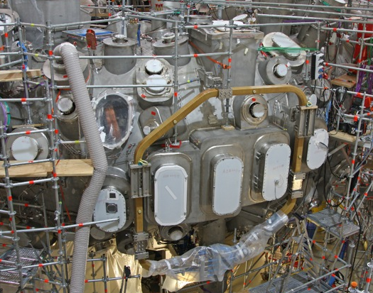
Stellarator research
Critical for fusion:
steady-state, disruption-free,
high gain plasma
Pursuing through international collaboration (transport and stability studies)
W7-X in Germany
LHD, Japan
Providing magnetic trim coils,
Prep for experiments in 2015
Spectroscopy, 3D modeling

Slide 24
Optimization Studies
3D shaping to minimize turbulent transport
Methods to simplify 3D coils
Aimed to provide a vision for a US stellarator experiment,
needed to fill key gaps in world stellarator program

Slide 25
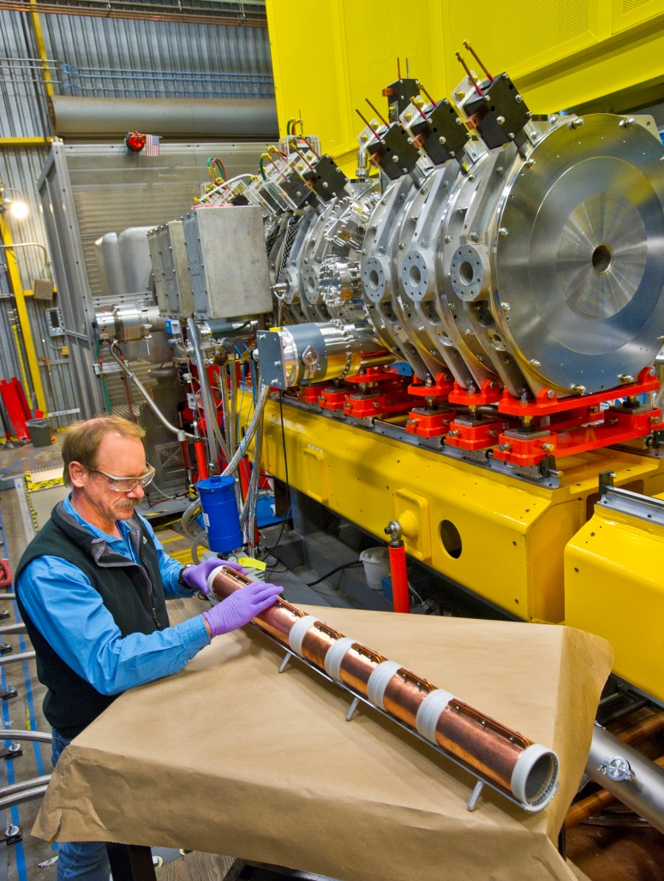
PPPL activities in inertial fusion
Heavy ion fusion
Partner in HIF Virtual National Lab
(with LBNL, LLNL)
Developed plasma source
for NDCX II at LBNL
Developing x-ray spectroscopy (high resolution)
To be tested on Omega-EP, and used for reconnection studies

Slide 26
Summary
In ~ 2 years, the US will have a “new” magnetic fusion facility (NSTX-Upgrade)
PPPL focus is on breakthroughs, breakouts, and ITER

Slide 27
BACKUP SLIDES

Slide 28
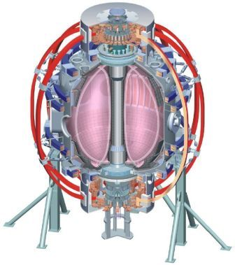
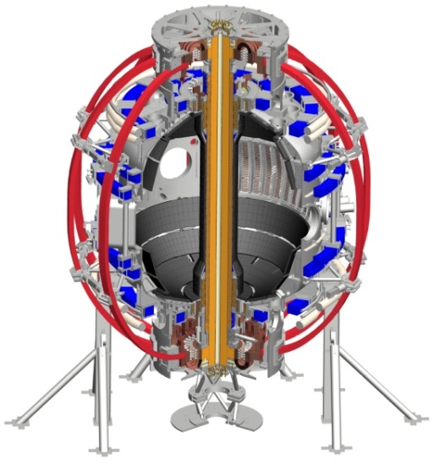
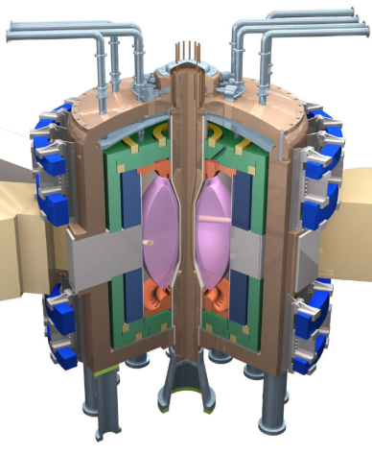
NSTX-U will access next factor of 2 increase in performance to reduce extrapolation to ST-based FNSF/CTF/Pilot
Parameter | NSTX | NSTX Upgrade | Fusion Nuclear Science Facility | Pilot Plant
Major Radius R₀ [m] | 0.86 | 0.94 | 1.3 | 1.6 – 2.2
Aspect Ratio R₀ / a | ≥ 1.3 | ≥ 1.5 | ≥ 1.5 | ≥ 1.7
Plasma Current [MA] | 1 | 2 | 4 – 10 | 11 – 18
Toroidal Field [T] | 0.5 | 1 | 2 – 3 | 2.4 – 3
Auxiliary Power [MW] | ≤ 8 | ≤ 19* | 22 – 45 | 50 – 85
P/R [MW/m] | 10 | 20 | 30 – 60 | 70 – 90
P/S [MW/m²] | 0.2 | 0.4 | 0.6 – 1.2 | 0.7 – 0.9
Fusion Gain Q |  |  | 1 – 2 | 2 – 10
* Includes 4MW of high-harmonic fast-wave (HHFW) heating power
Achievable confinement
Non-inductive ramp-up and sustainment
Divertor solutions for mitigating high heat flux
Radiation-tolerant magnets
Key issues to
resolve for FNSF

