Slide 1
Pathways to Fusion Beyond NIF
Presented at:
The 34th Annual Meeting and Symposium
Fusion Power Associates
December 10, 2013
Tom Anklam, Mike Dunne, Ed Moses
Lawrence Livermore National Laboratory

Slide 2
Key post-ignition steps on the path to commercial, inertial fusion energy
Adequate fusion gain for a power plant
Feasibility of low-cost, mass manufactured fuel
Reliable, high average power driver
Validated models for supporting technologies
  Chamber physics, Tritium production, etc
Certification tests of fusion chamber structural materials
Stakeholder education and early regulatory engagement
These efforts need to be done in the context of an integrated power plant design and economic modeling activity

Slide 3
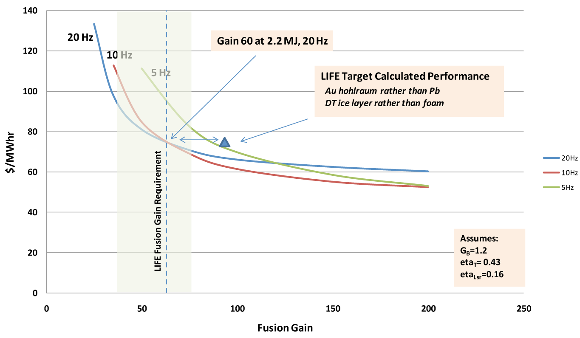
Systems analysis shows gain ~60 is good balance between economics and testability on NIF
Cost of electricity as a fusion gain and PRF

Slide 4
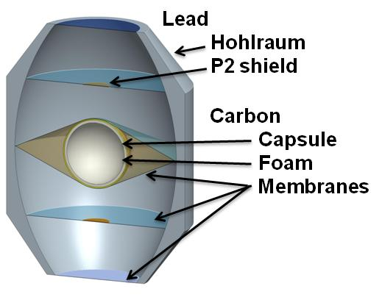
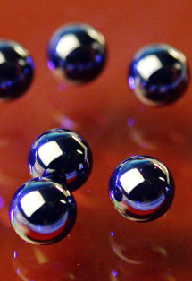
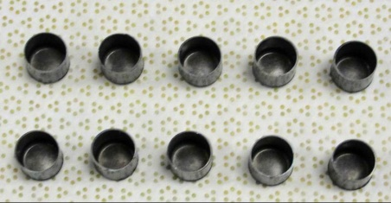

Low-cost, mass manufacture will require a completely different paradigm
Carbon Capsules
Die-cast hohlraum parts
Collaboration with semi-conductor manufacturing community is proving valuable

Slide 5
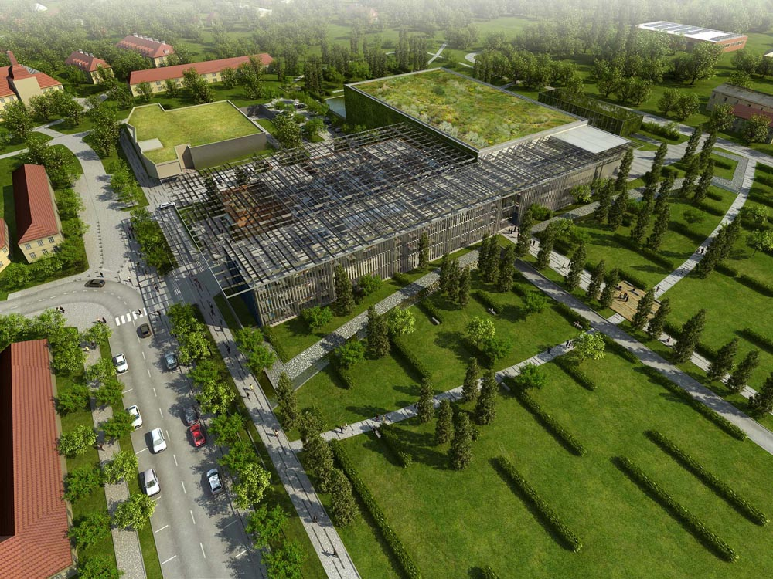
LLNL diode-pumped laser technology is being integrated into the “ELI Beam lines” facility in Europe
HAPLS project:
Delivery of a laser system for a 10 Hz, 1 Petawatt user facility, incorporating a 200 J / 10 Hz DPSSL pump laser

Slide 6
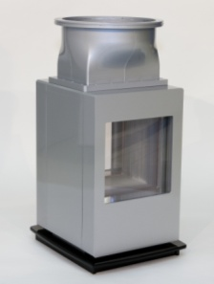
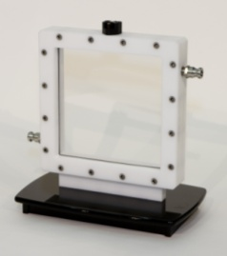
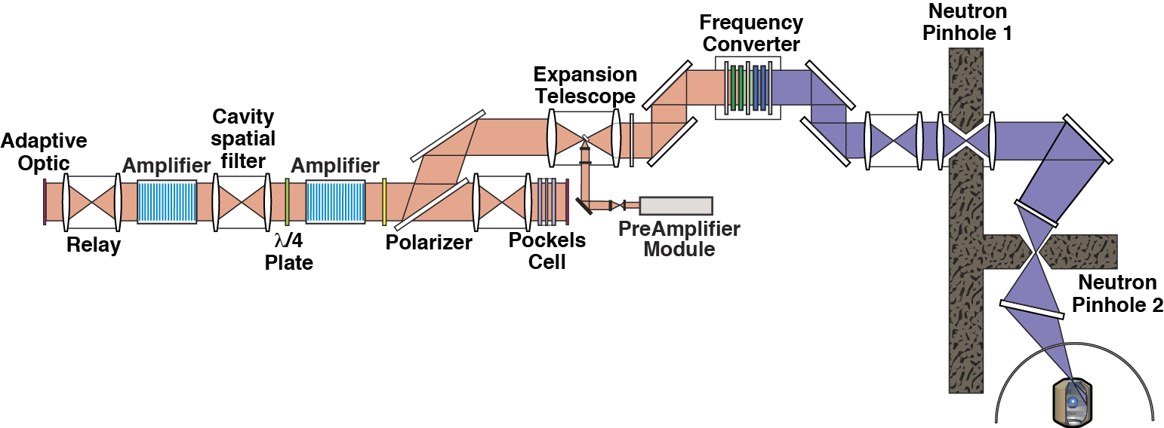
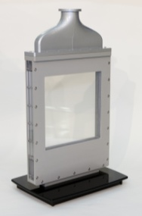
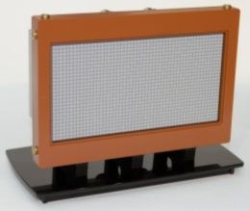
HAPLS leverages many elements of the LIFE design scaled down from multi-kJ operation
Rotator
λ/4
Diodes
Diodes
Diode pumps → high efficiency
Helium cooled amps → high repetition rate with low stress
Normal amp slabs → compensated thermal birefringence, compact amp
Passive switching → performs at repetition rate
Lower output fluence → less susceptible to optical damage

Slide 7
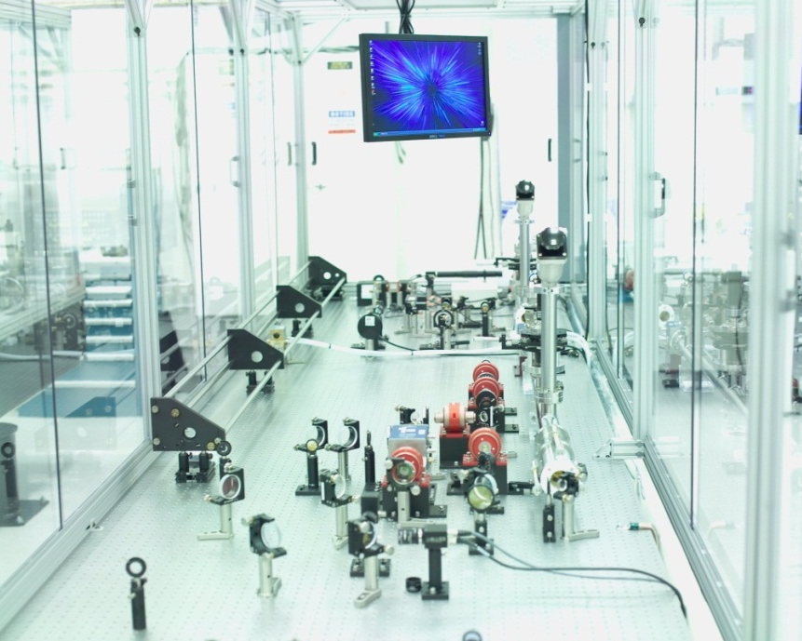
Optics durability will be key
GOLD System under construction – giga-shot, multi-year test campaign
120 Hz, >10 J operation
Low fluence design – providing a robust source to test optics under
LIFE-relevant conditions
Of immediate-term application to facilities such as ELI
100 Hz amplifier front-end
DPSSL performance to exceed kW

Slide 8
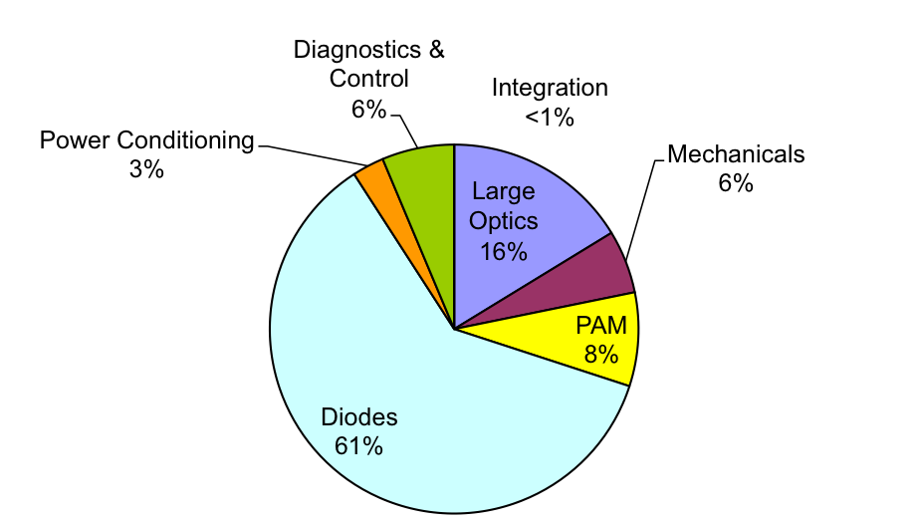
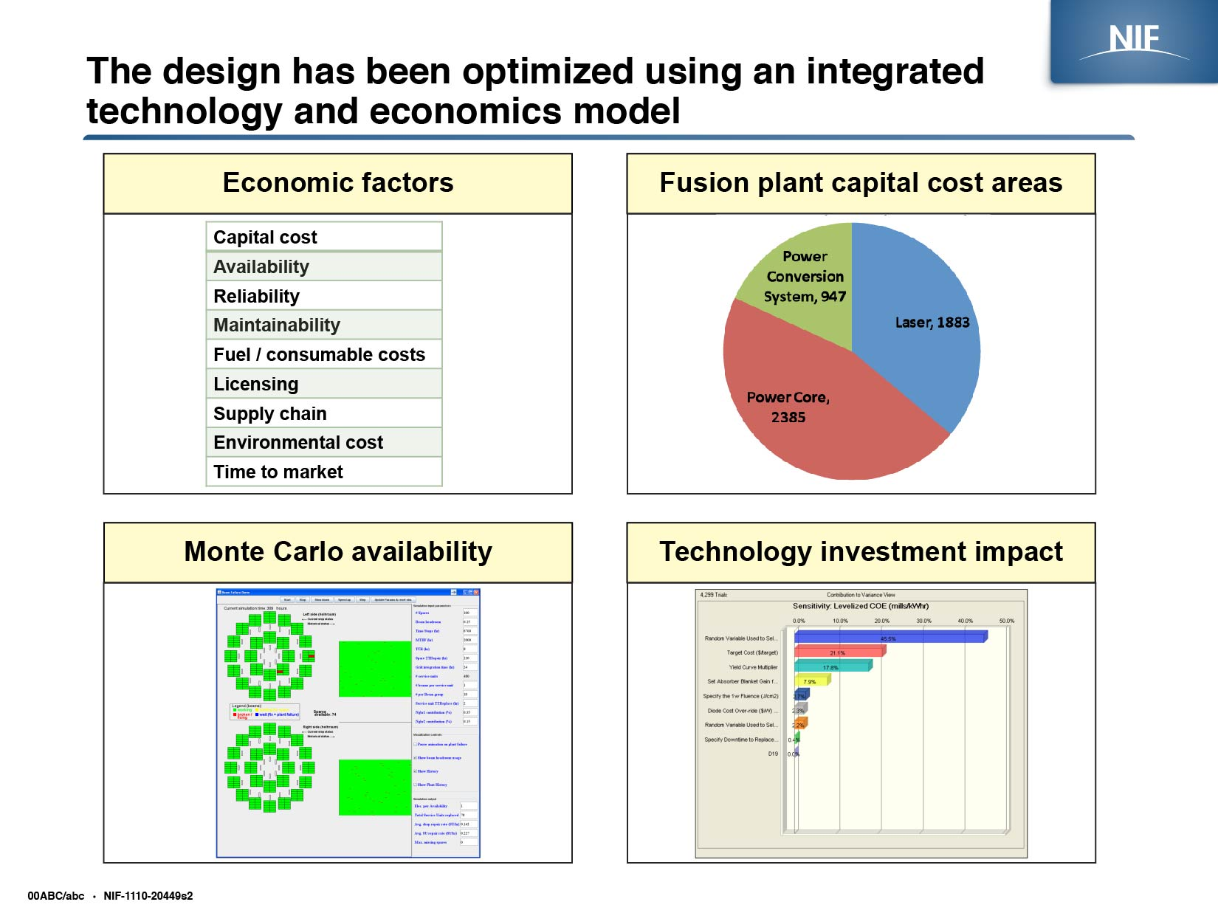
Technology development needs to be done in the context of an integrated plant design
Economic factors
Capital cost areas
Capital cost
Availability
Reliability
Maintainability
Fuel/consumable costs
Licensing
Supply chain
Environmental cost
Time to market
Example: laser
Statistical plant availability
Technology investment impact

Slide 9
NIF-1210-20668s2.ppt
Anklam—PS&A Review, January 20, 2011

