Slide 1

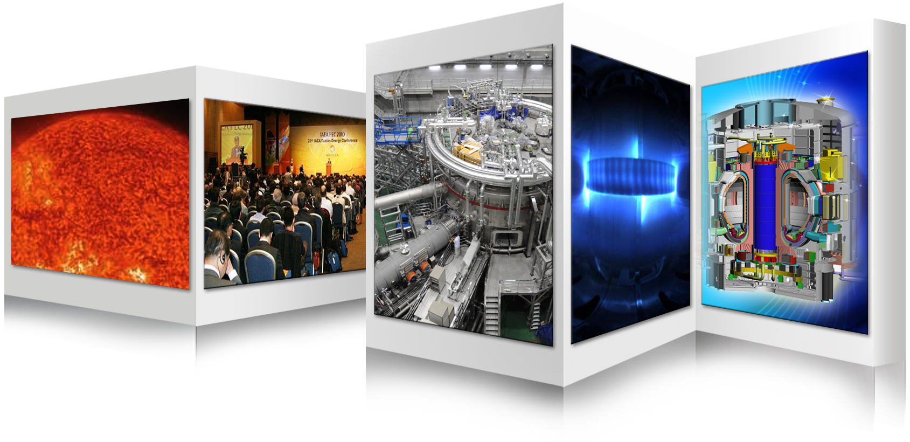

K-DEMO Design and R&D Plan
December 10, 2013
on behalf of K-DEMO Team
G. S. Lee

Slide 2
Mid-Entry Strategy : Korea, Year 1995
Conventional Device (Cu)
Superconducting Device
DEMO
ITER
1GW
First Mover
JET
TFTR
KSTAR
1MW
JT-60U
JET
Fast Follower
TFTR
JET/TFTR
Fusion Power
1KW
DIII-D
PDX
DIII
Superconducting Device
PLT
1W
ALCATOR C
T-3
(1968)
KAIST-T
ATC
ALCATOR A
SNUT-79
KT-1
1965
1970
1975
1980
1985
1990
1995
2000
2005
2010
2015
2020
2040
Year
2

Slide 3
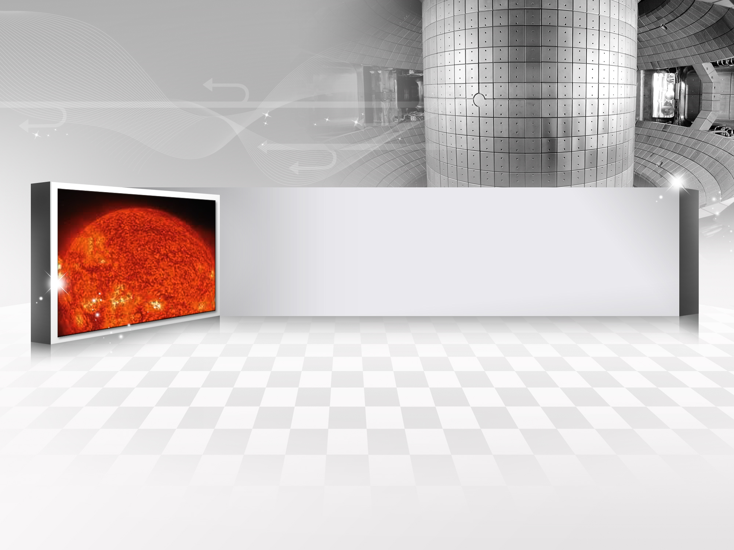
Fusion Energy Development
Roadmap in Korea

Slide 4
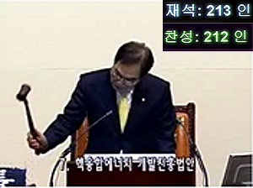
Fusion Energy Development Promotion Law
To establish a long-term and sustainable legal framework for fusion energy development phases.
To promote industries and institutes participating fusion energy development by support and benefit.
The first country in the world that prepared a legal foundation in fusion energy development.
History of the FEDPL
1995. 12 : National Fusion R&D Master Plan
2005. 12 : National Fusion Energy Development Plan
2007. 3 : Fusion Energy Development Promotion Law
2007. 4 : Ratification of ITER Implementation Agreement
2007. 8 : Framework Plan of Fusion Energy Development
(First 5-Year National Plan)
2012. 1 : The 2nd 5-year National Plan has started.

Slide 5
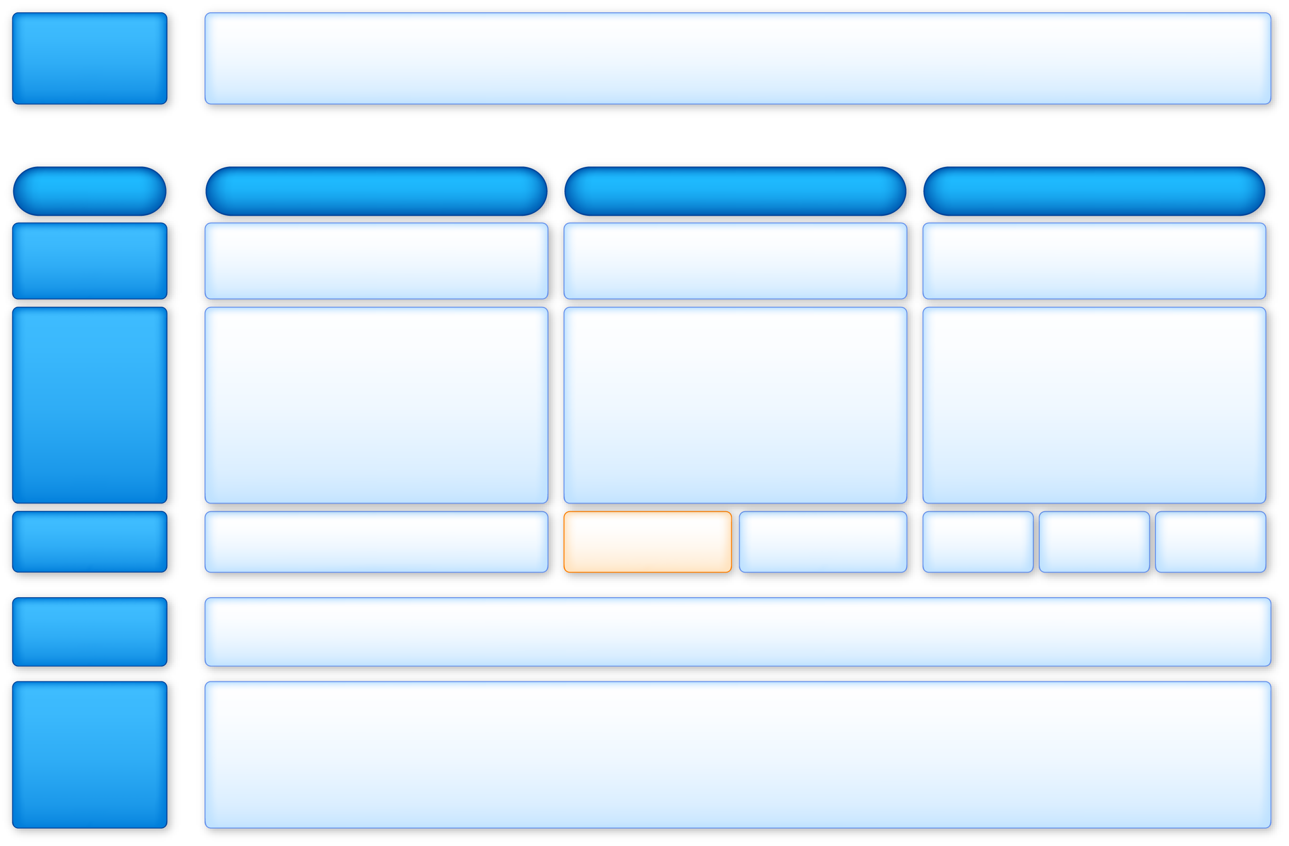

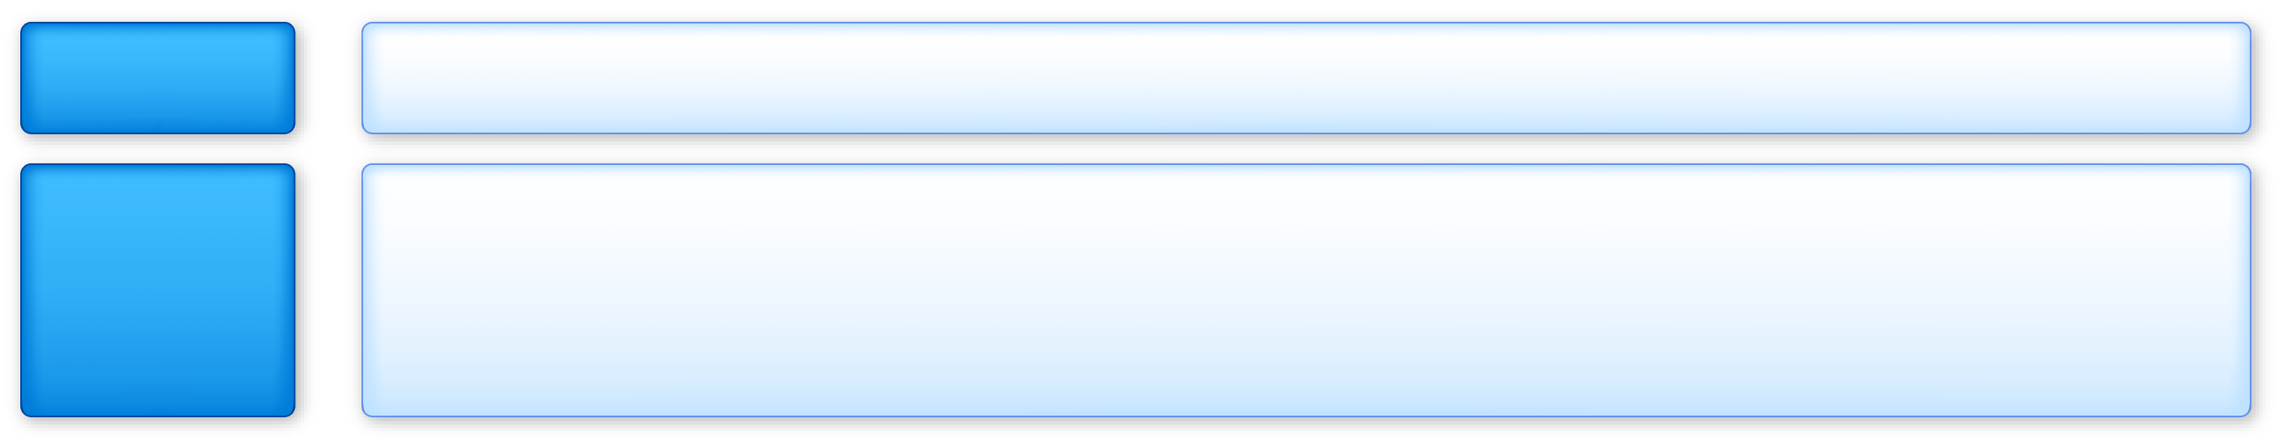

Vision and Goal of Fusion Energy Development Policy
Vision
Secure sustainable new energy source by technological development and the commercialization of fusion energy
Phase
Phase 1 (’07~’11)
Phase 2 (’12~’21)
Phase 3 (’22~’36)
Policy Goal
Establishment of a foundation for fusion energy development
Development of Core Technology for DEMO
Construction of DEMO by acquiring construction capability of fusion power plants
Basic Directions
Acquisition of operating technology for the KSTAR
Participation in the international joint construction of ITER
Establishment of a system for the development of fusion reactor engineering technology
High-performance plasma operation in KSTAR for preparations for the ITER Operation
Completion of ITER and acquisition of core technology
Development of core technology for the design of DEMO
DEMO design, construction, and demonstration of electricity production
Undertaking of a key role in ITER operations
Completion of reactor core and system design of the fusion power reactor
Commercialization of fusion technology
Basic Promotion Plan
Basic Promotion Plan 1 (’07~‘11)
Basic Promotion Plan 2 (‘12~‘16)
Basic Promotion Plan 3 (‘17~‘21)
Basic promotion plan 4 (‘22~‘26)
Basic promotion plan 5 (‘27~‘31)
Basic promotion plan 6 (‘32~‘36)
Policy Goal for Plan-2
R&D for DEMO Technology based on KSTAR and ITER
Primary Strategy for Plan-2
Attainment of KSTAR high-performance plasma and development of DEMO basic technology
Basic research in fusion and cultivation of man power
International cooperation and improvement of status in ITER operations
Commercialization of fusion/plasma technology and promotion of social acceptance

Slide 6
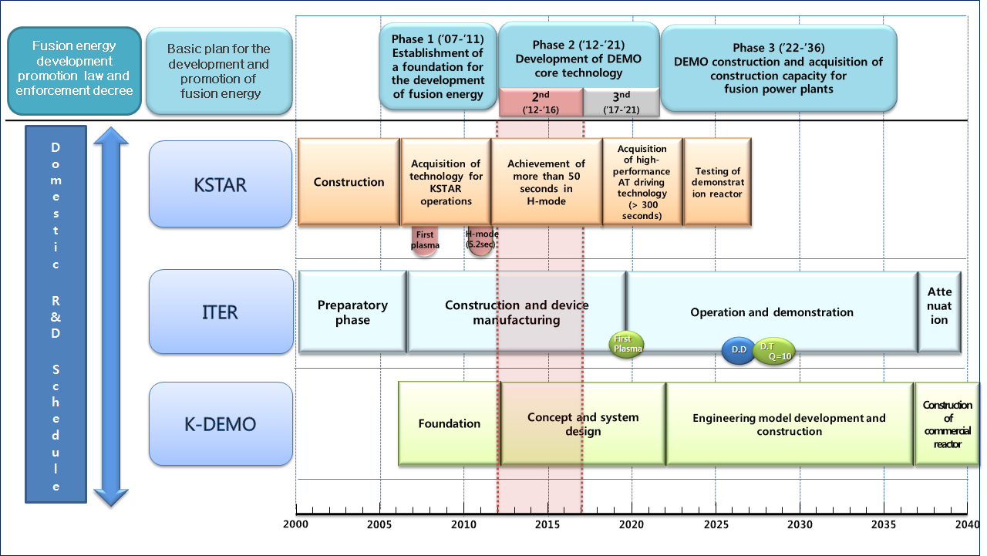
Korean Fusion Energy Development Roadmap
“Key Milestones”
Pre-Conceptual Design Study
DEMO R&D Launch & CDA
DEMO EDA Start
DEMO Final Design & Constr. Start
DEMO Phase-1 Construction Finish
6

Slide 7
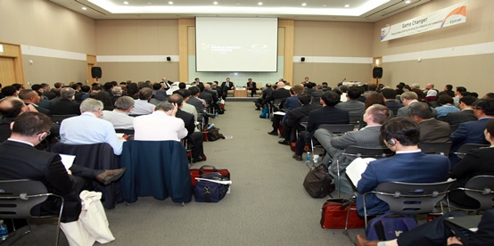
The First Fusion Energy Session in WEC2013
The 22nd World Energy Congress in Daegu, Korea (October 14, 2013)
“Fusion: Betting on a different future?”

Slide 8
K-DEMO Conceptual
Design Activity

Slide 9
K-DEMO Pre-conceptual Baseline Selection
Natural Path: KSTAR → ITER → K-DEMO → Fusion Power Plant
  KSTAR is for the Steady-state Advanced Physics Research
  ITER is for the Burning Plasma Physics & Fusion Engineering
  K-DEMO is for the Demonstration of Fusion Energy
Size of K-DEMO : Similar Size of ITER (engineering approach)
  Larger Tokamak : too many engineering constraints, power plant consideration
  Smaller Tokamak : Net power is too small for a power plant, heat removal issue
  Higher B-field using high-current density Nb3Sn SC cable technology
  Major Issues : Divertor, Current Drive, Blanket, etc. ⇒ Gap Study for R&D
Selection of “Two-Staged Approach”
  Stage-1 : Material Validation, Component Testing, Licensing
  Stage-2 : Fuel-cycle & RAMI Validation, Electricity Generation, Higher-Qeng

Slide 10
K-DEMO Operation Points in Two-stage
High-beta Approach
ARIES-AT
CREST
ARIES-RS
PPCS-D
K-DEMO ( Stage II )
SSTR
High-field Approach
ITER
K-DEMO ( Stage I )

Slide 11
K-DEMO Design Parameters (Options)
Basic Parameter | Option I | Option II | Option III
Major Radius | 6.0 m | 6.8 m | 7.3 m
Minor Radius | 1.8 m | 2.1 m | 2.2 m
Elongation (k₉₅) | 1.8
Magnetic Field (B_{o})/Peak Field | 7.4 Tesla / ~ 16 Tesla
Divertor Type | Double Null (or Single Null)
Bootstrap Current Fraction | ~ 0.6
Normalized beta | ~ 4.0
Safety Factor (q₉₅) | 3.5~5.0
Plasma Current | > 10 MA | > 12 MA | > 13 MA
Total Fusion Power (Neutron) | 1469 MW | 2181 MW | 2736 MW
Q-value | 24 | 27 | 30
Total H&CD Power | 140 MW | 160 MW | 180 MW
Thermodynamic Efficiency | 0.35
Gross Electric Power | 690 MW | 1009 MW | 1258 MW
Recirculating Fraction | 0.8 | 0.6 | 0.55
Recirculating Electric Power | 553 MW | 605 MW | 692 MW
Net Electric Power | 138 MW | 403 MW | 566 MW

Slide 12
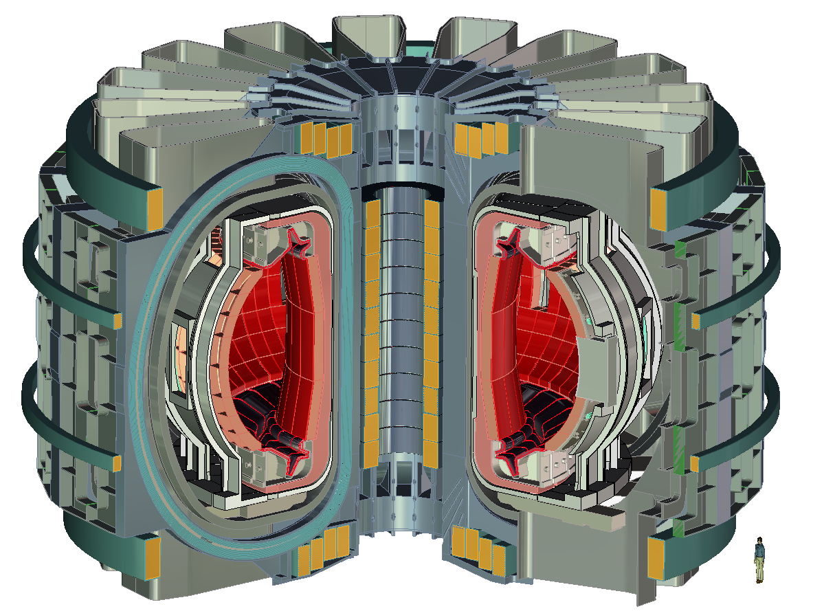
K-DEMO (Option 2) Tokamak Arrangement

Slide 13
K-DEMO Design Integration Schedule
2012.1~2012.12 |  |  |  | 2013.1~2013.12 |  |  |  | 2014.1~2014.12 |  |  |  | 2015.1~2017.12 |  |  | 2018.1~2021.12
Pre-study
Pre-study Report
Design Parameter Options
Physics & Backup Study (Phase I)
Physics & Backup Study (Phase II)
Pre-Conceptual Design Study Report
★
Improvement of Report
CDA Phase I
★
CDA Phase II + CDR

Slide 14
Major R&D Issues :
Need Innovation, “Eureka” !

Slide 15
DEMO-relevant Physics & Engineering Issues
Assumption : All ITER Physics Missions are Achieved!
Metric : Efficient(Cost-effective), Safe(Licensing)
Reliability, Availability, Maintainability
● Beyond-ITER Physics Issues
  Qeng ≥ 1 (τE βN …) ?? Efficiency
  Heat and Particle Control ?? Steady-State
  Current Drive & Bootstrap Current Control ?? Steady-state
  MHD Control (Disruption-free, ELMs, NTC …) ?? Stable
  ● DEMO Engineering & Technology Issues
  New Divertor Concept and First-wall Materials
  Tritium Breeding and Fuel Cycle
  Blanket & Power Conversion System
  Safety and Licensing Issues

Slide 16
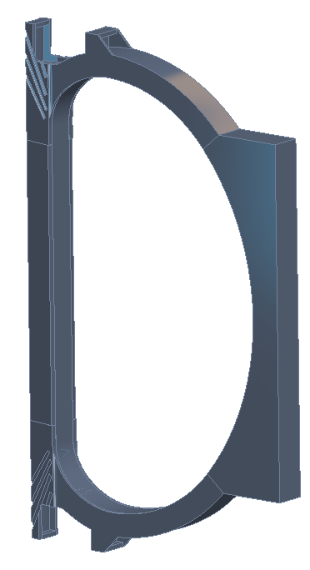
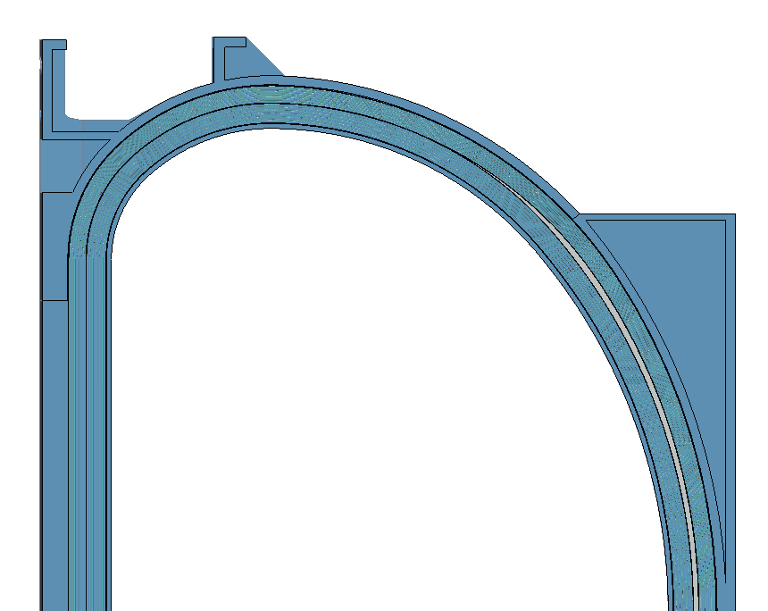
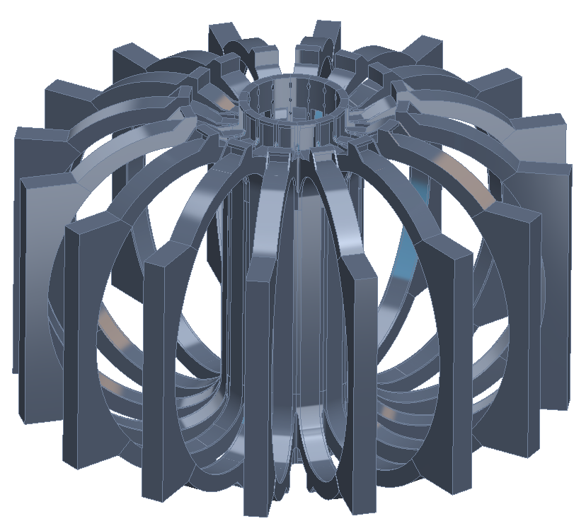
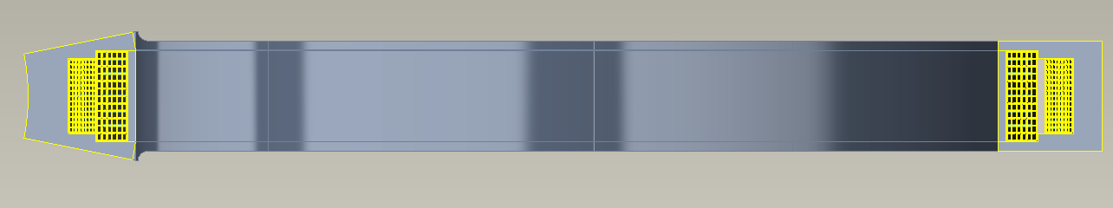
TF New Coil Winding Scheme & Structure

Slide 17
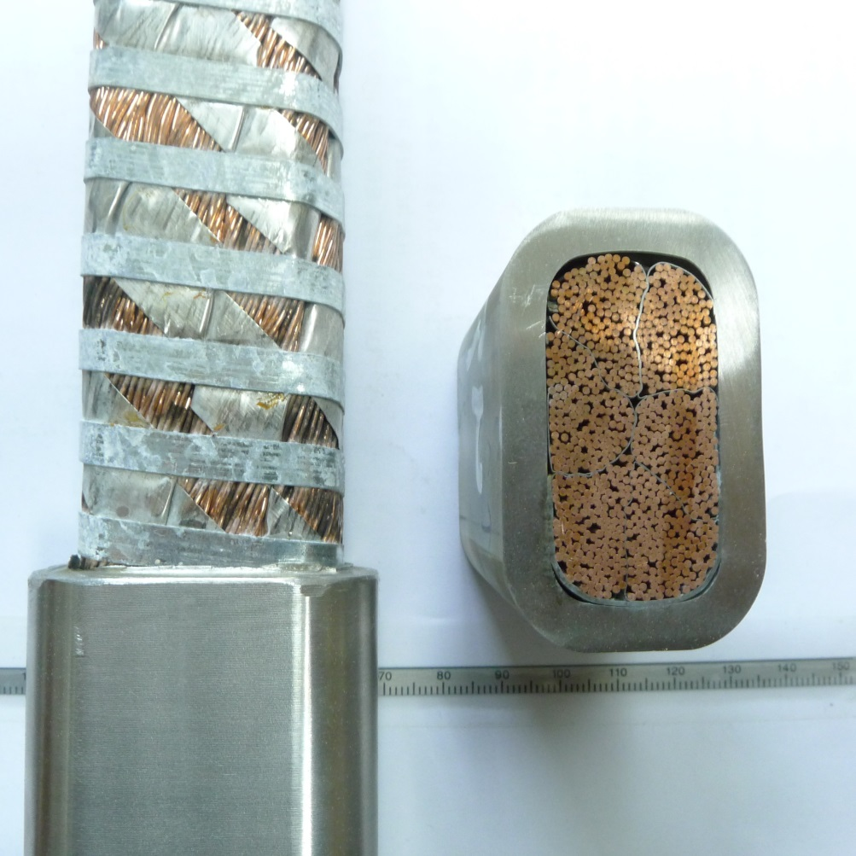
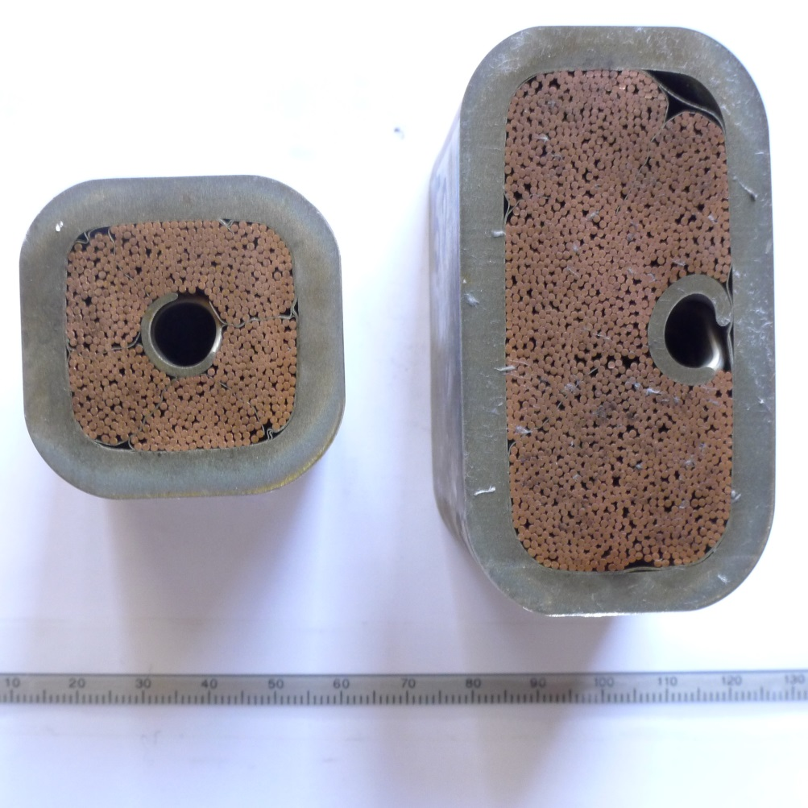
Test Samples of New Conductor Concepts
ENEA/ICAS
DEMO CS CICC (corner channel) Small & Large TF CICC (spiral)
* Huge Cost Saving (No Radial Plate)

Slide 18
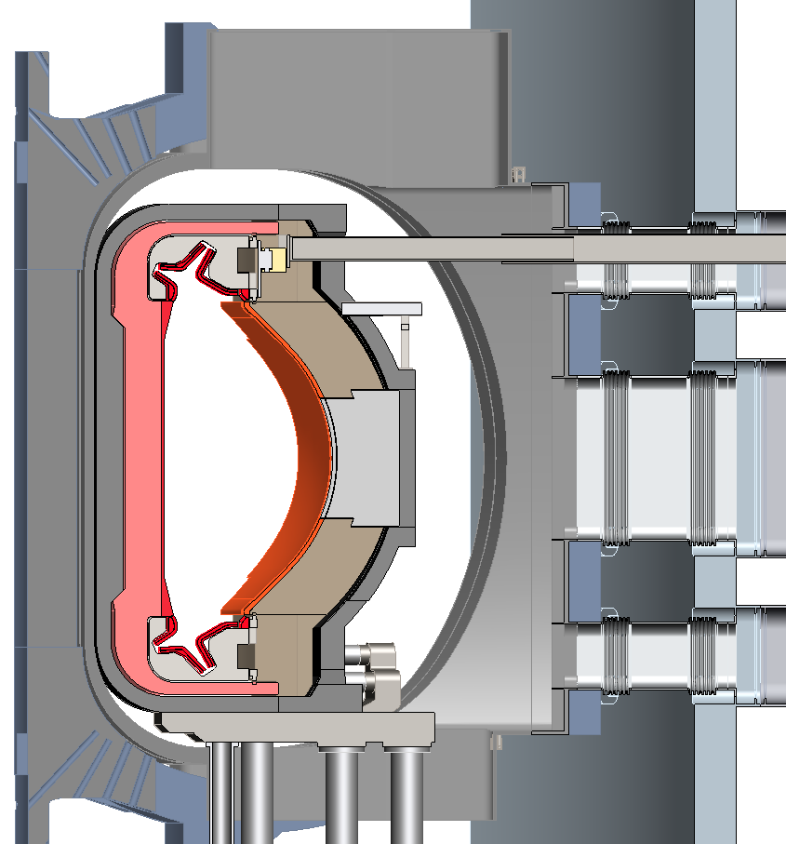
Concept of Vertical Maintenance & RAMI
Internal VV maintenance space expanded
Enlarged TF
VV (~150° C)
Horizontal assisted maintenance
Semi-permanent Inboard Shield structure (~350° C)
Horizontal assisted maintenance
Blanket (350/450° C)
Gravity support / coolant supply plenum
Coolant supply from below

Slide 19
DEMO Core Technology
Development Plan

Slide 20

DEMO Core Technology Development Study
System Integration
DEMO-relevant
Core Physics &
Simulators
Fusion Materials
Gap-Study based
Core Technology
R&D Action Plan
Superconducting
Magnet
HeatingㆍCD
& Diagnostics
Safety & Licensing
DEMO System
Engineering
● Key Metric : Reliability, Availability, Maintainability, Efficiency, Safety

Slide 21
K-DEMO Core Technology Development Plan
Development of Core Technology
3 Major Research Fields, 7 Core Technologies, 18 Detail Technologies
and 6 Major Research Facilities
Through the complete technical planning process with the full participation of experts
from all fields covering fusion, fission, physics, computing, mechanics, material,
electrics, electronics, and so on.
K-DEMO 3 Major Research Fields | K-DEMO 7 Core Technologies | Major Research Facilities
Design Basis Technology | Tokamak Core Plasma Technology | Extreme Scale Simulation Center
 | Reactor System Integration Technology
 | Safety and Licensing Technology
Material Basis Technology | Fusion Materials Technology | Fusion Materials Development Center Fusion Neutron Irradiation Test Facility SC Conductor Test Facility
 | SC Magnet Technology
Machine and System Engineering Basis Technology | H&CD and Diagnostics Technology | Blanket Test Facility PMI Test Facility
 | Heat Retrieval System Technology

Slide 22
K-DEMO Design & Core Technology Development
K-DEMO Conceptual Design & Core Technology Development
Engineering Design
& Construction
of
K-DEMO
K-DEMO Conceptual Design
Key Technology Development Program
Safety
Tokamak
Core
Simulator
Fusion
Materials
Concept
Definition
(DRD)
Pre-
Conceptual
Study
(PCSR)
Conceptual
Design
(CDR)
System
Integration
SC
Magnet
HCD &
Diag.
Fusion
System
Eng.
ITER
International
Related Facilities
JET, EAST …
PPPL, ORNL, KIT …
IFMIF, KOMAC …
(JT-60SA, CFETR …)
…
KSTAR
Fusion Basic Research and HR Development Program

Slide 23
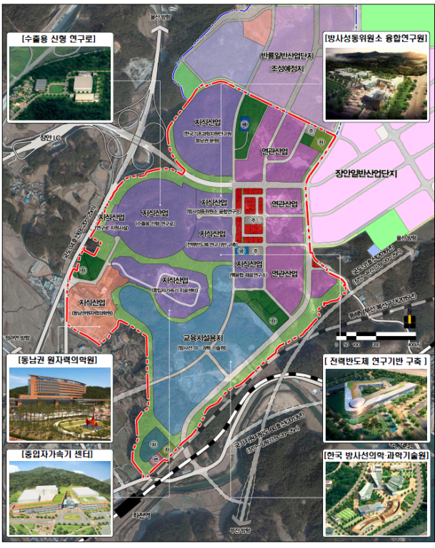
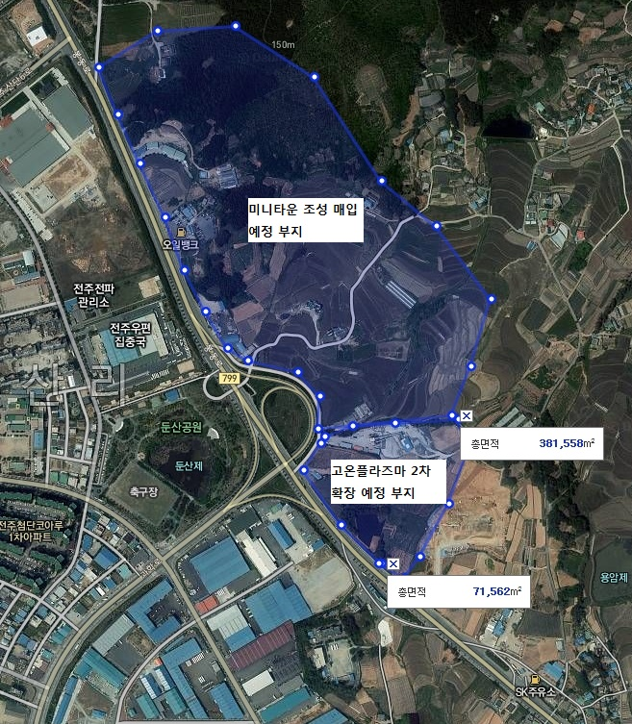
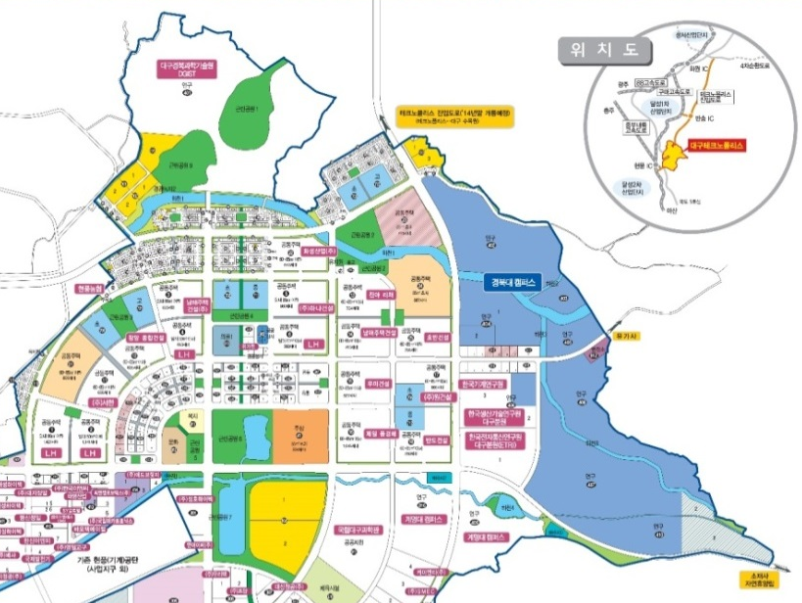

Nation-wide DEMO R&D Center Planning
연구부지
(고자기장센터 후보지)
Daegu Province
Busan Province
Chonbuk Province
Extreme Environment Material R&D Hub
- Fusion Reactor Materials R&D
Advanced Magnetic Field Center
- Superconductor Magnet Test Facility
High Enthalpy Plasma Application R&D Center
- Plasma-Material Interaction Test Facility etc.

Slide 24
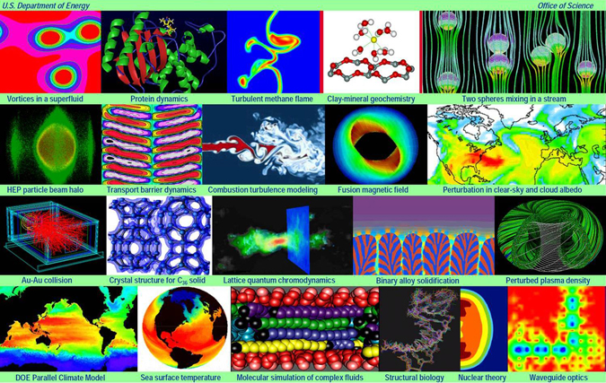
Proposed Key Facility
World-class Material Research Cluster
Establishment of world-class material research basis and global collaboration hub
to establish the next-generation strategic hub for future high-tech material development
  Development of SiC-based material, future structural material (ex: RAFM)
  Extension of 100 MeV – KOMAC (proton accelerator) for neutron irradiation test,
  and 400 keV TEM for ion-beam irradiation in-situ investigation
Fast Neutron Irradiation Facility
International: IFMIF → Started as Broad Approach (EU, JA) → EVEDA & Searching for Post-BA Plan
Domestic: KOMAC with capability of neutron irradiation
→ Limited function for Fusion Material Test Facility
Strategic Collaboration Possibility: IFMIF-based Neutron Source (DONES …)
Extreme Scale Simulation Center
International: SciDAC → Exascale Simulation (USA)
Domestic : Extreme Scale Simulation Center
for fusion and extreme material research
  Math. and S/W development for extreme simulation
  Fusion center for bridging science, engineering and ICT

Slide 25
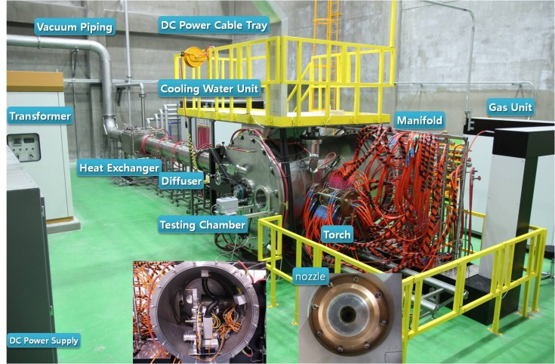
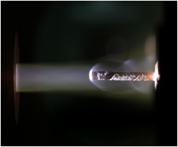
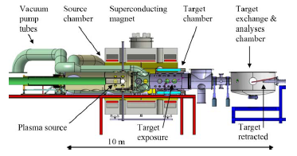
PMI Test Facility
● 400kW High-Temperature Plasma Test Facility
- Upgrade Plasma Facility for PMI Test
- Additional, Blanket Test Facility
MAGNUM-PSI (Cf.)

Slide 26
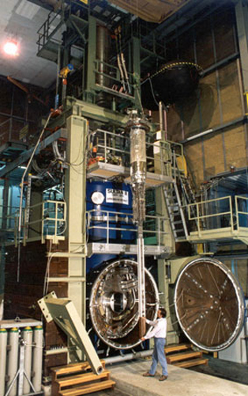
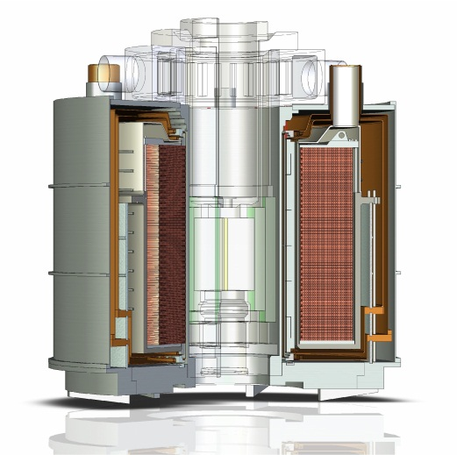
Superconducting Test Facility
SUCCEX
  Background field : 16 Tesla
  Split-pair Solenoid Magnet System
  Inner-bore Size : ~ 1 m
  Test Mode :
    Semi-circle type conductor sample test mode
    Sultan-like sample test mode
  (Cf.) SULTAN
    Background field : 11 Tesla
    100 kA SC Transformer
    for the short sample test
SULTAN

Slide 27
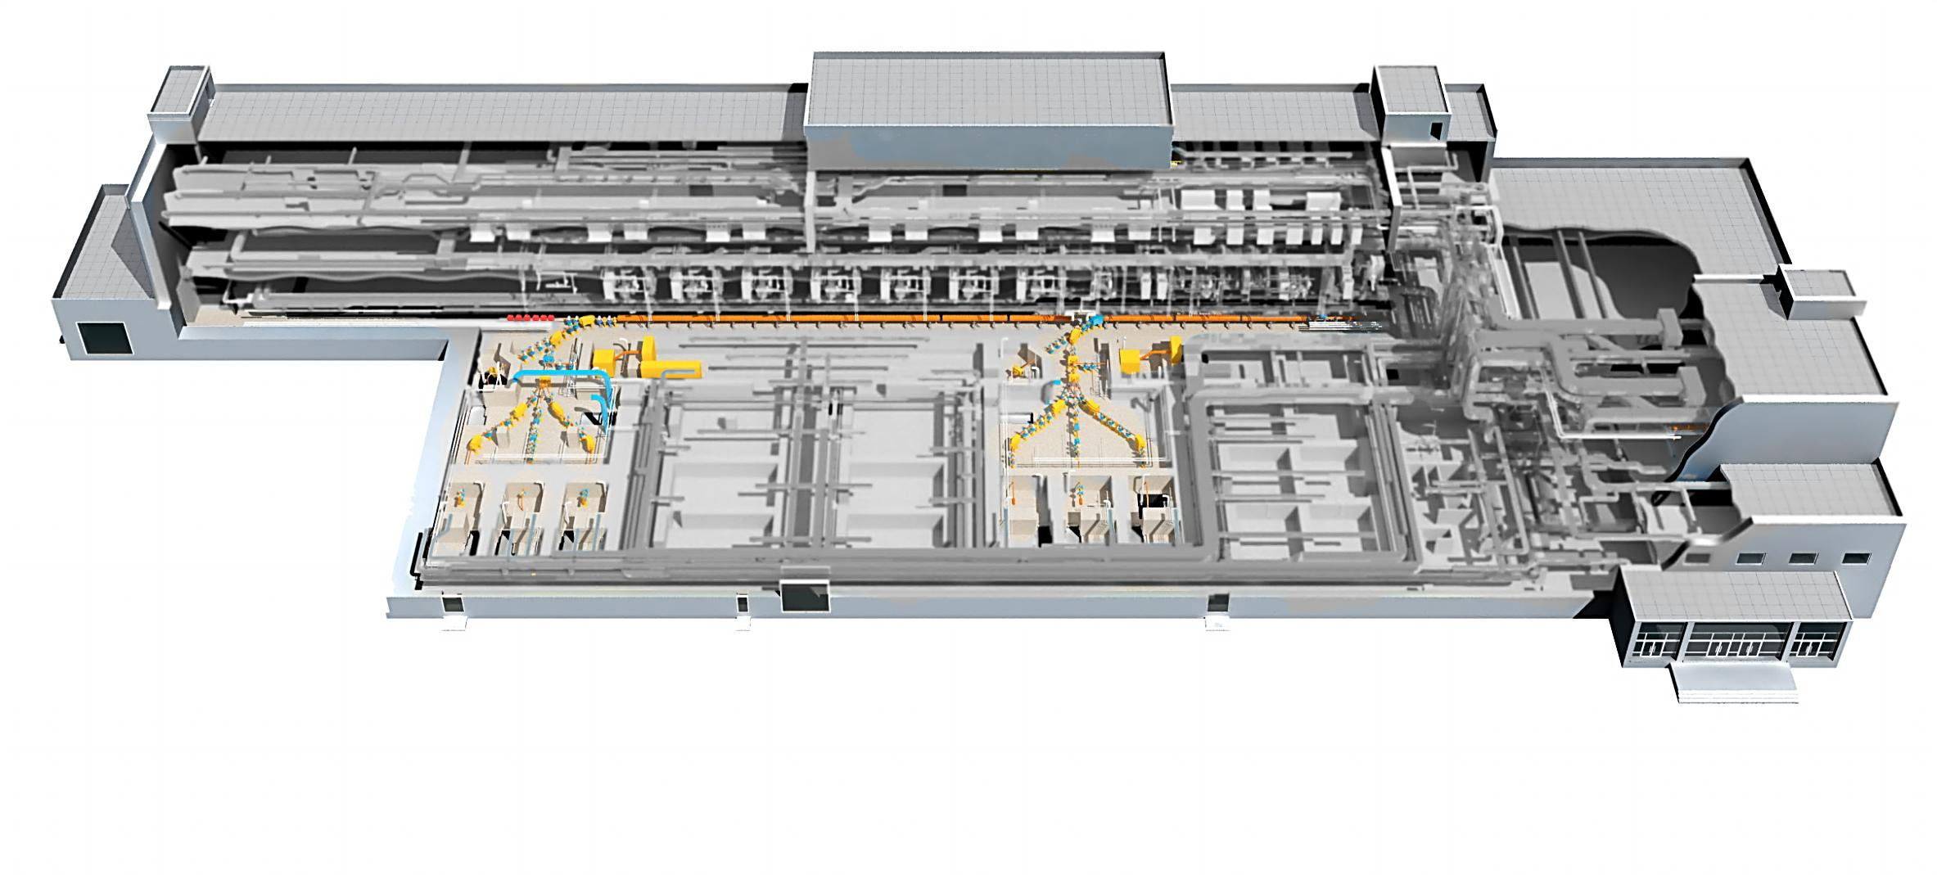
20 & 100 MeV KOMAC Proton Linac
Energy (MeV) | 20 | 100
Peak Current (mA) | 0.1 ~ 20 | 0.1 ~ 20
Max. Duty (%) | 24* | 8
Max. Ave. Current (mA) | 4.8 | 1.6
Pulse Width (ms) | 0.05 ~ 2 | 0.05 ~ 1.33
Max. Repetition Rate (Hz) | 120 | 60
Max. Beam Power (kW) | 96 | 160
Emittance (mm-mrad) | 0.22(x), 0.25(y) | 0.3 / 0.3
Features of 100 MeV linac
50 keV Injector (Ion source + LEBT) 3 MeV RFQ (4-vane type) 20 & 100 MeV DTL RF Frequency: 350 MHz Beam Extractions @ 20 or 100 MeV 5 Beamlines for 20 MeV & 100 MeV
SRF TB
100 MeV DTL
20 MeV DTL
50 keV Injector
Neutron Source
RI
RI
Semiconductor
3 MeV RFQ
Basic Science
Aerospace App.
Medical App.
Basic Science
Life-Medical App.
Nuclear Materials
Materials
100 MeV Beamlines
20 MeV Beamlines

Slide 28
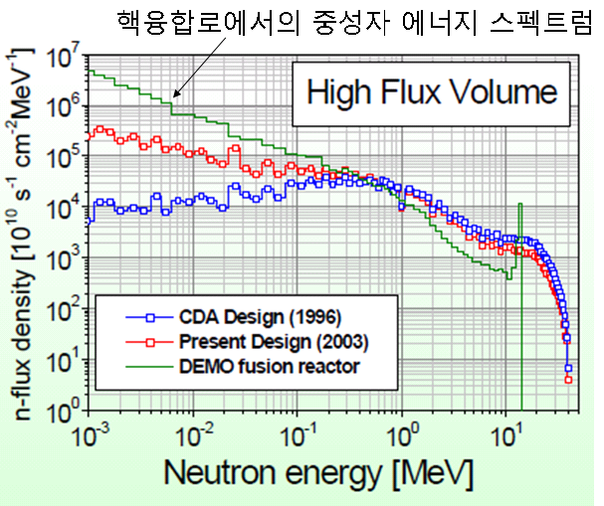
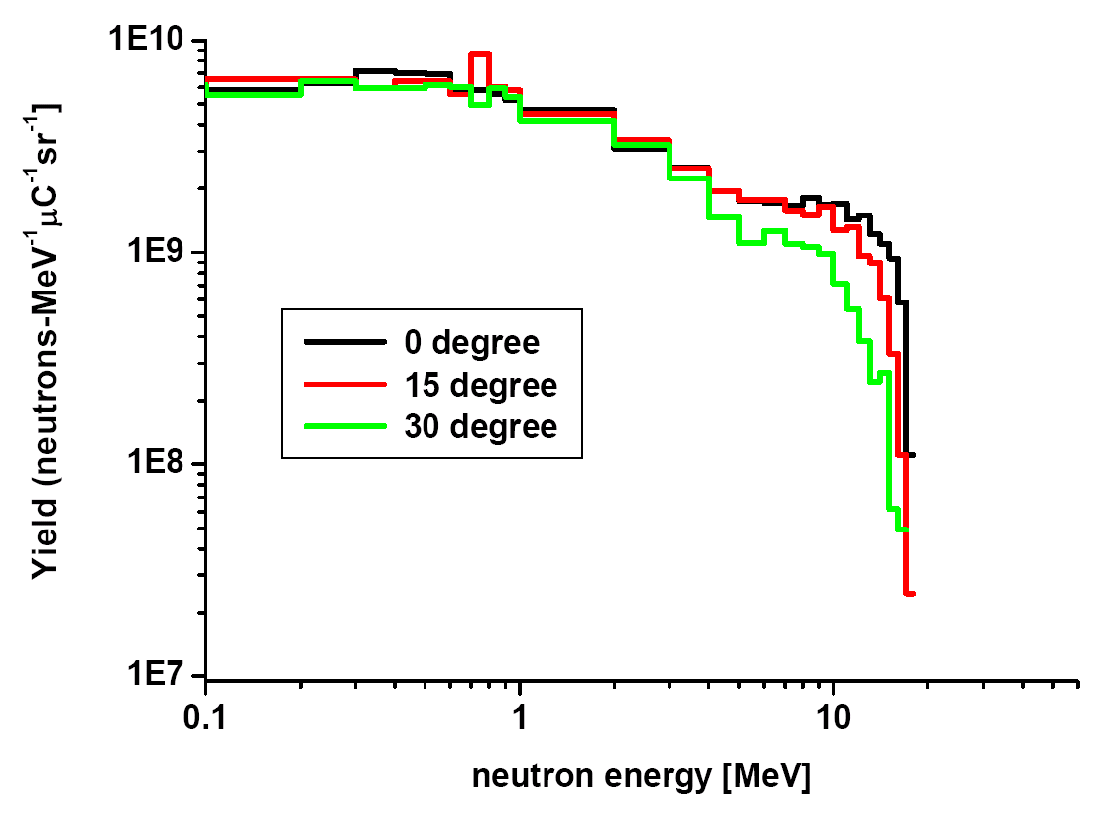
Neutron Energy Spectrum in KOMAC
Fusion Neutron similar Spectrum by Pulse-type Proton beam on Be-target (>1dpa/y)
(Ref.) Institute for Materials Research, KIT
I A. Möslang
Neutron Energy Spectrum in KOMAC

Slide 29
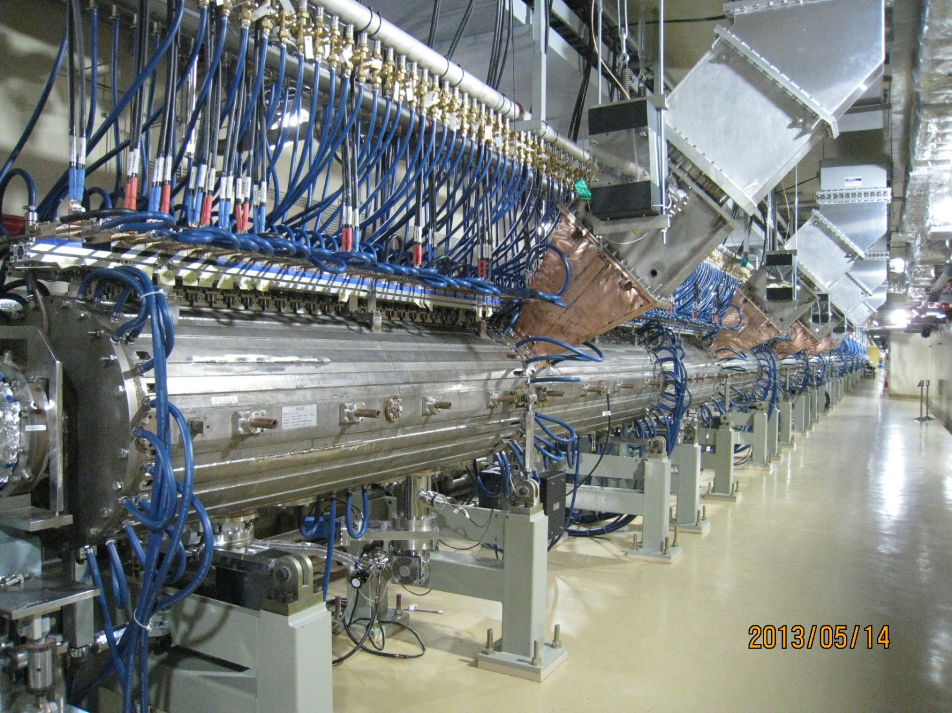
Fusion Neutron Irradiation Test in KOMAC
Ion Source
PIE
Neutron Irradiation Test Lab.
(20MeV Proton, Helium ion, H+ ions Tri-ion Test)

Slide 30
Developing New Way to
“International Collaboration”

Slide 31
International DEMO R&D Programs
Divertor Issues
  Physics, Technology and Engineering Issues
Current Drive and Technology Issues
Blanket and Tritium Issues
Materials Issues (+ IFMIF)
…
DEMO R&D Consortium
Participant
Team
LEAD
Team
Participant
Team
▶ Forming Separate R&D Consortium for Major Issues
⇒ Different Approach from ITER
Participant
Team

Slide 32
Joint Research Framework for Steady-state Advanced Physics (Example)
ITER Project
(JIA)
ITER Members
CN, EU, IN, JA, KO, RF, US
BA
(JA-EU Agreement)
Broader Approach
JA/EU
(JT60-SA)
JRF
(JA/EU-CN-KO Agreement
with US, IN, RF)
Associate Program
CN
(EAST)
KO
(KSTAR)
★ KSTAR-Upgrade is planned for K-DEMO, when ITER in full Operation.

Slide 33
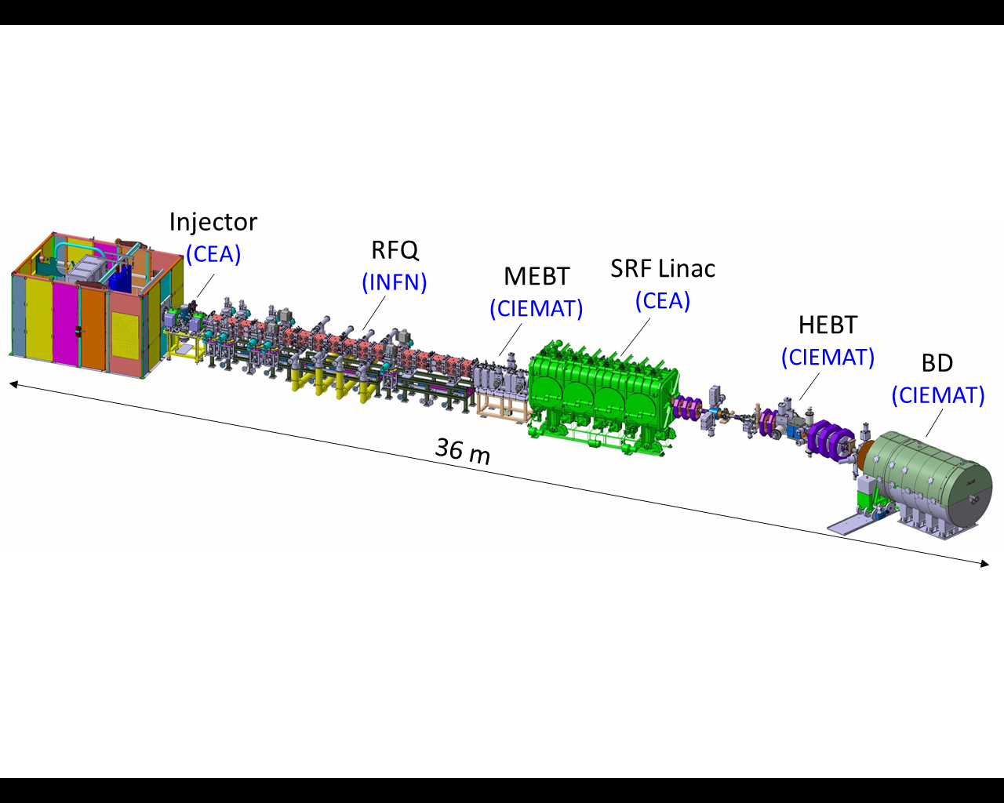
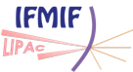
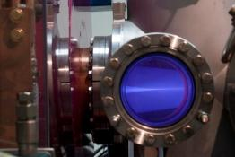
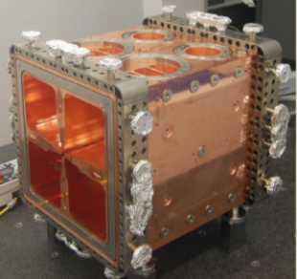
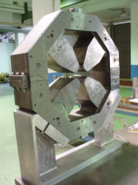
Seek Possibility to build CW 14MeV Neutron Source (such as DONES)
with Post-BA Collaboration.

Slide 34
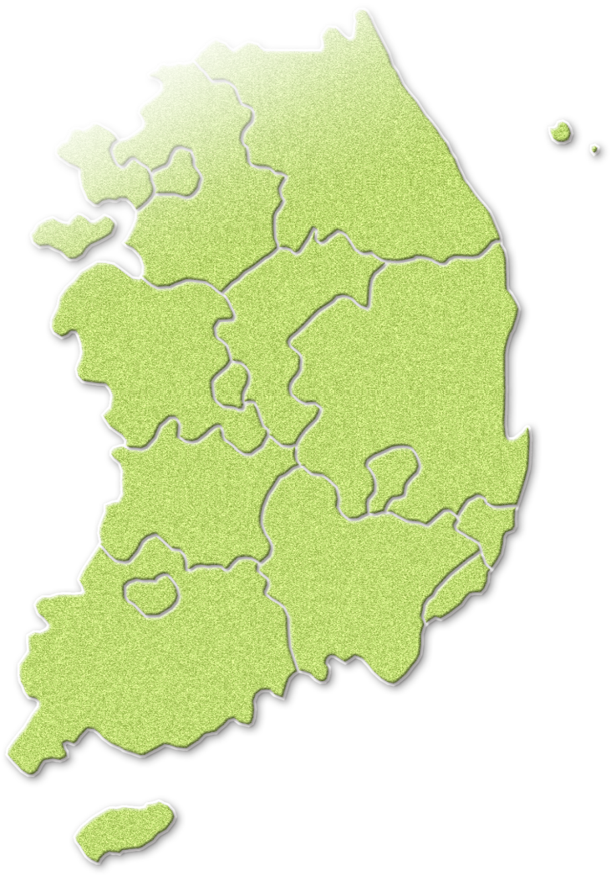





K-DEMO R&D and Construction Siting
Perfect Location for DEMO
Heavy water reactors producing
a large supply of tritium
ISBB
Low to intermediate-level radioactive
waste repository site nearby
Daeduck
Wolsong
Equipped with large-capacity power
transmission facilities for testing
Saemangeum
Kijang
34

