Slide 1
Update on Magnetized Liner Inertial Fusion
Mark Herrmann
Director
Pulsed Power Sciences Center

Slide 2
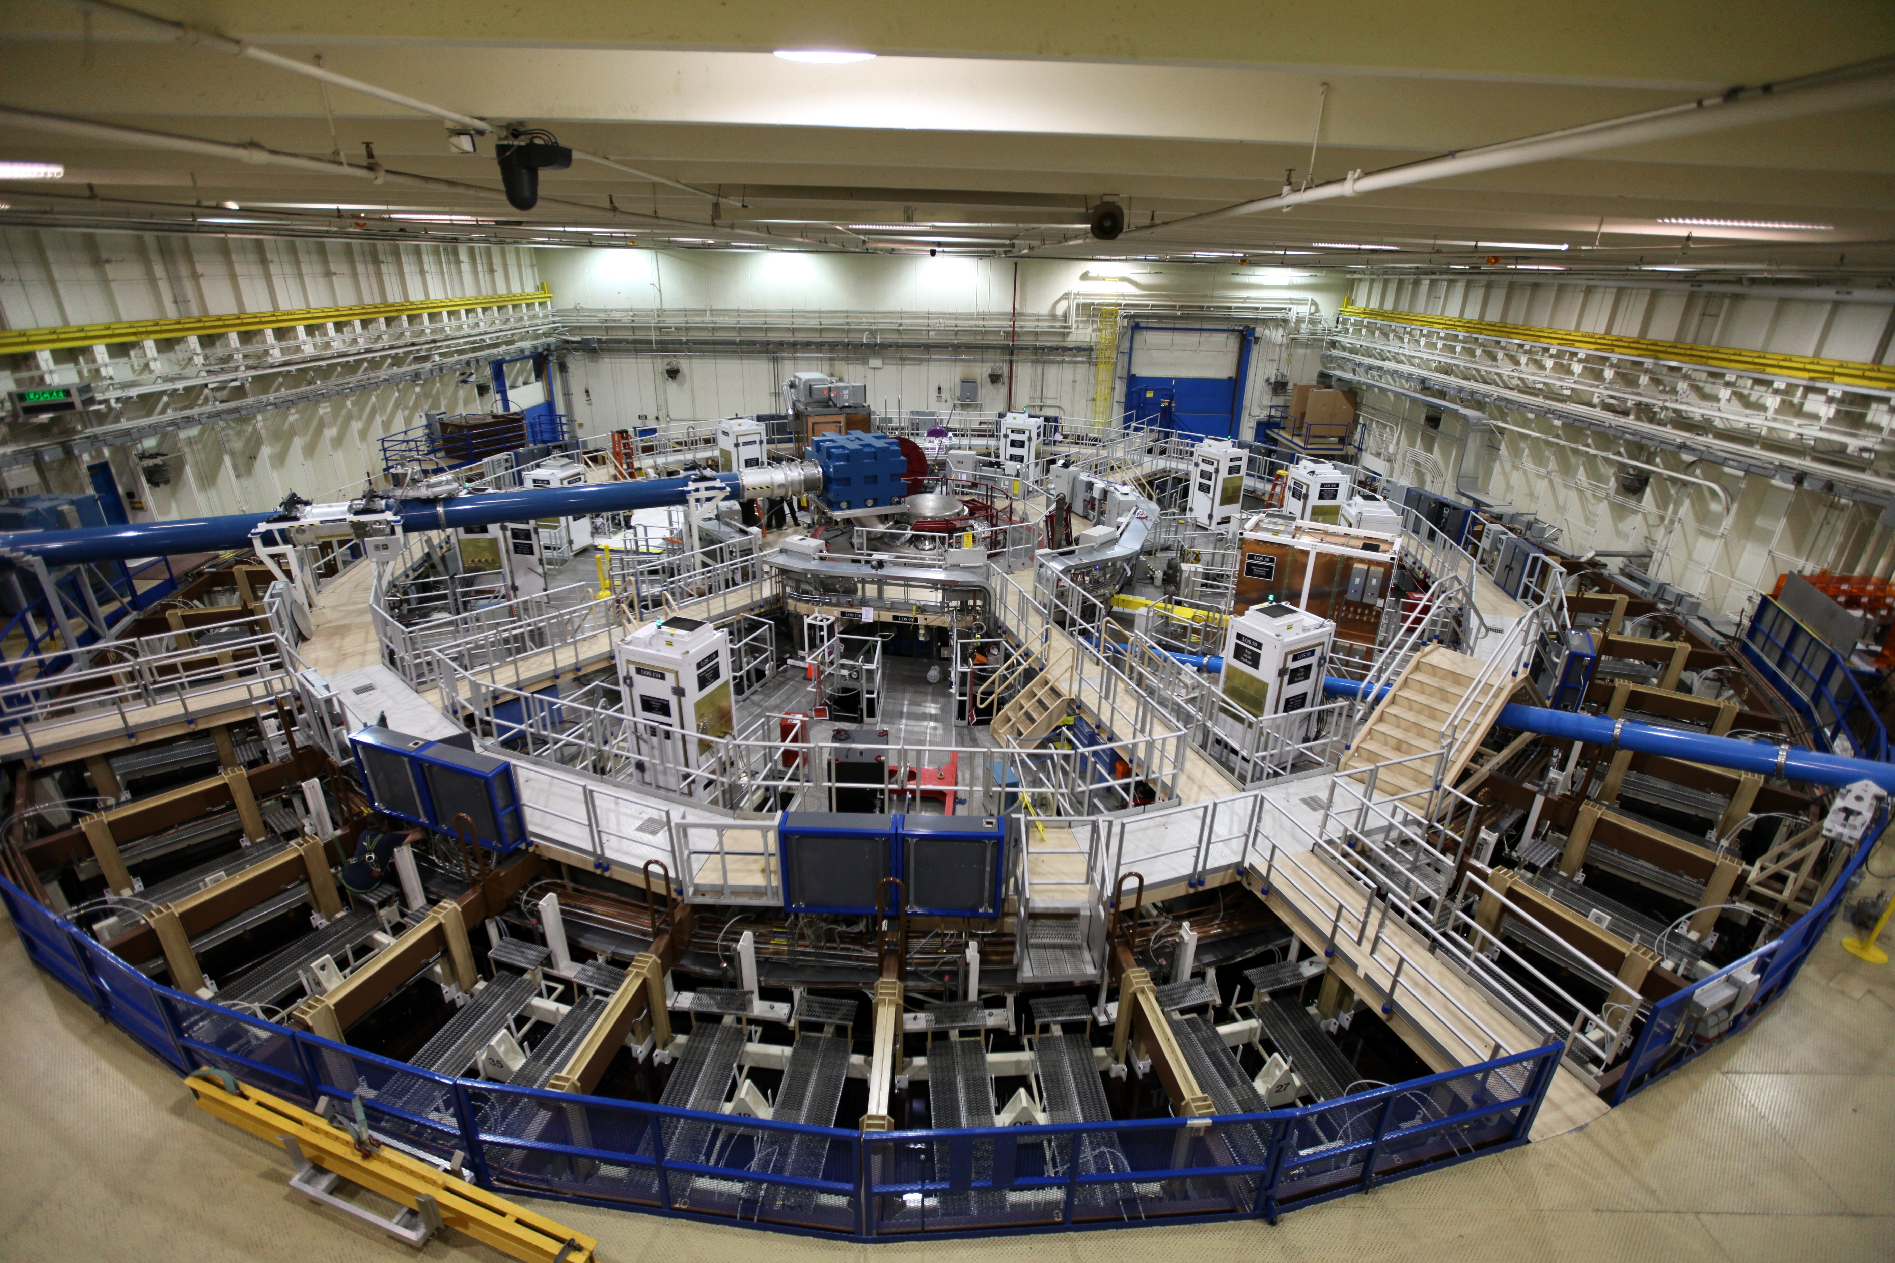
The Z facility is the world’s largest pulsed power driver. It is used extensively for NNSA’s stockpile stewardship program to study dynamic material properties, radiation effects, and fusion.
Tank~10,000 ft²
22 MJ stored energy
3MJ delivered to the load
26 MA peak current
5 – 50 Megagauss (1-100 Megabar)
100-600 ns pulse length

Slide 3
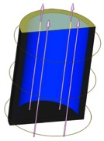
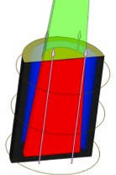
We are pursuing Magnetized Liner Inertial Fusion (MagLIF)* on Z
liner (Al or Be)
The magnetic field directly drives a solid liner containing fusion fuel.
An initial 30 T axial magnetic field is applied
Inhibits thermal conduction losses
Enhances α-particle energy deposition
During implosion, the fuel is heated using the Z-Beamlet laser (about 6 kJ)
For ignition on Z (with DT), preheating reduces the required compression from 40 to ~25, and the implosion velocity from 350 km/s to ~ 100 km/s.
~50-250 kJ energy in fuel; 0.2-1.4% of capacitor bank
The required stagnation pressure is reduced from 300 Gbar (hot-spot ignition) to ~5 Gbar.
Our goal on Z is to achieve 100 kJ of fusion yield with DT fuel
azimuthal
drive field
cold DT gas (fuel)
axial magnetic
field
laser
beam
preheated
fuel
~1 cm
compressed
axial field
*S.A. Slutz et al., Phys. Plasmas 17, 056303 (2010).

Slide 4
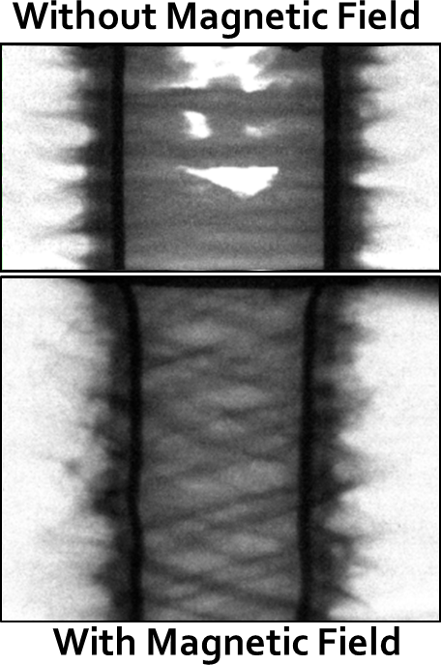
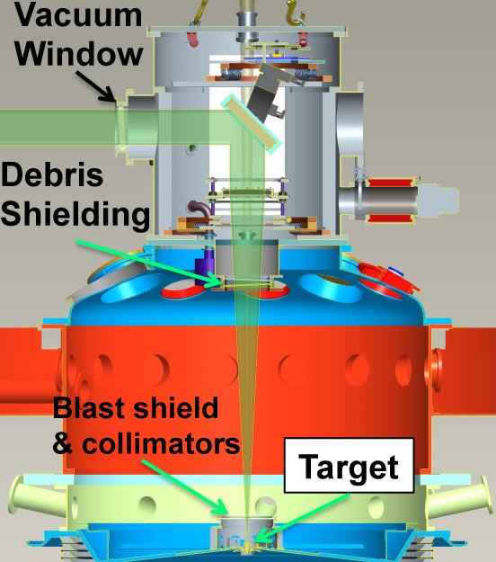
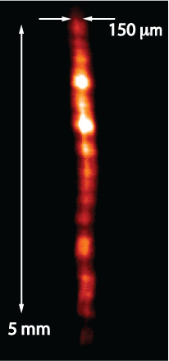
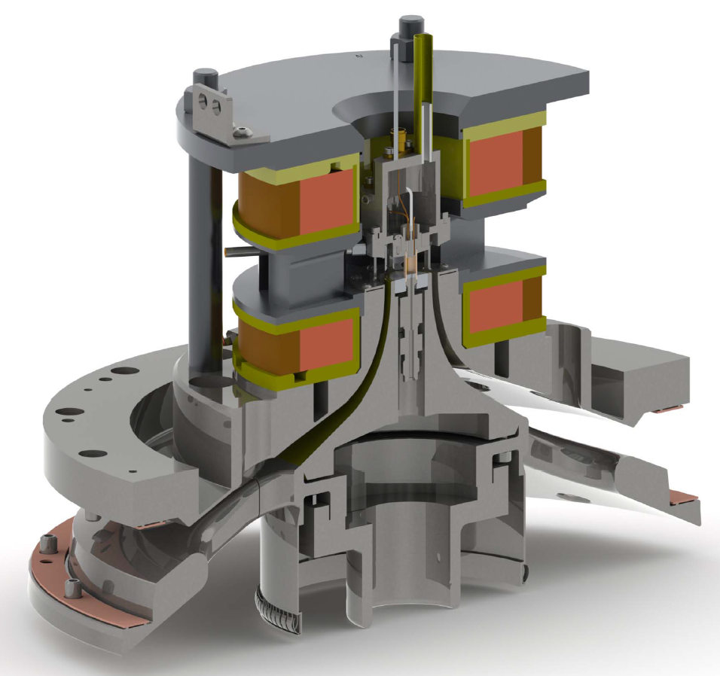
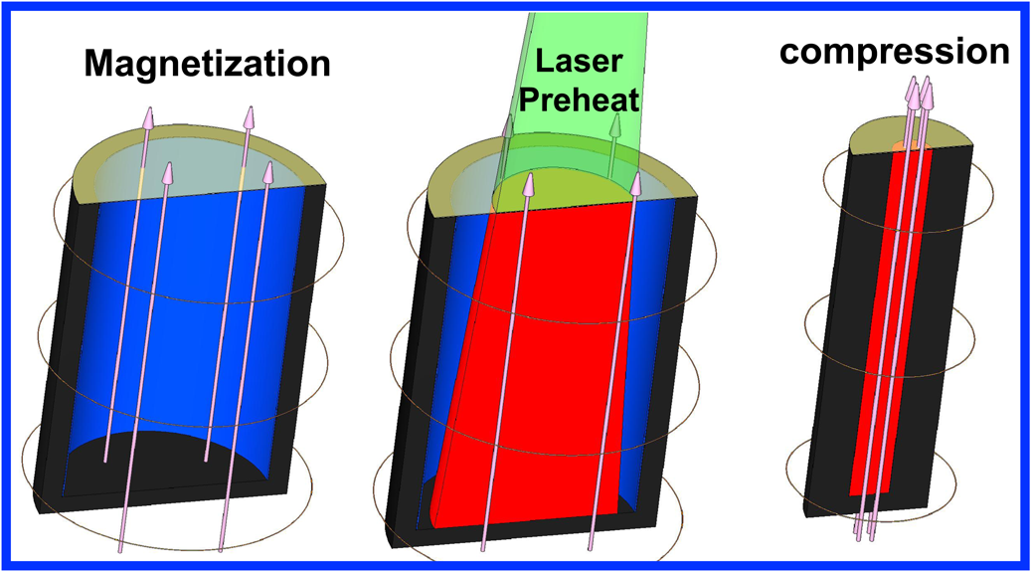
We had an exciting year for magnetically-driven implosions on Z—we completed our first fully-integrated Magnetized Liner Inertial Fusion (MagLIF) experiments and measured neutrons!
Developed experimental platform (Dec. ’12-Feb. ’13)
Commissioned 10 T ABZ system; 1st axially-magnetized liner implosions (Feb. ’13)
Commissioned new Final Optics Assembly and 2 kJ preheating (Aug. ’13)
1st successful integrated MagLIF experiments (Nov.-Dec. ‘13)
Integrated Experiment Setup
D2 fill
CH-coated Be liner
10 T Axial Field
2-2.5 kJ preheat
20 MA current
Integrated Experiment Preliminary Results
T_{i}~2 keV
~150 μm diameter emission
over >5 mm height
~5e11 DD yield (~1 %YOC_{2D}*)
~1.5e9 DT yield (B contrib.?)
* YOC based on pre-shot calculations not yet adjusted to reflect actual experimental conditions

Slide 5
Our path to assessing MagLIF in 2014-2015 builds on increasing understanding and improving capabilities
Improve experimental capabilities to support ~100 kJ DT yield experiments on Z
Continue to advance our understanding of liner implosions
Have a large database of radiography-based acceleration instability studies with images up to convergence ratio of 8
Will begin working on deceleration instability studies in 2014
Developing methods to measure liner implosion symmetry
Increase current from 20 MA to 25 MA
Increase Bfield from 10 T to 30 T
Increase laser energy from 2 kJ to >6 kJ
Begin designs for DT capabilities on Z
Understand the physics of target magnetization and fuel preheating
Performing and diagnosing integrated implosions
Understand and measure efficacy of magnetic flux compression by the liner implosion (e.g., Nernst effect)
Understand the efficacy of heat loss suppression (Braginskii transport valid?)
Understand laser-plasma coupling efficiency and dynamics
Apply diagnostics to understand stagnation conditions
Study the implosion performance with changing inputs
Begin exploring non-laser-based methods for preheating to couple >10 kJ

