Slide 1
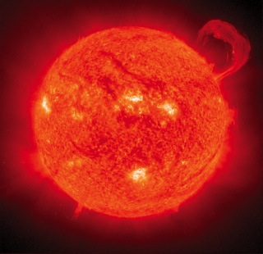
Fusion Power
ASP’s Next Steps on Fusion Power

Slide 2
Why is ASP working on Fusion?
Climate change a national security threat
Need clean baseload power
Current energy technologies insufficient or have downsides
Renewables important, but slow to scale up
Fossil fuels both dirty and finite
Nuclear fission uses uranium; weapons and waste concerns

Slide 3
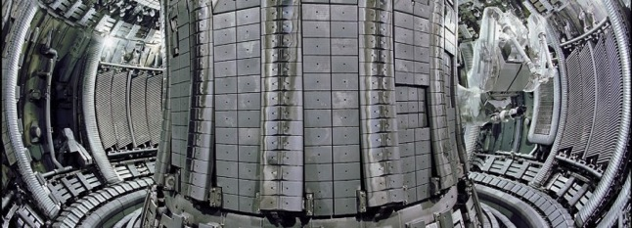
Why Fusion?
Fusion is Clean – no greenhouse gases or pollutants emitted
Fusion is Safe – no chain reaction
Fusion is Secure – no long-lived radioactive waste
Fusion is Abundant – produced from virtually inexhaustible supply of hydrogen

Slide 4
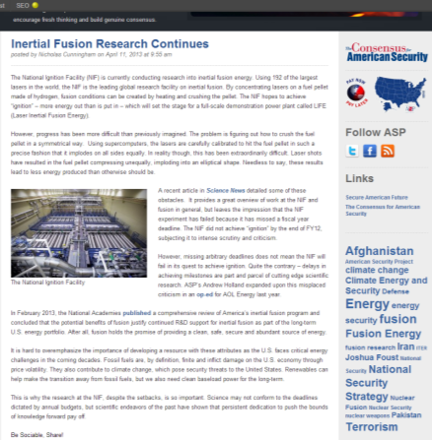
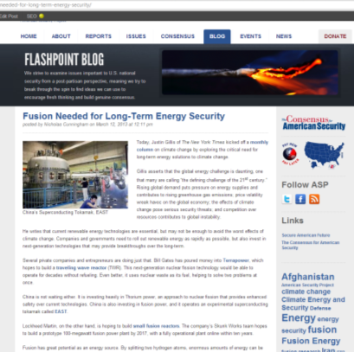
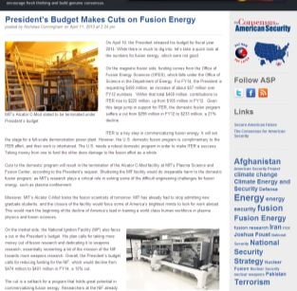
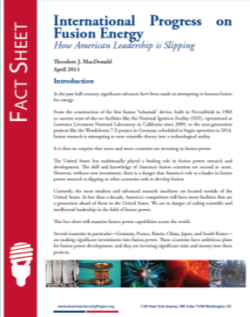
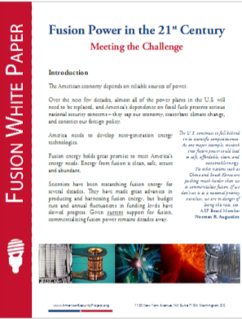
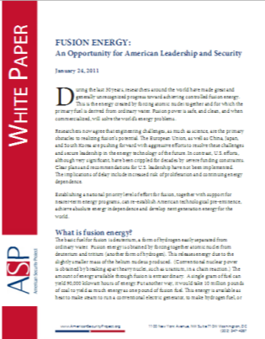
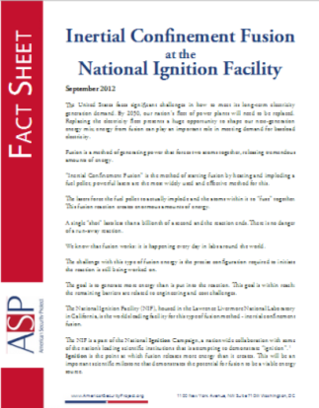
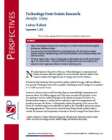
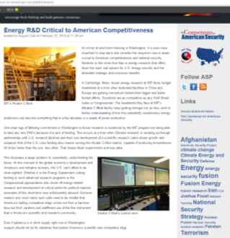
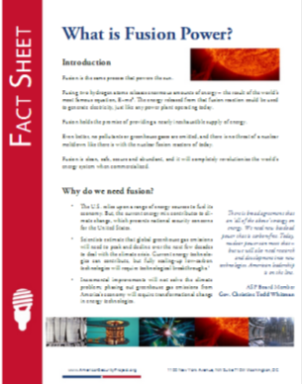
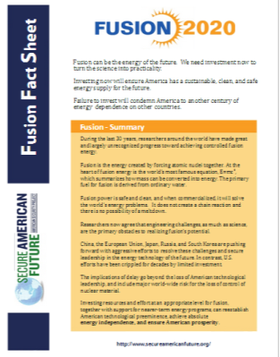
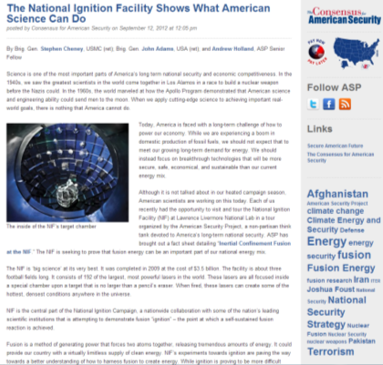
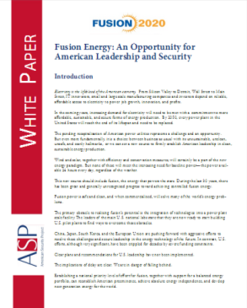
ASP’s Work on Fusion
Publications:

Slide 5
ASP’s Work on Fusion
In the Media:

Slide 6
ASP’s Work on Fusion
Over the last 24 months, ASP has focused heavily on fusion power
Main publication, “Fusion Power - A 10 Year Plan to Energy Security”
Launched on Capitol Hill
Over 2,200 reads on Scribd
Congressman Rush Holt distributed report to staff, saying “Read this”

Slide 7
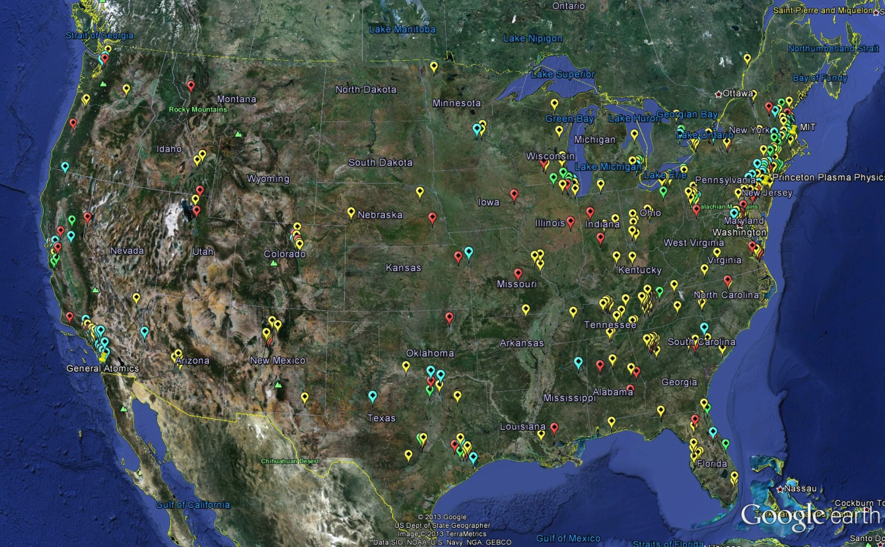
ASP’s Work on Fusion
ASP produced an interactive map that depicts nationwide footprint for fusion industry
Fusion touches 47 out of 50 states
Over 775 research institutions and businesses supporting fusion research
At least 1,200 direct research positions in the fusion industry – with countless more supporting positions
Key States:
California: At least 168 affiliated institutions and businesses
Tennessee: At least 108
Massachusetts: At least 95
Full interactive map available on ASP web site
Notes:
Fusion is important today to

Slide 8
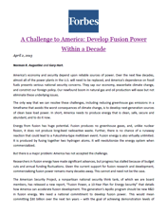
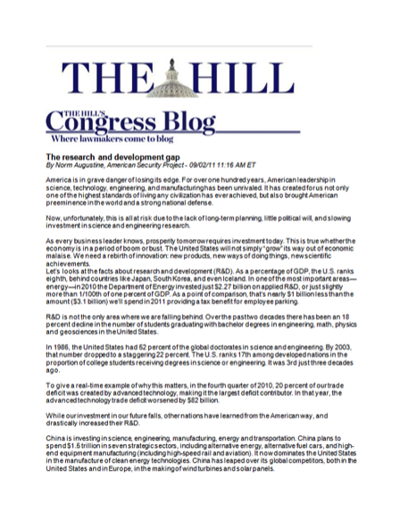
Two of ASP’s Key OpEds on Fusion
Forbes
“A Challenge to America: Develop Fusion Power Within a Decade” – By Senator Gary Hart and Norm Augustine
The Hill
“The Research and Development Gap” – By Norm Augustine

Slide 9
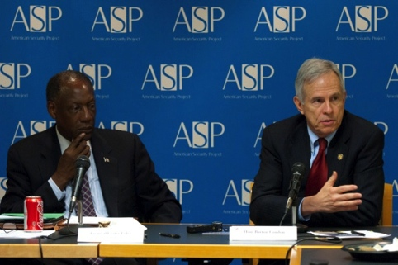
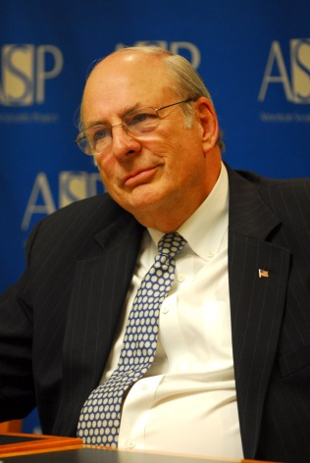
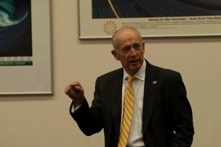
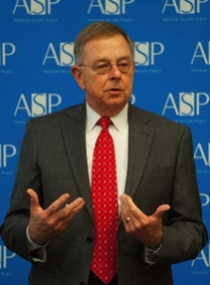
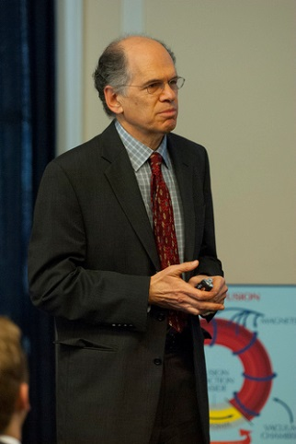
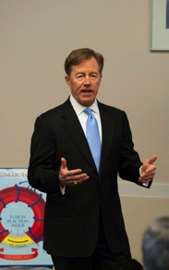
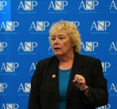
ASP Events on Fusion
“Fusion Power – A 10 Year Plan to Energy Security” – March 13, 2013, with Rep. Zoe Lofgren; Vice Admiral Lee Gunn, USN (Ret.); Dr. Stewart Prager; Andrew Holland
“Science and National Security Forum” – September 19, 2012, cohosted with American Geophysical Union
“Magnetic Fusion – Steps to Commercialization” – June 5, 2012, with Gen. Les Lyles and former Rep. Bart Gordon
“The Research and Development Gap” – January 20, 2012, with Norm Augustine
“Fusion Energy – An Opportunity for American Leadership and Security” – August 3, 2011, Hill Briefing with Rep. Rush Holt, LtGen Dan Christman, Dr. Stewart Prager, and Dr. Ed Moses

Slide 10
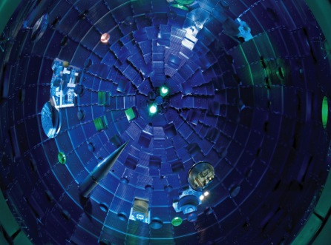
Next Steps
Strategic Aims
Show fusion as a mainstream energy choice
Promote the 10 year plan
Build political and decision making constituency for fusion power
Short-term budget strategy (MIT)

Slide 11
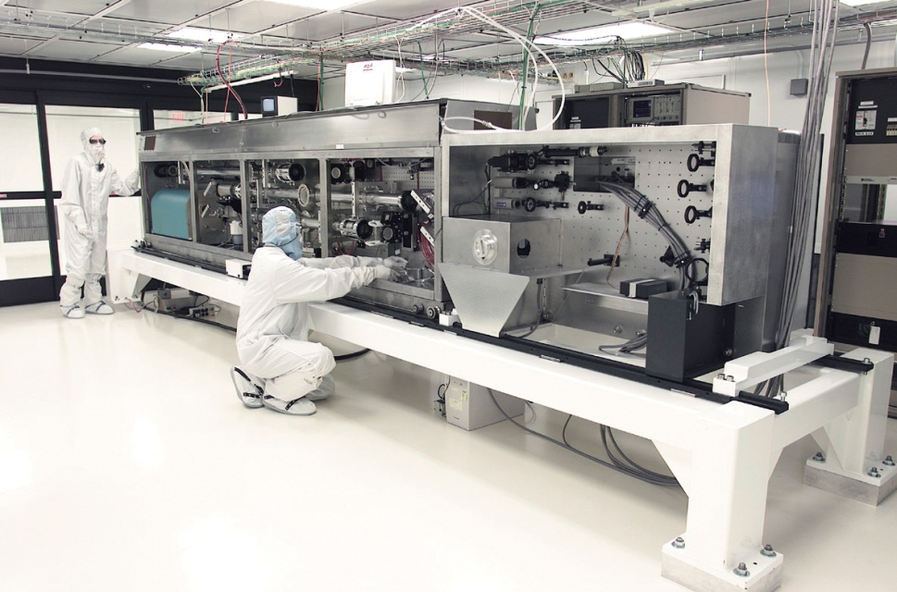
Next Steps: Mainstreaming Fusion Energy
Energy Choices
Continue to discuss fusion as part of America’s energy future and choices
American Competitiveness
Continue to discuss fusion as best example on why we are falling behind in competitiveness
Fusion’s Impact
Continue to discuss and demonstrate the reality of fusion and its current and future impacts

Slide 12
2014 Next Steps - Tactics
Fusion Power: 10 Year Plan
Promote ASP’s 10 year plan further with Key Stakeholders
Host Capitol Hill Event with VIPs (early Spring?)
ITER: An Example of Successful International Collaboration
Host Capitol Hill Briefing with representatives of all 7 ITER countries
Show how important ITER is for International engagement
Other
Work to bring outside groups (other key institutions, policy makers etc.) to meet with key stakeholders

Slide 13
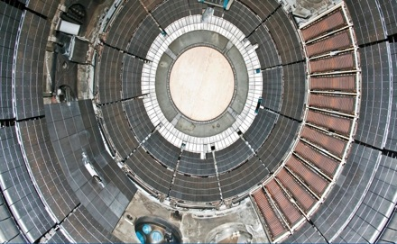
Next Steps: Build Constituency for Fusion Power
ASP Reports & Events
ASP Reports
Expand on 10 Year plan recommendations
Fact sheets on the National Labs and individual progress
Discussion of the challenges that we can overcome
ASP Events
Events on the above papers
Annual Fusion event on the Hill

Slide 14
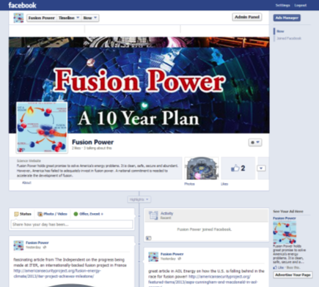
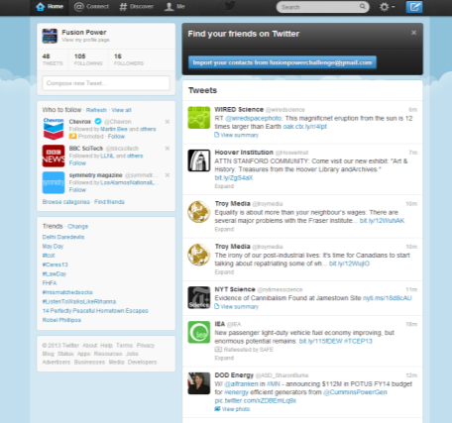
Next Steps: Build Constituency for Fusion Power
ASP Social Media
ASP Blog
Frequent blogs on fusion
Amplify positive fusion news stories on ASP’s blog
Facebook
Expand the ASP fusion facebook account and followers
Twitter
Expand the ASP fusion twitter account and followers
Use of SEO tools
Create and use SEO to push up ASP fusion page on Google
YouTube and other Videos
Investigate the best way of creating fusion educational videos
Interactive Space
Host interactive discussion boards and other tools on fusion
Other
Use other key social media tools

Slide 15
Next Steps: Build Constituency for Fusion Power
ASP Traditional Media
Background Briefings
Conduct series of background briefs with appropriate journalists and opinion writers
On the record Quotes and Statements
Offer quotes and commentary on fusion and related subjects
Editorial Board Briefings and Packages
Arrange a series of editorial board briefs with key individuals and ASP board
Distribute a full editorial board package
Op-eds
Write and place a series of opeds on fusion and related subjects – authored by Board members, Consensus members and ASP staff
LTEs
Respond to fusion news stories with Letters to the Editor– authored by Board members, Consensus members and ASP staff

Slide 16
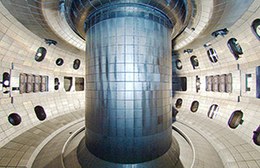
Next Steps: Build Constituency for Fusion Power
Congressional Outreach
Key Member and Staff Briefings
ASP staff and board briefing key members and their staff
Continue to build and maintain relationships
Build on AGU-ASP Congressional Partnership
Establish Fusion Caucus
Build momentum for caucus in House for fusion. Regular meetings for members to discuss fusion program
ASP to provide “secretariat” services to the caucus
Committee Hearing
A hearing in authorization committee to elevate conversation of fusion power
Site Visits
Organize site visits to fusion facilities for members and staff

Slide 17
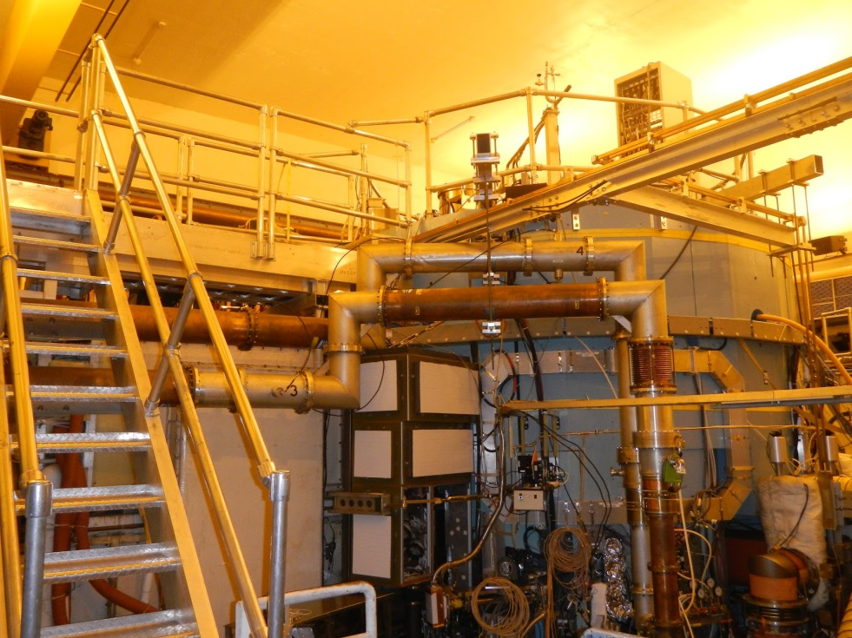
Next Steps: Budget Strategy
Placing budgets in an overall fusion push / plan context
Keep MIT Open
Putting MIT’s Alcator C-Mod in context: how closing it will harm the future of America’s fusion program
More funding will ensure a ‘bigger pie’ for both ITER and domestic program
MIT’s Alcator C-Mod

Slide 18
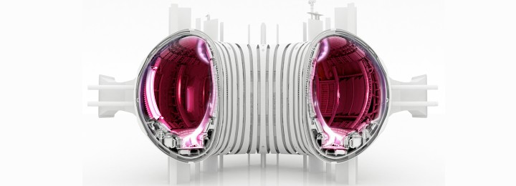
Science and Fusion Community Outreach
Media Monitor
Issue Briefs
AGU and ASP Partnership – explaining science policy on the Hill and to the media
Outreach to fusion scientists

Slide 19
The American Security Project
Why ASP?
ASP is a non-partisan public policy research and advocacy.
ASP works on a range of national security issues.
ASP promotes informed debate about the appropriate use of American power.
ASP provides long-term, strategic responses to 21st Century challenges.
Why Fusion Power?
Fusion is clean, safe, secure, and abundant source of energy.
Fusion will establish new high-tech industry – creating spin off innovation.
Fusion will revolutionize energy system and help solve climate change.
Why Now?
Solutions needed for long-term energy security and climate change.
U.S. at a crossroads. Other countries investing in fusion power, U.S. cutting budgets.

Slide 20
Contact Information
http://americansecurityproject.org/
Main Office Number: 202.347.4267
Senior Energy & Climate Change Fellow Andrew Holland: aholland@americansecurityproject.org.

Slide 21
FURTHER READING
ASP’s Work on Fusion
Fusion Energy: An Opportunity for American Leadership and Security
Fusion Fact Sheet
Factsheet: Inertial Confinement Fusion at the National Ignition Facility
Map: Fusion’s Reach Across America
The National Ignition Facility Shows What American Science Can Do
Through Innovation and Investment, the U.S. Can Lead on Next-Generation Energy, Nuclear Fusion
Fusion for the Future
Other Work
Magnetic Fusion Energy: Status and Challenges
Accelerating Progress in Magnetic Fusion Energy
Technology from Fusion Research Benefits Today
The Path to Net Electricity for Magnetic Fusion
Fusion Status ITER Materials – Developing a Vendor Base for Fusion Commercialization
Small Fusion Reactors
Princeton Plasma Physics Laboratory
The National Ignition Facility
Academy of Engineering – Challenges for the Future
www.americansecurityproject.org

