Slide 1
Activities and Strategy in Japan on Fusion Technology for DEMO
Fusion Power Associates
34th Meeting 10/12/2013
Hiroshi Horiike
Osaka University
Graduate School of Engineering

Slide 2
CV
1976-86 : Ion source and injector R&D for JT-60
1987-92: JT-60U project manager
1992 : ITER-EDA
1993 : Assoc. Prof. Osaka Univ. Dept. Nuclear Engineering
1996- :Professor Osaka Univ. Dept. Nuclear Engineering
2001-05: Liquid Lithium Target R&D for IFMIF-KEP
2007-14: Liquid Lithium Target R&D for IFMIF-EVEDA
2008,9 : Briscoe Panel member
2008- :Chairman on ITER-BA Technical Promotion Committee
2013,14 :President, Atomic Energy Society Japan

Slide 3
INTRODUCTION
Purpose of ITER and BA (broader approach project) is in early realization of DEMO.
Deep comprehension of DEMO is important for the successful realization, with using ITER and satellite machines like JT-60SA. And preliminary design activity is initiated in BA.
Comprehension of most optimal way to the goal is important, and it helps smooth transition from conceptual design activity to engineering design activity, with utilizing the human resources and experiences stocked in ITER and the satellite projects.
Especially important is before late 2020’s, in parallel with the DT plasma campaign at ITER, a single integrated scientifically and technologically secure development plan to DEMO has to be agreed and attained.
Value of the fusion energy, as an answer for environmental and energy issues, and continuous human resources development, have to be explained clearly on this phase.
The fusion energy forum Japan gathered up three recommendations on 2007 – 2009,
1)road map to DEMO,
2)cultivation of human resources on fusion road map, and
3)challenging issues excluded from ITER and BA.

Slide 4
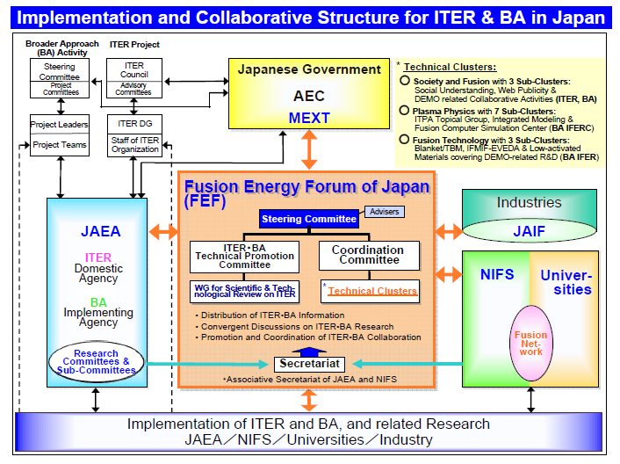

Slide 5
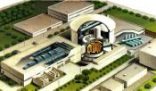
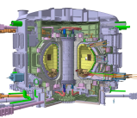



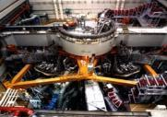
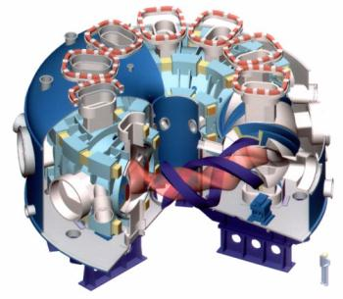
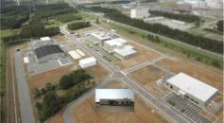
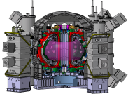
Road to Fusion Energy Realization
Test Facility
Experimental Reactor
Demo Reactor
Real
Fusion
Energy
DEMO
Fusion Core Plasma Research
ITER
0.5GW of Fusion
Energy Production
JT-60
520million ℃
World Record
【Cadarache】
Electricity
Generation
Support ITER
Broader Approach
Establish Basis for DEMO
Accelerate
DEMO
【Naka】
【Rokkasho】
LHD
Satellite Tokamak
（JT-60SA）
International Fusion Energy Research Center

Slide 6
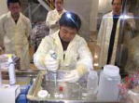
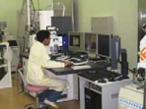
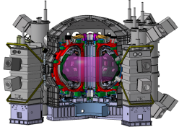
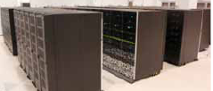
Outline of Broader Approach
■Three Projects for early realization of DEMO under JA-EU Collaboration
■10 Years Period from Jun. 2007
Rokkasho
Naka
Intn’l Fusion Energy Res. Center （IFERC）
IFMIF/EVEDA
Satellite Tokamak
（JT-60SA）
Demo Design, R&D
Engineering Validation
Research for Supporting ＩＴＥＲ
R&D for Electricity Production
Validation of Prototype Accelerator and Li Target Loop
Plasma Research for supporting ITER
Challenging Research for DEMO
Engineering Design
ITER Remote Experimentation
Steady-state, High β,
Div. contr., Impurity Contr.
リチウム流
重陽子
中性子
Supercomputer simulation

Slide 7
Schedule of Projects in BA
07
08
09
10
11
12
13
14
15
16
17
18
19
20
21
22
Start of Assembly
Operation
First Plasma
Manufacture of TF Coil Conductor
Trial fabrication of full-scale TF coil
Manufacture of TF Coil
ITER
Manufacture of Divertor Target
Manufacture of Remote Handling System
Manufacture of EC System
Manufacture of NBI System
Manufacture of Diagnostics System
Engineering Design
BR2 Irradiation
Fusion DEMO Frontier
IFMIF/
EVEDA
Li Target Validation
Validation
Prototype Accelerator Validation
Injector
RFQ
SRF
Demo Design・R&D
Conceptual Design Activity
IFERC
Computor Center
Machine Selection
Operation
Remote Experiment
Design
Assemble&Test
Preparation
JT-60SA Assembly
Operation
Advanced Plasma Platform
JT-60SA
Manufacture of Components
JT-60 Disassebly
Commissioning
Integrated
Test

Slide 8
Our Road Map to DEMO

Slide 9
Indispensable issues outside of ITER & BA
0. Conceptual and engineering design for DEMO.
ITER-TBM and blanket engineering.
Super conducting coil research.
Divertor; DEMO relevant heat flux handling
Initial Tritium procurement and breeding.
Tritium safety and its measuring control.
Remote maintenance and its consistency with construction design.
Materials development and design standard.
Environmental safety evaluation and its method.
Core Plasma development in JT-60SA, Heating, Current Drive and analytical knowledge.

Slide 10
Facilities of Fusion Demo Frontier Project
① Blanket Cold Test Facility
Validation tests for full size TBM fabrication & its licensing
Establish DEMO Blanket concept
②Neutron Source & Irradiation Room
Proto-type Accelerator and Li target loop will be combined and expanded in Rokkasho site
Strengthen technical basis for IFMIF construction
Confirm integrity of blanket function and Test materials under fusion reactor relevant condition.
Database to DEMO reactor technology
③Tritium Plant
Tritium recovery generated in Li target
Safety confinement of Radio isotopes in RI test complex buildings
Integrated tritium processing R&D for DEMO
(and test stand for ITER)

Slide 11
Facilities of Fusion Demo Frontier Project
④ Irradiated TBM Storage/Disassembling Facility
Receive TBMs after ITER test, PIE, Storage
Large activated components disassembly
⑤ Remote Maintenance R&D Facility
Install & remove large blanket module and transportation
Remote maintenance of large conpornents
⑥⑦ Green Innovation Facilities
Lithium for tritium breeder in fusion reactor & Lithium for large cell
R&D for Lithium recovery, purification, accountancy, storage
⑧３R Facility for Radioactive Waste Handling
R&D for Reduce environmental influence
R&D for Reuse & Recycle of Li / Be materials & other components

Slide 12
Function of the Design Activity
Conceptual design engineering design Construction
Design and R&D for DEMO consists of these phases.
Through these phases we have to,
1. develop technological bases and select one out of various options to prepare fabrication and construction of DEMO,
2. complete conceptual design of major elements and fix the specifications of DEMO,
3. prepare all information for decision making on transitions from CDA to EDA, and EDA to construction, and
4. account significance of DEMO and fusion energy, safety and environmental conformity.
These jobs have to be executed by a design team.

Slide 14
Conceptual design, engineering design/R&D and the core design team
Core design team implemented in BA, will be grown up to full team.
This team will control whole activities about DEMO design and R&Ds executed by partakers.
It is expected to narrow down concepts to one, to manage R&D activities, and to prepare numerical tools in phases followed.
Cultivation of human resources for future is a large mission for them.
The team grows up to the strong head quarter with larger responsibility for management of the whole processes in EDA/R&D phase.

Slide 15
Key points of the DEMO design
Multi-purpose application of DEMO, not only electricity generation but chemical application or nuclear transmutation may be studied.
Physical difficulty in the design must not be solved by technological difficulty. Technological issues have to be solved by physics invention, so as to suppress cost overrun. e.g. TFC and VV for ITER
The design has to be optimized on the viewpoint of, physics, fabrication technology, work machines available in industries, skilled engineering designers, good weld workers, materials with good availability and workability, and radio active wastes.
In this context, the nuclear power industries and human resources employed there will conduct crucial role for DEMO realization.

Slide 16
Conclusion
Three recommendations proposed on 2008 from the fusion energy forum Japan. Those are, road map to DEMO, cultivation of human resources, and challenging issues excluded from ITER and BA.
Proposed were, start of the conceptual design and the team, design concept consistent with RH, DEMO-TBM scenario, fuel technology of tritium and lithium, Q=1 class plasma device, and coordination with industry technology.
The recommendations strongly insist importance of human resources and industry contribution to the fusion development.
They insist importance of optimization of physical issues to technological issues, in order to come to agreement with the performance and cost.

Slide 17
Thank you very much for your attention.
Thank you very much for you and ANS support and aid to the Fukushima Daiichi Nuclear Plant Accident and post-accident managements.

Slide 18


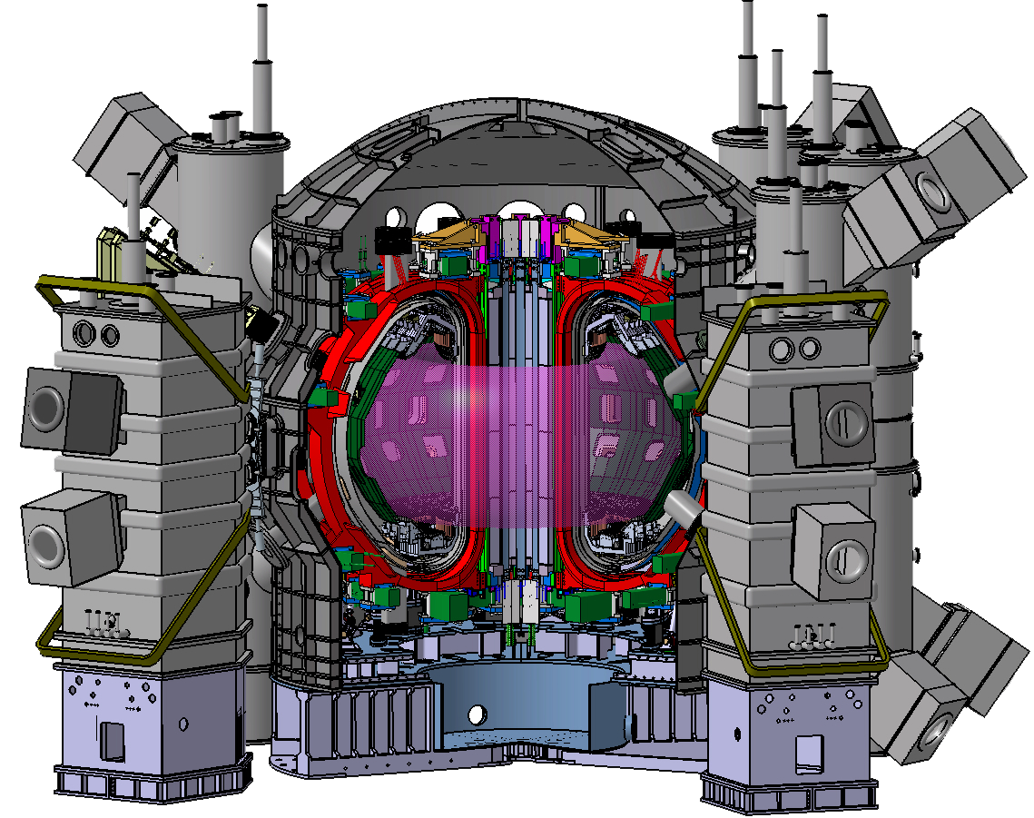



Three major resources for Demo Realization
DEMO
Advanced Plasma Platform
Fusion Demo Frontier
＠Naka
＠Rokkasho
Support ITER and
Challenge to DEMO
Establish Technological Basis for DEMO
Plasma Research for
supporting ITER and
for Demo Design
DEMO CDA
Cold Tests of Blanket
& Material R&D
Steady-state, High β,
Div. contr., Impurity Contr.
ITER Team Japan
＠Cadarache
RI Tests of Blanket
& Material R&D
JADA Activities in ITER site in addition
to those in Naka site, to accumulate data required for Demo
R&D under core plasma environment
Li recovery R&D
and Pilot plant
Assemble Phase
・JAEA staffs
・Industrial Companies
Operation Phase
・JAEA staffs
・JA Res. Institutes
Remote Handling, Fuelling,
Advanced Divertor, Safety
Others
・TBM Development
・Blanket Cold Test Facility
・Neutron Source and
Irradiation Facility
・Others
Broader Approach
・IFERC
・IFMIF-EVEDA
・Satellite Tokamak JT-60SA
Satellite Tokamak(JT-60SA)

