Slide 1
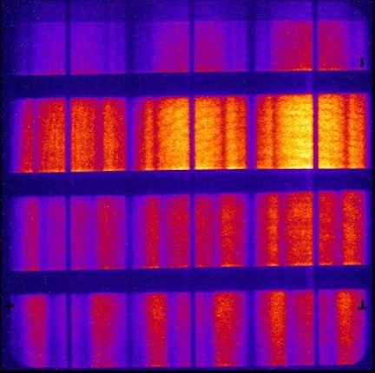
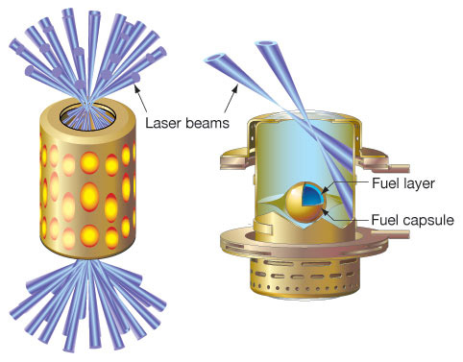
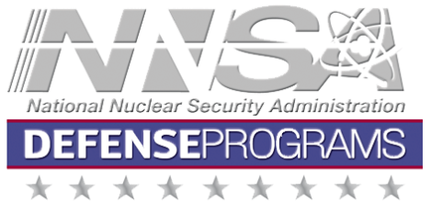
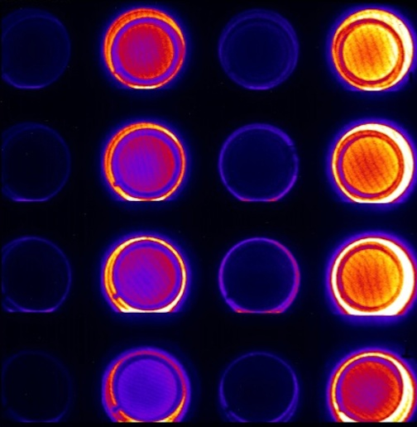
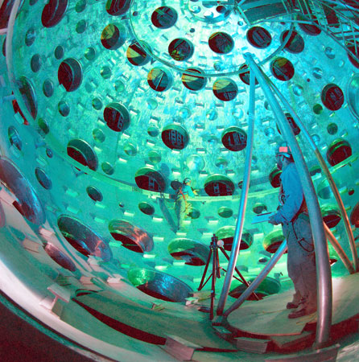
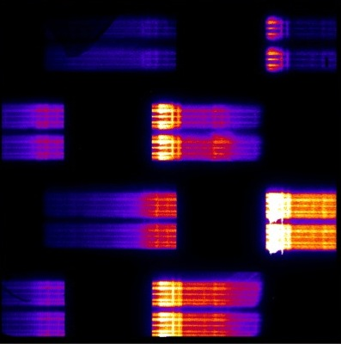
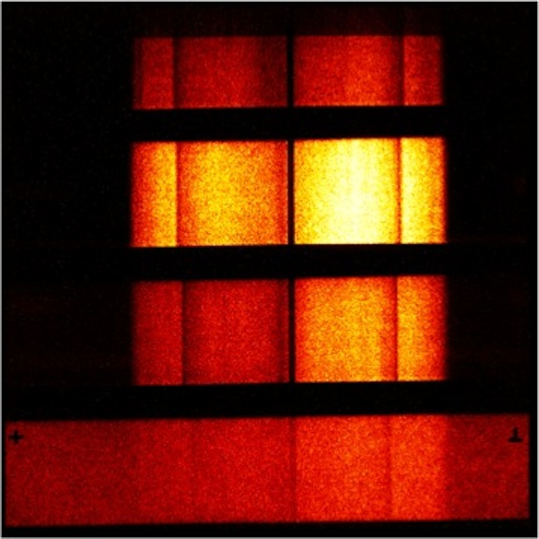
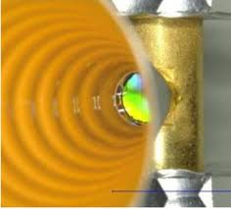
NATIONAL NUCLEAR SECURITY ADMINISTRATION OFFICE OF DEFENSE PROGRAMS
NNSA’s ICF Strategy
Presented to
Fusion Power Associates
34th Annual Meeting and Symposium
Washington, DC
December 11, 2013
Kirk Levedahl NNSA

Slide 2
ICF is vital to NNSA’s stockpile stewardship and national security missions
Show relevance to Stockpile Stewardship through HED science.
Equating [gain 1] ignition goal to fusion energy undercuts support for ICF out of the 050 account.
Provides unique environments for model validation that include radiation hydrodynamics, transport models and TN burn.
Recent 5x10¹⁵ allows a credible program on TN burn without substantial further increases in yield
HED science is exciting work that attracts and trains those whose judgment will be relied upon to maintain our nuclear deterrent.
Ignition remains a goal to pursued deliberately (in a scientifically defensible and productive) fashion. But we are at 1/200th of goal.
Demonstrate scientific quality and credibility to national and international communities in areas relevant to our national security goals.
Operate efficiently and effectively.

Slide 3
ICF Program has 5 principal elements
Develop a “burning plasma” platform for stockpile stewardship and continue to pursue ignition and high yield in a deliberate fashion.
Obtain fundamental physical properties of materials and plasmas in HED environments (in collaboration with Science Campaigns)
Provide experimental basis for code and model validation in the HED regime (in collaboration with the Advanced Scientific Computing Campaign).
Develop and advance capabilities in HED Science nationally and internationally.
Strengthen the HED community and grow the next generation of stewards

Slide 4
NNSA’s ICF program has transitioned from the NIC to a stockpile science program.
Ended the National Ignition Campaign marked the end of construction and commissioning of major facilities.
Completed the first year under the 2012 Path Forward Report to Congress
Transitioning NIF and other ICF facilities to routine operations under governance models based upon peer review.
Increased focus of the NNSA ICF program on its Stockpile Stewardship Mission.
FY 2014 ICF Budget, Continuing Resolution and potential for Sequestration
NAS report on Inertial Fusion Energy
Basic science access to ICF facilities will continue.

Slide 5
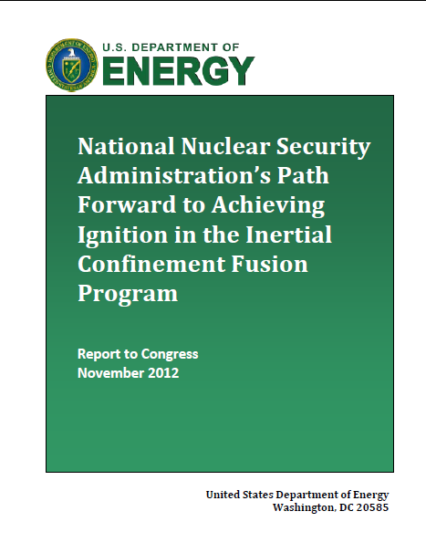
Path Forward provides consensus view from the National ICF Program leadership
May 2012
November 2012
~120 scientists from around the world met to identify key missing understanding & path to resolve
Consensus document submitted to Congress with proposed plan to resolve issues & achieve ignition

Slide 6
Under the 2012 plan the principal elements of the ignition plan are:
Continue a modified approach in pursuing the indirect drive approach to ignition (IDI) by:
Exploring the physics revealed in experiments designed to evaluate integrated performance of the system.
Adding a significant experimental effort to explore single physics effects and improved models to develop an understanding of why the NIC ignition effort failed and most likely paths for improvement.
Exploring alternative indirect drive approaches.
Explore the underlying physics and develop a path forward for Polar Drive Ignition (PDI) or symmetric direct drive approaches, principally using the capabilities of Omega while performing higher energy PDI experiments on NIF.
Explore magnetically driven implosions (MDI) on Z.
Continuously update diagnostics capability
Provide targets and advance capabilities in the most efficient manner (including appropriate partnerships with industry).

Slide 7
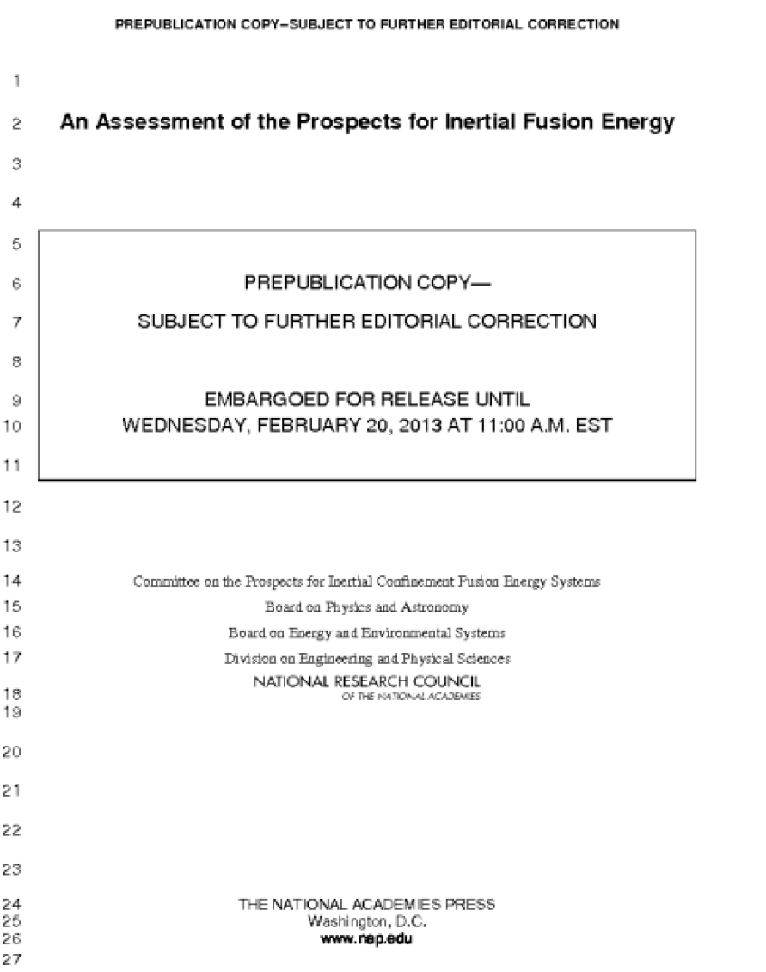
The NRC 2013 Report on Inertial Fusion Energy is consistent with the NNSA program
“The appropriate time for the establishment of a national, coordinated, broad-based inertial fusion energy program within DOE is when ignition is achieved.” [Conclusion 4-13]
The Target subcommittee report:
“[t]he national program to achieve ignition using indirect laser drive has several physics issues that must be resolved if it is to achieve ignition.” [Conclusion 4-1]
“Based on its analysis of the gaps in current understanding of target physics and the remaining disparities between simulations and experimental results, the panel assesses that ignition using laser indirect drive is not likely in the next several years.” [Conclusion 4-2]

Slide 8
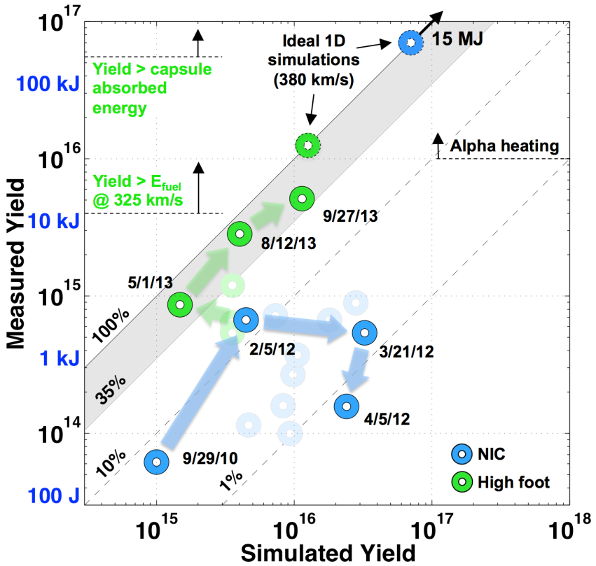
Recent “High Foot” design is showing promising results

Slide 9
Further requested reports from Congress
“120-day study” – “a plan to increase the shot rate at NIF over the next 3 years with a budget of $329,000,000 over the next 3 years.”
Working groups formed by LLNL to review operations and recommend improvements
Results will be reviewed by panel established by NNSA
“60-day study” - “3-year plan that lays out significant milestones NIF plans to achieve on the path to ignition and critical experiments needed to support the stockpile stewardship program
HED council is planning the weapons physics program
“ICF council” established for ignition.

Slide 10
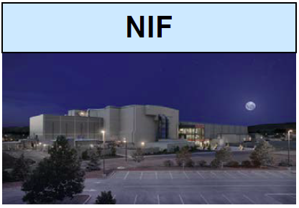
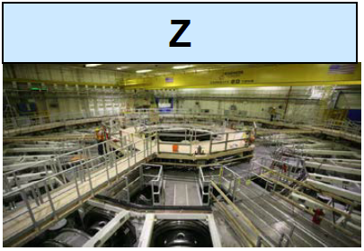
We will continue to operate NIF, Omega / EP and Z as our key facilities.
60% of the ICF Program budget is applied
to facility operations at NIF, Z, and Omega
Research on indirect
drive ignition
Laser plasma
instabilities
Hydrodynamic
instabilities
Radiation
hydrodynamics
Materials at extreme
conditions
Research on polar
drive ignition
Diagnostics
development
Open science platform
Focused experiments
on scientific issues
for ICF
Platform development
for NIF experiments
Research on
magnetically-driven
ICF
Dynamic material
properties – including
Pu
Radiation effects
Radiation
hydrodynamics
Radiation transport

Slide 11
ICF FY 2014 PBR by MTE
Total = $484,635

Slide 12
Summary
Developing a burning plasma platform to achieve ignition is a principal goal of the ICF Program for stockpile stewardship and ignition remains and important goal
Alternate concepts to the mainline indirect drive approach are advancing
HED facilities are operating well and are oversubscribed (by a lot)
Vibrant HED community is recognized to be critical to the success of SSP
ICF is an exciting grand challenge endeavor and remains a leading attractor for talent and the next generation of stewards

