Slide 1
HED Science research at LLNL
Pravesh Patel
Lawrence Livermore National Laboratory
Fusion Power Associates
Washington D.C.
Dec 10-11, 2013

Slide 2
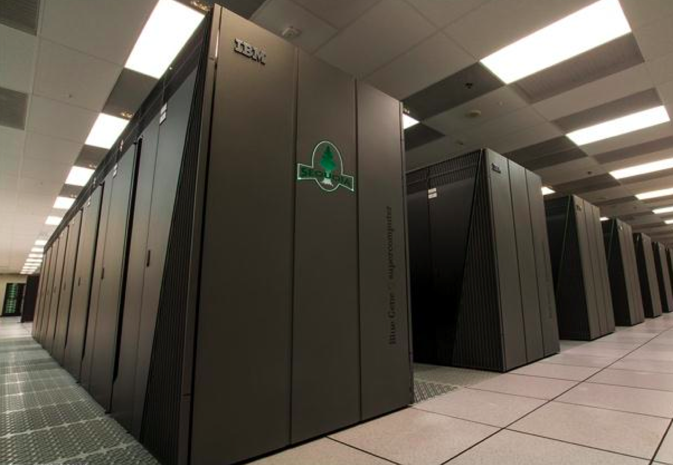
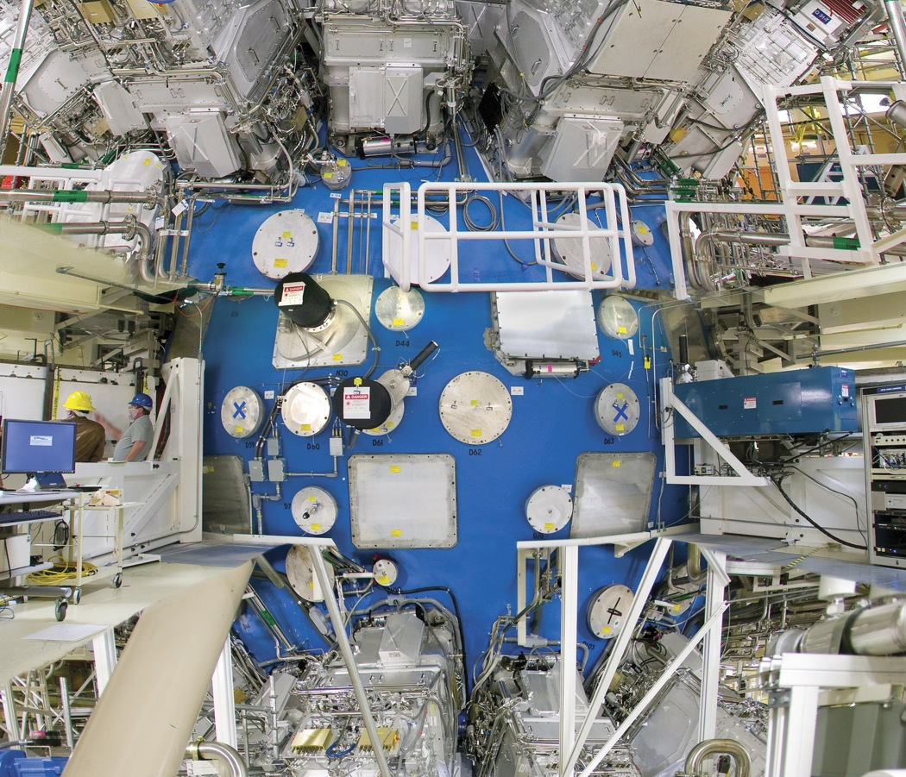
Office of Science funded activities in HED Science
Modeling intense laser-matter interactions
Fast ignition ICF
Collisionless shock physics
Non-equilibrium physics in HED matter
Electronic structure of HED matter
Isochoric heating
High harmonic probing of hot dense matter
XAFS studies
Eagle nebula physics
Notes:
Theme:
Advances in simulation enabled by advances in codes and high-performance computers
Extreme conditions that will be accessible on NIF

Slide 3
Office of Science funded activities in HED Science
Modeling intense laser-matter interactions
Fast ignition ICF
Collisionless shock physics
Non-equilibrium physics in HED matter
Electronic structure of HED matter
Isochoric heating
High harmonic probing of hot dense matter
XAFS studies
Eagle nebula physics
Notes:
Theme:
Advances in simulation enabled by advances in codes and high-performance computers
Extreme conditions that will be accessible on NIF

Slide 4
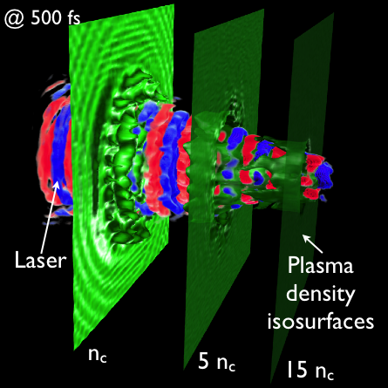
Modeling intense laser-plasma interactions at realistic scales is challenging
Interaction of an intense laser pulse with a solid target
Particle-in-cell (PIC) codes model particles and electromagnetic waves at the most fundamental (non-QED) level
Need to resolve very fine spatial and temporal resolution — computationally demanding to simulate large-scale plasmas and high densities
Physical processes such as relativistic self-focusing and filamentation need to be modeled in 3D
F. Fiuza

Slide 5
One approach is to scale codes to large numbers of processors
Sequoia IBM BG/Q
1.6 million cores
16.3 PFlops

Slide 6
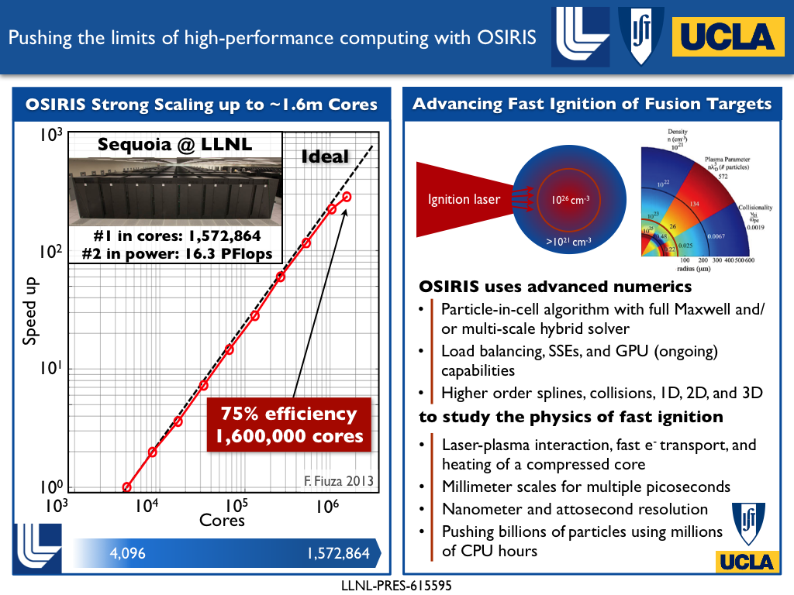
One approach is to scale codes to large numbers of processors
F. Fiuza

Slide 7
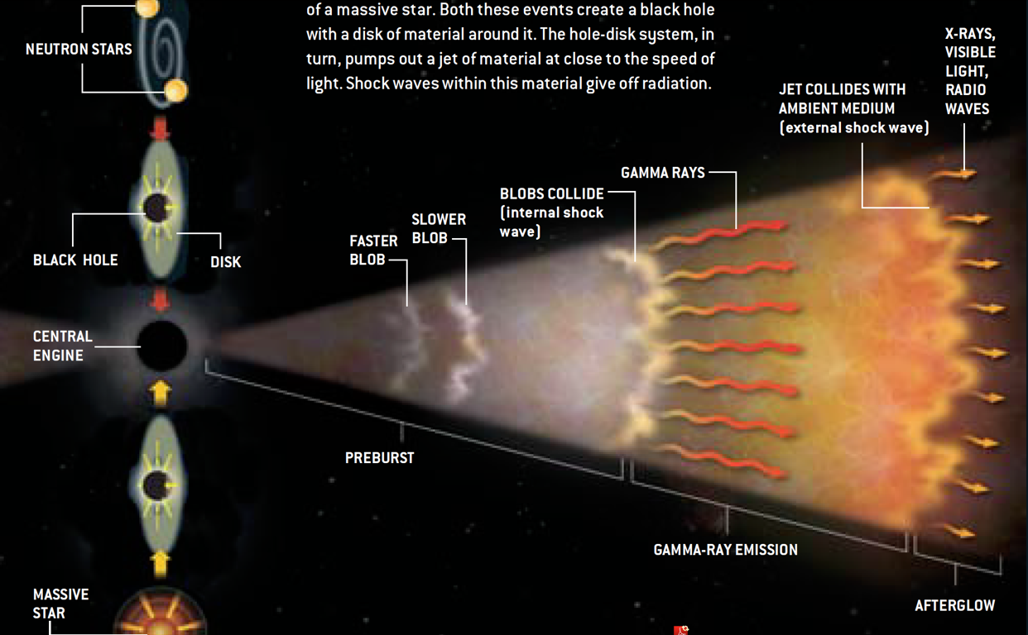
An example is in modeling collisionless shocks in large-scale plasmas
Collisionless shocks are believed to be a mechanism for producing cosmic-rays, e.g., in supernova remnants, gamma-ray bursts
©
N. Gehrels, L. Piro, and P.J.T. Leonard, Scientific American (2002)

Slide 8








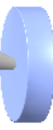



Recent experiments on OMEGA have revealed Weibel instabilities in counter-streaming plasma flows
0.4
0.2
B (MG)
0.0
-0.2
-0.4
3
2
n/n₀
1
0
Spitkovsky, Fiuza
Laser-ablated plasmas
n_{e} ~10¹⁸ cm³
v ~1000 km/s
proton backlighter
C. Huntington, F. Fiuza, J. S. Ross, A. Zylstra, H.-S. Park et al., submitted (2013)

Slide 9
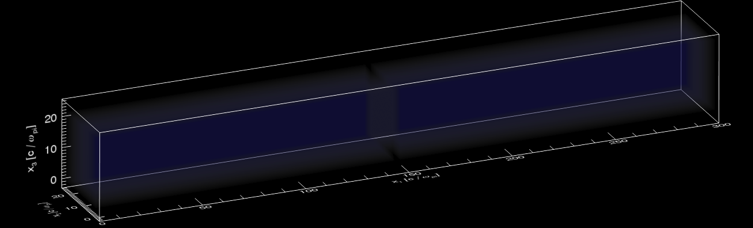
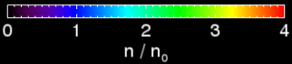

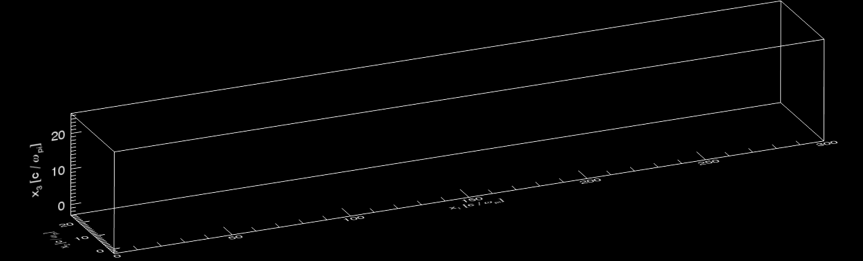
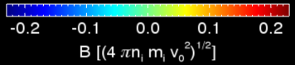
Large regions and higher densities accessible with NIF are predicted to produce full Weibel-mediated shocks
flow 2
flow 1
Density
shock 2
B-field
shock 1

Slide 10
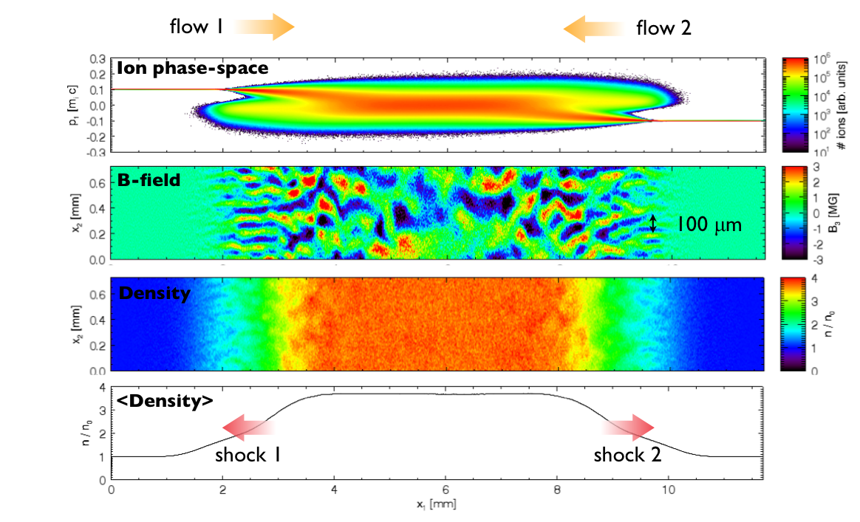
Collisionless shocks require large regions of interpenetrating plasma
3
4
2
3
n/n₀
n/n₀
2
no shock
1
shock
1
0
0

Slide 11
Simulating interactions with high density matter require new approaches
At high densities (solid density and above) it is computationally prohibitive to resolve the the plasma frequency and Debye length
Fast Ignition ICF
Ignitor laser pulse >10²⁰ W/cm² in 20 ps
Compressed DT core > 300 g/cm³

Slide 12
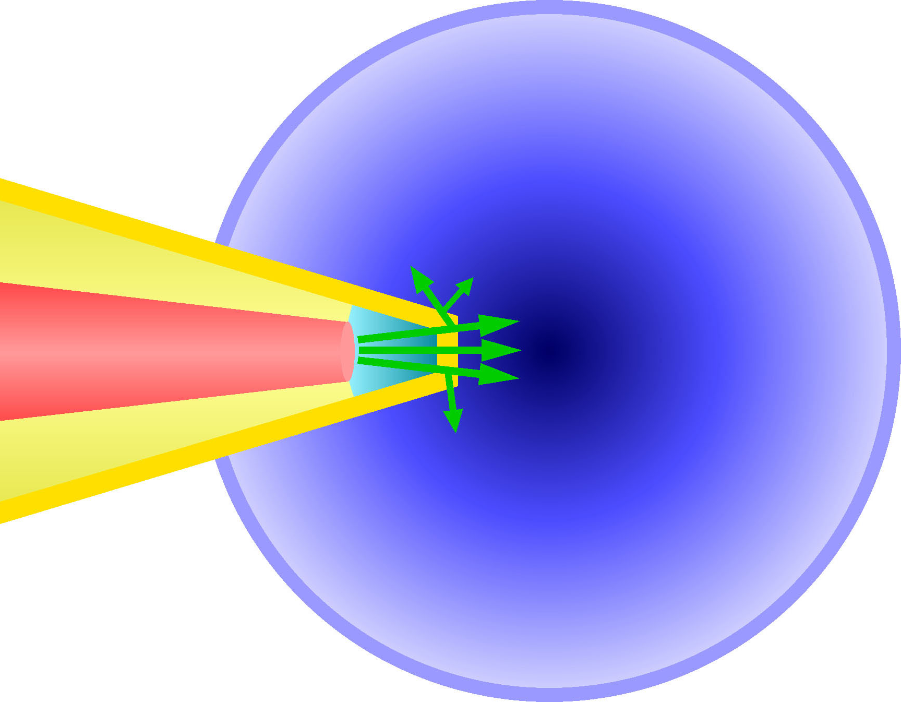
We have developed a hybrid-PIC model that can extend simulations to high densities
Laser light
n_{e}>>100 n_{crit}
FI target simulation at full scale
(200 x 200 µm², 10 ps)
Full Maxwell’s equations
Hybrid reduced field equations
n_{crit}
~100 n_{crit}
Full-PIC
n_{e}<100 n_{crit}
Hybrid-PIC
n_{e}>100 n_{crit}
Full-PIC
6x10¹¹ grid cells
1x10⁷ iteractions
3x10¹⁰ CPU-hours
Full/Hybrid-PIC
6x10⁸ grid cells
5x10⁵ iteractions
1x10⁶ CPU-hours
Hybrid treatment in dense region allows reduced spatial & temporal resolution
1000x speed enhancement demonstrated in 2-D
30,000x speed enhancement possible
†B. I. Cohen et al., J. Comp. Phys. 229, 4591 (2010); A. J. Kemp et al., Phys. Plas. 17, 056702 (2010)

Slide 13
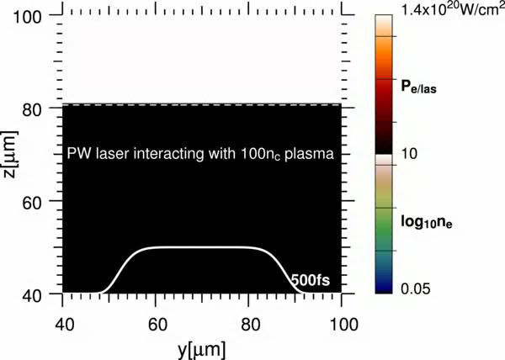
Simulation of a full-spatial scale ignitor pulse over multiple picoseconds
Absorbing boundary
Deuterium plasma
Laser
1.3 PW
140x120μm box, 2m_{p} ions
no density gradient
50cells/micron
120e+40i particles/cell

Slide 14
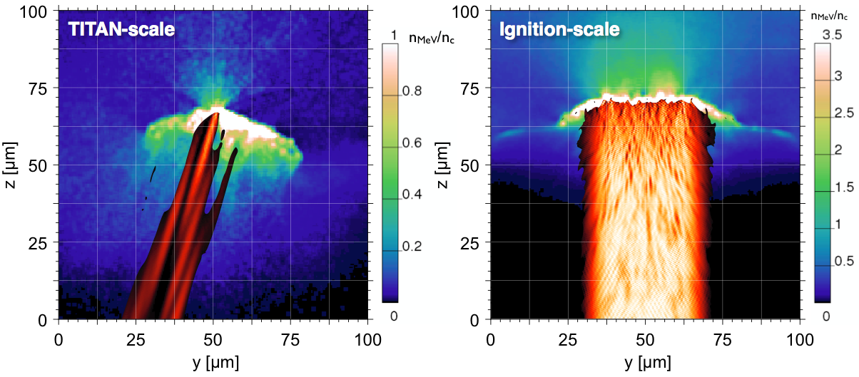
Integrated core heating simulation
PIC simulation of ignitor pulse
PIC-hydro simulation of core heating
DT
Fast electron density
Pressure
Divergence (35-50˚), mean energy (1.4x theory)
Laser energy required for ignition is ~3 MJ

Slide 15
Self-generated magnetic fields can be used to guide the electrons and improve coupling to the core
η₂
η₁>η₂
j_{f}
η₁
A. P. L. Robinson, Phys. Plasmas 20, 062704 (2013); C. Bellei, APS DPP, Providence RI (2012)

Slide 16
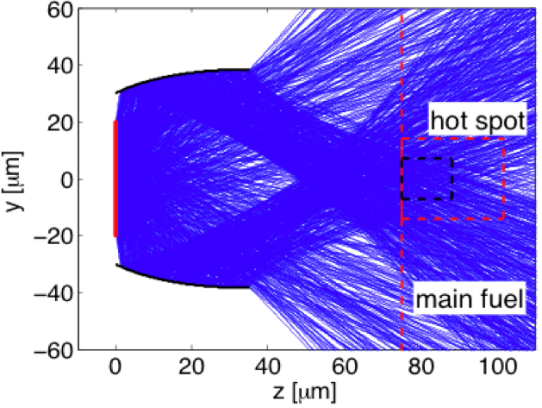
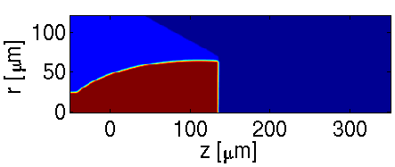
Self-generated magnetic fields can be used to guide the electrons and improve coupling to the core
η₂
η₁>η₂
j_{f}
η₁
CH
DT
Al
B_{θ} @ 15 ps
A. P. L. Robinson, Phys. Plasmas 20, 062704 (2013); C. Bellei, APS DPP, Providence RI (2012)

Slide 17
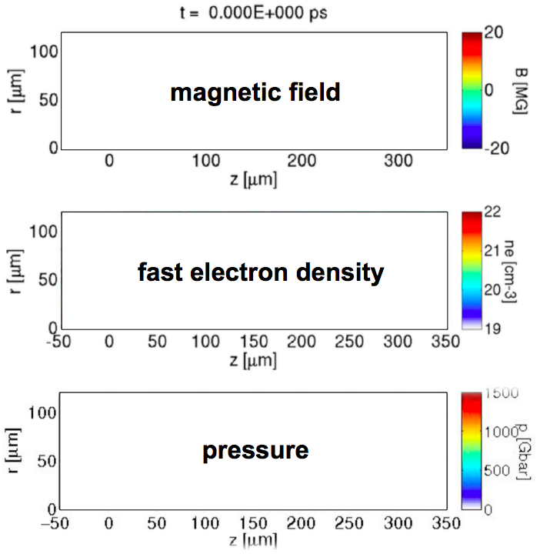
Core heating simulation

Slide 18
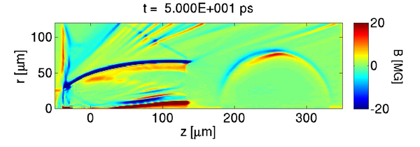
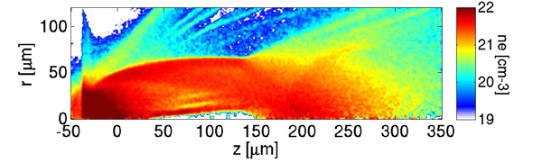
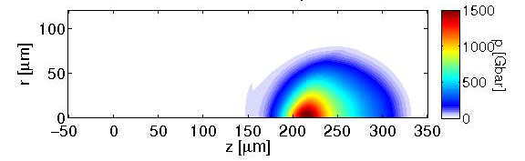
Core heating simulation

Slide 19
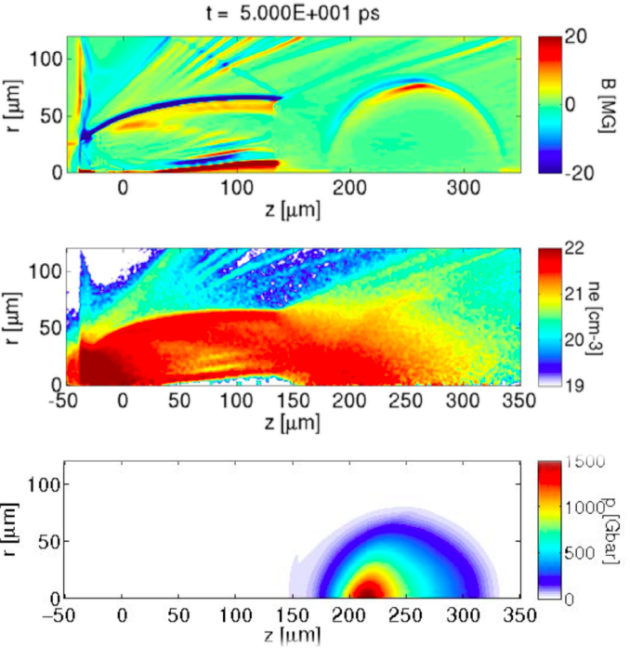
Core heating simulation
Ignition energy is reduced by a factor of 3x to ~1.2 MJ
Corresponds to a target gain of ~40x, with >100 MJ yield
Required ignition energy is very sensitive to uncertainties in the fast electron distribution — rapid progress is being made in simulation capability but the physics is challenging

Slide 20
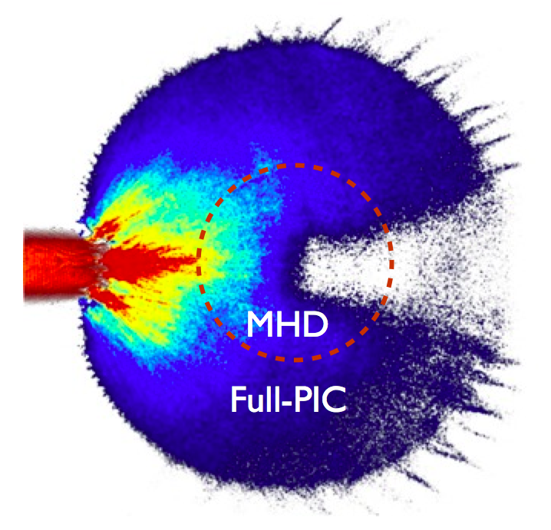
We are performing code-to-code comparisons to assess physics and modeling uncertainties
PSC code
OSIRIS code
DT
Preliminary results are indicating significant differences in the fast electron beam divergence

Slide 21
Existing facilities can be used to validate simulations, explore core heating physics, and refine designs
100kJ
Gekko+LFEX
NIF+ARC (2014)
10kJ
OMEGA EP
LMJ+PETAL (2016)
1kJ
Short Pulse Energy
ORION
Vulcan PW
TITAN
LULI 2000
Gekko XII
Texas
Trident
100J
Vulcan TAW
Helen
LULI 100TW
10J
10J
100J
1kJ
10kJ
100kJ
1MJ
10MJ
Long Pulse Energy

Slide 22
Existing facilities can be used to validate simulations, explore core heating physics, and refine designs
?
Fast Ignition
100kJ
Gekko+LFEX
NIF+ARC (2014)
10kJ
OMEGA EP
LMJ+PETAL (2016)
1kJ
Short Pulse Energy
ORION
Vulcan PW
TITAN
LULI 2000
Gekko XII
Texas
Trident
100J
Vulcan TAW
Helen
LULI 100TW
10J
10J
100J
1kJ
10kJ
100kJ
1MJ
10MJ
Long Pulse Energy

Slide 23
NIF ARC will provide the capability to study fast electron heating of a compressed core at ignition-scale
500 kJ drive
10kJ, 10ps
DT/CD capsule

Slide 24
Office of Science funded activities in HED Science
Modeling intense laser-matter interactions
Fast ignition ICF
Collisionless shock physics
Non-equilibrium physics in HED matter
Electronic structure of HED matter
Isochoric heating
High harmonic probing of hot dense matter
XAFS studies
Eagle nebula physics
We can leverage state-of-the-art high-performance machines and experimental facilities to study extreme HED plasma states
Notes:
Theme:
Advances in simulation enabled by advances in codes and high-performance computers
Extreme conditions that will be accessible on NIF

