Slide 1
Fusion Materials Research
Steve Zinkle
UT/ORNL Governor’s Chair,
University of Tennessee and Oak Ridge National Laboratory
Fusion Power Associates 35th annual meeting and symposium
Washington, DC
Dec. 16-17, 2014
Notes:
SDM meeting July 10-11, 2001
1

Slide 2
General Comments
The enormous challenge of developing fusion energy requires multidisciplinary science solutions involving forefront researchers
  Much can be gained from interactions with the broader scientific community
Many of the critical path items for DEMO are associated with fusion materials and technology issues (PMI, etc.)
  Low-TRL issues can often be resolved at low-cost
Alternative energy options are continuously improving
  Passively safe fission power plants with accident tolerant fuel that would not require public evacuation for any design-basis accident
  Low-cost solar (coupled with low-cost energy storage); distributed vs. concentrated power production visions

Slide 3
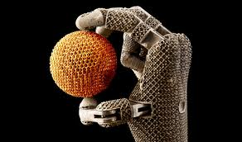
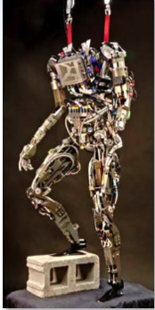
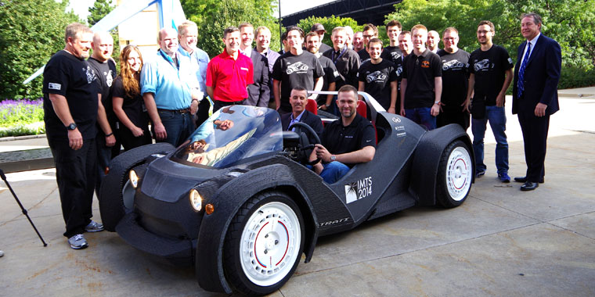
Advanced manufacturing technologies will reshape how we fabricate engineering components in the 21st century
Car made by 3D printing in 44 h (ORNL/Local Motors)
International Manufacturing Technology Show, Chicago, Sept. 2014
Notes:
Unprecedented ability to fabricate components that could not be produced using traditional manufacturing methods; also can embed sensors, etc.
Lonnie Love and Craig Blue in blue shirts next to car
Shelby Cpbra to be printed during the Jan. 2015 North American Auto Show in Detroit

Slide 4
Current paradigm: tradeoff between geometric complexity and base material properties for conventional vs. advanced manufacturing processes
 | Strength | Radiation resistance | Heat flux capacity | Fabrication complexity and cost
Conventional manufacturing | + | + | - | -
Additive manufacturing | - | - | + | +
Anticipated future paradigm: superior geometric complexity and base material properties for additive manufacturing
 | Strength | Radiation resistance | Heat flux capacity | Fabrication complexity and cost
Conventional manufacturing | - | - | - | -
Additive manufacturing | + | + | + | +

Slide 5
3 High-Priority Materials R&D Challenges
Is there a viable divertor & first wall PFC solution for DEMO/FNSF?
  Is tungsten armor at high wall temperatures viable?
  Do innovative divertor approaches (e.g., Snowflake, Super-X, or liquid walls) need to be developed and demonstrated?
Can a suitable structural material be developed for DEMO?
  What is the impact of fusion-relevant transmutant H and He on neutron fluence and operating temperature limits for fusion structural materials?
  Is the current mainstream approach for designing radiation resistance in materials (high density of nanoscale precipitates) incompatible with fusion tritium safety objectives due to tritium trapping considerations?
  Can recent advanced manufacturing methods such as 3D templating and additive manufacturing be utilized to fabricate high performance blanket structures at moderate cost that still retain sufficient radiation damage resistance?
What range of tritium partial pressures are viable in fusion coolants, considering tritium permeation and trapping in piping and structures?
  What level of tritium can be tolerated in the heat exchanger primary coolant, and how efficiently can tritium be removed from continuously processed hot coolants?
S.J. Zinkle, A. Möslang, T. Muroga and H. Tanigawa, Nucl. Fusion 53 (2013) 104024
Notes:
PbLi, water coolant might not be viable options based on tritium considerations.

Slide 6
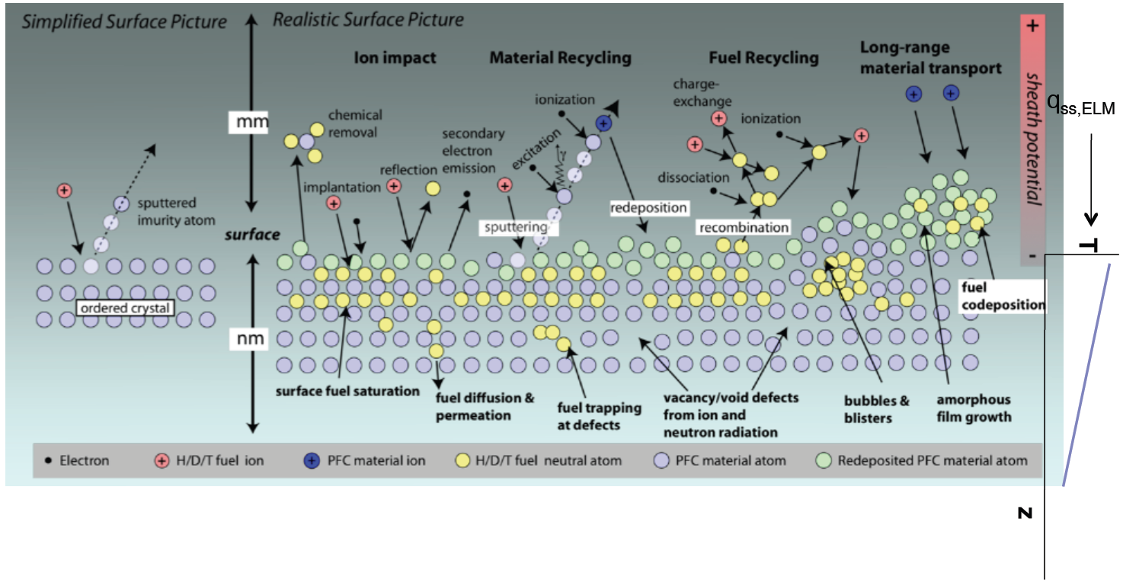
There are numerous fundamental scientific questions regarding Plasma Surface Interactions
Wirth, Nordlund, Whyte and Xu, MRS Bulletin (2011).
M. J. Baldwin et al., PSI 2008
Recent observations of tungsten ‘nano fuzz’ highlight the complexity & importance of plasma surface interactions in controlling plasma performance (plasma impurity generation) & safety (tritium inventory, dust)
300 s 2000 s 4300 s 9000 s 22000 s
T_{s} = 1120 K, Γ_{He+}= 4–6×10²² m^{–2}s^{–1}, E_{ion} ~ 60 eV

Slide 7
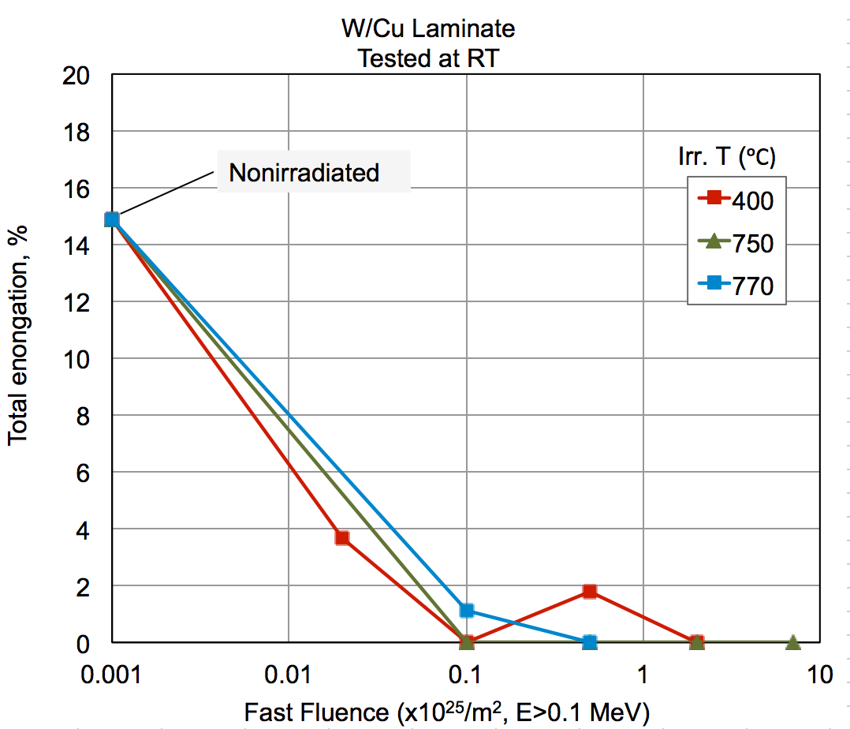
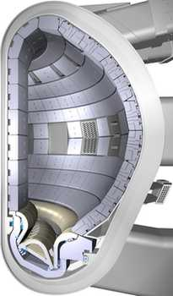
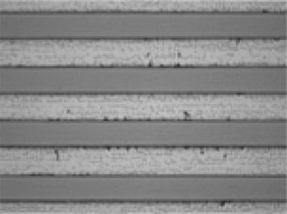
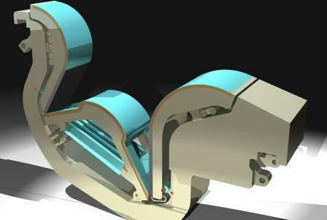
Initially ductile W-Cu laminates rapidly embrittle during irradiation at 400-800ºC
Vertical Target
Dome

Slide 8
Ductile to Brittle Transition Temperature (DBTT) of Reduced Activation 9Cr Ferritic/Martensitic Steels will require operating temperatures above ~350ºC
5-20 dpa
Fission neutrons
S.J. Zinkle, A. Möslang, T. Muroga and H. Tanigawa, Nucl. Fusion 53, no.10 (2013) 104024
Notes:
Based on Sokolov et al., JNM 367-370 (2007) 68 and 644, and E. Gaganidze et al., JNM 367-370 (2007) p. 81
Disk compact tension [DC(T)] and Precracked Charpy V- notch [PCVN] specimens show the same trend of DTo with increasing Tirr

Slide 9
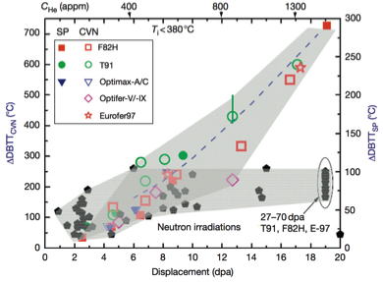
Evidence for enhanced low temperature embrittlement due to high He production has been observed in simulation studies
DBTT shift in ferritic/martensitic steel after fission and spallation (high He/dpa) irradiation
EUROFER, <10 appm He
EUROFER, 10-500 appm He
Y. Dai, G.R. Odette, T. Yamamoto, Comprehensive Nuclear Materials, vol. 1, R.J.M. Konings, Ed (2013) p. 141
Open question: Are B-doping and He-injector (Ni foil) simulation tests prototypic for actual fusion reactor condition?
E. Gaganidze et al., KIT

Slide 10
Cavity swelling in irradiated 8-9%Cr reduced activation ferritic-martensitic steels may become unacceptable above ~50 dpa
Fission neutron irradiation
Dual Ion irradiation
(6.4 MeV Fe + 0.2-1 MeV He)
G.R. Odette, JOM 66, 12 (2014) 2427
Zinkle, Möslang, Muroga & Tanigawa, Nucl. Fusion 53, 10 (2013) 104024
Notes:
Tirr=400-430C (near peak swelling region) for FM steels
Based on data from Wakai JNM 2000, Odette FM 2012

Slide 11
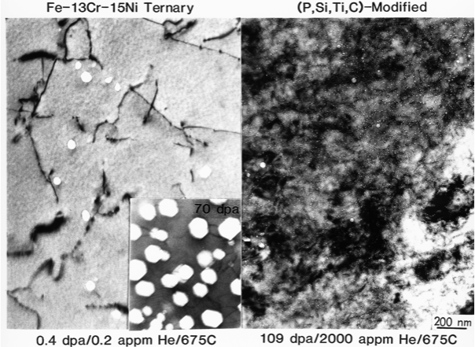
Effect of Sink Strength on the Volumetric Void Swelling of Irradiated FeCrNi Austenitic Alloys
109 dpa
200 nm
S.J. Zinkle and L.L. Snead, Ann Rev. Mat. Res., 44 (2014) 241

Slide 12
Effect of initial sink strength on radiation hardening of ferritic/martensitic steels (fission neutrons ~300ºC)
Current steels
Next-generation (TMT, ODS) steels
Zinkle, & Snead, Ann Rev. Mater. Res. 44 (2014) 241
Notes:
Figure 9. Effect of initial sink strength on the radiation hardening of ferritic/martensitic steels following fission neutron irradiation near 300ºC.
Based on McClintock et al. JNM 2009, Moeslang et al. 2008 (sink strengths assessed by Zinkle et al, Nucl. Fusion 53 (2013) 104024) and Henry et al. (40-78 dpa data), JNM 417 (2011) 99

Slide 13
New steels designed with computational thermodynamics exhibit superior mechanical properties compared to conventional steel
Three experimental RAFM heats (1537, 1538, and 1539), together with an optimized-Gr.92 heat (C3=mod-NF616), were investigated
Tensile strength of new TMT steels were much higher than conventional steels (comparable to ODS steel PM2000)
Dramatic improvement in thermal creep strength also observed
1.6X
L. Tan, Y. Yang & J.T. Busby, J. Nucl. Mater. 442 (2012) S13
Notes:
Tensile properties based on Tan et al. JNM 422 (2012)45 and ICFRM15 proceedings, in press
JP30/31 design: 300C, 400C, and 650C for up to 21 dpa by the 3rd calendar quarter of 2013
SSJ3 tensile specimens
The TMT on NF616 showed 35-43% increase in strength (comparable to PM2000)

Slide 14
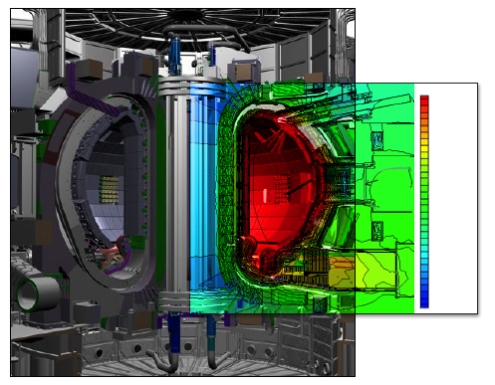
A wide range of irradiation environments will exist in ITER and a DEMO fusion reactor
ITER lifetime
DEMO annual
Neutron flux varies by 10⁷
ITER Lifetime Fast Neutron Fluence (n/m2; E>0.1 MeV) | Fusion Power Reactor Annual Fast Neutron Fluence (n/m2, E>0.1 MeV) | Compo-nent
3.7e25 | 5e26 | Blanket
5.1e18 | 7e19 | Magnet
1.9e25 | 2.6e26 | Divertor
1.1e23 | 1.5e24 | Vacuum Vessel
3.4e15 | 4.5e16 | Cryostat
n/m²-s
2.8E+17
9.7E+16
3.4E+16
1.2E+16
4.0E+15
1.4E+15
4.8E+14
1.7E+14
5.7E+13
2.0E+13
6.9E+12
2.4E+12
8.2E+11
2.8E+11
9.8E+10
3.4E+10
Zinkle & Snead, Ann Rev. Mater. Res. 44 (2014) 241
Notes:
Fig. 1: Overview of ITER tokamak. The inset figure on the right highlights the position-dependent total neutron fluxes. The table on the left compares calculated fast neutron fluences for several key components in ITER and a demonstration fusion reactor.

Slide 15
Optical absorption of SiO₂ optical fibers is typically rapidly degraded by neutron irradiation (dose limit ~10⁻³ dpa)
Induced loss
(~10⁻³ dpa)
(~6x10⁻⁵ dpa)
T. Kakuta et al.

Slide 16
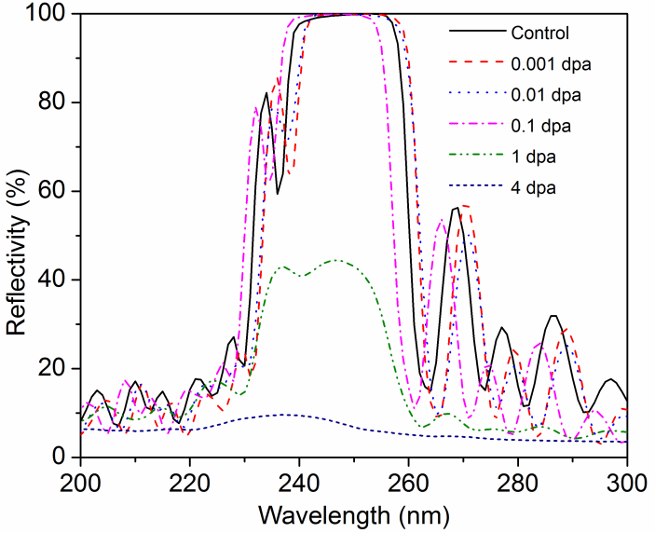
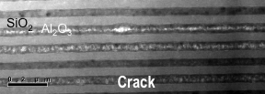
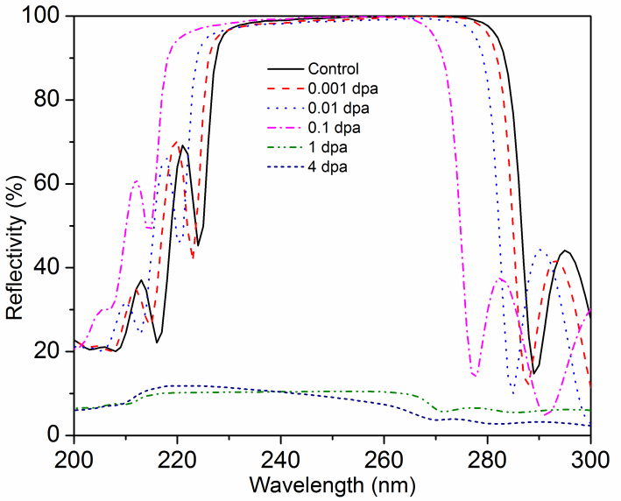
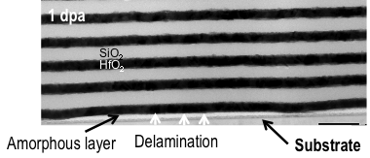
New dielectric mirrors exhibit adequate behavior up to 0.1-1 dpa
Δλ
Al₂O₃/SiO₂
Al₂O₃/SiO₂ – 1 dpa
λ_{ο}
Δλ
HfO₂/SiO₂
HfO₂/SiO₂ – 1 dpa
λ_{ο}
K.J. Leonard

Slide 17
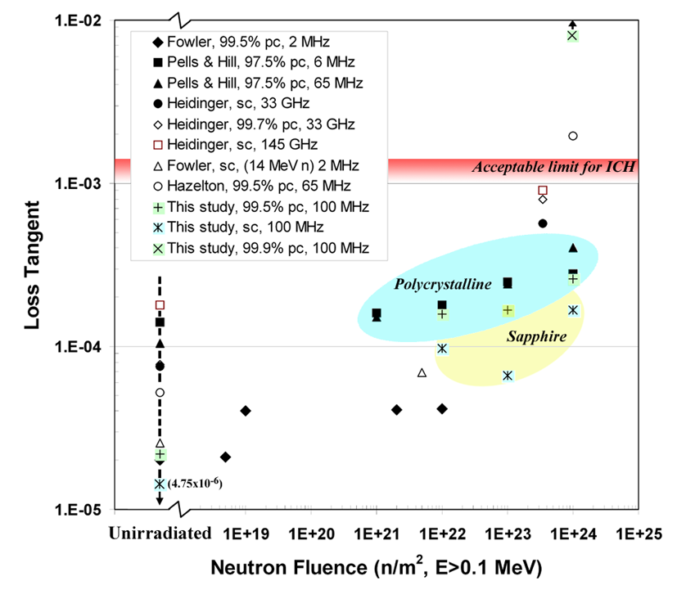
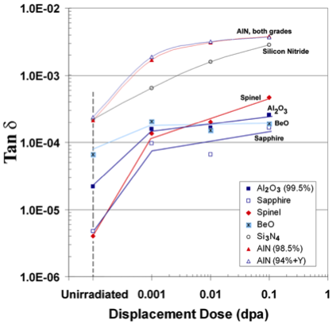
The dose limit for ICRF feedthroughs/windows is ~0.1-1 dpa based on loss tangent degradation
Loss tangent in Al₂O₃ after neutron irradiation near room temperature
100 MHz loss tangent in ceramics after 70ºC neutron irradiation
(1.1x10⁻²)
Deranox
Irradiation
at 150 ºC
Measured data under ICH relevant conditions
0.001
0.01
0.1 dpa
Several grades of Al₂O₃ are unacceptable
(e.g., Deranox)
AlN, Si₃N₄ are unacceptable
Sapphire, BeO are best

Slide 18
Concluding comments
A rich set of scientific issues on materials performance under extreme conditions need to be resolved for fusion energy to be successful
  Strong leverage with BES, ASCR, NNSA, NE and other federal programs
Numerous materials challenges will need to be resolved for next-step fusion devices (not just PMI and structural materials issues)
  Research is currently focused only on PMI and structural materials due to budget limitations

Slide 19
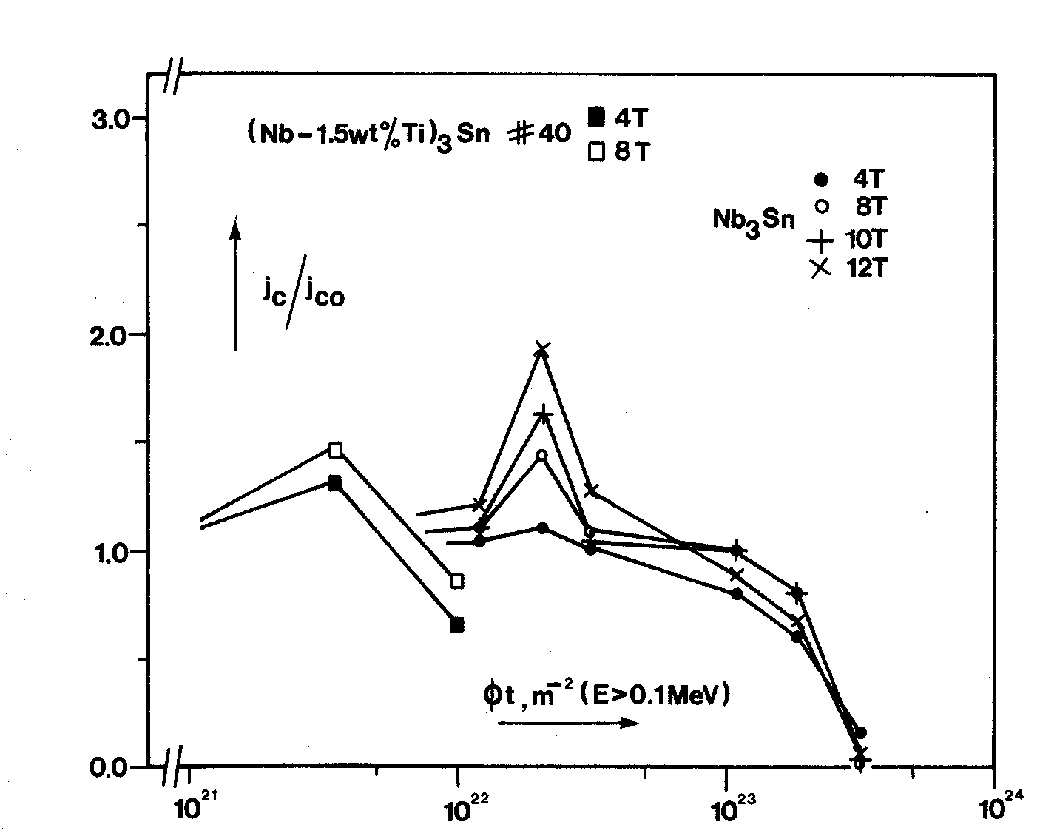
Conventional (Low-Temp) Superconductors: NbTi, Nb₃Sn J_{c}/J_{co} vs. Reactor Fluence Levels
Dose limits are controlled by polymer insulator
10⁹ Rad, insulation limits design
>10¹⁰ Rad, sc limits design
ITER – advanced Nb₃Sn should be within allowable
FIRE, ARIES-AT, RPD don't use Nb₃Sn – good thing
Allowable
FIRE-SCST
ITER
ARIES-AT
TF, Calc
RPD

Slide 20
Irradiation effects in High Temperature Superconductors
Critical currents in YBCO at 77 K
Similar neutron dose limit as conventional superconductors
F.M. Sauerzopf: PRB 57, 10959 (1998)

Slide 21
Comments on next-step device
In order to progress from ITER to DEMO, a dedicated intermediate-step fusion nuclear science facility is anticipated to be important to address integrated-effects phenomena (TRL~5-7).
  ITER and mid-scale facilities are expected to provide necessary but insufficient fusion nuclear science information to enable high confidence in the optimized design for DEMO
  A detailed US fusion energy roadmap (at least at the level of detail as other international roadmaps) should be jointly developed by DOE-FES and the research community
The specific objectives and concept for FNSF eventually need to be established
  Key questions to address include whether FNSF needs to be a prototypic design for DEMO (versus a non-prototypic magnetic configuration simply used for component testing)
Meaningful community discussions on FNSF cannot be held until we have improved foundational knowledge on multiple fusion nuclear science issues
  A modest fusion nuclear science program can provide this foundational knowledge
Notes:
For example, could FNSF be constructed from a linear device, or a normal conducting copper coil machine?

