Slide 1
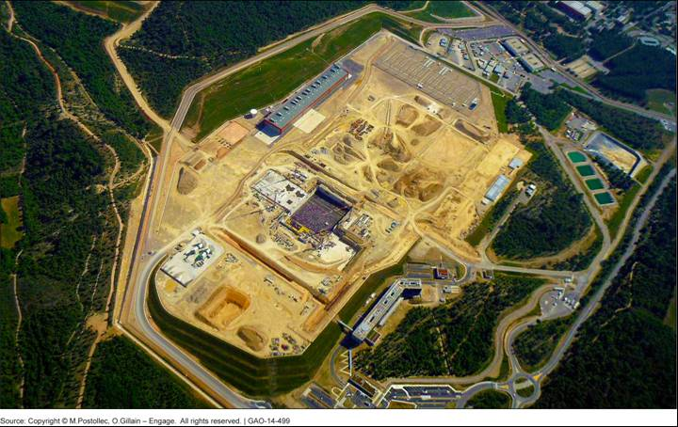
The ITER Site June 2013

Slide 2
U.S. ITER Cost Estimates

Slide 3
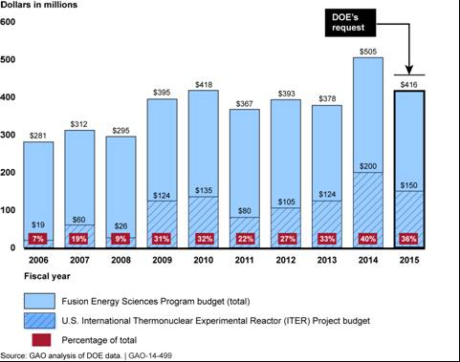
ITER’s Share of Total Fusion Budget

