Slide 1
Current Status of IFMIF
Yoshikazu OKUMURA
Deputy Project Leader, IFMIF/EVEDA
FUSION POWER ASSOCIATES, 35th Annual Meeting and Symposium
December 16-17, 2014

Slide 2
What is IFMIF/EVEDA?
IFMIF
International Fusion Materials Irradiation Facility
EVEDA
Engineering Validation & Engineering Design Activities
Article 1.1 of Annex A of the Broader Approach (BA) Agreement
mandates IFMIF/EVEDA
…to produce an integrated engineering design of IFMIF and the data necessary for future decisions on the construction, operation, exploitation and decommissioning of IFMIF, and to validate continuous and stable operation of each IFMIF subsystem
Signed in February 2007
Entered into force in June 2007

Slide 3
IFMIF through all technical steps
IFMIF
has successfully passed through all needed key steps
Conceptual Design Activity (CDA) phase in 1995-1997
as a joint effort of the EU, Japan, RF and US
Conceptual Design Evaluation (CDE) report in 1998
towards a design simplification and cost reduction
Comprehensive Design Report (CDR) in 2004
co-written by a committee of EU, Japan, RF, US

Slide 4
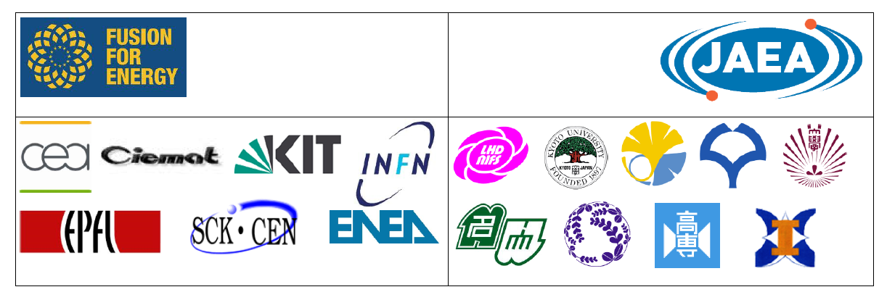
IFMIF/EVEDA Project under BA Activities
Since 2007, IFMIF/EVEDA (Engineering Validation and Engineering Design Activities) under the Broader Approach Agreement between EU and Japan
Validation Activities: 1. Accelerator Facility
2.Target facility
3. Test Facility
7 countries involved
with the respective main research labs in Europe
and main labs and universities in Japan

Slide 5
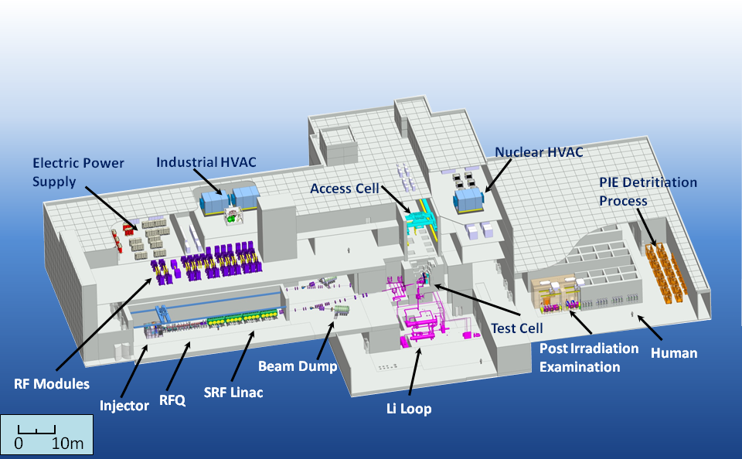
Engineering Design of IFMIF 2013
IFMIF Intermediate Engineering Design report
was successfully accomplished

Slide 6
IFMIF Concept
IFMIF is an accelerator based neutron source using Li(d,n) reactions aiming at providing a material irradiation database for the design, construction, licensing, and safe operation of DEMO.
IFMIF consists of two deuteron linear accelerators, free surface liquid lithium target, test cell, and the post irradiation examination facility.
Accelerator
(125 mA x 2)
Lithium Target
25^{±1} mm thick, 15 m/s
Test Cell
Engineering Validation IFMIF/EVEDA in BA
Engineering Validation IFMIF/EVEDA in BA
LEBT
MEBT
L
Injector
140 mA D⁺
RFQ
HEBT
M
Half Wave Resonator
Superconducting Linac
H
100 keV 5 MeV 9 14.5 26 40 MeV
Beam shape:
200 x 50 mm²
High (>20 dpa/y, 0.5 L)
Medium (>1 dpa/y, 6 L)
Low (<1 dpa/y, > 8 L)
RF Power System

Slide 7
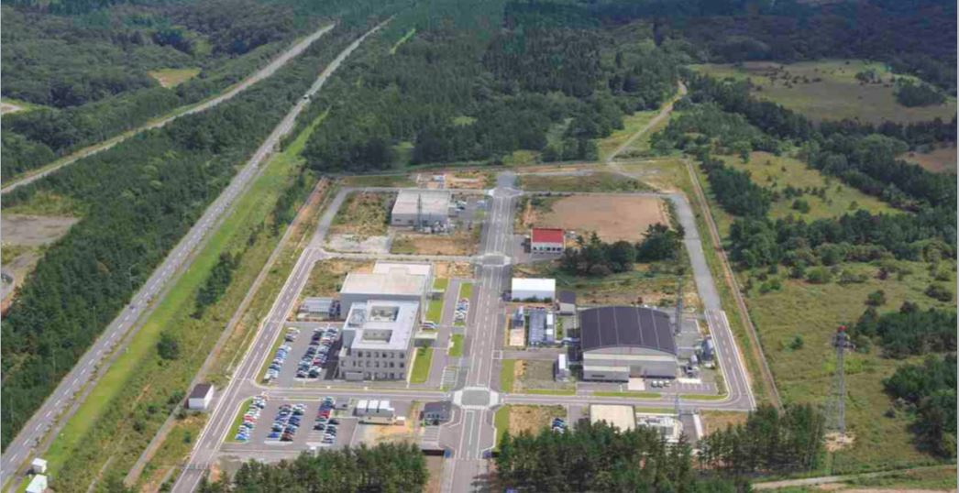
IFMIF/EVEDA Project in Rokkasho
A new research center was established in Rokkasho for Broader Approach activities in 2007.
★
Rokkasho
DEMO R&D Building
Cafeteria
Computer Simulation & Remote Experimentaion
Building
IFMIF/EVEDA Accelerator
Building (for LIPAc)
Administration & Research Building

Slide 8
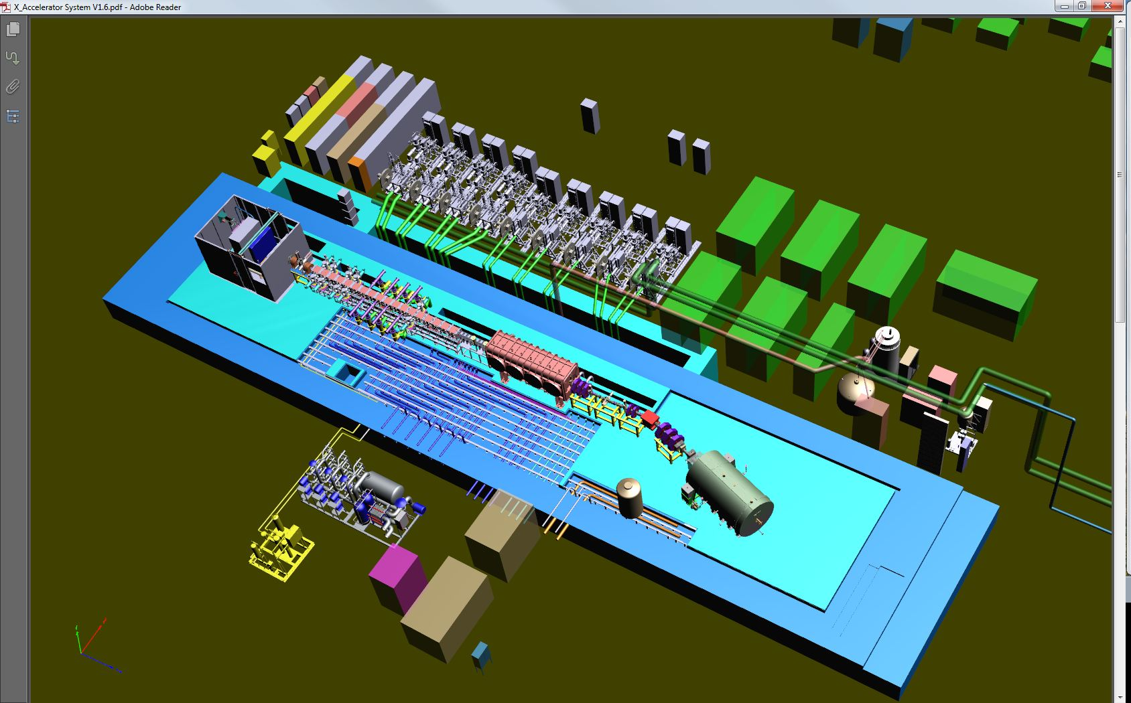
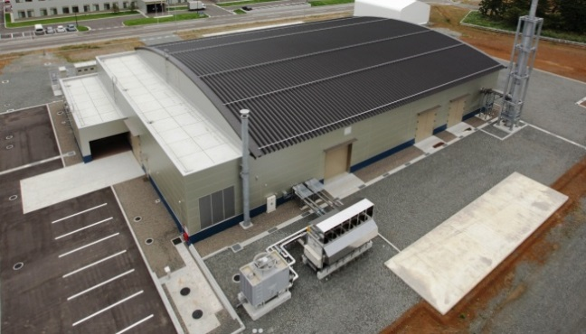




Linear IFMIF Prototype Accelerator (LIPAc)
Building, Auxiliary
System, Control
RF Power Supply
Injector（100keV）
Beam Dump
(1.1MW/CW)
Radio Frequency Quadropole
（RFQ)(0.1MeV-5MeV)
Super-Conduction Linac (5MeV-9MeV)
8

Slide 9
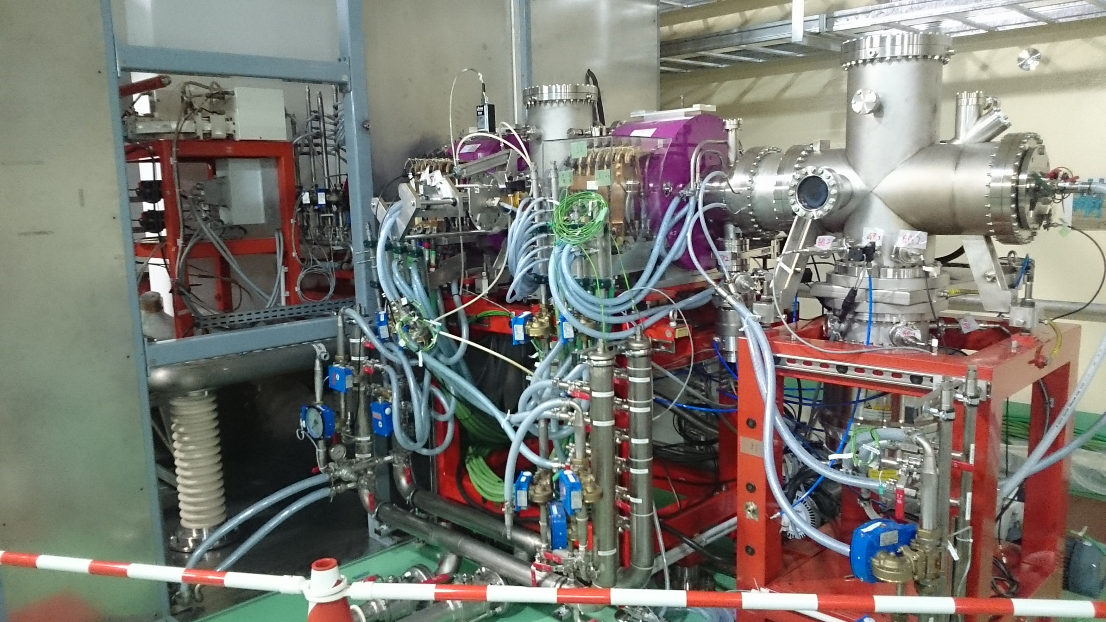
LIPAc installation in Rokkasho
Injector has been installed in Rokkasho and commissioning started.
Requirements | Target value
Particles | D⁺
Output energy | 100 keV
Output D⁺ current | 140 mA
D⁺ fraction | 95 %
Beam current noise | 1 % rms
Normalized rms transverse emittance | 0.25 π.mm.mrad
Duty factor | CW
Beam turn-off time | < 10 µs

Slide 10
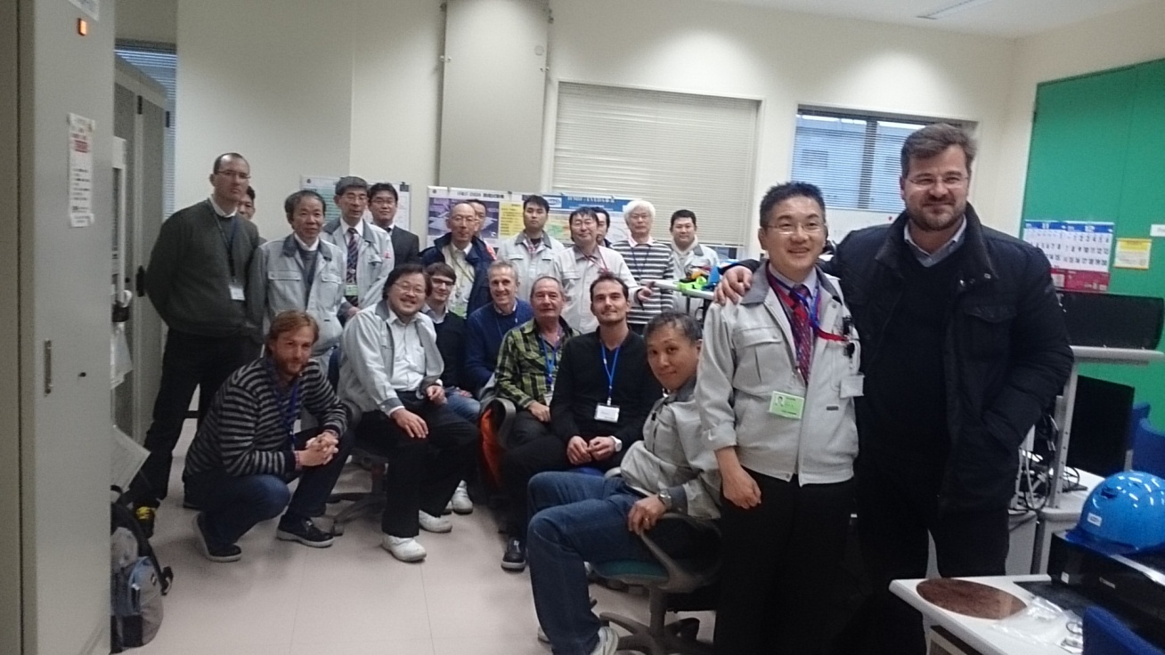
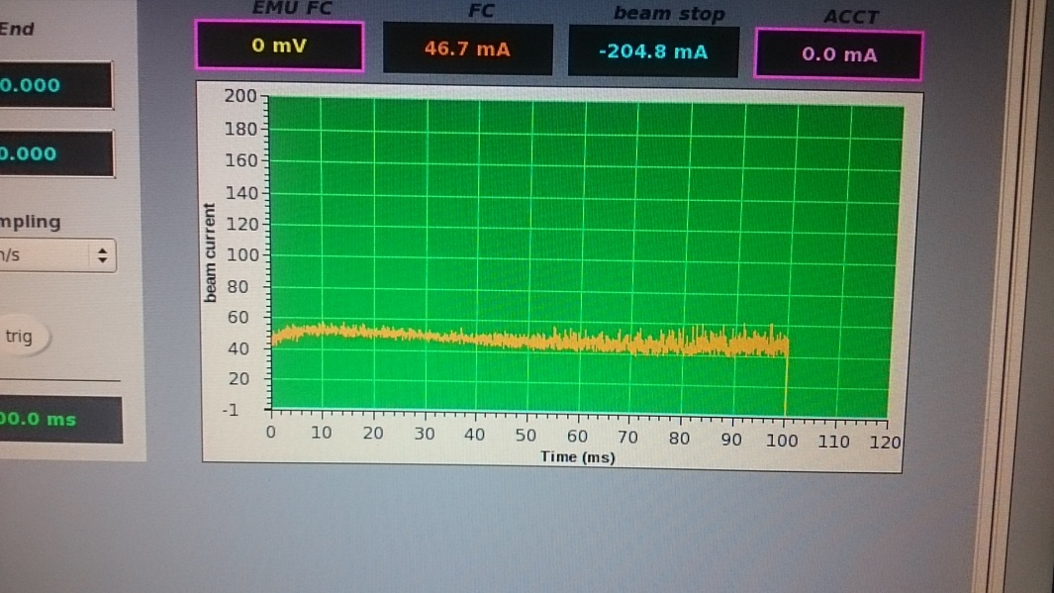
LIPAc First Beam
The first beam was obtained on 4th November 2014, under the collaboration with EU and Japan

Slide 11
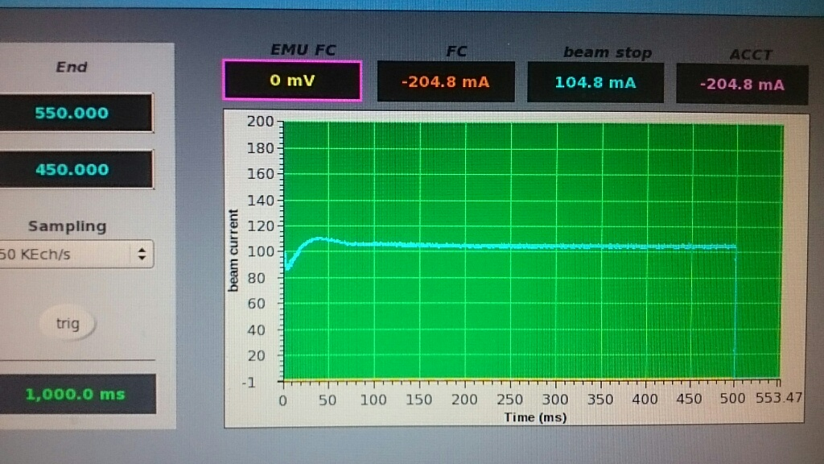
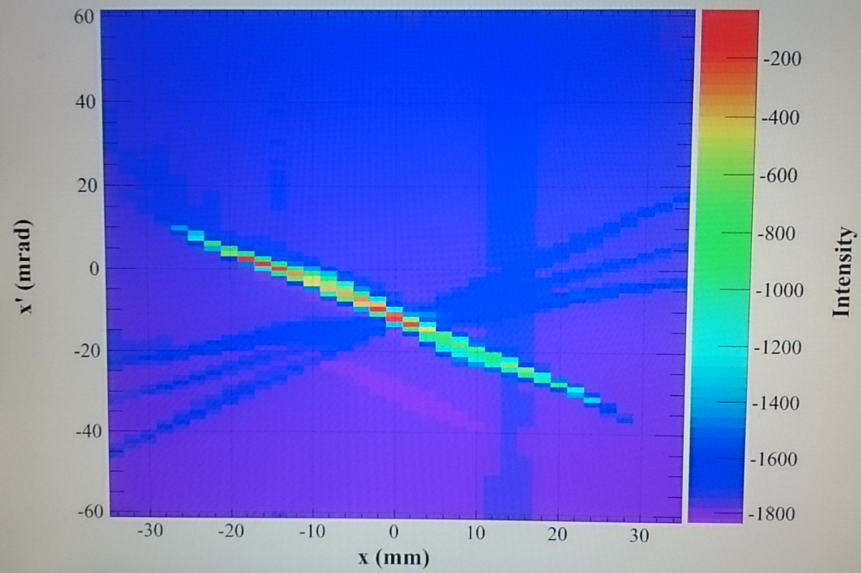
Injector Commissioning
Reached to 100keV/105mA 0.5s 50%duty on 6th Nov.
Demonstrated 100% duty operation at 100keV/70mA on 12th Dec.
Considering the aperture diameter of 8mm in the plasma electrode, we can expect more than 100mA D+ with 12 mm diam. aperture.

Slide 12
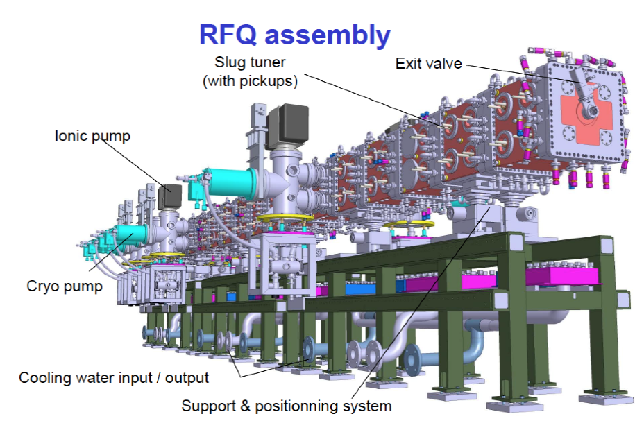
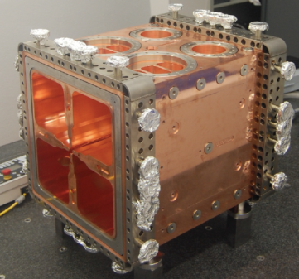
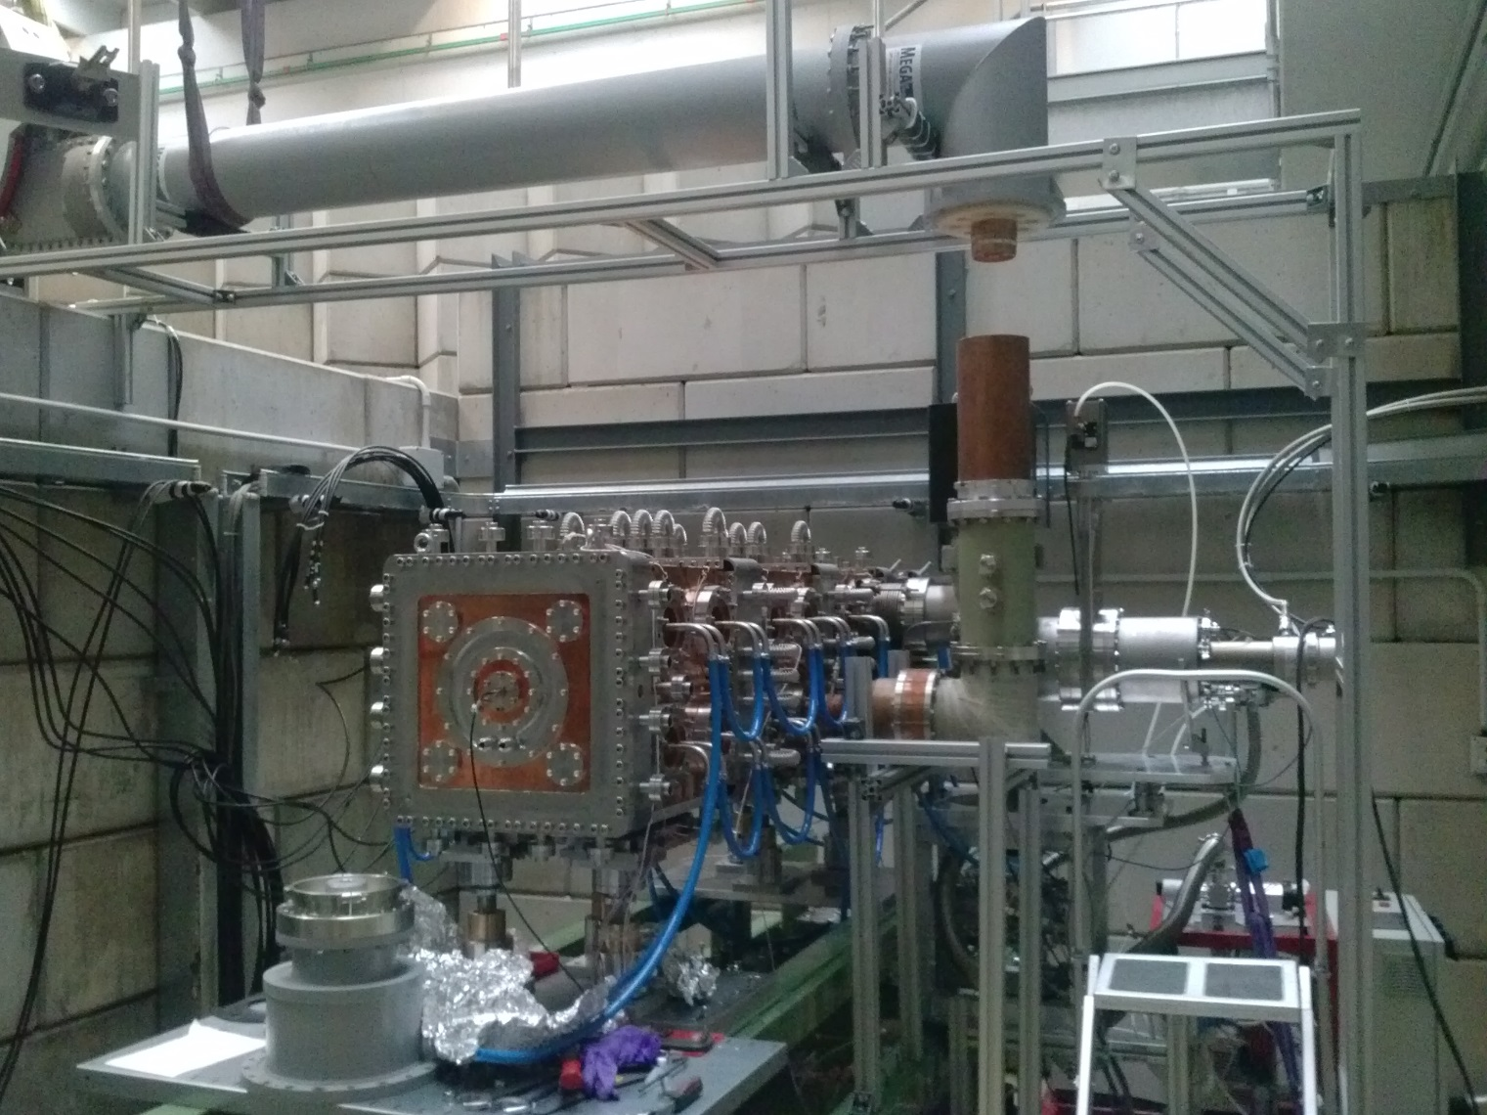
RFQ will be delivered in spring 2015
2015
9.85 m long
175 MHz; I_{input}= 130 mA ; E_{output}= 5 MeV
Up to 10mA beam losses allowed
Max surface field 25.2 MV/m (1.8 Kp)
Fabrication of RFQ is almost completed in INFN, Italy.
Delivery to Rokkasho scheduled in spring 2015

Slide 13
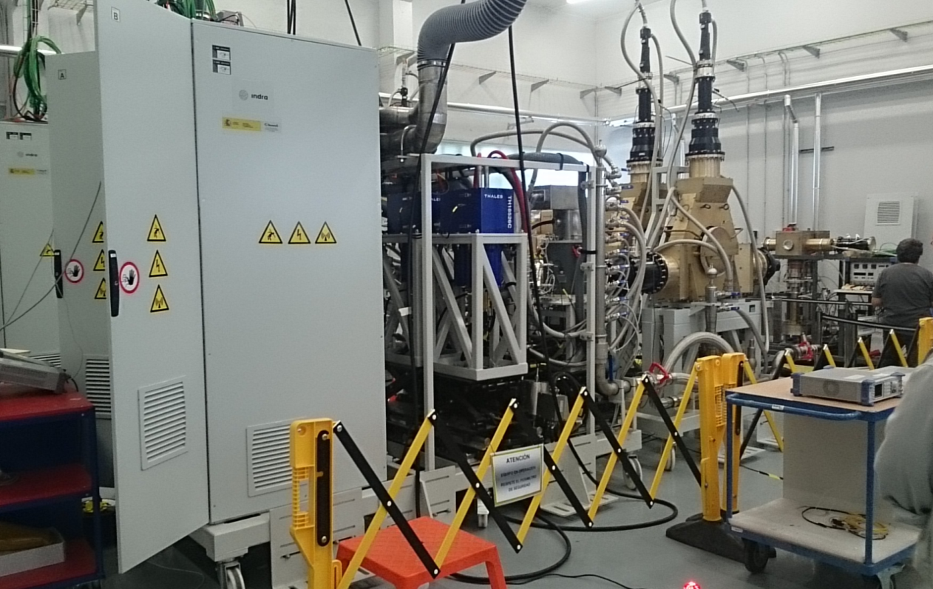
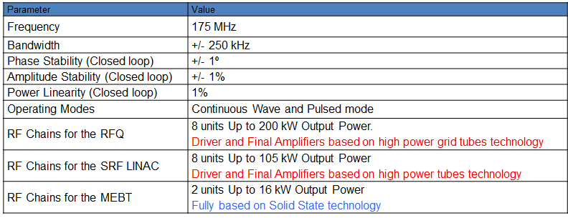
RF Modules are ready for shipping
RF Power Supply (CIEMAT, Spain)

Slide 14
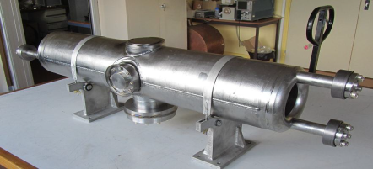
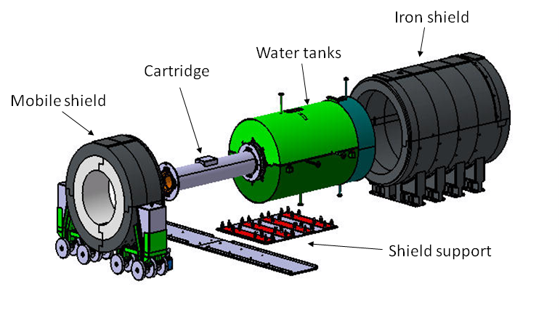
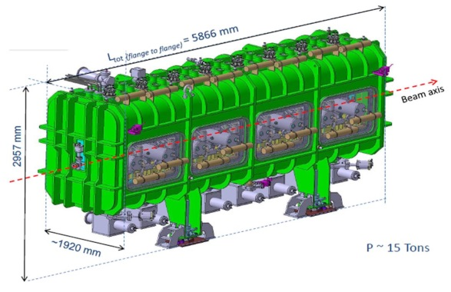
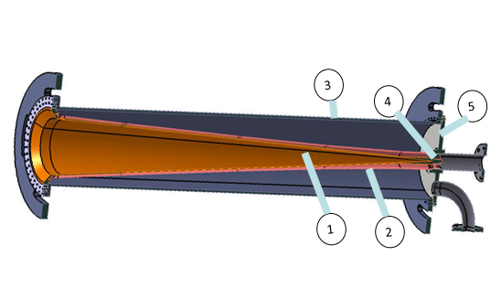
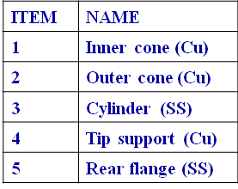
Linac and B.D. are under fabrication
Superconducting Linac (CEA, Saclay)
Beam Dump (CIEMAT, Spain)
9MeV, 125mA, (1.13MW) CW
Radiation Shielding
Superconducting HWR resonator at 175 MHz
E_{input}= 5 MeV
E_{output}= 9 MeV
Beam loss < 10W
E_{acc}=4.5 MeV/m
Max transm. RF power = 70 kW

Slide 15
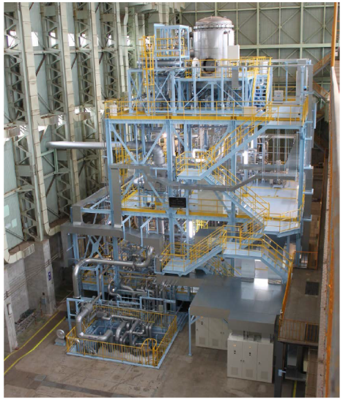
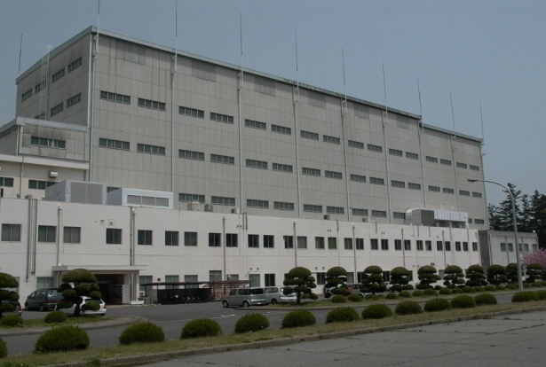
Lithium Target Facility
World largest liquid Li loop
constructed by
JAEA in Oarai
Target Assembly
(in a enclosure)
★
Rokkasho
Vacuum
pumps
★
Oarai
Li Sampling system
∼20 m
Electromagnetic pumps (3000 l/min)
Built in Nov 2010
Started operation in March 2011
Li dump tank

Slide 16
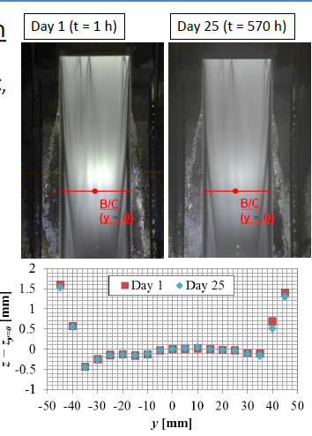
Target Facility Validation main achievements
Operation conditions of the IFMIF;
Temperature: 250 ℃
Vacuum: 10⁻³ ~ 10⁻² Pa
Li flow rate: 15 m/s
has been achieved.
Long term operation stability
(>1000 hours)
demonstrated
Completed its operation in October 2014

Slide 17
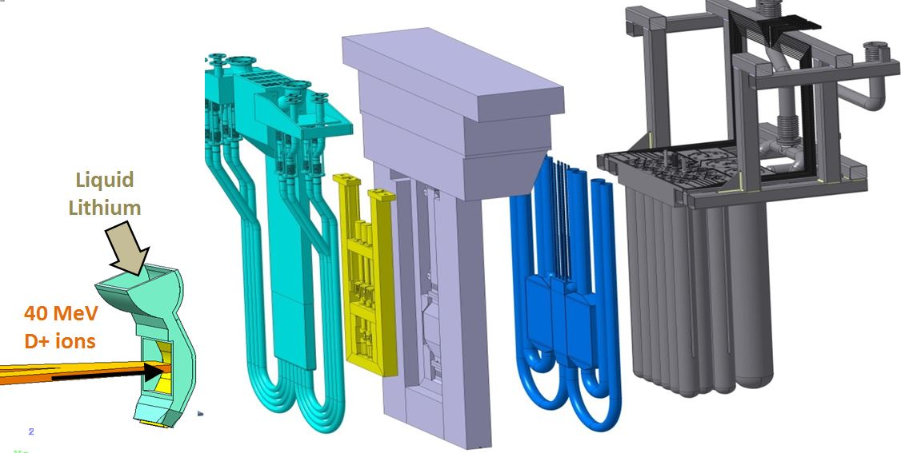
IFMIF Test Facility
TEST CELL
High >20 dpa/y, 0.5 liters
Medium >1 dpa/y, 6 liters
Low <1 dpa/y, 8 liters
LFTM
HFTM
MFTM

Slide 18
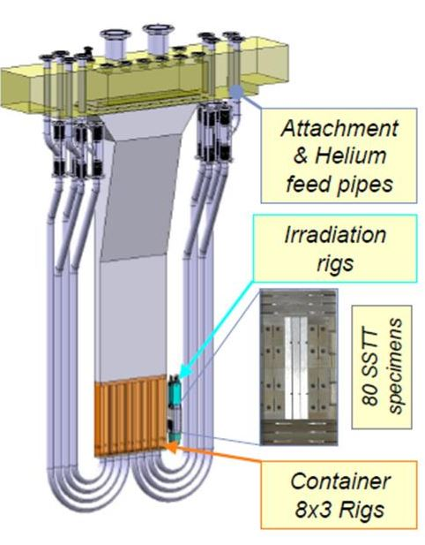
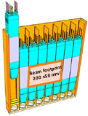
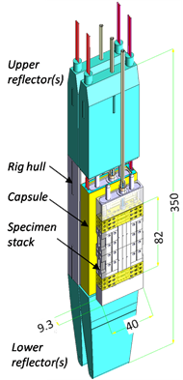
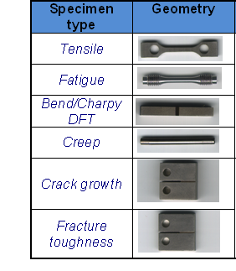
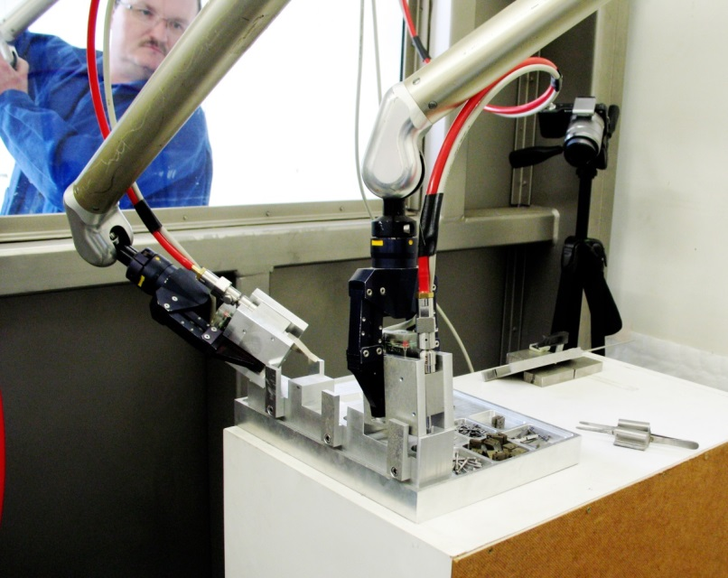
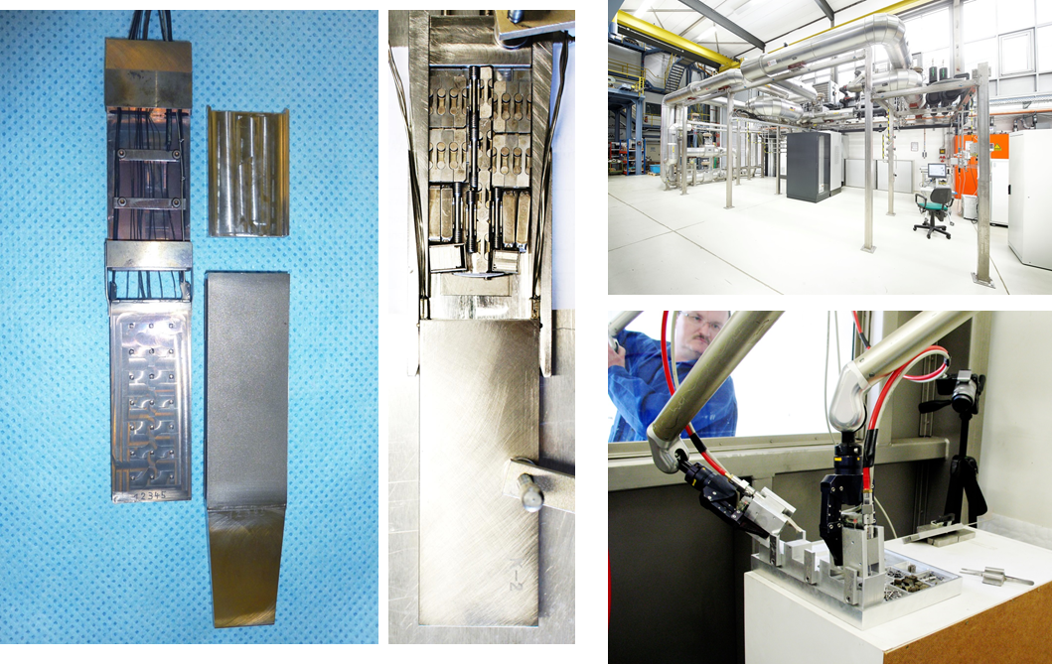
Validation of High Flux Test Module
12 capsules within beam footprint
x2 sets of 40-45 spec/set
within 3% ΔT/capsule
80-90 specimens/capsule
Handling of specimens in hot cell demonstrated
Specimen filling in hot cell

Slide 19
Test Facility Validation Achievements
Capsules of HFTM
have successfully entered
a nuclear reactor environment
Stack assembly (unirradiated specimens)
validated in Hot Cell environment
Small Specimens shape defined
for a full characterization of RAFM
Successful cooling with He gas of capsules
reaching ΔT within 3% gradient per capsule
Understanding behaviour of
capsule heaters and thermocouples
under irradiation conditions
On-going

Slide 20
IFMIF/EVEDA Global Schedule
Accelerator Facility
INJECTOR & LEBT
RFQ
SRF Linac.
SYSTEM DESIGN, FABRICATION,TEST & DELIVERY
COMMISSIONING
Target Facility
SYSTEM DESIGN, FABRICATION & COMMISSIONING
EXPERIMENT
BR2 Irradiation
Test Facility
Start
2nd Cycle
3rd Cycle
End of HFTM-H (Japan)
Validation Activities
Completed
SYSTEMS DESIGN; FABRICATION; COMMISSIONING & TESTING
HELOKA-LP
Commissioned
HFTM-SR
Manuf. & Tested
End of HFTM-V (Europe)
Validation Activities
IFMIF ENGINEERING DESIGN ACTIVITIES
Syst.
DDD-I
Syst.
DDD-II
IIEDR Final
Delivery.
PHASE I
PHASE II
PHASE III

