Slide 1
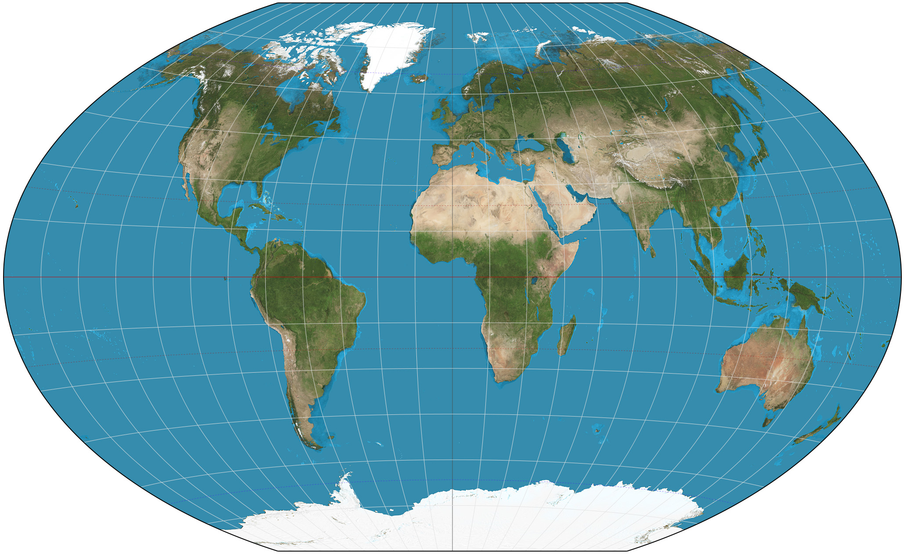

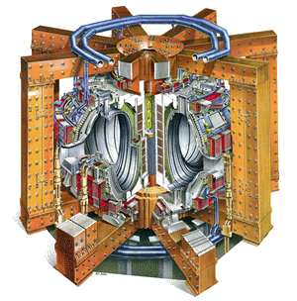

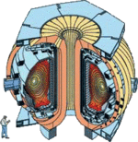





MAST Abingdon, UK (1997)
W7-X Greifswald, Germany (2015)
JT60-SA Ibaraki Prefecture, Japan (2019)
JET Abingdon, UK (1983)
ASDEX-U Garching, Germany (1991)
KSTAR Daejon, South Korea (2008)
DIII-D San Diego, CA (1986)
NSTX-U Princeton, NJ USA (1999)
ITER Cadarache France (2023)
EAST Hefei, China (2006)
LHD Toki, Japan (1998)
SST-1 Gandhinagar, India (2005)
International Collaborations
and the Road Ahead
Stephen Eckstrand
Fusion Power Associates Meeting
December 17, 2014

Slide 2
International Collaboration in Fusion Research (1)
FES has a long history of international collaboration
  Formal collaborations with Europe, Russia and Japan began more than 30 years ago
  The first major collaboration on the superconducting tokamak Tore Supra was initiated about 27 years ago
  ITER CDA began more than 25 years ago
For more than 20 years, international activities were focused on collaborations on JET, Tore Supra, TEXTOR, and JT-60
The International Tokamak Physics Activity (ITPA), which now operates under the auspices of ITER, began as the ITER Expert Groups nearly 20 years ago
For much of this time there were only a few institutions with significant involvement in international collaborations

Slide 3
International Collaboration in Fusion Research (2)
With the emergence of major new international facilities during the past decade, FESAC was charged with identifying opportunities for collaboration on superconducting tokamaks and stellarators abroad
FESAC identified three “compelling” areas of research
  Extending high performance core regimes to long pulse
  Development and integration of long pulse plasma-wall solutions
  Understanding the dynamics and stability of the burning plasma state
FESAC also made recommendations on Criteria for Selecting Int’l Collaboration Opportunities and Modes of Collaboration
Subsequently, FES issued DE-FOA-0000714 and began selecting international collaborations via peer review

Slide 4
Two New International Collaboration Teams Funded in FY 2014
These new multi-institutional teams collaborate mainly on EAST and KSTAR
  Control and Extension of ITER and Advanced Scenarios to Long Pulse in EAST and KSTAR
      GA (lead), Lehigh Univ., LLNL, MIT, ORNL, PPPL, UCLA, Univ. of Texas
  Development of Long-Pulse Heating and Current Drive Actuators and Operational Techniques Compatible with a High-Z Divertor and First Wall
      MIT (lead), LLNL, PPPL, UCLA, UCSD, College of William & Mary
FY 2014 funding: $2M per team
FY 2015-16 funding: $2.4M per team

Slide 5
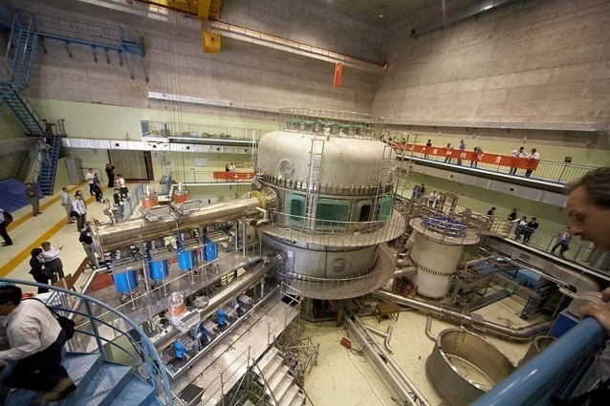

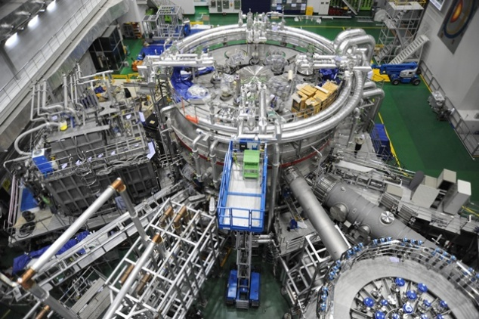

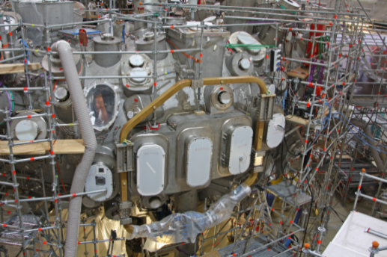

Major International Collaborations
EAST Tokamak (Hefei, China)
  Goal: 1000s pulse, 1 MA
  US involvement: plasma control, scenario modeling, design analysis for RF antennas and launchers and divertor components, diagnostics, planning and participating in experiments
KSTAR superconducting tokamak (Daejon, S. Korea)
  Goal: 300s pulse, 2 MA
  US Involvement: MHD mode control, high beta-normal operation, diagnostics, planning and participating in experiments
W7-X Stellarator (Greifswald, Germany)
    US involvement: trim coils and power supplies, high heat flux divertor components, IR imaging and X-ray imaging crystal spectrometer diagnostics, planning for future operation

Slide 6
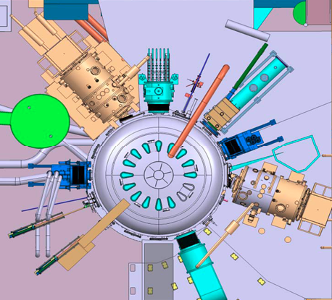
Significantly enhanced Heating & CD capability (EAST)
NBI: 4+4 MW （50－80 kV）
Sufficient power to probe β limits
Variable rotation/ rot-shear
Current profile control /sustainment
ECRH: 4 MW （140GHz）
Dominant electron heating
Current profile tailoring
Instability control
ICRH: 6+6 MW （25－75MHz）
Ion and Electron Heating
Central Current Drive
Fast Ion Source
LHCD: 4+6 MW （2.45/4.6GHz）
Fast Electron Source
Edge Current Drive /Profile
LHCD-2
NBI-2
ECRH-2
ICRH-1
ICRH-2
NBI-1
ECRH-1
LHCD-1
RF-dominant H&CD: 26MW@2014 → (26+8) MW@2016
capable to address key issues of high performance SS operations

Slide 7
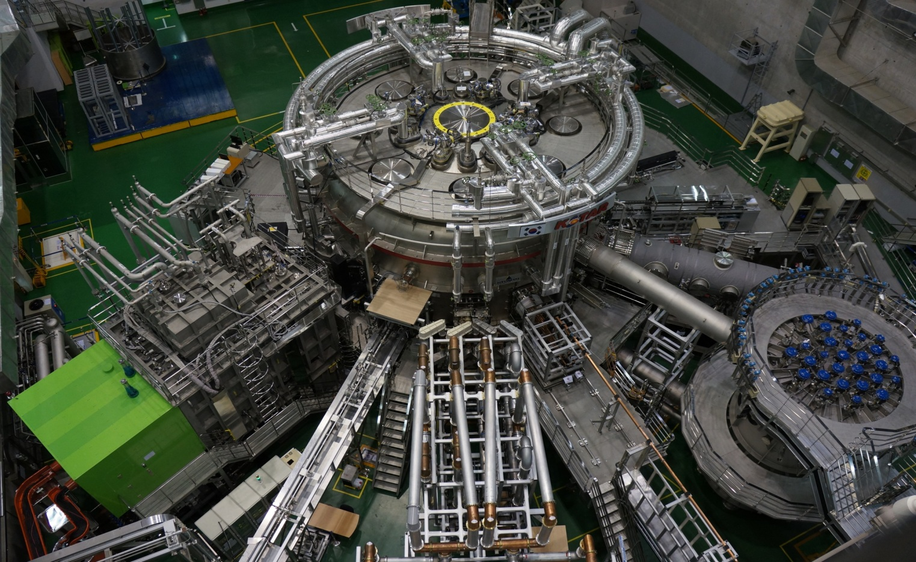
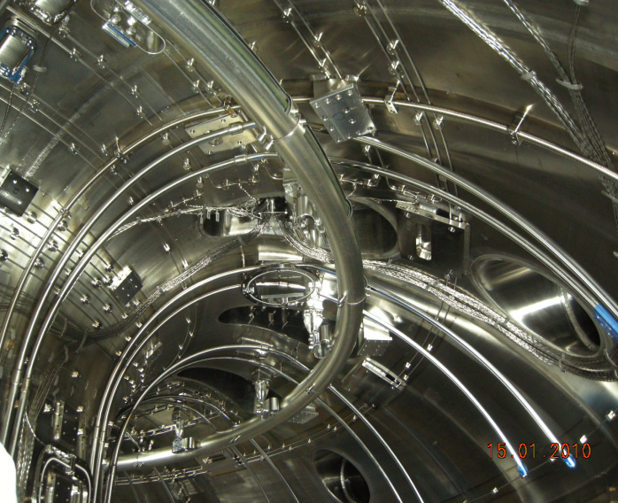
NBI and ECH power upgrades enabled KSTAR to explore more exciting regimes in 2014
NBI-1
(PNB, co-tangential)
(3 beams, 4.5MW/95keV)
170 GHz ECH
(1 MW/50 s)
Full Graphite PFCs
( Water cooling pipe is installed)
110 GHz ECH
(0.7 MW/2 s)
30 MHz ICRF
(1 MW/10 s)
5 GHz LHCD
(0.5 MW/2 s)
Divertors
In-vessel Cryopump
(Temporal cryo-pumping is available)
Baffle
IVCP

Slide 8
Progress in 2014
EAST
  Plasma initiation and vertical control experiments
  Microwave reflectometer installed and first data obtained
  SQL disruption database established
  Assessment of ICRF antenna systems
  300X acceleration in speed of data transfer
KSTAR
  Achieved plasmas with high normalized beta up to 4.3 (transiently)
  Fabricated water-cooled fixed and steerable mirrors for ECH
  Developed and implemented a real-time feed-forward algorithm
W7-X
  Completed installation and testing of trim coils and power supplies
  Prepared to install XICS and IR camera
  Preliminary design of TDU scraper element

Slide 9
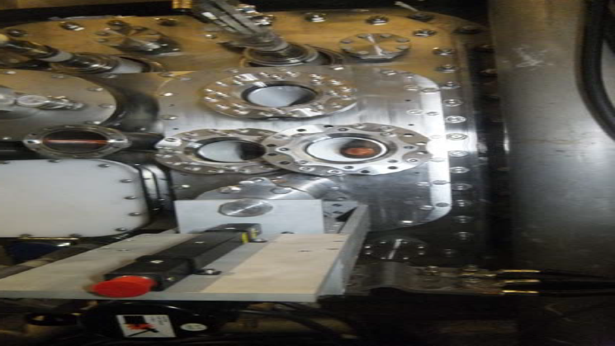
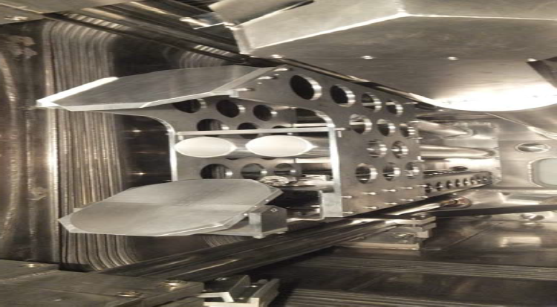
Components for Reflectometer Systems Installed on EAST
Exterior and interior views of new
integrated microwave front-end system
installed on EAST!
Interior of UCLA-built 8-channel
DBS source/receiver system

Slide 10

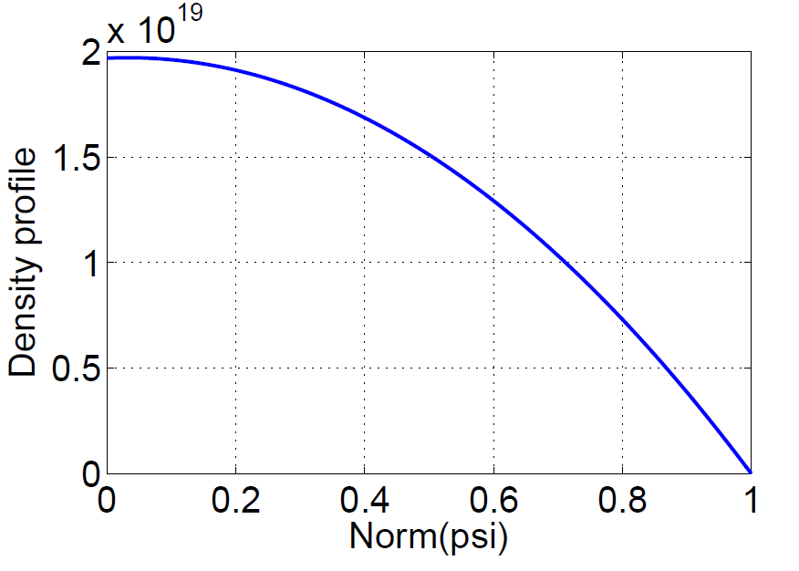
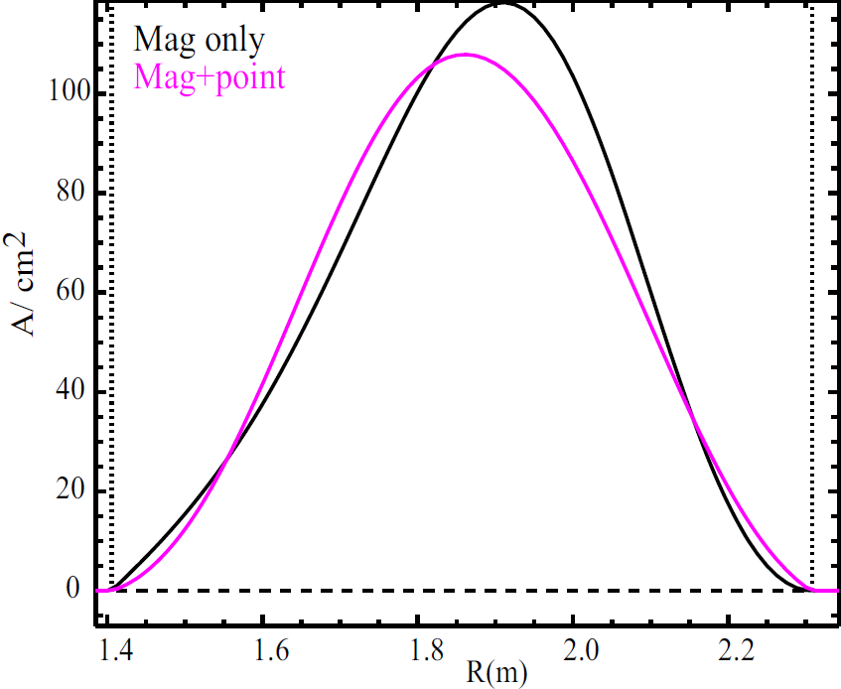
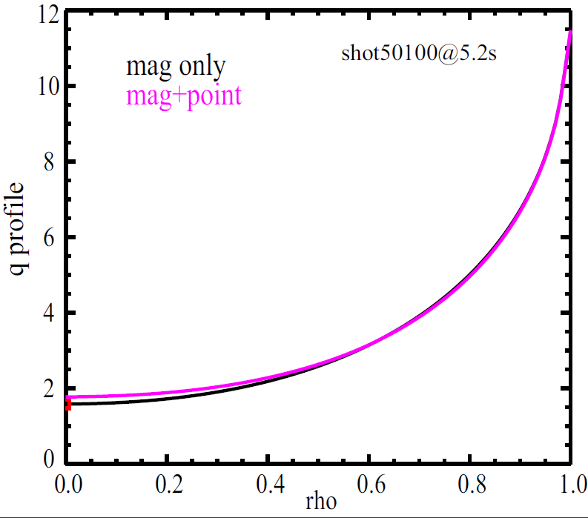
Initial results for current profile from EFIT using Faraday rotation measurements
EAST
Faraday rotation angle resolution ~ 0.1º ,
Density resolution 1x10¹⁶m⁻³. (ICRF test shot)
Density profile
Current profile
q-profile
@t=5.2 seconds
Notes:
偏振干涉仪可以得到可靠的密度分布；法拉第旋转角的测量结果对于电流密度分布和q分布起到了很好的约束效果。

Slide 11
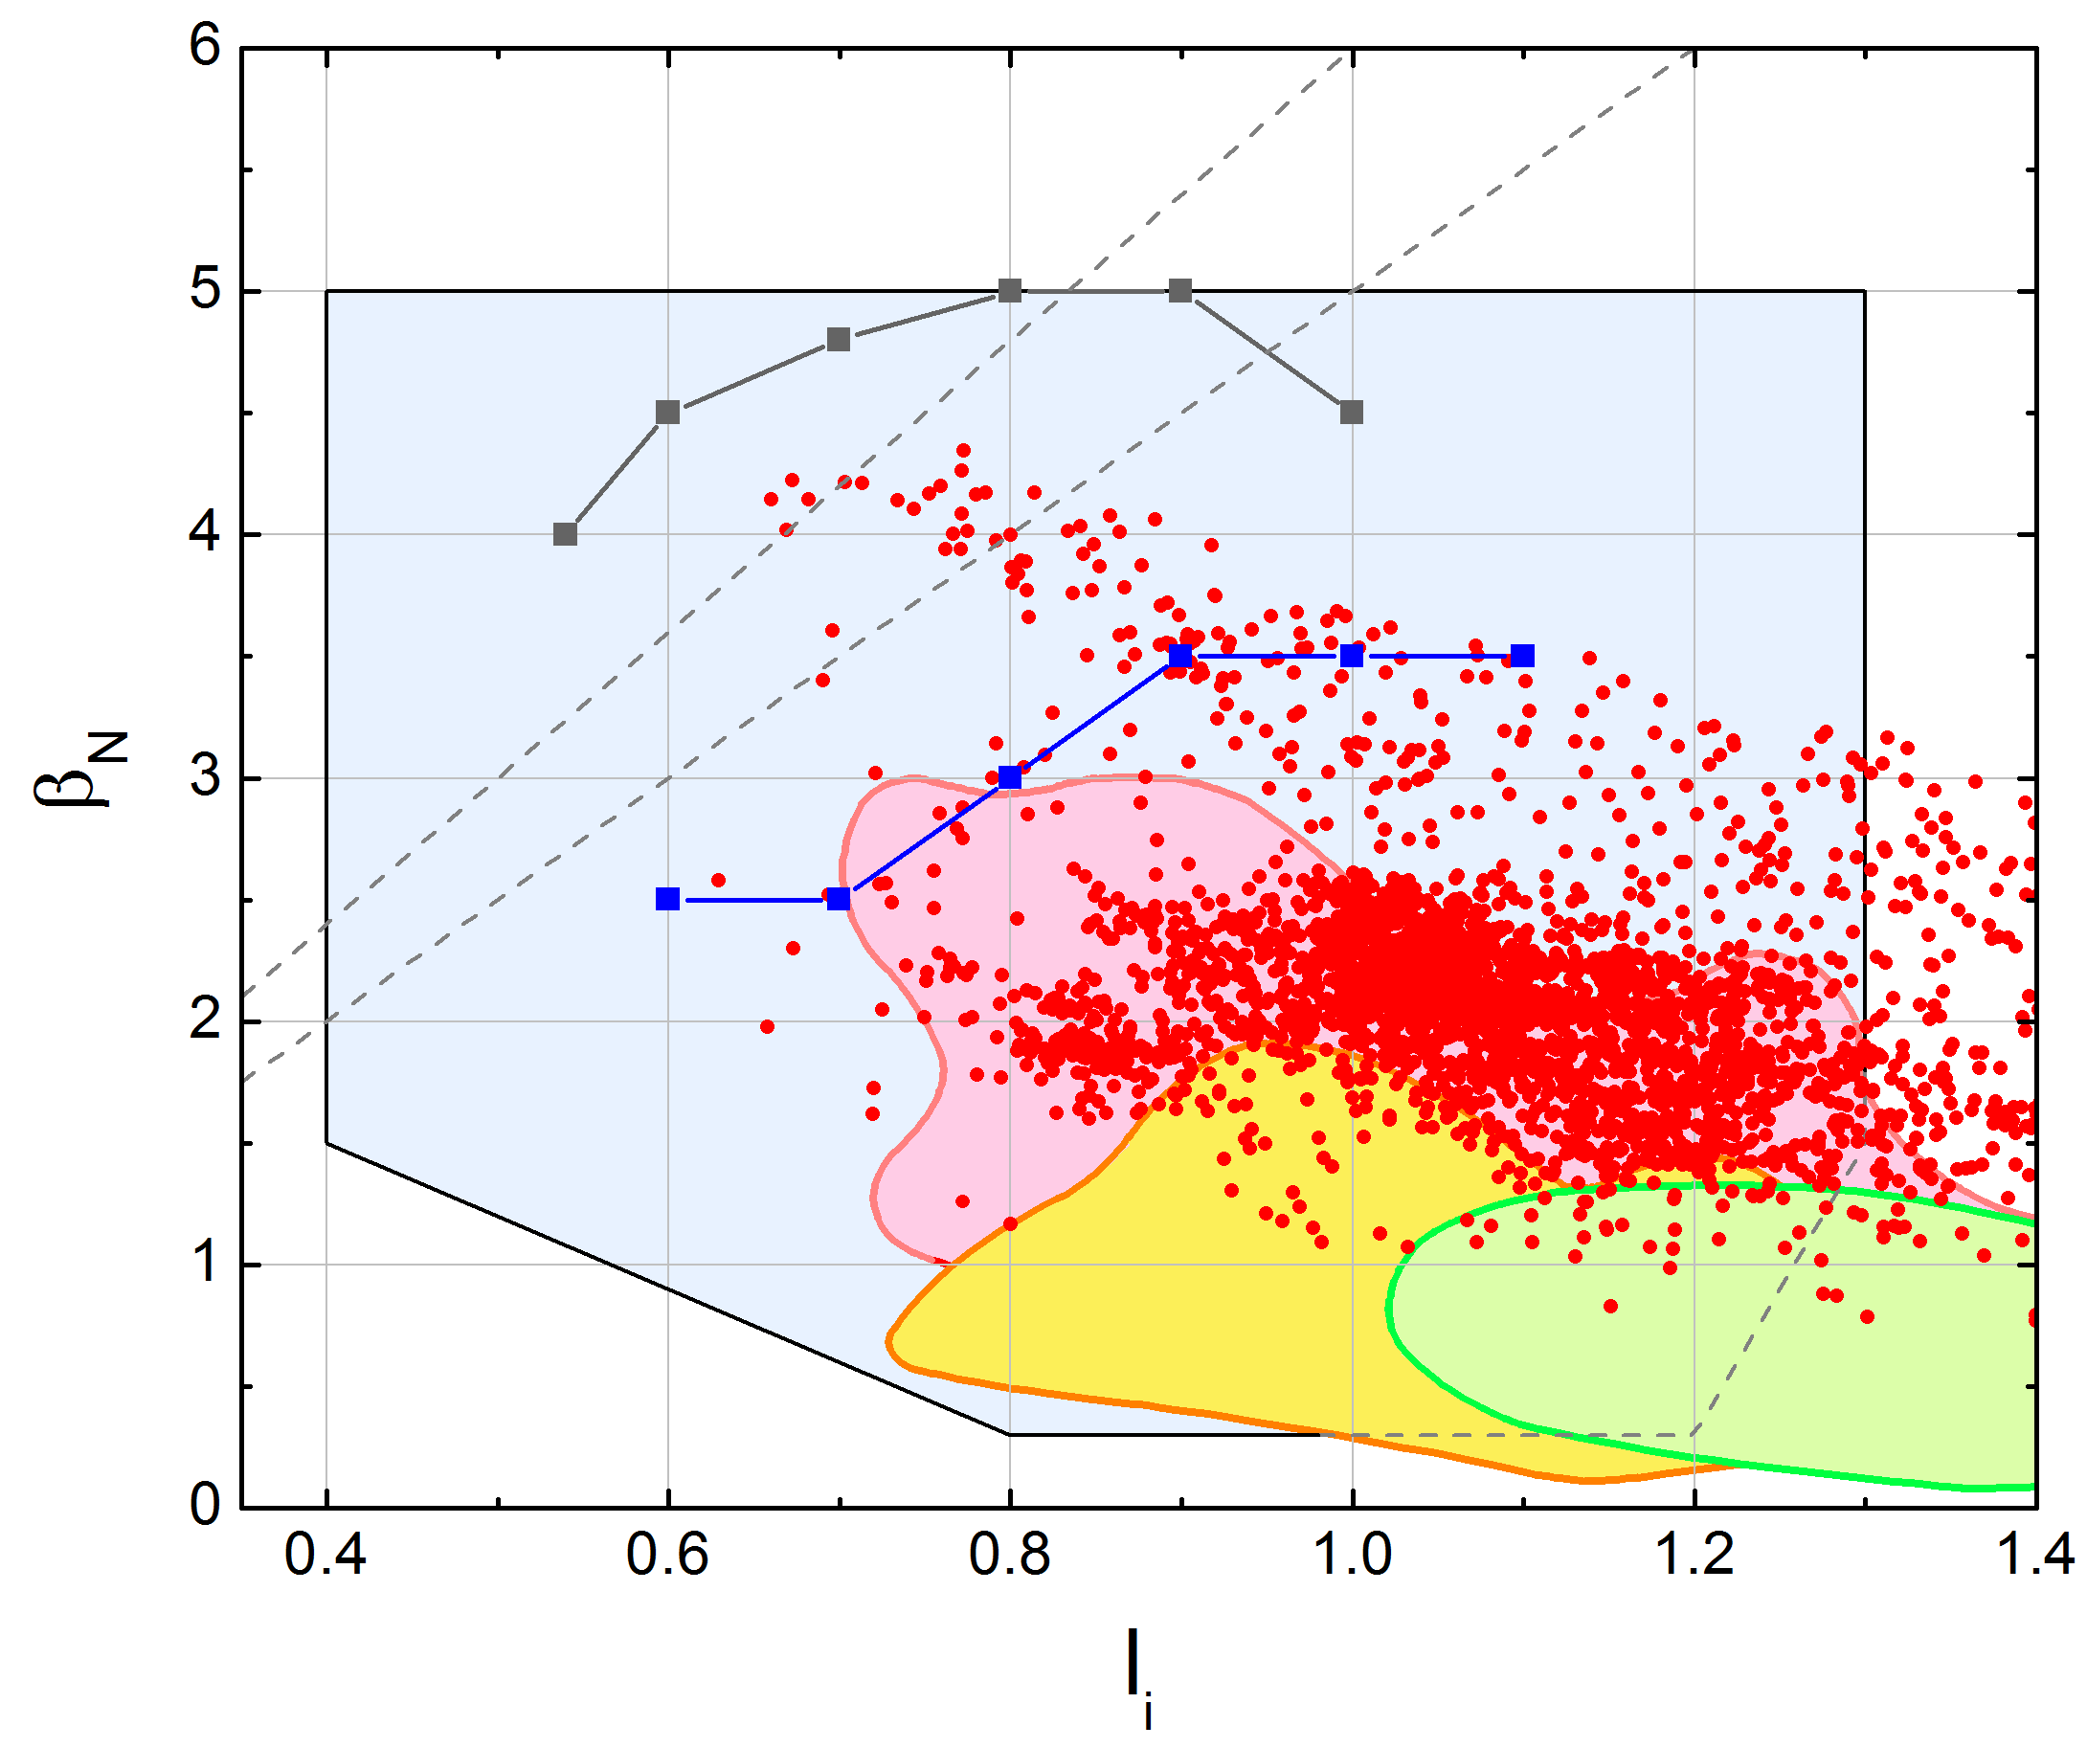
Recent experiment MP2014-05-02-007 produced high β_{N} and β_{N} /l_{i} - record values for KSTAR
MP2014-05-02-007
by Sabbagh and Y.S. Park
β_{N} /l_{i} = 6
β_{N} /l_{i} = 5
n = 1 with-wall
limit
Recent operation
in 2014
n = 1 no-wall limit
Operation
in 2012
Operation
in 2011
KSTAR design target
operating space
First H-mode operation
in 2010

Slide 12
EAST & KSTAR:
Plans for FY 2015
Plans are still being developed, but likely items include
EAST
  Running additional simulations; developing upgrades for the PCS system
  Bringing microwave diagnostics into full operation
  Further use of BOUT++ to model the edge plasma, including the effects of RF and impurities
KSTAR
  Further experiments to extend beta-normal toward the with-wall limit
  Studies of the effect of ECH on neoclassical tearing modes
  Commissioning of the off-normal/fault response system and application to disruption “avoidance” and mitigation studies

Slide 13
W7-X: Plans for 2015
National laboratory team (PPPL, ORNL, LANL) goals for 2015
  Commissioning and first exploitation of the trim coils.
  Delivery of U.S. XICS, IR camera and pellet mass detectors.
  Design of TDU scraper element and associated diagnostics (IR camera, divertor manometers, Langmuir probes)
  Ti, Te profiles with XICS
  High-resolution limiter temperature profiles with IR camera
  Magnetic field mapping, including trim coil effects
One-two new university grants to be funded in Spring 2015

Slide 14
W7-X Schedule
Trim coil magnet tests: completed 04 Dec.
Magnet cool down: starts 05 Jan.
Plasma vessel closed: 06 March.
SC magnet tests: starts 27 March.
Flux surface measurements: starts 15 May.
Plasma vessel bakeout: starts 05 June.
First plasma: 02 July.

Slide 15
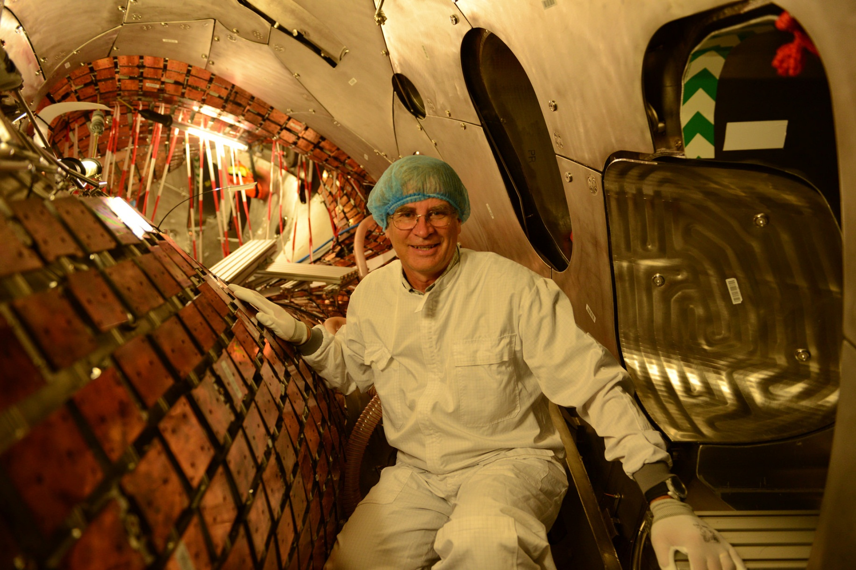
Interior of Wendelstein 7-X

Slide 16
Plans for Student Collaborations on W7-X
W7-X will provide excellent opportunities for U.S. graduate students
  Research on unique, world-class facility
  Interaction with a multi-national research team
  Integration in IPP academic culture
    Four faculty members
    ~50 PhD students, ~20 postdocs expected
    International Helmholz Graduate School for Plasma Physics
    Student seminars, guest lectures
    English language as the standard
IPP proposes a team approach for supervising graduate students
  The student’s U.S. supervisor
  An IPP mentor / host, accountable to the W7-X scientific directorate
Assistance with living in Greifswald
  Many resources, e.g., Welcome Centre, Max Planck Society Manual for Researchers, U.S. “FAQ” document, etc.
  Superb support from IPP administration team (housing, governmental formalities, etc.)

Slide 17
International Collaboration and the Road to ITER
Current collaborations should develop effective ways to participate on ITER
  Topical teams, with some members on-site for short- and long-term assignments
  Remote participation with rapid access to data
Collaborate on JET DT experiments?
  A new generation of US scientists and engineers would gain experience with DT plasmas prior to ITER operations
Establish a truly international team as a prototype for the ITER team?
  Facility focus: JET? JT-60SA?

