Slide 1
Laying the foundational technology for IFE laser drivers
Fusion Power Associates Meeting
December 16, 2014
Tom Anklam
NIF&PS Deputy Associate Director for S&T

Slide 2
Feasibility and Technology Challenges for IFE
Demonstrate ignition
Design and demonstrate a laser driver
Address issues affecting availability such as optical damage
Target mass manufacturing, injection, tracking, engagement
Fusion chamber design, materials of construction, durability issues
Closing the tritium fuel cycle
Economics
Laser drivers also have scientific and commericial applications

Slide 3
IFE laser attributes – indirect drive
High electrical efficiency
MJ – class energy level
10 Hz to 20 Hz repetition rate
Steering capability to engage moving targets, compensate for vibration
Optical damage resistant at billion-shot level
High system availability
Appropriate form factor for production environment
Designed for manufacturability and cost effectiveness

Slide 4
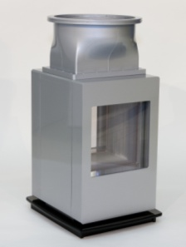
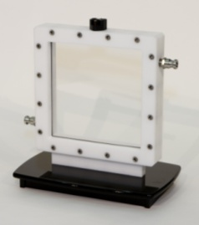
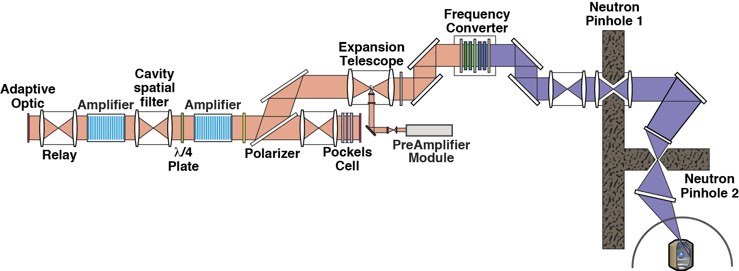
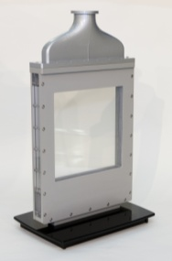
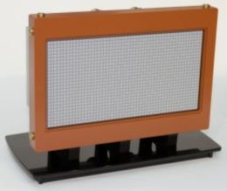
LLNL design combines the NIF architecture with high efficiency, high average power technology
16 J/cm² 1ω
4.7 J/cm² 3ω
Rotator
λ/4
Diodes
Diodes
Diode pumps → high efficiency (18%)
Helium cooled amps → high repetition rate (16 Hz) with low stress
Normal amp slabs → compensated thermal birefringence, compact amp
Passive switching → performs at repetition rate
Lower output fluence → less susceptible to optical damage

Slide 5
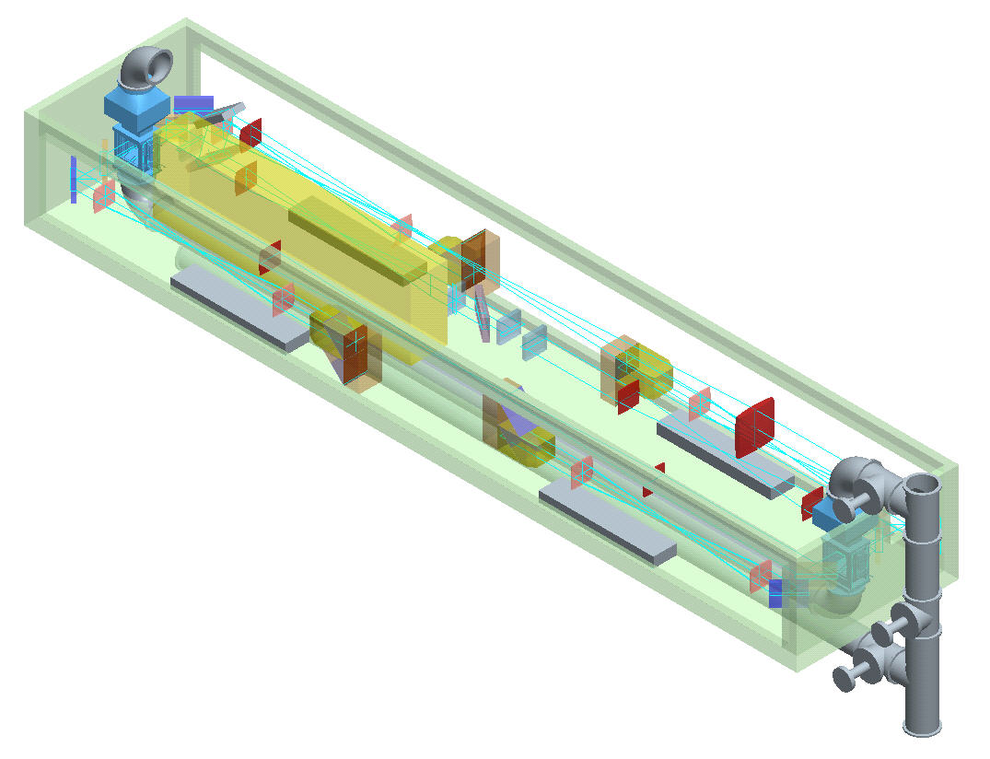
An entire 1ω beamline that provides 130 kW average power can be packaged into a 31 m³ box
2.2 m
Amplifier head
Preamplifier module (PAM)
1.35 m
Pockels cell
Diode array
Deformable Mirror
10.5 m
NIF Beam Line Capability in a Very Small Box

Slide 6
The LLNL laser design is projected to achieve high efficiency
Electrical to 3ω Optical Efficiency
Laser point
Design
variability
83 μs
125 μs
106 μs
164 μs
223 μs
Pump pulselength
APG-1 laser glass
5.7 kJ/beam @ 3ω
25-cm aperture @ 1ω
1-cm-thick slabs
Cooling power not included
(~16% including cooling)
78 104 130 156 182 208 234
Capital Cost →

Slide 7
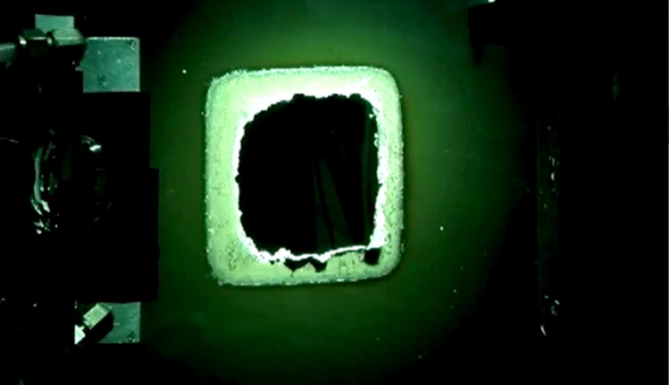
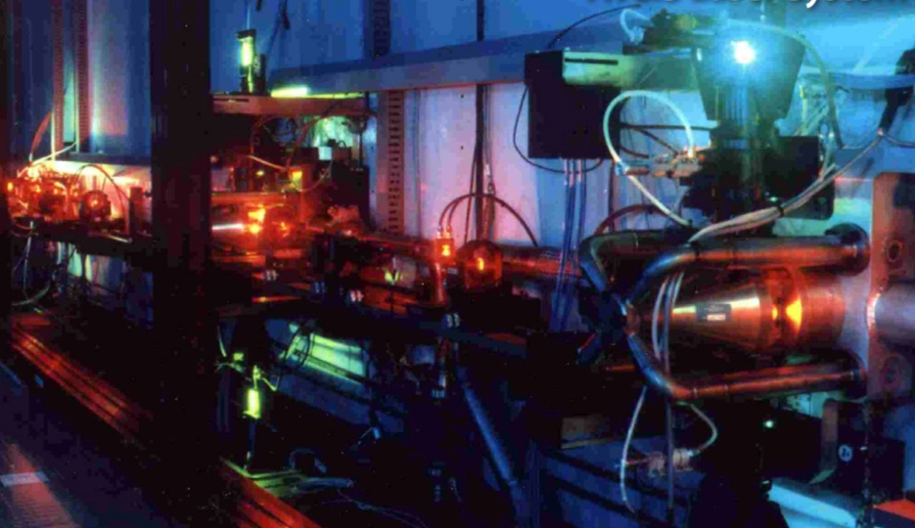
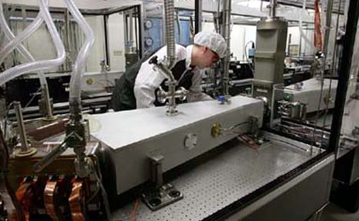
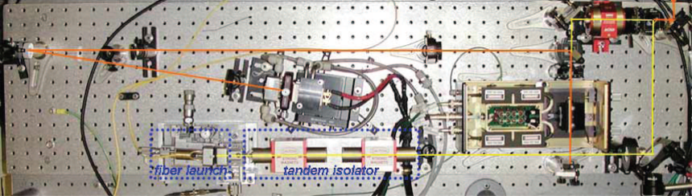
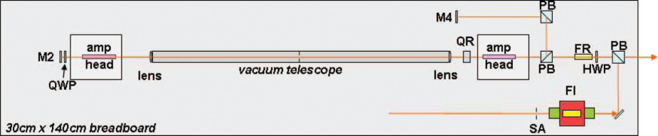
LLNL average power lasers have been proving grounds for several key proposed laser technologies
25 kW high average power laser
AVLIS 24/7 operational laser
600W, 10 Hz Mercury Laser
300 Hz, 38 W Pulse Amplifier

Slide 8
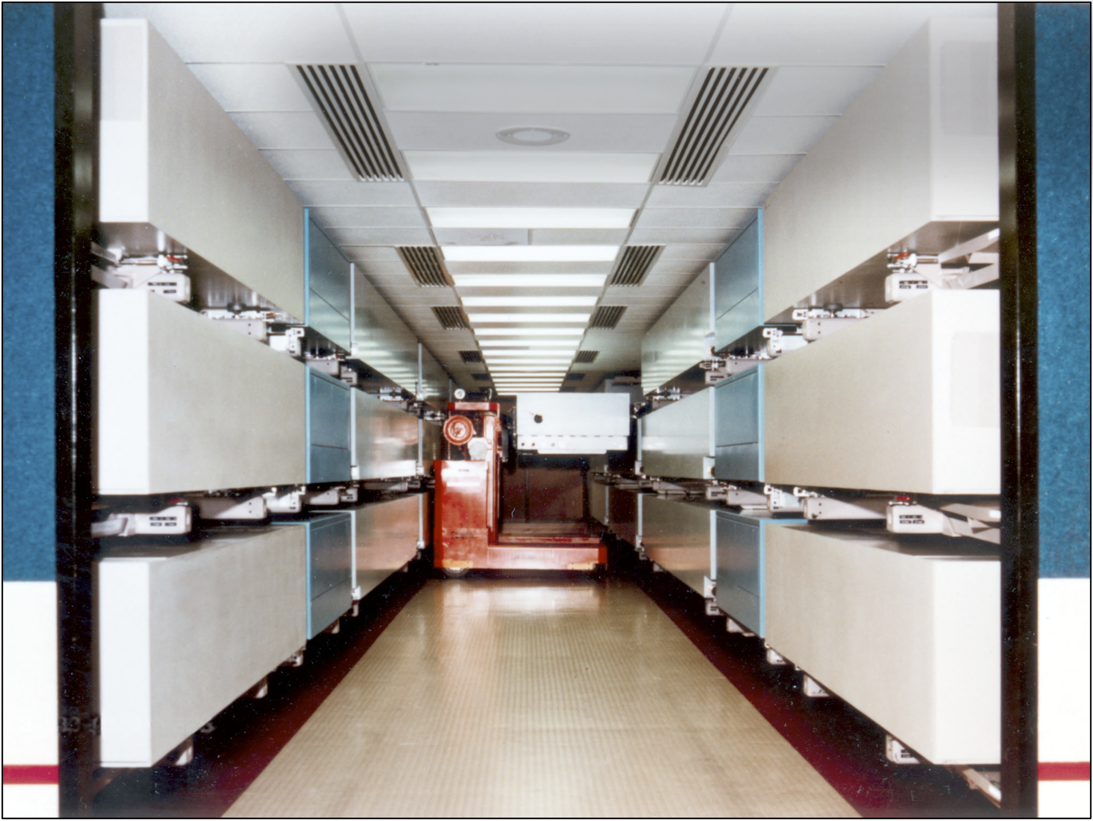
High availability using hot-swappable components was demonstrated on AVLIS
AVLIS maintained long-term (10 year) 24/7 operation at 99% availability
with 1500 hr MTBF line replaceable units (LRUs)

Slide 9
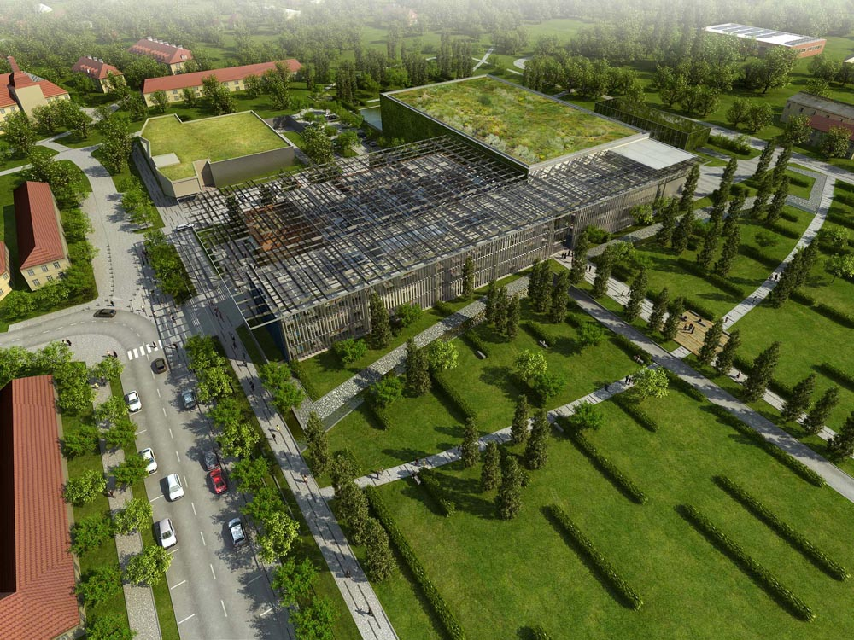
LLNL diode-pumped laser technology is being integrated into the “ELI Beam lines” facility in Europe
HAPLS project:
Delivery of a laser system for a 10 Hz, 1 Petawatt user facility, incorporating a 200 J / 10 Hz DPSSL pump laser

Slide 10
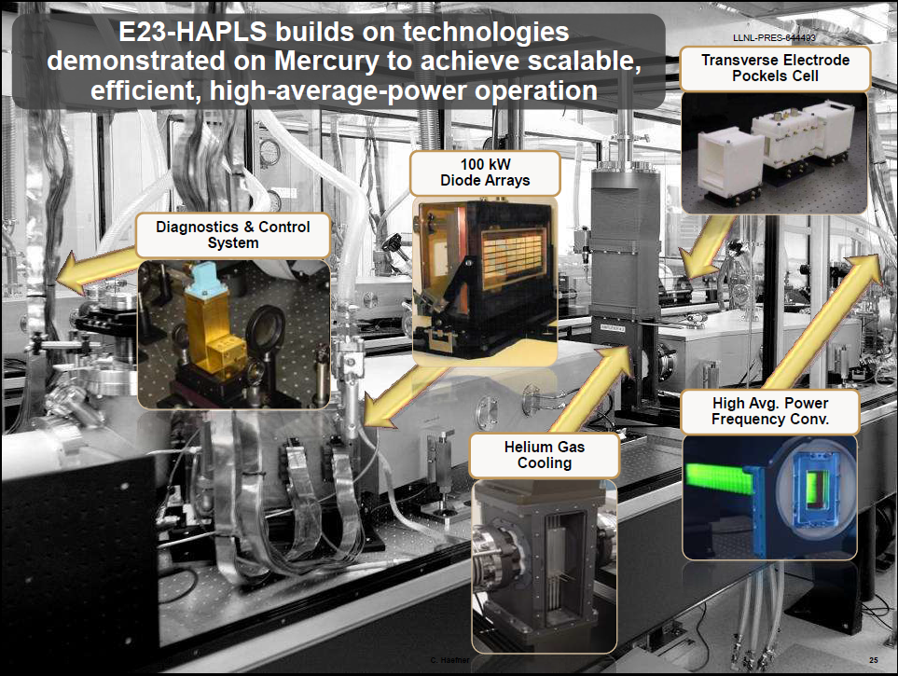

Slide 11
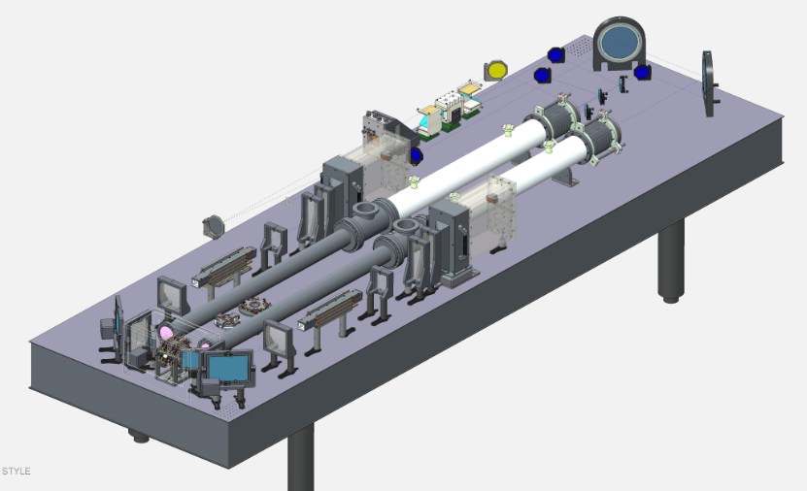
GOLD Laser System is being developed to test optical damage at the gigashot level
100 Hz, 10J
7mm x 7mm beam footprint
20J/cm2 red, 12J/cm2 blue
First light end of FY15
DPSSL performance to exceed kW

Slide 12
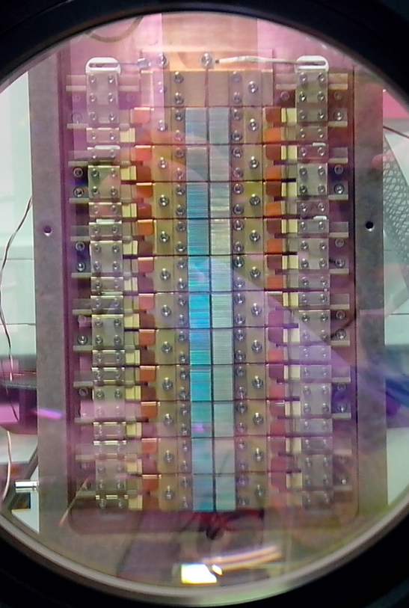
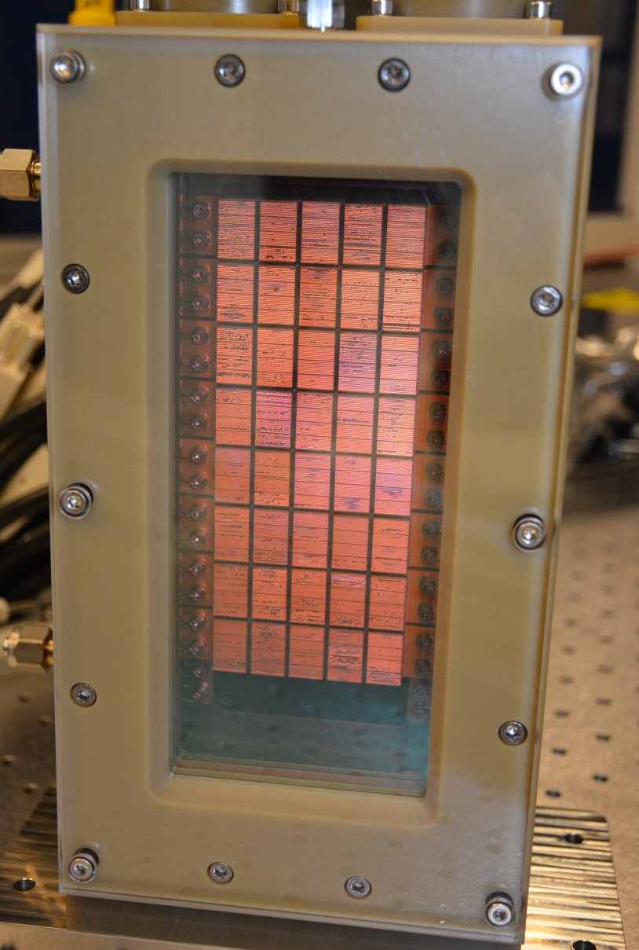
GOLD and ELI are driving demonstration of increasingly capable diode arrays
GOLD: 120 Hz, 126 kW
ELI L3: 10 Hz, 800 kW

Slide 13
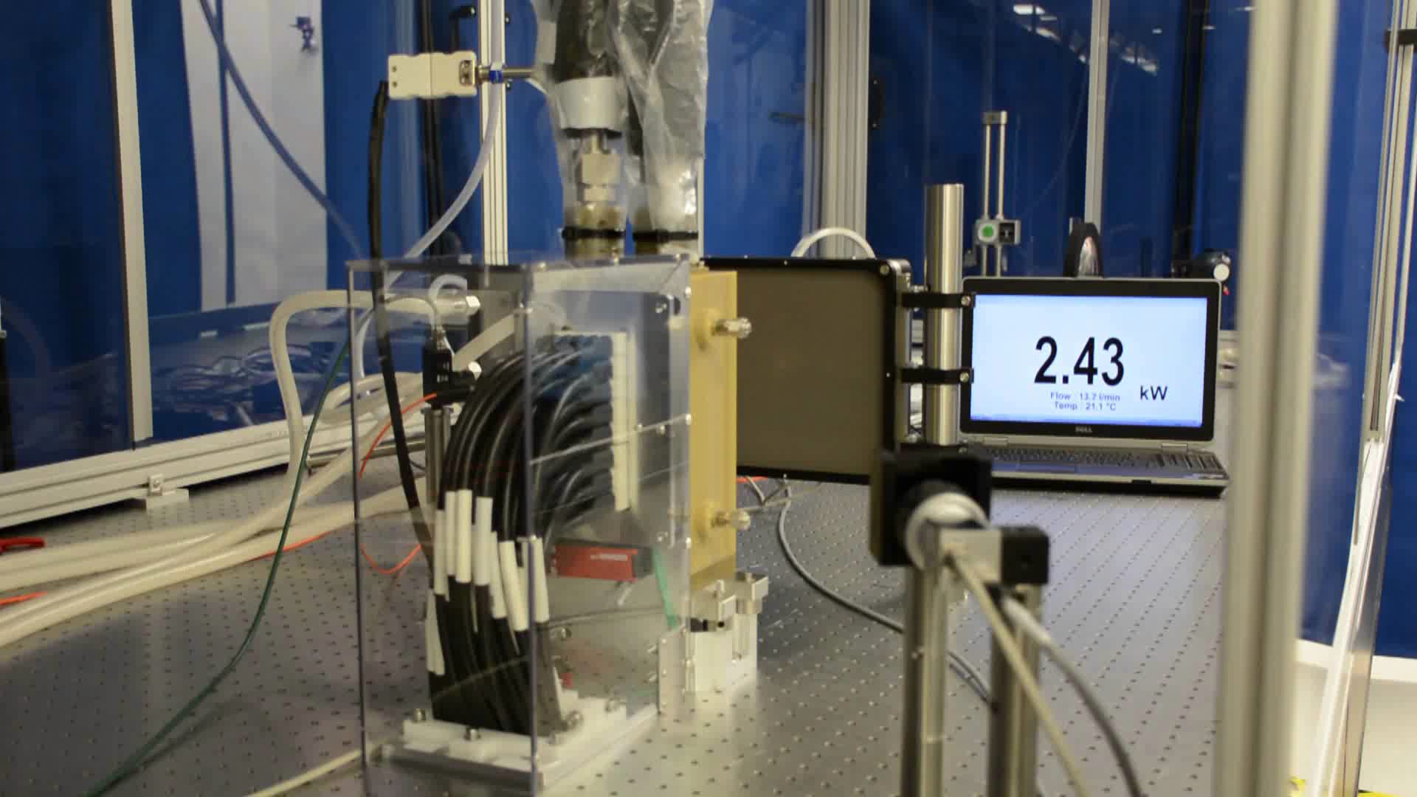
800 kW QCW diode array in action at 10 Hz
800 kW peak @ 120 Hz
2.4 kW average power

Slide 14
Near-term laser development for scientific and commercial application also advances that needed for IFE
Diode pumps → high efficiency (18%)
Helium cooled amps → high repetition rate with low stress
Normal amp slabs → compensated thermal birefringence,
Passive switching → performs at repetition rate
Lower output fluence → less susceptible to optical damage

Slide 16
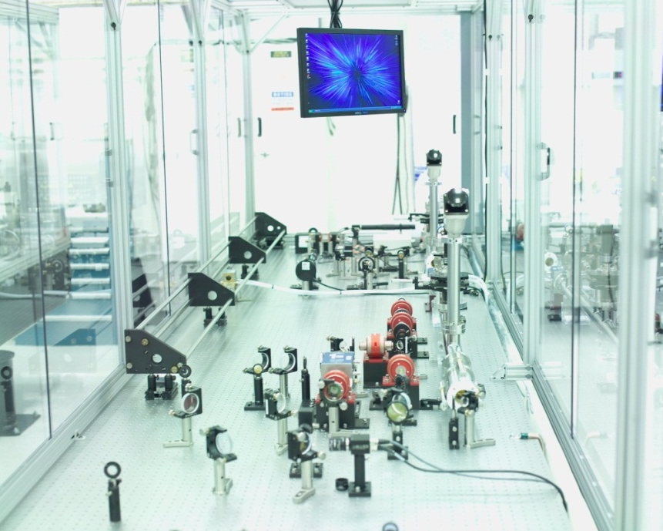
Optics durability will be key
GOLD System under construction – giga-shot, multi-year test campaign
120 Hz, >10 J operation
Low fluence design – providing a robust source to test optics under
LIFE-relevant conditions
Of immediate-term application to facilities such as ELI
100 Hz amplifier front-end
DPSSL performance to exceed kW

Slide 17
NIF beamline capability in a very small box:
Proposed high average power laser architecture attributes
Provides efficiency (~18%) at high repetition rate (16 Hz)
  High brightness efficiency diode pump arrays
  Helium gas-cooled amplifiers
  High harmonic conversion efficiency
Designed to be built with existing materials
  Glass slabs: thermal birefringence compensated by architecture
  DKDP Pockels cell: passive polarization switching minimizes heat load
Designed for high reliability and low operating costs
  Low 3ω fluence operation
  Margin in beamline power
  Optics preparation to mitigate damage effects
Designed with modular beamlines in clean protective boxes that can be transported
  Maintenance can be performed by removal and replacement of beamlines
  Assembly can be performed at factories rather than at the laser operating site

Slide 18
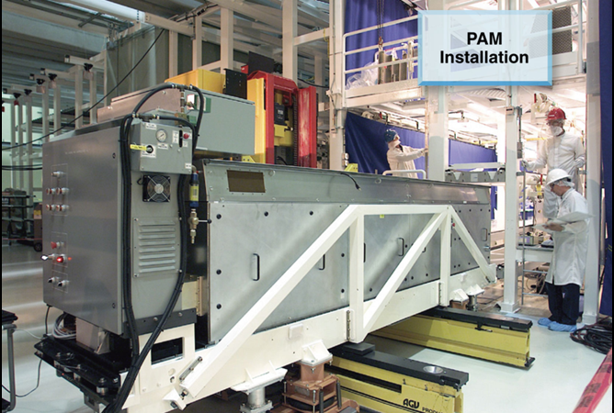
Architecture has previously been used to demonstrate high availability and maintainability
Beam-in-a-Box

Slide 19
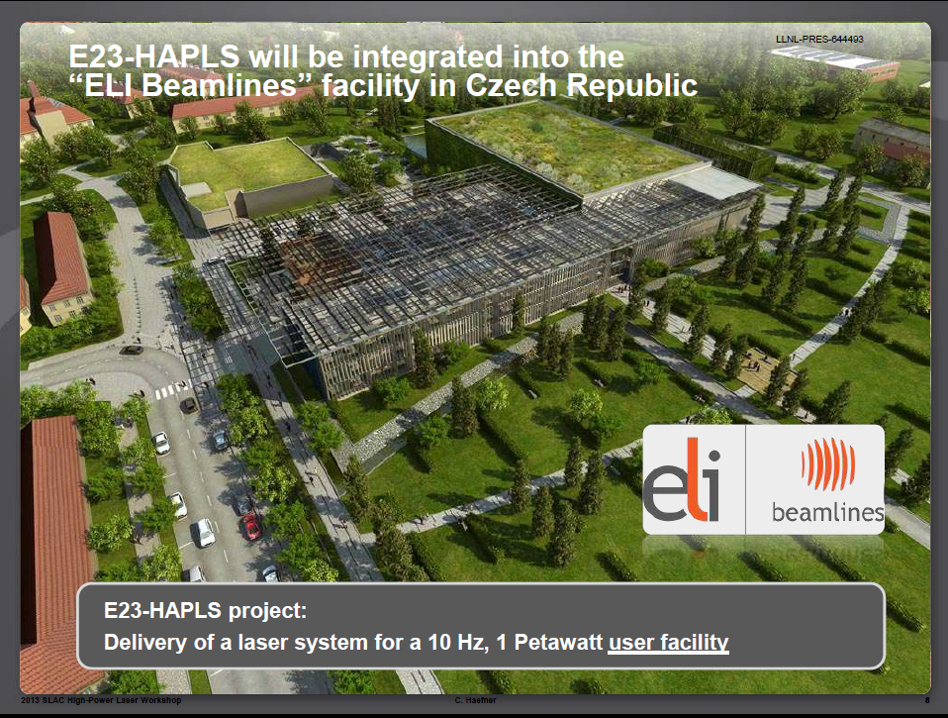

Slide 20
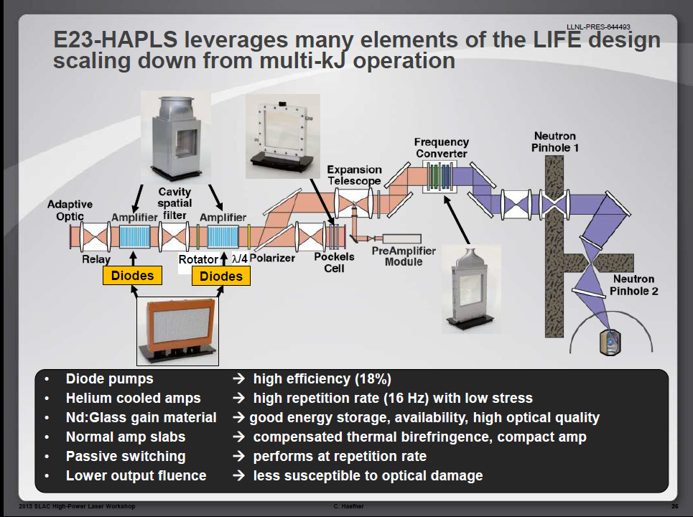
the proposed design,

Slide 21
HAPLS leverages many elements of the LIFE design scaled down from multi-kJ operation
Rotator
λ/4
Diodes
Diodes
Diode pumps → high efficiency
Helium cooled amps → high repetition rate with low stress
Normal amp slabs → compensated thermal birefringence, compact amp
Passive switching → performs at repetition rate
Lower output fluence → less susceptible to optical damage

