Slide 1
Program on Technology Innovation: Assessment of Fusion Energy Options for Commercial Electricity Production
FPA 33rd Annual Meeting.
Washington, DC.
December 5 to 6, 2012.
John Sheffield
on behalf of EPRI (Project Manager, A. Machiels).

Slide 2
Purpose of the Report
The electric power generation industry today is focused on nuclear
power from fission energy as a power generation source. However,
energy from fusion has been a long-term vision for many decades.
Some notable recent accomplishments are worthy of review with
regard to fusion energy’s potential to become a practical source of
power. This report summarizes an industry effort to assess the state
of the art of fusion energy, through a review of seven proposals for
near-term applications.

Slide 3
Lead Institutions Presenting Proposals
General Fusion, Inc.
Georgia Institute of Technology
Helion, Inc.
Lawrence Livermore National Laboratory
Naval Research Laboratory
Princeton Plasma Physics Laboratory
University of Texas

Slide 4
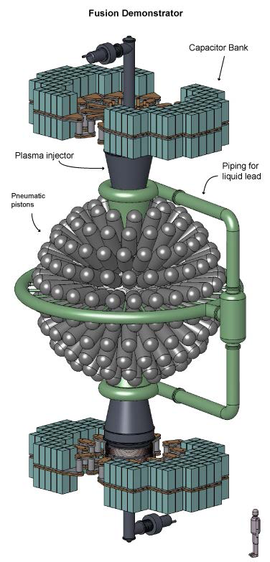
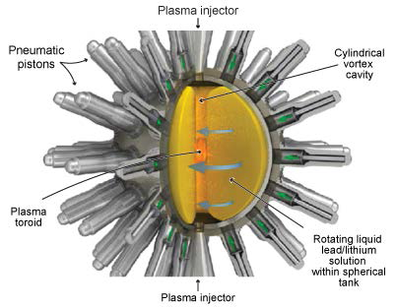
General Fusion: Pistons compress a liquid lead-lithium blanket into which two D-T plasmoids have been injected.
Configuration
Pistons compress lead-lithium vortex plasma

Slide 5
Georgia Tech: SABR, a fusion-fission hybrid based upon an ITER-like tokamak.

Slide 6
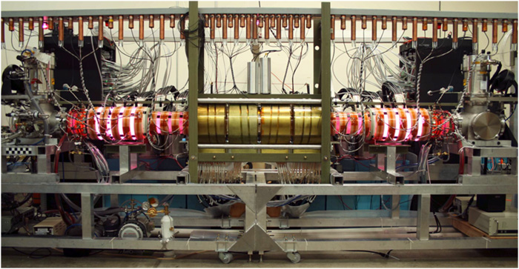
Helion Inc: a pulsed Field Reversed Configuration Reactor. Colliding FRCs compressed by a magnetic field.

Slide 7
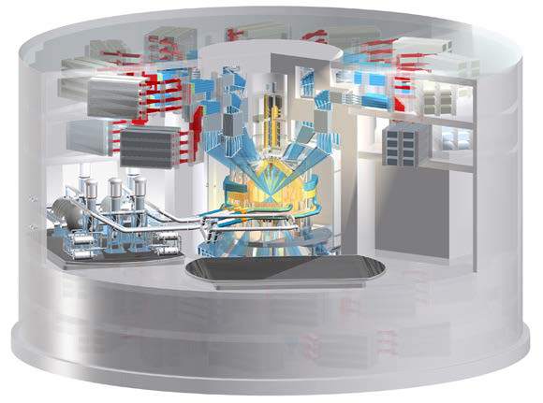
LLNL: LIFE fusion power plant—Diode Pumped Solid State Lasers, indirect-drive based.

Slide 8
NRL: Fusion power plant—KrF laser, direct-drive based.

Slide 9
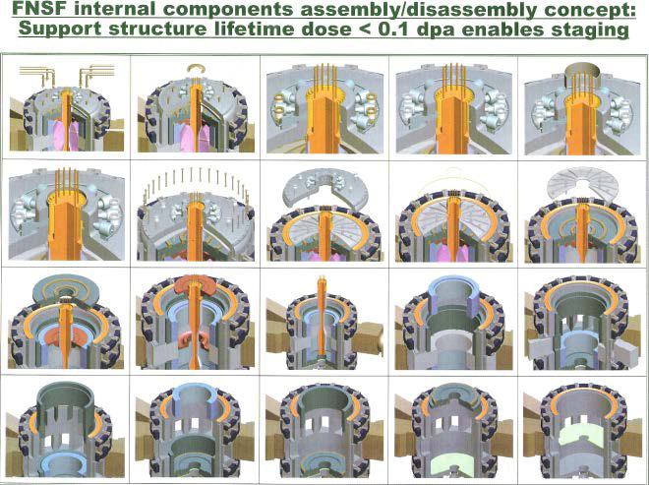
PPPL: a Fusion Nuclear Facility, ST, tokamak, or stellarator.

Slide 10
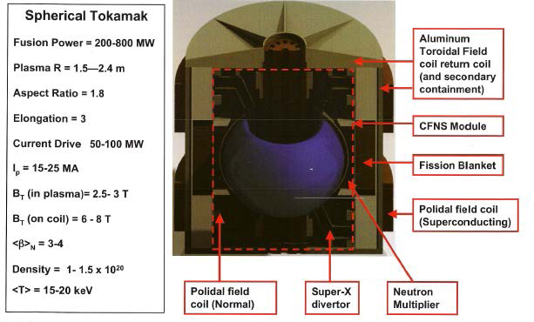
University of Texas: a Fusion-Fission Hybrid based on a ST.

Slide 11
ABSTRACT
Fusion energy options were reviewed to assess technical readiness
levels for commercial electricity production for the power industry.
Magnetic and inertial confinement systems, in addition to
nontraditional fusion concepts, were reviewed by a technical panel of
experts, based on workshop presentations by the proponents of each
technology. The results are summarized in this report. The
conclusion of the review is that, although significant progress is being
made in many areas, commercial application is not likely for at least
30 years—if the concepts prove feasible. Recommendations are
provided to focus more of this research on engineering and power
applications and to engage the power industry in monitoring
progress.

Slide 12
Report Preparation
The report was prepared by
* A Kadak, Exponent, Inc.
* T. Christopher, NPPA, LLC.
* J. Sheffield, Technical Consultant.
Based on contributions from
Eugene Grecheck, Dominion Generation
Martin Greenwald, Massachusetts Institute of Technology
Hermann Grunder, Argonne National Laboratory (retired)
Stan Milora, Oak Ridge National Laboratories
Tom Mulford, EPRI
John Soures, University of Rochester

Slide 13
Technical Conclusion Summary-1
Several innovative fusion technologies were reviewed and assessed from the standpoint of a technical readiness level (TRL) analysis; the TRL analysis showed the technologies to be at an early stage of readiness. The conclusion of this review is that no near-term (less than 30 years) fusion options are available to the power industry. However, global commitments to fusion technologies in excess of $23 billion (USD) are now under way, which might lead to breakthroughs. Ultimately, demonstration facilities sponsored by the U.S. Department of Energy will be required, just as was the case in the early days of water reactor technologies.

Slide 14
Technical Conclusion Summary-2
The three inertial confinement approaches are based on
lasers, heavy-ion beams, and pulsed-power system drivers.
The committee heard about two laser-drive options. The greatest financial support is being directed to the laser inertial fusion energy (LIFE) concept for the National Ignition Facility.
The Naval Research Laboratory’s direct-drive laser program is less well funded, but it is steadily meeting its technical challenges and might have the more useful technological approach in the longer term.

Slide 15
Technical Conclusion Summary-3
The international thermonuclear experimental reactor (ITER)
tokamak is the largest magnetic confinement facility in the program, and it will address many of the physics and engineering challenges for magnetic fusion power facilities during its construction and operation in the next 20 years.
Alternative magnetic fusion energy approaches are also being pursued by private venture capital–funded companies that are making progress in the development of fusion energy on a smaller scale. These initiatives are less well funded, but they have the potential for smaller fusion devices with possible earlier deployment, should they reach demonstration stages.

Slide 16
Utility Perspective
From the utility perspective, the production of electricity should be the main objective of a fusion development program.
At present, electricity generation appears to be an add-on and not a primary objective to the basic science of the fusion development program, largely due to the challenges of developing a fusion device that produces more energy than it consumes.

Slide 17
Recommendations for Future Actions - 1
Direct more fusion research on the engineering and operational challenges of a power plant, including how to maximize the value of the fusion power produced.
More consideration should be given to the conversion of the heat of fusion to power production and the reliability of any fusion device.
Consider developing more advanced and perhaps direct power conversion systems to enhance the overall efficiency of energy-to-electricity conversion.

Slide 18
Recommendations for Future Actions - 2
Identify common materials and technology needs (such as tritium production) that a fusion test facility could address to meet most of the needs for both magnetic and inertial confinement systems.

Slide 19
Recommendations for Future Actions - 3
Monitor and periodically re-evaluate the fusion programs to
assess the potential for electric power production in the nearer
term to identify which concepts are likely to produce tangible
fusion power. At the appropriate time, do the following:
− Create a utility advisory group to focus fusion energy
research and development projects to address more utility
needs, particularly in the area of operations and maintenance,
and to provide input into the design of the fusion power plants.
− Begin to consider the regulatory requirements for commercial
fusion power plants in terms of establishing safety and
licensing standards.

