Slide 1
Fusion Research in India
Fusion Power Associates
32nd Annual Meeting & Symposium,
Dec. 14-15, Washington DC
Shishir Deshpande
Project Director
ITER-India

Slide 2
Introduction
Institute for Plasma Research (IPR), an autonomous unit of the DAE is located in Gandhinagar, the capital city of the state of Gujarat. IPR is the main center for fusion research with about 500 persons
IPR is the nodal agency for plasma research and international collaboration activities
ITER-India is a specially created group within IPR for the execution of ITER packages in India’s scope

Slide 3
Fusion Activities
1989 : ADITYA tokamak operation
1994: Design of SST-1
2004: First commissioning tests of SST-1
2006: ITER Participation
2007: 11th Plan: R&D on Magnet, Div., Cryopump
2008: TBM concept for testing in ITER
2010: Testing and qualification of SST-1 systems
2012: SST-1 2nd Assembly
2012-17: 12th Plan. (Magnet, Div, TBM, Materials, H&CD, RH); Design of next step machines
An intermediate sized machine is necessary to do engineering tests

Slide 4
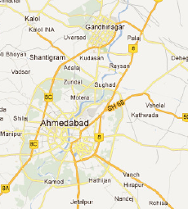
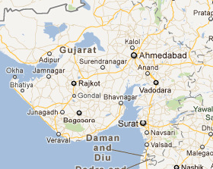
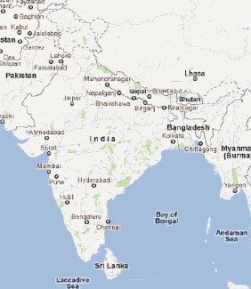
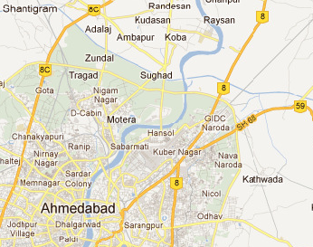
Location

Slide 5
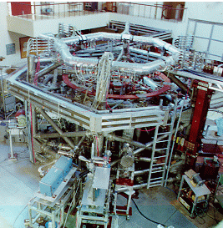
ADITYA Tokamak
First tokamak designed by IPR and fabricated in India. Routinely operated since 1989 for various expts.
Major Achievements
Physics :
  Discovery of ‘intermittency’ in plasma transport and associated phenomena
Realized technologies:
  Large volume UHV toroidal vessel
  large copper magnets
  various plasma diagnostics, control systems
Technologies for future:
  RF heating and current drive systems developed and tested in this machine
5

Slide 6
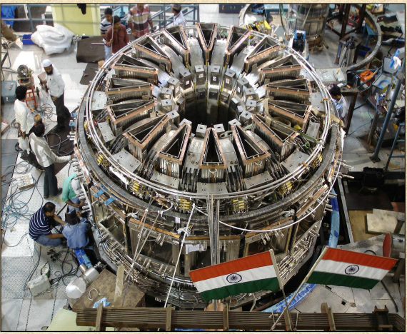
SST-1 Tokamak
Progress:
First assembled in 2004
Integral testing continued up to 2007
Leaks were identified and analyzed
New techniques developed and refurbishment was initiated
Joints with sub nano-ohms developed, tested & implemented
5 K SHe cooled bubble type shields developed
All TF coils tested successfully
Assembly started, First Plasma expected in mid-2012
Plasma Shape, Density and Impurity Control
Heat removal by active cooling
Plasma Heating & Current Drive
6

Slide 7
Enabling Technologies R&D

Slide 8
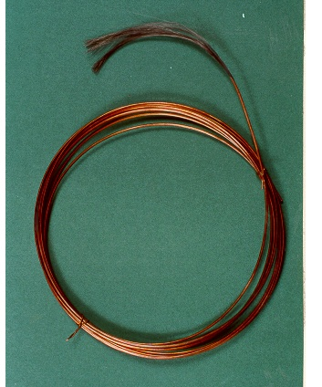
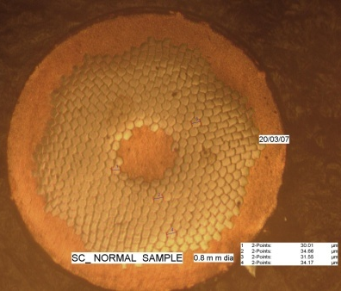
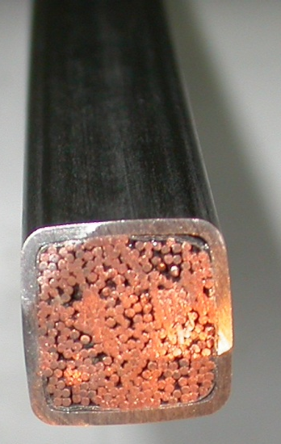
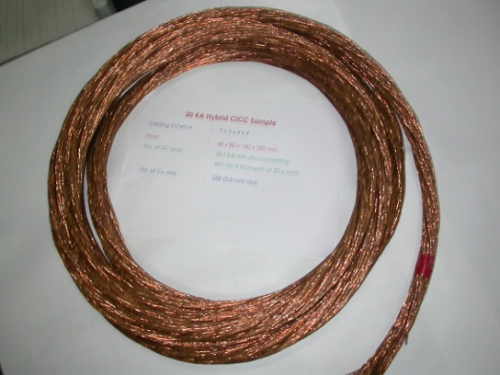
Magnet R&D
IPR & AFD(BARC) have launched a joint initiative towards
realizing fusion grade superconductors (NbTi) & Nb3Sn &
Cable-in-conduit-conductors (CICC) since Sep 2006.
Strand X-section
(NbTi, 0.8 mm dia)
Strand (NbTi)
Fusion grade CICC designed (NbTi)
Cabled strand
NbTi
CICC (NbTi)
30 kA, hybrid

Slide 9

Preliminary results for CICC
Cross section of 20x20mm CICC containing 336 wires of 0.8mm dia out of which 48 nos. are SC wires
0.8mm dia SC wire having 492
Nb-Ti Filaments
CICC developed at IPR and BARC have shown that 11000 A of current could be passed at 6 K against designed value of 10000 A at 4.5 K supercritical helium.
This hybrid conductor has about 25% less superconductor compared to that of SST-I conductor.

Slide 10
Divertor R&D
W-alloy (W+1% La2O3) monoblock for div. target: Test mock-ups fabricated using high pressure, high temp. diffusion bonding.
W & graphite macro brush: 10x10x5 W tiles brazed to Cu water cooled Cu alloy substrate using Ag-free filler. Mock ups of 50x30 mm, tested up to 7.5 MW/m^2

Slide 11
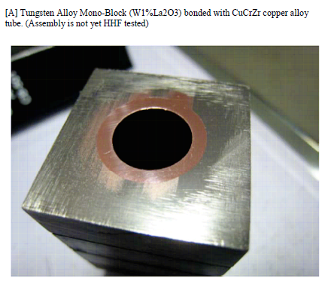
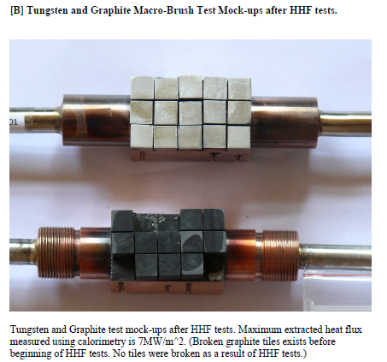
W-alloys are being developed with conventional and microwave sintering proc. Plan to test these with QSPA Kh-50 at Kharkov plasma accelerator for high heat flux tests

Slide 12
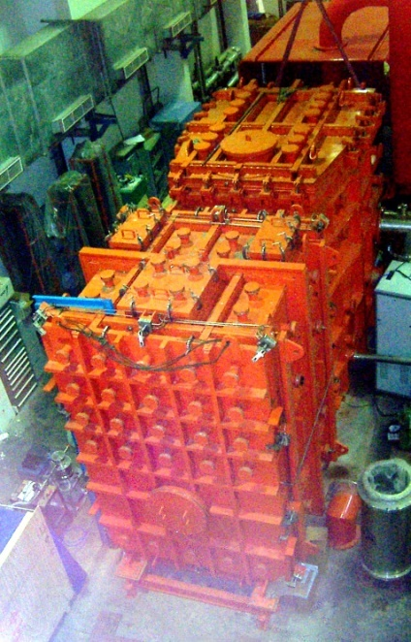
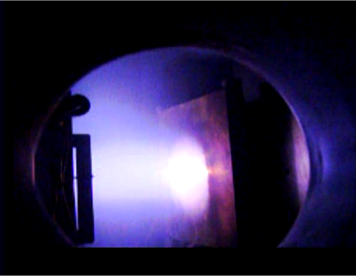
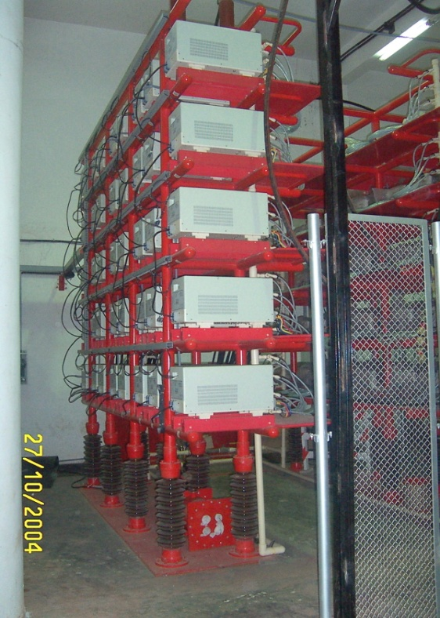
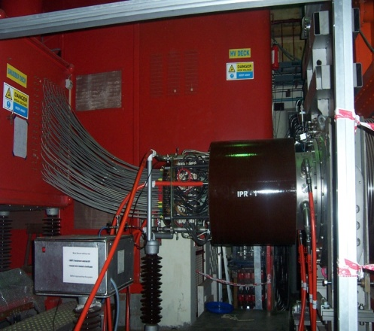
SST-1 NBI system
100kW beam intercepted by a beam dump
High voltage power supplies

Slide 13
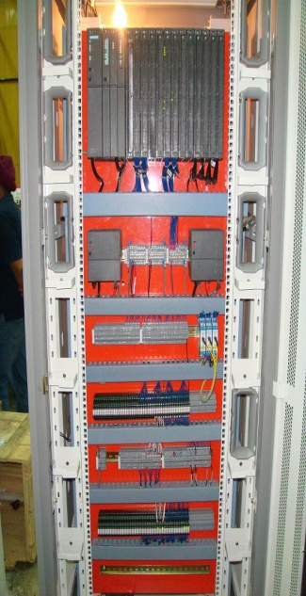
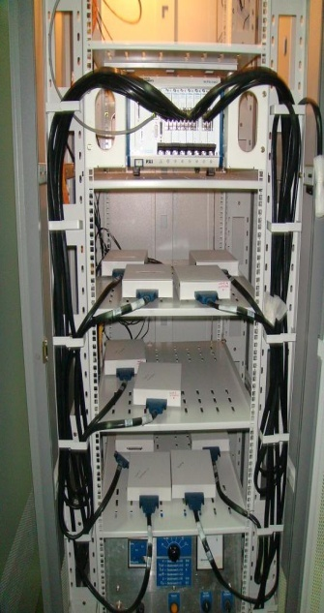
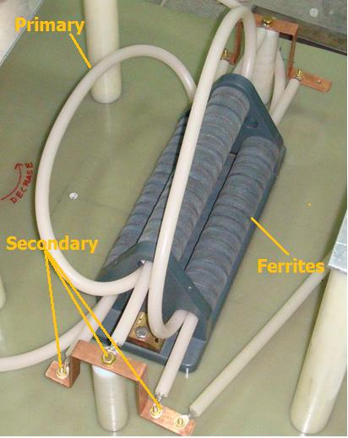
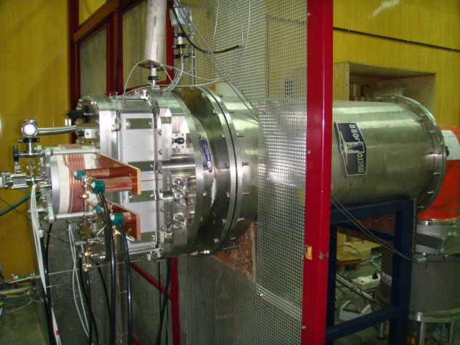
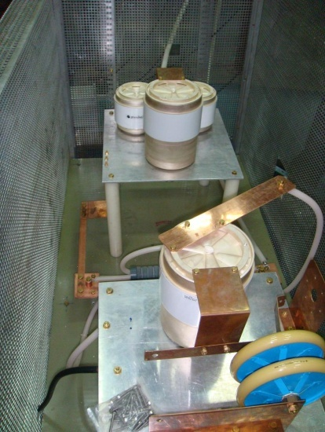
RF based –ve ion sources
S7-400 based PLC control system
PXI based data acquisition system
Matching circuit with 100kVDC isolated RF transformer
Integrated source in operation
With acknowledgements to collaboration with IPP Garching
View of RF matching circuit

Slide 14
Test Blanket Module R&D
Indian TBM team is developing both Liquid and Solid Breeder blanket concepts:
  Liquid Breeder type: Lead-Lithium Ceramic Breeder (LLCB) (To be tested in one half of ITER port no-2)
  Generic TBM Arrangement being developed
  TBM Safety Report being discussed with IO
  Solid Breeder type: Helium Cooled Solid Breeder (HCSB) (Sub-Module type testing planned in collaboration with other ITER partners)

Slide 15
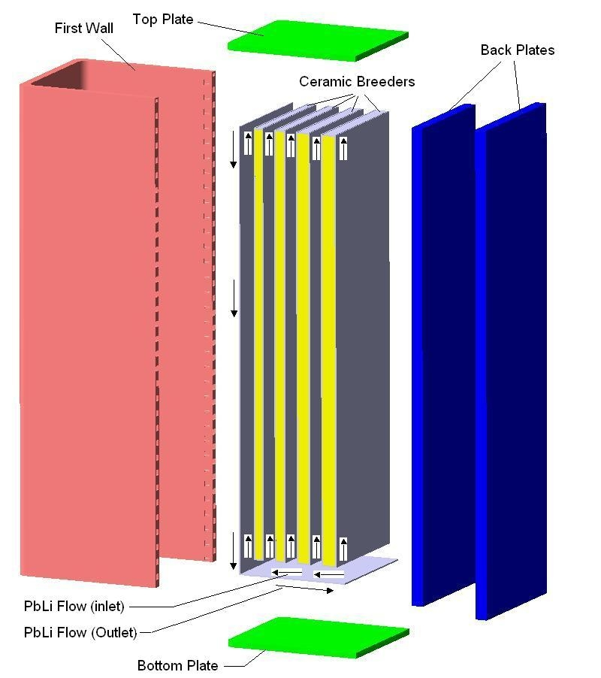
LLCB TBM Parameters
Structural Material | IN-RAFMS
Breeder | Pb-Li, Li₂TiO₃
Lithium Enrichment | 90 % in Pb-Li 60% in CB
Coolants | Helium & Pb-Li
Helium Inlet/Outlet Temp. | 300 – 400 C
Helium Pressure | 80 bar
Pb-Li Inlet/outlet Temp. | 325-450 C
T Purge gas | Helium/ 1.2 bar
1.66 m (h) x 0.484 m (w) x 0.57 m (t)
Notes:
15

Slide 16
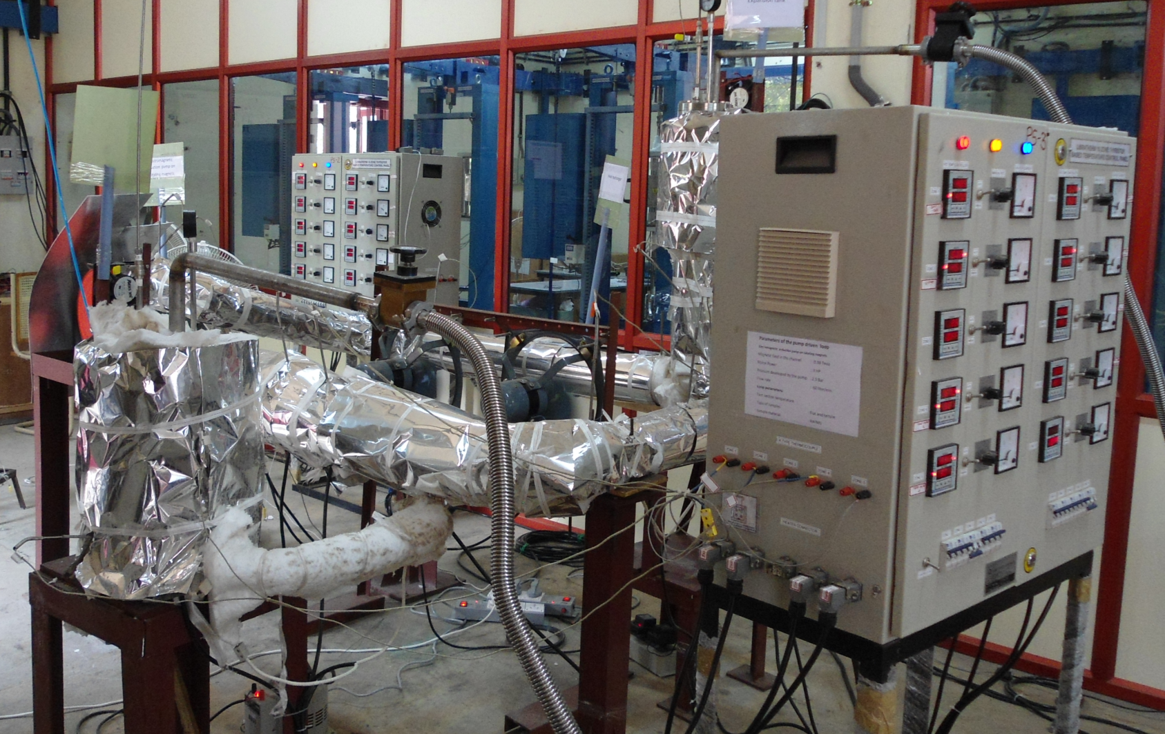
Pump driven Lead-Lithium loop at IPR
Notes:
16

Slide 17
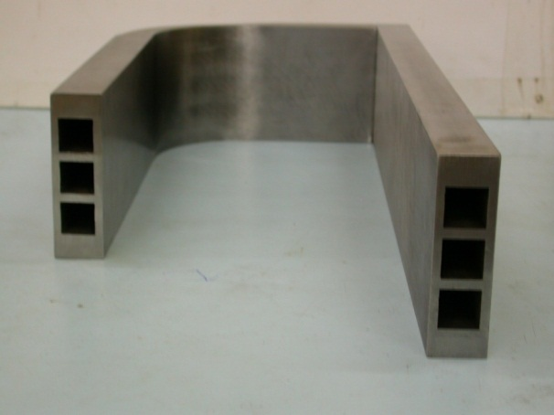
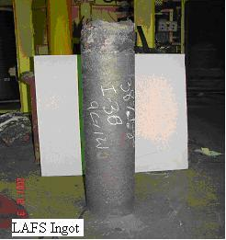
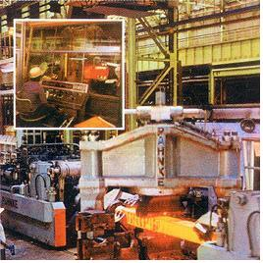
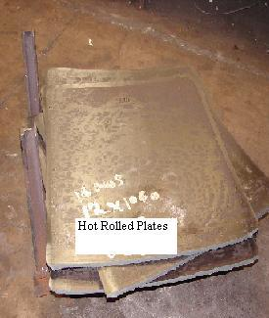
Indian-Reduced Activation Ferritic Martensitic Steel Development
3 nos. of 3 ton melts completed
Chemical Composition under control
RAFMS filler wire development completed
Plates (Straight as well as with L-Bend) with 500 mm Long Square Channels (trials)
IN-RAFMS INGOT
Forging of IN-RAFMS
IN-RAFMS Plates

Slide 18

A few words about ITER-India

Slide 19
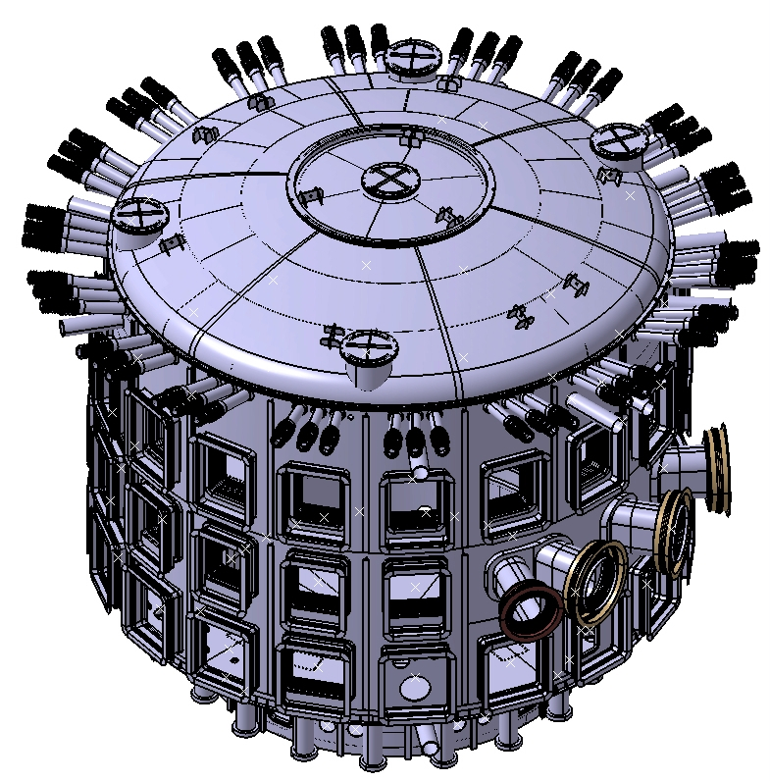
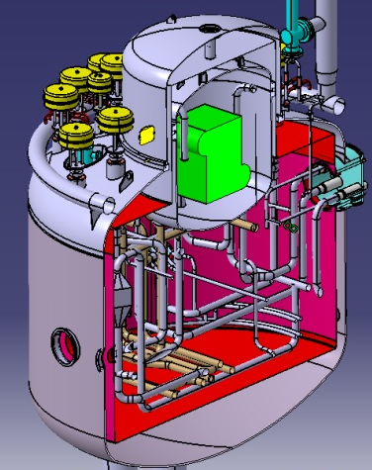
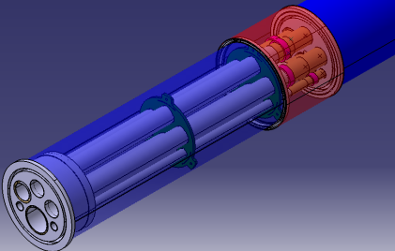
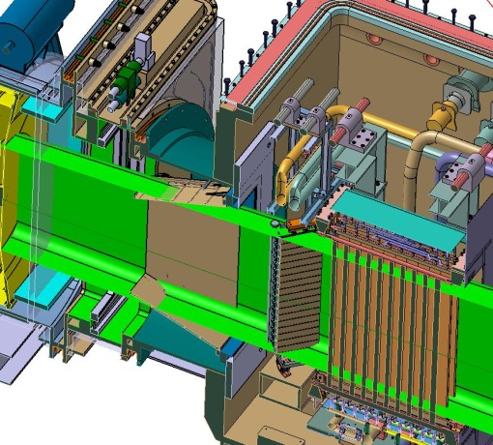
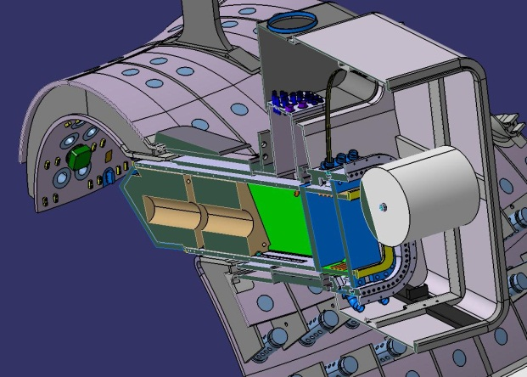
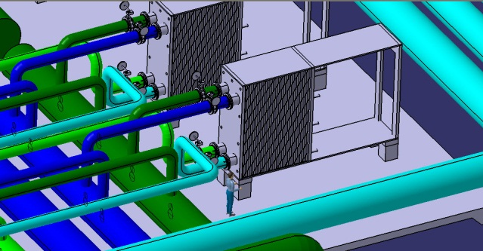
ITER-India Packages
4K He, Cryodistribution (~3.7 kg/s) & Cryolines~ 7 km
Cryostat: dia~30 m, SS-304, 5000 T
Other I-I Packages
In-Wall shield
ICRF Sources
ECRF Sources
Power Supplies
100 kV modulated Diagnostic Neutral Beam
Diagnostics & Port Plug
CWS: 18 no. of 70 MW Heat Exchangers

Slide 20
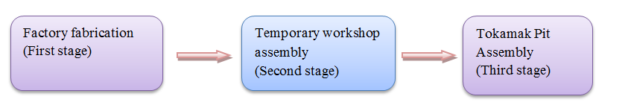
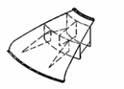
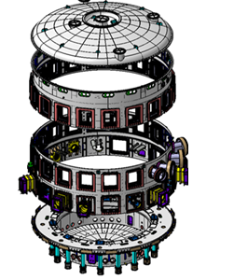
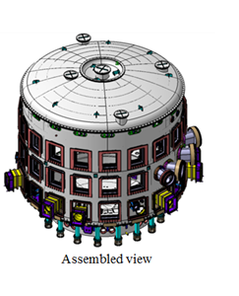

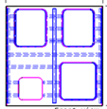

Manufacturing Plan Cryostat:
Fabricated in three main stages
s:
Main section assembly
Temporary workshop (France)
Cryostat
Pit assembly at France
40 ⁰segment
(Indian Factory)

Slide 21
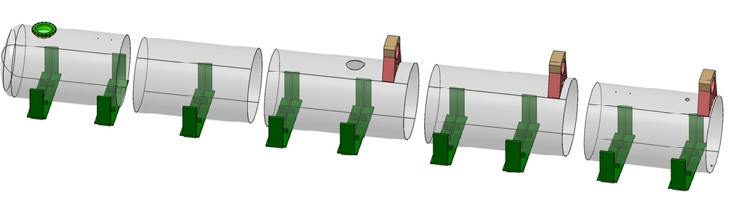
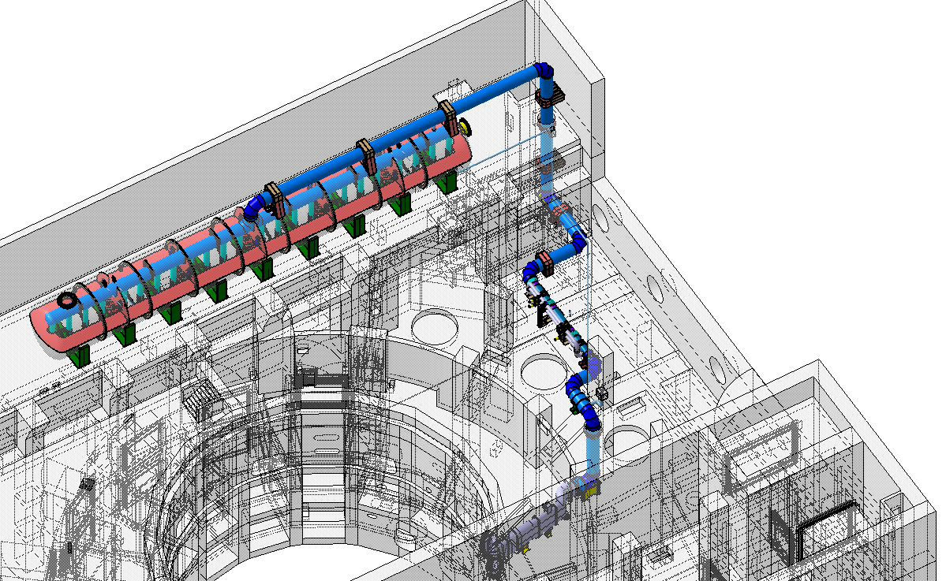
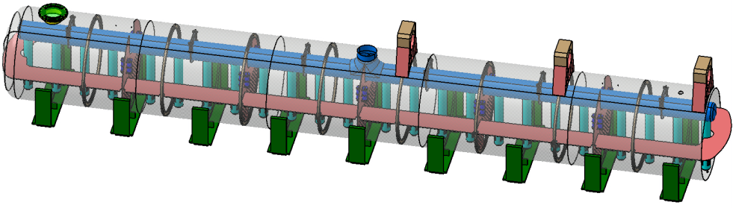
Manufacturing and Assembly VVPSS
Manufacturing Plan VVPSS
.
6 Segments shall be fabrication in India
Factory fabrication
Assembly in Tokamak hall
VVPSS and Tokamak building
Transferred to Tokamak building
Segments shall be assembled in Tokamak building

Slide 22
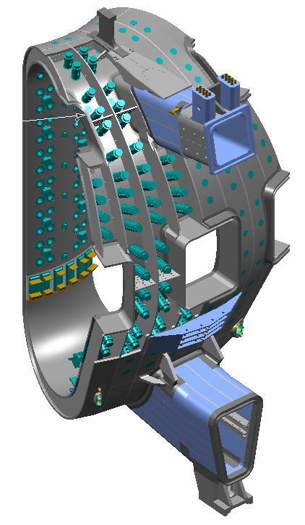
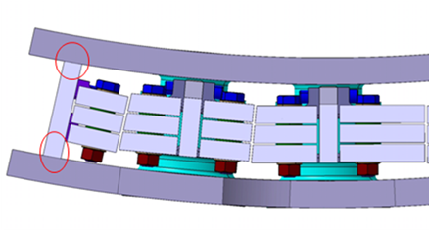
Vacuum Vessel: In-Wall Shielding Blocks
Space between the VV double wall is filled with materials (60 ~ 80% of volume);
  - borated steel for neutron shielding
  ferromagnetic steel
Total weight: 1733 ton, Total number of blocks: > 8000
IWS BLOCKS

Slide 23
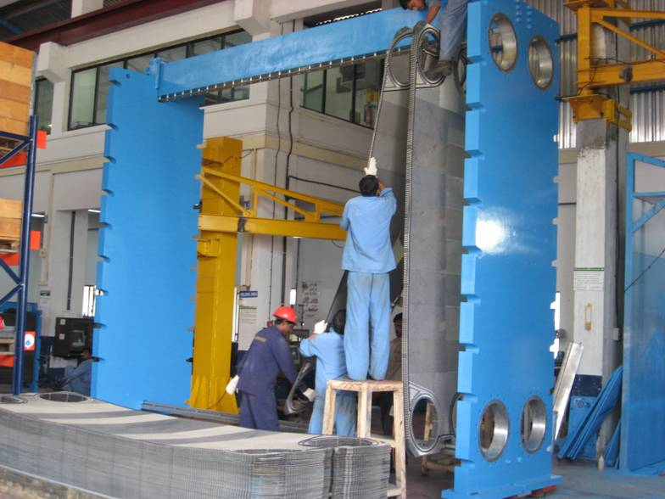
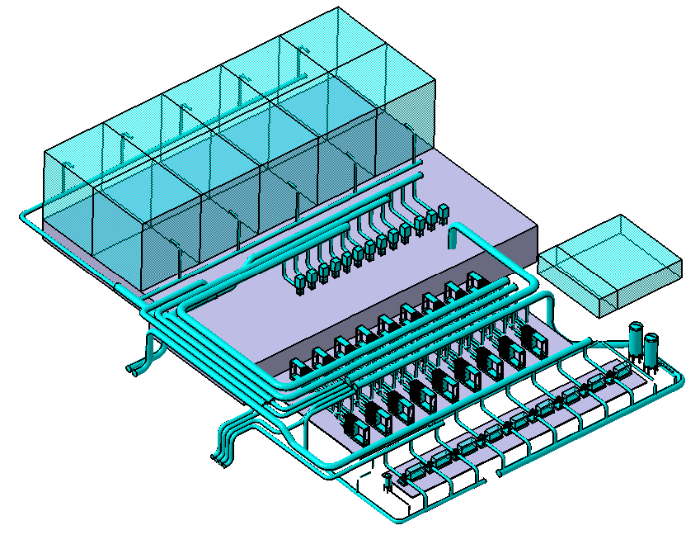
Cooling Water & Heat Rejection System
Plate type heat exchangers: An idea of present size

Slide 24
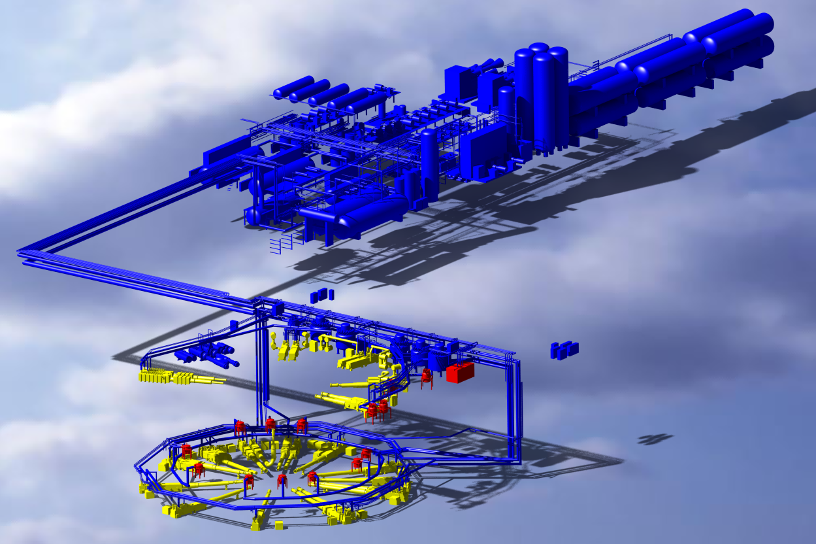
ITER Cryogenic System (Overall view).
India’s contribution (a) Cryolines, (b) Cryodistribution System
Cryoplant building
Cryoplant Infrastructure Area
Plant bridge
~ 4 km Cryolines
49 type of cryolines
~ 7 km warm lines
55 type warm lines
9 cryo-distribution boxes
ST
TF
PF
CS
Two main cryolines
CP ACB
Network of cryoline inside
Tokamak building

Slide 25
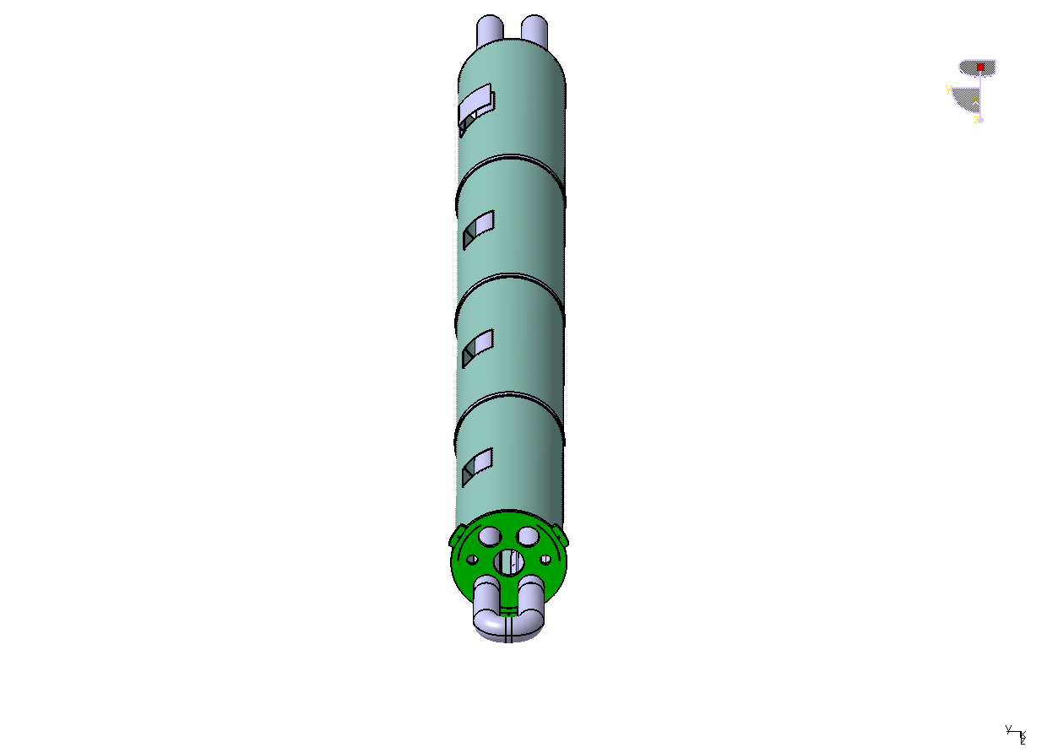
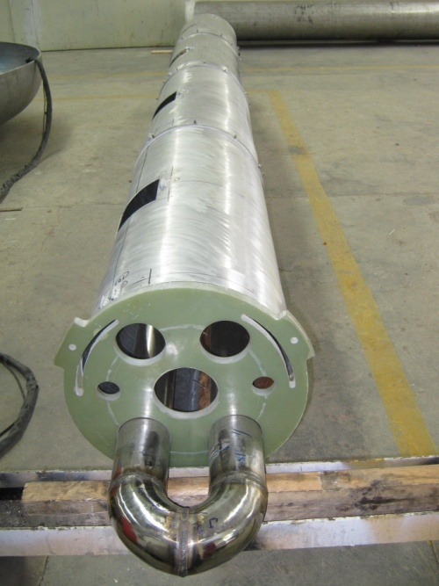
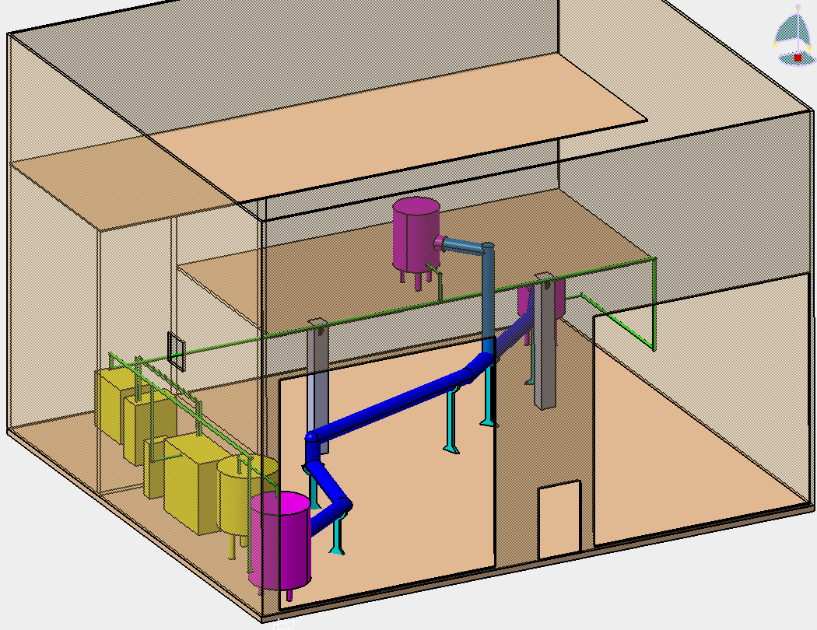
Cryolines:Technical Progress
Prototype inside lab with infrastructure for testing
Prototype thermal shield

Slide 26
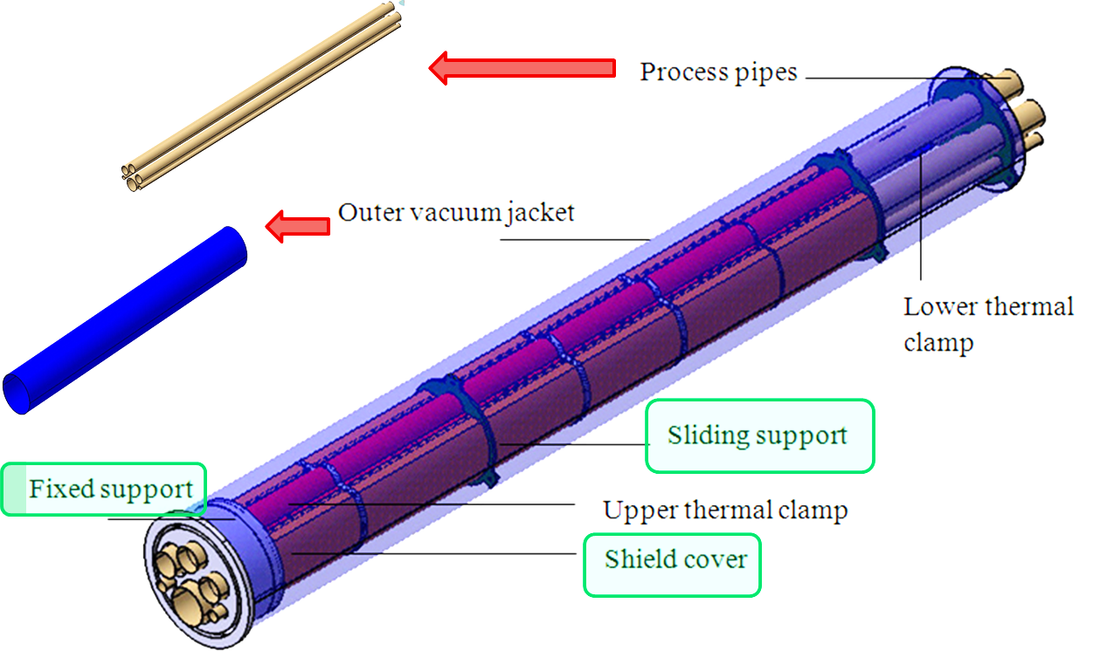
Cryolines: design

Slide 27


Auxiliary Cold Box: Design
LHe bath
6.5 m Height
Internal piping with LHe bath
6 m Diameter
Gross weight of one ACB is ~30 ton

Slide 28

Building and Layout-DNB
DNB Injector
HNB Injectors
(Under EU-JA procurement)

Slide 29

DNB Components & beam source specs
Ion species | H⁻
Energy | 100 keV
Beam current | 60 A
Pulse length | 3600 s, modulated at 5 Hz for 3 s every 20 s
Accelerated current density | 300 A/m²
Beamlet divergence (core) | <7 mrad

Slide 30




Planned R&D activities in the new Lab at IPR
Diag. Neutral Beam Facility
Gyrotron Test Facility
Cryoline Test Facility
Other systems to be tested
ICRF Source: Prototype for 2.5 MW
Power Supplies: for IC, EC and DNB
Diagnostics
IWS Blocks: desorption studies
ITER-India Lab. At IPR

Slide 32



ICRH Package
RF Source enclosure
Weight of one RF Source ~ 6 ton
Pre-driver Stage Amp.
Driver & Final
Stage Amp.
RF
Output
DAC
Phase Shifter
Dimension ~
3.4 X 9 X 5 m³
3dB Hybrid Coupler

Slide 33


ICRH Technical progress

Slide 34



ICRH Technical progress contd…
Mechanical analysis for 12” Tx-line initiated
Outer conductor
Material :- Al / ETP Cu
Inner conductor
Material :- ETP Cu
Support Disk
Material :- Teflon/
Ceramic/ Quartz
Inner conductor Joint
Material :- CuBe2Pb with Sliver plating
Three Layer of Contact finger

Slide 35
Sr. No. Signed Date Signed PA as on 6/9/2011 Value (kIUA)
1 19/04/2009 DNB Power Supply 9.700
2 24/9/2009 In-Wall Shielding 37.300
3 5/2/2010 ICRF Power Sources 18.000
4 22/03/2010 Cooling Water System 50.160
5 22/03/2010 DNB Beamline 13.100
6 10/6/2010 Torus & Cryostat Cryoline 3.600
7 15/12/2010 SPIDER and 100 KV PS 0.910
8 16/03/2011 ICHVPS Power Supply 6.900
9 6/9/2011 Cryostat 69.819
Total 209.489
Next due: Later Delivery Cryolines, Cryodistribution, Diagnostics

Slide 36
Fusion Research Plan Summary

Slide 37

















ADITYA
SST-1
Fusion R&D
Next Step
Machine
IFMIF/CTF
DEMO
Heating
SST-2
Magnet
ITER
Vessel

Slide 38
Thank you

