Slide 1
The LIFE approach capitalizes upon the multi-B$ investment in the NIF
Provides a huge collection of established technologies, operational experience, and vendor relationships; this represents a very large effort over more than a decade
Other approaches may ultimately work but potential advantages are insufficient to justify delaying a program by a decade or more and adding several B$ while we wait for them to be investigated
Many ideas may be put forth to enhance the performance of the driver, the target or the chamber, but they must provide:
  An integrated story that does not invoke miracles
  Timely delivery
  Simplicity & robustness of design for high availability

Slide 2
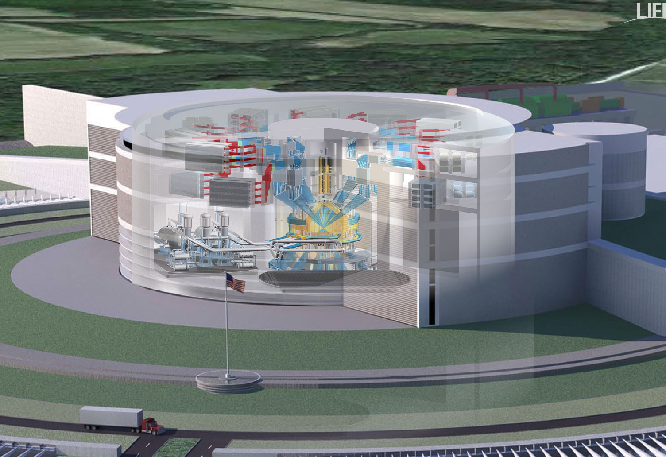
LIFE delivery requires integration of physics, technology, licensing and operational considerations
Full-scale demonstration
of LIFE targets on the NIF
Maximum use of existing vendors and technologies
Performance-based, simplified licensing under 10 CFR 70
Optimization at the power plant level
Laser technologies that enable high-efficiency and plug –n- play philosophy
Extension of line replaceable unit (LRU) philosophy to the chamber

Slide 3
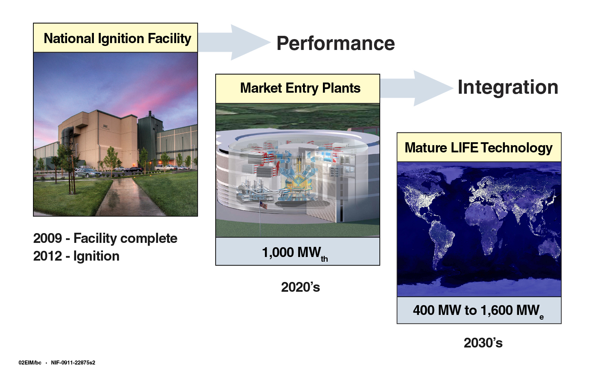
Fusion energy – soon enough to make a difference

Slide 5
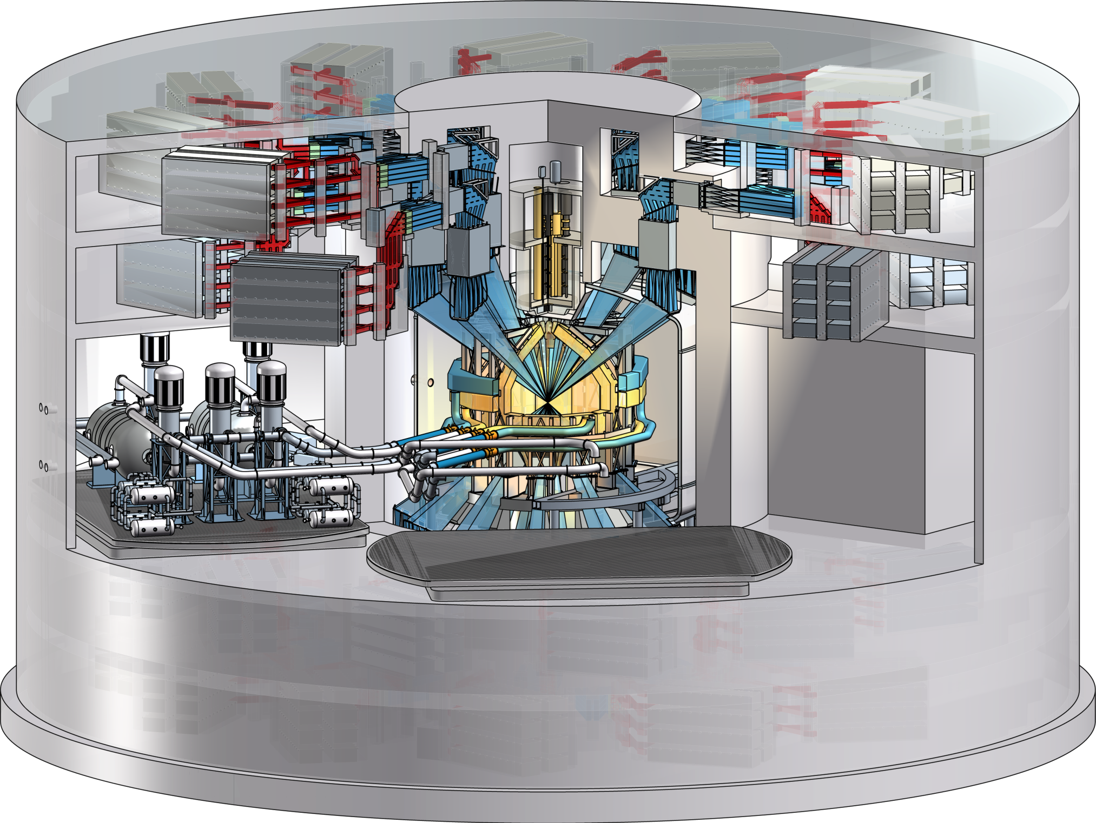
LIFE makes maximum use of available technologies, industrial capabilities and simplicity in design
Gas-protected first wall enables use of reduced activation ferritic martensitic (RAFM) steels
Target material selection minimizes need for chamber clearing
Chamber designed to be modular and easily replaceable
Coolant selection and large chamber coverage provide ample tritium breeding margin and high blanket gain
Commercially available power cycle provides high (and improving) efficiency
Coolant selection greatly reduces tritium permeation and reduces site inventory
Radiation-tested final optic solution is available

Slide 6
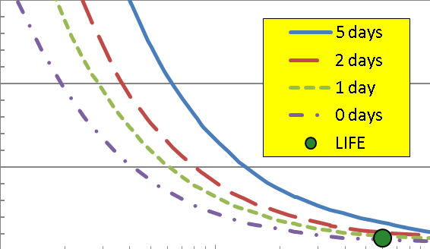
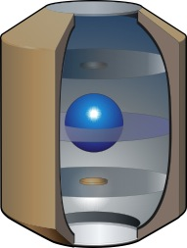
LIFE tritium systems are compact and able to maintain the site inventory at ~ 500 grams
High burnup results in a low TBR requirement (Abdou 1986)
More than 50% of the plant’s T inventory resides in the target factory
1.3
1.2
Required TBR
1.1
1.0
0.5%
5.0%
50.0%
Burnup
LIFE targets each contain
only ~ 0.7 mg of tritium
Compact system for T recovery from lithium demonstrated by Maroni in 1974
Tritium throughput is ~ 1 kg/day
300 g/day is burned
300-400 g/day can be bred in the blanket
A new plant can be supplied with T inventory every week
Blanket
Li
Electrolytic Salt Processing Tank
Separator
Mixer
Li + LiT
H/X
Salt
To secondary
From secondary

Slide 7
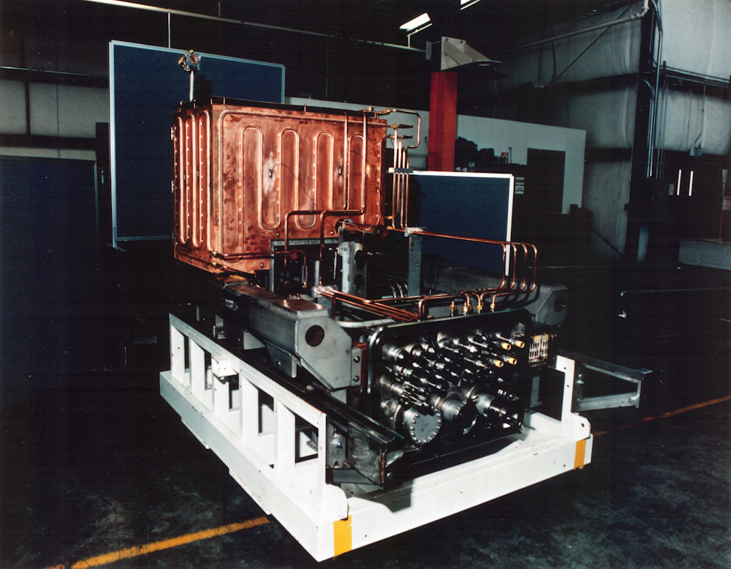
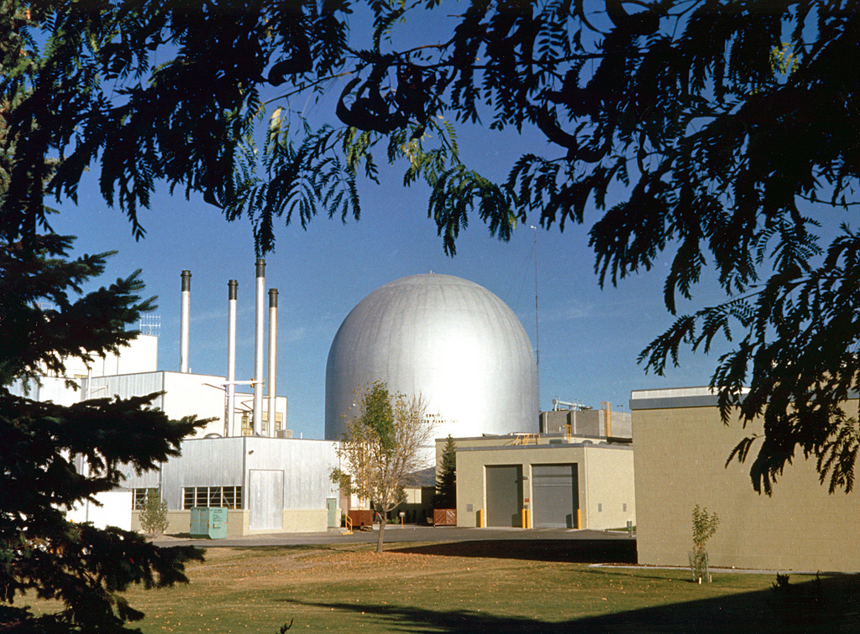
Controls associated with handling of lithium are quite similar to those for uranium and sodium
LLNL has multi-decade experience in
liquid metal technology from Atomic Vapor Laser Isotope Separation Program
EBR-II sodium-cooled reactor operated for 30 years at Idaho National Laboratory
Photo: Plant scale uranium metal evaporator. Systems of this type were operated at metric ton levels of throughput. Program spanned roughly two decades.
Generated over two billion kW-hr of electricity
Sodium-to-steam generator performance was
exceptional.

Slide 8
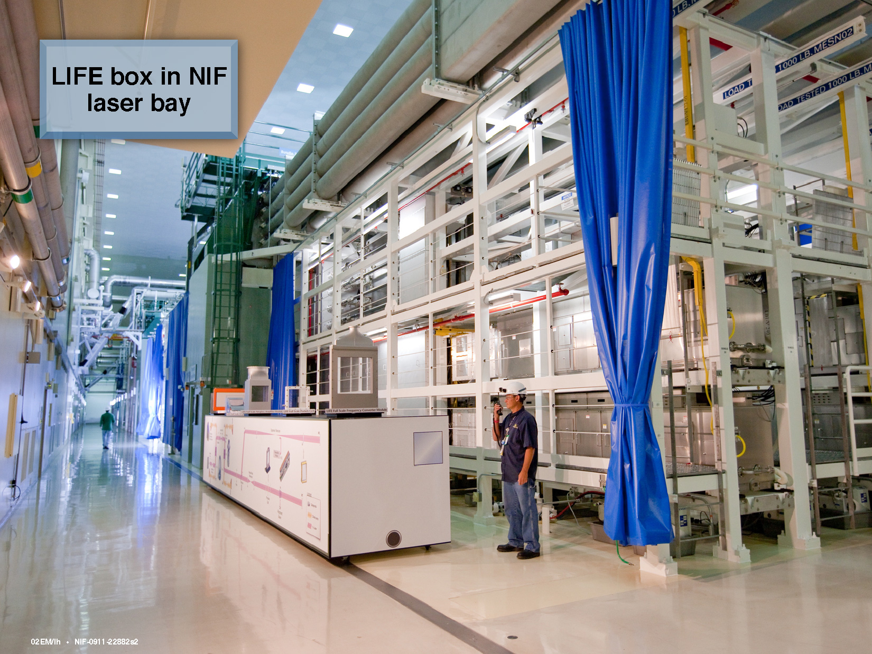
LIFE Box in NIF Laser Bay

Slide 9
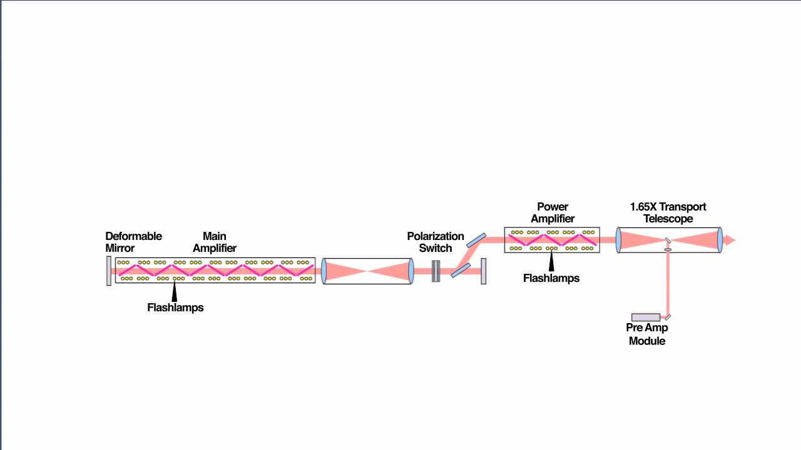
The evolution of NIF architecture to LIFE

Slide 10
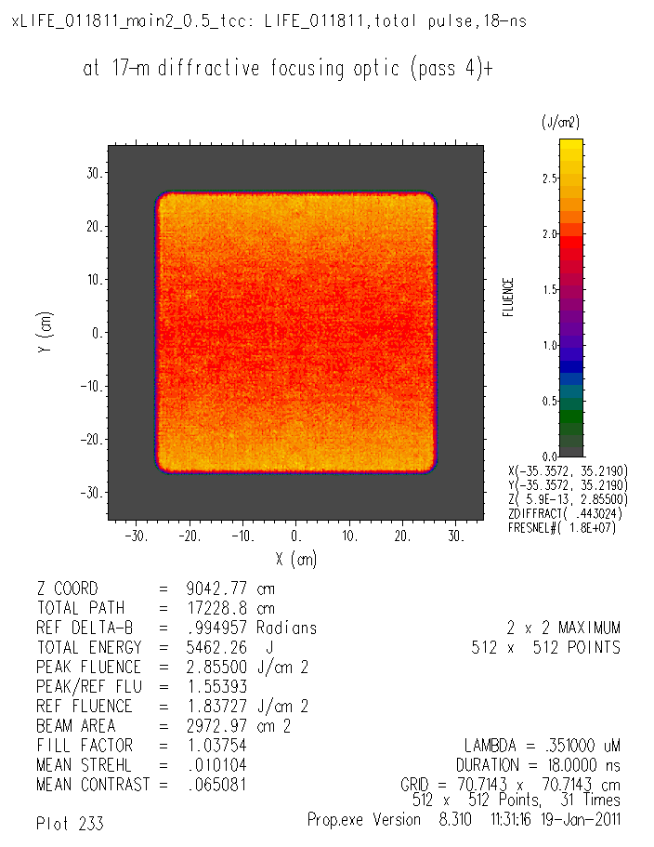
Detailed propagation simulation (based on measured NIF optics aberrations) shows excellent performance
Beam contrast at the final Fresnel optic is excellent.
Focal spot at hohlraum
clears the laser entrance hole
30
20
10
0
-10
-20
-30
Fluence
(J/cm²)
2.5
2.0
1.5
1.0
0.5
0.0
Y (cm)
-30 -20 -10 0 10 20 30
X (cm)
Energy = 5462 J
Mean fluence = 1.55 J/cm²
Contrast = 6.5%
Outer illumination cone is shown, with allowances for pointing and plasma closure.
3ω fluence reduced by 2X to add margin for high average power

Slide 11
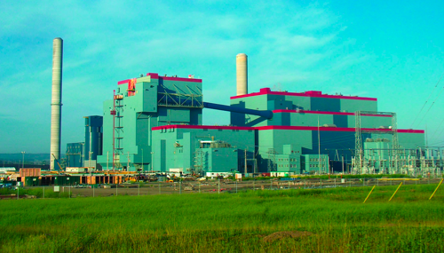










LIFE will use existing ultra-supercritical steam turbine technologies
There are nearly 400 power plants using supercritical steam technology; available today: 600-620°C, 45-47%
AD700/COMTES700 projects aim to demonstrate ultra-supercritical technology at 700-720°C, 52-55%
Industry leaders are saying 50%+, as early as 2014
  LIFE design utilizes 44% for 570°C
Industry is already developing and building high-efficiency Rankine cycles
Genesee Phase 3, Canada’s first supercritical steam plant. Completed 2005.

