Slide 1

Update on NNSA’s
Inertial Confinement Fusion Program
Presented to:
Fusion Power Associates
32nd Annual Meeting and Symposium
Washington, DC
Presented by:
Kirk Levedahl, PhD
National Ignition Campaign Program Manager
December 15, 2011

Slide 2
The goal of the NNSA ICF program is to maintain excellence in HED science in support of US national security policies.
Ignition is a key element (see talks by E. Moses and S. Koonin)
  Grand challenge goal that maintains excitement, attracts the best people, and stimulates scientific advances
  Direct application to stockpile stewardship if successful
  Energy is not an NNSA mission
Non-ignition weapons physics experiments support stockpile stewardship
Open Science experiments
Other National Security Users

Slide 3
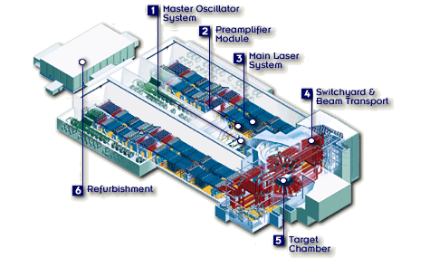
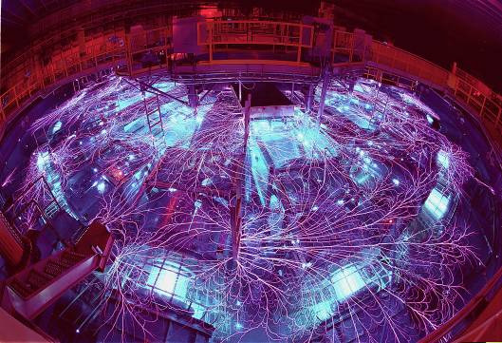
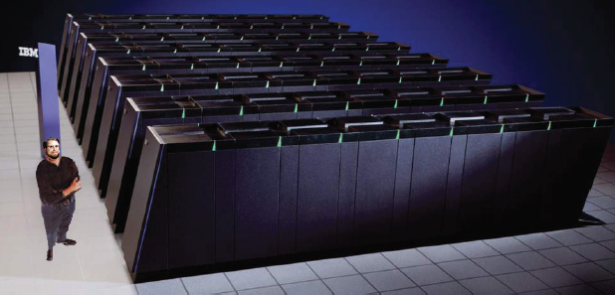
In support of its mission NNSA operates key HED facilities
National Ignition Facility (NIF)
  Only access to burning plasma conditions
  Important mission experiments have already been performed
Omega EP
  Sophisticated high irradiance capabilities
  Important venue for advanced fusion
  research
Z Machine
  Key venue for materials science
  measurements
  outstanding new results at 4 Mbar.
Codes and platforms are key to understanding HED physics
Notes:
Pictorially represents correlative development – computational and experimental– a lot of productivity and sharing this with the broader scientific world- certainly good for the nation.
NNSA manages Many other facilities such as DARHT, JASPER
but this is cast for the HED drama
For balance start with some of the non-ignition agenda

Slide 4
ICF experiments, including ignition, are key elements of the NNSA plan to advance nuclear weapons assessment and certification
Notes:
This “Predictive Capability Framework” chart provides a high level view of the major activities that are required to maintain the safety, security and reliability of the stockpile
The Nuclear Explosive Package Assessment schedule of work is the central element in continually affirming the reliability of the stockpile

Slide 5
Near Term ICF Program Goals
National Ignition Campaign FY2012 goals:
Alpha-heating Q2
Ignition (gain =1) Q3
Robust ignition platform Q4
Transition NIF to user facility and end NIC Q4
Develop plan for Polar Direct Drive
Develop Strategic Plan for FY 2013-2017
Marks end of period of facility building and commissioning.
Uses of Ignition and non-ignition capabilities
Role of intermediate facilities
Advanced ignition and alternative approaches to ignition
Building a broader HED science community for national security needs

Slide 6
Whither Ignition Planning?
SEWD Subcommittee Report for FY 2012 Appropriations requires that by Nov 2012 NNSA provide a report including:
Scientific and Technical Barriers to Ignition
Revised Schedule and Path (“plan B”)
Impact on Stockpile Stewardship
S. Koonin review recommends that we begin to consider plan “B.”
NNSA will develop a plan with “national” input and review.

Slide 7
Recent experimental successes demonstrate the ICF program is supporting NNSA’s HED Science goals

Slide 8
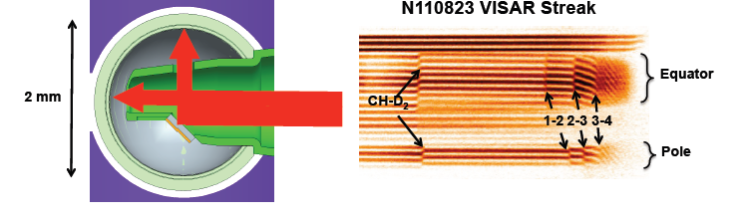
NIF experimental diagnostics provide ground-breaking results
Two axis velocimetery allows simultaneous measurements of pole and waist shocks on NIF capsules
Shock timing measurements so accurate and reproducible that these experiments are now used as a “standard candle” for laser performance.

Slide 9
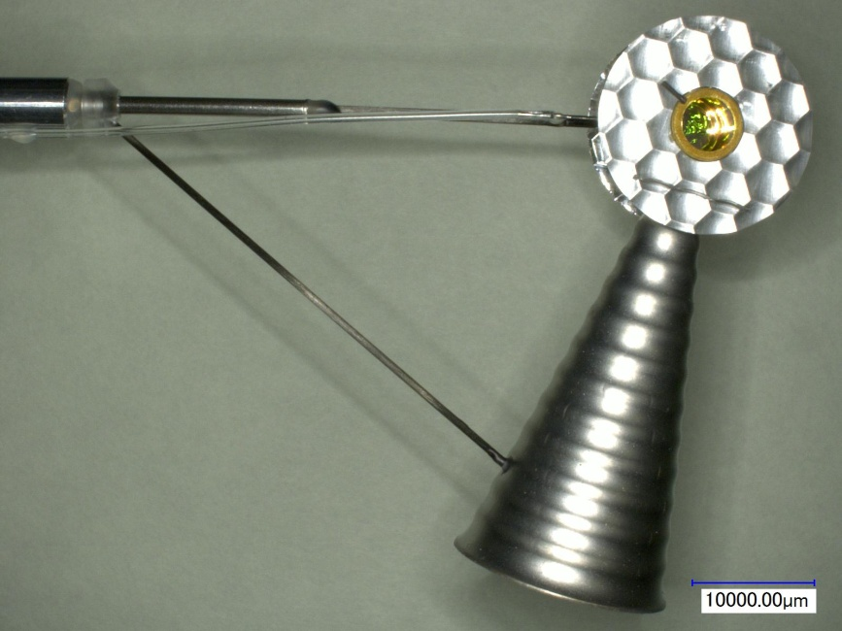
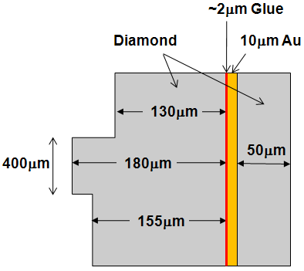
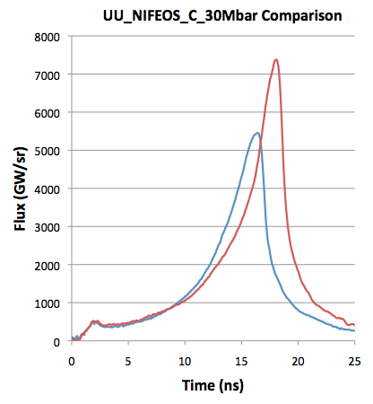
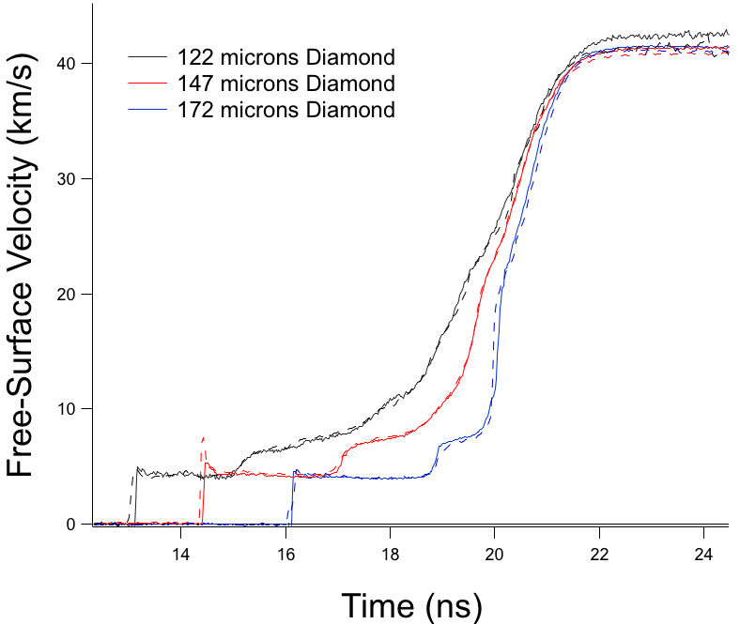
NIF has recently compressed carbon to 50 Million atmospheres pressure
Gas-filled, room-temperature, stepped target mounted on side of Hohlraum with VISAR cone.
122µm
172µm
147µm
<= flux history for 2 NIF
Diamond ramp experiments. 1st experiment (blue) shocked up due to physics understanding. Models and pulse shape were adjusted, NIF delivered ~ exactly what was asked for=>Diamond was ramp compressed to 25-30 Mbar
2nd shot
1st shot
Raymond Jeanloz UCB, Tom Duffy Princeton, Ray Smith, Jon Eggert, Peter Celliers, Matt Cowan, Gilbert Collins

Slide 10
Z provided high accuracy EOS measurements on
Diamond and Be validating DFT EOS predictions.
Stress versus density for diamond
Measurements on Z have an
accuracy of ≤ 1%
QMD predicted
region of melt

Slide 11
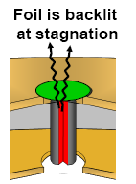
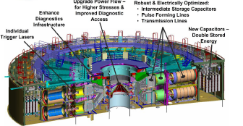
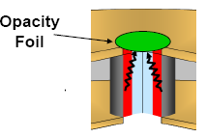
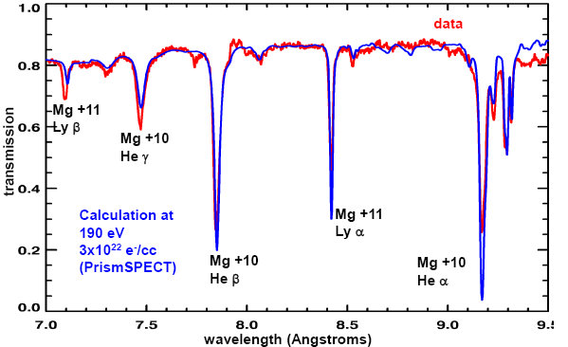
The Z Machine has opacity data has illuminated issues in astrophysics
Recent Z experiments
reach the
temperature
at the solar convection
zone boundary

Slide 12
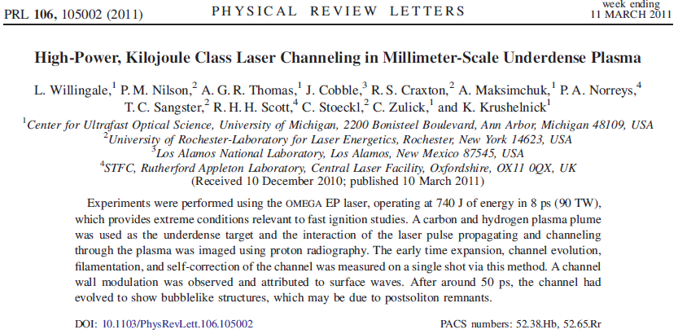
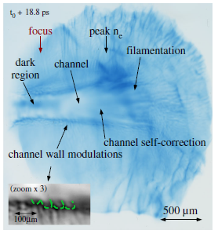
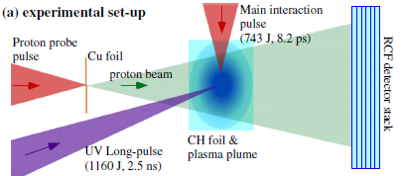
An OMEGA EP experiment illustrates laser filamentation

Slide 13
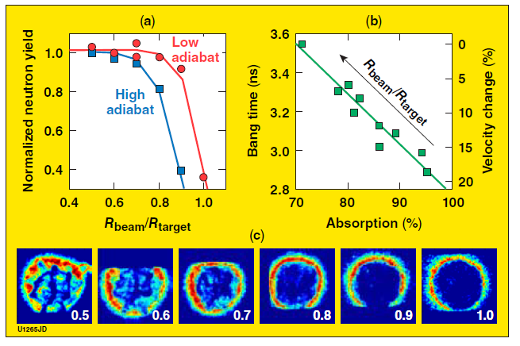
LLE experiments show effect of spot size on cross beam energy transfer and target coupling

Slide 14
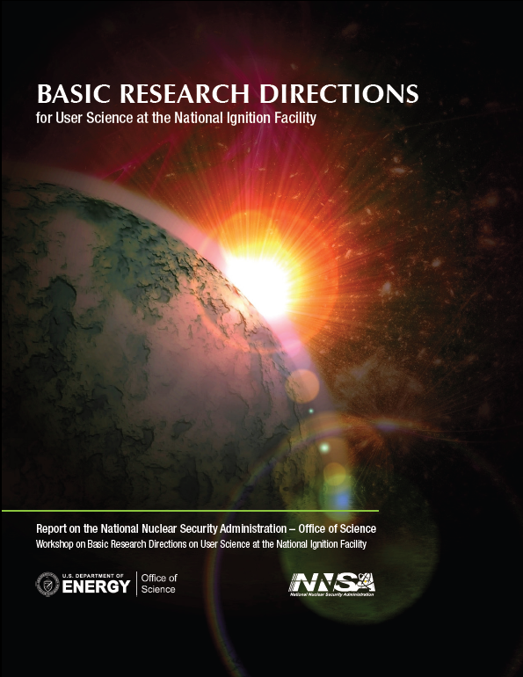
NNSA / Office of Science Collaboration in HED
Science will make NNSA facilities available to basic science users.
Workshop Report on Basic Research Directions at the National Ignition Facility
Joint High Energy Density Laboratory Physics Program – 180+ proposals received for evaluation

Slide 15
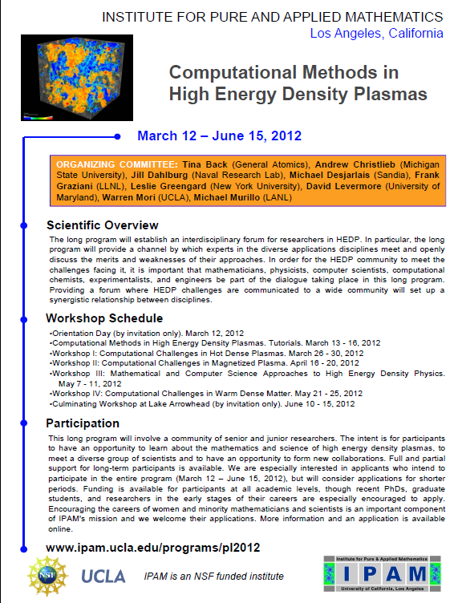
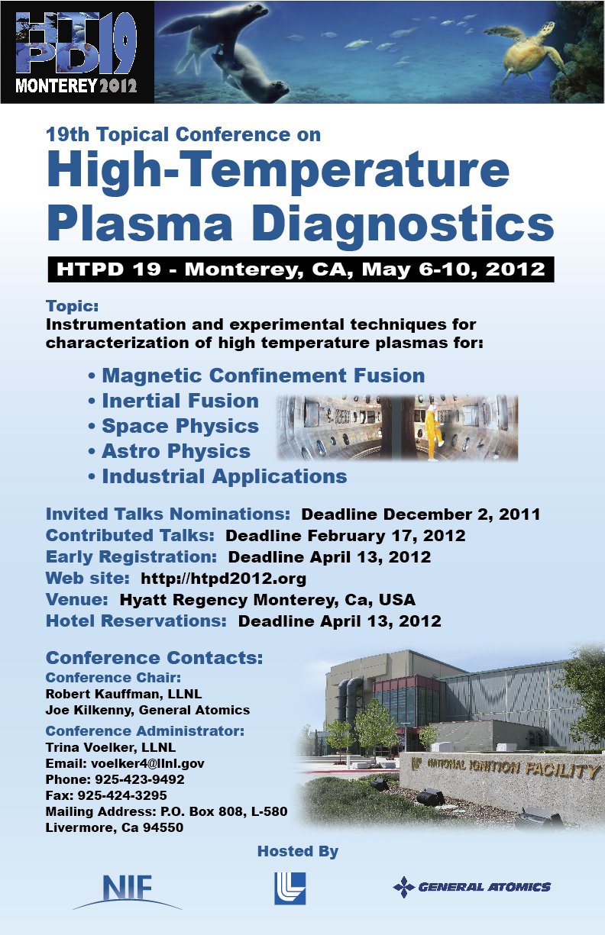
Community activities demonstrate that HED is a thriving community

Slide 16
Summary
NNSA supports ICF facilities and programs to further its stockpile stewardship and national security missions.
With the completion of a number of facilities and upgrades (NIF, Omega EP, Z-R) we have entered an exciting and productive period of experimentation.
Ignition remains a challenge and an opportunity
NNSA is focused on the strategy and program planning for the next decade to make best scientific use of these facilities in support of NNSA and DOE missions.

