Slide 1

S a n d i a N a t i o n a l L a b o r a t o r i e s
December 15, 2011
HEDLP Fundamental Science on the Z Facility
Keith Matzen
Sandia National Laboratories

Slide 2
Key astrophysics questions can be addressed with laboratory z-pinch experiments
Why did models for Cepheid variable pulsation disagree with observations?
Why do modern solar models disagree with measurements?
Did the giant planets form by accretion onto a solid massive core?
Do photoionized plasma observations carry information about matter in the strong field limit of general relativity?
How do astrophysical jets form and evolve?
How does radiation influence astrophysical shocks?
The foundation for significant advances has been established. We are poised to capitalize on the investment.

Slide 3
We have established a fundamental science program on Z and have allocated time to outside users
External committee chaired by A. Wootton performed peer review
1 proposal received 8 days in CY2011
3 proposals were awarded 20 shot days in calendar year 2012
3 proposals were also awarded ride along time
Proposals address exciting scientific issues:
  Do we understand the structure of the sun?
  Can we use white dwarfs as cosmic chronometers?
  How does the accretion disk around a black-hole behave?
  What is the structure of the planets in our solar system (and beyond)?
  How did the Earth and the Moon form?
Earth formation
Harvard
Photo-ionized plasma
UNR, LLNL
Solar/White Dwarf Opacities
SNL, U. Texas Austin
Planetary structure
U. Rostok, SNL

Slide 4
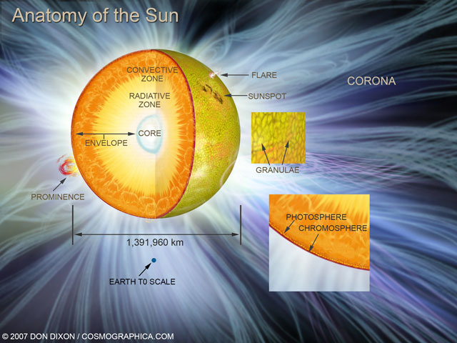
Laboratory opacity measurements at stellar interior temperatures are possible for the first time
Predictions of solar structure do not agree with observations
Solar structure depends on opacities that have never been measured
Z experiments measure opacities at solar interior temperatures for the first time
(T= 1,700,000 ºK)
convective
zone
radiative
zone
core
Fe + Mg transmission
1.0
Mg XI
0.8
transmission
2007 Don Dixon / cosmographica.com
0.6
0.4
0.2
Fe XVI-XX
0.0
7.0
8.0
9.0
10.0
11.0
12.0
13.0
14.0
15.0
λ (Angstroms)

Slide 5
We have established a fundamental science program on Z and have allocated time to outside users
All proposals are part of collaboration with Sandia and there is significant involvement by SNL experimentalists and theorists
Annual meeting to discuss fundamental science work on Z
  typically late July

