Slide 1
Fast Ignition
Inertial Confinement Fusion
Pravesh Patel
Associate Program Leader for Fast Ignition
Fusion Power Associates
32nd Annual Meeting and Symposium
Washington D.C.
December 14-15, 2011

Slide 2
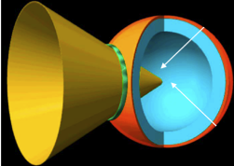
Fast Ignition is an ICF scheme that has the potential for high gain by decoupling fuel compression and heating
Conventional implosion compresses DT fuel:
ρ ~ 300 g/cm³
ρR ~ 2 g/cm²
Large fuel mass can be compressed with low velocity, low convergence implosion ⇒ high gain (>100)
Intense laser-generated electron beam rapidly heats core to 10 keV:
E_{ign} ~ 10 kJ
P ~ 0.5 PW
I ~ 10²⁰ W/cm²
The new challenge FI introduces is to create the required electron flux and couple it efficiently to the dense core to achieve ignition

Slide 3


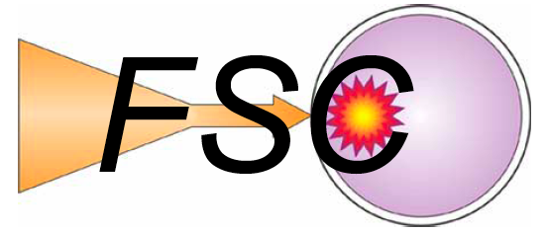








There is a large active research community studying Fast Ignition HED Science – at national & international level
Electron FI
University of Rochester
General Atomics
UCLA
MIT
UCSD
Ohio State University
University of Nevada
University of Texas
ILSA
LLNL
HEDLP
Ion/Proton FI
This work is supported by the OFES-NNSA Joint Program in High-Energy-Density Laboratory Plasmas
Notes:
FI challenge has generated research interest across universities and national labs across the world.
In the last couple of years we have seen a new level of co-ordination at national and international levels

Slide 4
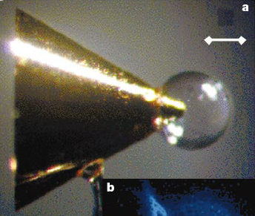
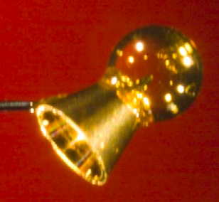
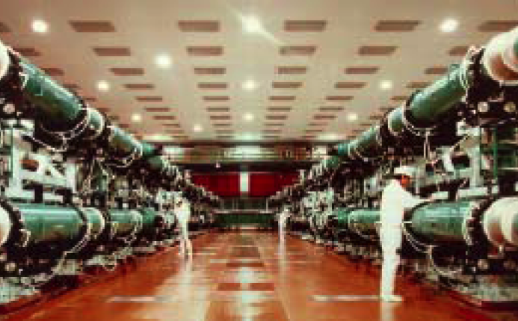
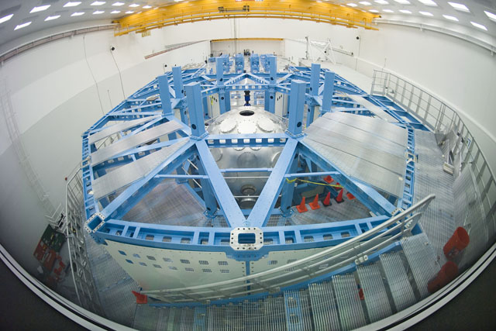
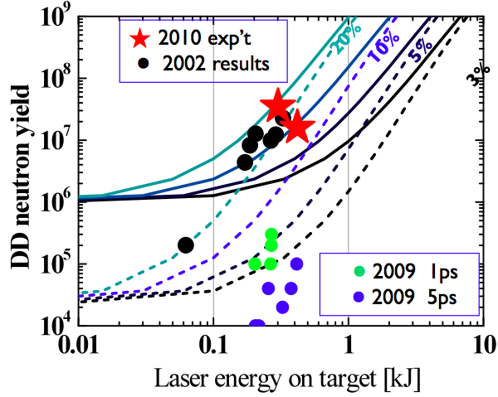
Two major facilities are performing integrated core heating experiments to test FI physics, at ~0.01 to 0.1 ignition scale
Gekko XII laser facility, Japan
OMEGA laser facility, US
2.5 kJ 9 beam compression + 400 J heating
Demonstrated core heating of ρR≈<0.1 g/cm² core
20 kJ 48 beam compression + 1 kJ heating
Demonstrated core heating of ρR≈0.3 g/cm² core
Kodama et al. (2003)
Theobald et al. (2011)

Slide 5
We are able to leverage newly emerging laser facilities to test all of the key physics of fast ignition
100kJ
10kJ
1kJ
Short Pulse Energy
Vulcan PW
TITAN
Pre-2009
LULI 2000
Gekko XII
Texas
Trident
100J
Vulcan TAW
Helen
LULI 100TW
10J
10J
100J
1kJ
10kJ
100kJ
1MJ
10MJ
Long Pulse Energy

Slide 6
We are able to leverage newly emerging laser facilities to test all of the key physics of fast ignition
High Gain FI
100kJ
10kJ
1kJ
Short Pulse Energy
Vulcan PW
TITAN
Pre-2009
LULI 2000
Gekko XII
Texas
Trident
100J
Vulcan TAW
Helen
LULI 100TW
10J
10J
100J
1kJ
10kJ
100kJ
1MJ
10MJ
Long Pulse Energy

Slide 7
We are able to leverage newly emerging laser facilities to test all of the key physics of fast ignition
High Gain FI
100kJ
10kJ
OMEGA EP
2009+
1kJ
Short Pulse Energy
Vulcan PW
TITAN
Pre-2009
LULI 2000
Gekko XII
Texas
Trident
100J
Vulcan TAW
Helen
LULI 100TW
10J
10J
100J
1kJ
10kJ
100kJ
1MJ
10MJ
Long Pulse Energy

Slide 8
We are able to leverage newly emerging laser facilities to test all of the key physics of fast ignition
High Gain FI
100kJ
Gekko+LFEX (2012)
NIF+ARC (2012)
10kJ
LMJ+PETAL (2015)
OMEGA EP
2009+
1kJ
Short Pulse Energy
ORION (2012)
Vulcan PW
TITAN
Pre-2009
LULI 2000
Gekko XII
Texas
Trident
100J
Vulcan TAW
Helen
LULI 100TW
10J
10J
100J
1kJ
10kJ
100kJ
1MJ
10MJ
Long Pulse Energy
To establish the feasibility and energy requirements for FI we need an integrated target design, or point design, at high gain

Slide 9
Integrated modeling of FI is challenging due to the multi-scale physics inherent in short & long-pulse interactions
We began a program to develop a predictive integrated simulation capability for FI (intense laser interaction with HED plasma)

Slide 10
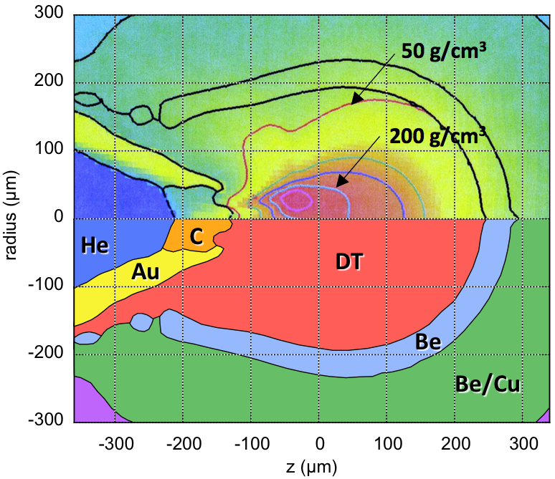
We have designed NIF-compatible cone-in-shell implosions that if ignited can release 150 MJ fusion yield
1.4 MJ laser drive
Yield =150 MJ
Gain ~100 (without ignitor energy)

Slide 11
To model the ignitor pulse we have performed 3D PIC simulations of a 1.3 PW pulse at full spatial scale
PSC-hybrid† simulation of ignition pulse
Fast electron source distribution
n_{e}/n_{c}
Laser
3D cartesian simulation (60 kcpu-hrs)
1.4x10²⁰ W/cm², 40 µm spot, 1 ps
Parameterized as functions of energy, angle, radius, time – dN/d(E, θ, r, t)
Electron flux 50-75% – higher than previously assumed
Mean energy (1.4x theory), divergence (35-50˚) – higher than assumed
†B.I. Cohen et al., J. Comp. Phys. 229, 4591 (2010); A.J. Kemp et al., Phys. Plas. 17, 056702 (2010)

Slide 12
The PIC source is injected into integrated simulations of fast electron transport, heating, and burn
full yield (64 MJ)
Artificially collimated (Δθ=10˚)
PIC-source (Δθ=90˚)
Predicted electron divergence is the most crucial parameter
— is it right?
— can we use new target designs to improve coupling?

Slide 13
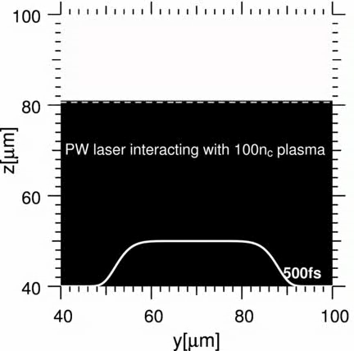
Understanding the properties of laser absorption, electron generation and transport is our fundamental challenge
Simulations of laser-matter interaction at FI-scale test the limits of current computational capabilities
Electron generation & transport are highly coupled processes
Independent code predictions do not presently agree
Experimental validation is absolutely critical
In 2D we can now run full spatial scale simulations to >5 ps (300 kcpu-hrs, 1-wk on 2000 cpus)

Slide 14
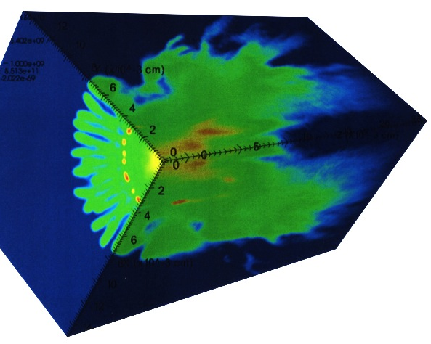
Understanding the properties of laser absorption, electron generation and transport is our fundamental challenge
PSC-Hybrid
ZUMA+HYDRA
Simulations of laser-matter interaction at FI-scale test the limits of current computational capabilities
Laser
Electrons
Electrons
Electron generation & transport are highly coupled processes
Independent code predictions do not presently agree
Giga-Ampere current flowing into dense plasma induces response through return current, electric, magnetic fields
We are developing a self-consistent framework
Experimental validation is absolutely critical

Slide 15
Understanding the properties of laser absorption, electron generation and transport is our fundamental challenge
Simulations of laser-matter interaction at FI-scale test the limits of current computational capabilities
Kemp, Strozzi (LLNL)
Chrisman (UNR)
Electron generation & transport are highly coupled processes
Independent code predictions do not presently agree
Debayle (U. Madrid)
Fiuza (IST, Portugal/UCLA)
Experimental validation is absolutely critical
We initiated code comparison workshops (2009, 2010 at LLNL) bringing together >30 FI modelers across US, Europe, and Japan
Helped to reveal and assess uncertainties

Slide 16
Understanding the properties of laser absorption, electron generation and transport is our fundamental challenge
Target
v/c
red-shift
Simulations of laser-matter interaction at FI-scale test the limits of current computational capabilities
Data
n_{crit}
Simulation
TITAN laser
10²⁰ W/cm²
Reflected light
blue-shift
Electron generation & transport are highly coupled processes
Electrons
PIC simulation of TITAN laser interaction with solid target
450 kcpu-h run at full spatial and temporal scale
Independent code predictions do not presently agree
Laser
Experimental validation is absolutely critical
Experiments on Titan laser (LLNL) & Omega (LLE) are now providing high quality data to validate simulations and understanding

Slide 17
As we gain understanding of the electron source we can use target design to optimize coupling to core (maximise gain)
Flux compression of a seed field
Resitively generated magnetic field
Electron current
No
B-field
Compressed B-field
Au/Cu/Au multilayers
Magnetic flux compression of a seed field has been demonstrated at LLE
A hollow axial field ~50MG can efficiently guide electrons to core
A resistivity gradient created by two layers of different materials can generate a multi-MG field through (∇η)×j_{f}

Slide 18
Advances in simulation capability are now enabling us to develop FI designs in an integrated, self-consistent manner
We are close to being able to model and study the ignitor laser interaction at full spatial and temporal scale
The self-consistent treatment of electron generation and transport is currently the area of greatest uncertainty
Experiments on current generation facilities are playing a critical role in validating these simulation tools
We expect to develop a robust point design that serves as the basis for high gain fast ignition demonstration

Slide 19
Backup Slides

Slide 20
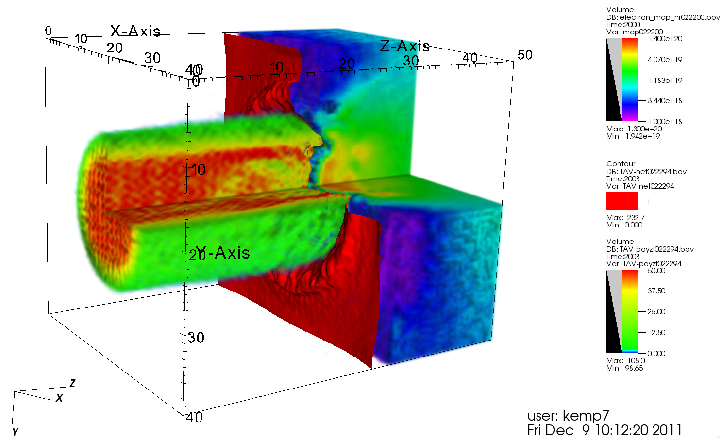
We are now doing larger scale simulations and developing methodology to inject to Zuma, Hydra

Slide 21
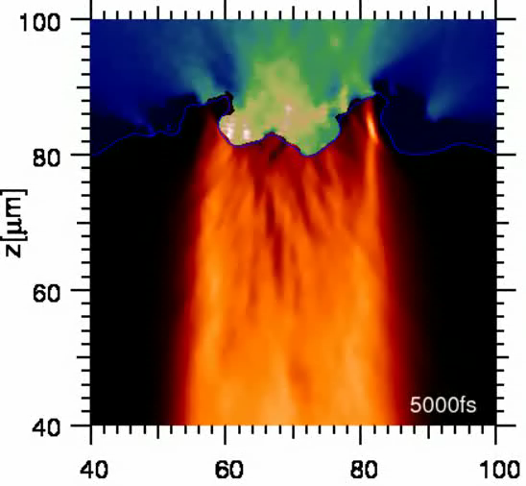
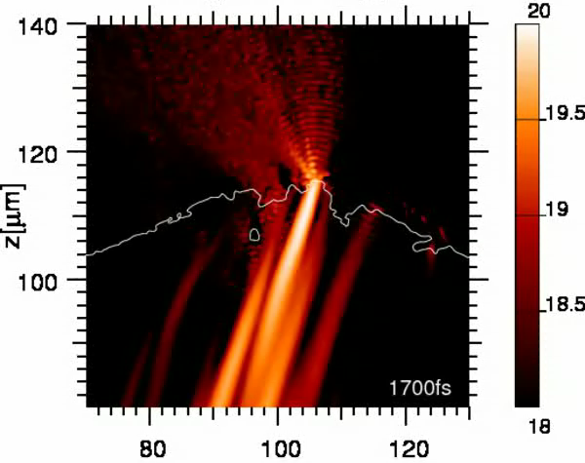
We are now studying the surrogacy between ignition-scale and Titan-scale laser-plasma interaction
Ignition-scale
Titan-scale
f/20 focusing
40 µm wide uniform spot
20 ps pulse duration
f/3 focusing
5 µm wide Gaussian spot
0.5 ps pulse (typically)
Critical question: Is the dominant physics the same in both cases?

Slide 22
Understanding the properties of laser absorption, electron generation and transport is the fundamental challenge
Simulations of laser-matter interaction at FI-scale test the limits of current computational capabilities
Electron generation & transport are highly coupled processes
Independent code predictions do not presently agree
Experimental validation is absolutely critical
In 2D we can now run full spatial scale simulations to >5 ps (300 kcpu-hrs, 1-wk on 2000 cpus)

Slide 23
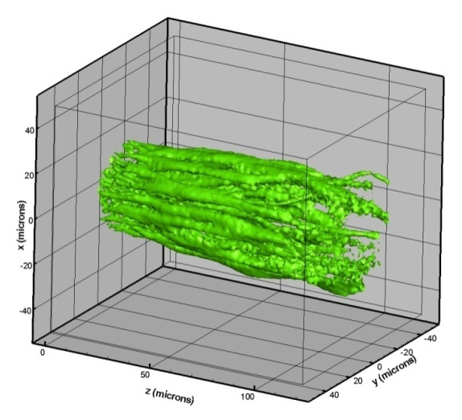
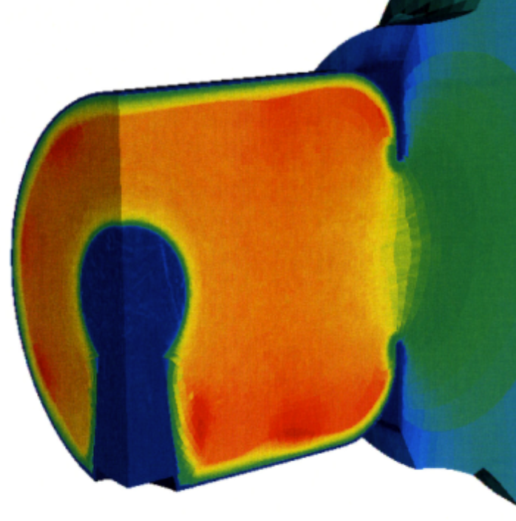
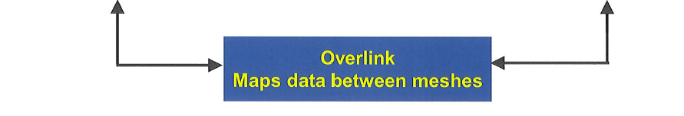
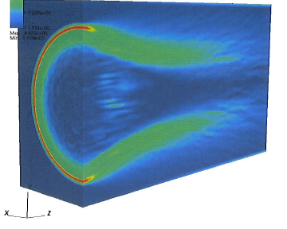
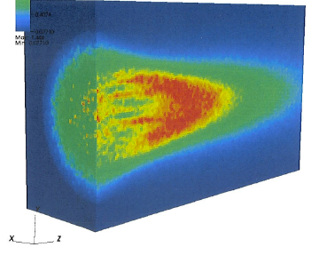
To model electron transport and burn we have linked the ZUMA hybrid-PIC code with the HYDRA code
ZUMA:
3-D hybrid-PIC relativistic electron transport code
HYDRA:
3-D multiphysics radiation-hydrodynamics ICF code
Two codes run in parallel: dissimilar domains, meshes, and timesteops
Energy, momentum deposition rates and magnetic fields exchanged
Test case: 3-D relativistic electron beam injected into 50 g/cc DT plasma
Magnetic field
Plasma temperature

Slide 24
  Since the first ignition calculations we have studied the electron source in more detail
    I. Source is not really separable into f(E,θ,y) = f_{E}(E) × f_{θ}(θ) × f_{y}(y)
  Electrons in centre of beam, and electrons with higher energy have smaller divergence
  We are now putting full source distribution into ignition calc.
    II. Simulation is short in time (365 fs)
  We have performed longer duration, full spatial-scale, 2D PIC simulations (> 5ps)
  We have compared with reduced scale 3D PIC simulations

Slide 25
PIC simulations need to be validated by experiment
Target
v/c
2-D PIC sumulation of Titan laser pulse (full spatial/temporal scale)
Critical density surface
fast electrons
Titan laser
10²⁰ W/cm², 1.4 ps
Reflected light
Data
Simulation
red-shift
blue-shift
Agreement is only achieved by inlcuding relativistic self-focusing/filamentation in the preplasma, and accurate modeling of plasma heating (to get right back-pressure)

Slide 26
Next step is to study electron distribution and compare with data (Kα and bremsstrahlung)
Electrons fluctuate rapidly in time – important for time-integrated data
We are coupling electron distribution to ZUMA to compare with data

