Slide 1
Fusion contributions to other fields of science

Slide 2
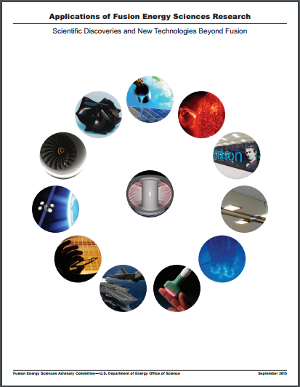
2015
FESAC Report

Slide 3
Fusion contributions to other fields of science

Slide 4
Visualizing
Fusion contributions to other fields of science

Slide 5
Identifying Connections

Slide 6
Ideas

Slide 7
Ideas
Publications

Slide 8
Ideas
Publications
Citations

Slide 9
Citations

Slide 10
Journals
Citations

Slide 11
Fields of Science
Journals
Citations

Slide 12
Journals

Slide 13
2015
FESAC Report

Slide 14
“… the development of a precise criterion for transition to chaos in Hamiltonian systems, …”
p. 3

Slide 15
“A method for determining a stochastic transition”
John M Greene, Princeton Plasma Physics Laboratory
Journal of Mathematical Physics, Volume 20, Issue 6, pp. 1183-1201 (1979)
762 citations
3804 referenced sources

Slide 16
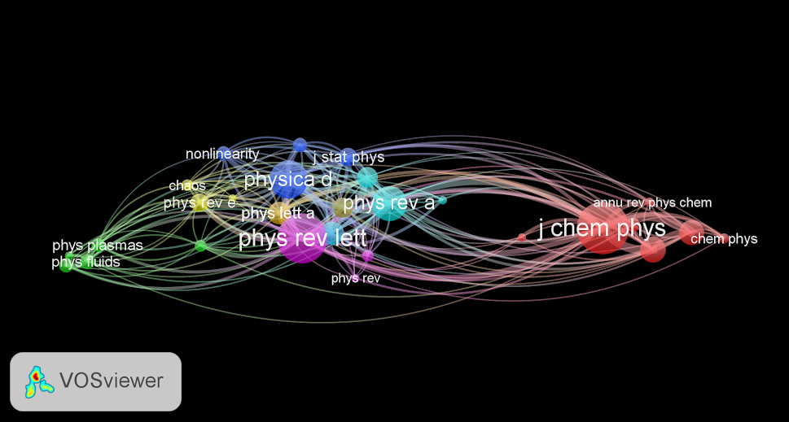

Slide 17
Size = Number of Citations

Slide 18
Distance = Topical Similarity

Slide 19
Cluster

Slide 20
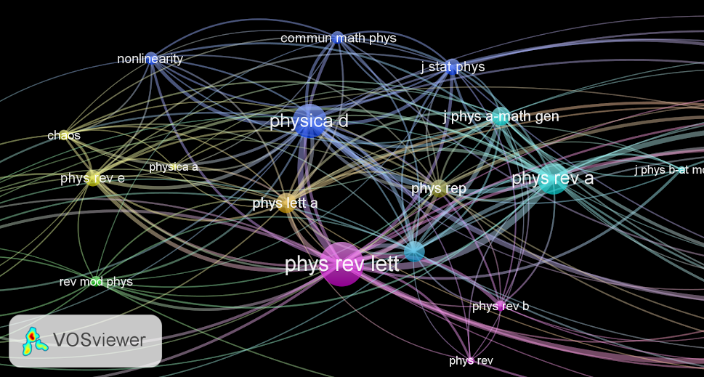

Slide 22
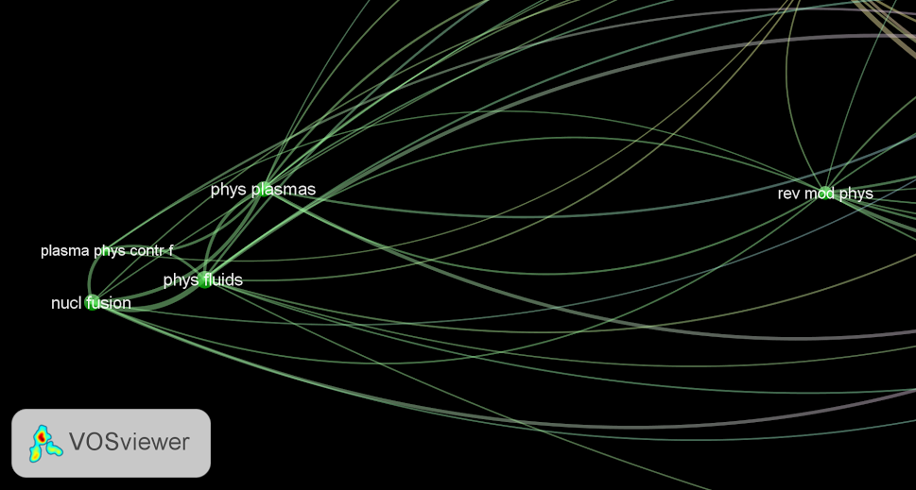

Slide 24
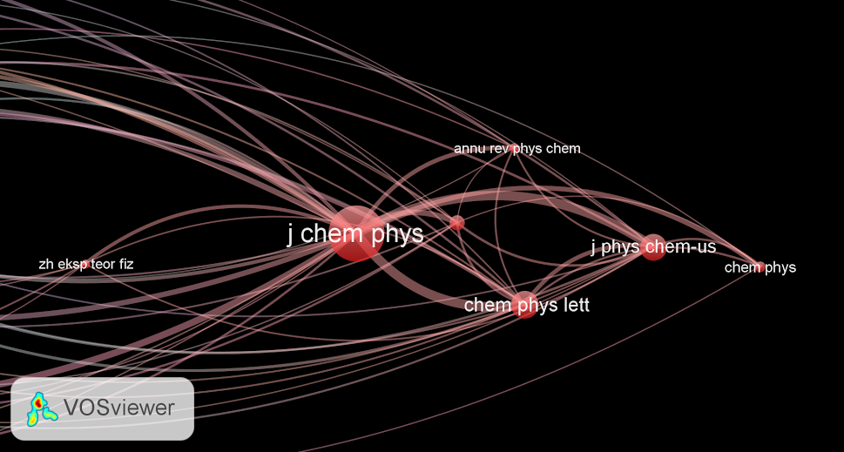

Slide 25
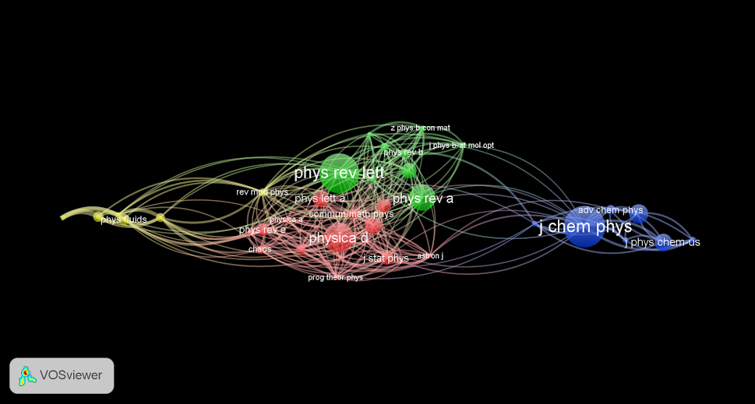

Slide 26
“… the formulation of a mathematical theory of solitons, solitary waves which are seen in everything from plasmas to water waves to Bose-Einstein Condensates, …”
p. 3

Slide 27
“Method for Solving the Korteweg-deVries Equation”
Clifford S. Gardner, John M. Greene, Martin D. Kruskal, and Robert M. Miura
Princeton Plasma Physics Laboratory
Phys. Rev. Lett. 19, 1095 (1967)
2165 citations
8472 referenced sources

Slide 28
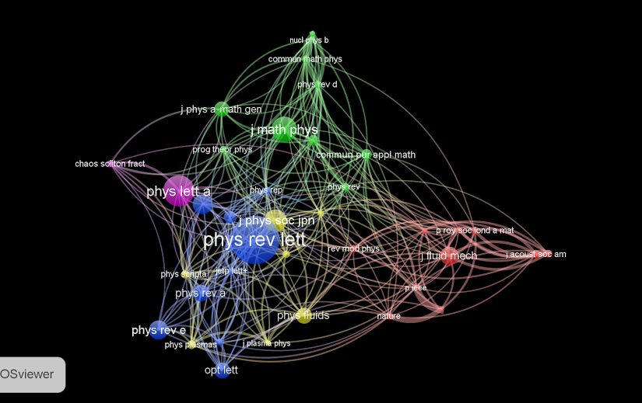

Slide 29
final thoughts

Slide 30
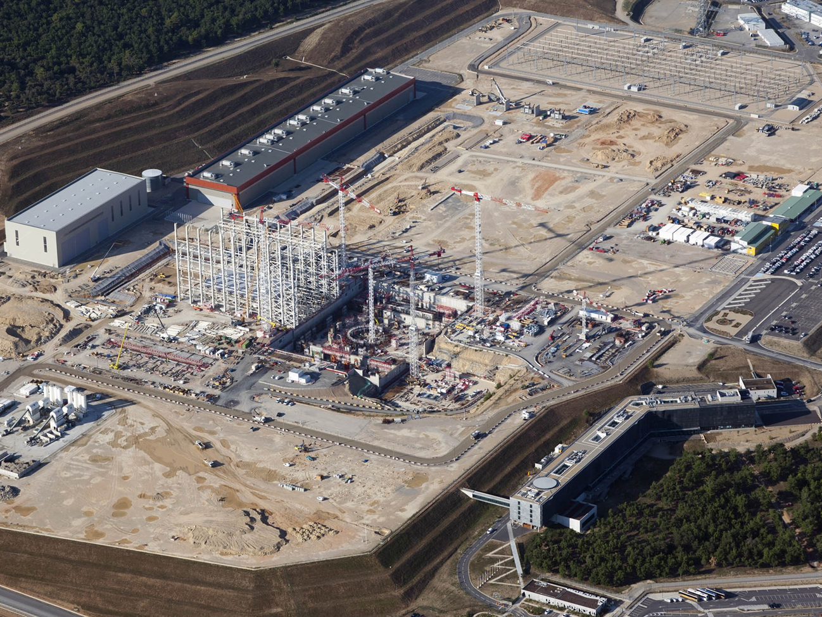
ITER

Slide 31
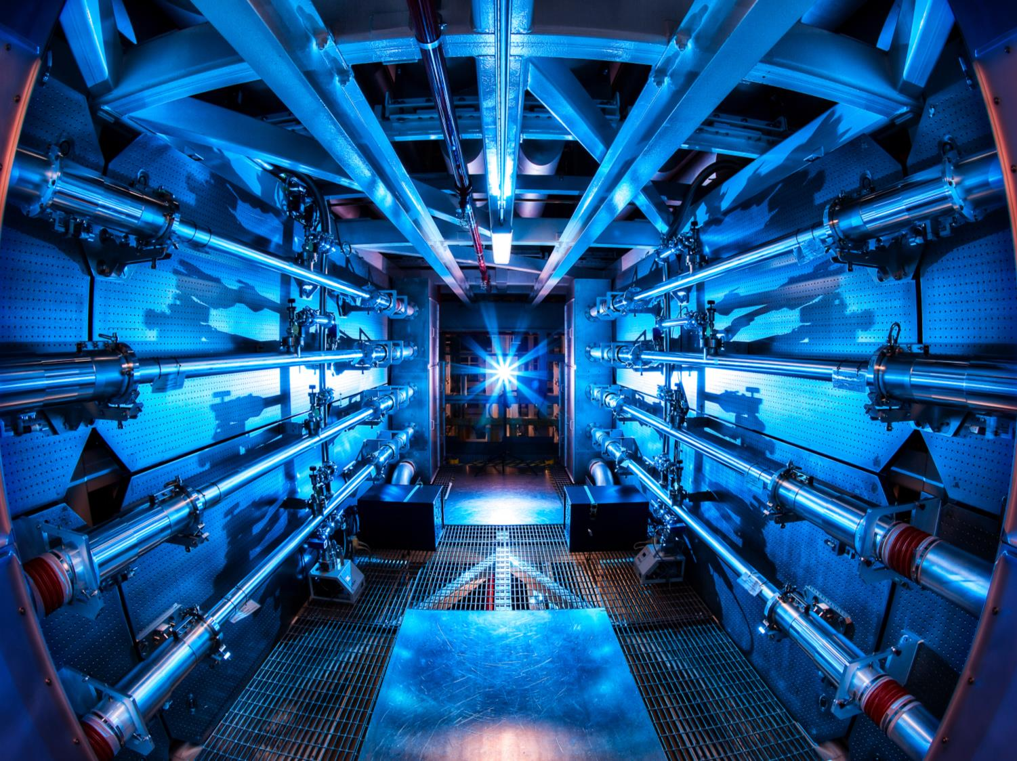
The National Ignition Facility

Slide 33
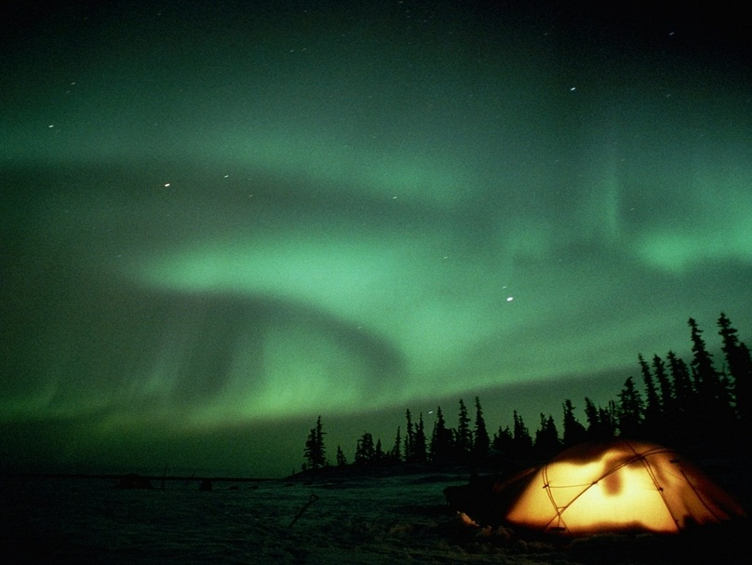

Slide 34
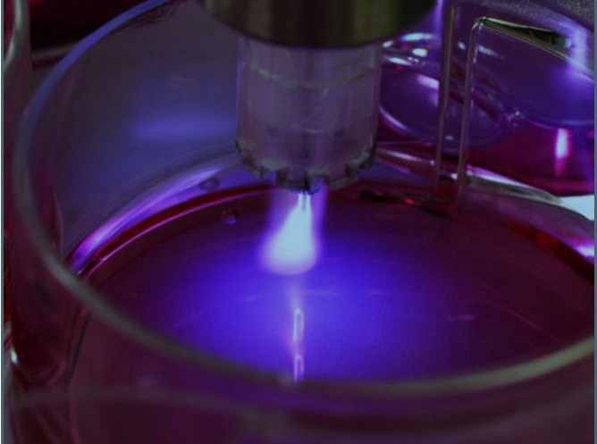

Slide 35
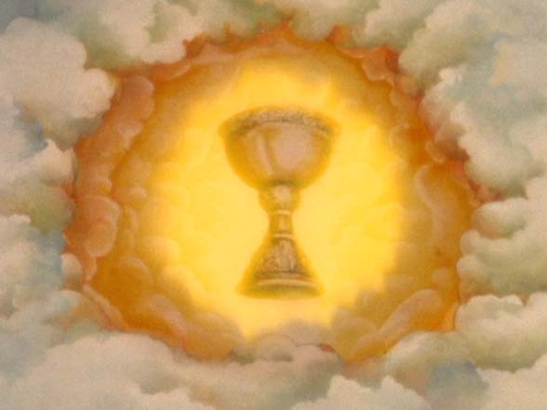

Slide 36
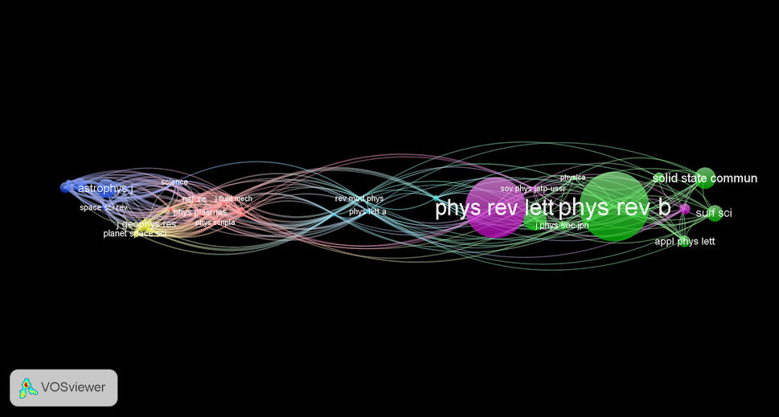
“Existence of Electromagnetic-Hydrodynamic Waves”
H. Alfven
Nature, Volume 150, Issue 3805, pp. 405-406 (1942)

Slide 37
