Slide 1
Materials Prospects for Fusion Power Plants
Steve Zinkle
UT/ORNL Governor’s Chair,
University of Tennessee and Oak Ridge National Laboratory
Fusion Power Associates 36th annual meeting and symposium
Washington, DC
Dec. 16-17, 2014
Notes:
SDM meeting July 10-11, 2001
1

Slide 2
Longstanding vision for fusion energy is based on three tenets
Accessible and proliferation-resistant fuel
Environmentally attractive
  No adverse public consequences for design basis accidents
  No long-term radiological waste disposal burden
Economically competitive
  High (>50%) and predictable availability
  High component lifetime (MTBF) and short repair times
  High thermodynamic efficiency
Tenets 2 (reduced activation materials, low tritium sequestration) & 3 (high performance, long-lifetime materials) are directly dependent on materials choices

Slide 3
Fusion materials challenges and opportunities
Increasing opportunities for leveraging broader mater. sci. community
Challenges
  Plasma facing components
    Will tungsten work?
  Tritium containment and online extraction/fuel reprocessing
  Nonstructural materials lifetime in a DT fusion environment
    Plasma diagnostics (optical fibers, electrical insulators, etc.)
    Plasma heating feedthrough insulators
    Next generation magnet systems (insulation, HTC superconductors?)
    Ceramic breeders
  Structural materials
    Is there a viable option beyond 5 MW-yr/m²? (50 dpa)

Slide 4
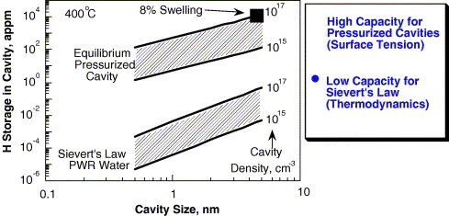
Irradiation damage (cavity formation) will result in significantly higher tritium retention compared to H solubility in unirradiated materials
Example of H sequestration in fission neutron irradiated Type 316 stainless steel
Retained H level is ~100x higher than expected from Sievert’s law solubilities
Measured H conc.
(~10dpa irrad. 316SS with cavities)
Sievert’s Law
(defect-free 316SS)
Fusion may need to avoid operation at conditions that produce fine-scale cavities in structural materials
F.A. Garner et al., J. Nucl. Mater. 356 (2006) 122

Slide 5
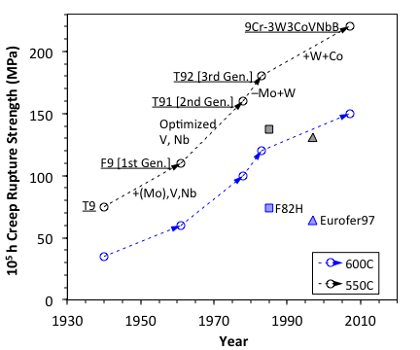
Development of RAFM Steels
USA, Japan, and European Union initiated development of RAFM steels in 1980s, and came up with respective alloys such as 9Cr-2WVTa, F82H, and Eurofer97 (adopted in 1997). China, India, Korea, etc. started relevant R&D activities afterwards.
Despite comparable tensile properties as compared with the ASME codified Grade 91, RAFM steels have significantly lower creep strength at temperatures above ~500°C.
L. Tan, ORNL. ICFRM17

Slide 6
Concerns of Current 9-12Cr FM Steels
Higher Cr₂₃C₆ amount results in greater creep rate.
Coarse Z-phase forms by consuming fine MX during long-term services.
Stress accelerates the replacement of MX by Z-phase.
(V/Nb/Ta)N
Cr(V/Nb/Ta)N
 | T91 | T92
V, wt% | 32.4 | 34.8
Cr | 44.0 | 44.2
Nb | 19.4 | 16.3
Fe | 4.2 | 4.7
@600°C | 34,141h | 39,540h
Size | 166 nm | 155 nm
Fraction | 0.7% | 0.3%
Laves phase coarsening degrades strength.
L. Tan, ORNL, ICFRM17, Aachen
[K. Sawada, et. al. ISIJ Inter. 46 (2006) 769.]

Slide 7
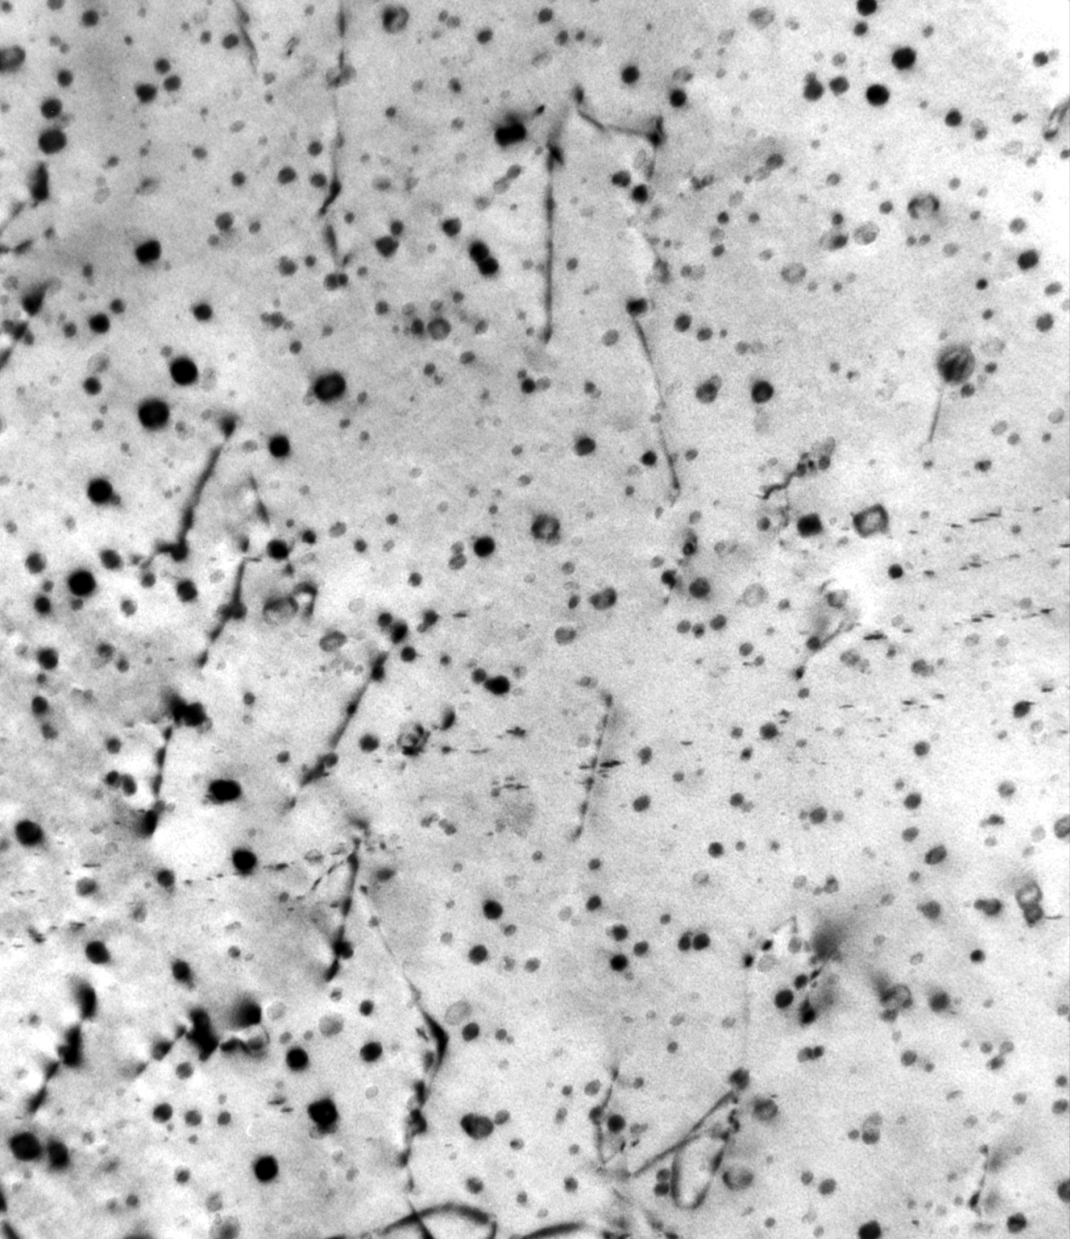
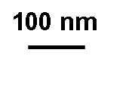
Computational thermodynamics modeling identified potential new thermomechanical treatment (TMT) processes for commercial 9-12%Cr steels: Improved microstructure
Commercial 9Cr-1Mo and 12 Cr steels were processed
TMT (hot rolling) on 25.4–mm plates
  Several TMT conditions were investigated
Precipitates formed on dislocations introduced by hot rolling
Precipitate dispersion is much finer than observed in conventionally processed 9-12Cr steel
  Up to 1000X increase in density (TMT precipitate density is 0.2-1x10²²/m³; d~4-8 nm)
Modified 9Cr-1Mo—New TMT
Potential drawback: TMT may be difficult to implement in some product forms, and can’t be retained in weldments
R.L. Klueh et al., J. Nucl. Mat. 367-370 (2007) 48; Scripta Mat. 53 (2005) 275
Notes:
Precipitates in standard N&T 9Cr steel is d~32nm, N~8e18/m3)
TMT Precipitate sink sink is ~5e14/m2 (needs to be increased by another 10x)

Slide 8
EU researchers have recently embarked on a broad program to design next-generation RAFM steels

Slide 9
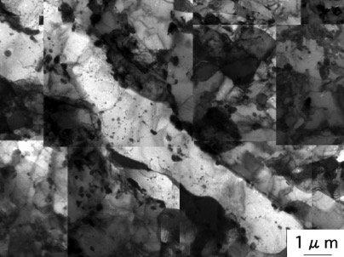
Motivation for Castable Nanostructured Alloys (CNAs) based on 9Cr ferritic steel
The significant recovery of T91 at 600°C, 100 MPa suggests that the low amount of MX in the current RAFM steels (e.g., Eurofer97) may lower resistance to recovery.
T91@600°C/100MPa/34,141h
[K. Kimura, et al., Key Eng. Mater.
171-174 (2000) 483]
Noticeable aging-induced softening in F82H-IEA at T > 500°C.
[K. Shiba, et al., Fus. Eng. Des. 86 (2011) 2895.]
L. Tan, ORNL, (ICFRM-17, Aachen)

Slide 10
Tensile and Creep Resistance of CNAs
CNAs exhibited ~100–300 MPa increases in yield strength compensated by some reductions in ductility as compared with the FM/RAFM steels.
Creep at 650°C showed superior creep resistance of CNAs as compared with Eurofer97 and F82H.
L. Tan, ORNL, (ICFRM-17, Aachen)

Slide 11
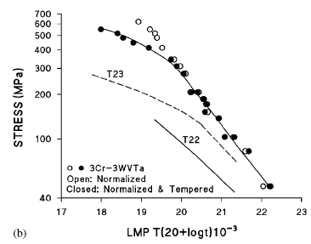
Overview of Bainitic Steel Development
Target: Fusion structural applications in next-step fusion devices (FNSF or DEMO);
Vacuum vessel (>400-500°C, relatively low dose)
Structural ring, magnet shields
Why 3Cr-3WV(Ta) steels?:
Inexpensive low alloy steel
Improved creep properties due to formation of carbide-free acicular bainite ferrite (lower bainitic microstructure)
potentially no requirement of PWHT, suitable for large volume components
>100X lower waste disposal burden vs. 316SS
L. El-Guebaly, Fus. Sci. Tech. 64 (2013) 449
Approach:
  Computational thermodynamics for alloy design
    Effect of minor alloying additions on transformation kinetics
    Phase equilibrium of strengthening second-phases
  Property evaluation of 3Cr-3WV(Ta) steels
    Production of CCT diagrams
    Mechanical property / weldability
3Cr-3WVTa
LMP plot of 3Cr-3WVTa steel, compared with 2.25Cr-1Mo (T22) and 2.25Cr-1.6WVNb (T23)
R. Klueh, JPVP (2007)
Y. Yamamoto, ORNL (ICFRM-17, Aachen)
Notes:
3Cr VV may qualify for Class A waste (least costly radwaste category); also eases recycling.

Slide 12
Improved Creep-rupture Properties in 3Cr Steels
Better properties compared to P92 F-M steels:
  All 3Cr-3WV(Ta) steels at 600°C-200MPa
  Only 3Cr3WVTa steels at 600°C-170MPa (test in progress)
Modified alloys tend to show improved properties at lower stress range:
  Requires multiple long-term creep testing (lower-temperature, lower-stress) to verify
600°C/200MPa
(3Cr-3WVTa)
Mod.
Base
(3Cr-3WV)
Base
Mod.
Y. Yamamoto, ORNL (ICFRM-17, Aachen)

Slide 13
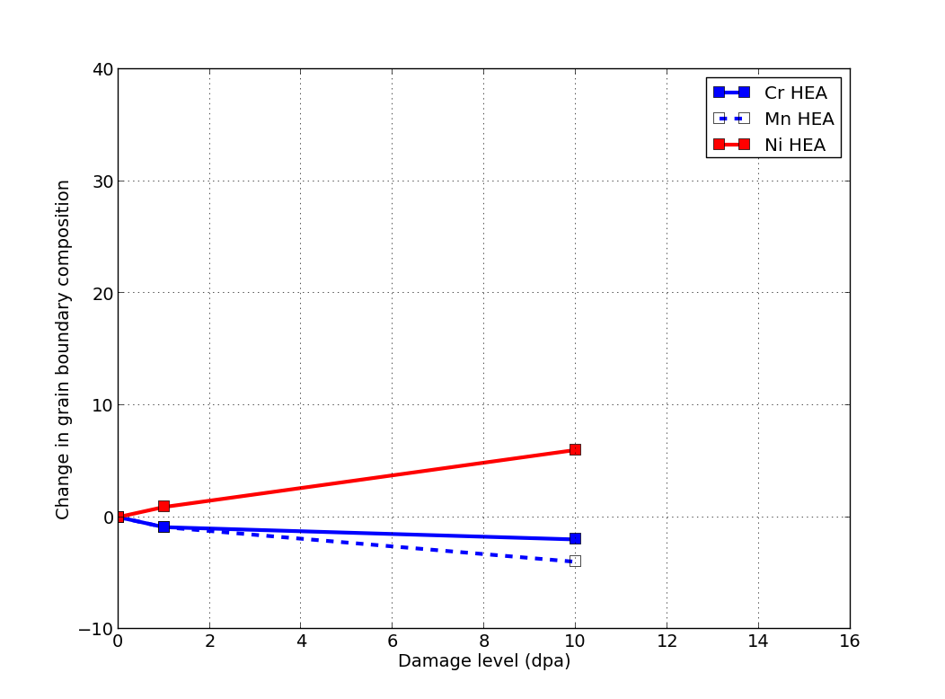
Radiation Induced Solute Segregation in Irradiated
Fe-Cr-Ni-(Mn) Face Centered Cubic Alloys
27Fe-27Mn-28Ni-18Cr HEA
500ºC, 5.8 MeV Ni ions, 10 dpa
Ni enrichment
Cr, Mn depletion
N.A.P. Kiran Kumar et al., submitted
Inverse Kirkendall vacancy mechanism
RIS behavior for High Entropy Alloys is more sluggish than traditional FCC FeCrNi(Mn) Alloys
  HEA effect on solute diffusivities
Also no visible void formation at 400-700ºC after 10+ dpa
Vacancy-solute drag
Interstitial-solute drag
Notes:
Conventional austenitic Fe-Cr-Ni-(Mn) alloys: Ni is slow vacancy diffusivity/ undersized; Cr is fast vacancy diffusivity/ oversized
Similar results observed by numerous other researchers at 300-500C

Slide 14
SiC/SiC composites are now being qualified for jet turbines
Turbine shrouds using SiC/SiC
Joint venture by GE and Snecma
  1st deployments on Airbus 320neo (2016) and Boeing 737 MAX (2017)
Two new SiC fiber and CMC fabrication plants to be built in USA
Higher temperature and lower weight will produce ~15% fuel savings
  Should spur development of improved SiC fibers and lower cost composites for other applications
Flight test of LEAP engine with SiC/SiC parts
Notes:
Similar program underway at Rolls Royce
Planned to be used in GE9X engine in Boeing 777X in 2020
Huntsville, Alabama plants to cost $200M; start operation in 2018; GE R&D investment to date is over 1 B$
Also see article in MRS bulletin, 40 (Nov. 2015) p. 916-917.

Slide 15
Concluding Comments
Multiple options are available for high performance structural materials for nuclear environments
  High confidence of suitability for fission neutron environments
  Uncertain suitability for fusion beyond ~5 MW-yr/m²
  Potential impact of tritium retention in cavities needs to be assessed
Many of the critical path items for DEMO are associated with fusion materials and technology issues (PMI, etc.)
  Low-TRL issues can often be resolved at low-cost
Alternative energy options are continuously improving
  Passively safe fission power plants with accident tolerant fuel that would not require public evacuation for any design-basis accident
  Low-cost solar, wind (coupled with low-cost energy storage); distributed vs. concentrated power production visions

