Slide 1
Comments on Fusion Development Strategy for the US
S. Prager
Princeton Plasma Physics Laboratory
FPA Symposium

Slide 2
The current situation in the US
Guidance from government is tight research budget for near-term
ITER funding uncertainty complicates planning
Nonetheless, we must
Initiate new activities over next 5 – 10 years
Continuously articulate and aim for a more aggressive fusion program

Slide 3
What to do?
Identify opportunities for dramatic advances in fusion
Criteria:
World-leading research on important topics
Focus on original, important, selected, exciting activities where the
US can lead or be at the world forefront
Linked/preparatory to ITER and/or a decisive next step in fusion
Scope out experiments at all scales – small to mid to large
Notes:
For breakout potential, keep some capabilities even if not world competitive

Slide 4
The field is overflowing with ideas and exciting potential new research activities

Slide 5
The list of possibilities is well-known
e.g.,
Novel solutions to the plasma-materials interface
Advanced magnetic divertors
Fundamental studies in a high heat flux linear facility
Liquid metals
Taking the tokamak the final distance
Experiments preparing for ITER
High field superconductors for compactness
Solving the transients problem
Spherical tokamaks for compact, high beta confinement
Configurational improvements
Stellarators for steady-state, disruption free, high gain
Low field approaches (RFP, FRC…..)
Magnetized target fusion
Integrated simulation (whole system modeling)

Slide 6
Thrusts should be motivated by aggressive next steps, such as a fusion pilot plant
(aggressive, but realistic)
Note: there is no one “silver bullet;” fusion likely will require a multiple of the above innovations

Slide 7
Examples of some PPPL interests
Spherical tokamak research
(leading to an ST pilot plant or FNSF)
Stellarator research
(leading to a stellarator pilot plant or FNSF)
Liquid metal research as a novel solution to the first wall problem

Slide 8
NSTX-U (National Spherical Torus Experiment – Upgrade)
August: Completed construction
Obtained first plasma
A new US experiment

Slide 9
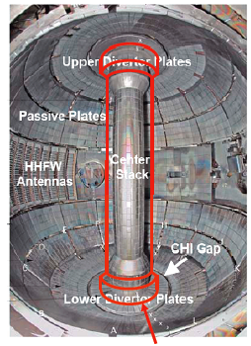
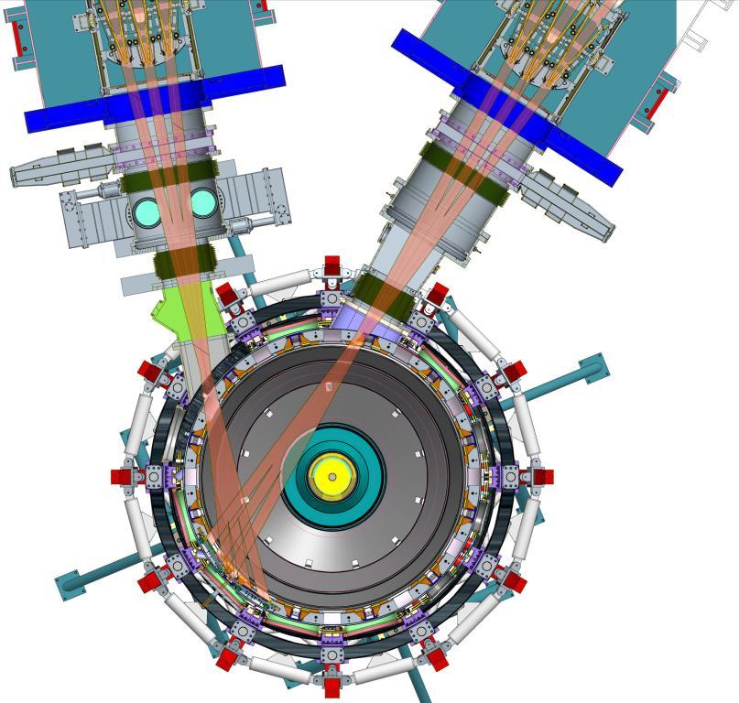
NSTX-Upgrade
new center magnet second neutral beam
Large increase in scientific capability of NSTX
(2 x current, 2 x field, 5 x duration)

Slide 10
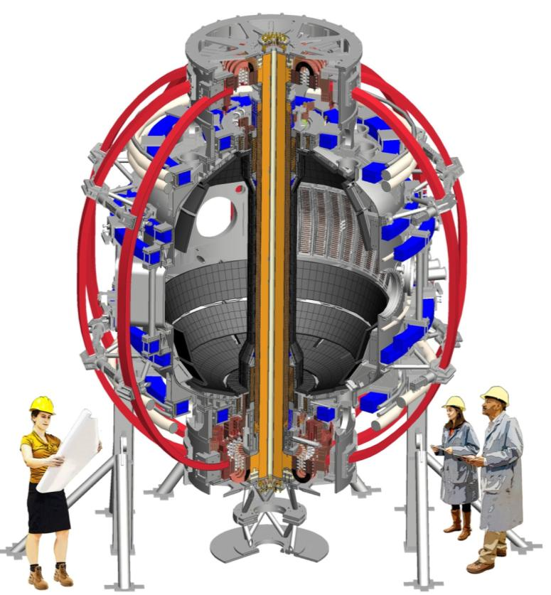
The central magnet
Two functions:
Produces toroidal field
Produces plasma current
(via vertical magnetic flux)

Slide 11
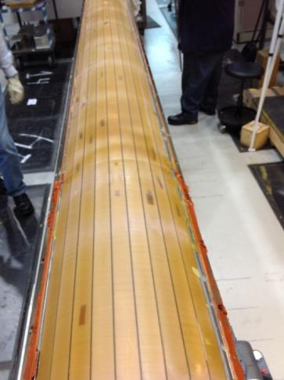
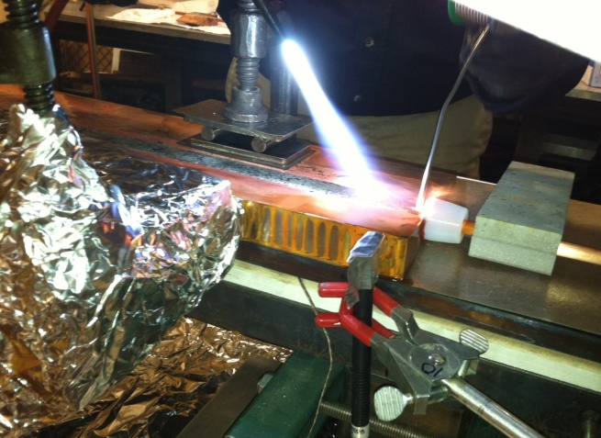
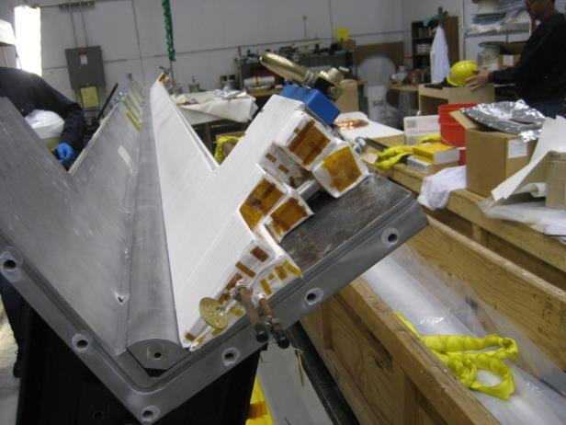
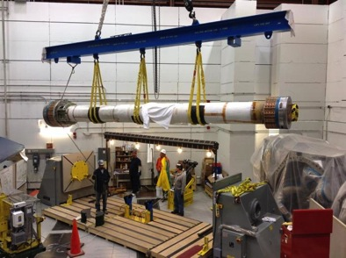
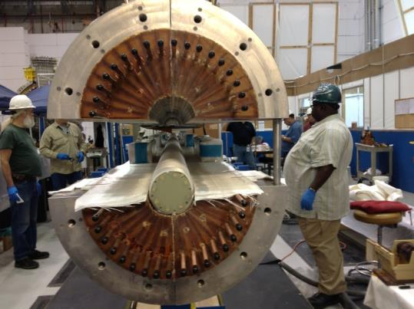
Magnet designed and fabricated at PPPL

Slide 12
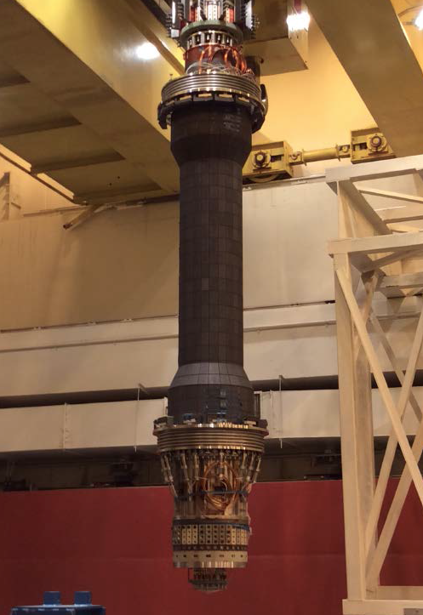
magnet in its casing
Casing being installed over magnet

Slide 13
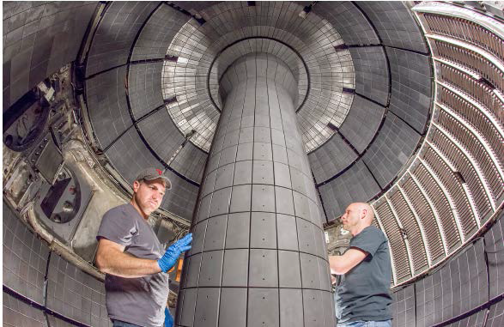
A new central magnet

Slide 14
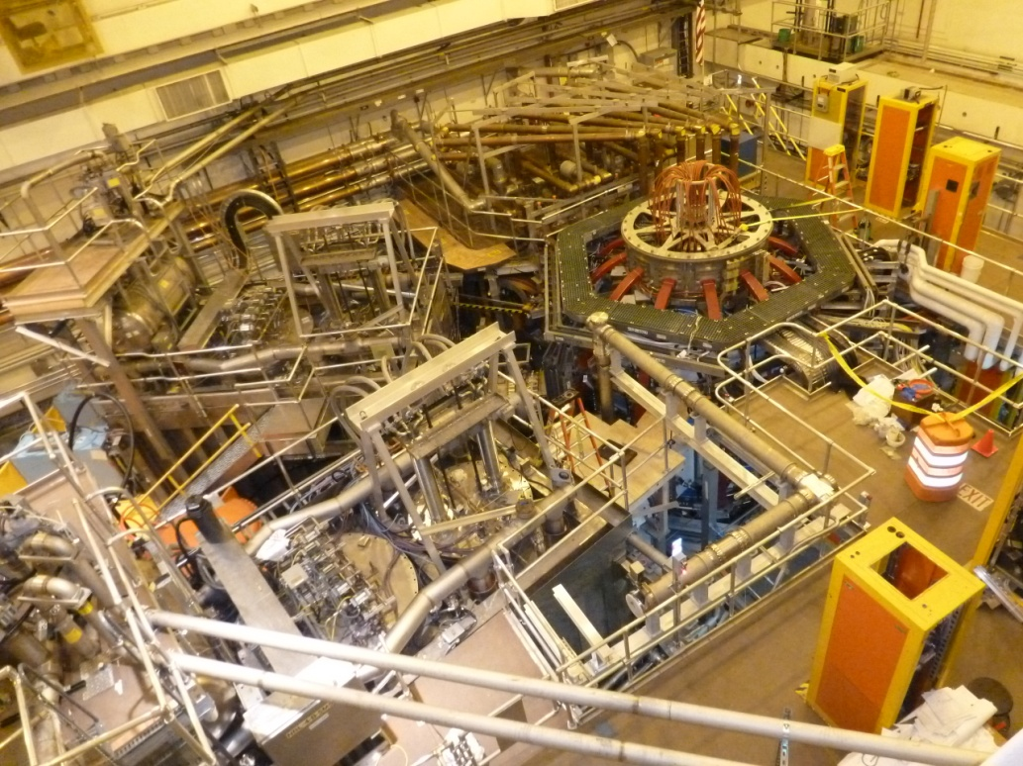
NSTX-Upgrade
A new experiment at PPPL
New central
magnet
New Neutral Beam

Slide 15
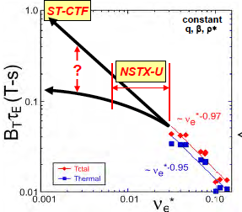
ST confinement scaling is favorable. Why?
ST Pilot
Confinement quality
Collisionality ( )
hotter
Unlike a tokamak with larger aspect ratio;

Slide 16
ST confinement scaling is favorable. Why?
ST Pilot
Confinement quality
NSTX-U
Collisionality ( )
hotter
Unlike a tokamak with larger aspect ratio;
Answer thought to lie in physics of turbulence:
in electron turbulence, in magnetic turbulence

Slide 17
Upgrade will enhance missions
Advance toroidal confinement physics for ITER and beyond
New physics regimes: e.g., understand stability, turbulence and transport in high pressure plasmas at low collisionality
Develop solutions to the plasma-material interface
ITER-level heat fluxes: develop magnetic channeling and liquid metal boundary
Advance ST as a candidate for a next-step fusion facility
Establish sustained, high performance plasmas suitable for Fusion Nuclear Science Facility or pilot plant

Slide 18
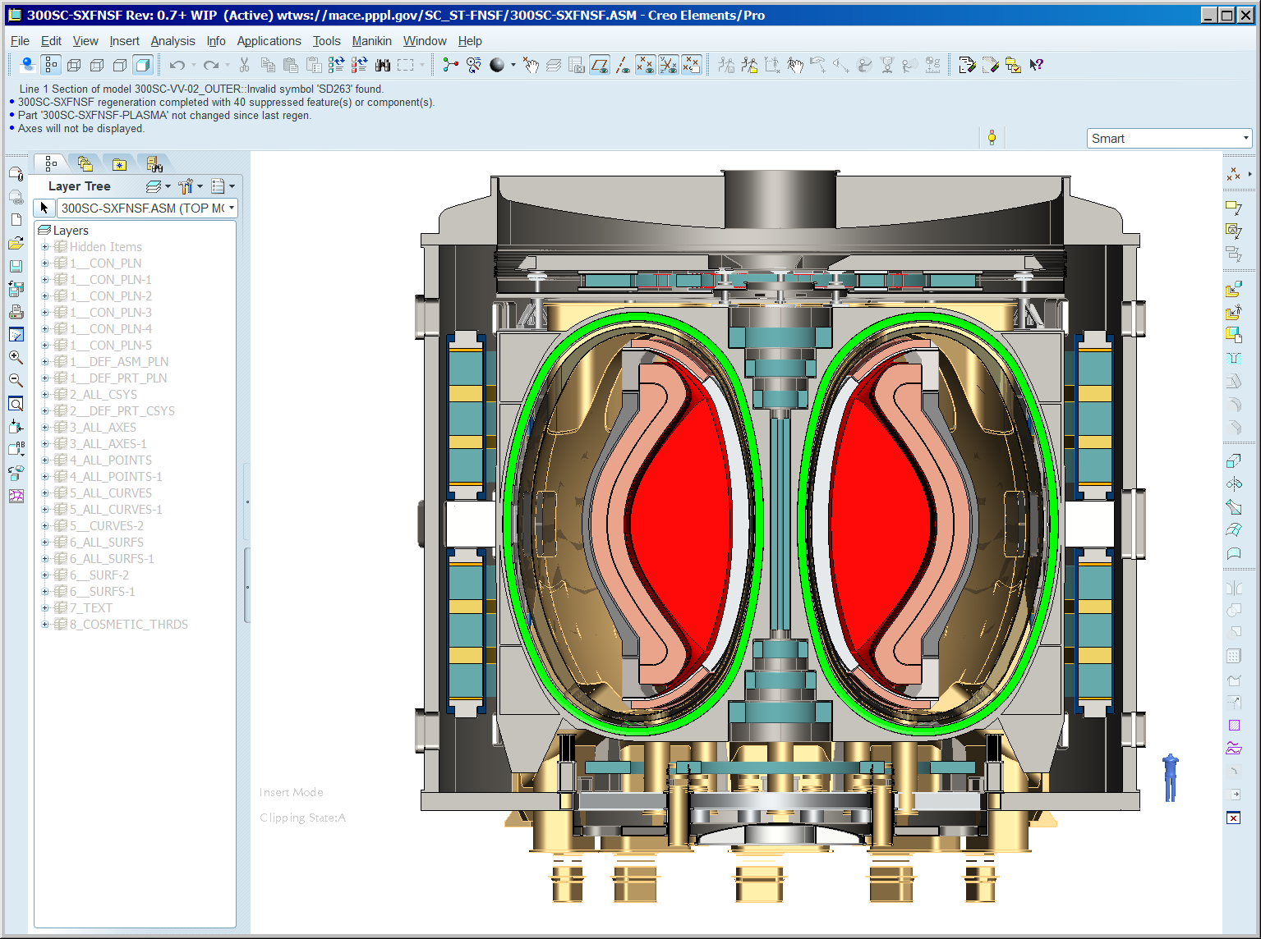
We are performing design scoping studies for pilot plants/FNSFs
R = 3 m, but tall
High temperature superconductors (continuous) facilitate realization of ST potential

Slide 19
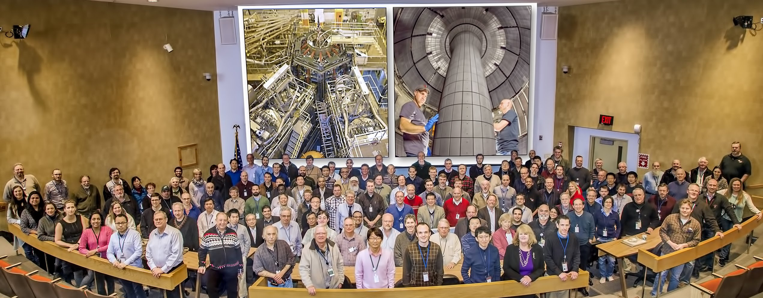
A robust 10-year program is planned for NSTX-U
300 researchers eagerly await the beginning of research
Research operations likely begins next week!

Slide 20
Steady-state, high performance plasmas
Stellarators are a mandatory research element to provide steady-state, disruption-absence, high gain
Quasi-axisymmetric stellarators are a mandatory research element for size reduction (and physics understanding)
Large gap in the world stellarator progam:
only two large stellarators, and only one is “optimized”
Therefore, PPPL envisions a future that includes forefront stellarator research

Slide 21
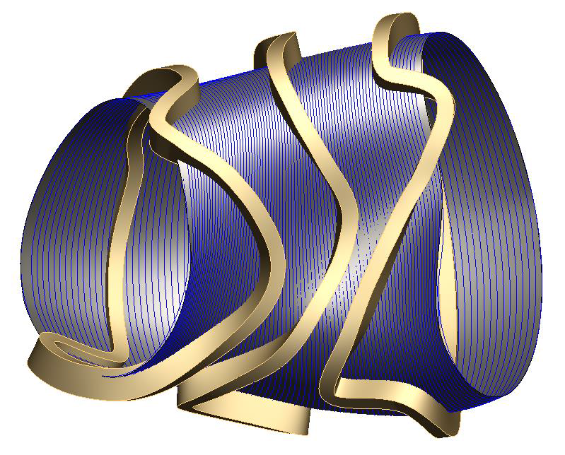
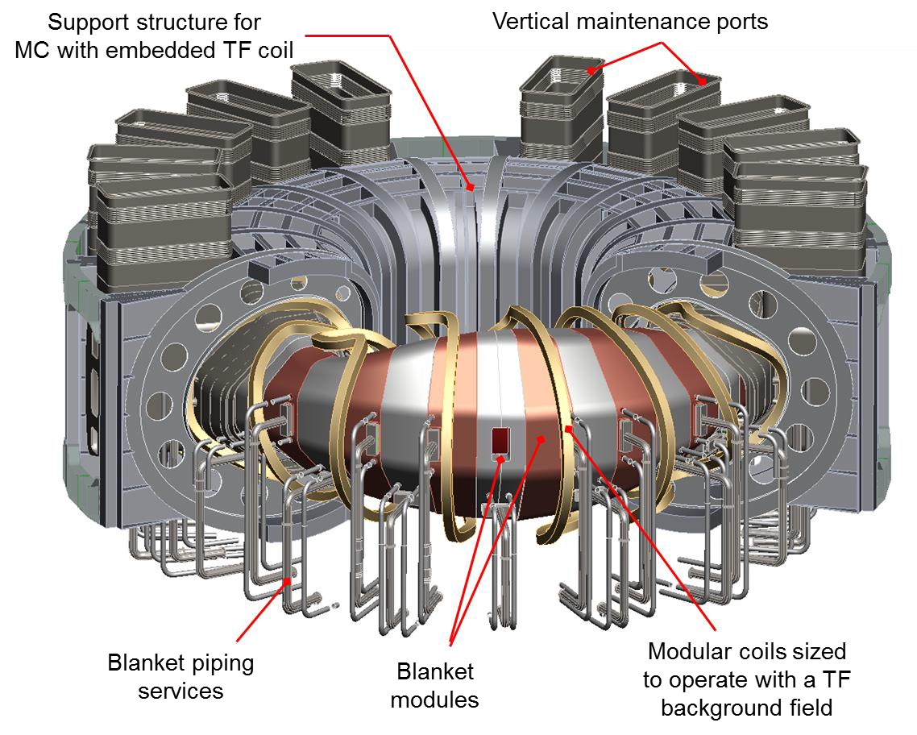
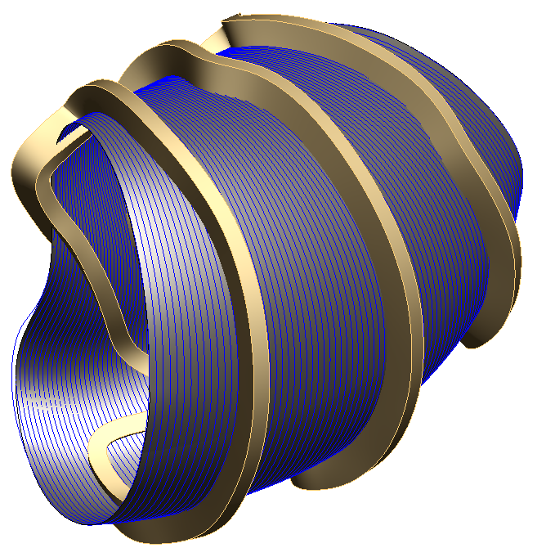
Exploring Options for a U.S. Stellarator Initiative
examining options
Critical missions
Configuration characteristics (QA, QH…..)
New ideas (turbulence minimization, coil simplification)
Examining stellarator for pilot plant,
Stellarator is arguably the most physics-optimized fusion concept

Slide 22
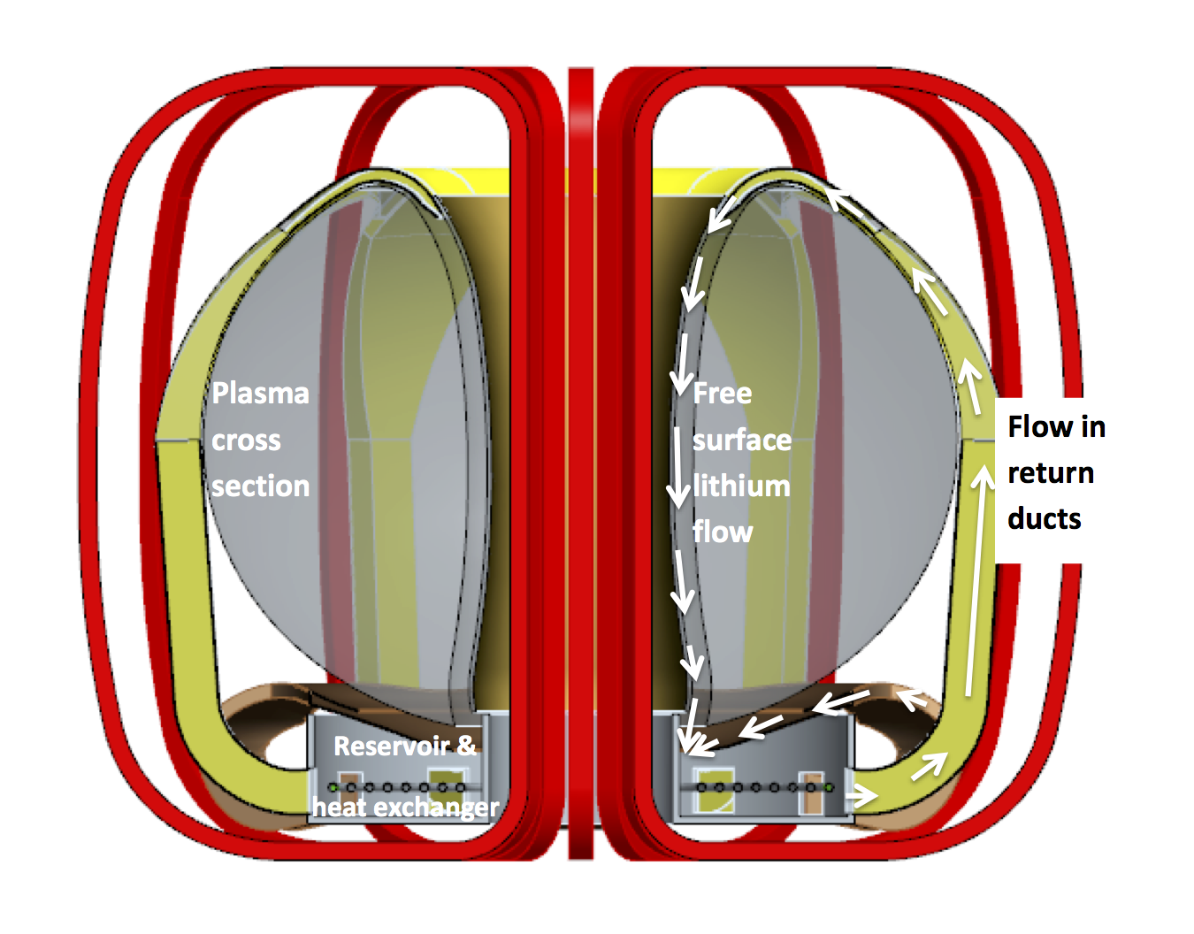
The plasma-material interface
Two approaches : solids (tungsten) and liquid metals
Neither is yet known to work in a reactor
The world program
Strong in tungsten
Only emerging work in liquid metals
Liquid metals could be a
breakthrough solution

Slide 23
Summary
The US fusion community needs to develop multiple new opportunities
The community needs to debate the various ideas, and be ready for and drive the production of new funding opportunities
As articulated at the UFA forum earlier this week

