Slide 1
High Temperature
Superconducting Magnets and other Innovations For Fusion
Dr David Kingham
Tokamak Energy
Notes:
Fusion is the reaction that powers the Sun and the stars, and we want to use this energy source here on Earth. We are all aware of the fact that global energy demands are increasing. Yet at the same time we are running out of the fossil fuels we predominantly use to provide that energy. Costs are likely to increase as supplies dwindle and may increase further as issues of pollution and global warming are considered. Renewable energy can help plug the gap, but it is questionable whether renewables alone can satisfy the rising energy demands. The world needs a new, abundant source of energy, and the energy of the stars is one of the best sources in the universe.
Because we don’t have the huge gravitational force of the Sun at our disposal, on Earth we trap fusion fuels at very high temperature in machines called tokamaks. You’re probably wondering where the word tokamak comes from. It’s a Russian acronym. It stands for toroidalnaya camera magnitnaya katushka, which is a bit of a mouthful but explains exactly what a tokamak is. Toroidal chamber, magnetic coils - a ring-doughnut-shaped magnetic trap for hot plasma. Tokamak Energy have a new approach to develop fusion faster.

Slide 2

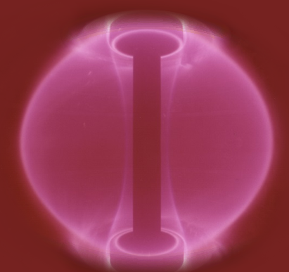
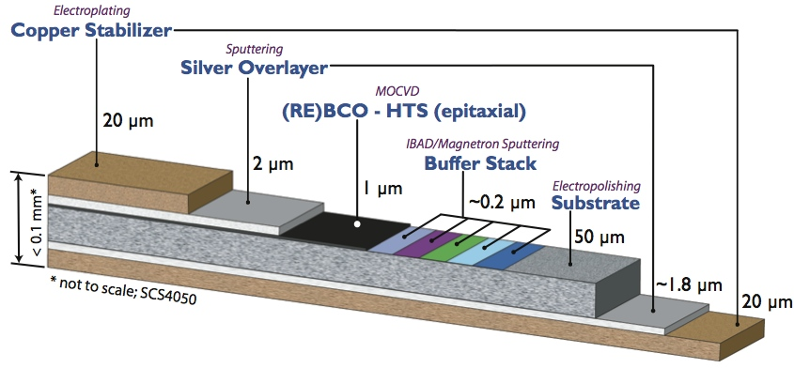
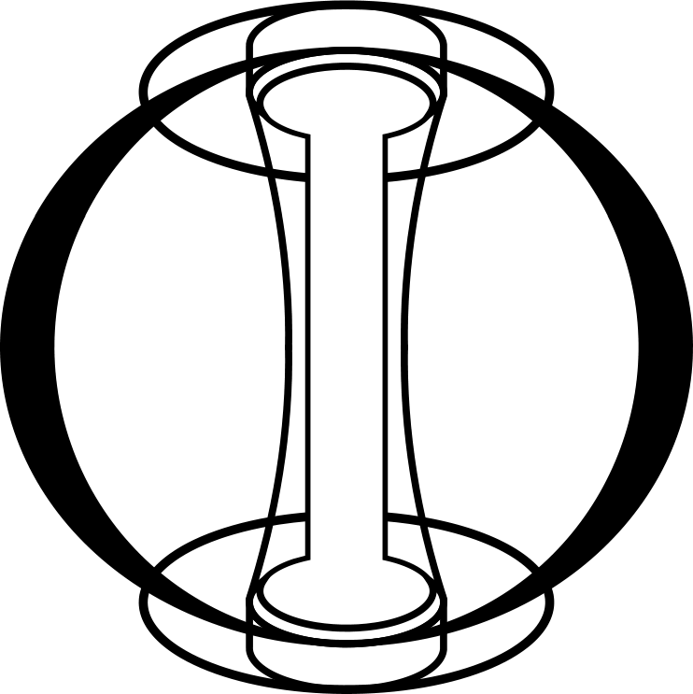
The Technology
Spherical Tokamaks
Squashed shape
Highly efficient
From 12% to 40% efficiency
High Temperature Superconductors
High current at high field
Lower cryogenic cooling requirements
smaller, cheaper, faster
Notes:
Tokamak Energy wants to accelerate the development of fusion energy.
We will do this by exploiting two emerging technologies – efficient Spherical Tokamaks and High Temperature Superconductors.
Spherical Tokamaks are tokamak machines that have been squashed up so they make more efficient use of the magnetic field.
This magnetic field in a tokamak is made by superconductors - materials without resistance. HTS can reach higher magnetic fields at more attainable temperatures than conventional superconductors. This will enable us to build smaller, cheaper machines, which means we can make progress faster.
We have already built a small tokamak, ST25, and demonstrated the use of HTS magnets on the tokamak – a world first.

Slide 3
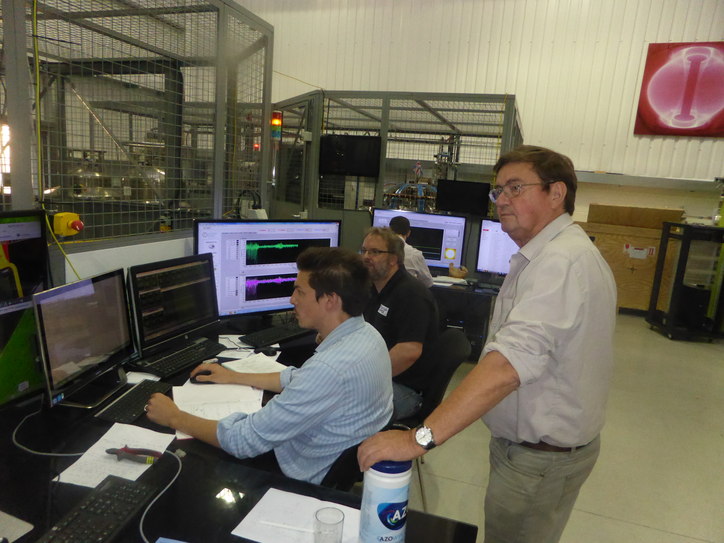
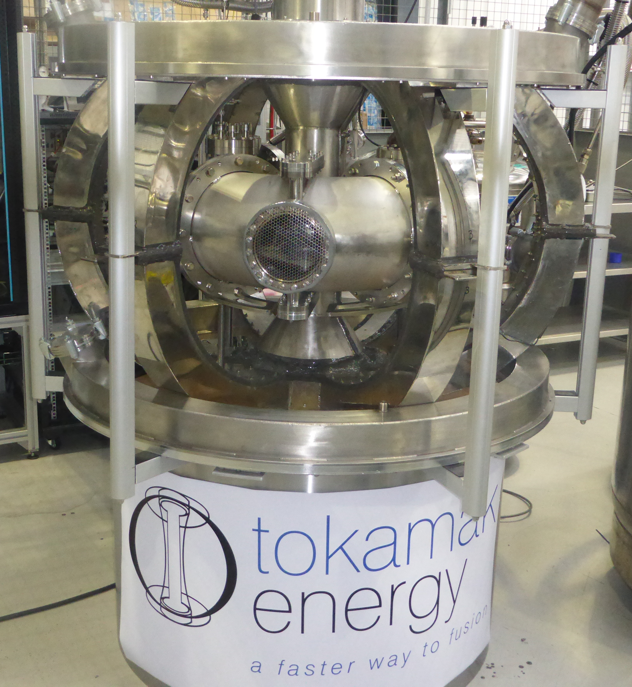
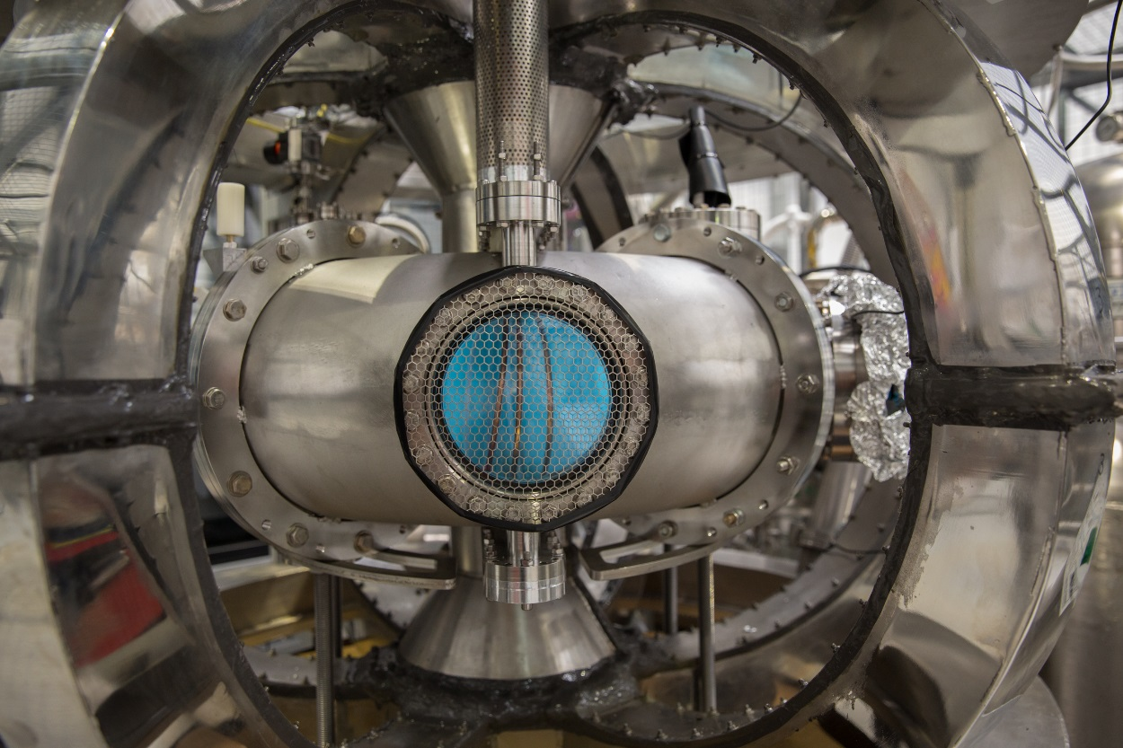
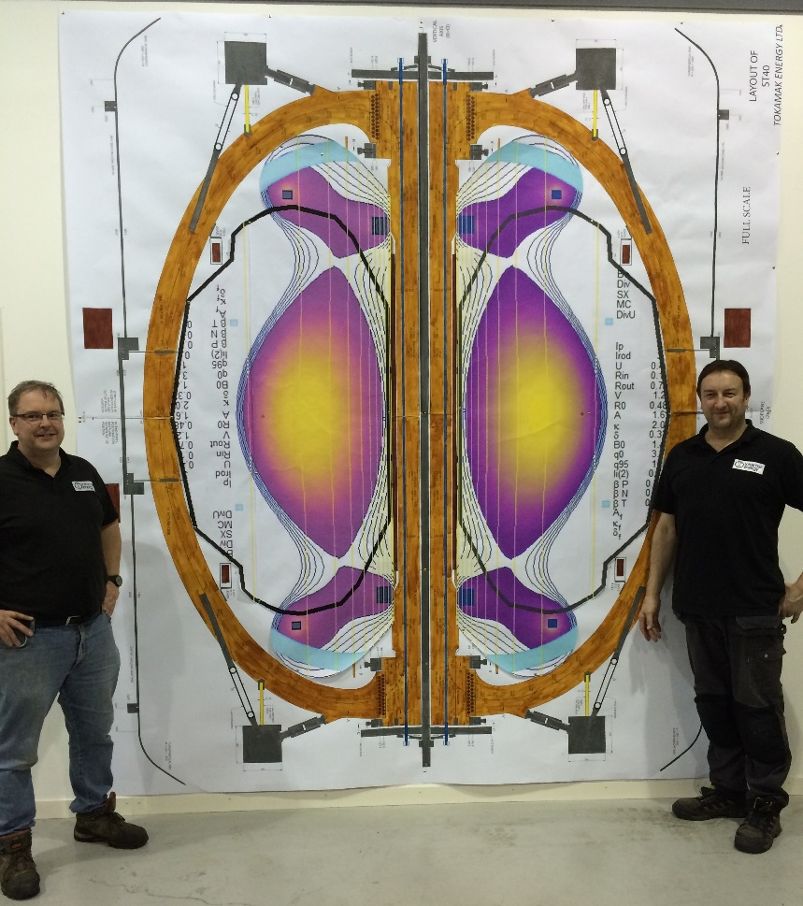
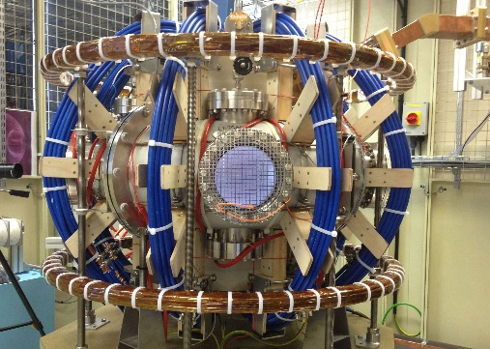
Our tokamak engineering centre

Slide 4
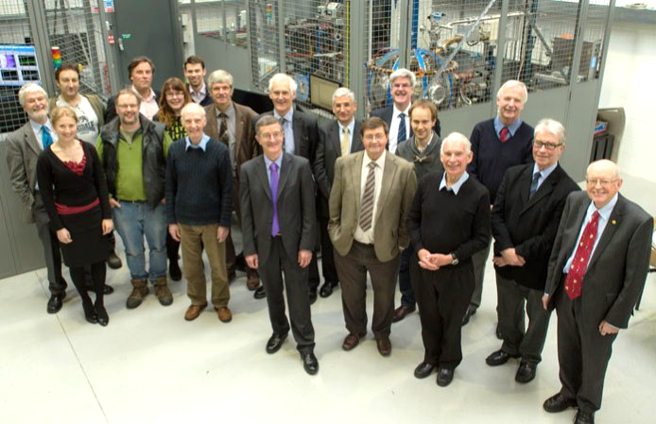
Advisory Boards and team members
March 2014

Slide 5
The logic for our approach
Fusion is vital for the future of the planet
Tokamaks have the best performance so far
Spherical Tokamaks (STs) are more efficient
Tokamaks don’t have to be huge to be powerful
Superconducting magnets are essential for fusion power
High temperature superconductors (HTS) are easier to cool
HTS is now an engineering material and can deliver
high current density in a strong magnetic field
So compact STs with HTS magnets are a
great way forward to fusion power

Slide 6
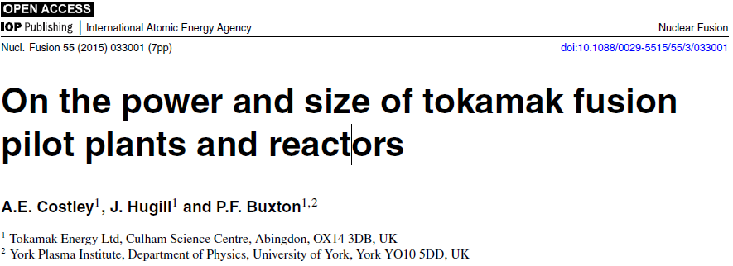
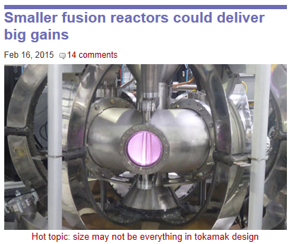


Slide 7
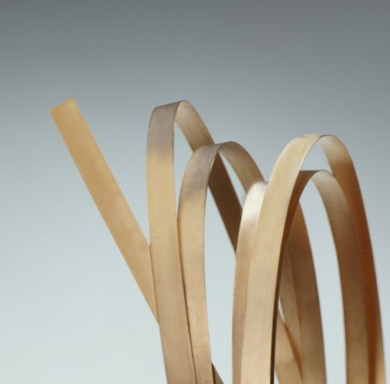
High Temperature
Superconductor (HTS)
Limit of LTS at 4K

Slide 8
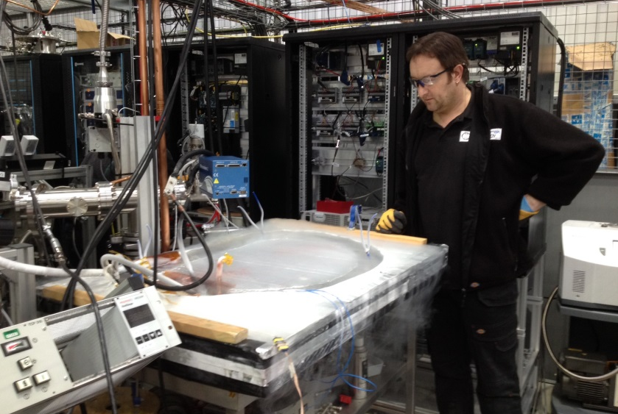
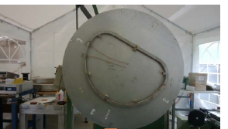
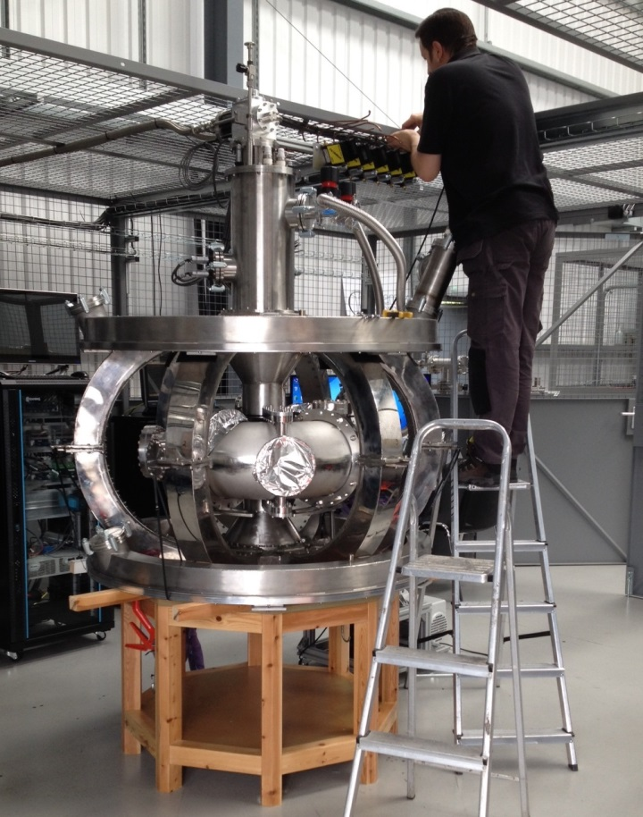
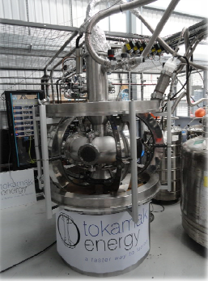
ST25 (HTS): first version
6 TF limbs, each containing a D-former with 48 turns of 12mm YBCO tape. Design current 300A/tape at LN, considerably more at 20K.
D-coils tested at LN (and at 50K in vac rig)
D-former on winding table
Adjusting He coolant flow
3 dewars of He required

Slide 9
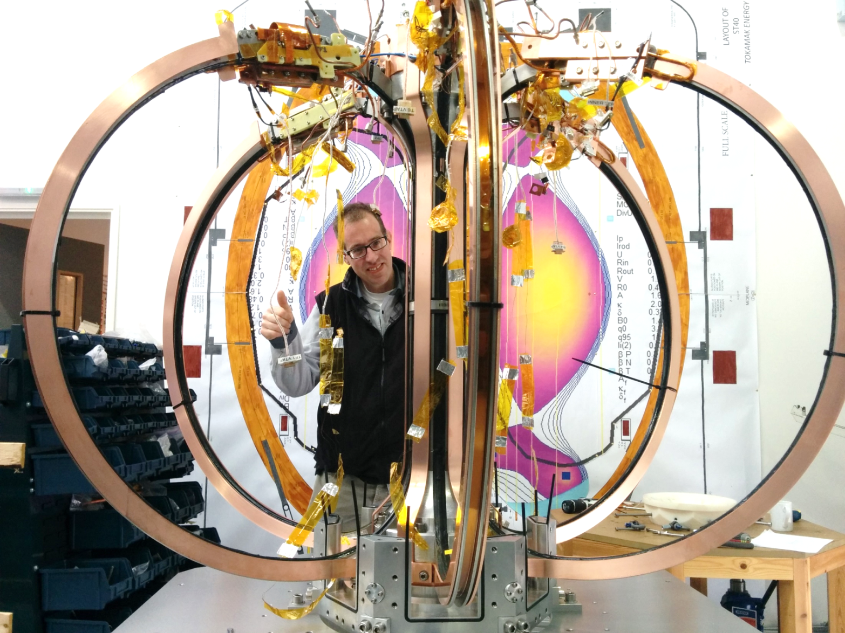
ST25 (HTS) – cryo-free version
early stages of copper cladding, to enable top-mounted cold head to cool whole structure to 20K. The helium feed pipes are not then necessary

Slide 10
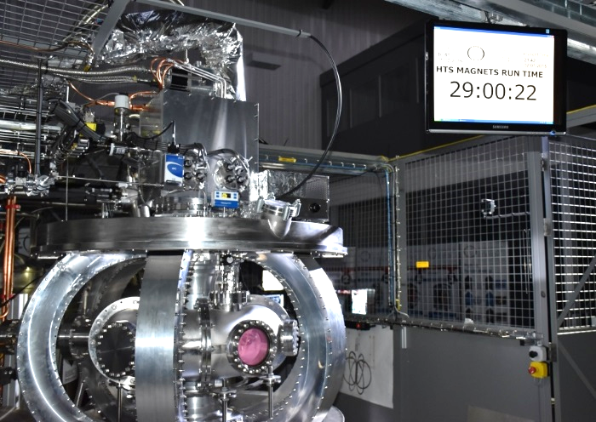
ST25(HTS): Long pulse – July 2015
ST25(HTS)
6 TF return limbs cooled ‘cryo-free’ to ~20K using single Sumitomo cold head; 2 PF coils, cooled by He gas to 20-50K
6 limb cryostat machined from solid aluminium to TE design.
Achieved good cryostat vacuum; 29 hour run obtained in July 2015, using 13MHz helicon (600watts).

Slide 11
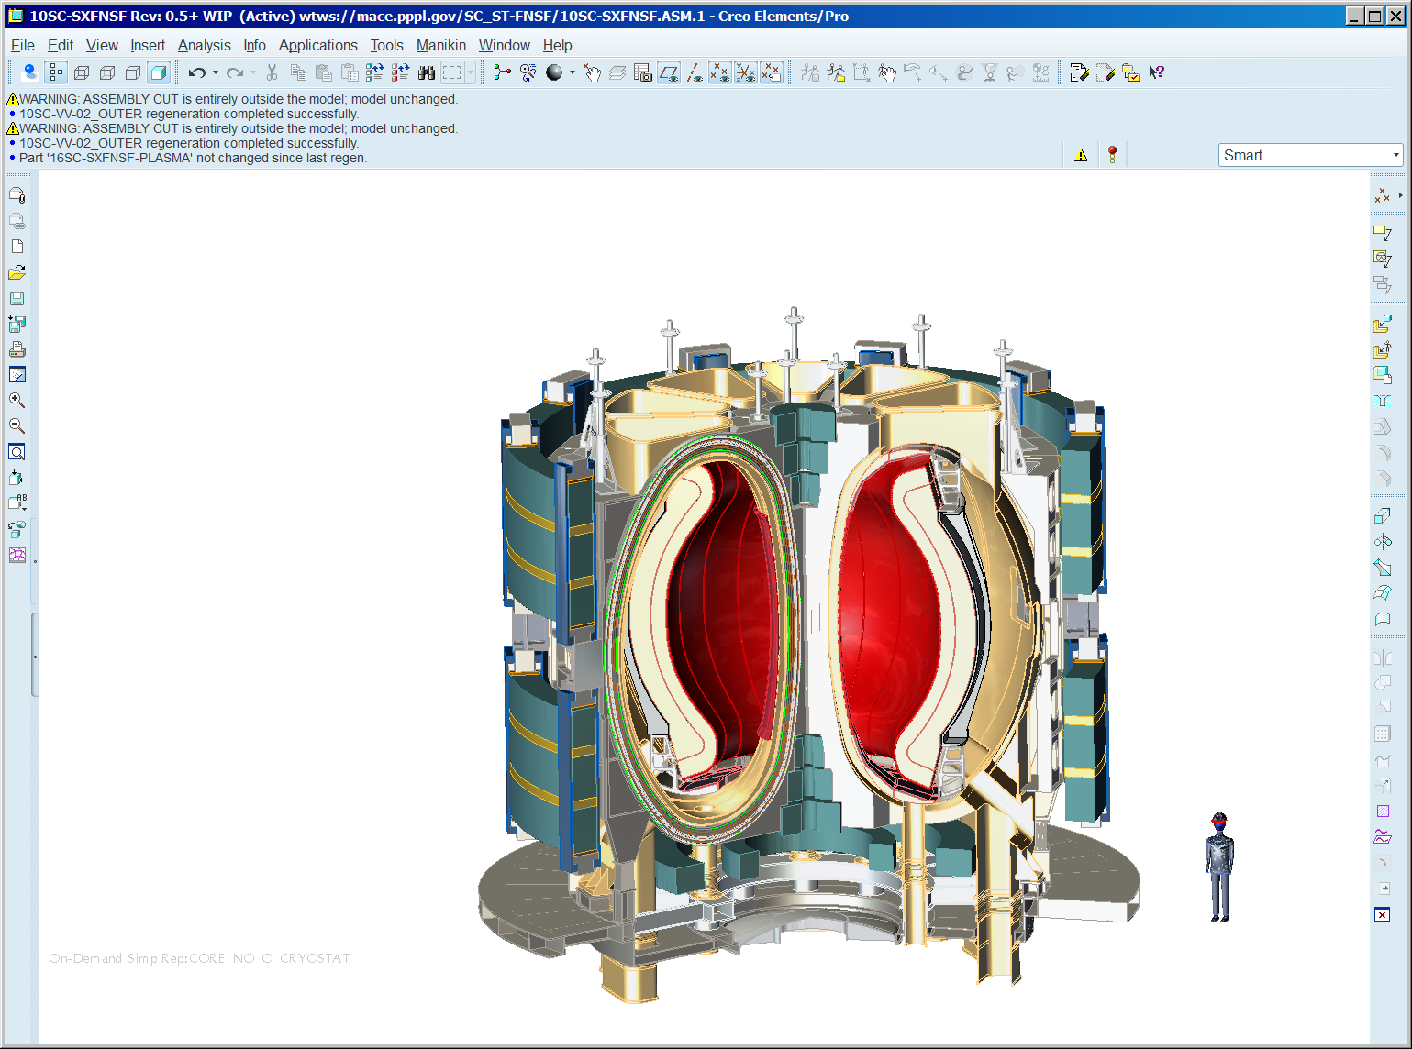
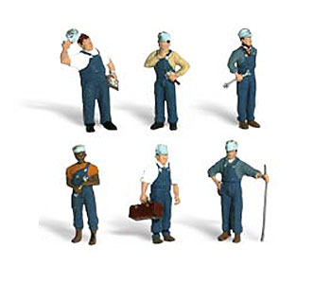
ST140: a Spherical Tokamak pilot plant
This concept pilot plant of Ro=1.4m,
volume ~40m³,
field > 3T,
ReBCO HTS magnets,
32cm tungsten-carbide neutron shield has fusion power of 185MW
at a wall loading of 1.8MW/m².
(Design by Menard/Brown,
PPPL for Tokamak Energy)

Slide 12

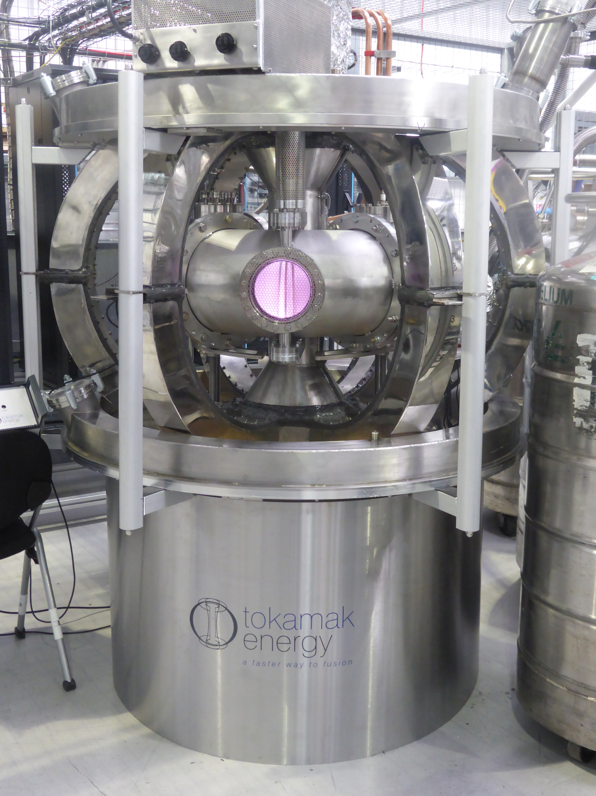
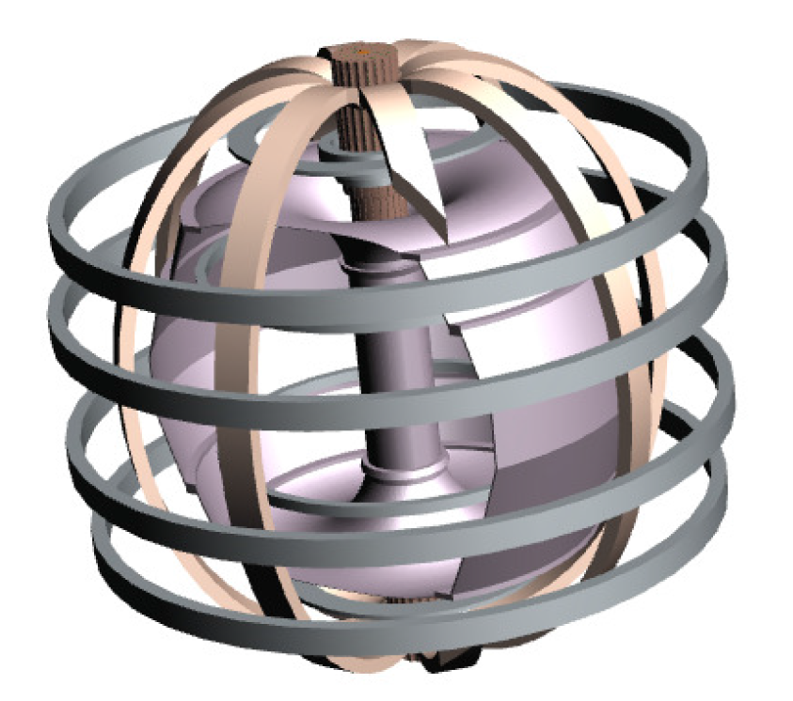
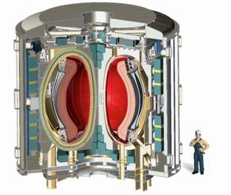
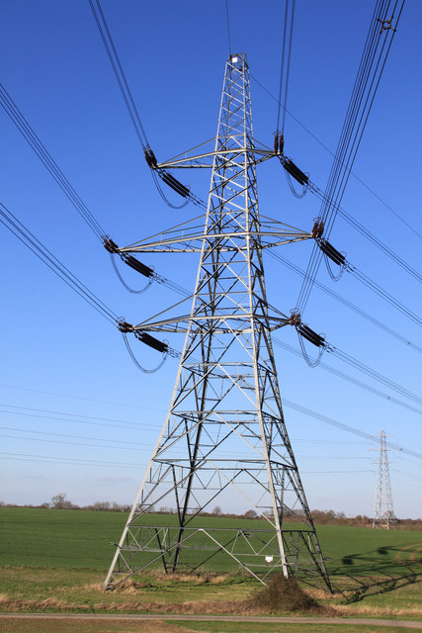

Global Agenda Council on Decarbonizing Energy
What? Fusion power in compact tokamaks.
Potential? Compact devices can be developed quickly.
Market Introduction? Off-grid first.
Acceleration? Additional investment
Cost and affordability? Gets better with volume
Feasibility and Scalability? Feasibility is the big challenge

Slide 13
THANK YOU
@tokamakenergy
#fasterfusion
www.tokamakenergy.co.uk
Notes:
Thank you for your interest. If you have any queries please do get in touch.

Slide 14
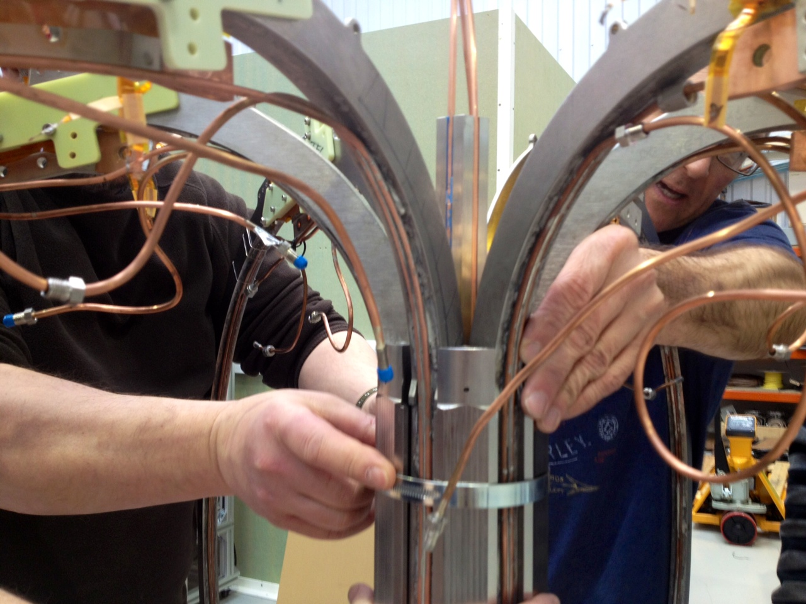
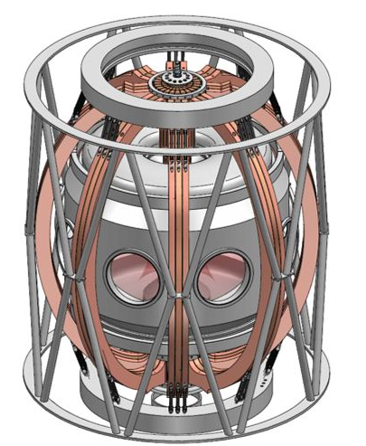
Engineering Challenges
High Field Superconducting Magnets
Magnet engineering to deal with stress and strain
Quench protection
Availability of materials to meet our specification
Tokamak Engineering
Efficient neutral beams and RF devices for heating and current drive
First wall, divertor and neutron shielding materials

