Slide 1
Fusion Energy Development at ORNL
(non-US ITER)
Phil Ferguson
Fusion Power Associates 36th Annual Meeting
December 17, 2015

Slide 2
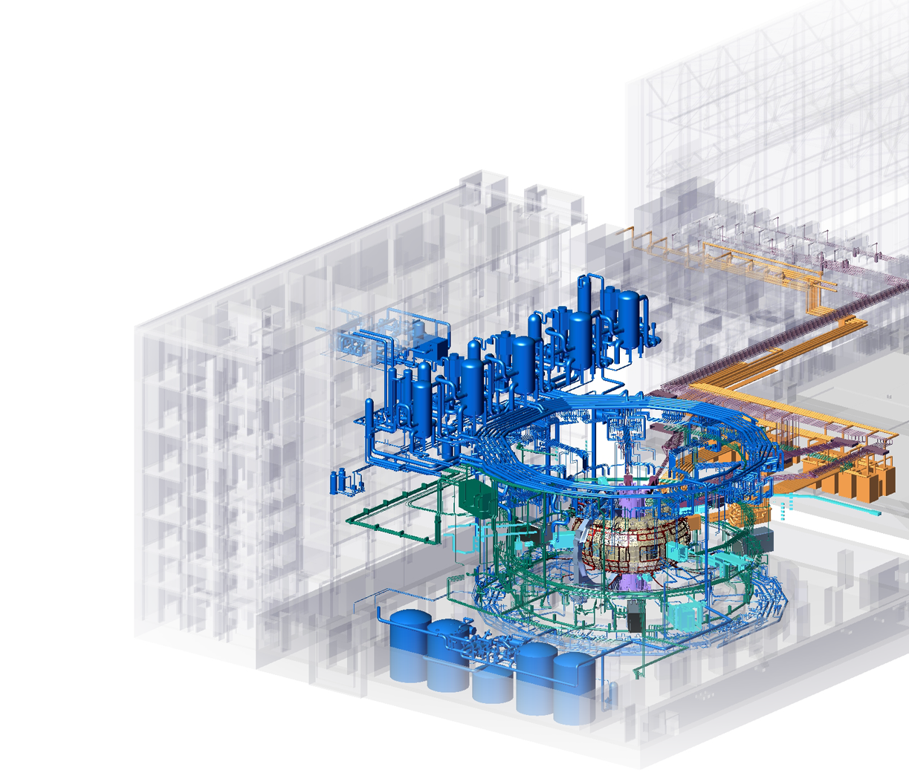
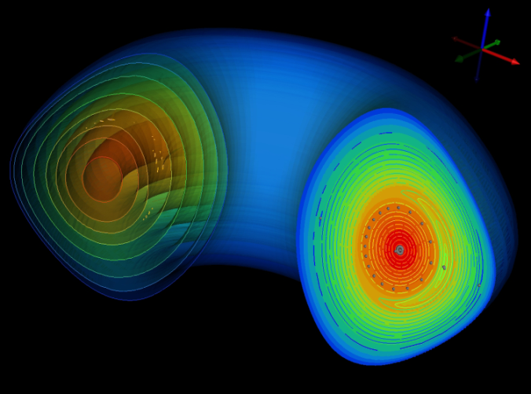
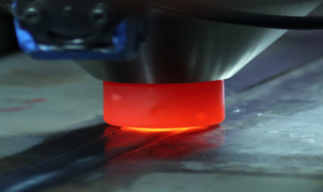
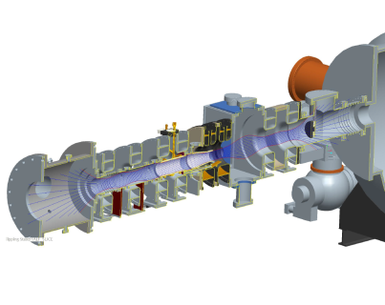
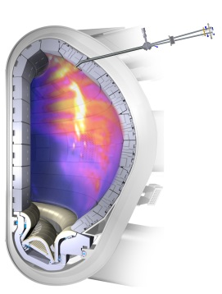
Delivering fusion nuclear science for the ITER era and beyond
Planning and executing R&D contributions to US ITER
Understanding the plasma-materials interface through experiment and modeling
Developing theoretical & computational tools to explore and understand present and future fusion devices
Delivering technology advances for plasma heating,
fueling, control, and fusion materials science
Collaborating nationally & internationally to achieve high impact outcomes for fusion energy
Prototype Materials-Plasma Exposure eXperiment
(Proto-MPEX)
Fusion theory
and simulation
Modern materials science
Plasma transient control

Slide 3
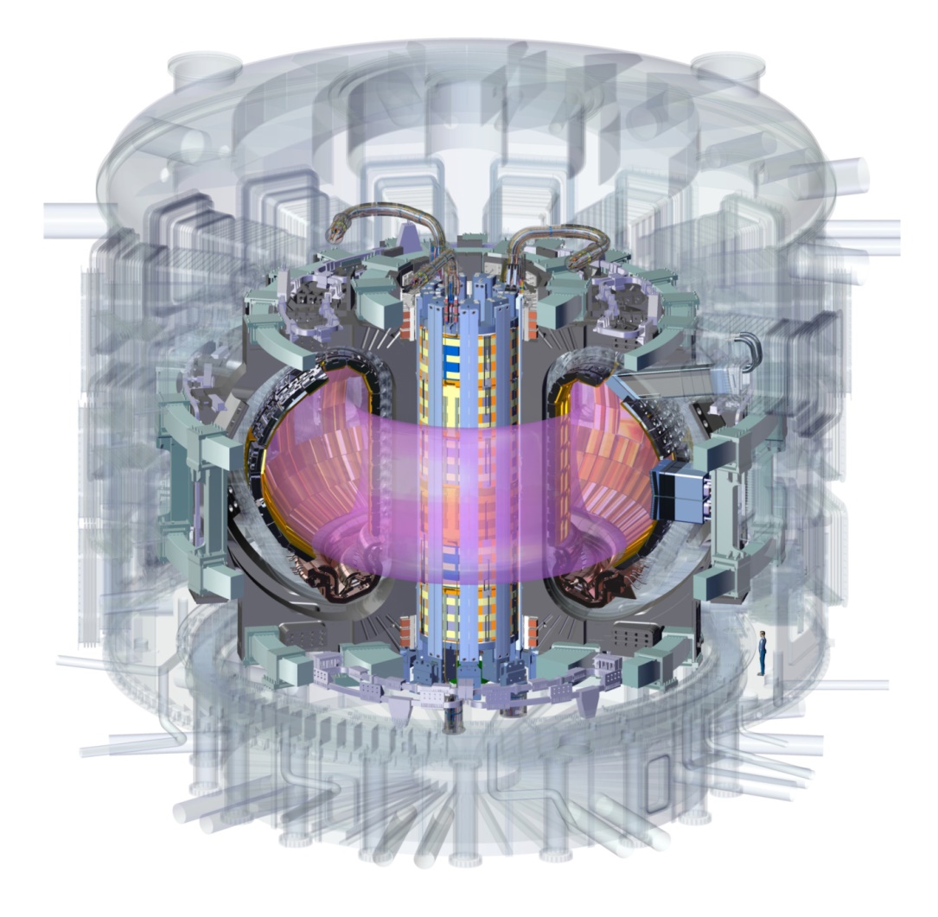
US ITER is Providing Enabling Technology to Confine, Heat and Fuel the Plasma; Pump (He, D, T); Recycle T; Cool the Walls; Optimize Performance
Central Solenoid
Windings
Toroidal
Field Conductor
Pellet Injector
Disruption Mitigation
Blanket/Shield
(design only)
Tokamak Cooling Water System
Steady State
Electrical Network
14% of Port-based
Diagnostics
88% Ion Cyclotron
Transmission Lines
88% Electron
Cyclotron
Transmission Lines
In-Vessel Coils
(prelim. design only)
Roughing Pumps,
Vacuum Standard Components
100% Tokamak Exhaust
Processing System
SCALE
Significant R&D must be accomplished by the US fusion community for the success of ITER
Notes:
Magnet systems (mainly CS): Mike Cole
Pellet Injector and Disruption Mitigation: including Larry Baylor, Steven Combs, Charlotte Barbier, Steve Meitner, William McGinnis, Paul Fisher, Michael Morrow III, Tam Ha
Cooling Water: including Graydon Yoder, David Felde, Richard Hale
Ion Cyclotron: including Rick Goulding, Charlotte Barbier, Phil Pesavento, Terry White, Ian Campbell
Electron Cyclotron: including Tim Bigelow, Mike Kauffman, John Caughman
Diagnostics: Ted Biewer, Christopher Klepper, Michael Morris, Van Graves
Vacuum and Roughing Pumps: Larry Baylor, Steve Meitner, Robert Duckworth, Steven Combs
In-Vessel Coils: Robert Duckworth

Slide 4
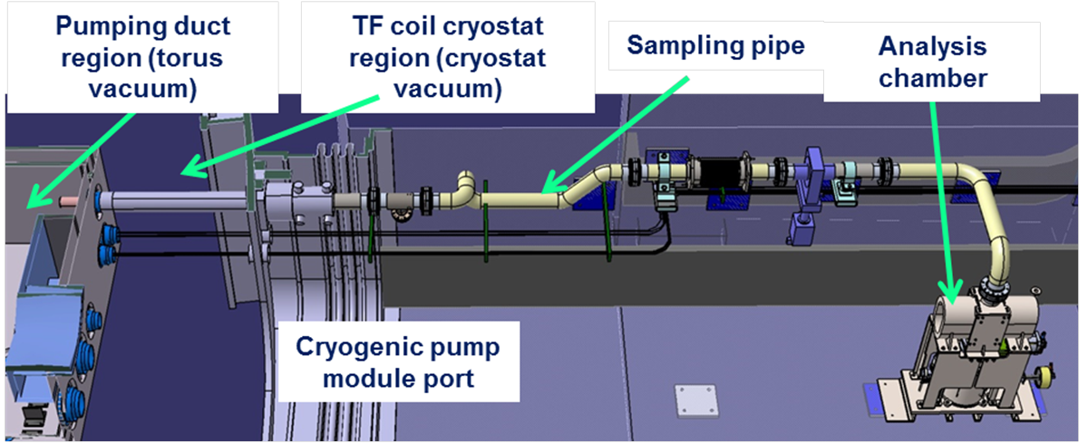
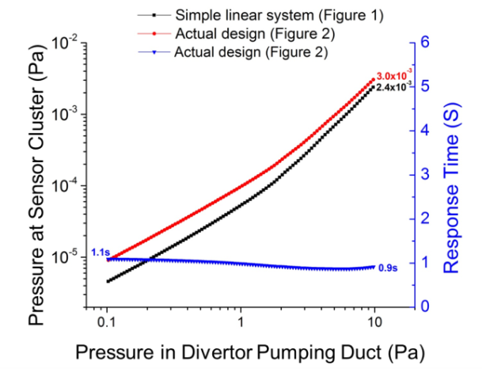
Design of the diagnostic residual gas analyzer (DRGA) for the ITER divertor
ITER plasma diagnostic that is:
  fast (~1 s) response time
  located more than 7m away from the sampled region
  Available on the first day of operations
C. C. Klepper et al., Fusion Engineering and Design 96–97, October 2015, pp 803-807 http://dx.doi.org/10.1016/j.fusengdes.2015.04.053)

Slide 5
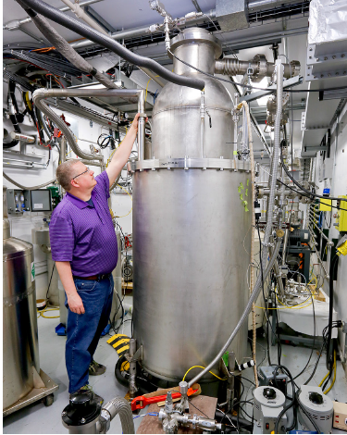
Full Scale ITER Prototype Cryo-Viscous Compressor (CVC) Demonstrates Ability to Handle D₂/He mixtures During Initial Testing at SNS
CVC was designed to separate helium ash from deuterium/tritium fuel in ITER exhaust gas stream
Testing conducted at SNS Cryogenic Test Facility to utilize super critical He supply (7 g/s at 5.0 K and 2.6 bar)
Low pressure (2,000 Pa) and high pressure (20,000 Pa) gas mixtures of D₂ and He were added to test performance of the CVC
Initial results indicate CVC was able to handle 20 g (12,650 Pa-m³) of D₂/(0.5%) He at a flow rate of 134 Pa-m³/s
Detailed analysis of test data is underway to determine best means to reach target performance
CVC installed in SNS Cryogenic Test Facility

Slide 6
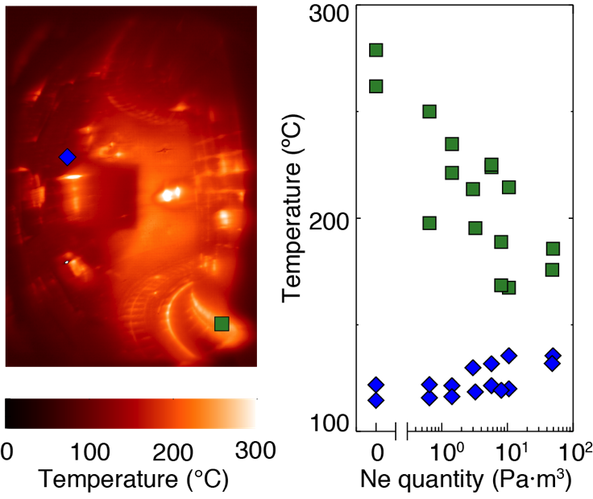
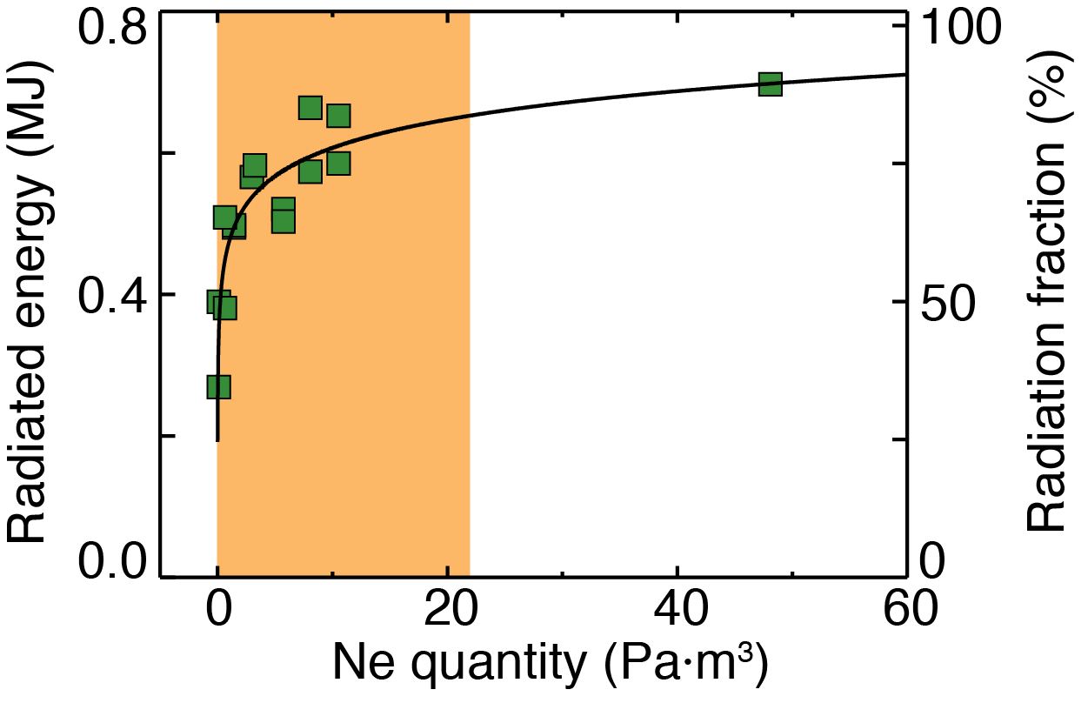
Disruption mitigation studies for ITER show ability to vary thermal and current quench
Shattered pellet injection is the primary method for ITER disruption mitigation system being designed by ORNL
Mixed species (Ne/D₂) shattered pellets allow control of mitigated disruption properties in DIII-D tokamak
Variation of neon quantity in pellet allows control of thermal quench and current quench properties in order to meet ITER targets
Mitigation metrics saturate at modest neon quantities, within injection limits anticipated for ITER
Scaled ITER
quantities

Slide 7
The Plasma Durations Required for an FNSF Involve a Large Leap Compared to Present/Planned Facilities
β_{N}
Power Plant
6
ACT1
5
Range of power plants
KSTAR
4
JT-60SA
3
EAST
FNSF
DEMO
Present facilities
ITER
ACT2
2
Pulse length, s
10⁰
10¹
10²
10³
10⁴
10⁵
10⁶
10⁷
1 day
2 weeks
Shamelessly stolen from Chuck Kessel, via H. Neilson

Slide 8
Fusion Energy Sciences identified this issue and structured the budget in recognition
Plasma sustainment
Materials
Enabling Technologies

Slide 9
Fusion materials are a serious issue that need more attention
A combination of neutron sources leading to understanding of radiation damage is our best path forward
  High damage rate from reactors (e.g., HFIR)
  High He production through implantation, spallation sources, etc.
PMI science must become a priority
  Use the sources we have to develop understanding in a organized, consistent manner
  “All of the above” solution on sources: linear and tokamak
This is a global problem; we must continue to work globally and expand
  Continue PHENIX, add EUROfusion?

Slide 10
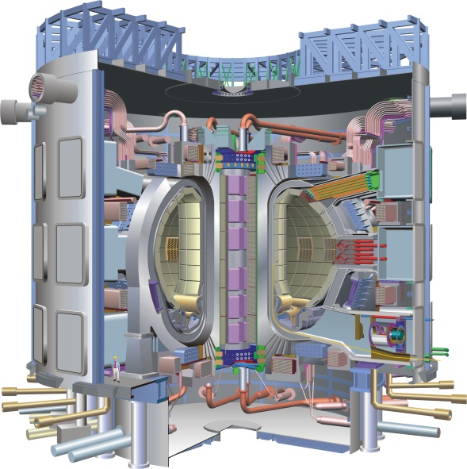
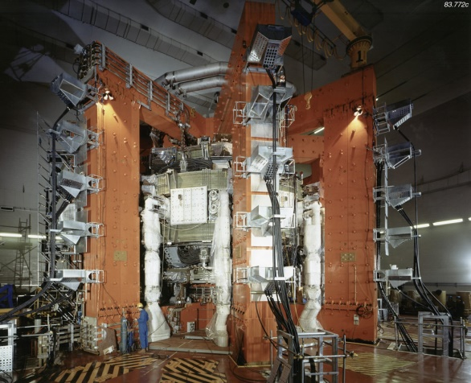
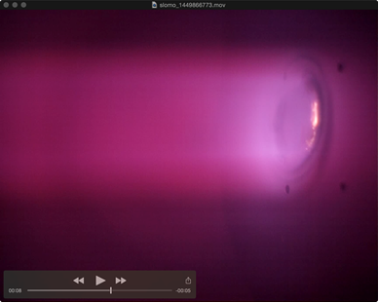
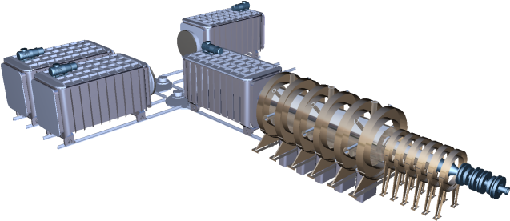
Challenges for divertor plasma facing components: fluxes and fluence
JET ITER Fusion Reactor
MPEX is ORNL’s initiative to address this regime
ITER divertor plasma parameters
Plasma Density ~ 10²⁰ - 10²¹ m⁻³
Temperature ~ 1 - 15 eV (11000 - 150000 K)
Ion fluxes ~ 10²³ - 10²⁴ m⁻²s⁻¹
Power fluxes ~ 10 MW/m²
Parameter range is inaccessible in present tokamaks and materials test facilities
50 times higher ion fluxes
5000 times higher ion fluence
up to 5 times higher ion fluence
1000000 times higher neutron fluence
100 times higher neutron fluence
MPEX will allow advancing PFCs from TRL3 to TRL4 and up to TRL6 for some end of lifetime studies

Slide 11
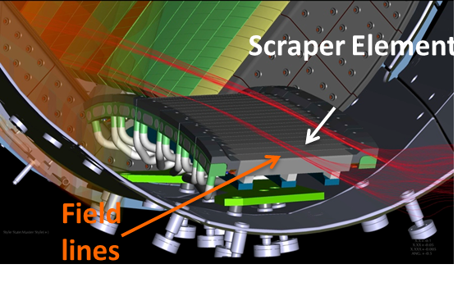
Advancing in long pulse means collaborating with SC tokamaks and W-7X
Congratulations to the W-7X team for their great accomplishment!
I believe we should continue to collaborate with them, building on the successes to date
Now is the time to understand how we reap the scientific benefit from a “large, overseas facility”
  Universities are getting involved, GREAT!

Slide 12
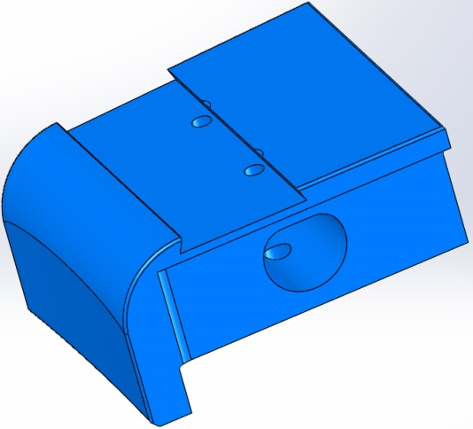
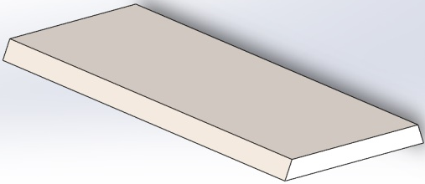
Metal tile project at DIII-D aimed at impurities
High-Z impurity sourcing & transport in the edge plasma with & without ELMs
Gradual migration across PFC surfaces to areas that can in-turn contaminate the confined plasma
2 W ‘strips’: ~5cm wide; ~1 micron thick
  Full toroidal tile arrays - mostly
  W coated Mo inserts
Divertor Tile &
Metal Insert

Slide 13
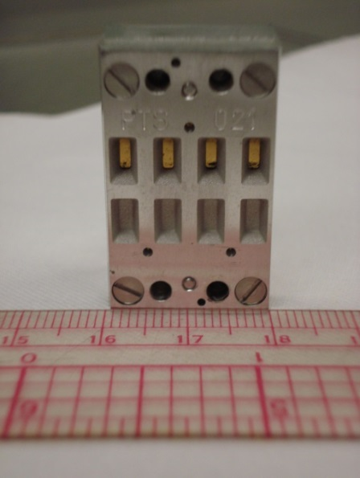
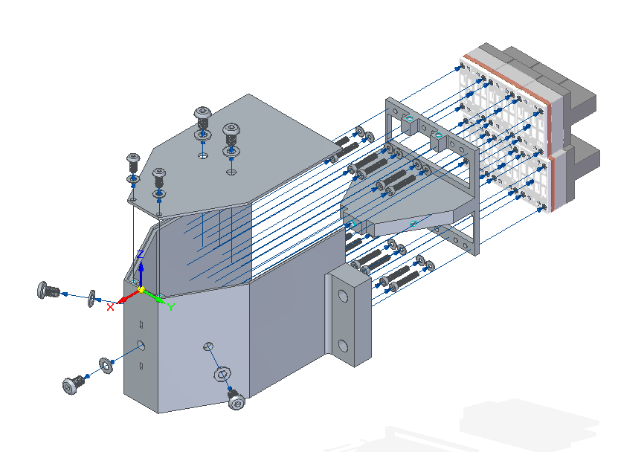

Collaborations with PPPL on New Tools for Measuring Radiated Power on NSTX-U
Upgrades to the National Spherical Torus Experiment-Upgrade (NSTX-U) spherical tokamak at the Princeton Plasma Physics Laboratory include enhanced heating power; future research will focus on radiative heat exhaust.
ORNL is leading development of a variety of new and innovative tools to measure radiative power loss.
  conceptual design activities completed for resistive bolometer tools to measure core and boundary emission, including innovations to improve sensor survivability; procurement underway.
4-ch resistive bolometer sensor
  developing and deploying a prototype IR-based imaging bolometer in collaboration with NIFS and DIFFER; design and initial benchtop testing presented at APS-DPP meeting in November.
  exploring a concept for a new radiation detector which uses fiber optic temperature sensing with Dr. Ming Han at the University of Nebraska.
New radiated power diagnostics will complement existing ORNL heat-flux diagnostics and simulation capabilities.
24-ch core pinhole camera for NSTX-U

Slide 14
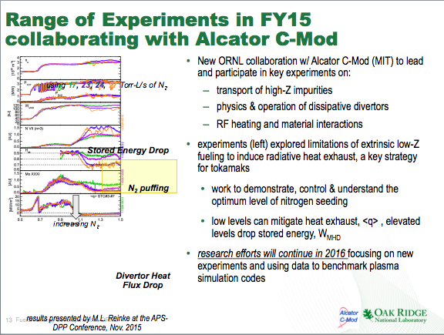

Slide 15
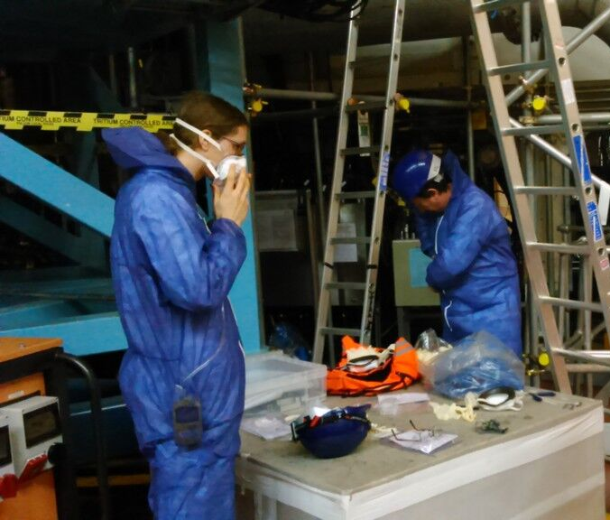
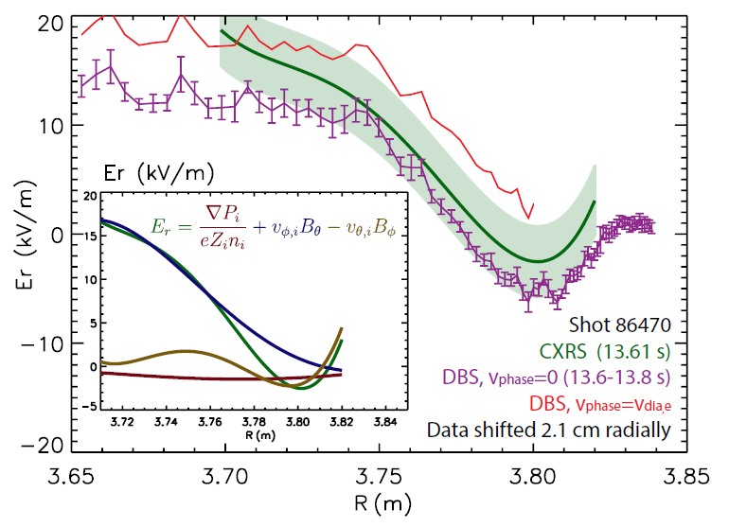

ORNL researchers work on JET restart after long, productive shutdown
In the fall JET ended a multi-month shut-down and entered a restart phase ahead of its 2015-2016 experimental campaign
During the long shutdown, a number of diagnostic hardware upgrades and calibrations involved ORNL personal, as part of a collaboration that has been in place for over three decades
One of the systems undergoing maintenance and calibration was the Edge CXRS (Charge Exchange Recombination Spectroscopy), a system important for measuring plasma motion and ion temperature in the boundary region, which helps to understand the physics behind the attainment of high energy confinement modes (“H-modes”)
Ephrem Delabie, putting on personal protection equipment ahead of reinstallation of the refurbished periscope.
Like JET, ITER will also operate with a beryllium (Be) wall.
  Performing maintenance and upgrade work on diagnostics in an environment with Be dust (and at times also tritium contamination) helps to build-up operational expertise for ITER
Right: Validation of radial electric field measurements by comparison of edge CXRS and Doppler backscattering.
[J. Hillesheim, E. Delabie et al., submitted to Phys. Rev. Letters]

Slide 16
Conclusions
We need to be united behind ITER, and do everything we can to make it successful
The challenge of long pulse operations is significant and needs attention
  Materials, enabling technologies, & sustained plasma operations
Together we can solve the problems on the road to fusion energy
  Exploit our excellent national facilities
  Collaborate internationally as well

