Slide 1
Status of US Contributions
to the ITER Project
Ned Sauthoff
US ITER Project Manager
Oak Ridge National Laboratory
Fusion Power Associates 33rd Annual Meeting
6 December, 2012
Washington, DC

Slide 2
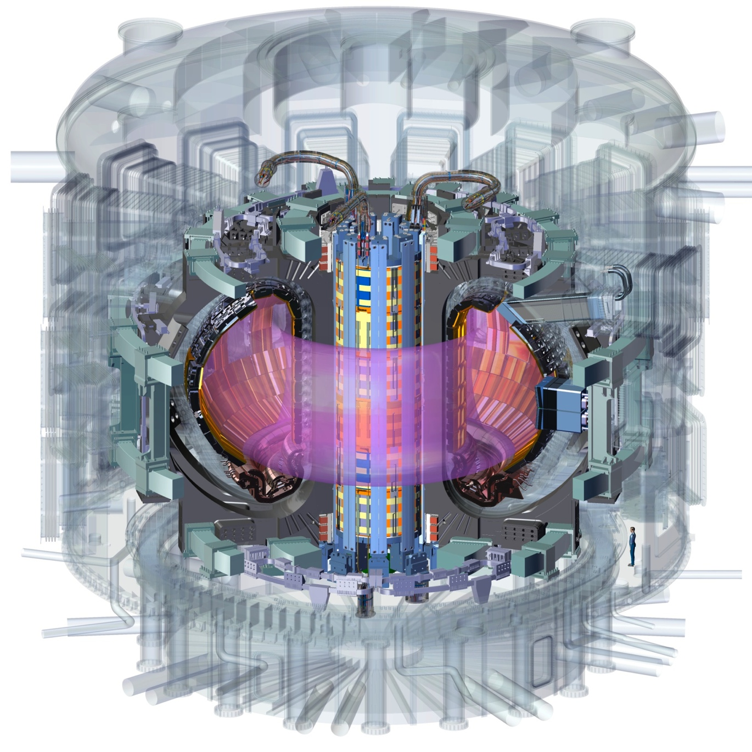
Contents
Status of US Industrial Contributions
Magnets & Superconductors
Cooling Water System
Vacuum and Exhaust Processing
Electron and Ion Cyclotron Heating
Steady State Electrical Network
Diagnostics
Pellet Injection
Plasma Disruption Mitigation

Slide 3
US Scope is Managed by ORNL in partnership with PPPL, SRNL and US Industry
ORNL
100% Central Solenoid
Windings
+ JA Support
ORNL
8% of Toroidal
Field Conductor
+ JA Support
ORNL
100% Pellet Injector
100% Disruption Mitigation
ORNL
Blanket/Shield
(design only)
ORNL
100% Tokamak Cooling Water System
PPPL
75% Steady State
Electrical Network
PPPL
14% of Port-based
Diagnostics
ORNL
88% Ion Cyclotron
Transmission Lines
ORNL
88% Electron
Cyclotron
Transmission Lines
PPPL
In-Vessel Coils
(prelim. design only)
ORNL
100% Roughing Pumps,
Vacuum Standard Components
SRNL
100% Tokamak Exhaust
Processing System
SCALE

Slide 4
US Hardware is Highly Integrated
with the Tokamak Core
Cooling Water System (TCWS)
ICH Transmission System
ECH Transmission System
Vacuum Auxiliary System (VAS)
Port Diagnostics
Central Solenoid (CS) Coil
Toroidal Field (TF) Coil (1)
Blanket/Shield (design only)
Pellet Injection (PI) &
Disruption Mitigation (DM)
Not Shown:
Roughing Pump System (RPS)
Steady-State Electrical Network
(SSEN)
Tokamak Exhaust Processing
(TEP)

Slide 5
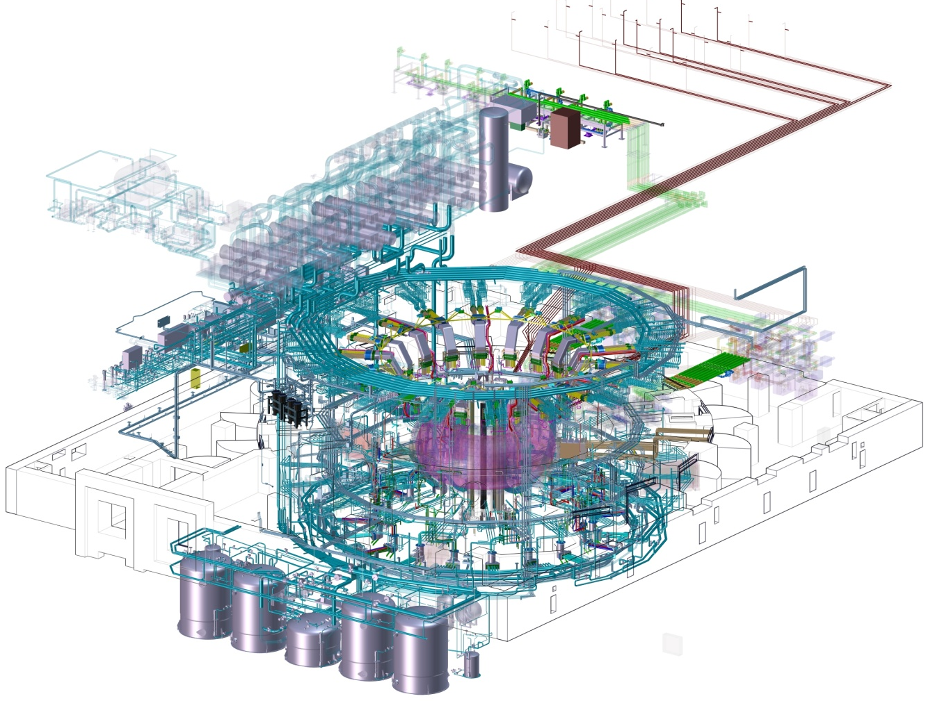
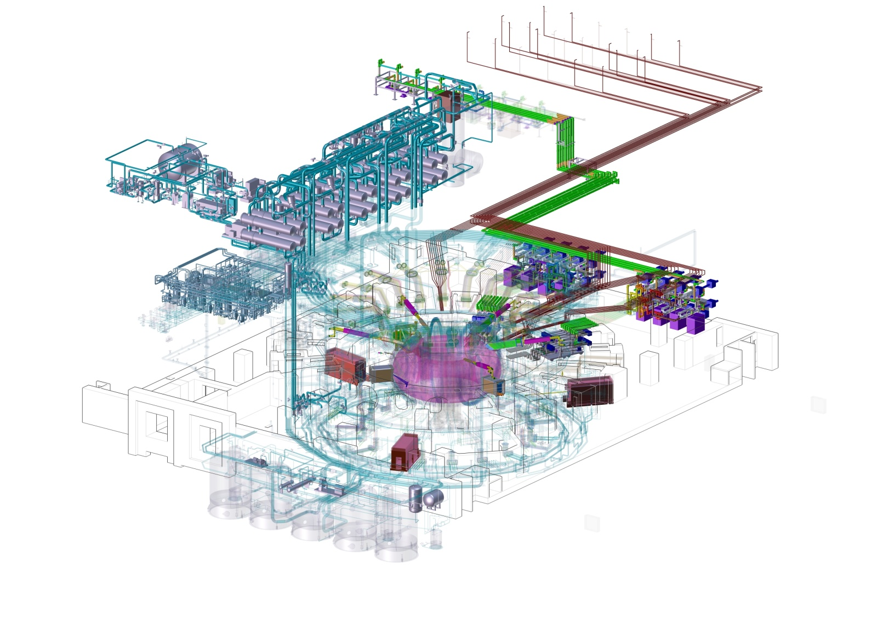
US Scope is Delivered in Two Phases
First Plasma
Post-First Plasma
Designs
CS Coil & TF Conductor,
TCWS, VAS/RPS, TEP, SSEN
Diagnostics
PI & DM
Design Support
In-vessel coils
Blankets/shields
Full Production
CS Coil & TF Conductor,
RPS, SSEN
Partial Production
ICH/ECH, TCWS, VAS
Production Completion
ICH/ECH
TCWS
VAS
Full Production
TEP
Diagnostics
All designs completed
during Pre-First Plasma
phase.

Slide 6
Transitioning from
Design to Fabrication
From developing requirements to completing designs
From R&D to large-scale prototypes
From prototypes to large-scale manufacturing
To fabrication

Slide 7
US Progress is Aligned
with International Partners
First shipments of US hardware to ITER site are already underway (vacuum test equipment)
Critical pacing items currently in fabrication
Toroidal field conductor
Drain tanks for tokamak cooling water system
Over 75 hardware prototypes under development & testing.
7

Slide 8
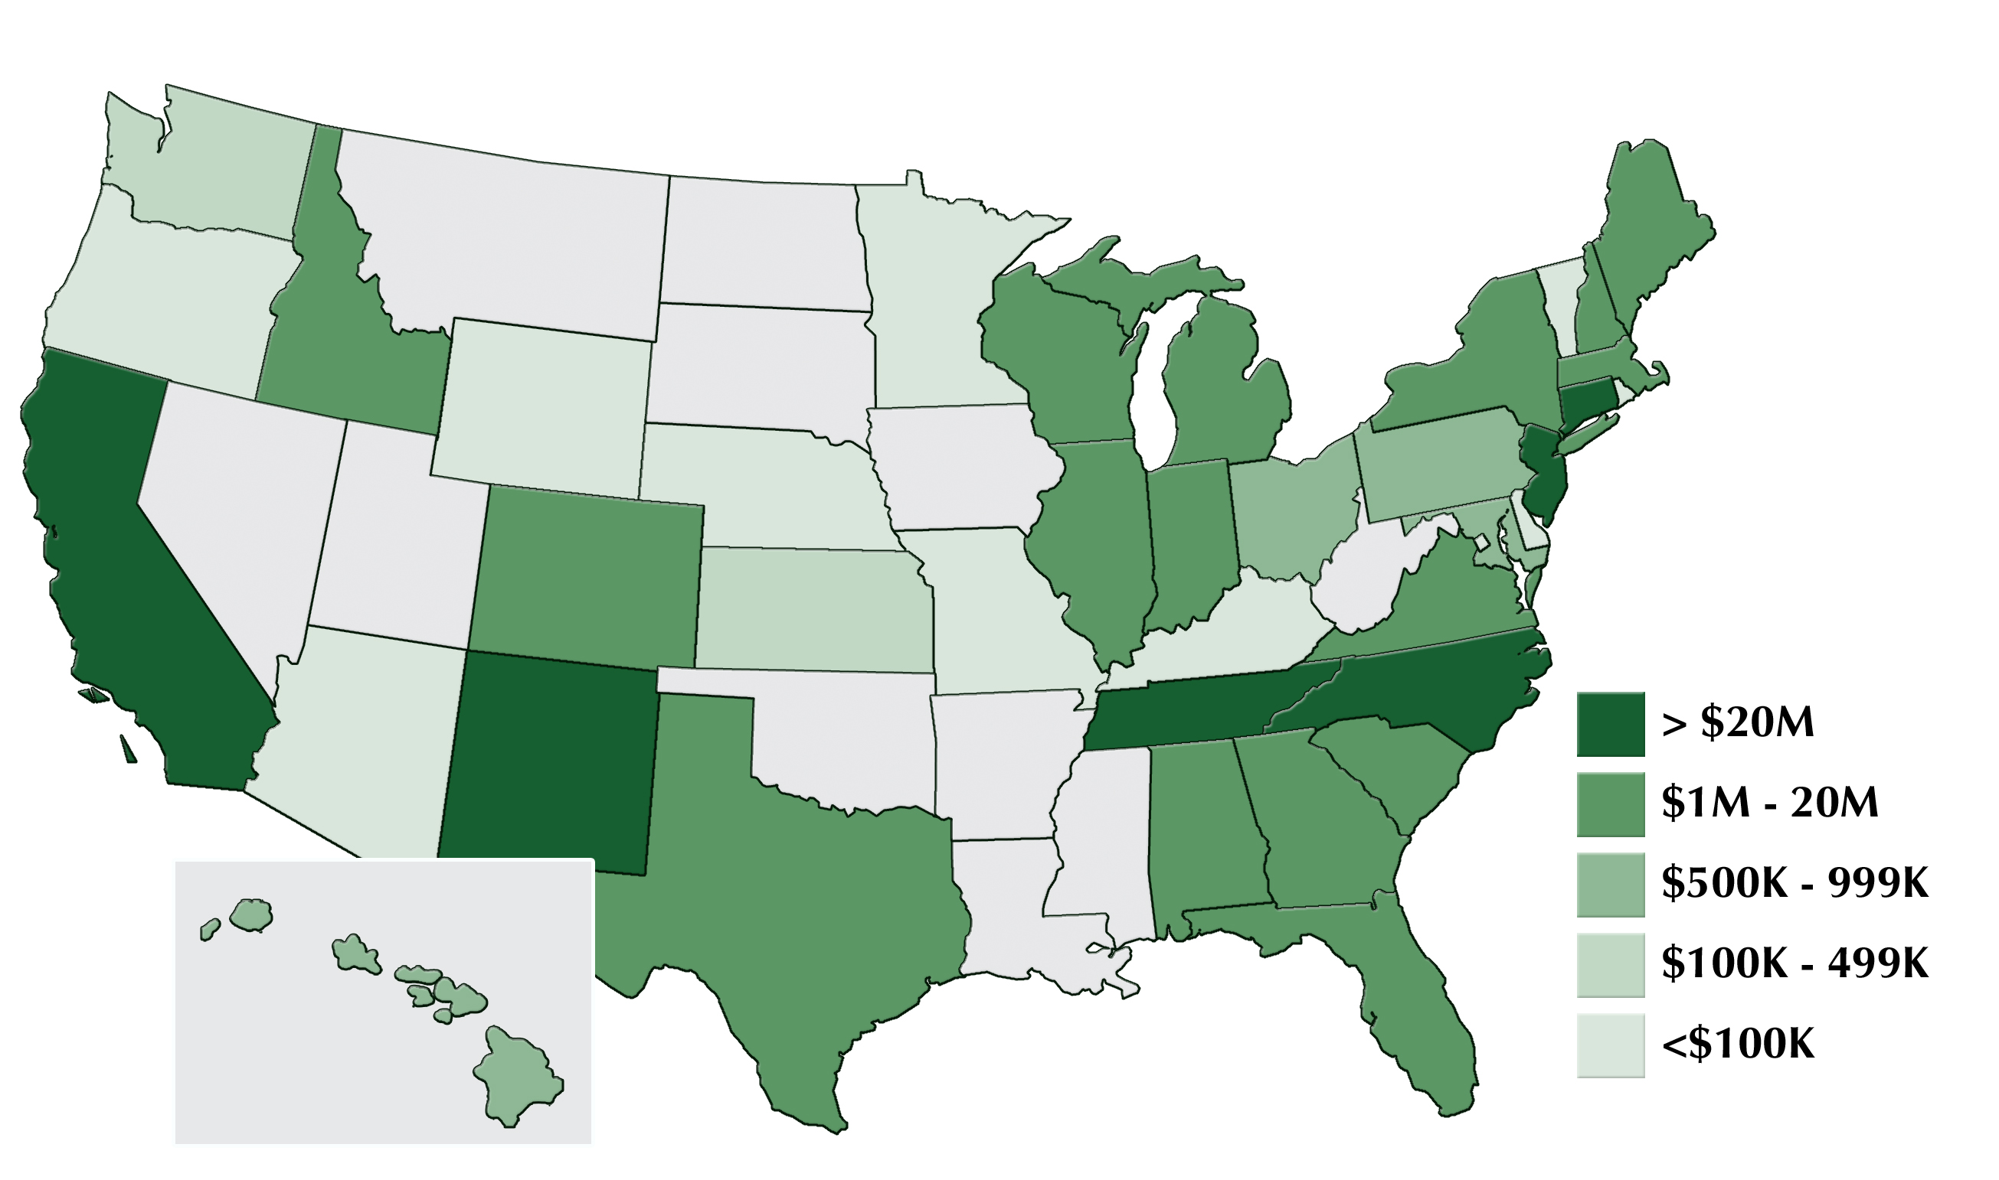
Over 80% of Project Funding
is Being Spent in the US
Industries, Universities, and National Laboratories Obligations
Total = ~$446M
Data accurate through September 30, 2012

Slide 9
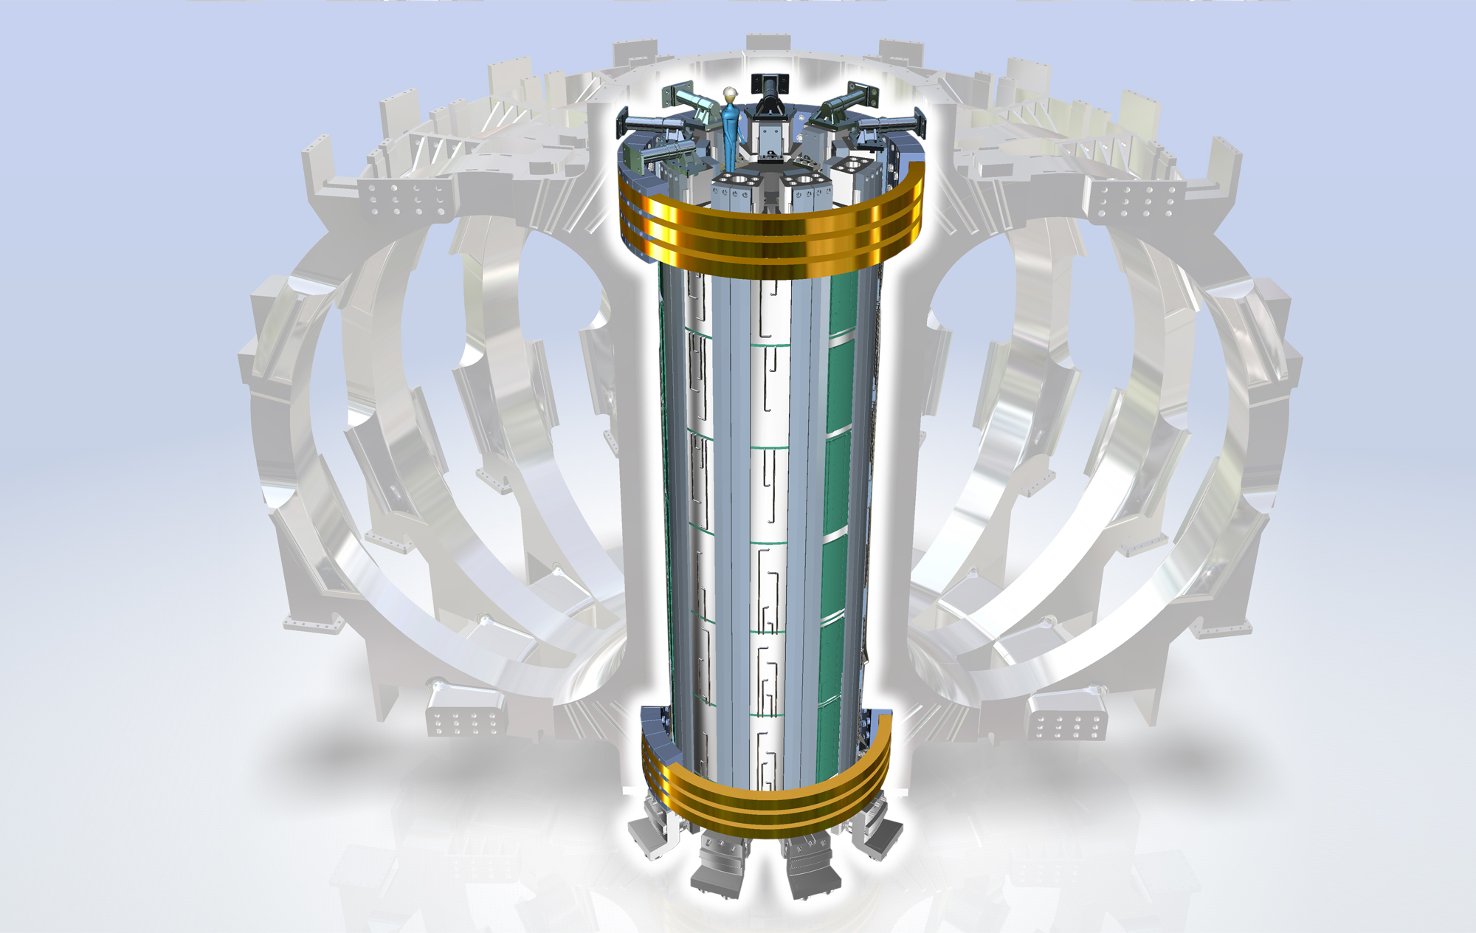
Central Solenoid Coil
13 Tesla
7 GJ
20 kV
1.2 T/s
Notes:
U.S. supplies 40 tons of Niobium-tin superconducting wire

Slide 10
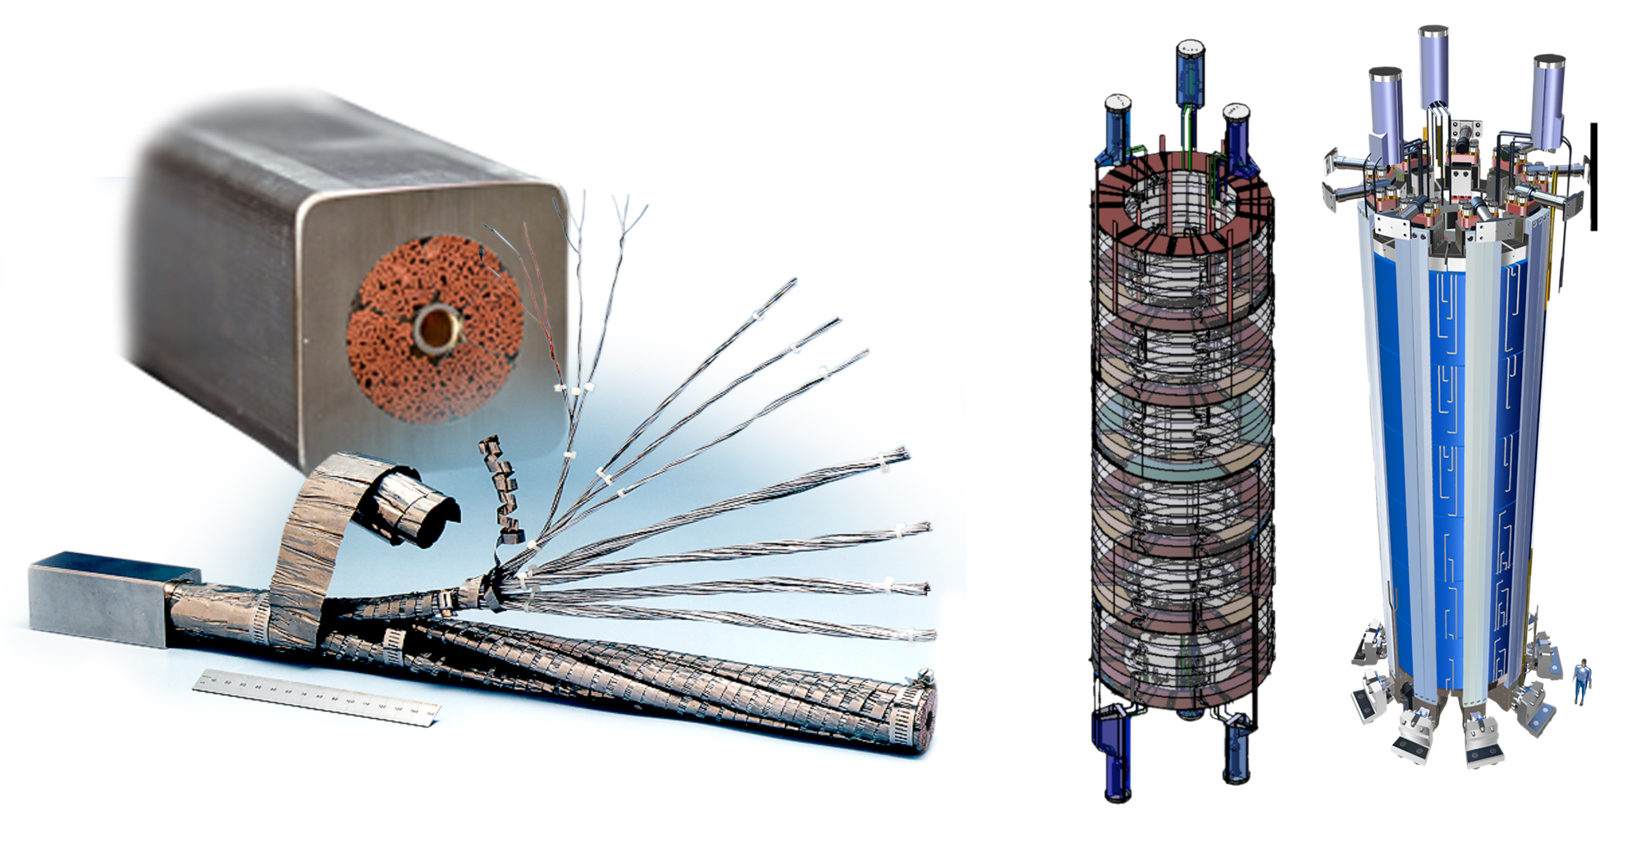
Central Solenoid Assemblies
JA CS Conductor Prototype
JA-Supplied Conductor
6 CS Coil
Modules
(+ one spare)
Integrated
CS Stack

Slide 11
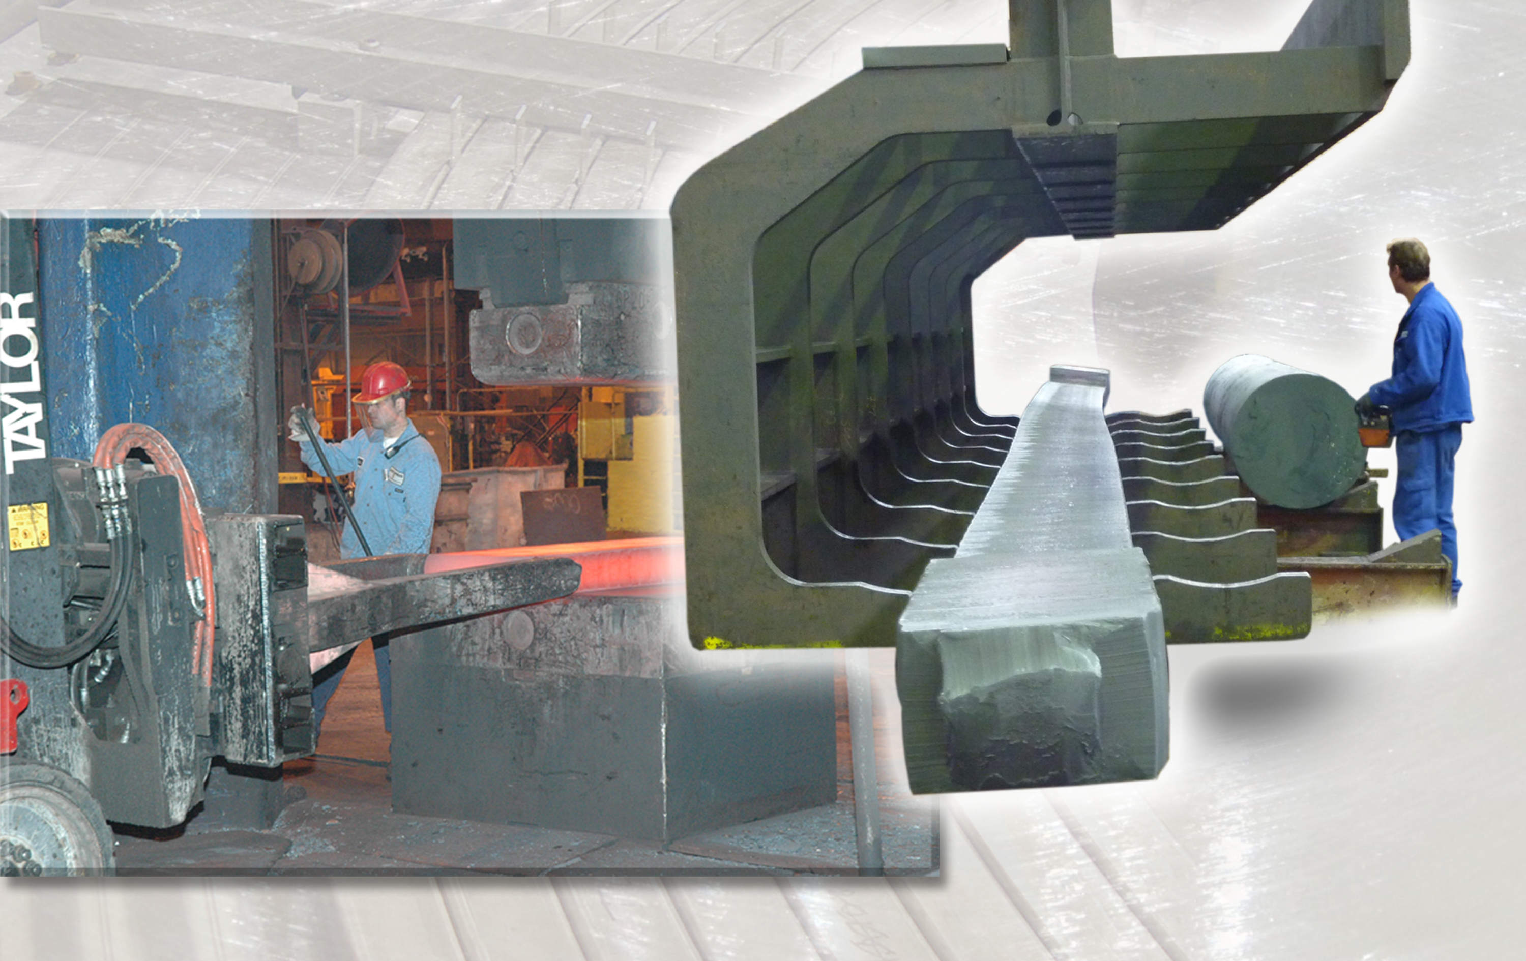
Central Solenoid Forging Prototypes
Welded Tie Plate Fabrication, Major Tool & Machine, Inc., Indianapolis, IN and Scot Forge, Spring Grove, IL.
One Piece Tie Plate Fabrication, G&G Steel, Russelville, AL and Kind LLC, Gummersbach, Germany

Slide 12
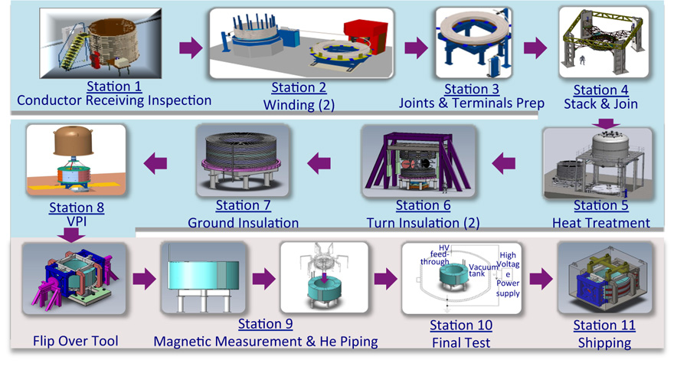
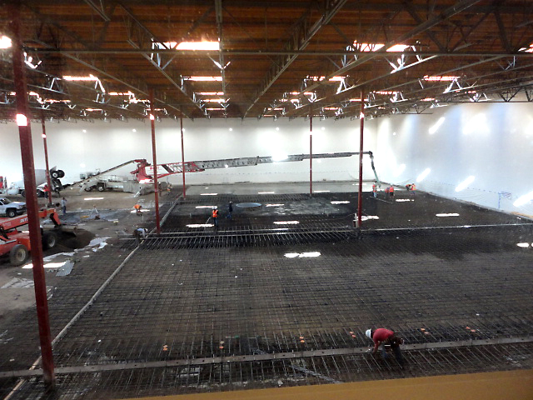
Central Solenoid Module
Fabrication Process at General Atomics
Preliminary Design Review held in Sept 2011 and R&D effort nearly complete
Contract for CS Module Fabrication awarded to General Atomics (GA) in July 2011
Fabrication of Production Module to begin in FY 2014
Module Manufacturing Facility in Poway, CA
Photo: General Atomics, San Diego, CA

Slide 13
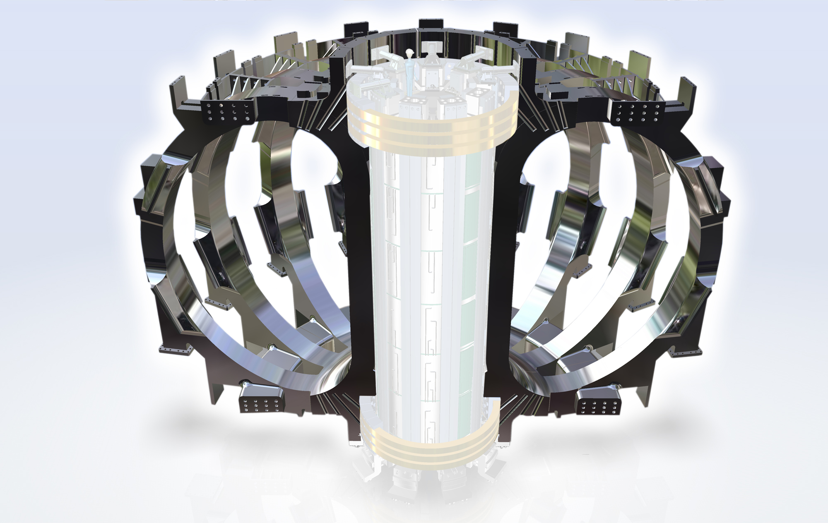
Toroidal Field Coil
11.8 Tesla
41 GJ
400 MN centering force
Notes:
U.S. supplies 40 tons of Niobium-tin superconducting wire

Slide 14
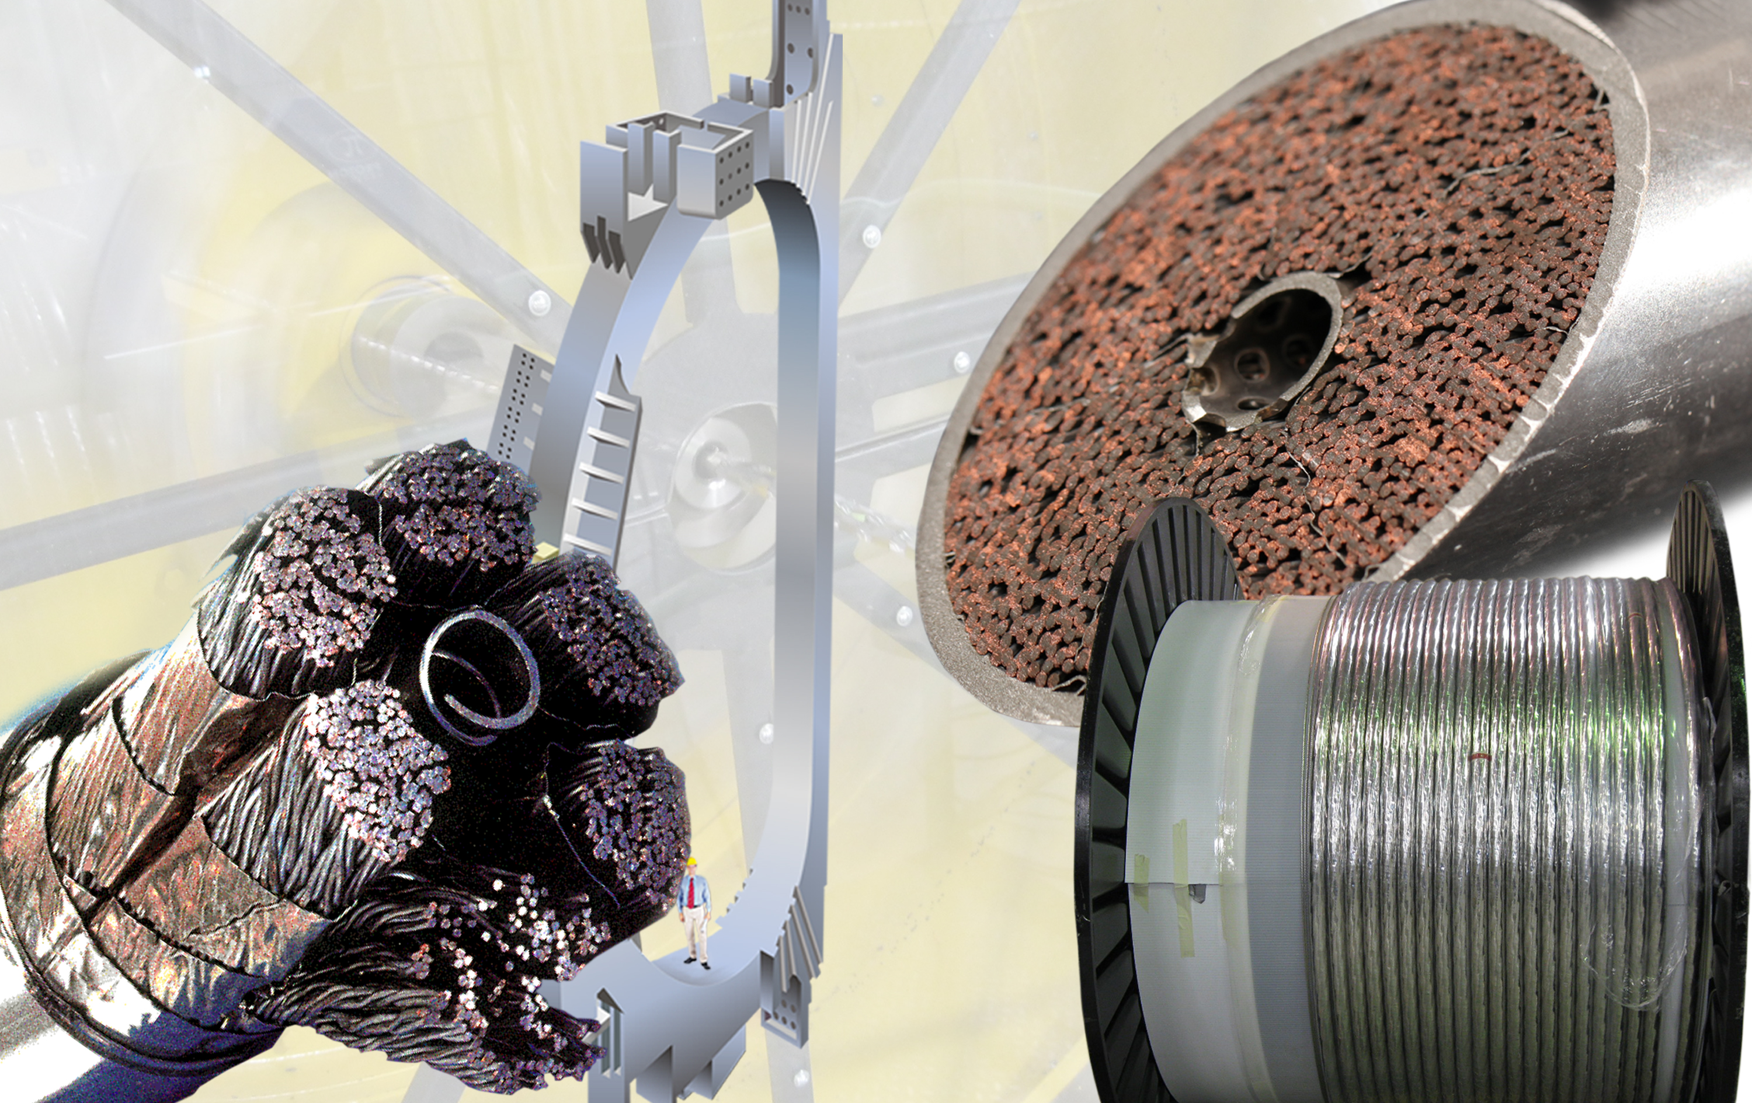
New US Production Scale for Nb₃SN
Notes:
Images: TCWS design and Stainless steel for drain tank fabrication being prepared for rolling at Joseph Oat Corporation in Camden, NJ.

Slide 15
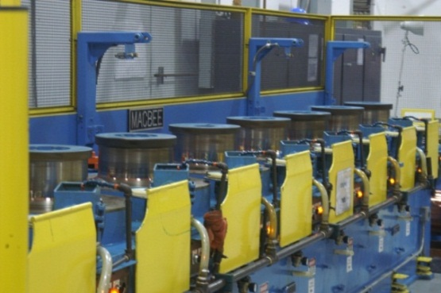
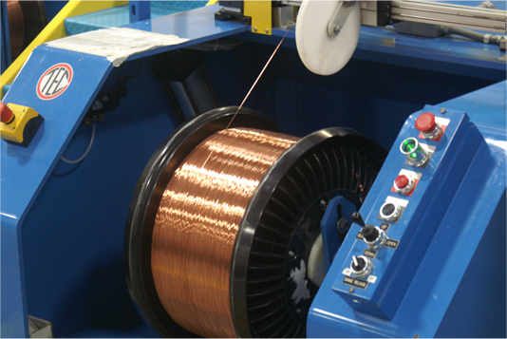
Oxford Superconducting Technology
– In Production
Completed all superconducting strand production included in
base awards. Additional strand being fabricated.
Oxford is now supplying EU with toroidal field strand.
Photos: Oxford Superconducting Technology, Carteret, NJ
Photos: Oxford Superconducting Technology, Carteret, NJ

Slide 16
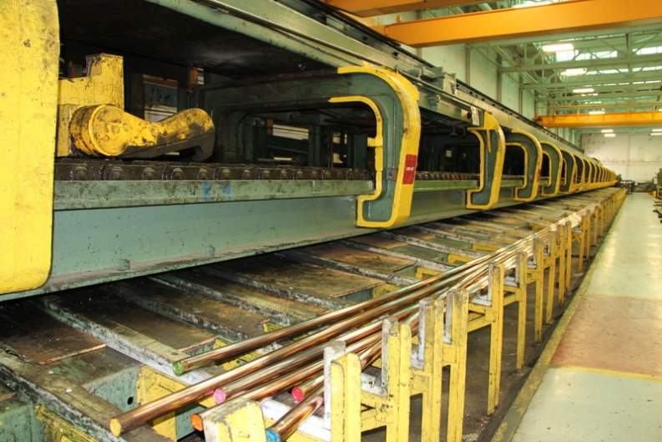
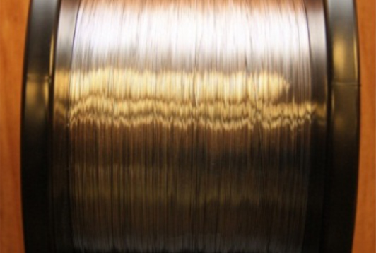
Luvata Waterbury – In Production
Completed all superconducting strand production included in
base awards.
Luvata Waterbury Inc. Assembled superconductor rods being drawn on their 400-ft long draw bench
Luvata is now supplying Korea with copper strand.
Photos: Luvata Waterbury, Inc., Waterbury, CT

Slide 17
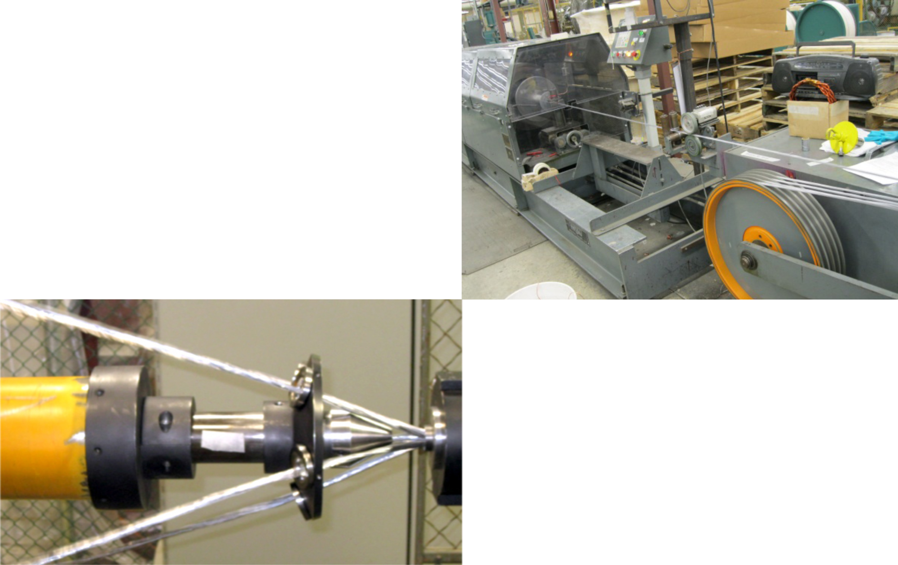
New England Wire Technologies Cable In Production
Completed refurbishment of 4th and 5th stage cabler and successfully cabled 770 m dummy conductor in June 2012.
Tubular cabler in production (Photo: NEWT, Lisbon, NH)
Planetary cabler into forming die (Photo: NEWT, Lisbon, NH)

Slide 18
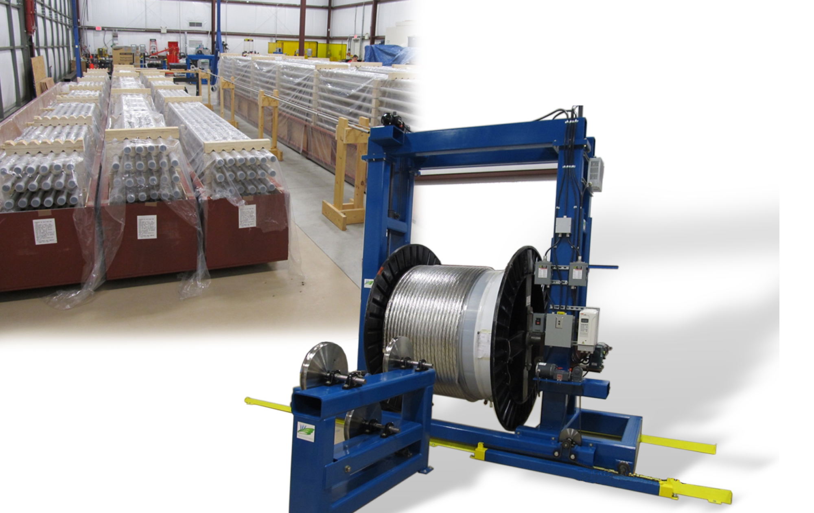
High Performance Magnetics – Production of Jacketed Conductor
New company formed to integrate cable-in-conduit for final jacketed superconductor.
Tube shipments in stored south warehouse (photo courtesy HPM, Tallahasse, FL)
All tube shipments received.
Production tooling: cable payoff and straightening machines (photo courtesy HPM, Tallahasse, FL)

Slide 19
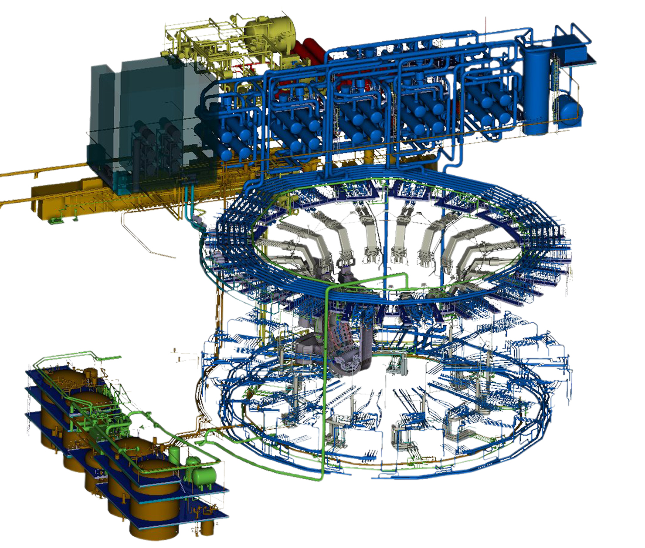
Tokamak Cooling Water System
Removes ~1 GW of heat
Plasma operations – 880 MW
Neutral Beam Injector (NBI): 85 MW
Vacuum Vessel (VV): 10 MW
Multiple functions
Water and gas baking
Plasma and decay heat removal
Confinement
Design nearing completion
~33,000 meters of pipe
Thermo-hydraulics well understood
System optimization underway
19

Slide 20
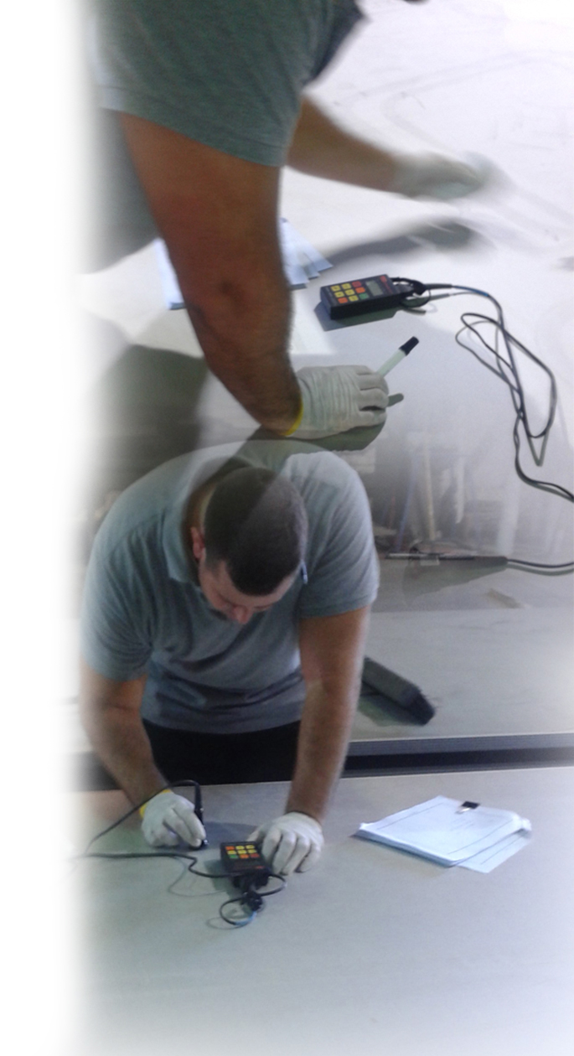
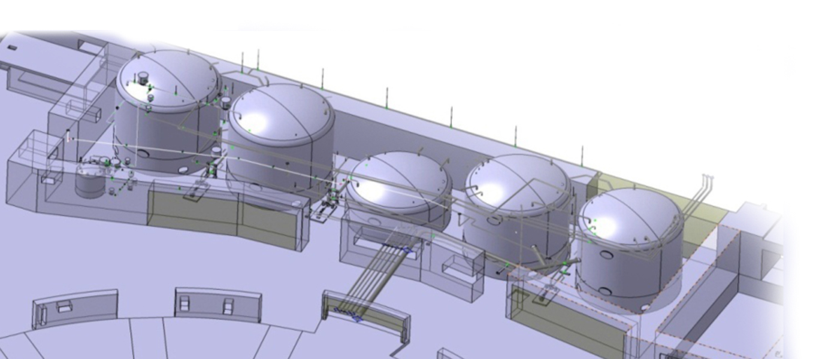
AREVA/Joseph Oat Corp - Entering Fabrication
Basic Ordering Agreement with AREVA Federal Services
Contract to AREVA/Joseph Oat Placed for Drain Tank Fabrication (September 2011)
Stainless steel plates produced for drain tank heads (March–July 2012)
Manufacturing process readiness review for drain tanks concluded (August 2012)
Final Design Review for full TCWS (February 2014)
Delivery of drain tanks scheduled in FY 14

Slide 21
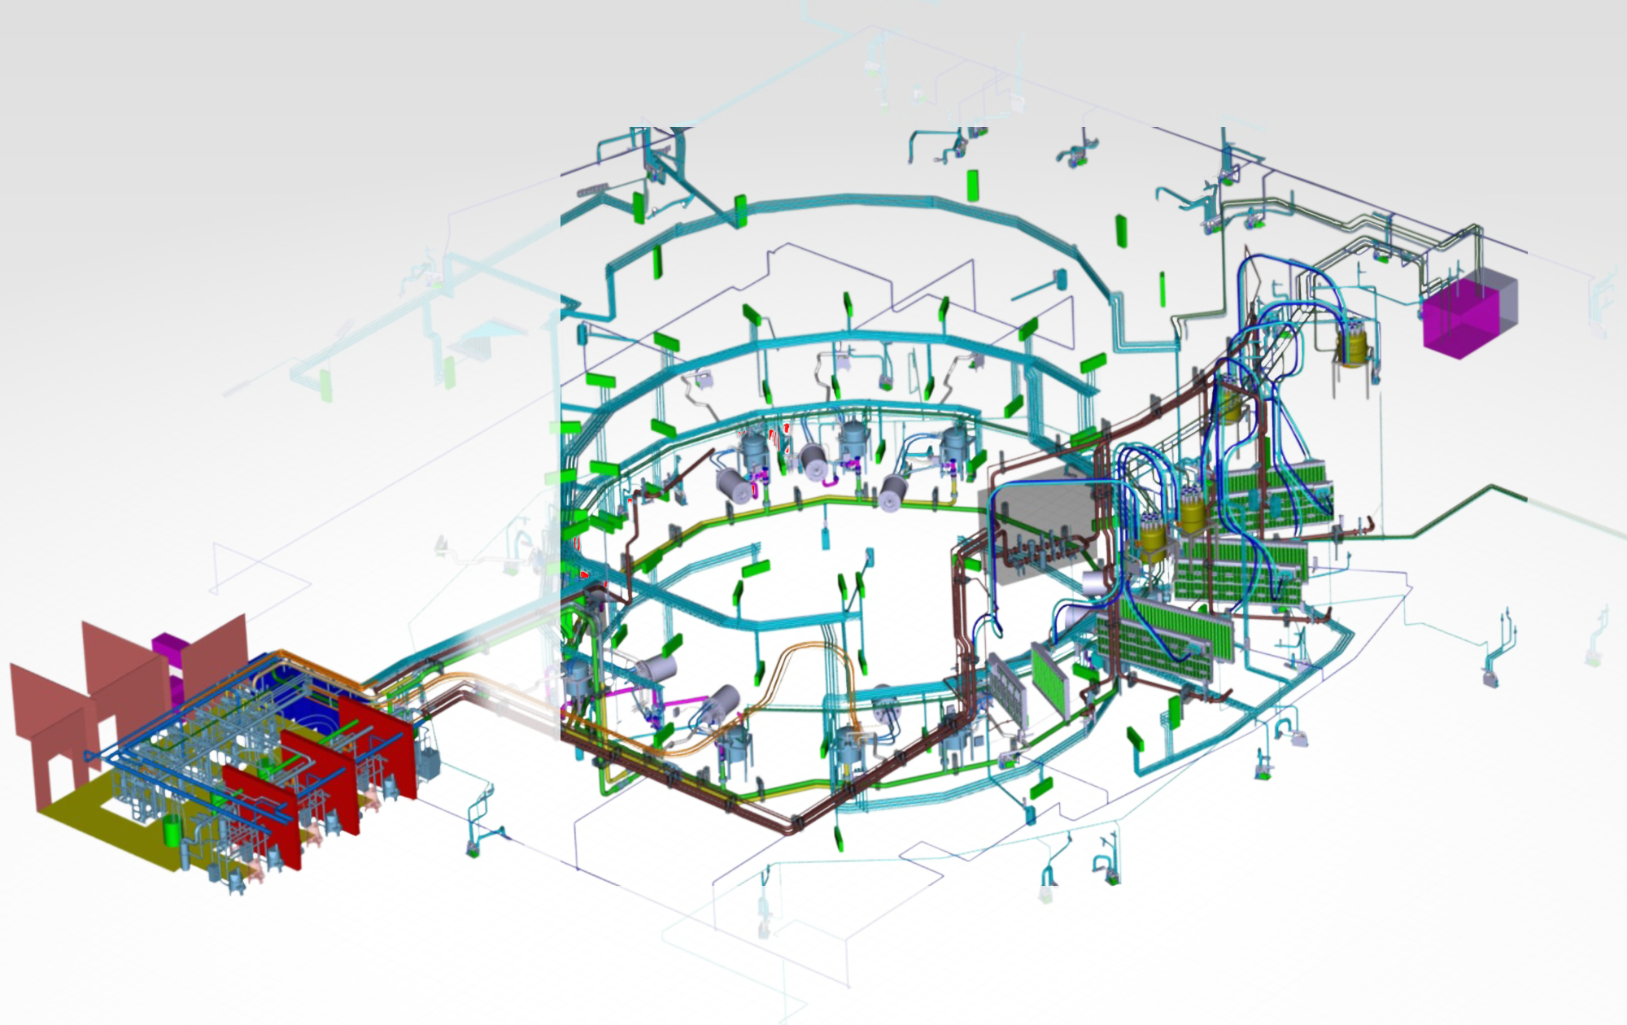
Vacuum Auxiliary and Roughing Pump Systems
Tritium-Compatible
Roots and Screw
Vacuum Roughing Pumps
Cryogenic Viscous Compressor Vacuum
Pumps
Design mods complete
Procurement underway
Computer model complete
Prototype design complete
Fabrication awarded
Roughing Pump System
(continuous H, D, T and He gas pumping)
Vacuum Auxiliary System
(service vacuum for ~5000 clients)

Slide 22
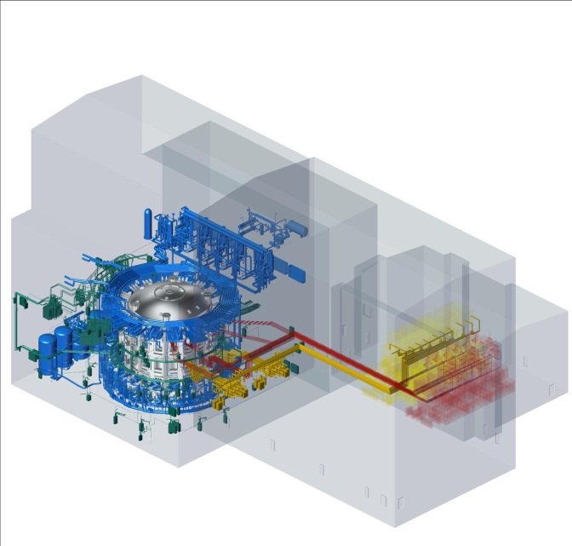
Ion Cyclotron and Electron Cyclotron Heating Systems
Ion Cyclotron Heating
Load-tolerant tuning over 40-55 MHz.
6 MWs/line for pulse lengths up to 3600s.
Electron Cyclotron Heating
Low-loss transmission at 170 GHz.
2 MWs/line for pulse lengths up to 3600s.

Slide 23
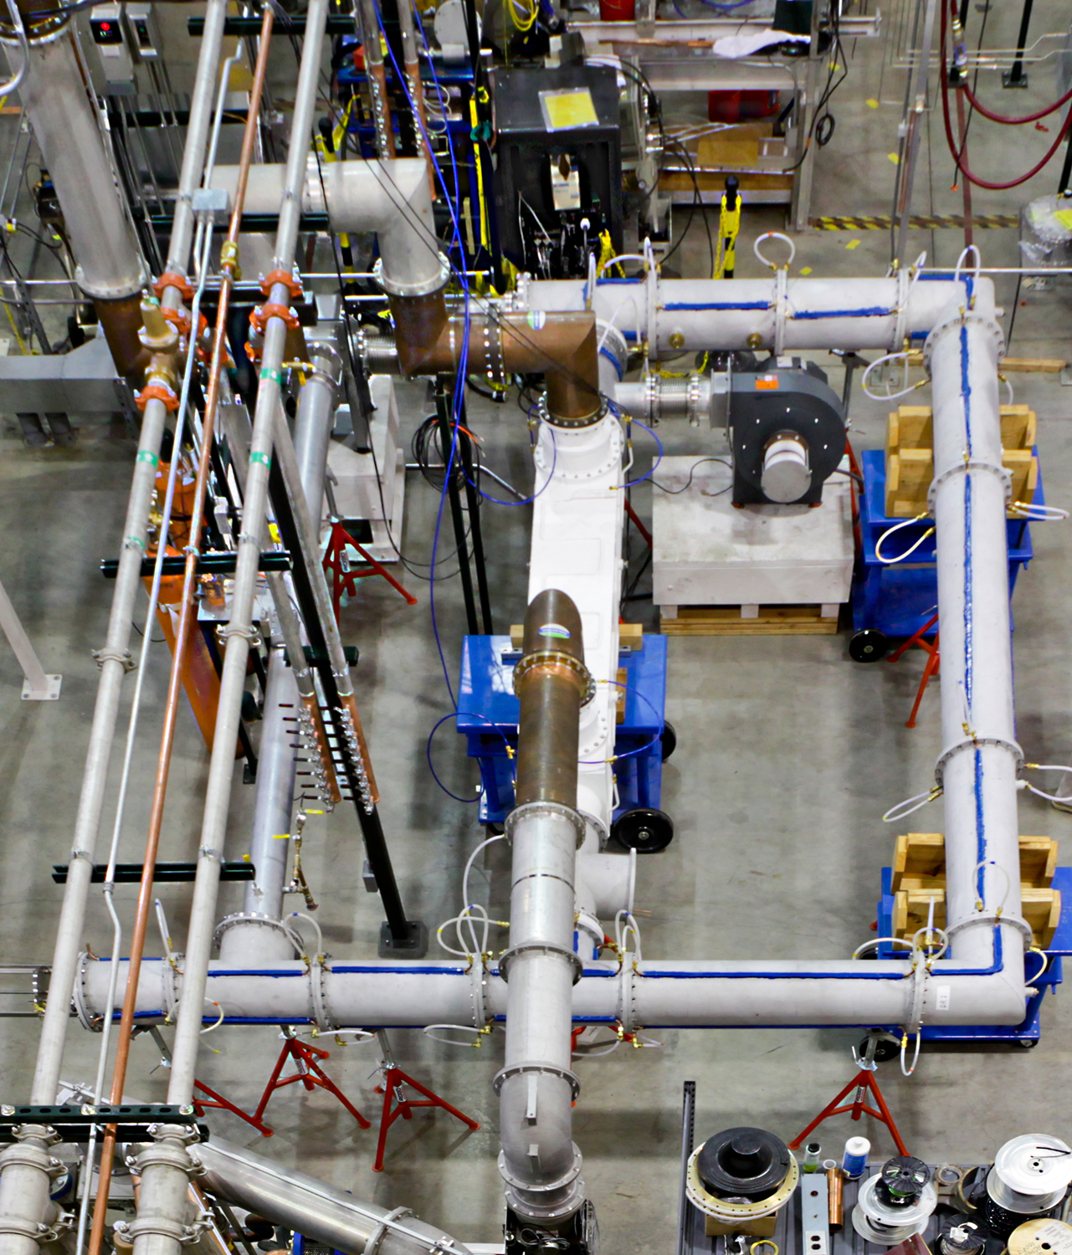
Ion Cyclotron Heating
Technical Challenge:
Delivering up to 6 MW per transmission line for 3600 seconds
Solution:
Coaxial turbulent heat exchange
3 atm air circulating between water-cooled outer conductor and inner conductor
Risk Mitigation:
Develop multiple designs and prototypes
Test to prove performance
ICH transmission line test stand has operated at > 6 MWs for 120 seconds

Slide 24
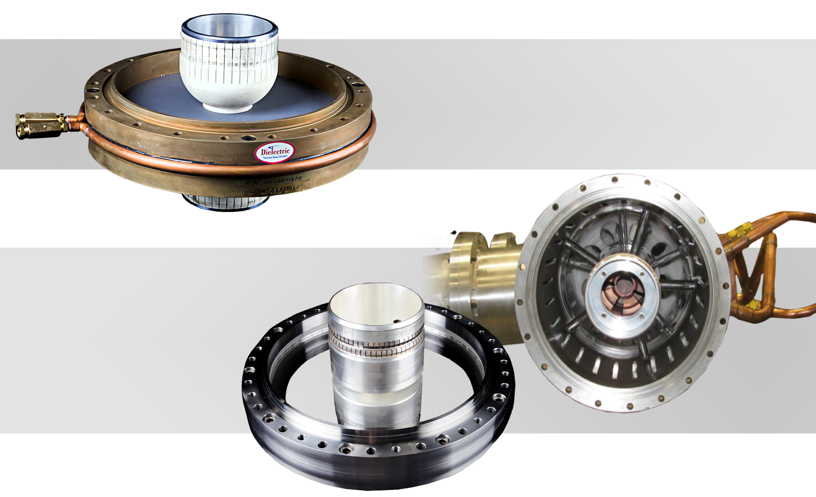
Three Types of Gas Barriers are being Tested
Edge-cooled aluminum nitride ceramic barrier
SPX – Dielectric (Maine)
Gas-cooled quartz barriers
General Atomics
(California)
Mega Industries (Maine)

Slide 25
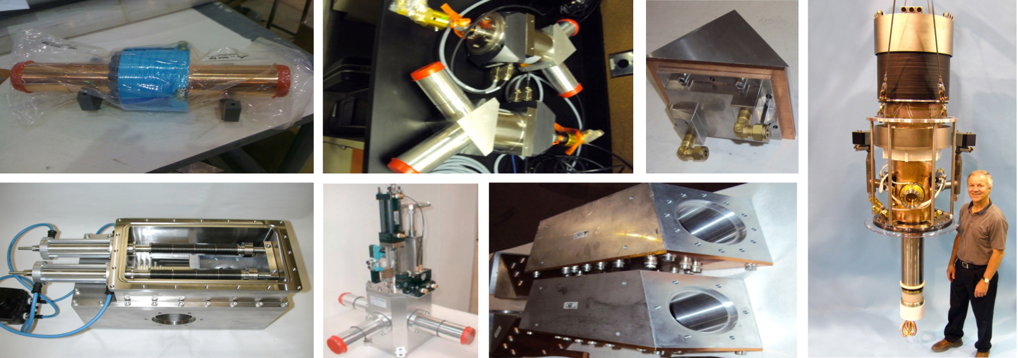
Electron Cyclotron Heating
Preliminary design phase complete
Prototype fabrication and testing underway
DC Break
Polarizing Miter Bends
Miter Bend
Waveguide Switches
140° Miter bend
CPI Gyrotron

Slide 26
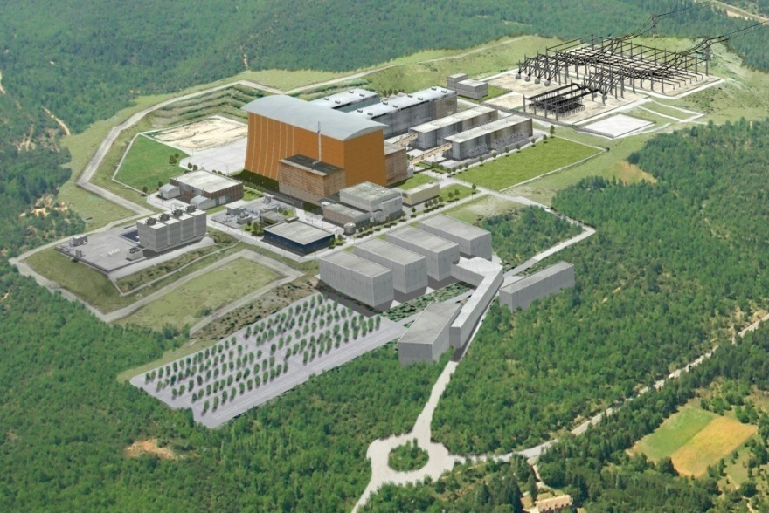
Steady State Electrical Network
Supplies electrical power to all conventional loads in the ITER facility.
Final design complete (EU).
- US will deliver 75% of equipment (EU 25%).
Procurement authorization in place.
Prionnet 400 KV substation at ITER site already completed and energized.

Slide 27
Diagnostics & Port Plugs Design Underway
Low Field Side Reflectometer
Design/R&D Contract to be Awarded Jan 2013
Port Plugs
Preliminary Designs to be Completed 2013/2014
Additional Diagnostics Post 1st Plasma with Preliminary Designs Underway
Upper IR/Visible Cameras
Motional Stark Effect
Electron Cyclotron Emission
Toroidal Interferometer/Polarimeter
Core Imaging X-Ray Spectrometer
Residual Gas Analyzer
Preliminary Design to be Completed Jul 2013

Slide 28
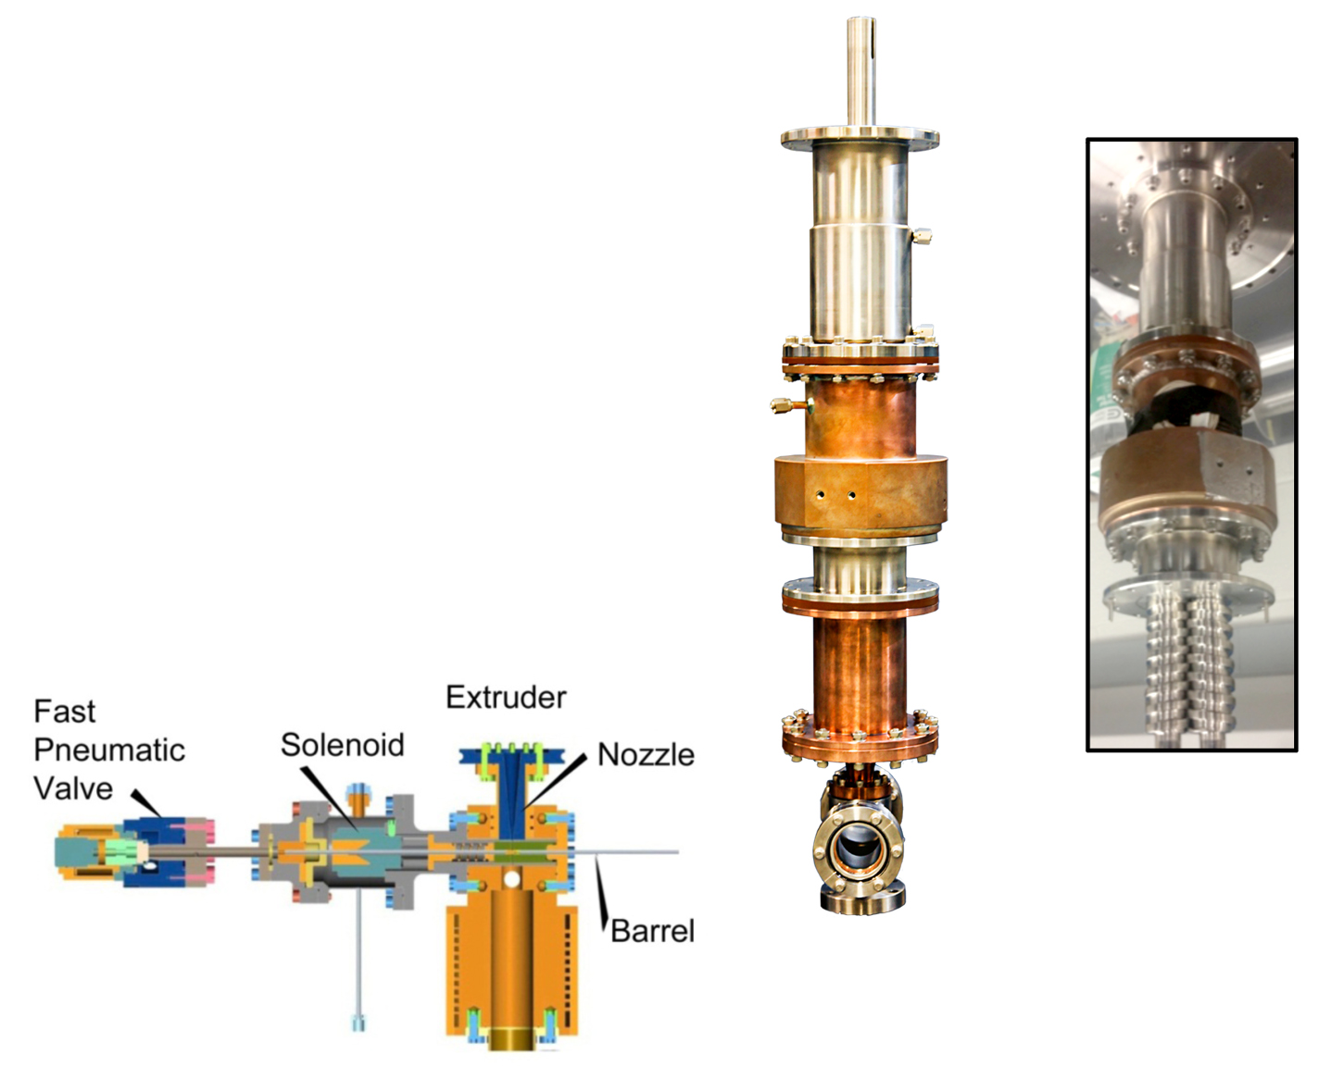
Pellet Injection Component Prototypes in Testing
R&D and Conceptual Design to develop
20 Hz D/T fueling capability
30 Hz ELM pacing capability
Impurity pellet injection
Pellet Injector
Sub-Assembly Design
Twin-screw extruder prototype for hydrogen isotope ice pellet formation.

Slide 29
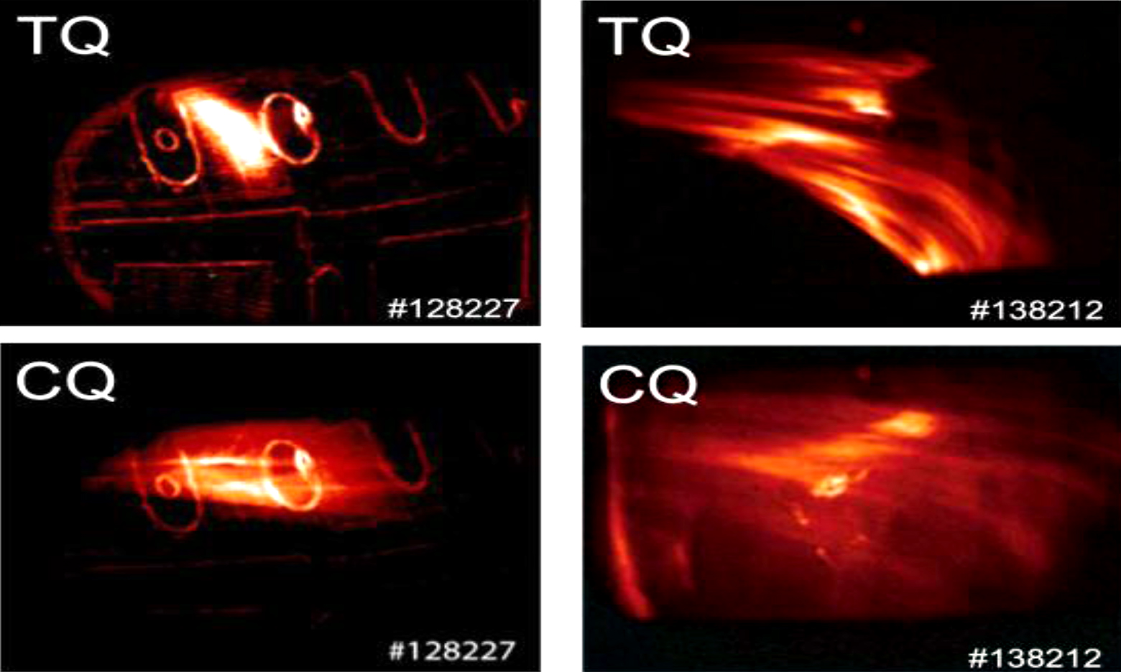
Plasma Disruption Mitigation
Methods in Testing at General Atomics
Massive Gas Injection
Massive Pellet Injection
Thermal quench (TQ) and current quench (CQ) test results from DIII-D (Photos courtesy GA).
Toroidal asymmetries indicate non-uniform wall irradiation and thus the need for multiple injection ports.

Slide 30
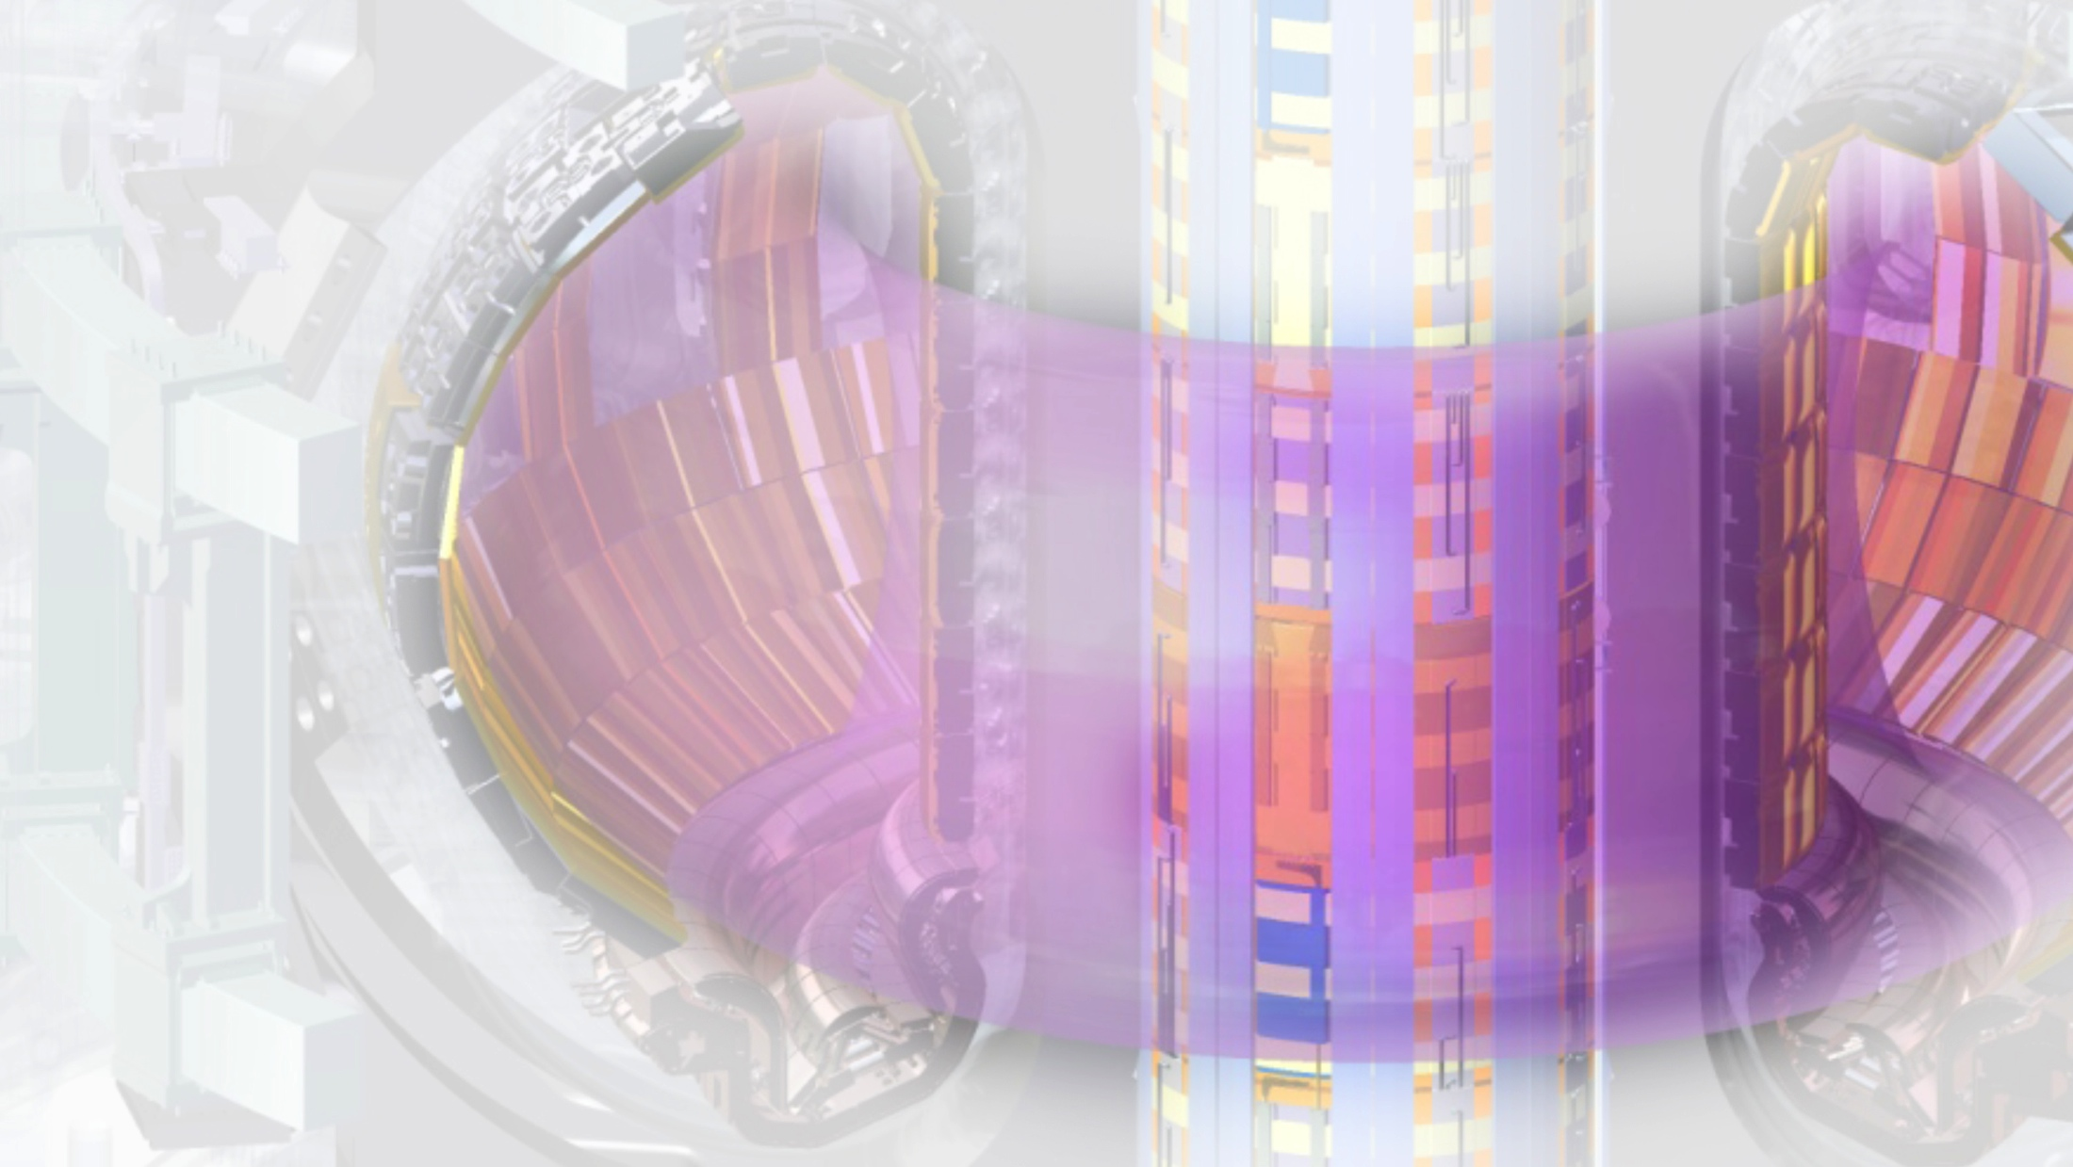
New US Industrial Capacity is Engaged and Growing
Continuing transition from design to procurement and fabrication.
Technical challenges are largely solved, moving to manufacturing.
US industry is engaged, and US technology is advancing.

Slide 31
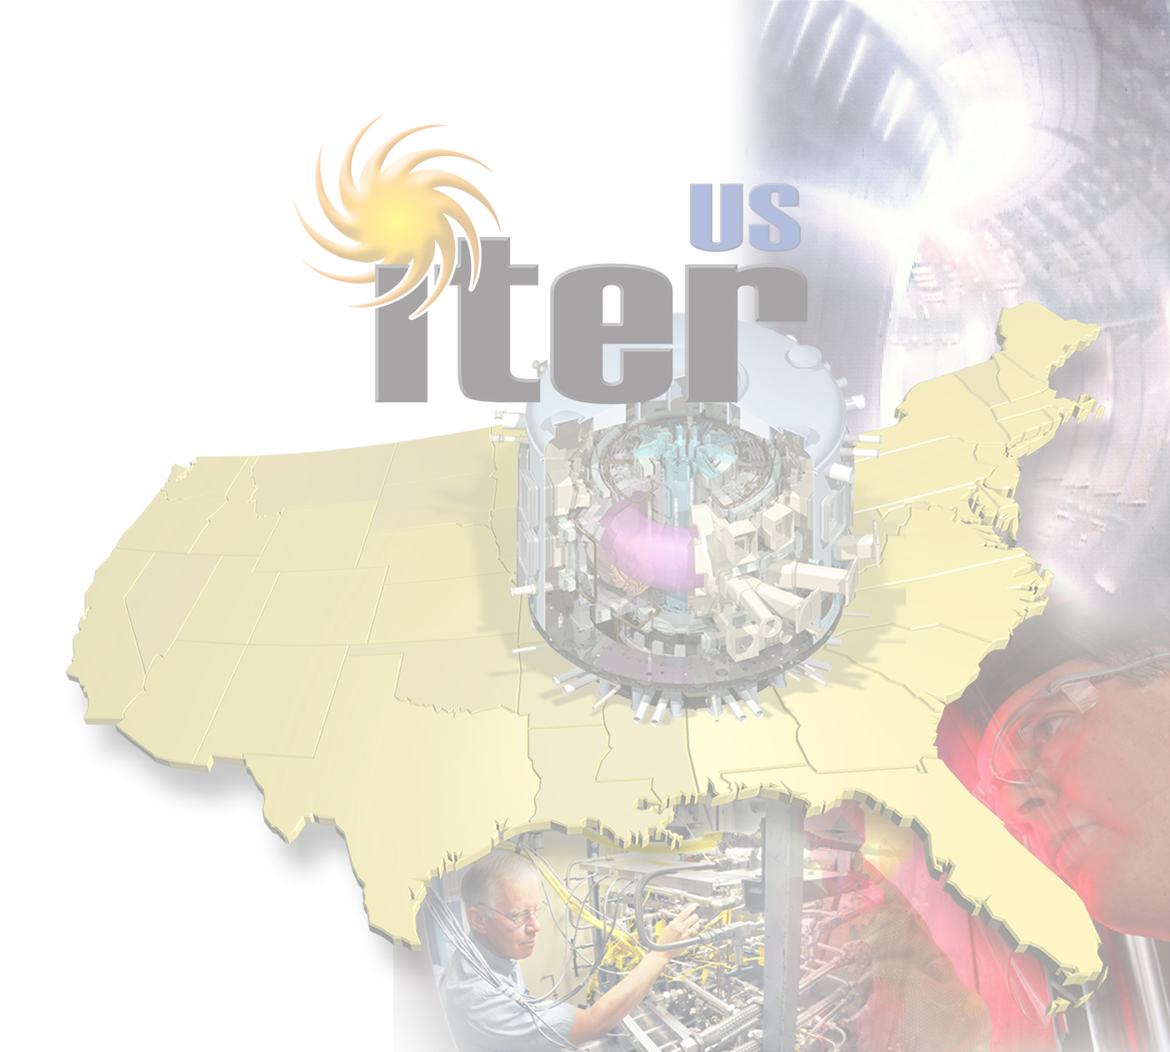
What ITER Means for the US
Provides the opportunity to create, understand, and control a reactor-size burning plasma.
Demonstrates the scientific and technological feasibility of a promising, virtually inexhaustible and relatively clean energy source.
Positions the US to provide fusion-reactor technology.
Creates high-tech jobs and economic growth in the US.
Notes:
Science of “Burning Plasmas”:
The next major step:
Create, understand, and contrdol a reactor-prototypical fusion plasma
New dynamics of self-heating
Size-scaling of phenomena at reactor scale
Effects of “faster-than-light” particles
International partnership
Refine a model international partnership on large science projects
Improve understanding and effective joint-work between ITER partiesDemonstrate the scientific and technological feasibility of an energy source with
Virtually-unlimited geographically-dispersed fuel
No CO2 or acid-rain gases
No high-level-radioactive waste
A relatively small scale up in various engineering parameters to a Fusion Demonstration Power Plant
200 GJ of fusion energy per pulse
Position the U.S. to provide fusion-reactor technology
Create high-tech jobs and work in the U.S.

