Slide 1
Future Direction of the U.S. Fusion Materials Program
Dr. Pete Pappano
US Department of Energy
Fusion Energy Sciences
Fusion Power Associates Annual Meeting
December 10-11, 2013

Slide 2
A Few Words from the Director
Fusion materials science will be an increasing focus
globally
The FES research program now has elements that will be key to determining how research should proceed to close gaps in fusion materials science. We likely will have to choose where we focus if budgets are constrained. However, even now this area supports a large number of university researchers and presents significant
opportunities for cost‐effective leverage across Offices.

Slide 3
Fusion Materials Program Goals
Increase experimental capabilities so that materials can be evaluated under fusion relevant conditions—specifically fusion neutron damage and plasma-material interactions.
Note that the term materials does not just mean structural materials
Utilize recent FESAC reports on material research opportunities and facility prioritization to help guide new and existing research.
Continue to utilize strong international collaborations, some of which have been active for 30+ years.
Continue to deliver world leading science even in potentially constrained budget times.

Slide 4
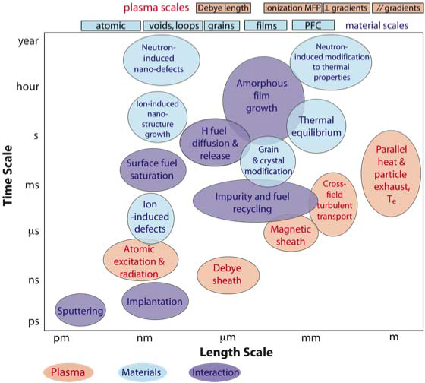
Trying to Exist in the Most Extreme Environment on Earth--PMI

Slide 5
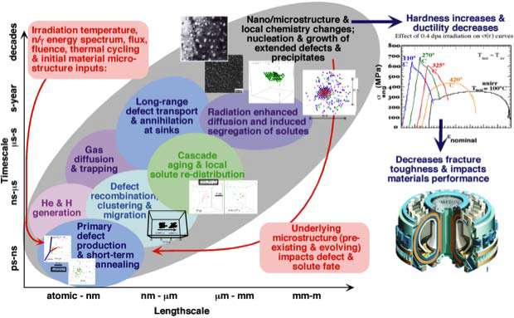
Trying to Exist in the Most Extreme Environment on Earth—Fusion Neutron

Slide 6
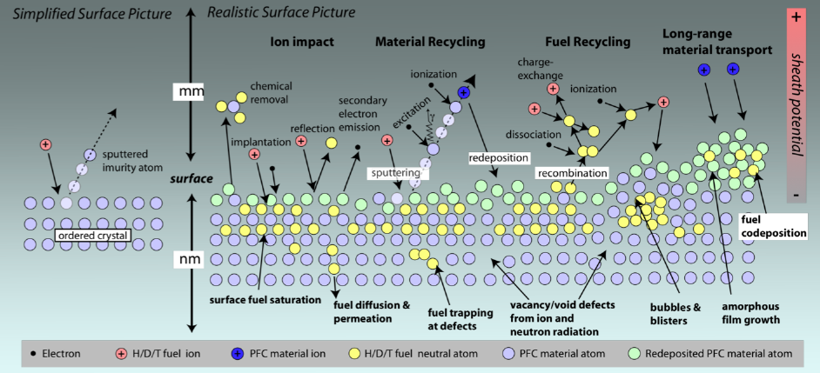
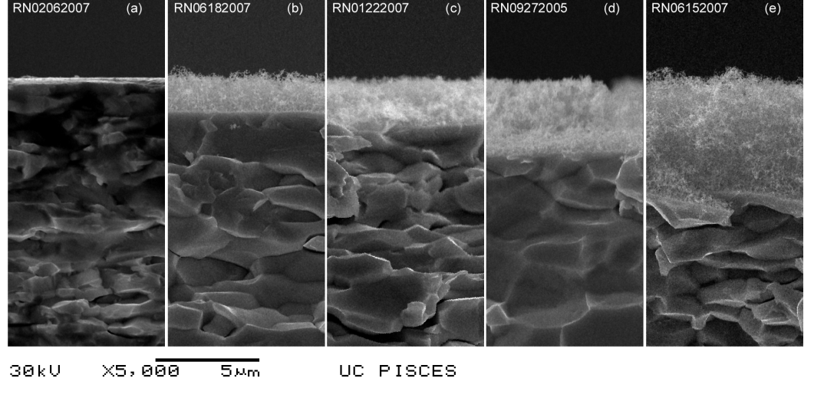
Current Capability-PMI
Modeling of these
individual
interactions
Use of linear
devices for
material exposure
to plasmas

Slide 7
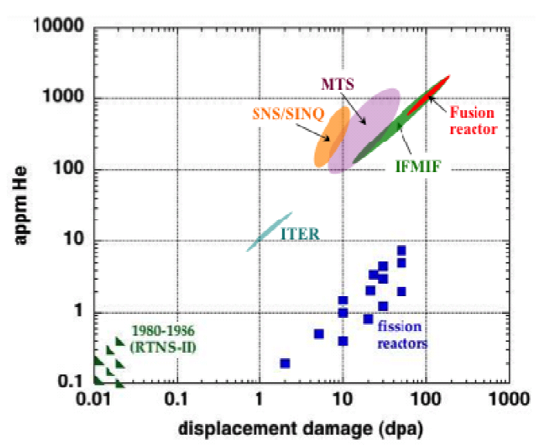
Current Capability—Fusion Neutron

Slide 8
Recent charge to SC Federal Advisory Committees
DOE established the following goal for the Office of Science:
Goal Statement: Prioritization of scientific facilities to ensure optimal benefit from Federal investments. By September 30, 2013, formulate a 10-year prioritization of scientific facilities across the Office of Science based on (1) the ability of the facility to contribute to world-leading science, (2) the readiness of the facility for construction, and (3) an estimated construction and operations cost of the facility.
SC therefore requested the Federal Advisory Committees for its six program offices to prioritize new facilities and upgrades according to two criteria:
The ability of the facility to contribute to world-leading science in the next decade (2014 – 2024)—Rank as: (a) absolutely central; (b) important; (c) lower priority; and (d) don’t know enough yet.
The readiness of the facility for construction—Rank as: (a) ready to initiate construction; (b) significant scientific/engineering challenges to resolve before initiating construction; and (c) mission and technical requirements not yet fully defined.
Final report delivered in March 2013

Slide 9
Step 1: FES provided a list of proposed new facilities and upgrades
Sent to FESAC (and posted on the FES web page for FESAC http://science.energy.gov/fes/fesac/reports):
DIII-D National Fusion Facility Upgrade
Fusion Nuclear Science Facility (FNSF)
Materials Facilities Initiative
QUASi-Axisymmetric Research (QUASAR) Experiment
Comments:
No implied priority among these four proposals, which are listed above alphabetically
The number of proposals was intentionally kept small
Two of these facilities focused heavily on fusion materials

Slide 10
Materials Facilities Initiative
Contributions to world-leading science | Readiness for construction
(a) Absolutely central The initiative would provide two cost-effective test facilities that can replicate extreme fusion conditions for the first time, providing information for the design of FNSF and allowing investigations of the behavior of materials under: irradiation by 14 MeV neutrons irradiation by combined high heat and particle fluxes | (a) Ready to initiate construction Some power source R&D is required

Slide 11
Steve Zinkle’s Fusion Materials FESAC report
“Materials Science and Technology Research Opportunities now and in the ITER ERA: A Focused Vision of Fusion Nuclear Sciences Challenges.”
This report was broken into three major sections, aligned with the ReNeW Report:
Taming the Plasma-Materials Interfaces
Conquering Nuclear Degradation of Materials and Structures
Harnessing Fusion Power
Summary of report already presented, highlighted here is the Technology Readiness Level (TRL) approach to guiding and evaluating materials research.
The TRL approach may have some debatable points, not meant to be discussed here, but it is clear that all would concur that additional experimental capabilities are needed in order to increase TRL.

Slide 12
International Collaborations
The US has had several long lasting collaborations that have added significant resources and access to world leading data.
This is especially true of the US-JA collaborations.
The TITAN collaboration, which was focused on mostly blanket focused materials, ended this calendar year.
Pleased to announce that another six-year collaboration was finalized and is called PHENIX, and is focused on divertor materials, namely tungsten.
The US-JA collaboration on the Japanese DEMO program has utilized the ORNL High Flux Isotope Reactor to achieve world leading displacement per atom data on reduced activation ferritic martensitic steel samples.
Material focused collaborations with other international facilities are planned.

Slide 13
Concluding Remarks
Experimental capabilities are needed to produce fusion relevant conditions for material research and development.
Access to these capabilities will allow for increased fusion materials TRL.
FES has issued two FESAC charges in the last several years in order to help elucidate these very challenging scientific grand challenges—taming the plasma-material interface, conquering nuclear degradation, and harnessing fusion energy.
Zinkle’s report directly addressed these issues and the facilities panel touched on them as well.
FES continues to maintain a strong international presence with regard to material focused collaborations.
Thank you for your attention.

