Slide 1
Magnetic fusion in the Czech Republic
Radomir Panek
Institute of Plasma Physics, ASCR, Czech Republic

Slide 2
Participation of Czech Institutions
Coordinated by Institute of Plasma Physics AS CR
Institutes involved:
  Institute of Plasma Physics AS CR
  Research Centre Řež, a.s.
  J. Heyrovsky Institute of Physical Chemistry AS CR
  Institute of Applied Mechanics, Ltd., Brno
  Institute of Nuclear Physics AS CR
  Institute of Physics of Materials AS CR, Brno
Universities:
  Faculty of Math&Physics, Charles University
  Faculty of Nuclear Science and Physical Engineering, Czech Technical University

Slide 3
Research Centre Řež
Technological Experimental Circuits
TEC
Structural
and System Diagnostics
SSD
SUSEN
“Sustainable Energy”
+ Fission research reactor for material tests
Nuclear
Fuel Cycle
NFC
Material Research
MAT

Slide 4
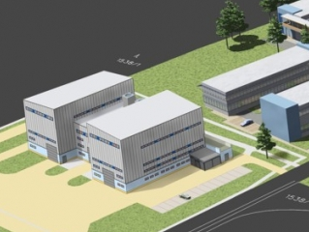
Experimental devices
IV.GENERATION FISSION REACTORS
SCWL-FQT - SUPERCITICAL WATER FUEL QUALIFICATION TESTS LOOP
UCWL - ULTRACRITICAL WATER LOOP
HTHL - HIGH TEMPERATURE HELIUM LOOP
S-ALLEGRO - HIGH TEMPERATURE HELIUM LOOP FOR ALLEGRO
SCO2 - SUPERCRITICAL CO2 LOOP
FUSION TECHNOLOGY
HELCZA - HIGH HEAT FLUX TEST FACILITY FOR FULL-SIZE PFC MODULES
TBM - TEST BLANKET MODULE FOR REMOTE HANDLING R&D
NG 14 - DEUTERIUM-TRITIUM TRUE FUSION NEUTRON GENERATOR
PILSEN
S-ALLEGRO,SCWL
HELCZA
TBM

Slide 5
Institute of Plasma Physics
Operates the COMPASS tokamak.
Main focus on edge and SOL plasma physics:
  L-H transition physics
  Inter-ELM heat flux studies: from SOL to divertor targets
  Experimental and theoretical studies of plasma response to magnetic perturbations
  Study of pedestal and ELM dynamics
  Isotope effects
  Runaway and disruption physics
EDUCATION AND TRAINING
Twice a year experimental 2-week international school organized on the tokamak experiment control, diagnostic methods and experimental plasma physics for students and young researchers

Slide 6
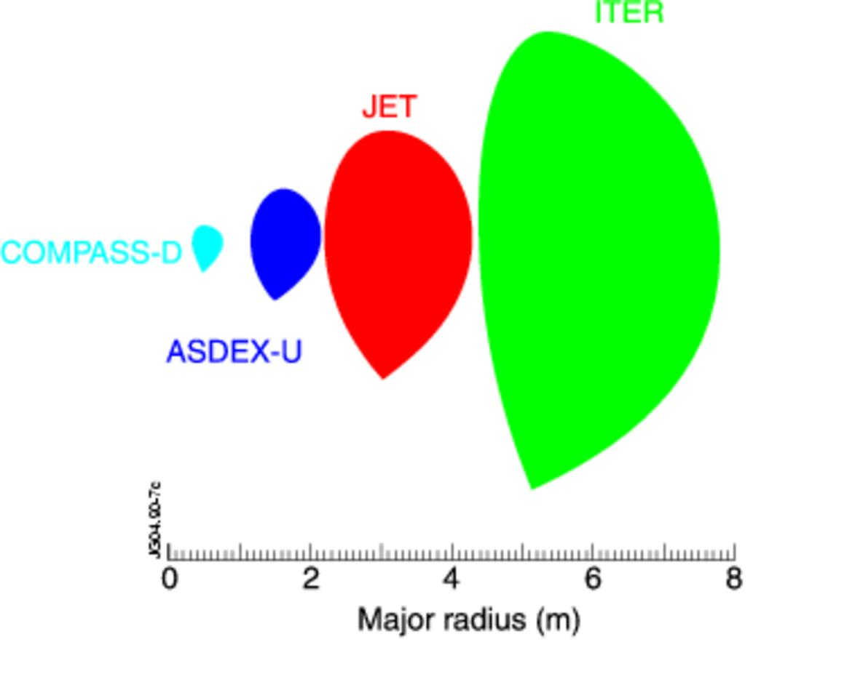
The COMPASS tokamak
Built in 2006-2010
In 2012 put into scientific exploitation
ITER-like geometry with a single-null-divertor (H, He, D)
Neutral beam injection heating system enabling either co- or balanced injection
Ohmic and NBI-assisted H-modes
New comprehensive set of diagnostics focused on the edge, SOL and divertor plasma
Major radius [m] 0.56
Minor radius [m] 0.2
Plasma current [MA] < 0.4
Magnetic field [T] < 2.1
Triangularity ~ 0.4
Elongation < 1.8
Pulse length [s] < 0.5
New NBI system (2 x 0.4 MW)
Co-injection
Balanced injection

Slide 7

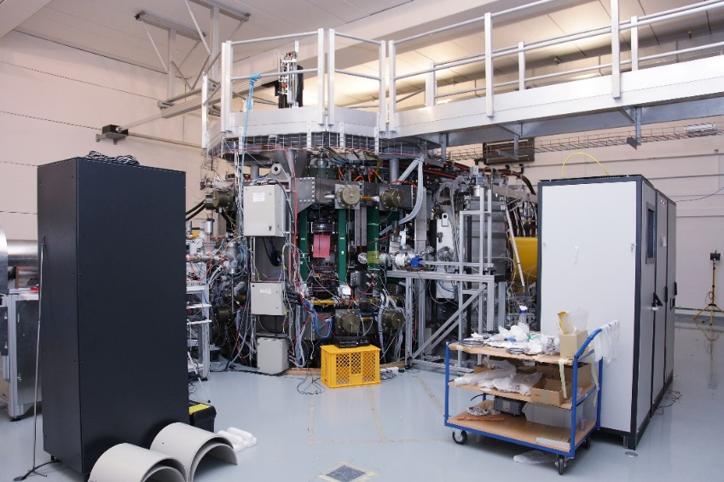
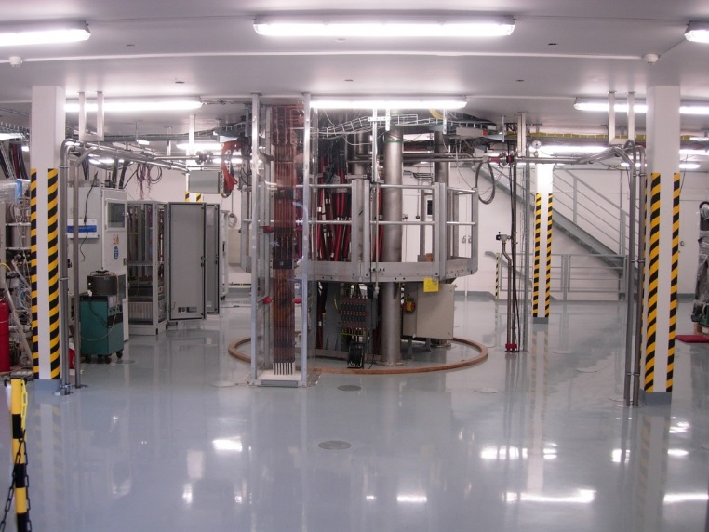
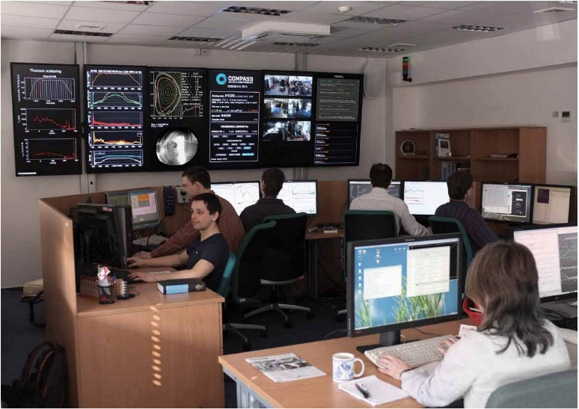
The COMPASS tokamak
The COMPASS tokamak – second floor
The COMPASS tokamak – first floor
Control room
Notes:
100 m vysoko, metru za sekundu.

Slide 8
Diagnostics available in 2014
Magnetic diagnostics (400 coils)
Microwave diagnostics
    2-mm interferometer
    microwave reflectometer (K & Ka bands)
    ECE / EBW radiometer
Spectroscopic diagnostics
  HR Thomson scattering
  3 fast VIS cameras
  photomultipliers (VIS, Hα, CIII + continuum for Zeff)
  HR2000+ spectrometers for near UV, VIS & near IR
  AXUV-based fast bolometers
  semiconductor-based soft X-ray detectors
  scintillation detector for hard X-rays & HXR camera
  slow IR camera & fast divertor thermography (35 kHz, 0.5 mm)
Beam & particle diagnostics
  HR2000+ spectrometer for Hα & Dα
  neutron scintillation detector
  diagnostics using Li-beam (BES, ABP)
  two Neutral Particle Analyzers
  CXRS
  detection of fusion products
Probe diagnostics
  39 divertor probes & set at HFS in divertor
  divertor ball-pen probes
  two reciprocating manipulators
  Langmuir probes in HFS limiter tiles
Notes:
100 m vysoko, metru za sekundu.

Slide 9
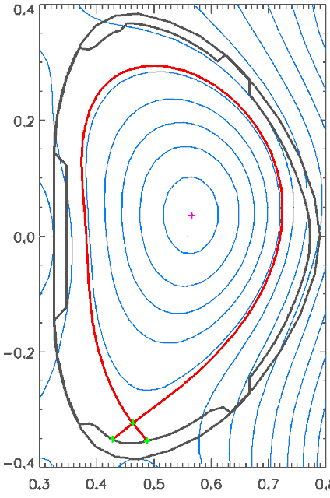
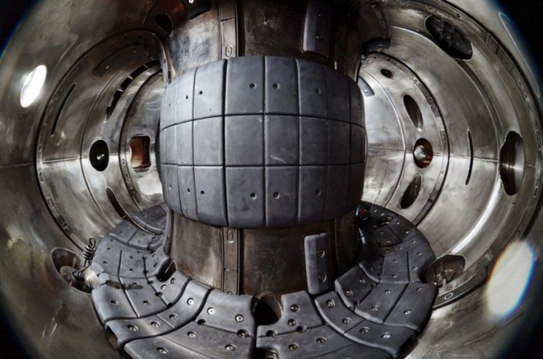
Plasma performance
  Types of H-modes achieved:
  Ohmic H-mode (Ip > 220 kA)
  NBI assisted H-mode (available power approx. 3 - 4 x P_{LH})
  Types of regimes:
  Type-III ELMs (f = 300 – 2000 Hz)
  Type-I ELMs (f = 80 – 200 Hz)
  ELM-free H-mode
  Present pedestal parameters:
  Te < 350 eV
  n_{e} < 10²⁰ m⁻³
  ν*_{e} ≈ 1 - 8
  Energy confinement time:
  L-mode τ_{E} ~ 10 ms
  H-mode τ_{E} ~ 20 ms
Notes:
100 m vysoko, metru za sekundu.

Slide 10
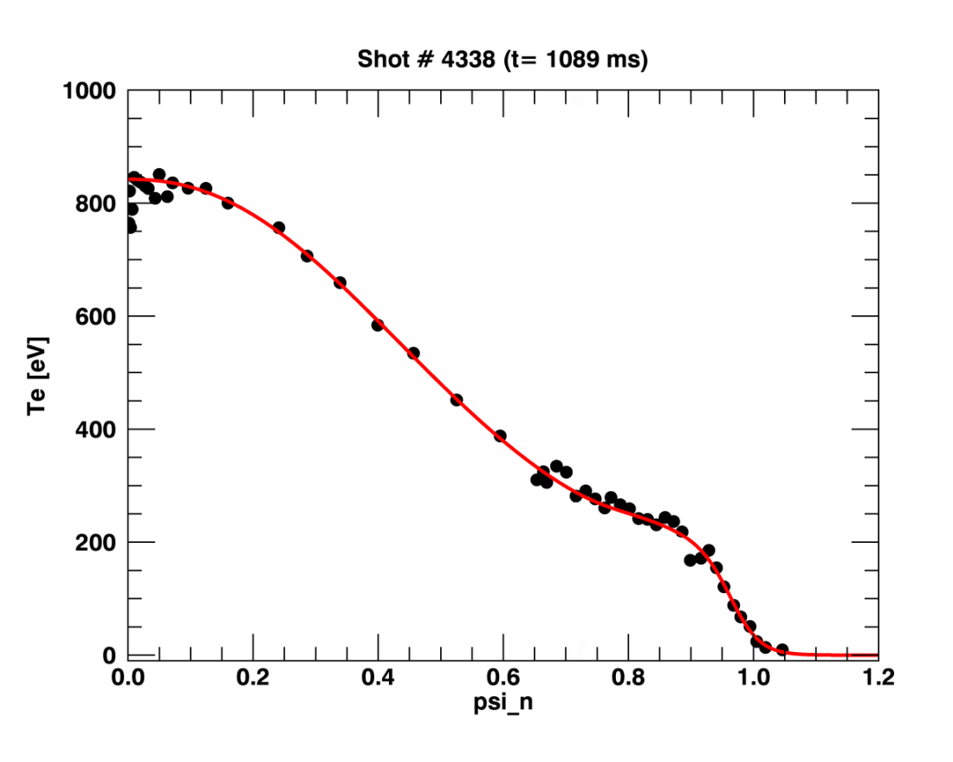
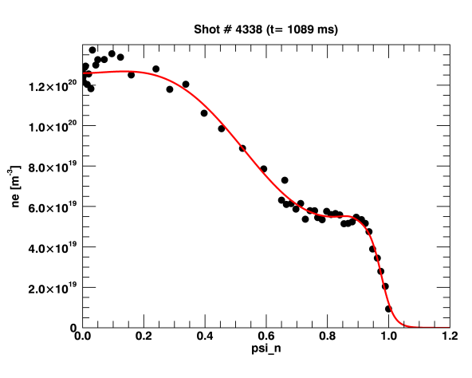
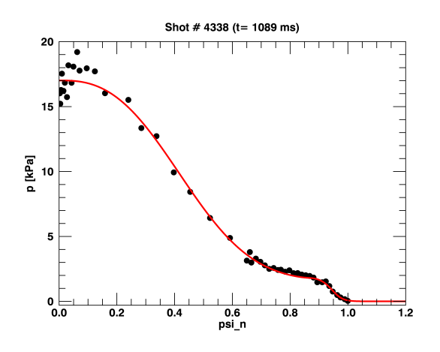
Pedestal profiles
Thomson scattering systems – 2 x lasers 1.6J/30 Hz
Core TS‏ - 25 spatial points, resolution ~ 6 mm
Edge TS - 32 spatial points, resolution ~ 2-3 mm
Upgrade in 2015 – new lasers – 6 lasers in total.
Electron temperature
Electron density
Electron pressure
a_{height}
F_{ped}

Slide 11
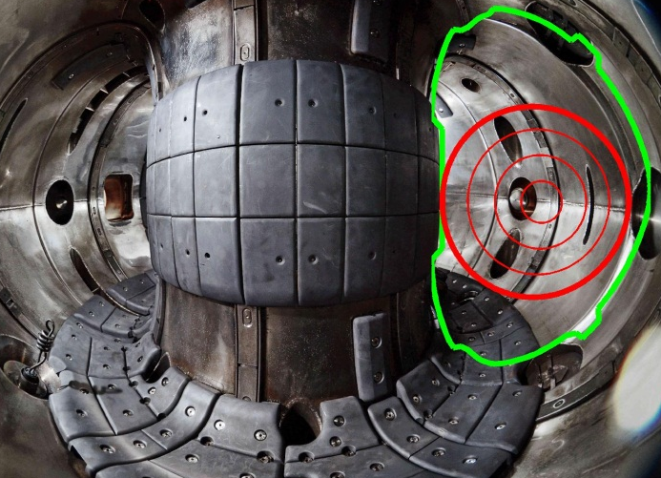
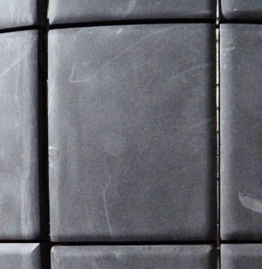
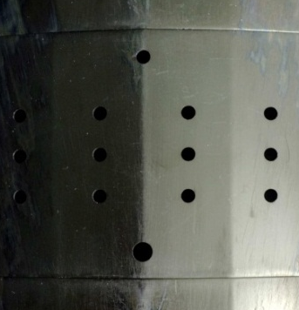
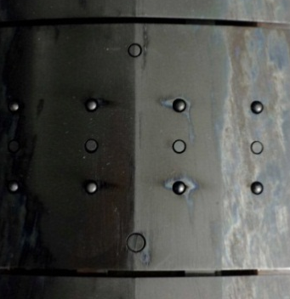
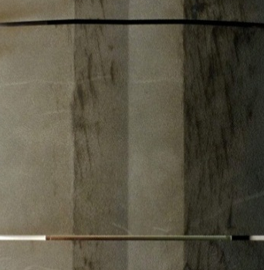

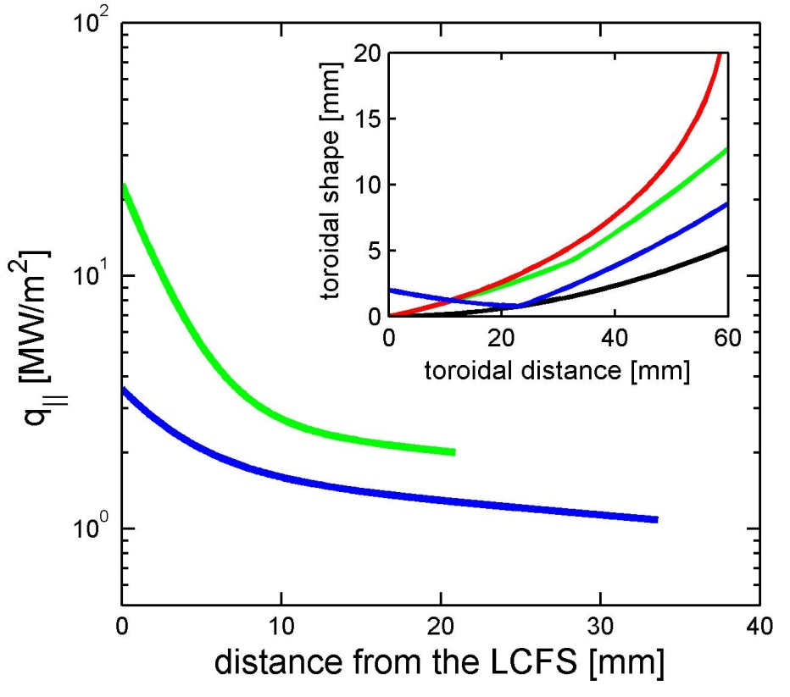
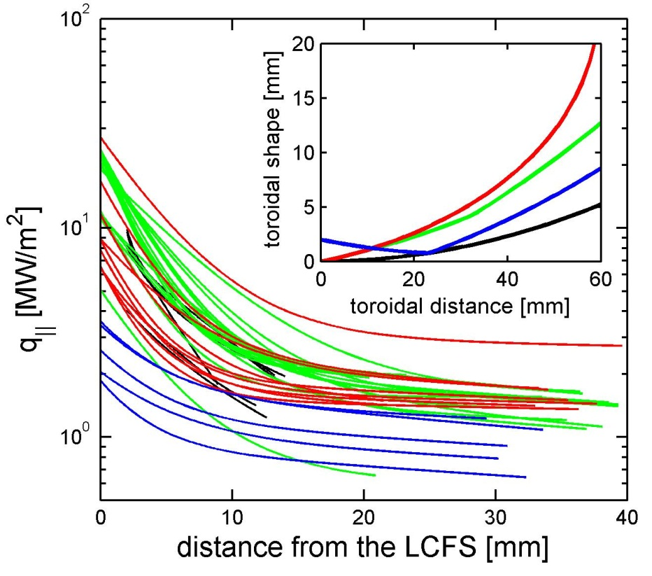
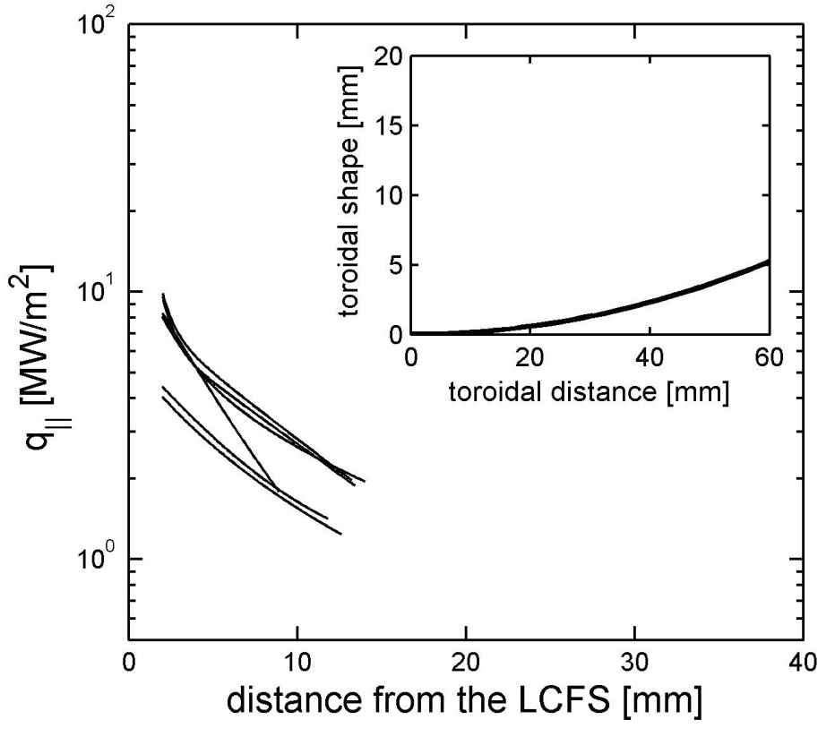
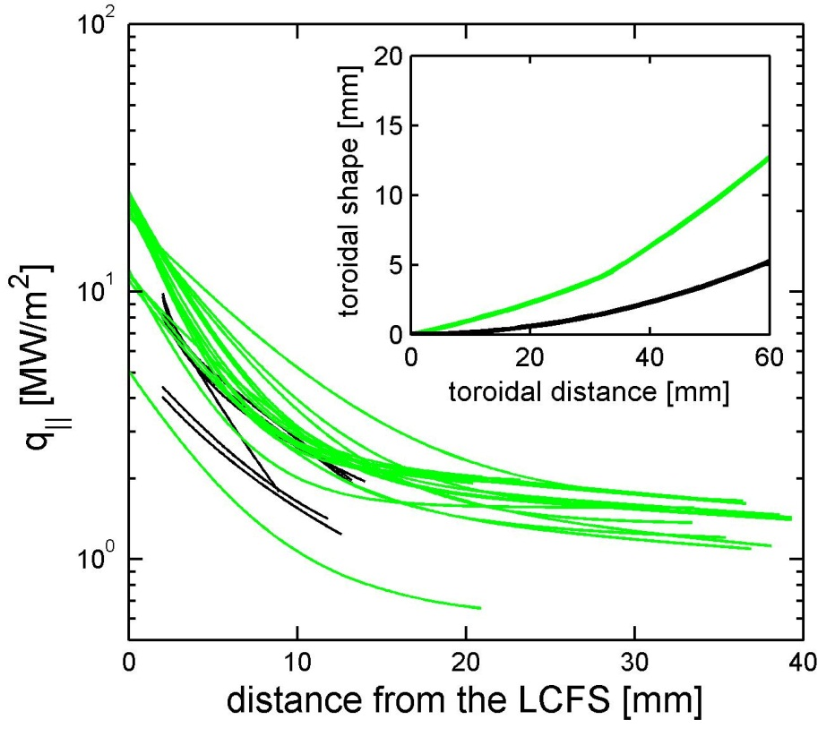
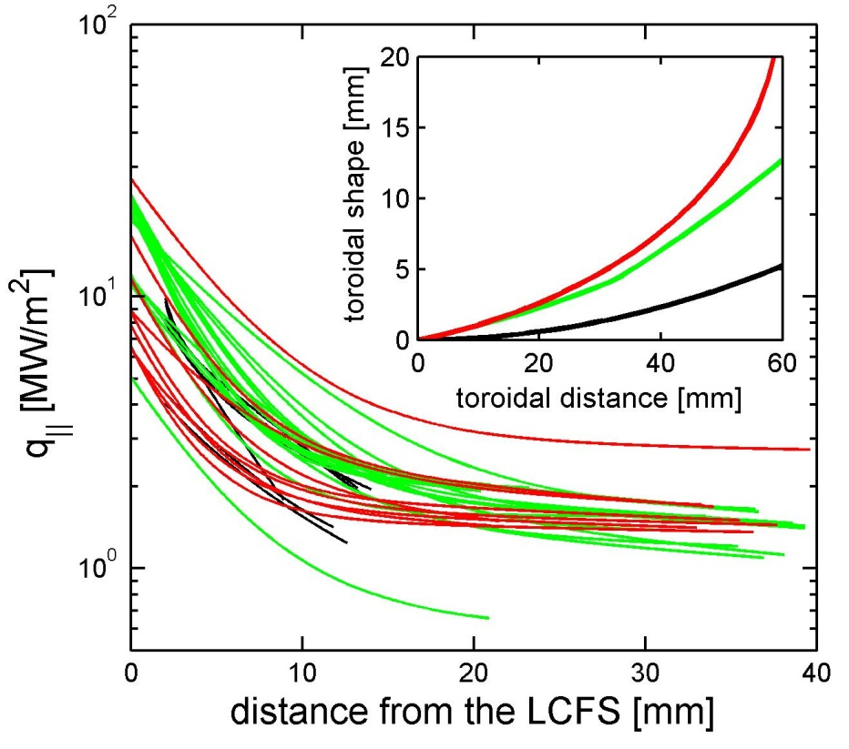
Comprehensive study of near-SOL feature HFS plasma
rounded
double-roof
logarithmic
recessed roof
four different limiters, large number of deliberate limiter misalignments
narrow feature observed by IR in all discharges without exception
seen clearly by embedded probes
λ_{q,near} = 2-8 mm, R_{q} = 1-10
larger R_{q} for a protruding limiter
Collaboration with R. Pitts, R. Goldston, P. Stangeby
rounded
double-roof
logarithmic
recessed roof
Limiter protruding into the plasma
λ_{q near} a few mm
λ_{q near} a few mm
λ_{q,near} a few mm
Limiter radially aligned with toroidal neighbors

Slide 12
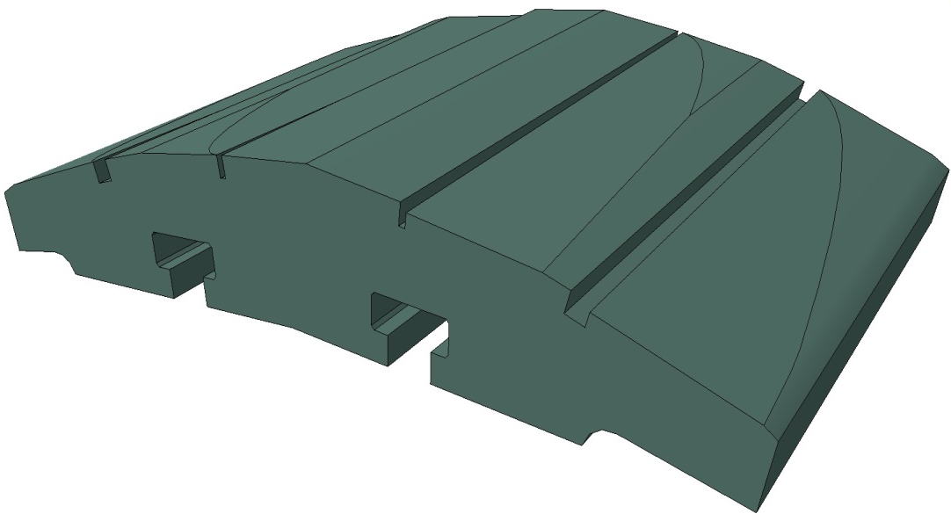
Plasma flow on misaligned limiter tile – PIC code benchmarking
Experiment to benchmark the modeling of the power fluxes to the castellated divertor (misaligned edges) – similar to JET lamella melting experiment
Proposed by IO – R. Pitts
Graphite limier - 4 different gaps with linearly changing misalignment in vertical direction
Leading edge misalignment [mm]
1.20
Vertical direction
0.00
0.15
0.20
0.50
Z=+32mm
1
2
0.85
3
1.00
Z= 0mm
4
Z=-32mm
Toroidal direction
Leading edge misalignment of gaps 1 & 4 similar to gap 3

Slide 13
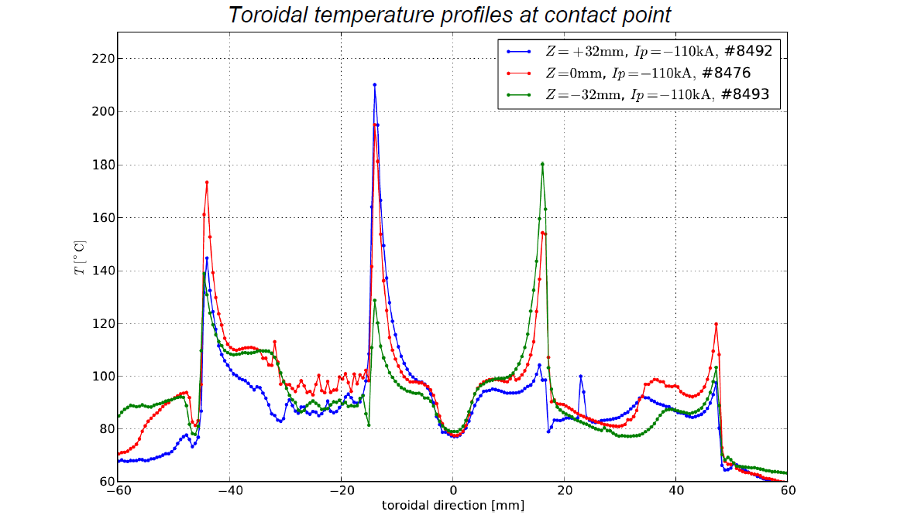
Plasma flow on misaligned
limiter edges
1.05mm
0.7mm
Ip
0.85mm
Bt
0.5mm
0.35mm
0.15mm

Slide 14
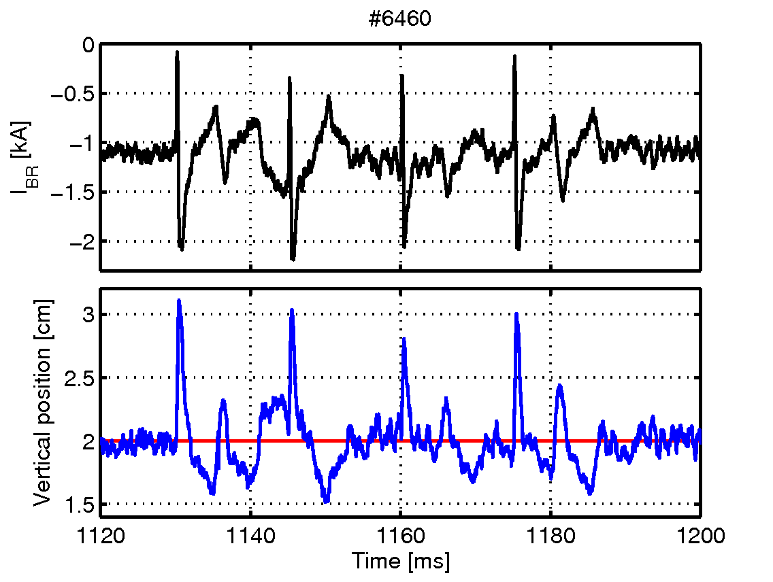
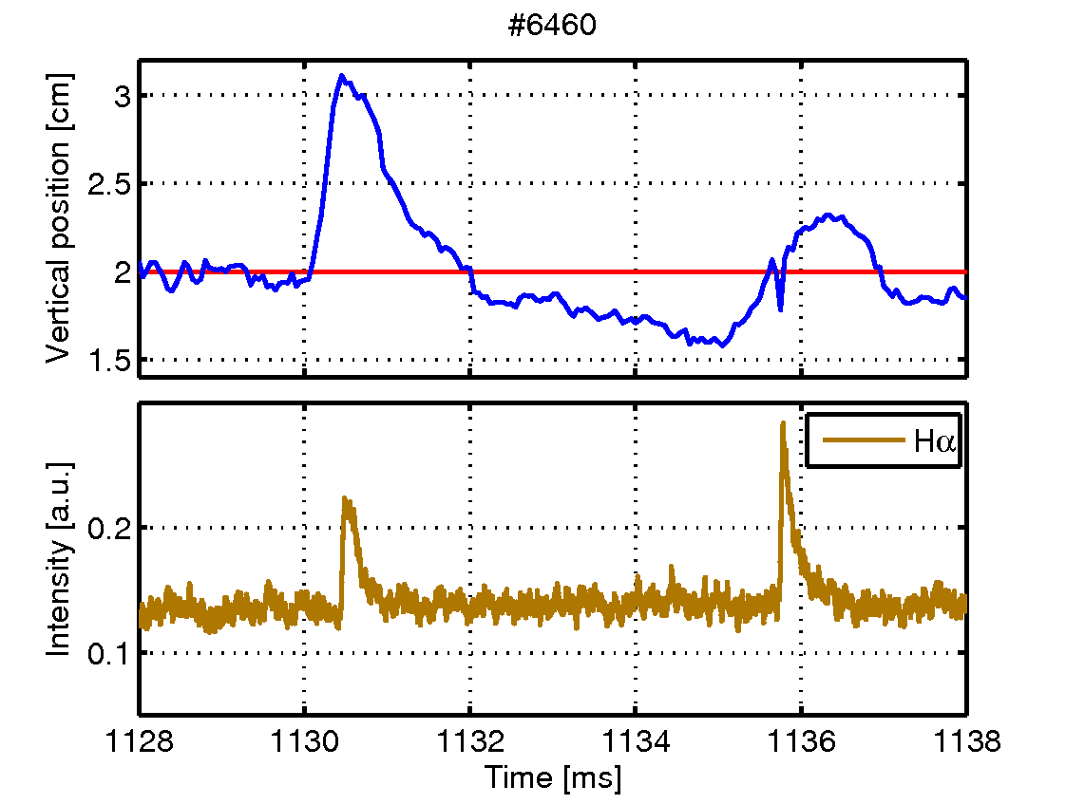
ELM control techniques –
Vertical kicks
1
2
3
4
  Vertical-kick system
  System commissioned in early 2014
  100 microsecond current pulse into vertical control coils
  system commission at beginning of 2014 – ELM generated by vertical kicks
  ELMs generated in ELM free phase, close to type I region)
  Δz/R = 0.018, in line with observations on other devices
Br current
z position
1
z position
Main goal:
Study of the physics behind ELM generation, comparison with JOREK
Zoom of vertical position evolution during two consequent ELMs
ELM 1
ELM 2
Notes:
100 m vysoko, metru za sekundu.

Slide 15
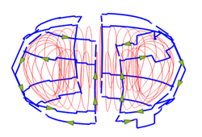
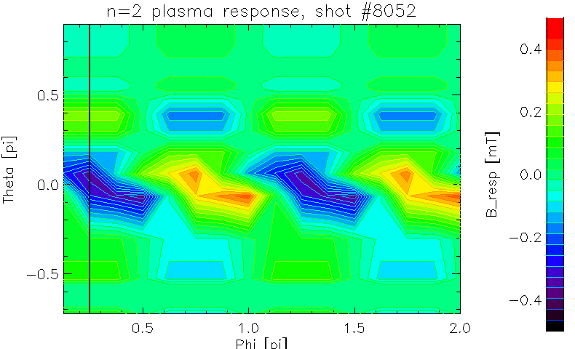
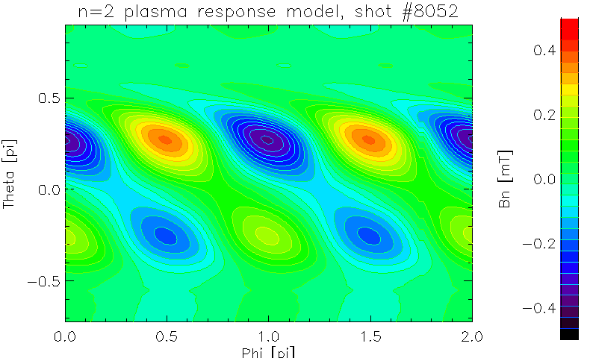
ELM control techniques –
Magnetic perturbations
MP coils on COMPASS
In operation since summer 2014
n = 2 magnetic perturbation
Study of plasma response, ELM structure, SOL and divertor physics
Response field experiment versus modelling with MARS-F/Q code
(collaboration with CCFE)
Experiment
Model

Slide 16
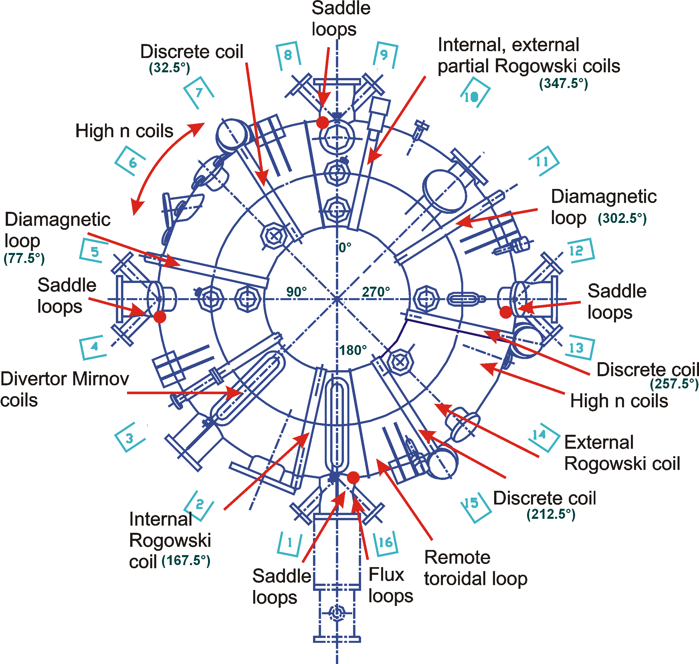
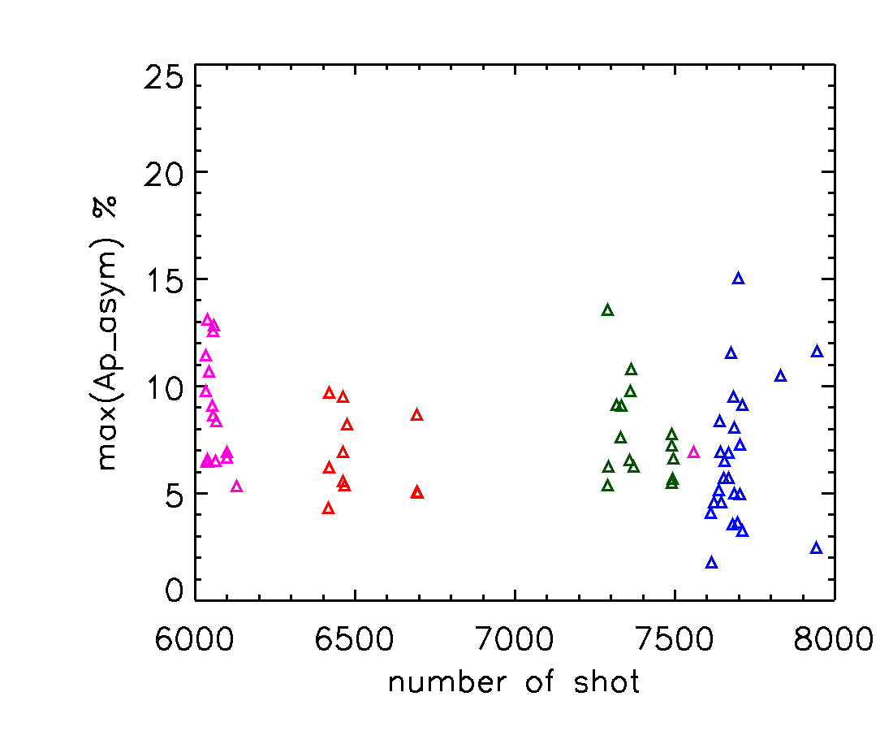
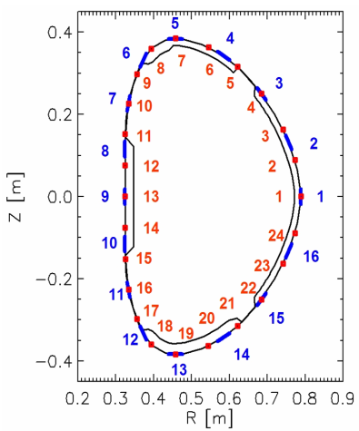
Toroidal current asymmetries
during disruptions
Toroidal current asymmetries during a disruption lead to substantial sideway forces
COMPASS ~400 diagnostic coils => plasma current asymmetries can be well measured
Comparative studies with JET has been initiated (S. Gerasimov) => 5 toroidal locations as compared to 4 locations of JET
Sideway forces on COMPASS ~ 3 000 N
installation of accelerometers under
consideration
COMPASS:
JET and COMPASS show same values
Notes:
100 m vysoko, metru za sekundu.

Slide 17
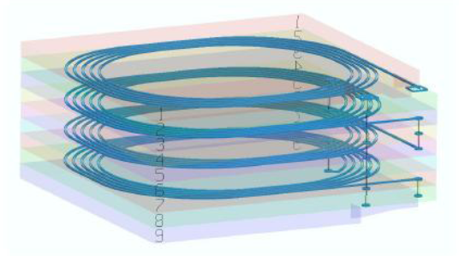
Metal Hall sensors and
LTCC irradiation tests
Metal Hall sensors (pioneered by IPP Prague) are attractive option for local magnetic field measurements in ITER/DEMO like fusion reactors:
  Contrary to pick-up coils, they allow for AC detection technique; much more resilient to spurious voltages due to various temperature/radiation asymmetries.
  More robust and more simple compared to MEMS.
Bismuth Hall sensors are presently accepted baseline concept for ITER steady state magnetic diagnostic.
LTCC technology is the basic concept for ITER inductive sensors.
We perform the first neutron irradiation test of ITER like LTCC sensors at LVR-15 fission reactor.
Total neutron fluence, E > 0.1 MeV, 1 × 10²⁰ cm⁻².
.
No systematic radiation structural effects!

Slide 18
Conclusion
Technology research to in the field of material irradiation, high heat fluxes and TBM ongoing.
COMPASS is a flexible device for studies of edge, SOL and divertor physics as well as some of the problems related to PWI
New set of diagnostics focused on edge plasma, SOL and divertor in operation providing unique possibilities
Suitable for benchmarking of numerical codes.
ELM control systems in operation
COMPASS is open for collaboration

