Slide 1
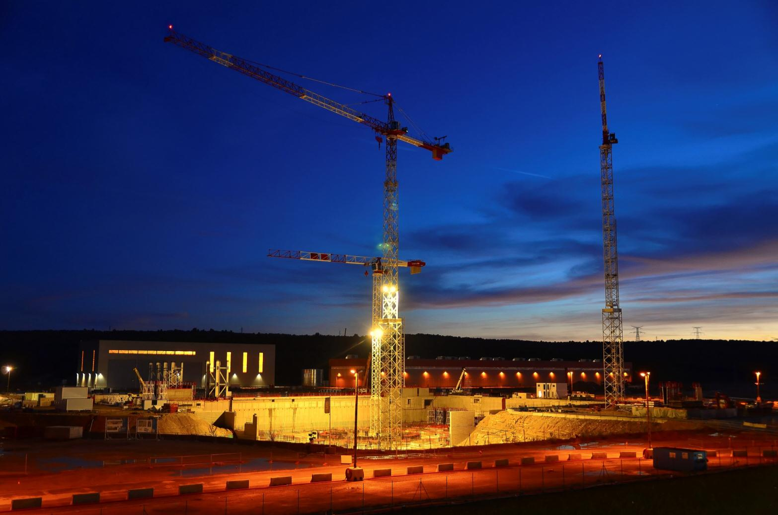
ITER
Where are we?
Carlos Alejaldre
Deputy Director-General
ITER Organization

Slide 2
Summary
The ITER Project
Worksite progress
Manufacturing milestones
Transport & Delivery
A « Basic nuclear installation »
Safety functions
Licensing process
Highlights 2014
Management assessment
Transition
Summary

Slide 3
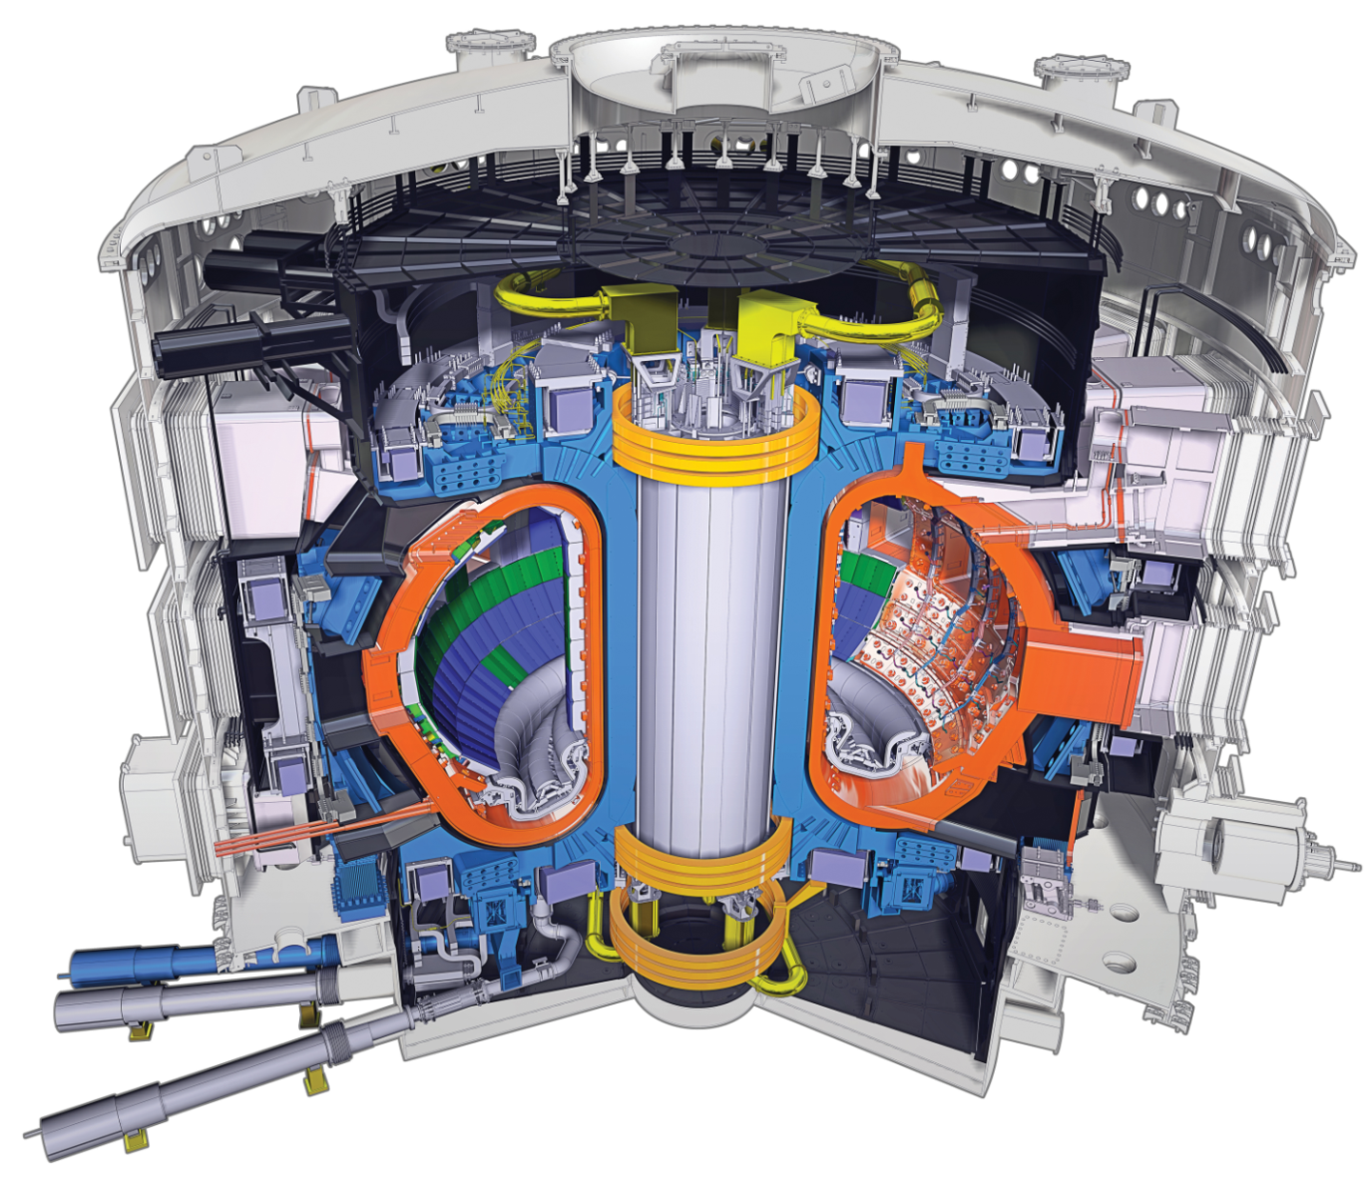
Demonstrating the availability and integration of the science, technologies and safety features for a fusion reactor
The ITER Project
A necessary step on the way towards a commercial fusion reactor
Q ≥ 10
50 MW in/ 500 MW out
Equal sharing of intellectual property between the seven ITER Members
R=6.2 m, a=2.0 m, I_{p}=15 MA, B_{T}=5.3 T, M=23,000 tons

Slide 4
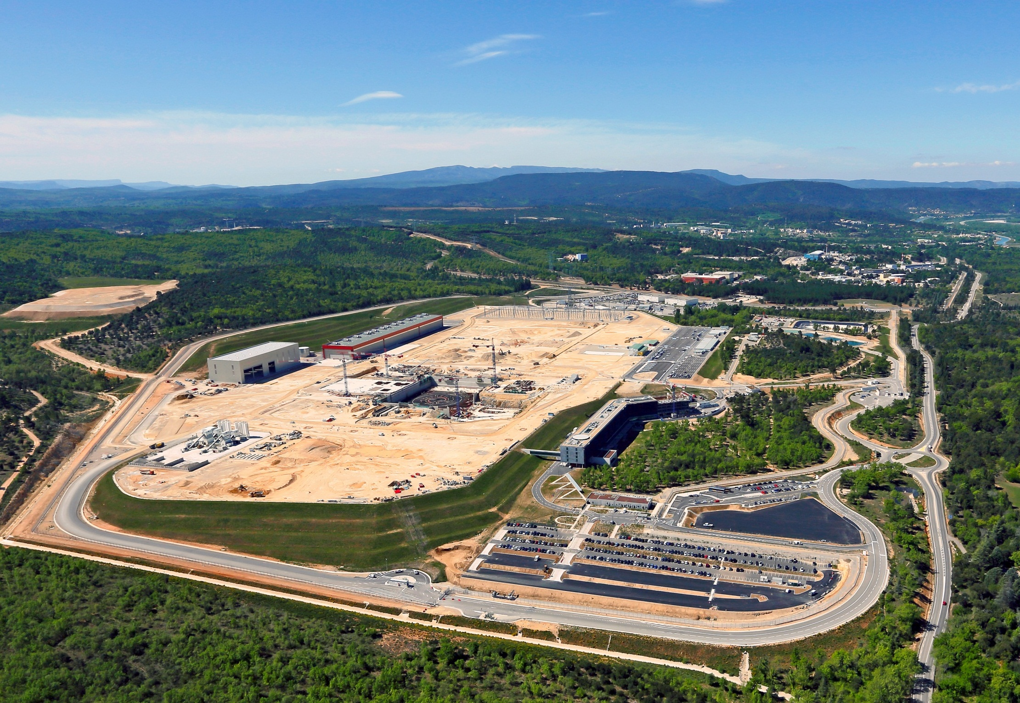
The ITER platform in 2014
Assembly Hall
PF Coils Building
400 kV switchyard
Tokamak Pit
Storage Area 3
Storage Area 2
Subcontractors Area
HQ Extension
Cryostat Workshop
Storage Area 1
ITER HQ
The 42-hectare ITER platform is located 35 km to the north of Aix-en-Provence, France.

Slide 5
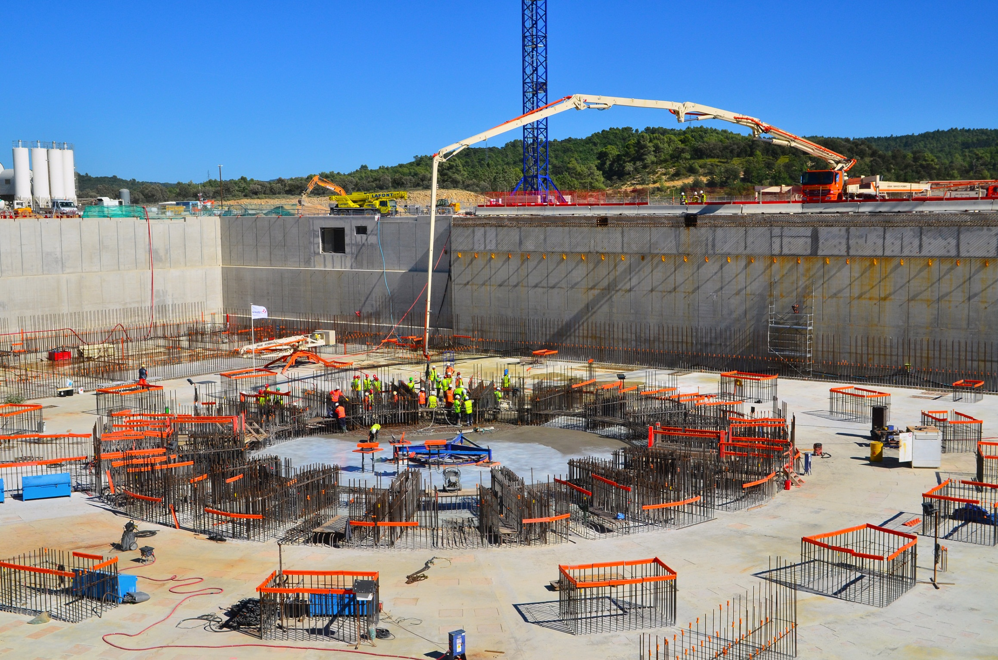
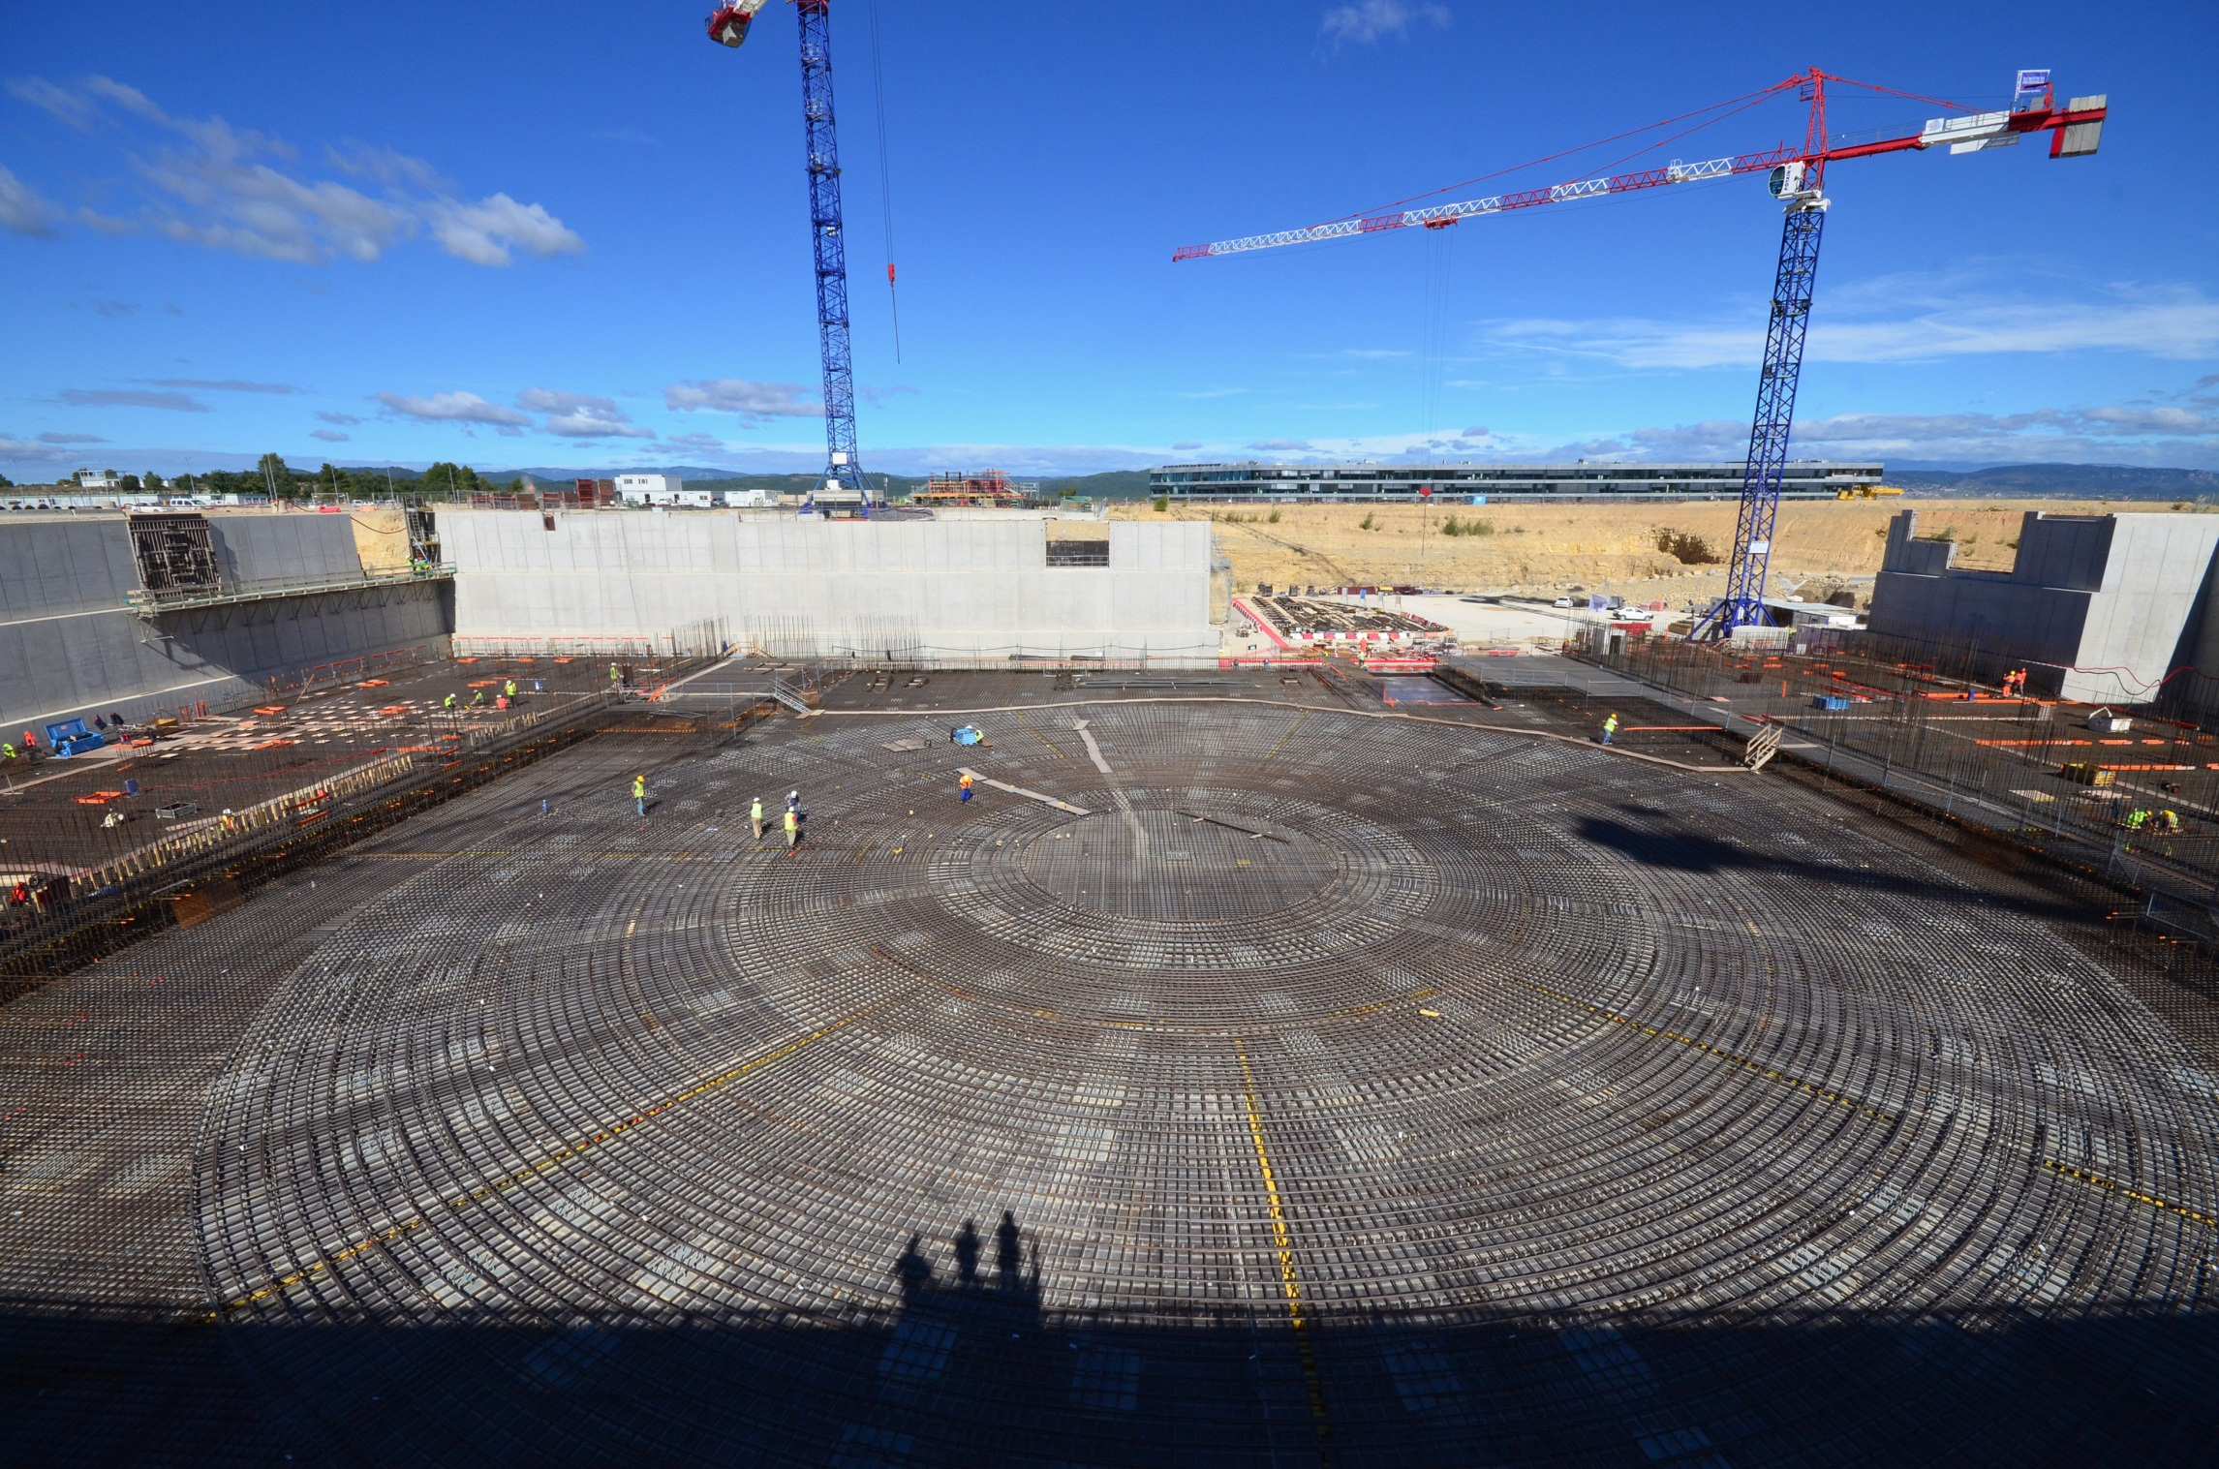
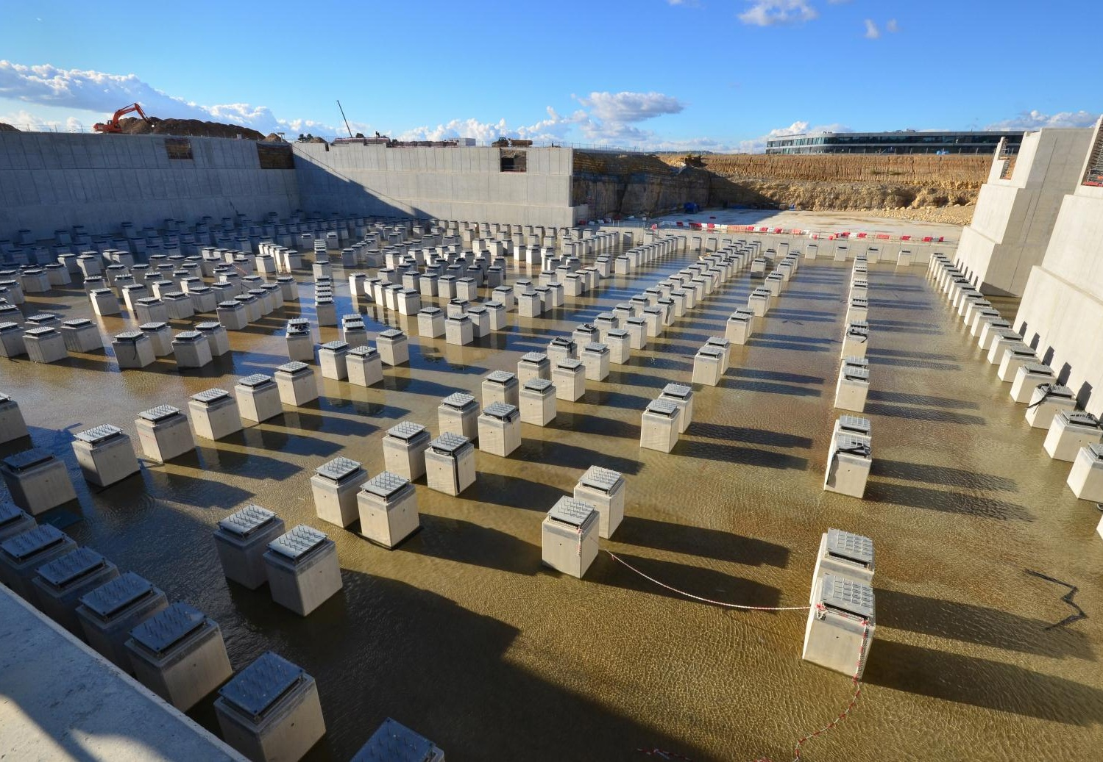
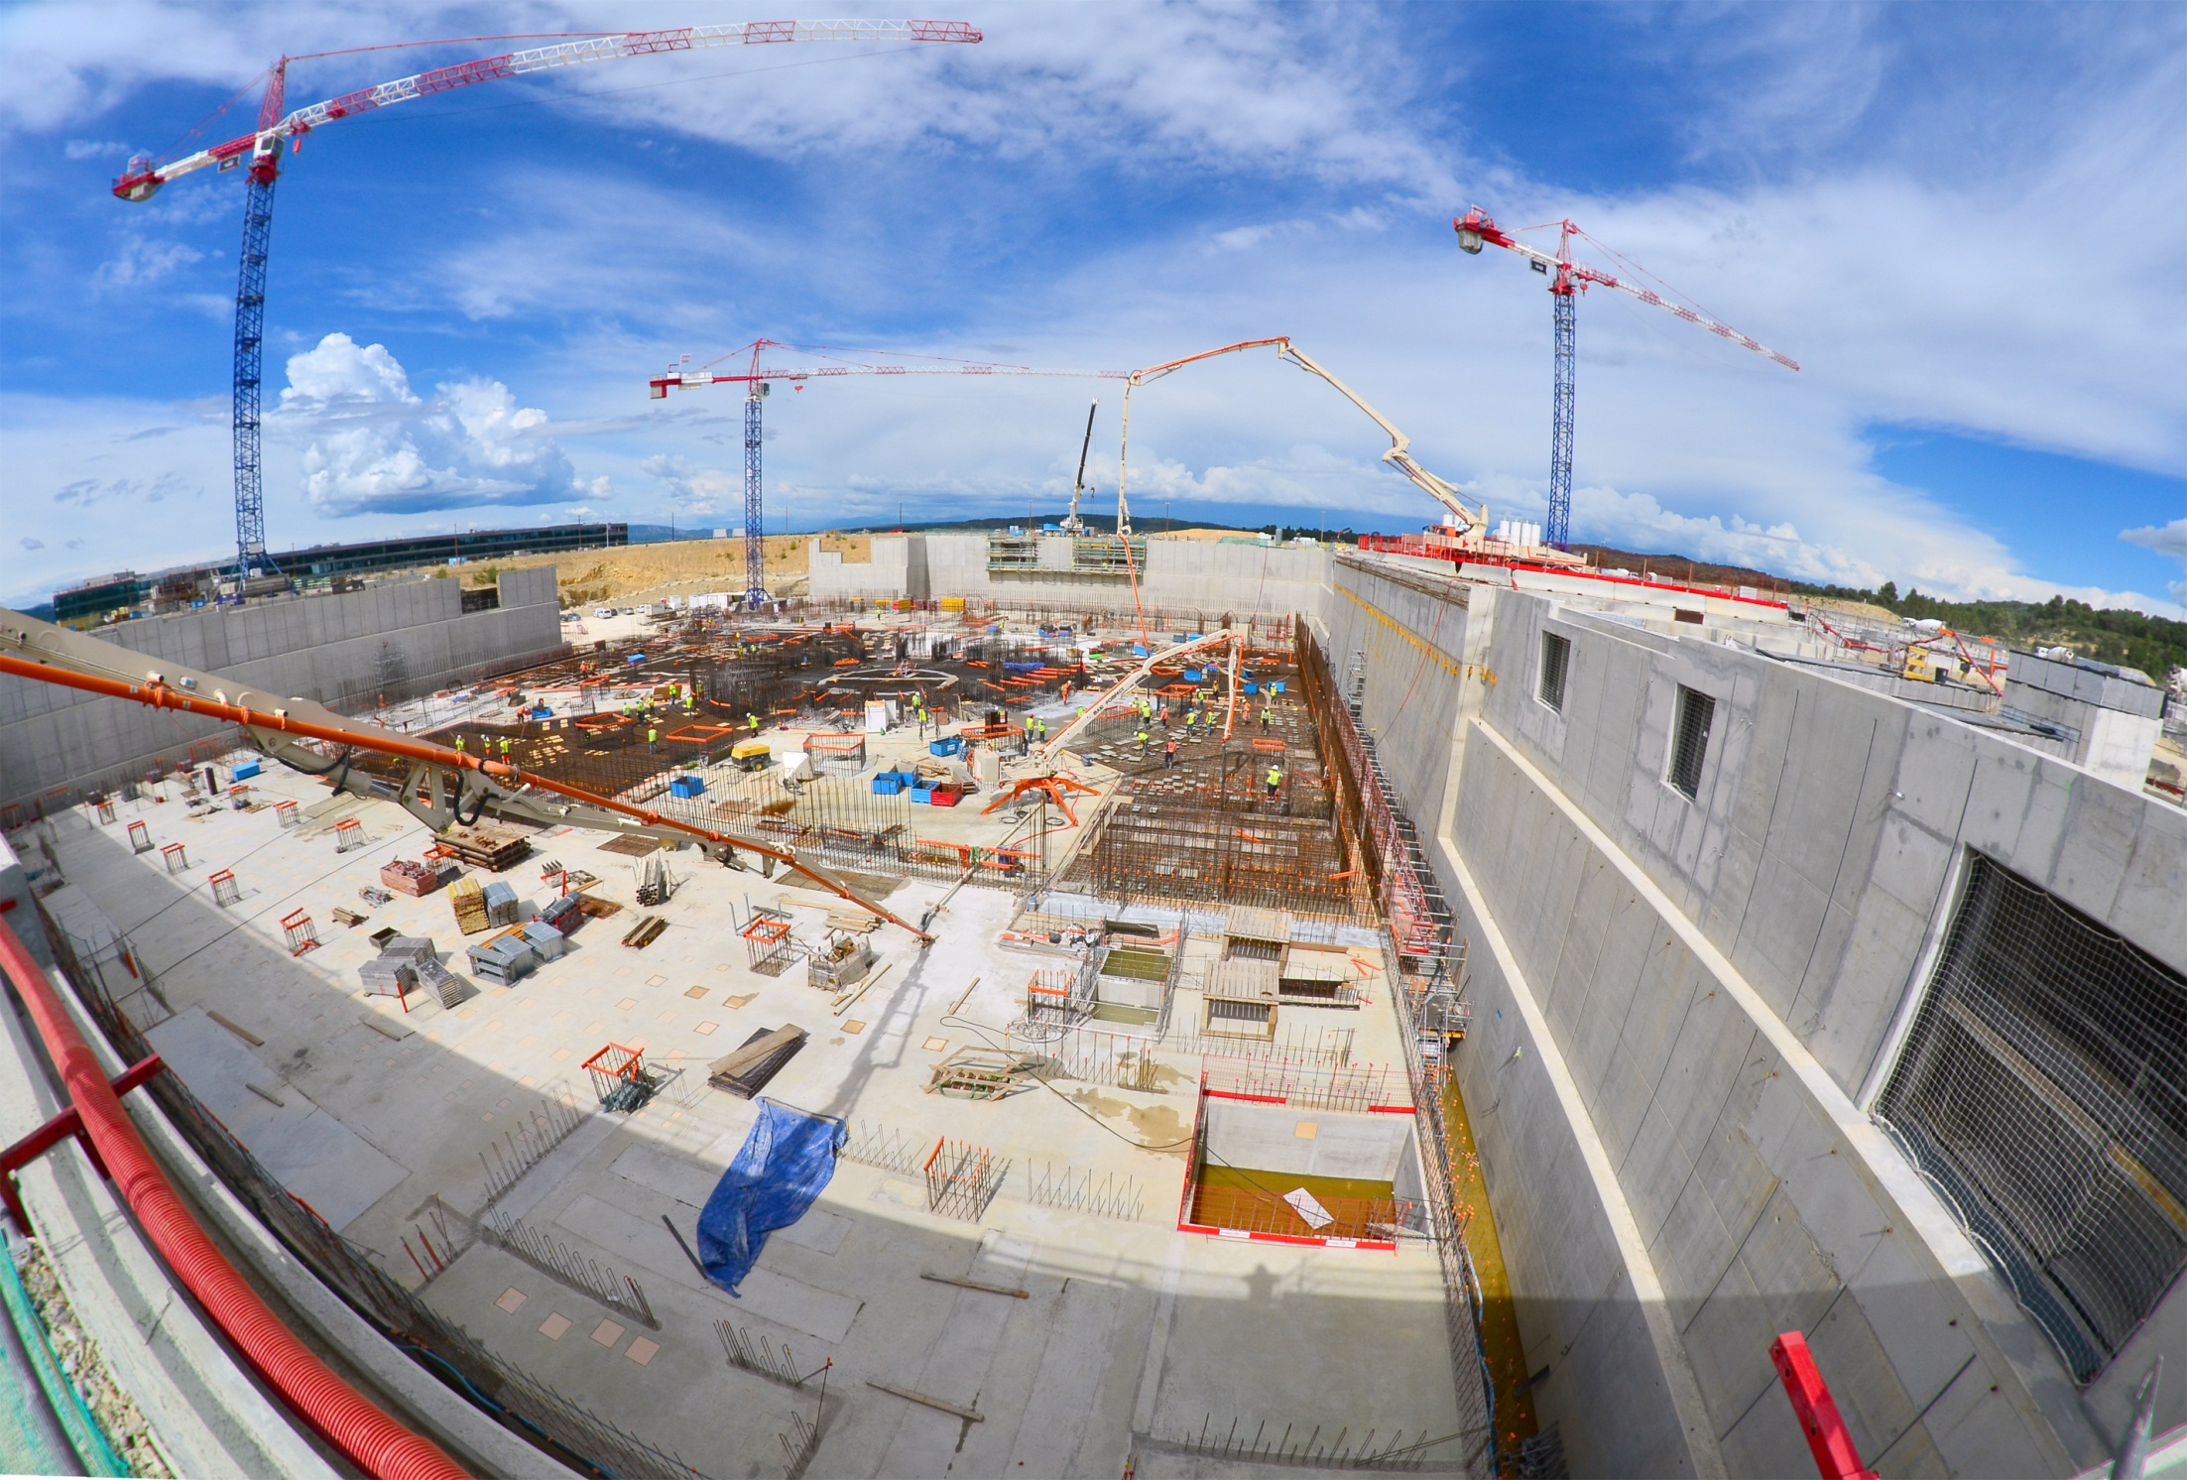
Worksite milestones
The Tokamak Complex basemat
Resting on the 493 columns of the paraseismic system, the Tokamak Complex basemat will support the Tokamak Complex buildings. Concrete pouring was finalized on 27 Aug. 2014
Notes:
La topographie de la dalle (basemat) du Hall d’Assemblage est plus complexe que celle du Tokamak Pit.
La dalle est également, à certains endroits, beaucoup plus épaisse pour faire place à des galeries et pénétrations.
La densité du ferraillage (rebar) est très forte (1 500 tonnes d’acier dans le béton)
Elle supportera les charges très lourdes des éléments et de l’outillage (tooling) d’assemblage.

Slide 6
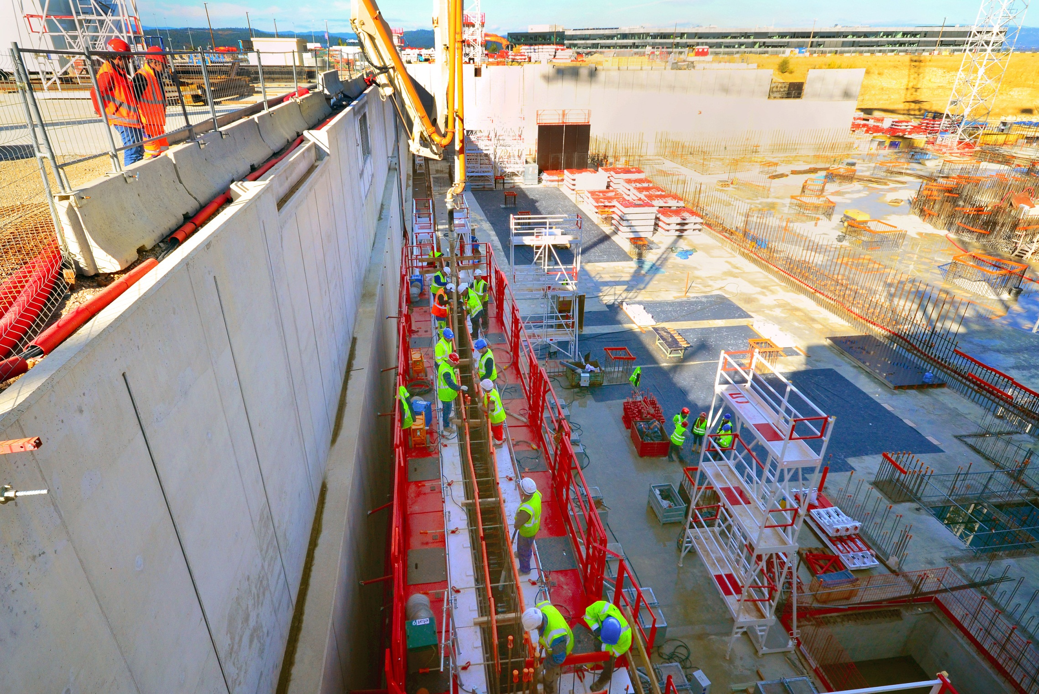
Worksite milestones
The basement-level walls
Work on the first level walls of the Tokamak Complex began in November. It is expected to last until mid-2015.

Slide 7
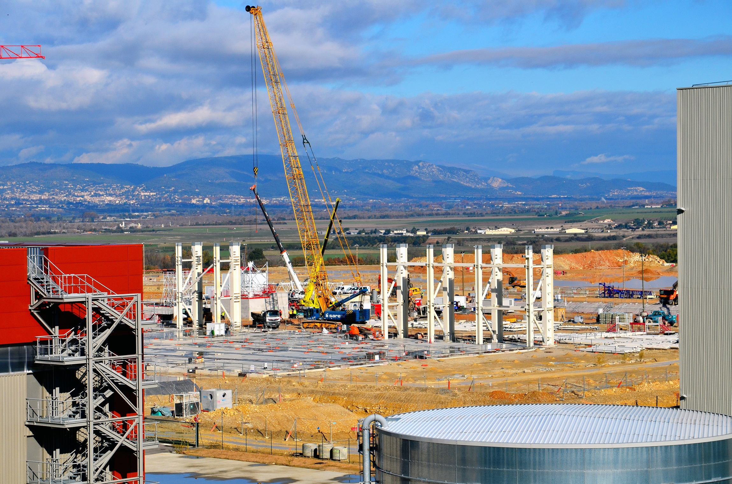
Worksite milestones
The Assembly Hall
The pillars for the metallic structure of the Assembly Hall building are being assembled (Nov 2014)

Slide 8
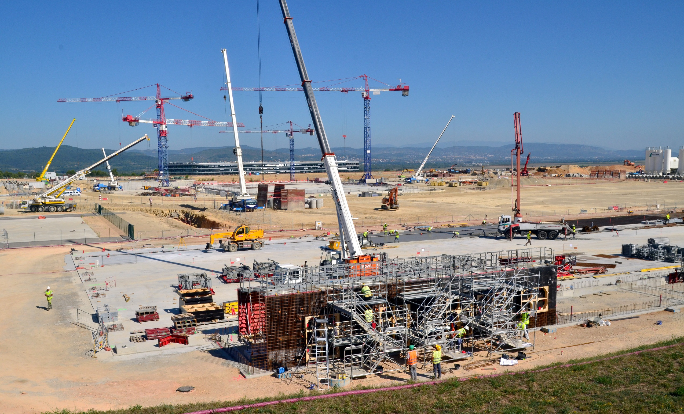
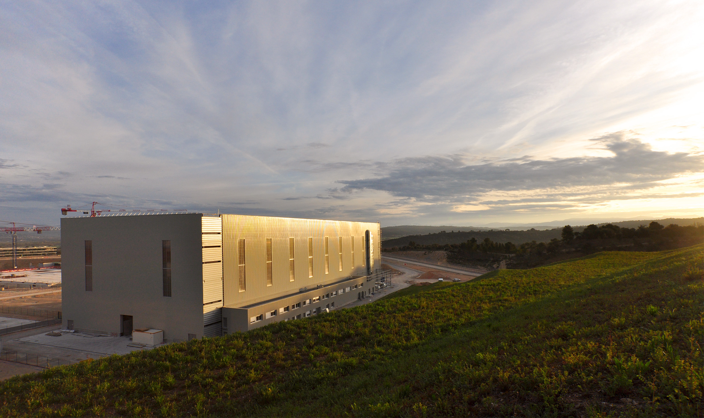
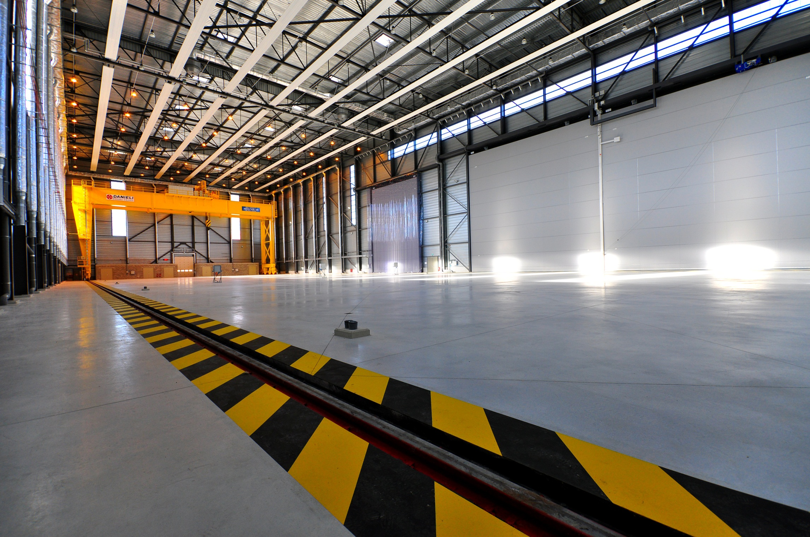
The Cryostat Workshop
Worksite milestones
Completed in February, the Cryostat Workshop (110 metres long, 44 metres wide and 27 meters tall) was inaugurated in November. Welding and assembly operations for the Cryostat should begin in 2015.

Slide 9
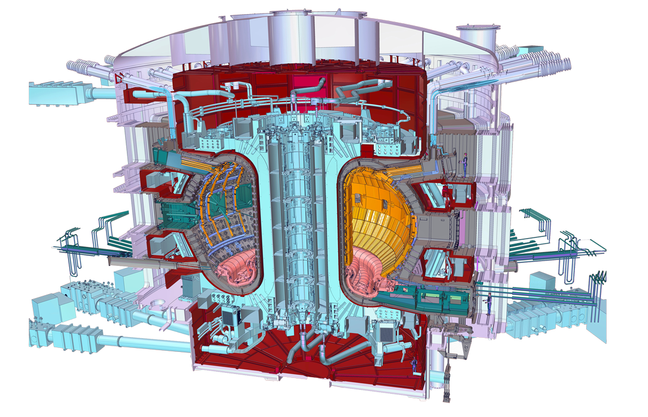
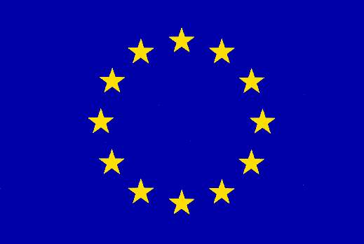
Manufacturing milestones
Who manufactures what?
Only the main components are represented on this slide
Cryostat
Feeders (31)
Toroidal Field Coils (18)
Thermal Shield
Vacuum Vessel
Poloidal Field Coils(6)
Internal coils
Blanket
Correction Coils(18)
Central Solenoid (6)
Cooling water system
Divertor

Slide 10
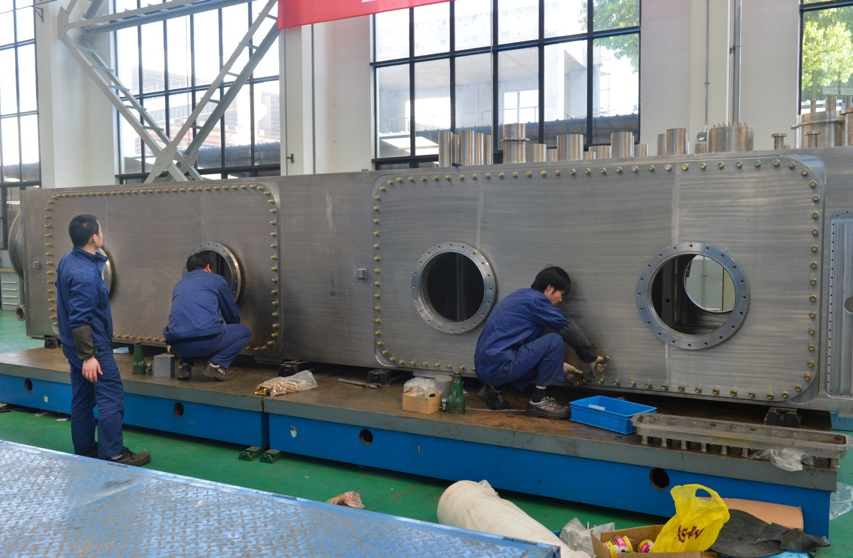
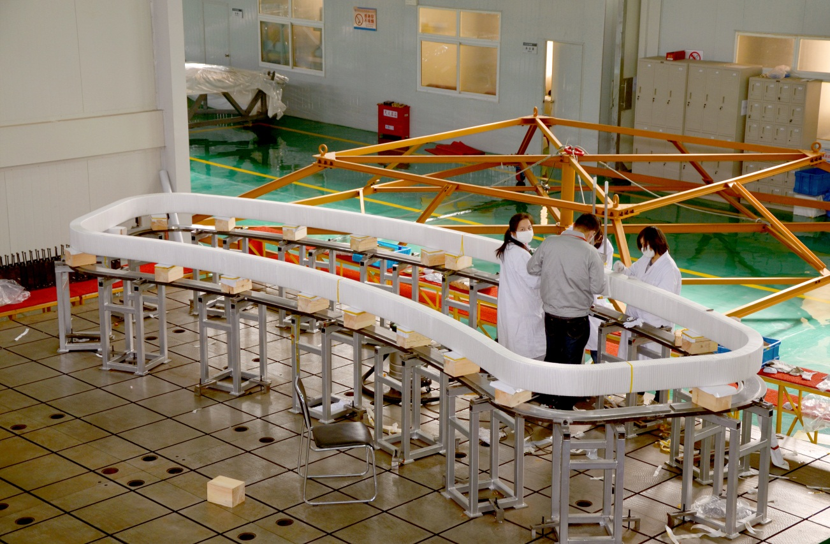
Manufacturing: a few examples
China
13 contracts were placed in this year (one more will be awarded soon. Up to now, 65 contracts have been awarded.
26 main suppliers, more subcontractors and Chinese industries are involved in the ITER project.
The machining of the Coil Terminal Box was completed in April 2014. The Box is now under integral test in ASIPP (Institute of Plasma Physics, CAS) factory
Following mockup development, manufacturing of the first of 18 Correction Coils will be done at the Institute of Plasma Physics, Chinese Academy of Sciences (ASIPP) in Hefei, China.

Slide 11
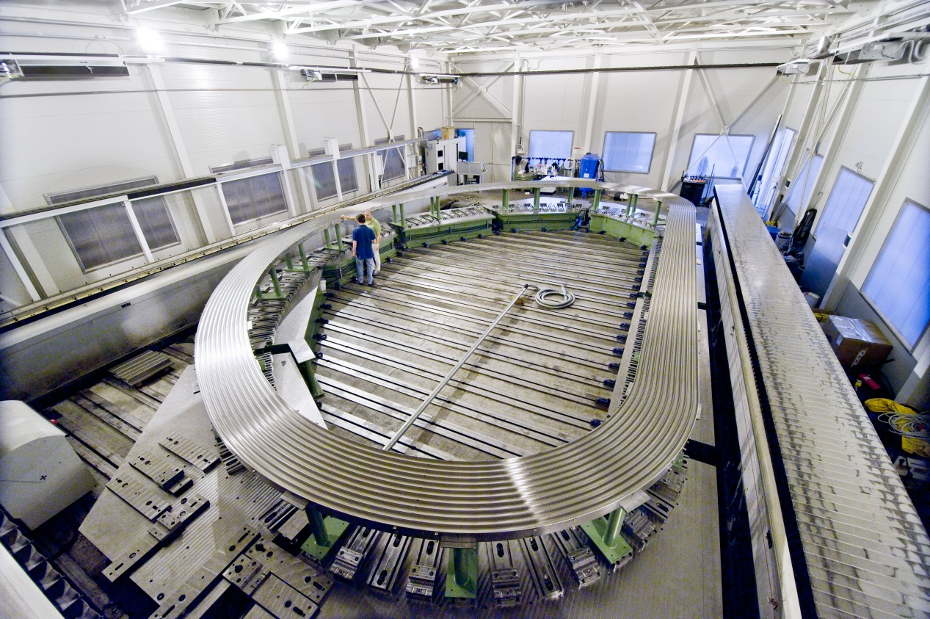
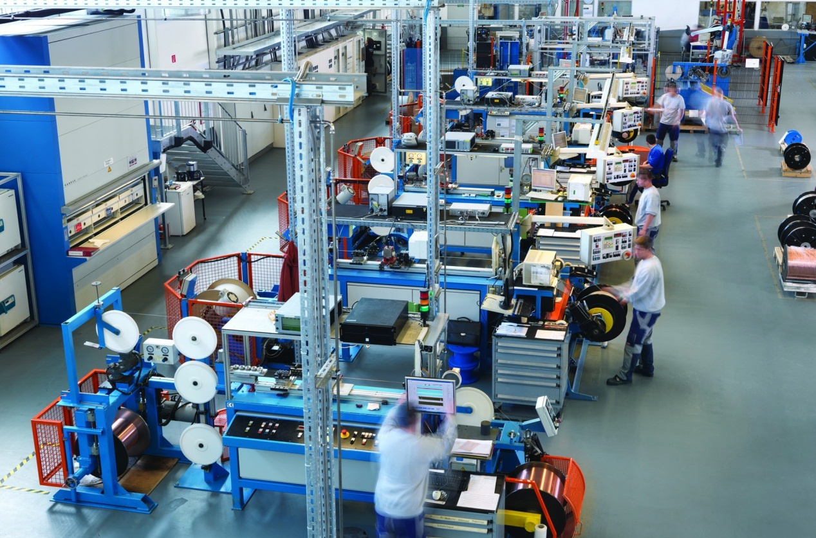
Europe
Manufacturing… a few examples
Europe is responsible for delivering the 39 buildings of the ITER installation.
Like all ITER Members, it also procures components for the ITER tokamak.
Europe’s contribution represents ~ 45% or the total value of ITER.
The manufacturing of the first of the 70 radial plates that will support the superconducting cables of ITER’s Toroidal Field coils has started in Italy and France.
Europe has completed its 20.2 percent share of niobium-tin strand production for ITER's toroidal field coils—some 97 tons of material produced by two European suppliers.

Slide 12
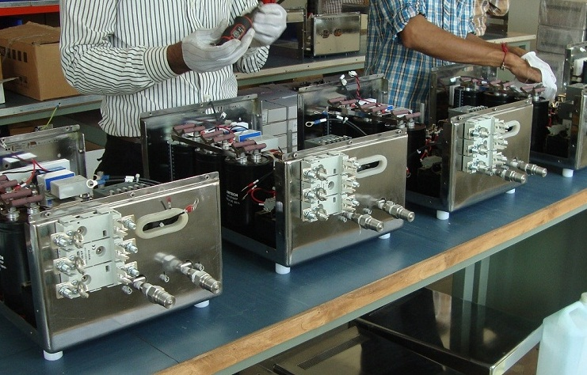
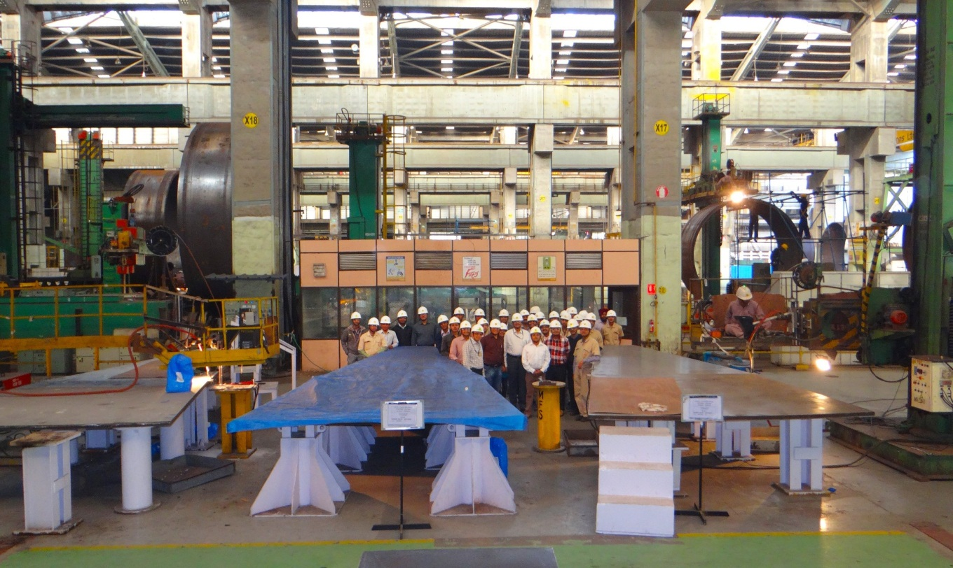
India
Manufacturing… a few examples
In-wall shielding, cryostat, Component Cooling Water System (CCWS), Chilled Water System (CHWS), cryolines, etc. have entered the manufacturing phase.
The on-site Cryostat Workshop was completed in February and inaugurated in November 2014.
In Hazira, India, Larsen & Toubro Ltd workers gather for a picture as the first longitudinal seam of the cryostat base section is readied for “submerged arc welding”.
​Manufacturing is underway in India for the acceleration grid power supplies that will be supplied to ITER's diagnostic neutral beam.

Slide 13
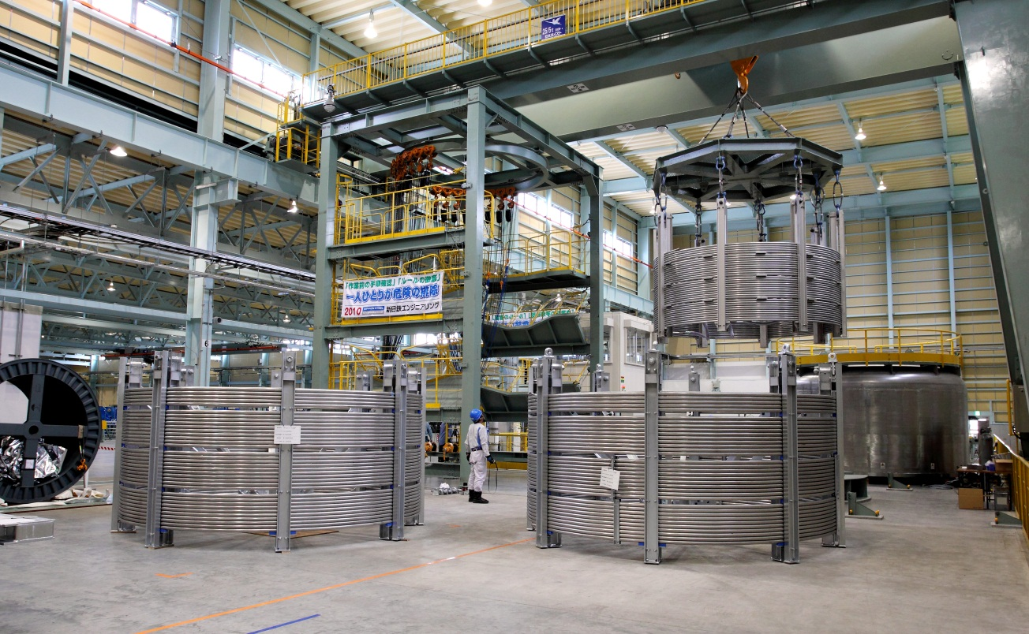
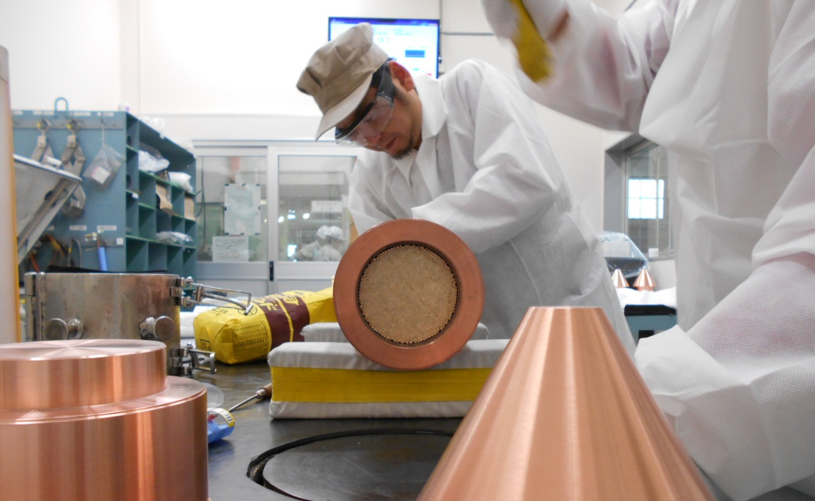
Manufacturing… a few examples
Japan
First manufactured Central Solenoid conductor (length :620m) at NSSE in Kitakyushu, Japan.
First 5 conductors shipped on 25 June to the US.
Tests completed for power supply for ITER Neutral Beam Test Facility
Manufacturing and testing of the 5 High Voltage bushing rings is ongoing
At JASTEC’s Moji factory, workers prepare 40- to 100-kg niobium-tin “billets” that will eventually be transformed into millimetre-thin strands.
Upon the completion of jacketing, 760-metre-long toroidal field conductor unit lengths are spooled to facilitate transportation.

Slide 14
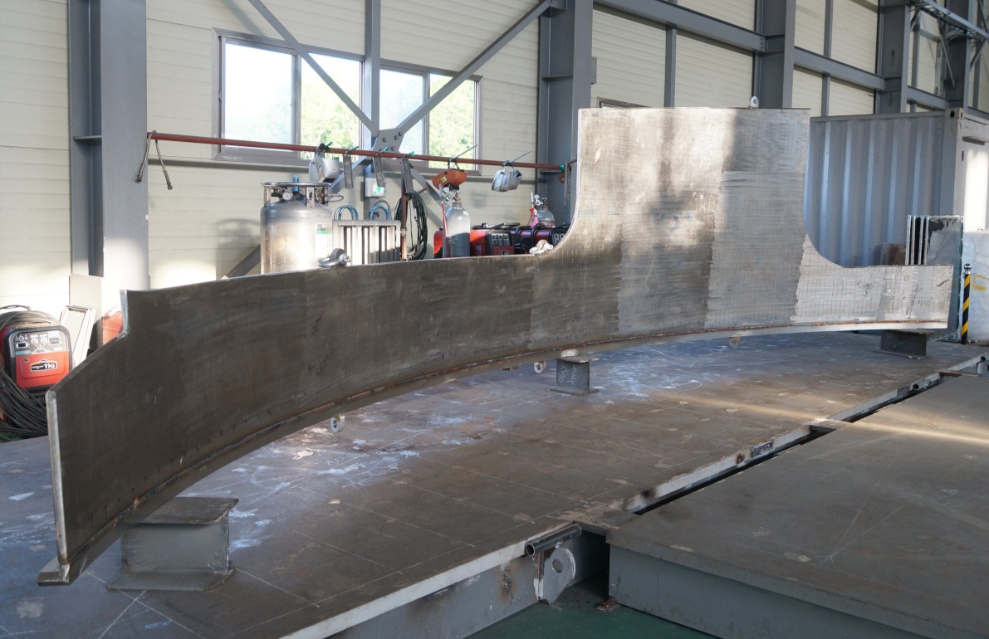
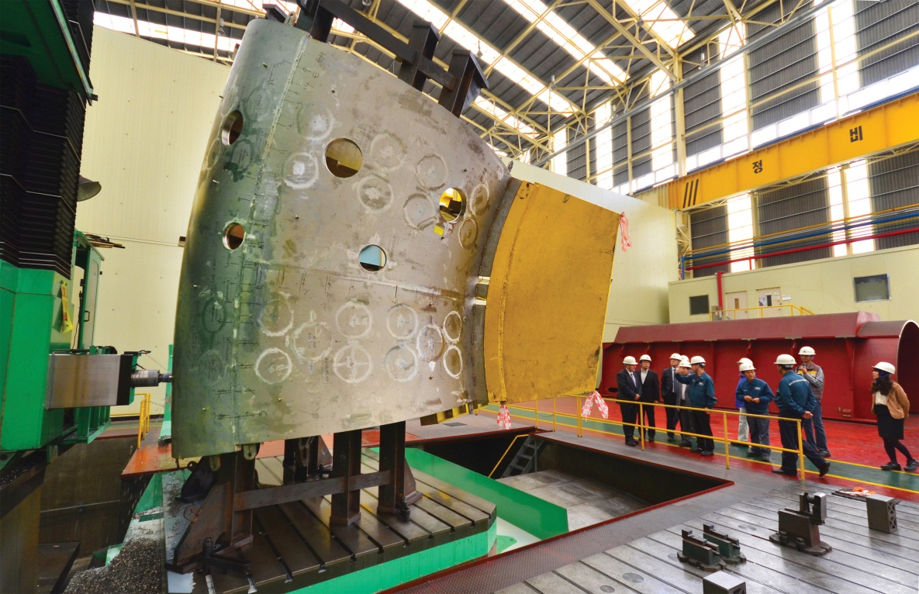
Manufacturing… a few examples
Korea
Manufacturing of 27 Toroidal Field conductors (20.18 %) is now completed. Last shipment to Japan in November.
Manufacturing of Vacuum vessel segments and ports is ongoing at Hyundai Heavy Industries.
The ITER Vacuum Vessel is being manufactured at the Hyundai Heavy Industries shipyard in Ulsan, Korea.
Thermal shield prototype fabrication has begun at SFA Engineering Corp.

Slide 15
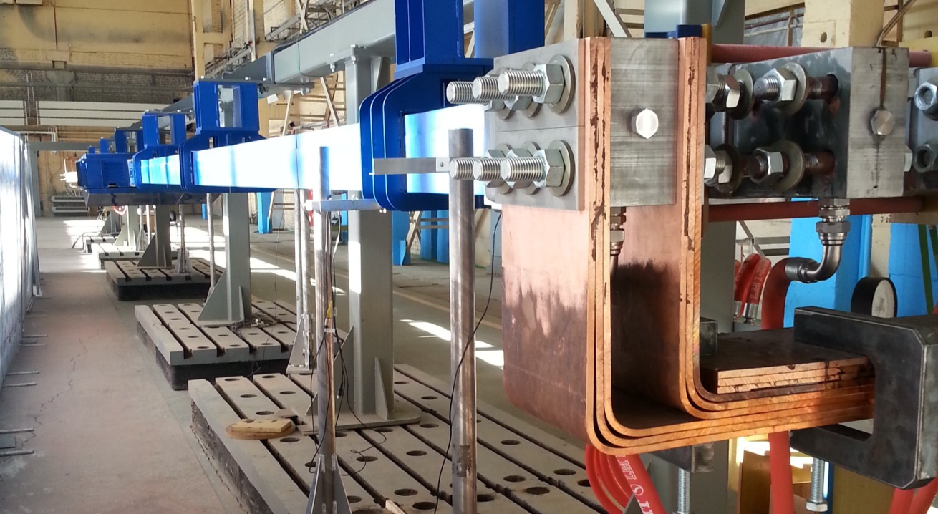
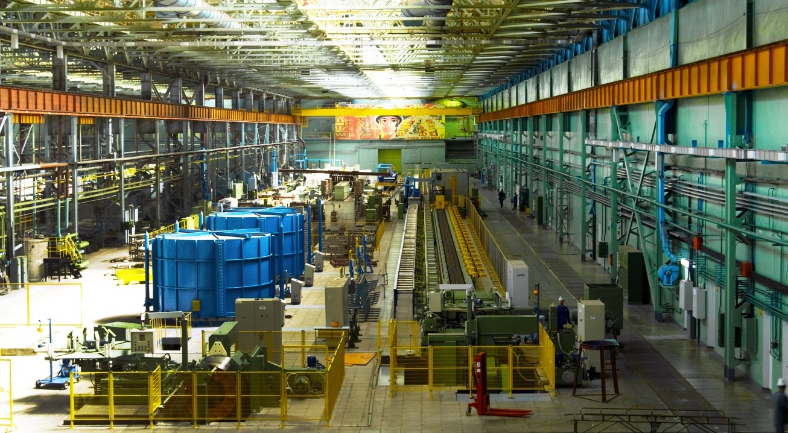
Manufacturing… a few examples
Russia
Manufacturing in ongoing for TF Conductors, Upper Ports, Blanket First Wall, Dome divertor, EC gyrotrons, etc.
The last batch of Russian-produced superconducting strands for the ITER magnet system was shipped for cabling on 3 December.
In the last six years, the Chepetsk Mechanical Plant has manufactured ~100 tons of niobium-tin (Nb3Sn) strand for ITER's toroidal field conductor and 125 tons of niobium-titanium (NbTi) strand for the poloidal field conductor.
A prototype of the toroidal field busbars that will feed power to ITER's 18 toroidal field superconducting magnet coils has been successfully manufactured.

Slide 16
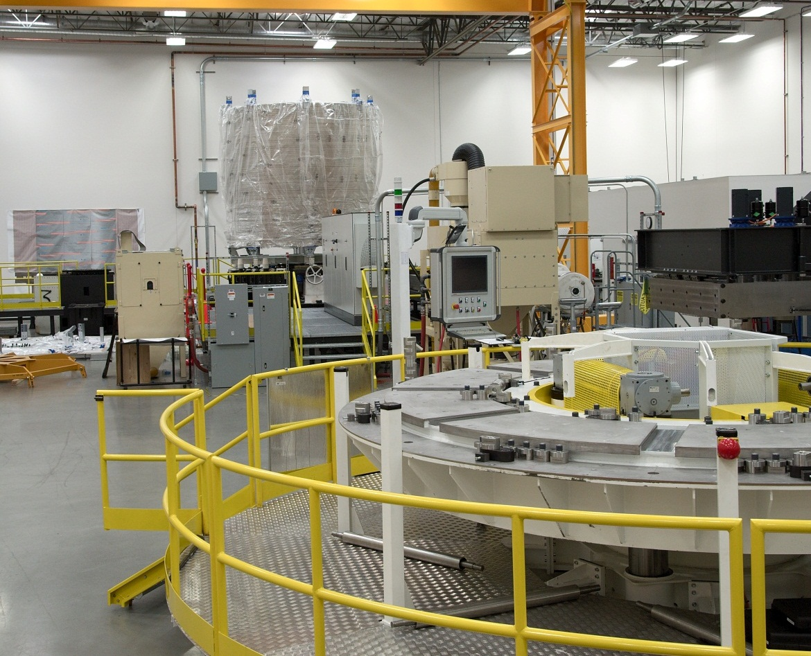
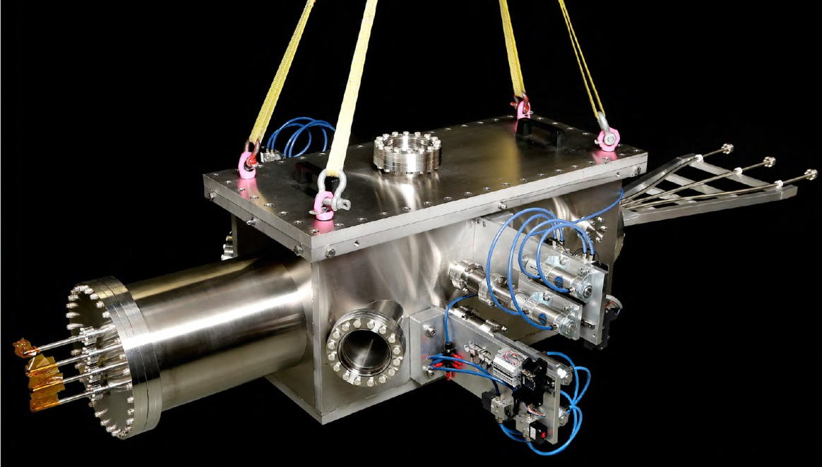
Manufacturing… a few examples
USA
The US ITER Project Office has begun fabrication of the magnet modules with vendor General Atomics. Six superconducting modules for the central solenoid plus a spare will be produced.
Manufacturing of Drain Tank # 1 completed.
Manufacturing of 800m dummy and 100m active Toroidal Field conductor delivered to EU.
Once de-spooled, the conductor passes to the winding station which forms the conductor into a spiral-wound coil composed of "pancake" layers.
A guide tube selector test unit for the pellet injection system is undergoing testing. The unit will support pellet type and pellet position flexibility.

Slide 17
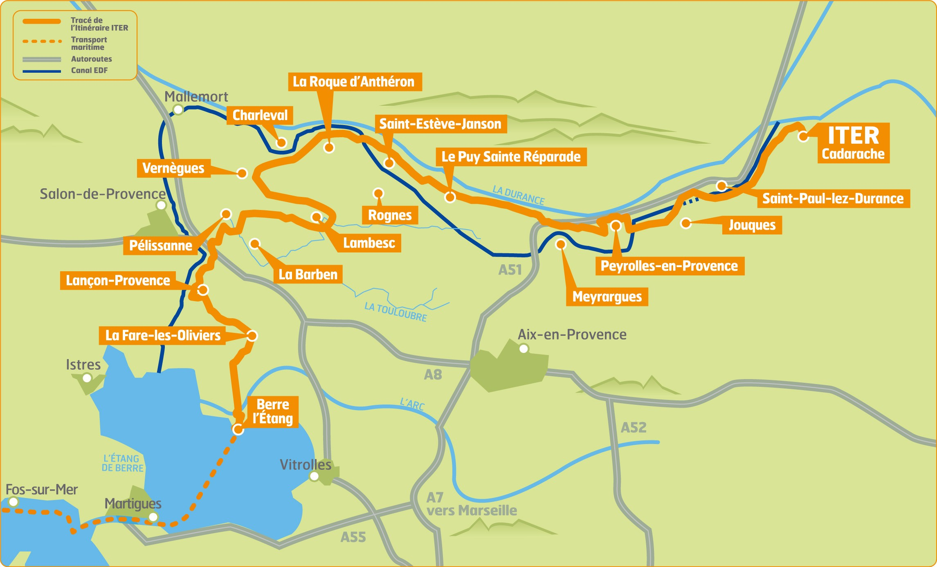
Successful tests
Transport and delivery
The ITER Itinerary test convoy, featuring an 800-metric-ton trailer replicating the weight and dimensions of ITER’s most exceptional loads, has successfully completed two full tests in September 2013 and April 2014.
The first heavy loads (from USA) are expected in early 2015.
Large-scale public works were carried out by France along the 104 kilometres of the ITER Itinerary in preparation for the exceptional size and weight of some of the ITER components.
The 104-kilometre long ITER Itinerary, from the Mediterranean to the ITER site

Slide 18
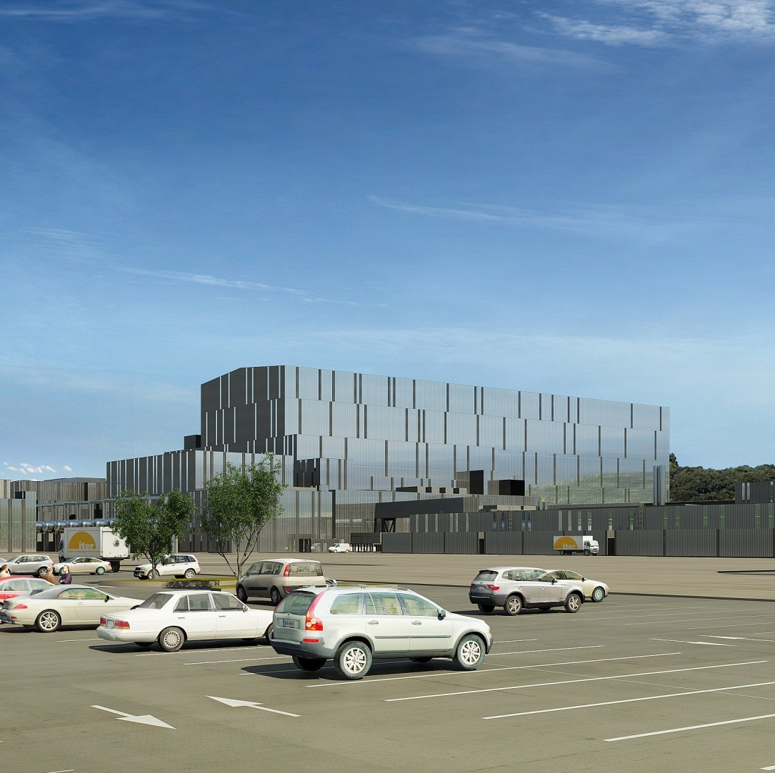
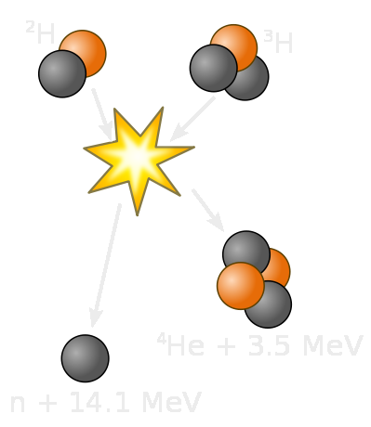
A “Basic Nuclear Installation”
Mainly because of a Tritium inventory > 27 g
But also because of:
Activated products -tokamak
Activated products -cooling systems
In addition ITER will produce
Operational and dismantling waste
Tritiated waste
Activated waste
Tritiated and activated waste

Slide 19
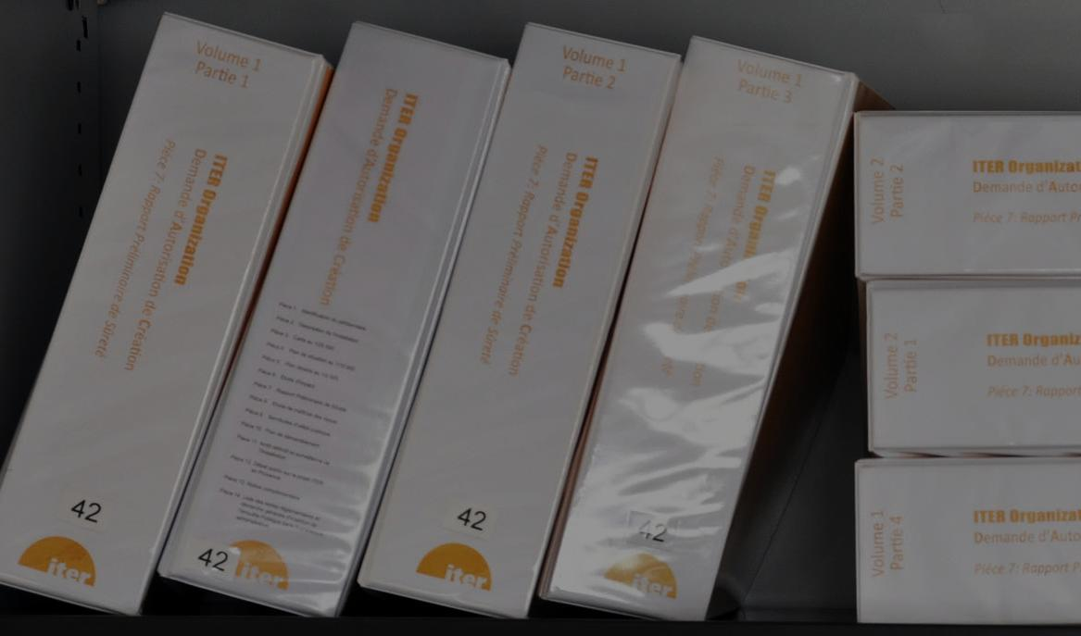
Licensing process
March 2010
Submission of DAC files
14 December 2010
Acceptance (MSNR)
January 2011
Transmission to Environmental Authority
13 January 2011
Submission to CLI Working Group
Public Enquiry files
23 March 2011
Advice from Environmental Authority
23 May 2011
Prefectoral Order for Public Enquiry
15 June – 4 Aug 2011
Advice from CLI-July 2011
Public Enquiry
9 September 2011
Advice from Enquiry Commission
30 November 2011
Examination of RPrS by “Groupe Permanent”
2012
CLI advice
Draft Technical Prescriptions by ASN
Authorisation for INB Creation
Decree

Slide 20
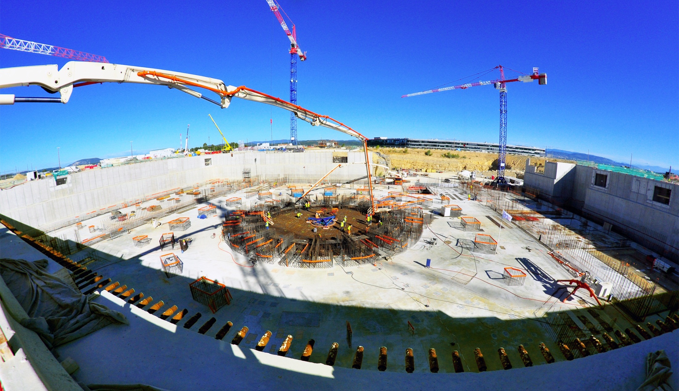
Licensing process
An essential milestone in the history of our Project
A historical achievement for the Fusion development
On 10 November 2012, the Official Journal of the French Republic published the Decree authorizing the International ITER Organization to create the basic Nuclear Installation named ITER at Saint-Paul-lez-Durance. (Bouches-du-Rhône).

Slide 21
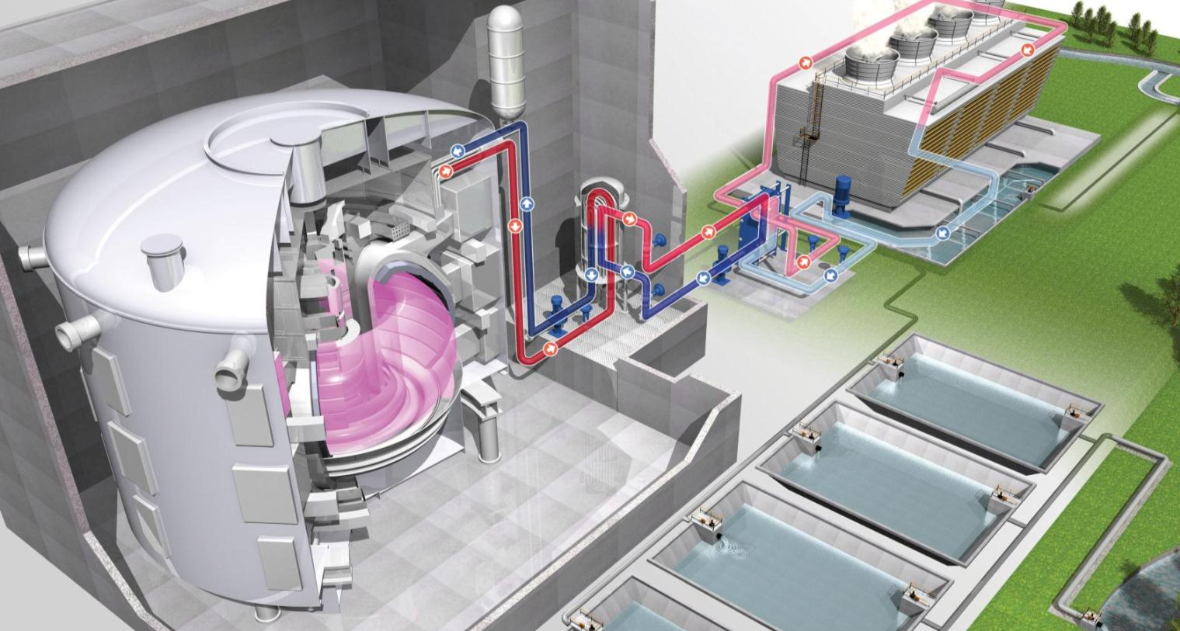
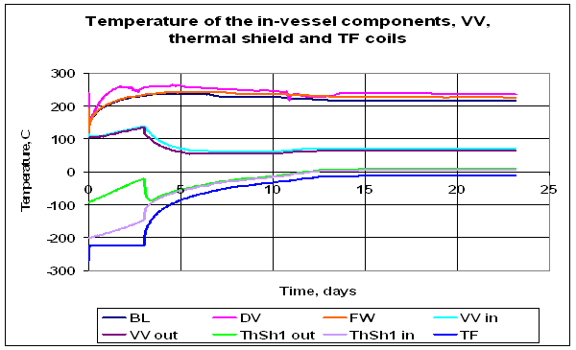
1- Confinement of radioactive materials
2 - Limitation of radiation exposure
Two Safety Functions
No safety function are associated to:
Control of the fusion reactions.
Power dissipation (cooling systems)

Slide 22
EU Commission Pdt J-M Barroso: "Europe is proud to believe in ITER"
Highlights 2014
11 July 2014

Slide 23
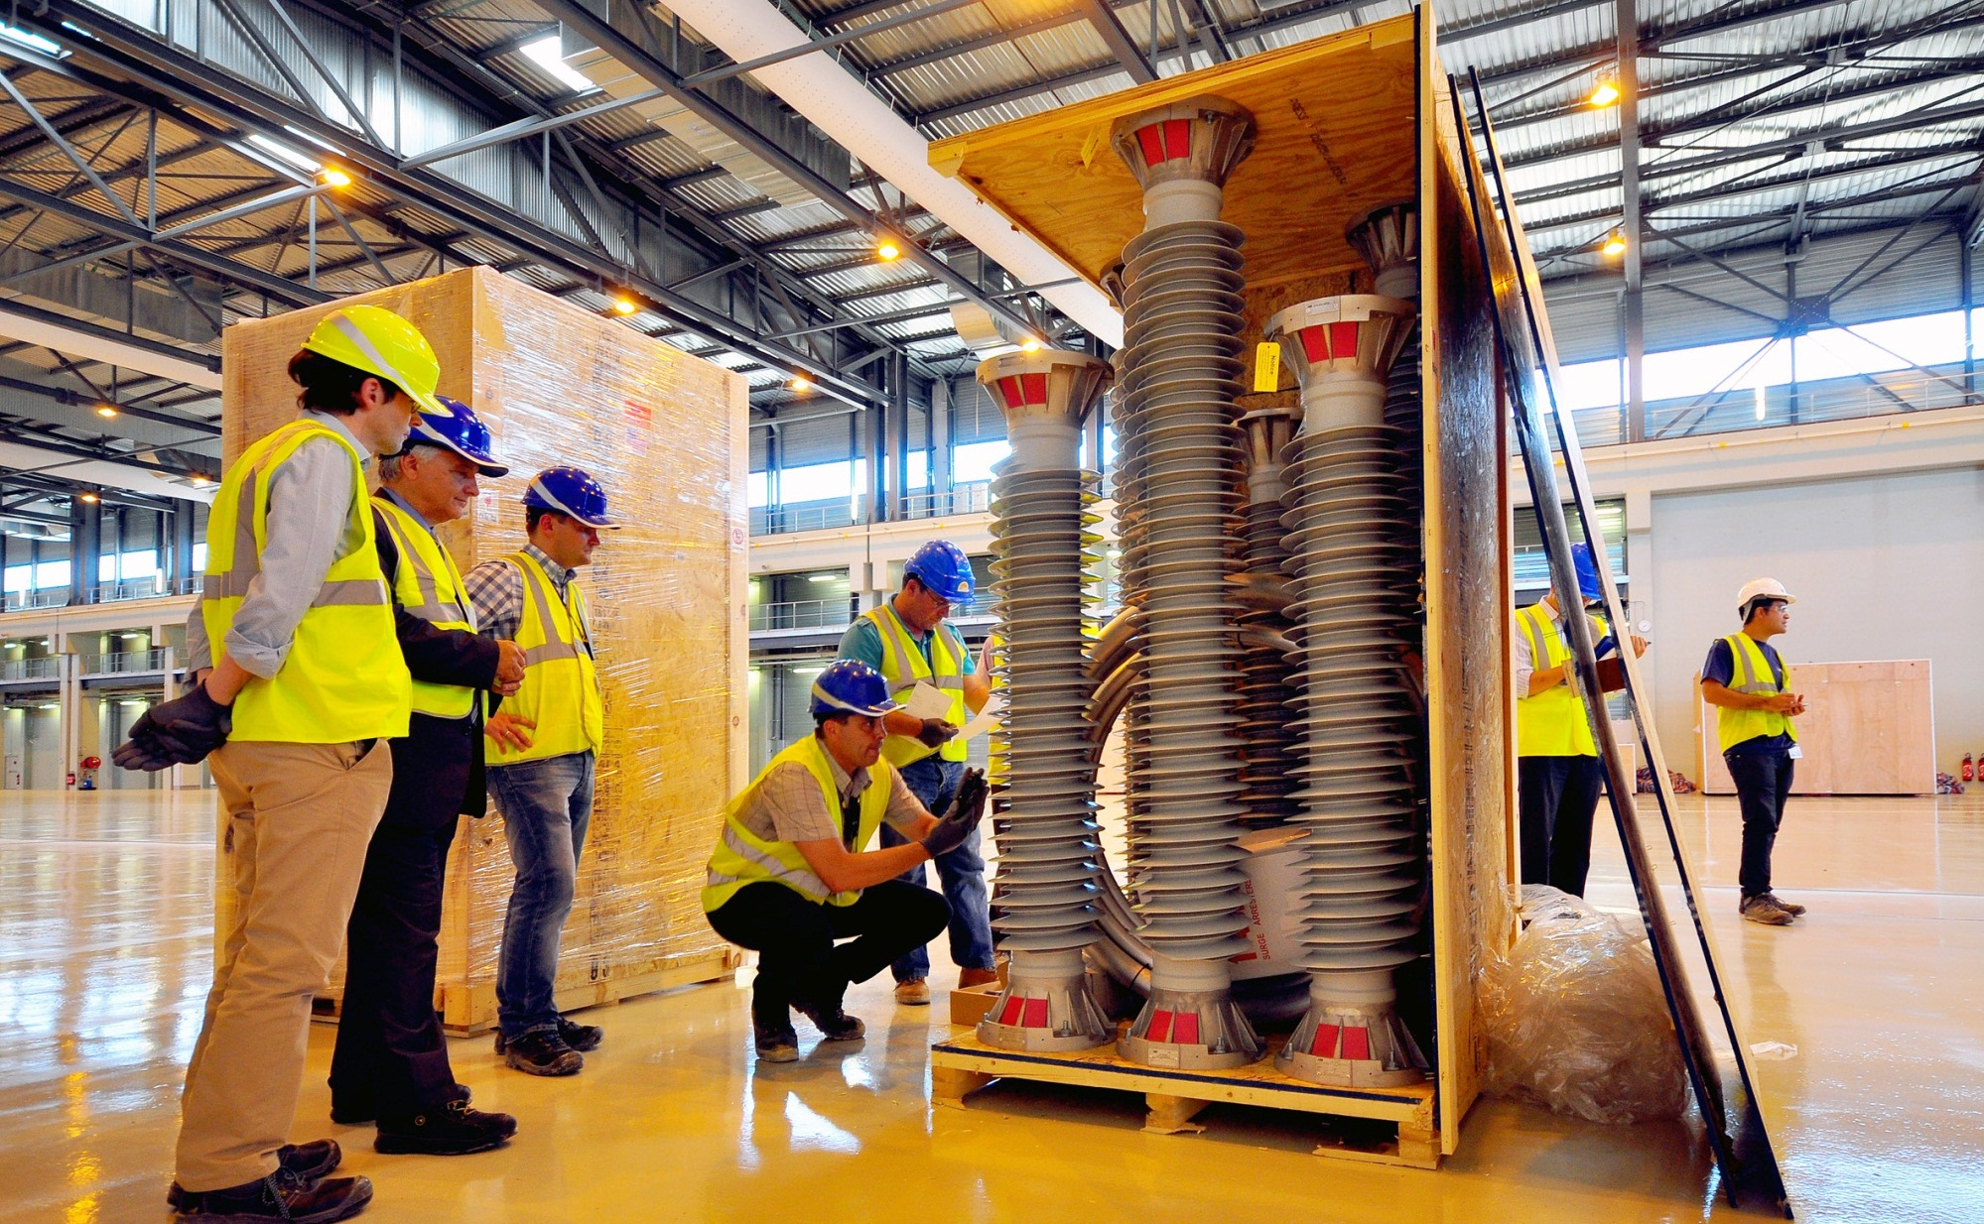
Highlights 2014
US delivers 1st plant components
4 Sept 2014

Slide 24
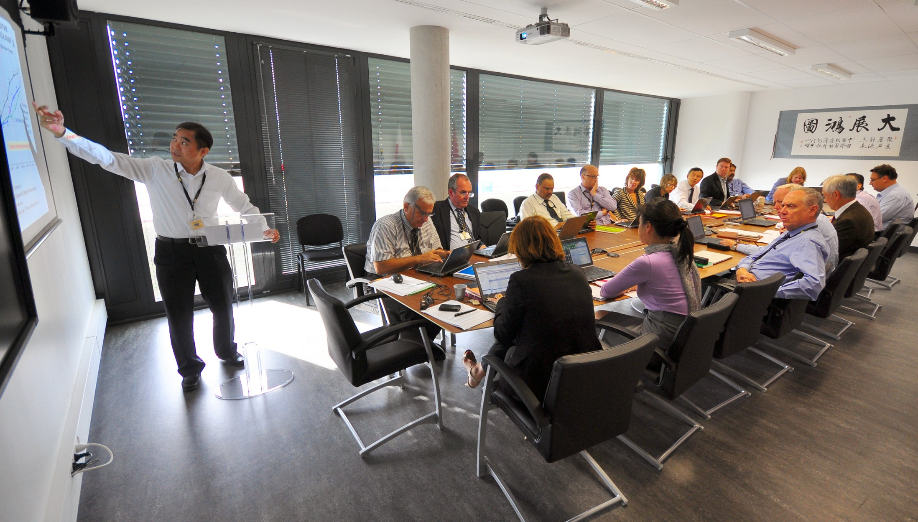
Management assessment
As required under the ITER Agreement, an independent management assessment of the ITER Organization (IO) is conducted every two years.
The recommendations of the 2013 Management Assessment were accepted by the ITER Council and IO, and an improvement action plan with detailed actions, indicators and timelines covering the specific areas highlighted in the MA Report, was proposed by the IO and approved by the ITER Council in February/ March 2014
The MA Action Plan is under full-scale implementation, and two follow-up reports on implementation status have been submitted to the IC in June and November 2014
Major ongoing improvement actions
Extensive improvements in the area of design integration and systems engineering, including recruitment of necessary resources
Close collaboration between IO and DAs in developing an updated long-term schedule for the IC’s consideration by June 2015, and also in implementing mechanisms for joint decision-making
Clear focus on improving nuclear safety culture (evidenced by release of B2 slab hold point and completion of concrete pouring) and project culture
Improved performance for decision process
Generation of substantial cost savings, to be used for meeting identified cost risks and contingencies

Slide 25
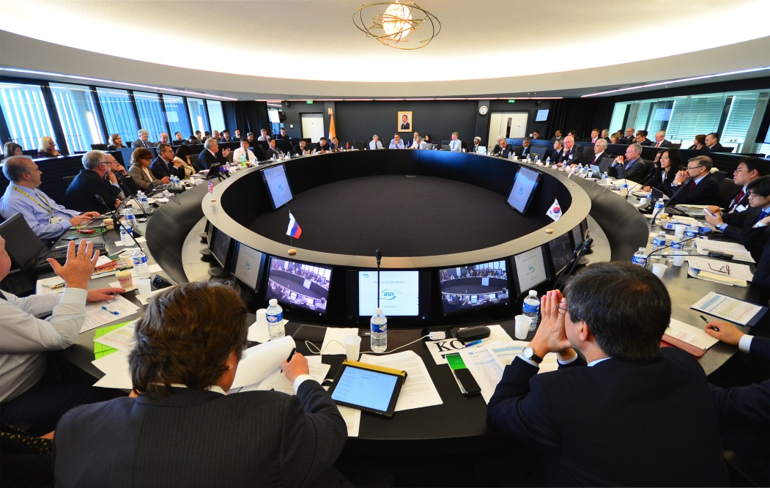
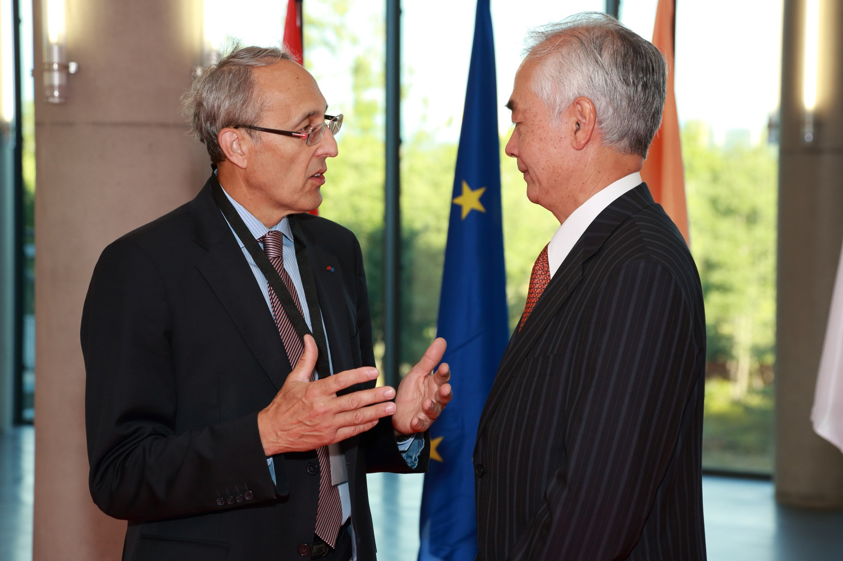
Transition
On 20 November, the ITER Council nominated Bernard Bigot, from France, presently the Adminsitrator -General of CEA, to succeed Osamu Motojima as the next Director-General of the ITER Organization.

Slide 26
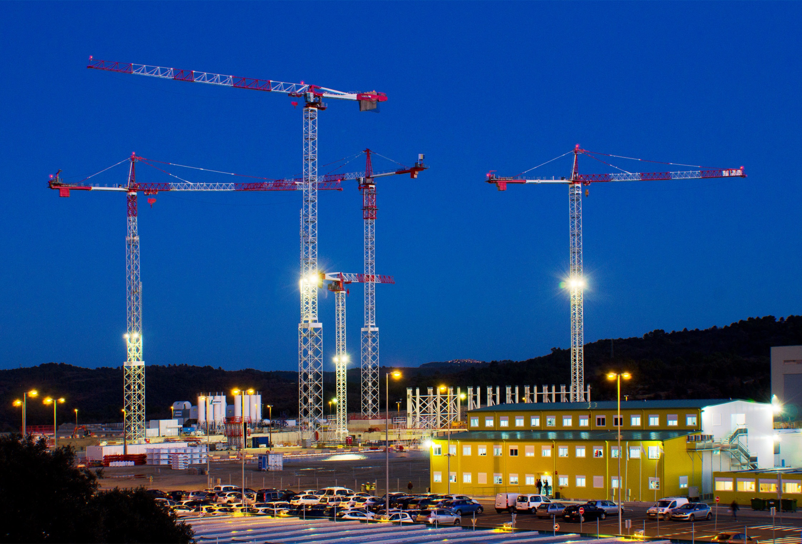
Summary
Procurement Arrangements already signed with Domestic Agencies representing 90% of the total value of the Project
Construction and components manufacturing in the Members’ industry is well advanced and progressing
Nuclear License under French regulation is obtained
Management Assessment recommendations are implemented
Updated Long Term Schedule will be presented in June 2015 by new Director General
Thank you
for your attention

