Slide 1
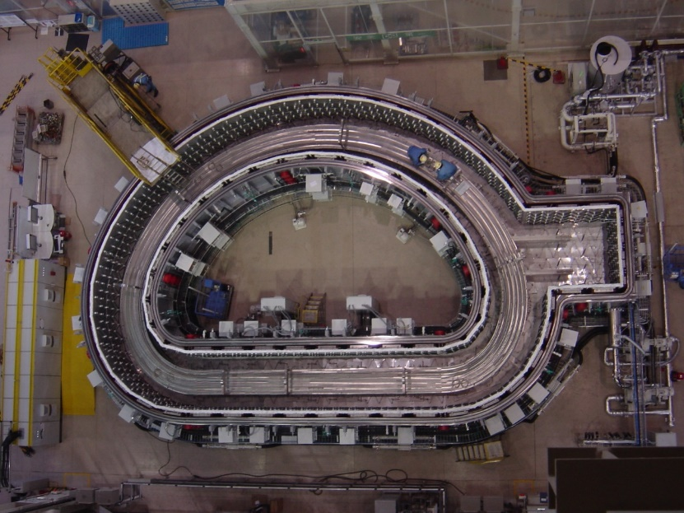
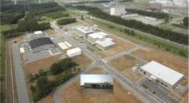
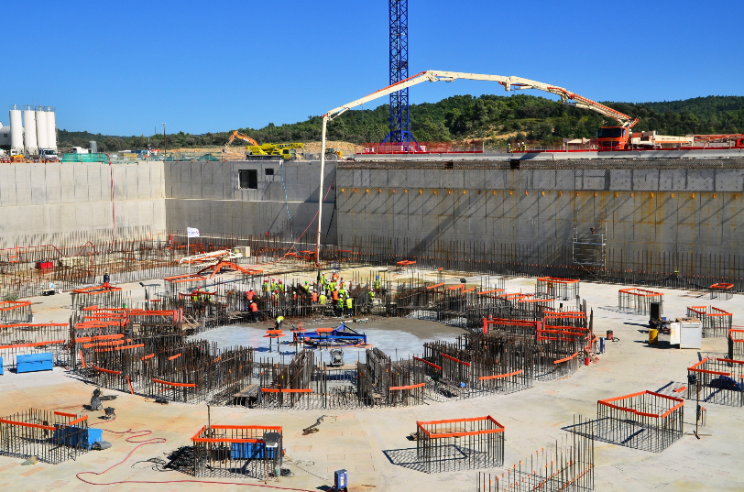
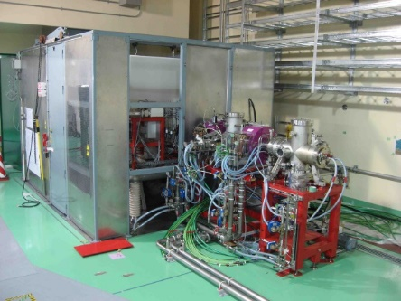
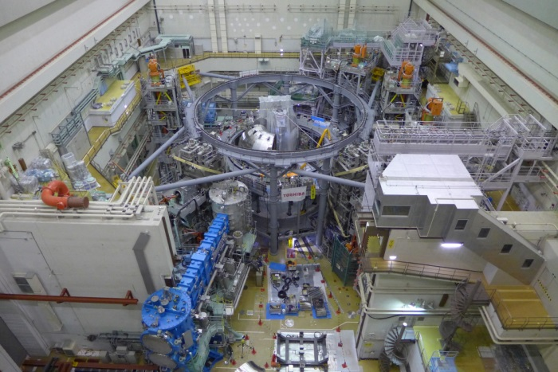
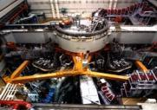
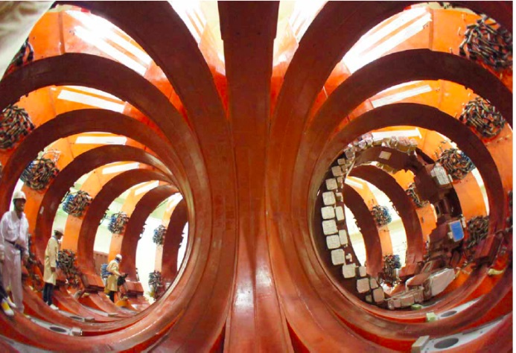
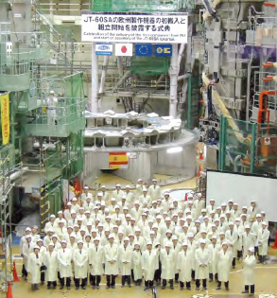
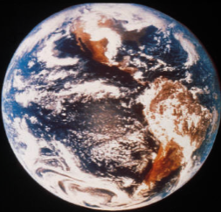
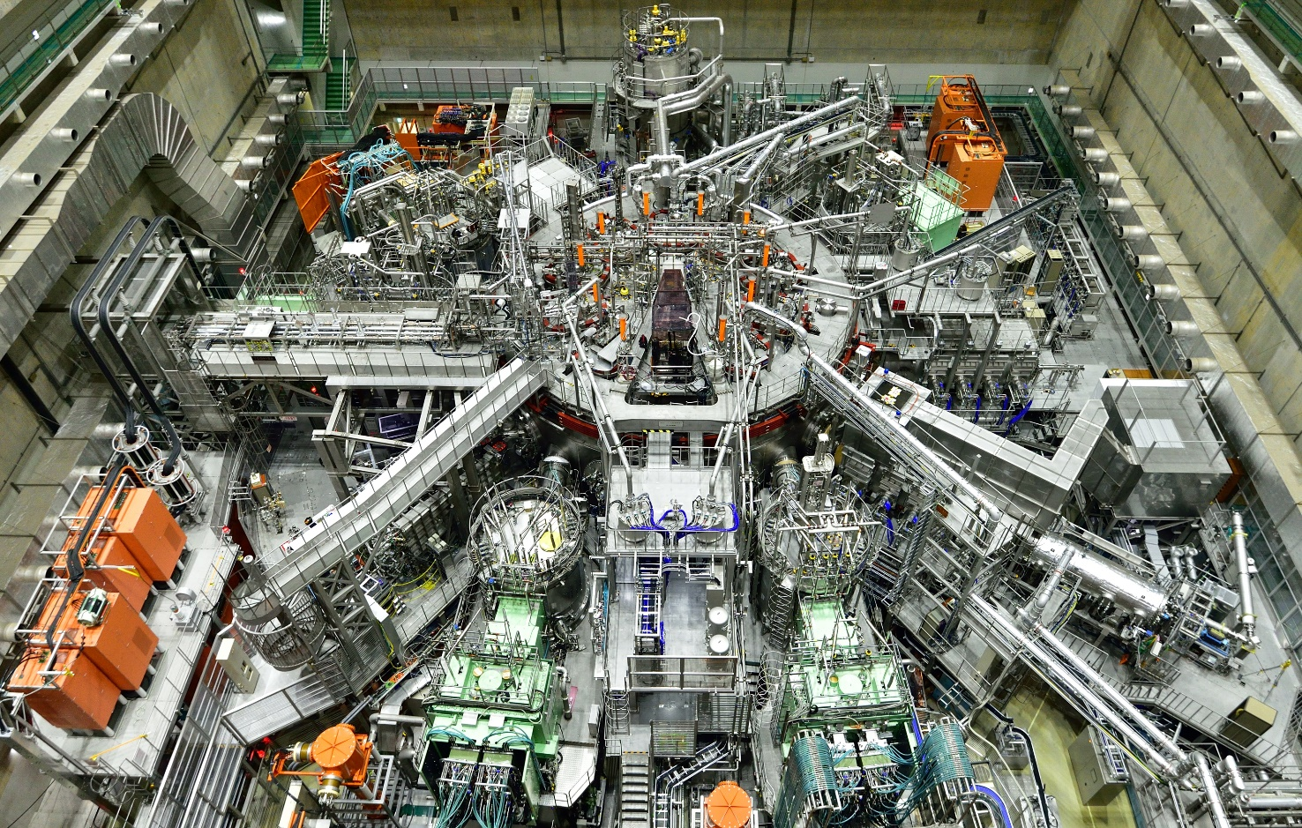
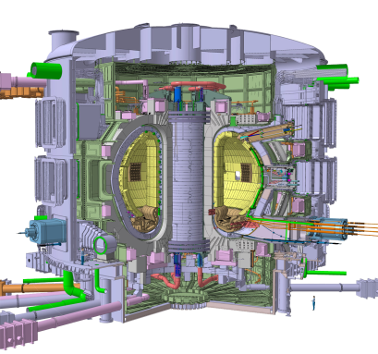
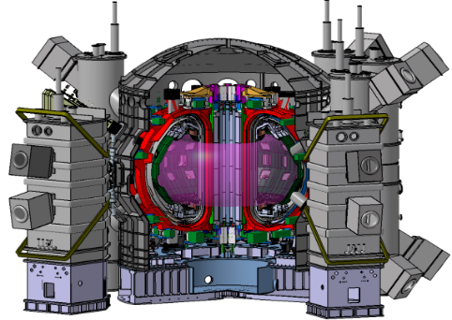

Fusion Power Associates 35th Annual Meeting and Symposium
Fusion Energy: Recent Progress and The Road Ahead
December 16-17, 2014.
At Hyatt Regency Washington DC on Capitol Hill
The Magnetic Fusion Program
in Japan
K. KURIHARA
Naka Fusion Institute
Sector of Fusion R&D
Japan Atomic Energy Agency

Slide 2
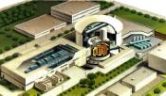








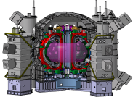
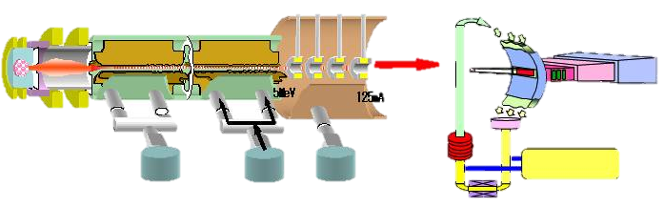
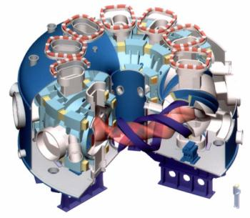
Magnetic Fusion R&D Program
Test Facility
Experimental Reactor
Demo Reactor
6
Fusion
Power
Plant
1
DEMO
ITER
JT-60
Fusion
Power
of 0.5GW
Core Plasma
Research
Q=1.25
Ti(0)=45keV
Q=10
DT Burning
Demonstration of Fusion Power Plant
@France
Supplement ITER toward DEMO
Support ITER
Broader Approach (BA) Activities
Establish Basis for DEMO
Helical Device
5
IFMIF/EVEDA
2
International Fusion Energy Research Center
(IFERC)
3
LHD
JT-60SA
@Rokkasho
@Toki
@Naka
4

Slide 3
ITER Project
- In-Kind Procurement Activities -
1

Slide 4

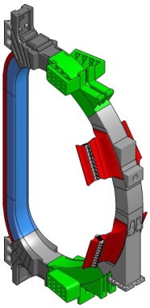
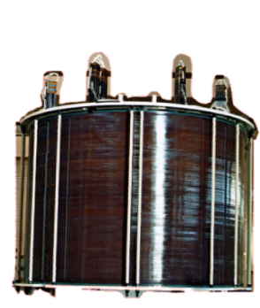
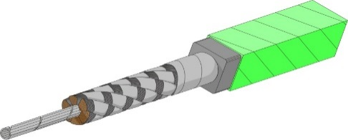
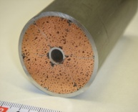
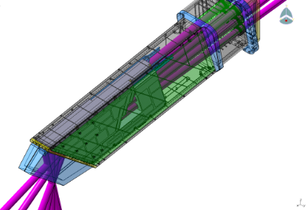
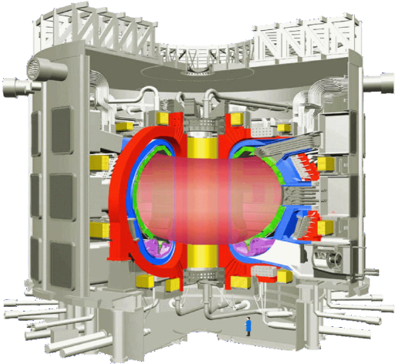
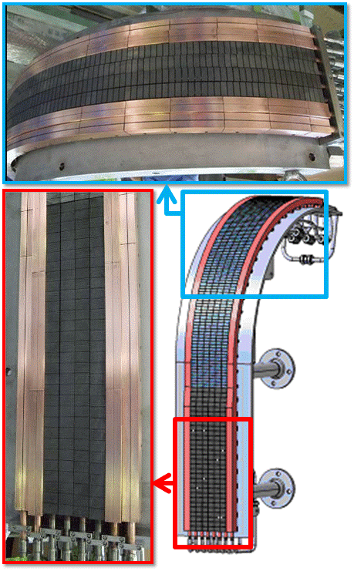
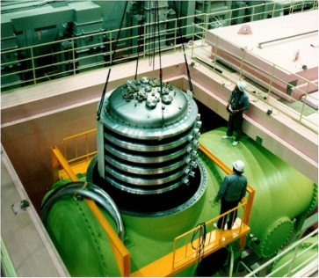
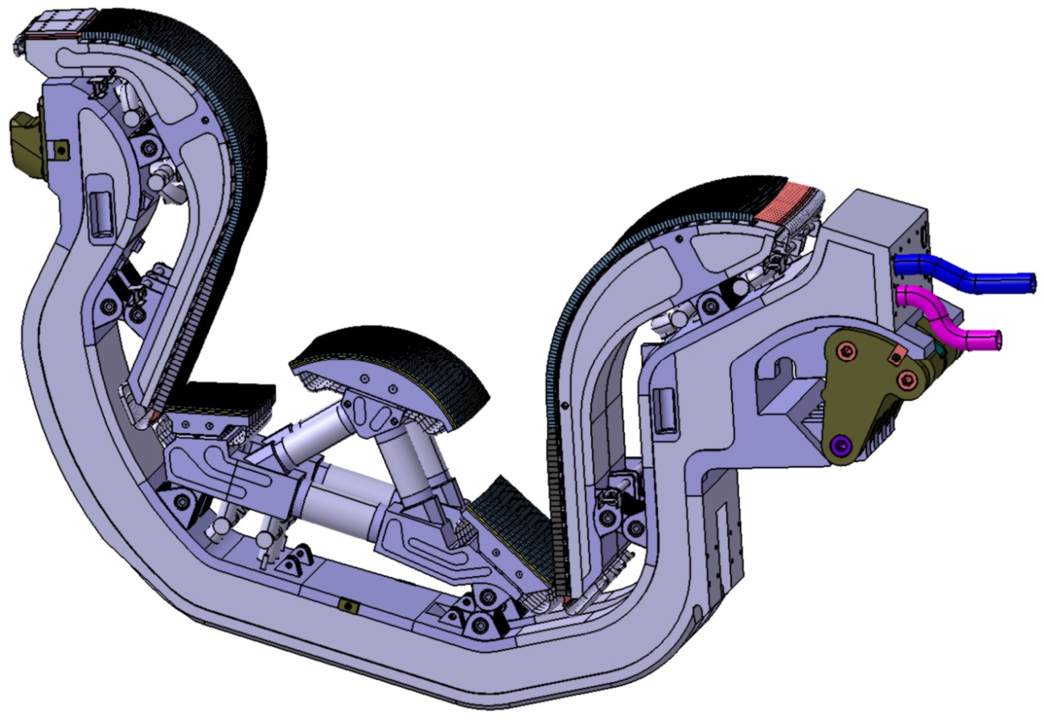
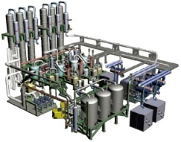
Japanese Contribution in ITER In-Kind Procurement
Now Achieved 88% in Contracted Credit!
Toroidal Field (TF) Coil
TF Conductors: 25%
TF winding, assembly: 47%
TF Structures: 100%
Central Solenoid (CS) Coil
Conductors CS conductors: 100%
Diagnostics
(under design)
Micro Fission Chamber
Poloidal Polarimeter
Edge Thomson Scattering
Divertor Impurity Monitor
IR Thermography
Thermocouples
Upper Port Integration
Lower Port Integration
Insulation
49 mm
Final Wrap (s.s.)
Nb₃Sn Cable
Jacket (JK2LB)
Central Spiral
Sub Wrap (s.s.)
Blanket Remote Handling
System (under design)
Electron Cyclotron H&CD (under design)
Gyrotron, Equatorial Launcher
Blanket
module
Vehicle with
Manipulator
Vacuum
Vessel
Neutral Beam H&CD
HV Bushing: 100%
1 MV Power Supply HV part: 100%)
1 MeV Accelerator: 33%
Rail
Manipulator
Vehicle
Divertor
Outer Target: 100%
Detritiation System
(under
design)
Notes:
4

Slide 5
JT-60SA Project
2

Slide 6

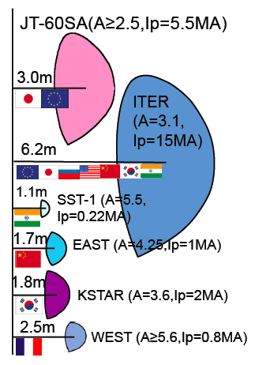
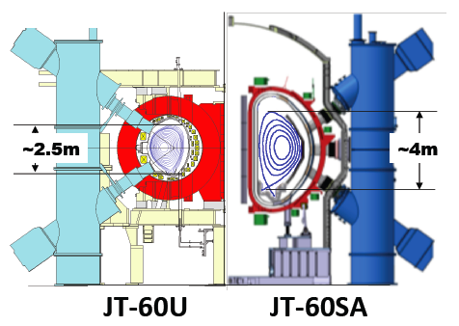
JT-60SA (JT-60 Super Advanced) Project
Mission
-support ITER: using break-even-equivalent class high-temperature deuterium plasmas lasting for a duration (typically 100 s) for optimization of ITER operation scenarios.
-supplement ITER toward DEMO: with long sustainment (100 s) of high pressure plasmas necessary in DEMO for establishment of DEMO operation scenarios.
24 PA’s have been completed: 87% of the total.
The First Plasma is now planned in March 2019.

Slide 7
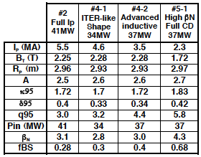
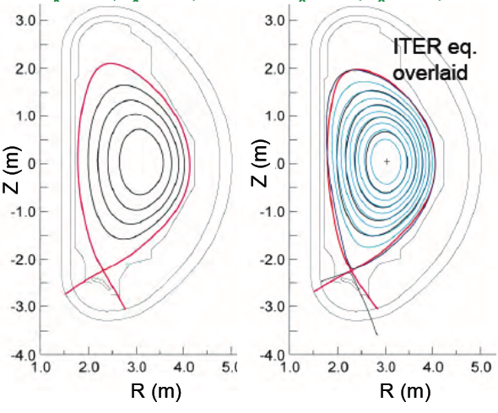
JT-60SA Target Plasma Design
JT-60SA: highly shaped (S=q₉₅I_{p}/(aB_{t}) ~7, A~2.5) large superconducting tokamak confining deuterium plasmas (Ip-max=5.5 MA) lasting for a duration (typically 100s) longer than the timescales characterizing the key plasma processes such as current diffusion time, with high heating power 41MW.
6
5
DEMO reactors
JT-60SA Target
4
β_{N}
3
FB ideal MHD limit
ITER
5.5MA
4.6MA
Steady-state
2
JT-60U
Existing Tokamaks
ITER
1
Inductive
0
0
20
40
60
80
100
400
3000
Sustainment Time (s)
Utilizing the ITER- and DEMO-relevant plasma regimes and DEMO-equivalent plasma shapes, JT-60SA contributes to all the main issues of ITER and DEMO.

Slide 8

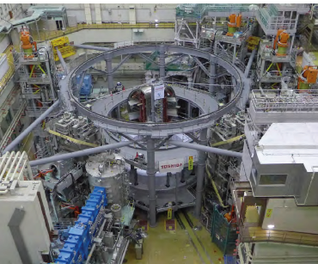
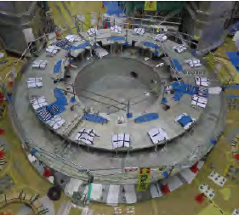
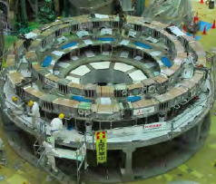

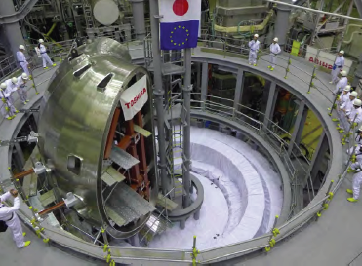
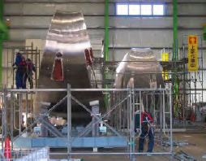
Status of JT-60SA Construction
JT-60SA Torus Assembly was started:
Temporary installation of EF4,5 & 6 on CB:
Assembly Frame was set up.
VV assembly was started in May 2014.
Cryostat Base
Lower 3 EF Coils
2 Jun 2014
Mar., 2013
Jan. 2014
Vacuum Vessel ➔
All sectors (40deg. X 7 + 30deg. X 2 + 20deg.) have been completed. on site.
4th Jun 2014

Slide 9

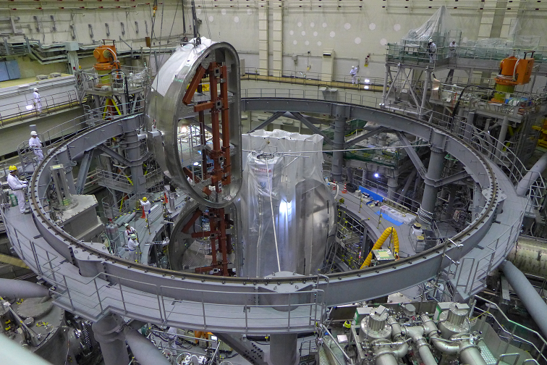
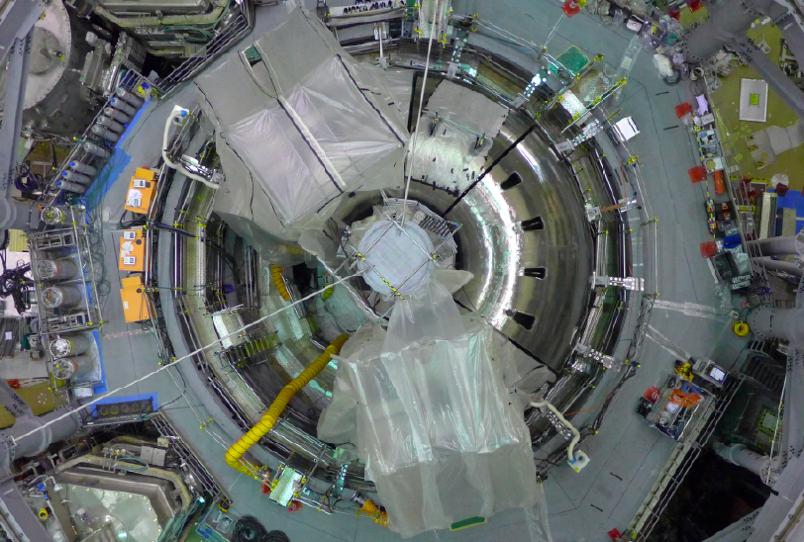
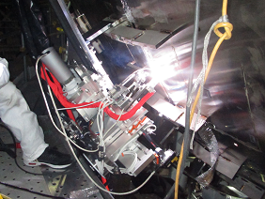
40-deg. VV sectors will be assembled up to 340-deg.
ready for the TFC installation.
The joint-welding of the first two 40-deg. VV sectors was started in July 2014, and will continue until the end of Sep. 2015 to form the 340-deg. VV torus.
The final 20-deg. sector will be set at the right position with the last TFC.
The third and fourth sectors on CB
Nov.28th. 2014
Now, seven 40-deg. sectors (= 280 deg.) have been placed on the cryostat base.
Joint-welding by the robot

Slide 10
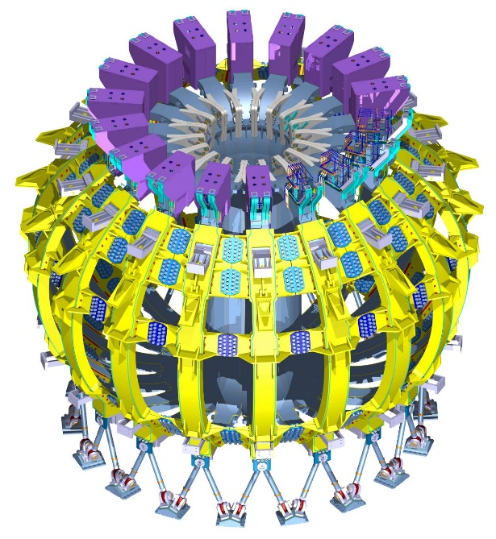
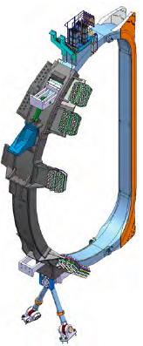
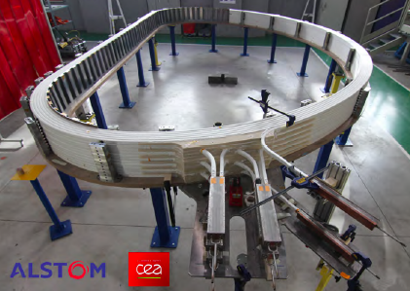

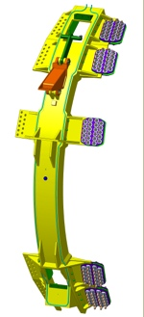
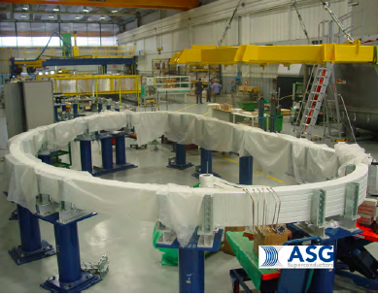


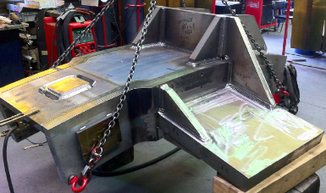
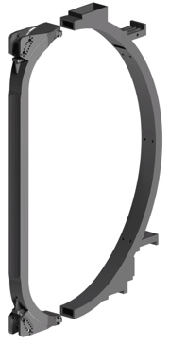

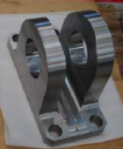
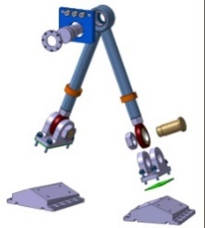
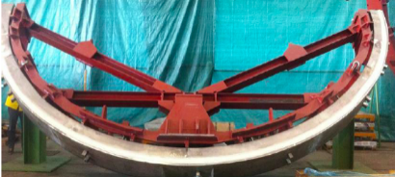
EU Procurements for JT-60SA devices are smoothly conducted and delivered to Naka on schedule.
TF coils & their related components manufacture are running
well in France
and Italy.
TF (Toroidal Field) Coil Winding started
(CEA, ENEA )
18 (+1 spare)
Outer Intercoil
Structures
Manufacture of structural components are also going well.
CEA (SDMS)
Gravity supports
Casings
CEA
Alstom
ENEA(Walter Tosto)
10

Slide 11
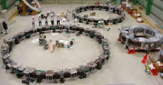
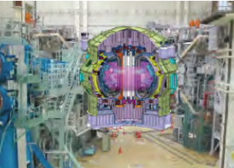






















JT-60SA: Manufacture on schedule in both EU and JA
JT-60U Disassembly
Completed in Oct. 2012
Toroidal
Field Coils
Winding started.
Lower 3 EF Coils
Vacuum
Vessel
Sectors
TF coil test facility has been almost completed.
First Plasma
2019 March
From
Dec, 2015
Mar., 2013
Jan. 2014
Cryostat Base
(260 tons)
HTS Current
Lead
Upper 3 EF Coils & CS
Cryostat:
Manufacture started.
Tokamak Assembly
started in Jan. 2013
by installing the cryostat base.
power supplies, cryoplant, NBI, ECH, diagnostics, etc
QPC: Sep. 2014
Mar. 2015

Slide 12

JT-60SA is a flexible ‘Test Stand’ for ITER
Examples of Test Items in Physics
(a) H-mode operations towards Q=10 ( H, He, D)
L-H transition, Pedestal Structure
H-mode confinement ( incl. compatibility with radiative divertor, RMP, etc.)
Local Ripple & TBM Test
(b) ELM mitigation (RMP, pellet, … )
(c) Disruption avoidance & mitigation (Intensive Gas, impurity pellet)
(d) Divertor heat load reduction
(e) Integrated operation scenario optimization with SC PF coils.
(operation scenarios, plasma actuators, diagnostics …)
(f) High energy particle physics using 10MW 500keV N-NB
NB Current Drive studies (incl. off-axis NBCD),
AE mode stability & effects on fast-ion transport,
Interactions between high energy ions and MHD instabilities
➔ JT-60SA Research Plan updated to Ver.3.1 (Dec. 2013)

Slide 13



MHD stability control (as an example)
Stabilizing Wall
Fast Plasma Position Control coil
Error Field Correction (EFC) coil)
RWM control
RWM Control coil: 18 coils. on the plasma side.
β_{N} = 4.1 (C_{β} =0.8) with effects of conductor sheath, noise (2G), and latency (150 ms).
+ ECCD (NTM), rotation control

Slide 14


JT-60SA Research Plan by EU and JA
“Research items and Strategy for JT-60SA” to solve critical issues in ITER and DEMO.
JT-60SA Research Plan updated to Ver.3.1 in 2013, Dec.
Co-authors: 331 persons
Japan: 150 ( 76 from JAEA, 74 from 15 Univ. )
EU: 176 ( 10 countries, 24 institutes)
Project Team: 5
=> Objectives: Encourage collaborative studies,
and Optimize hardware.
(Revised towards the first plasma)
Expected experiment participants: JA: 250-300, EU: 200-250
3rd. Research Coordination Meeting
( Naka, May.,2014)
Please visit➔
JT-60SA Research Plan: http://www.jt60sa.org/b/index_nav_3.htm?n3/operation.htm

Slide 15
IFMIF/EVEDA Project
3

Slide 16


IFMIF/EVEDA (Engineering Validation and Engineering Design Activity of International Fusion Material Irradiation Facility)
Three facilities to be validated
Li Target Facility
liquid Li screen flowing
at 15 m/s to stand
1GW/m² D+ beam load
Test Facility
Handling the irradiation
material samples and
acquisition of material data
Accelerator facility
Linear IFMIF Prototype Accelerator (LIPAc) @ JAEA Rokkasho
EVEDA Li Test Loop (ELTL) @ JAEA O-arai
Design, manufacturing and
validation of tools
(irradiation rig/mockup)
IFMIF

Slide 17





IFMIF EVEDA Project
Linear IFMIF Prototype Accelerator - LIPAc
  IFMIF vs LIPAc : D⁺ accelerator
  125 mA : LIPAc 9MeV (IFMIF 40MeV )
Injector+ LEBT
CEA Saclay
RFQ
INFN Legnaro
JAEA
MEBT
CIEMAT Madrid
SRF Linac
CEA Saclay
CIEMAT Madrid
HEBT
CIEMAT Madrid
BD
CIEMAT Madrid
Control System
JAEA
CIEMAT Madrid
CEA Saclay
INFN Legnaro
36 m
RF Power
CIEMAT Madrid
CEA Saclay
SCK Mol
Diagnostics
CEA Saclay
CIEMAT Madrid
LEBT: Low Energy Beam Transport line
SRF Linac: Superconducting Radio Frequency LINAC
RFQ: Radio Frequency Quadrupole
HEBT: High Energy Beam Transport lines
MEBT: Medium Energy Beam Transport
➔ IFMIF/EVEDA project will be presented by Dr. Okumura.

Slide 18





Status of IFMIF/EVEDA
Installation of Injector for the Linear IFMIF Prototype Accelerator (LIPAc) was completed.
Beam tests have been initiated by JAEA, CEA and IFMIF/EVEDA Project Team.
Installation of the Injector in the Accelerator Vault
70 kV and 40mA
LIPAc injector 1st beam was achieved on Nov. 4, 2014

Slide 19
International Fusion Energy Research Center (IFERC) Project
4

Slide 20







IFERC Project
International Fusion Energy Research Center
DEMO Design
Computer Simulation Center
Joint work to design feasible DEMO concepts
➔revisit later
Large-scale simulation for magnetic confinement fusion
DEMO R&D
-Advanced tritium breeder
-Advanced neutron multiplier
-Tritium technology
-Material technology
-Linpack performance: 1.23 Pflops (as of June 2014, world 30th fastest)
-Maintain extremely high availability (> 98%) and running rate ( > 85 %)
-Highly contributed to research: 275 publications and 847 presentations
Breeding blanket
Remarkable progress seen in each activity with efficient joint work of EU and JA

Slide 21
5
Large Helical Device (LHD) Project

Slide 22



Large Helical Device (LHD) Project
• The world-largest helical system, and the world-largest SC fusion machine at present.
• Intrinsic advantage and engineering capability of steady-state operation
• Complementary/alternative role to tokamak approach
The goal of the project
• Establish scientific basement for a helical fusion reactor
• Comprehend physics of toroidal plasmas
In-Vessel View of
LHD
• Outer diameter 13.5 m
• Cold mass 820 ton
• Total weight 1500 ton
• Magnetic field 3 T
• Magnetic energy 0.77 GJ
• Operation for 16 years since 1998 ➔ Engineering Base
• Several-month-long operation, 17 times since 1998
• Operational time of He compressor:76,400 hours ➔ Duty > 99 %
• Coil excitation number 1,580 times
• Plasma discharges: 125,000 shots (Plasma pulse every 3 min)
Heating capability
NBI 28 MW
ECH 4.6 MW
ICH 3.5 MW
H.Yamada
National Institute for Fusion Science
A large number of opportunities for diversified collaboration on physics.
プラズマ若手夏の学校
平成22年8月11日 六甲スカイヴィラ

Slide 23
Achieved plasma parameters encourage
the further next step.
Parameter | Achieved | Target
T_{i0} | 8.1 keV (1x10¹⁹ m⁻³) | 10 keV (2x10¹⁹ m⁻³)
T_{e0} | 13 keV (1x10¹⁹ m⁻³) | 10 keV (2x10¹⁹ m⁻³)
n_{e0} | 1.2x10²¹ m⁻³ (0.26 keV) | 4x10²⁰ m⁻³ (1.3 keV)
β | 5.1 % (0.425 T) | 5 % (1-2 T)
 | 3.7 % (1 T)
Discharge duration | 54 min. (500 kW) 48 min. (1,200 kW) | 1 hour (3,000 kW)
Red: achieved in FY2013
23
Notes:
23

Slide 24
Schedule for LHD deuterium experiment (tentative)
Concluding the Agreements for the LHD deuterium experiment with local government bodies on March 28, 2013.
Deuterium experiment will start in 2016, and during the planned 9-years’ experiments, 10keV of the T_{i} should be achieved.
FY2013
FY2014
FY2015
FY2016 – FY2024
Target
in D-Exp.
Preparation for D-exp. (3 years)
Deuterium Experiments (9 years)
H-Exp.
H-Exp.
Calibration Experiments for Neutron Diagnostics
Preliminary Experiments for Commissioning
Deuterium Experiments
T_{i} = 10keV
at 2×10¹⁹ m⁻³
Agreements for D-exp.
Legal License
Closed Helical Divertor with Pumping System
W_{p} = 3.8MJ
at 1×10²⁰ m⁻³
<β> ~ 3%
at T(0)~5keV
NBI: 18MW (60-80keV, 2sec)
14MW (180keV, 2sec)
ECH: 6MW-3sec, 1MW-CW
(77GHz & 154GHz)
ICRF: 6MW-5sec, 2-3MW-CW
Upgrade for Heating System
(NBI, ECH, ICRF)
Upgrade for Diagnostics System
(Neutron diagnostics, etc.)
nTτ
~1.4×10²⁰
m⁻³ keV s
Neutron Diagnostics
High-Energy Particle Measurement
3-Dimensional Measurement
High-Accuracy Measurement
Divertor Diagnostics
Steady-State Data Acquisition
Installation of Safety Equipments
(Tritium removal system, etc.)
3MW Heating
for 1 hour
Remodeling of Building and Facilities
PWI Laboratory
Notes:
24

Slide 25
DEMO Design Activities in Japan
6

Slide 26
Fusion Community for DEMO Design in Japan
Industry
JAEA, NIFS, Universities, etc.
R&D
Program
Industrial
soundness,
Manufacture,
Economy
Japan Atomic
Industrial Forum Inc.
Fusion Energy Forum of Japan
Fusion Network
Joint Core Team
(organized 2013-14)
Int’l Relation, &
Roadmap
Academic Societies, Associations
AESJ, JSME, CSSJ, JPSF, etc.
EU, USA, China, Korea, IAEA
WG for Fusion Research
Council for Science
and Technology, MEXT
The joint core team should discuss and show the grand strategy to DEMO which is cooperated with fusion community in Japan.
Government
MEXT, CSTP
Codes &
standards
Policy

Slide 27
The Joint Core Team Submitted a Special Report in July 2014
Report by the Joint-Core Team
for the Establishment of Technology Bases
Required for the Development of a Demonstration Fusion Reactor
18 July 2014 [ in Japanese ] English version will be released in Jan. 2015
1. Introduction
2. On the Concept of DEMO Premised for Investigation
2-1. Change of Energy Situation and Social Requirement
2-2. Fundamental Strategy
2-3. Development Strategy
2-4. Basic Concept Required for DEMO
2-5. Points of View for Changeover to DEMO Phase and Assessment of Transition Conditions
3. Technological Issues of Elements of DEMO
3-1. Superconducting Coils 3-2. Blanket
3-3. Divertor 3-4. Heating and Current Drive Systems
3-5. Theory and Numerical Simulation Research
3-6. Reactor Plasma Research 3-7. Fuel Systems
3-8. Material Development and Standards / Criteria
3-9. Safety of DEMO Reactor and Safety Research
3-10.Availability and Maintainability 3-11. Diagnostics and Control Systems
3-12.Newly Required Facilities and Platforms
4. Points of Reactor Design Activity
5. International Cooperation and Collaboration
6. Summary - Development of Grand Strategy towards Future Establishment of
Technological Bases for DEMO -

Slide 28


Organized Framework for Implementation throughout Japan towards Establishment of Technology Bases for DEMO (in plan)
Discussion towards DEMO Development Roadmap
by Working Group on Fusion Research
Council for Science and Technology, MEXT
Evaluation
Report and approval
of overall policy
Strengthening
cooperation
Related
Academic
Societies
Taskforce for Grand Strategy
of Technology Bases for Development of DEMO
⬅ Joint-Core Team
Guidance
Optimization of grand strategy and management based on comprehensive overlooking of technology
Provision
of information,
Facilitation of
new involvement
Ad hoc Team of
Conceptual Design
of DEMO
at Rokkasho Fusion
Institute of JAEA
Information
sharing,
Request
Superconducting coil
Divertor
Blanket
Heating & current-drive system
General
Coordination
Group
Theory and computational simulation
Fusion-relevant plasma
Diagnostics & control
Indus.
Univs.
Fusion fuel system & establishment of codes and standards
Fusion materials & establishment of codes and standards
Safety of fusion reactor and safety research
Availability & maintenance

Slide 29
Summary
Toward the earlier realization of a Magnetic Fusion DEMO reactor,
ITER Project and BA Activities are intensively being promoted in Japan.
In ITER Project: In-kind procurement activities have come to a peak of manufacturing processes at the factory in Japan (TFC, CS, etc.).
In BA Activities
  JT-60SA Project: Manufacture is running well on schedule by EU & JA:
  - VV assembly was started in May 2014.
  - Research Plan Ver3.1 was released in 2013 (available on the website)
IFMIF/EVEDA Project:
- The injector for the Linear IFMIF Prototype Accelerator was installed.
- The first beam of the injector has achieved in last Nov. 2014.
- The other components are ready for installation.
IFERC Project (DEMO Design, DEMO R&D, Computer Simulation Center, ITER Remote Experiment Center) is producing many results on each field.
The alternative to a tokamak: LHD will start Deuterium experiment in 2016
DEMO Design Activities:
- Joint Core Team discussing the grand strategy submitted a Special
Report to MEXT, in July 2014. (English version soon available)
- General Coordination Group for DEMO CDA will be newly organized soon.
.
1
2
3
4
5
6

Slide 30


Roadmap towawd Fusion Energy
The first plasma and Q>10 in ITER will be possibly the trigger
points to DEMO EDA and its construction, respectively.
BA will reach the assumed period in 2019 (JT-60SA), and 2017 (the other projects). Post BA activities are under discussion.
DEMO is expected to go into operation in a middle of 2040s.

