Slide 1
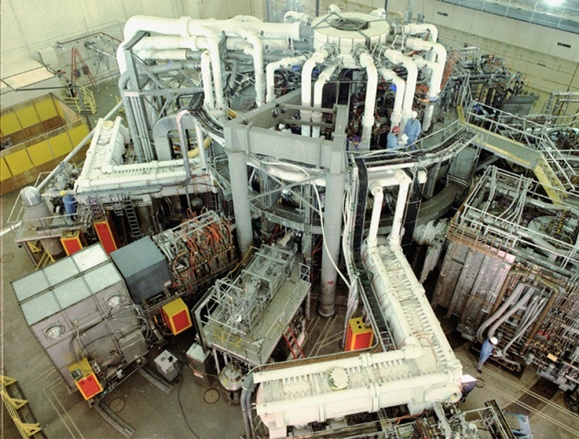
Tritium Handling and Management in MFE - What We Learned from TFTR -
C. A. Gentile
June 24, 2014
PPPL / ITER Workshop

Slide 2
Parameters
From 1993 to 1997 the TFTR Project processed ~ 99 grams of tritium in support of D-T operations.
Tritium for TFTR mostly came from the Savanna River National Laboratory (SRNL) located in Aiken, SC.
During 1997, the Tritium Purification System was successfully commissioned, closing the D-T fusion fuel cycle at the site. First to achieve this in the USA.
During the TFTR D-T campaign, > 1,000 D-T shots were performed.
Tritium is expensive. Being a National Laboratory, we were supplied tritium from the DOE.

Slide 3
Topics
Tritium Monitoring – Real time/ Passive – Process, Area, Occupational, Environmental.
Tritium Accounting – Material Control & Accounting Program.
Tritium Contamination Control – Containment / Confinement. Action limits.
Tritium Ground Water Contamination – Down wash-from stack releases.
Tritium Operator Training – Qualification Program/ Certification Program
Documentation.

Slide 4
Tritium Monitoring
Fusion energy research facilities (where there is a fusion machine) have more challenging requirements than tritium facilities.
Real time tritium monitors should be gamma-compensated. In some processes a heat mantle may be required to reduce internal tritium.
In some locations, should be magnetically shielded with mu metal.
Near machine locations should have to output “frozen” during shot(s).
Need to determine the appropriate range of the detector application.
Do not locate action / alarm set points close to internal range changes.
Internal check sources are valuable for daily (automated ) monitor responses.
Several vendors in the market for the supply of tritium monitor equipment including Femto-Tech, Overhoff Technology Corporation, Scintrex.
For hand held real time tritium monitors, appropriate dust filters should be used.
Length of tubing for external monitoring should to be limited to shortest length possible.

Slide 5
Tritium Accounting
Tritium accounting is difficult, particularly when starting up a new system.
Tritium tends to be “sticky”. Coats many internal surfaces. Consider “pre-wetting” process lines prior to full start up.
When measuring tritium in different process gases (i.e. Ar, N2, He) independent monitor response curves need to be developed to get best measurements of tritium in the stream
Tritium accounting needs to be a real-time activity.
During TFTR D-T operations >8,000 tritium transfers were performed. These were all recorded in real time and reviewed on a daily & weekly basis by a committee consisting of project technical cogs.

Slide 6
Tritium Contamination Control
Contamination is relatively easy to detect. Not always easy to control.
In vacuum vessels lined with graphite, tritium tends to co-deposit on graphite surfaces. Additionally contains tritiated dust. Easily migrates.
The use of Glove boxes to contain process lines is highly recommended.
Positive pressure ( results in less HTO in box ) v. Negative pressure ( results in less T2 into local rooms) glove boxes. TFTR operated glove boxes at negative pressure.
Blanket gases in glove boxes can suppress the formation of HTO, but can increase heat loads on equipment in the glove box – leading to premature failures of motors and heat sensitive equipment.
In some areas (around valves) an over-pressurized blanket gas can be useful in attenuating tritium leakage. Over pressure blanketing technique is very effective around seals. Pushes gas into the system.

Slide 7
Tritium Control Action Levels
PPPL surface removal tritium contamination level 1,000 dpm/100 cm2.
DOE surface removal tritium contamination level = 10,000 dpm/100 cm2.
ANSI proposed surface tritium contamination level = 100,000 dpm/100 cm2.
PPPL (liquid) release limit to the municipal sanitary system = 1 Ci / per calendar year.
PPPL ( gaseous)release limit to the station stack = 500 Ci / year.
PPPL airborne limit in work areas = 20 micro Ci/m3.
PPPL tritium site limit = 50,000 Ci.

Slide 8
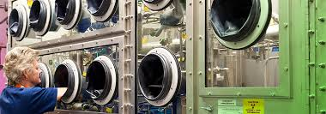
Containment
Glove Boxes –
Glove boxes work very well as secondary and tertiary containments.
In some deployments internal box heat buildup can be problematic.
Gloves and glove box seals often degrade due to ozone interactions.
Provides opportunity for using various “blanket” gases.
Provides time to respond to process leaks in lines and tanks.

Slide 9
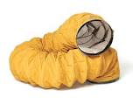
Confinement
Elephant ( portable negative ) trunks provide excellent localized negative pressure.
Can be easily configured to exhaust to stack ventilation system.
During plant construction, elephant trunk stations should be installed to provide for elephant trunk use in controlled areas.
Typically provide 100 LFM flows.

Slide 10
Ground Water Contamination
Down wash from stack releases can get into the ground water.
After several months of operation increased levels of tritium was found in site ground water.
Important to locate rain gutters and down sprouts to locations that do not direct rainwater to ground soil in / and around the facility.
Best to direct local rain water to storm drains.
A/C condensate should be monitored for tritium prior to release.
During summer months at TFTR >10,000 gallons / month of low level HTO water was from air conditioning condensate.

Slide 11
Tritium Operator Training
Certification or Qualification
Certification recommended for operators of nuclear systems. Requires testing, including oral boards.
Qualification useful for non-nuclear and secondary operations (i.e., I&C technicians, Motor Generator Operators, etc. ). Some testing / no oral board.
Operators need to have a strong conduct of operations culture. Must be competent in following detailed procedures.
Those with military-type backgrounds (i.e., the US Nuclear Navy) are well suited for this type work. Particularly for shift work in support of 24/7 operations.

Slide 12
Documentation
A large investment in detailed procedures & safety documentation costing several million dollars used during TFTR.
Use of controlled documentation highly effective in ensuring that the best / correct information was available to the operators. Ensuring appropriate operational outcome.
The use of operator aids highly useful if appropriately controlled.
Procedures used as a tool for ensuring positive control and safe configuration.

