Slide 1
ALPHA: Accelerating Low-Cost Plasma Heating and Assembly
Fusion Power Associates 36th Annual Meeting and Symposium
Strategies to Fusion Power
Dr. Patrick McGrath, Program Director, ARPA-E

Slide 2

Introduction to ARPA-E
In 2007, The National Academies recommended Congress establish an Advanced Research Projects Agency within the U.S. Department of Energy
…“The new agency proposed herein [ARPA-E] is patterned after that model [of DARPA] and would sponsor creative, out-of-the-box, transformational, generic energy research in those areas where industry by itself cannot or will not undertake such sponsorship, where risks and potential payoffs are high, and where success could provide dramatic benefits for the nation.”…
Mission: To overcome long-term and high-risk technological barriers in the development of energy technologies
Means:
Identify and promote revolutionary advances in fundamental and applied sciences
Translate scientific discoveries and cutting-edge inventions into technological innovations
Accelerate transformational technological advances in areas that industry by itself is not likely to undertake because of technical and financial uncertainty
Over 400 projects funded, >$1.6 B of funding since agency inception in 2009
Notes:
Updated to reflect 2015 numbers
Budget (Million) Data Source:
FY2009: $15,000 http://energy.gov/sites/prod/files/FY11Orgsum.pdf ARRA $388,856 http://energy.gov/sites/prod/files/FY11Orgsum.pdf (Note: rounded to $400 million in all public documents, did so here to maintain consistency.)
FY2010 $0 http://energy.gov/sites/prod/files/FY11Orgsum.pdf
FY2011 $179,640 http://energy.gov/sites/prod/files/FY13Volume4.pdf (p. 401)
FY2012 $275,000 http://energy.gov/sites/prod/files/2013/04/f0/orgsum.pdf
FY2013 $250,636 http://energy.gov/sites/prod/files/2014/04/f14/FY%202015%20DOE%20Budget%20by%20Organization.pdf
FY2014 $280,000 http://energy.gov/sites/prod/files/2015/01/f19/FY2016BudgetSummaryTableByOrg_0.pdf
F2015 $279,982 http://energy.gov/sites/prod/files/2015/01/f19/FY2016BudgetSummaryTableByOrg_0.pdf
FY2016 (Requested) 325,000 http://energy.gov/sites/prod/files/2015/01/f19/FY2016BudgetSummaryTableByOrg_0.pdf

Slide 3


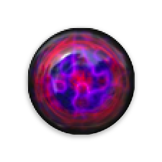

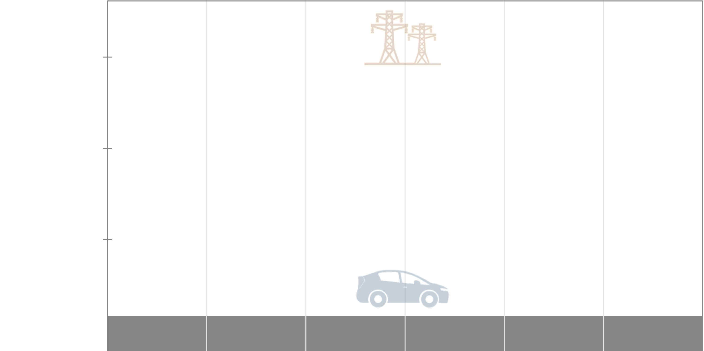


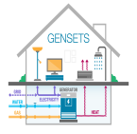
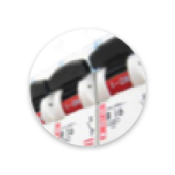
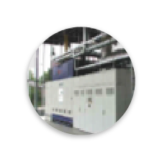
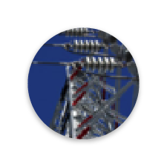




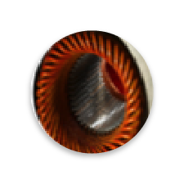








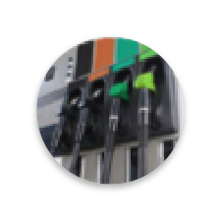


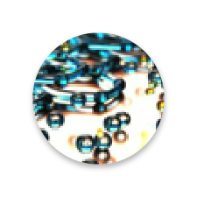
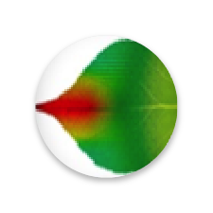

The ARPA-E Portfolio
Electricity Generation
Impacct
Solar Adept
focus
alpha
Mosaic
Electrical Grid
& Storage
Rebels
GENSETS
Grids
Heats
geni
charges
Nodes
Efficiency
Adept
Switches
React
Metals
Monitor
Transportation
& Storage
beetit
delta
arid
beest
amped
Range
ElectroFuels
Petro
Move
Remote
TERRA
Transnet
2010
2011
2012
2013
2014
2015

Slide 4
“We need innovation that gives us energy that’s cheaper than today’s hydrocarbon energy, that has zero CO2 emissions, and that’s as reliable as today’s overall energy system. And when you put all those requirements together, we need an energy miracle. That may make it seem too daunting to people, but in science, miracles are happening all the time.”
Bill Gates, as interviewed in The Atlantic, November 2015
Gates probably isn’t thinking about fusion. Should he be?

Slide 5
ALPHA seeks more options for fusion energy
Fusion energy would be transformational:
  Carbon-free, dispatchable power
  Virtually unlimited fuel
  No proliferation or meltdown risk
In the ALPHA program, we want to create
more options for fusion energy.
…but they have to offer low-cost
development pathways to be real options.
ALPHA seeks:
  New approaches to fusion based on
  low-cost technologies
  High shot rate for rapid learning
  All built to exploit physics of
  intermediate density regime
Scaling for power and energy requirements points to low-cost options at intermediate densities.
(ref. Lindemuth and Siemon, Am. J. Phys. 2009)
Early data from Sandia’s MagLIF experiments lend support the case for intermediate densities.
(ref. Gomez et al., PRL 2014)
Success in the ALPHA program will create new options
for fusion energy that can be compatible with private development.

Slide 6
ALPHA program goals
Intermediate density:
  Seeking approaches for 10¹⁸-10²³ cm⁻¹ (at full compression)
Rapid progress: high shot rate
  Projects required to perform hundreds of shots in 3-year program
  Long term goal: Pulsed reactors with repetition rate ≥ 1 Hz
Low cost per shot:
  Long term goal: Low cost drivers (< $0.05/MJ) and targets (< 0.05 ¢/MJ)
More options:
  Nine teams selected – $30M (total) over 3 years
  Diverse set of approaches across intermediate density regime(s)
See the archived Funding Opportunity Announcement for ALPHA, No. DE-FOA-0001184, at arpa-e-foa.energy.gov for rationale and references

Slide 7









Building the ALPHA community:
A portfolio of intermediate density approaches
Plasma liner implosion by merging supersonic plasma jets
Staged magnetic compression of field-reversed configuration plasmas.
Shear-flow stabilized Z-pinch pushed to higher density and fusion conditions
NumerEx
Scalable ion beam driver based on microelectromechanical systems (MEMS) technology
Piston-driven implosion of rotating
liquid metal liner as fusion driver
“Plasma rope” plumes as a
potential magneto-inertial fusion target.
Compression and heating of high energy density, magnetized plasmas at fusion relevant conditions
Staged Z-pinch – a radially-imploding
liner on a target plasma
Investigate collisions of plasma jets and targets to characterize fusion scaling laws

Slide 8

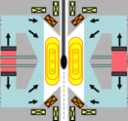




Breadth of ALPHA portfolio
pulsed magnetic
liquid liner
plasma liner
ion beam
accelerators
Taylor state
FRC
stabilized Z-pinch

Slide 9
Breadth of ALPHA portfolio
pulsed magnetic
liquid liner
NumerEx
plasma liner
ion beam
accelerators
Taylor state
FRC
stabilized Z-pinch

Slide 10
Building the ALPHA community:
A portfolio of intermediate density approaches
Plasma liner implosion by merging supersonic plasma jets
Staged magnetic compression of field-reversed configuration plasmas.
Shear-flow stabilized Z-pinch pushed to higher density and fusion conditions
NumerEx
Scalable ion beam driver based on microelectromechanical systems (MEMS) technology
Piston-driven implosion of rotating
liquid metal liner as fusion driver
“Plasma rope” plumes as a
potential magneto-inertial fusion target.
Compression and heating of high energy density, magnetized plasmas at fusion relevant conditions
Staged Z-pinch – a radially-imploding
liner on a target plasma
Investigate collisions of plasma jets and targets to characterize fusion scaling laws
ALPHA kicked off in October 2015
All teams have major go/no-go points at 12-18 months (Fall 2016-Spring 2017)

Slide 11

www.arpa-e.energy.gov

Slide 12
The right time to make a push
Scientific opportunity
  Promising early results from MagLIF, other approaches poised to contribute
Appetite for new options
  “Existence proof” of privately financed fusion development
Urgent need
  Today ~15% carbon-free electricity, need ~90% by mid-century
  ~100 GW carbon-free base load scheduled to retire by mid-century
…but tough competition
  ~17-25 ¢/kWh carbon-free electricity possible with renewables+storage
  (Budischak et al., J. Power Sources, 2013 )

