Slide 1
Time to Face Reality
Robert L. Hirsch
Senior Energy Advisor, MISI
Fusion Power Associates Annual Meeting
December 16-17, 2015.
Fusion Research

Slide 2
Overview
ITER-Tokamak will NOT BE COMMERCIALLY VIABLE.
Much can be learned from the tokamak experience.
Potential fusion winners can now be better identified.
Some References:
RLH. Fusion Research: Time to Set a New Path. Issues in Science & Technology. Summer 2015.
RLH. Revamping Fusion Research. JOFE- Strategic Opportunities. December 2015.
RLH. Fusion Power Illusions, Delusions, and Hope. Power Magazine. To be published.
RLH. The Year 2015 Fusion Power Conversations. JOFE. June 2002.
RLH, G. Kulcinski, R. Shanny. Fusion Research with a Future. Issues in Science and Technology. Summer 1997.

Slide 3
Thinking About Fusion Power
EPRI Criteria For Practical Fusion Power Systems
Economics
Regulatory Simplicity
Public Acceptance
Kaslow, J. et al. Criteria for Practical Fusion Power Systems: Report from the EPRI Fusion Panel. Journal of Fusion Energy, Volume 13, Nos. 2/3, 1994.

Slide 4
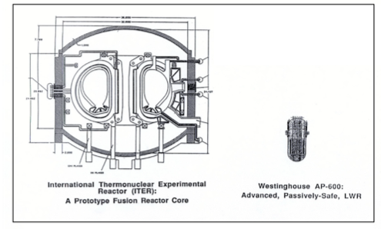
Tokamak Core Capital Cost
Tokamak Power Economics
An LLNL 1994 comparison between the ITER core & the core of the comparable power Westinghouse Advanced AP-600 nuclear reactor indicated a
mass ratio of over 60 times.
Rule of thumb: A rough cost comparison can come from the relative masses of systems of similar capabilities.
An ITER tokamak core was dramatically more expensive than a comparable fission reactor.

Slide 5
Tokamak Power Economics
Tokamak Fusion Power Operating Cost
Toroidal field coil warm-up & cool-down:
- The Chinese Experimental Advanced Superconducting Tokamak (EAST) took about 18 days to cool from room temperature to 4.5K after a quench in December 2006.
ITER cool-down is estimated to be roughly 30 days.
A 30 day heat-up / cool-down outage in a commercial power system would have a major, negative impact on plant economics.
Conclusion: The economics of ITER-Tokamak fusion power are significantly degraded by superconducting magnet cycle time requirements.

Slide 6
Fusion Regulation
Tokamak Fusion Regulation
GOOD NEWS
No nuclear runaway potential, unlike fission reactors.
Shorter life radwaste than fission.
MAJOR CONCERNS
Superconducting Magnet Quenching
Plasma Disruptions
Tritium Containment.
Radwaste Handling, Storage, & Disposal

Slide 7
Fusion Regulation
U.S. Regulation of Fusion Power
In 2009, the U.S. Nuclear Regulatory Commission (NRC) declared that U.S. fusion power plants are its purview.
Fission Power concerns – Partial List
Loss of coolant accidents
Failures in steam system piping
Breaks in reactor coolant lines
Internal fires
Internal flooding
Human origin hazards
An aircraft crash
Natural hazards
Earthquakes
Hurricanes
Floods
Tornados & Blizzards
Terrorist attack; etc.
In particular, regulators do not like things that can explode!

Slide 8
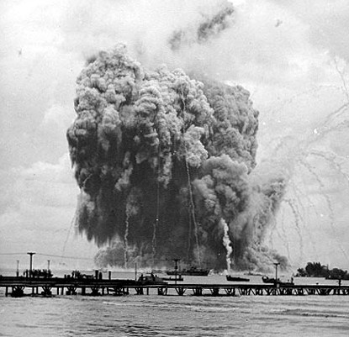
Fusion Regulation
& Economics
ITER-Tokamak Fusion Regulatory Issues
Superconducting Magnet Quenching
While a low probability event, an ITER S/C magnet quench could result in an explosive release of > 40 gigajoules.
That’s roughly 10 tons of TNT, about the size of a WWII Blockbuster Bomb.
Regulators will require an ITER-Tokamak core be adequately contained.
Because of the huge size of an ITER-like tokamak reactor, a blast-proof containment structure will be extremely expensive,

Slide 9
Fusion Regulation
ITER-Tokamak Fusion Regulatory Issues
Plasma Disruptions
“Tokamaks operate within a limited parameter range. Outside this range sudden losses of energy confinement can occur. These events, known as disruptions, cause major thermal and mechanical stresses to the structure and walls.”
Research on Tokamaks. http://www.fusion-eur.org/fusioncd/tokamak.htm
“Disruptions are one of the most troublesome problems facing tokamaks today. In a large- scale experiment such as ITER, disruptions could cause catastrophic destruction to the vacuum vessel and plasma-facing components.”
Angelini, S. Disruptions in ITER: Major Catastrophe or Minor Annoyance? http://sites.apam.columbia.edu/courses/apph4990y_ITER/6_Angelini_Disruptions.pdf
Regulators will focus on disruptions, identify all possible triggers & potential cascades, & require fail-safe protections.

Slide 10
Fusion Regulation
ITER-Tokamak Fusion Regulatory Issues
Tritium Containment
Tritium diffuses though solid materials, especially at high temperatures.
Vacuum & energy injection ports will facilitate tritium leakage into the reactor hall.
Equipment breakdown / damage provide other pathways for tritium release.
“The NRC's (tritium) dose limits for radiation workers and the general public are significantly lower than the levels of radiation exposure that cause health effects in humans.” NRC.gov
Regulators will focus on potential tritium leakage / streaming hazards & require expensive fail-safe protections.

Slide 11
Fusion Regulation
Tokamak Fusion Regulatory Issues
Radwaste Management
Assuming that the blanket of an ITER-Tokamak power reactor is replaced every three years due to radiation damage, the associated radioactive waste produced in a continuously operating ITER-Tokamak would be ~ 675 tons/year.
Assuming a typical Pressurized Water Reactor (PWR) fuel assembly is replaced every two years, the resultant radioactive, chemically dangerous waste production is roughly 150 tons / year.
While the toxicity & radioactivity lifetimes of fission waste are much worse & longer than ITER-fusion waste, NRC could easily require ITER-tokamak fusion waste to be handled in a similar manner.
Conclusion:
ITER-Tokamak radwaste is likely much more massive than fission radwaste & is certain to be subject to tight regulation.

Slide 12
Public Acceptance of Tokamak Power
The public has been told that fusion power will be economic, safe, and environmentally attractive.
When the public learns that ITER – tokamak fusion power is very expensive, not inherently safe, and produces large volumes of radwaste, the public could feel deceived, and a public backlash would not be surprising.
Utility Considerations
If there are significant NRC strictures & concerns, utilities will take note.
If the first commercial fusion system does not have the potential to be economic after 1-2 generations of development, interest will evaporate.

Slide 13
Finally, a question of operability
The Divertor Problem
Recent research indicates that no solid material, including tungsten, can operate under expected ITER conditions for a reasonable period of steady state operation.
Garrison, L.M. Dissertation Defense, August 27, 2013. Garrison, L.M. & Kulcinski, G.L. Irradiation resistance of grains near {001} on polycrystalline tungsten under 30 keV He+ bombardment at 1173 K. Physica Scripta, T159, 014020, (2014).
“The present knowledge base of tokamak divertor physics is not complete enough to specify a divertor ‘solution,’ ….. In fact, we do not know that a solution exists even in principle.”
FUSION ENERGY SCIENCES WORKSHOP ON PLASMA MATERIALS INTERACTIONS. DOE Fusion Energy Sciences. MAY 4-7, 2015.
Unless a solution is developed, ITER-Tokamaks will not operate for very long.

Slide 14
Conclusion:
ITER-Tokamak fusion has NO chance of being commercially attractive.
Learning from the ITER-Tokamak Experience -
Consider:
HIGH BETA, since it makes maximum effective use of the investment in magnets, which represent a huge cost.
ZERO / NEAR ZERO QUENCH MAGNETS, since S / C magnet quenching is a major explosion & regulatory hazard.
OPEN & PULSED SYSTEMS, since plasma / helium “dumps” will be required.
p + B¹¹, since high levels of neutron production will be a major source of operating & regulatory problems.

Slide 15
To Do
Assemble objective technologists to identify better directions & urge government to redirect fusion research.
Establish a substantial fusion engineering effort for independent analysis & project review, including commercial & academic engineers.
Ensure a program of basic plasma physics research, needed for fusion concepts, as well as to advance plasma science.
Of special interest are fusion concepts that are inherently small, since they can progress more rapidly at lower cost. Inherently large concepts are expensive & steps are time-consuming.
Develop & maintain substantial fusion-related materials research.
When possible, use existing, industrial materials, because the fewer new technologies associated with a new energy production technology, the better.
Remember “The best can be the enemy of the good.” A fusion concept that simply boils water may well facilitate the introduction of fusion power.

Slide 16
Conclusions
By a large margin ITER / Tokamak fusion will be commercially unacceptable, so terminate almost all related research.
Learning from the ITER - Tokamak experience can help identify potentially viable fusion concepts.
A major revamping of fusion research and management is needed.
Fusion challenges are large but the payoff could be huge.
Wouldn’t you rather work on a potential winner?

